Slide 1

Chapter 11
Introduction to jQuery
Lecturer Mr. Sok Dina
Market-driven quality education for the future success of our students.

Slide 2
Content
1. Using jQuery
1.1. What Is jQuery? 1.2. Adding jQuery 2. Accessing Page Elements Using the $ Function
3. The Concept of a Selector
3.1. CSS Selectors
3.2. Form Selectors
3.3. Features of Selectors in jQuery
4. Methods Managing jQuery Styles
4.1. Traversing. DOM Traversing Methods
4.2. Event Handling in jQuery
4.3. Assign One Handler for Multiple Events
4.4. Animation Methods in jQuery
5. Delegating Events
5.1. Canceling Event Handlers
6. jQuery and AJAX
Market-driven quality education for the future success of our students.

Slide 3
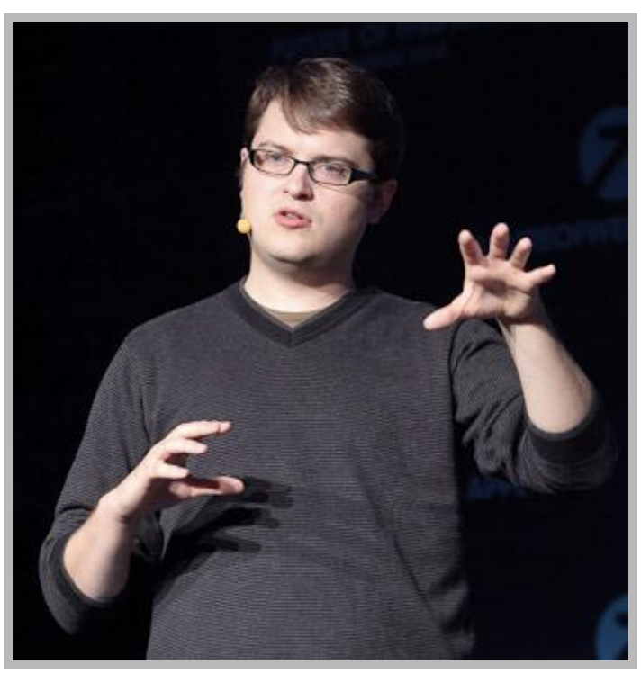
1.1. What Is jQuery?
jQuery: a JavaScript library written in JavaScript to manipulate DOM elements, handle events, create animation, and load or get AJAX data.
The developer of jQuery is John Resig who published the first version of jQuery in 2006.
jQuery:
+ Access to elements using selectors and various filters.
+ Cross-browser, meaning it worked equally among browsers
+ Create animation effects
Market-driven quality education for the future success of our students.

Slide 4
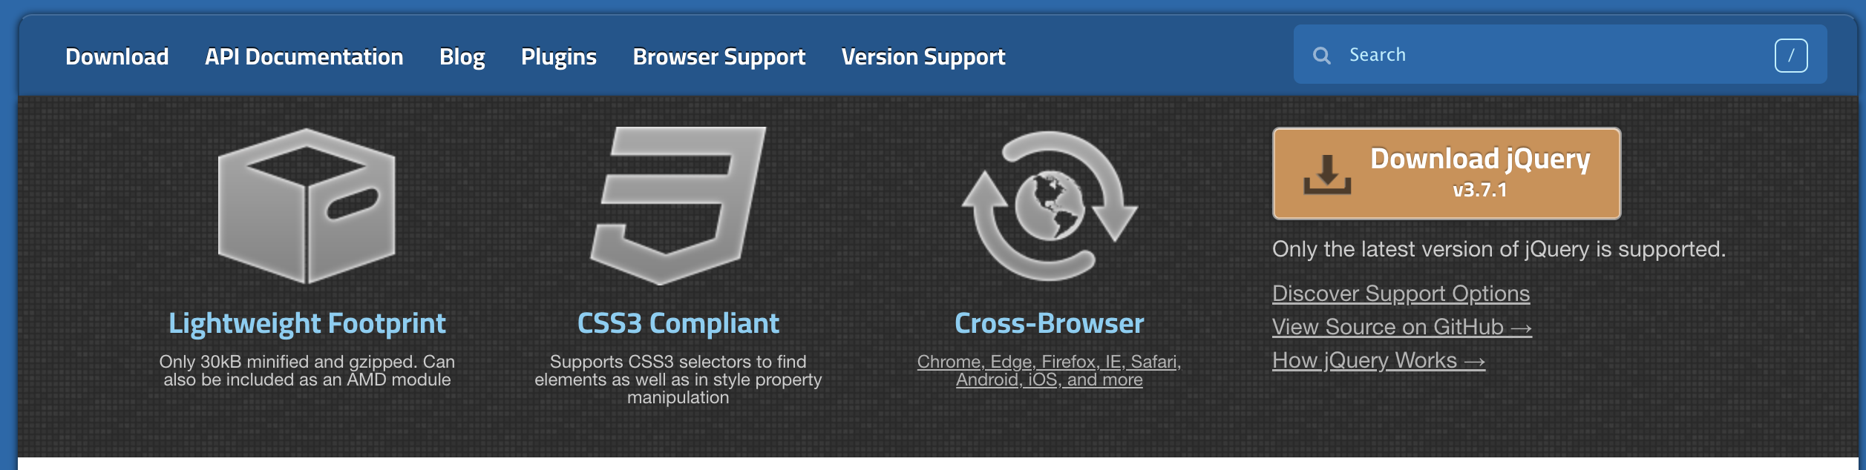
1.2. Adding jQuery
Go website at https://jquery.com/.
Click on the Download jQuery link that let you download in several options:
+ Compressed, production jQuery: a compressed, minified file is used for website pages.
+ Uncompressed, development jQuery is an uncompressed file for plugin developers with comments to functions
+ Slim build means a minified version of jQuery without all the animation methods and AJAX methods.
Market-driven quality education for the future success of our students.

Slide 5
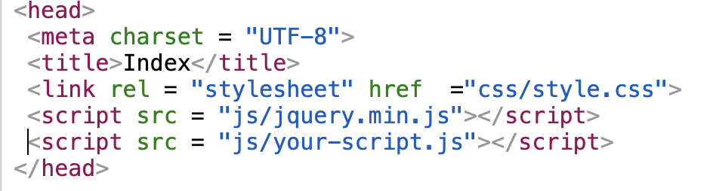
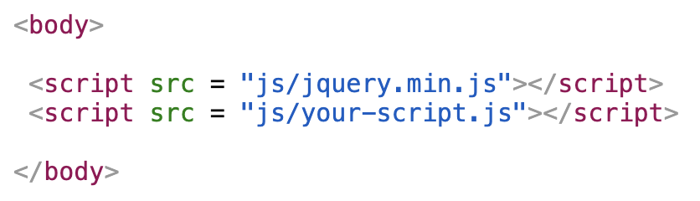
1.2. Adding jQuery
Download the “Download the compressed, production jQuery 3.7.1”
Click on the link, press CTRL+S, and save the file to the project folder
To add jQuery to the project using “src” attribute of the <script> tag in the <head> or <body> block:
In this case, adding jQuery without download by using Google CDN:
Market-driven quality education for the future success of our students.

Slide 6
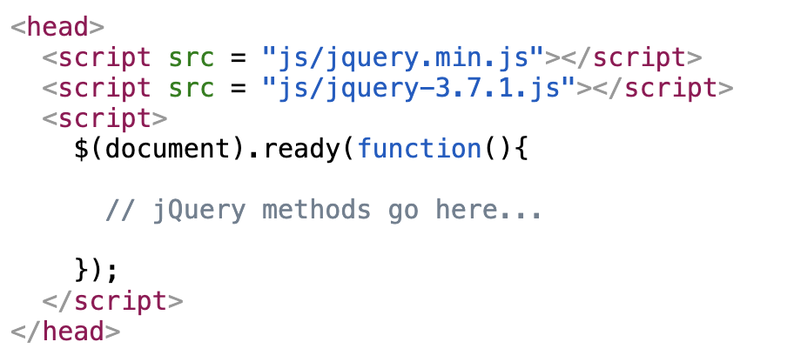
2. Accessing Page Elements Using the $ Function
In jQuery, any object must be referenced using a “jQuery” keyword or “$”.
Syntax: $(selector).action(function(){ // your code })
jQuery(selector).action(function(){ // your code }); The jQuery syntax is for selecting HTML elements and performing some action on the element(s).
“Ready” Event: prevent any jQuery code from running before the document is finished loading (is ready).
Market-driven quality education for the future success of our students.

Slide 7

3.1. CSS Selectors
A selector in jQuery is a string that specifies criteria for searching DOM elements on a page.
Syntax: jQuery(selector) or. $('selector')
<!DOCTYPE html><html>
<head>
<style> .intro{ background-color: yellow; } </style>
<script src="https://ajax.googleapis.com/ajax/libs/jquery/3.7.1/jquery.min.js"></script>
<script>
$(document).ready(function() {
$('#datenow').text(new Date().getFullYear());
$(".intro").css("background","lime");
});
</script>
</head>
<body>
<p class="intro">Books Online Library | <span id ="datenow"></span> | All rights reserved.</p>
</body>
</html>
$('#date-now') access to the element id="date-now" attribute
The $(".intro") selector access elements of the .intro class
Market-driven quality education for the future success of our students.

Slide 8
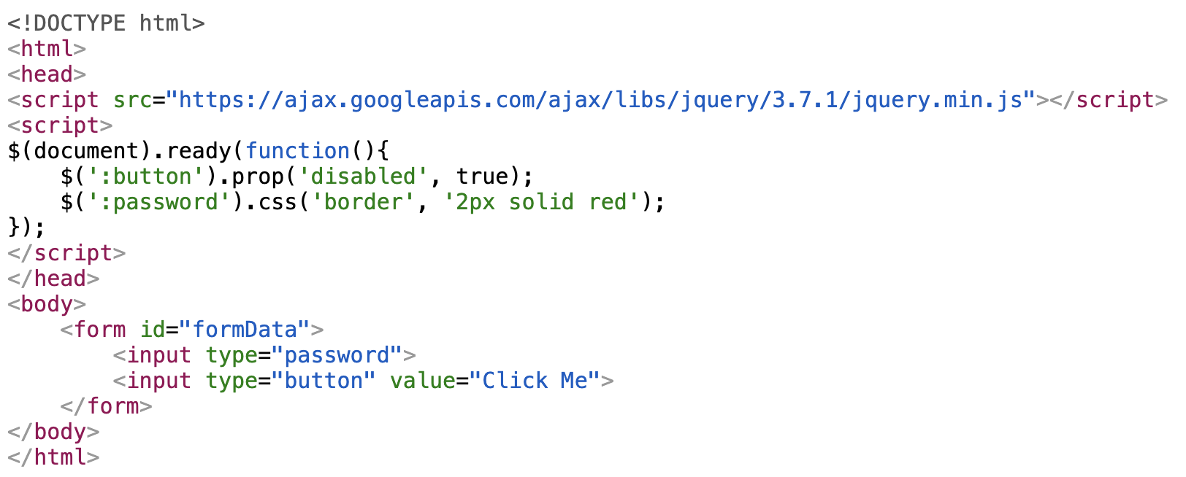


3.2. Form Selectors
Selectors: control form elements like input fields, radio buttons, checkboxes, dropdowns, and buttons. Syntax: $(‘:selector’) or. $(’:selector')
Market-driven quality education for the future success of our students.

Slide 9
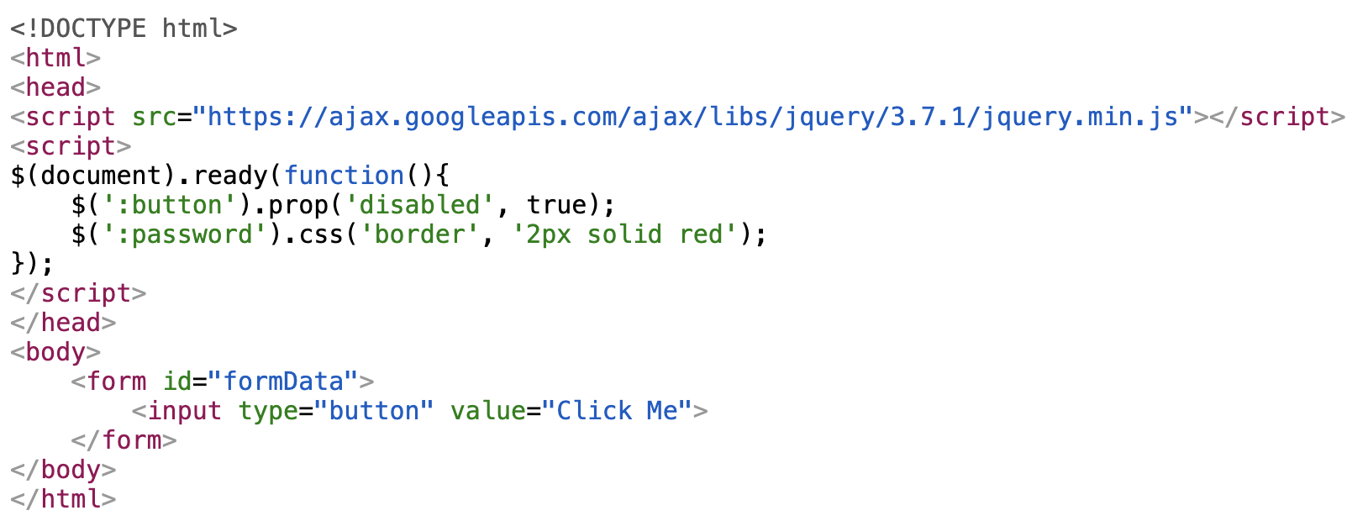

3.3. Features of Selectors in jQuery
Using selectors in jQuery always returns an object than error if incorrectly specify the selector or no such selectors.
Pros: jQuery code is executed normally without error
Cons harder to find what wrong because no errors in the console, and the code still executed
Market-driven quality education for the future success of our students.

Slide 10
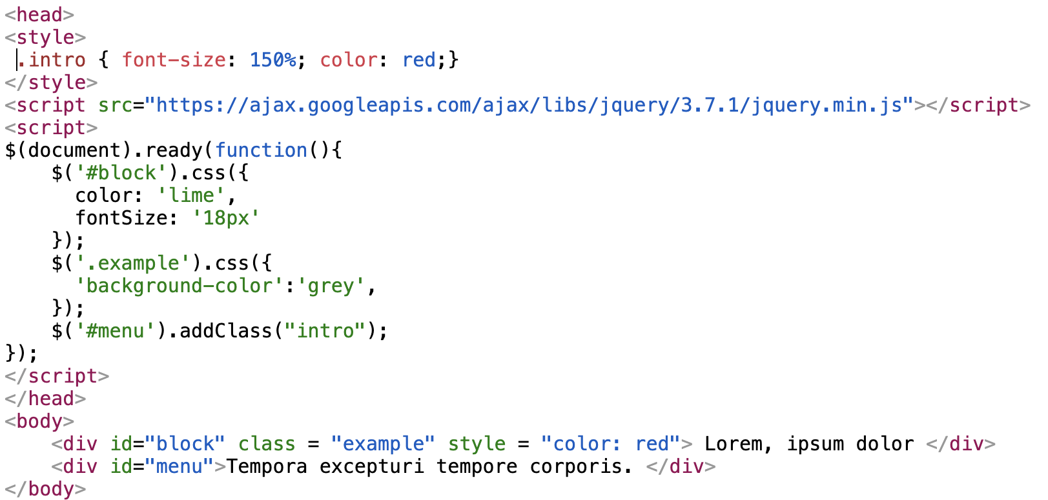
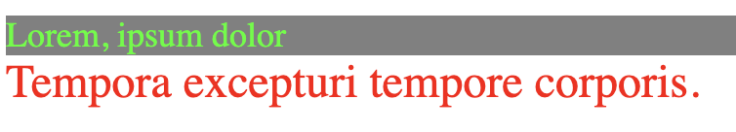
4. Methods Managing jQuery Styles
jQuery allows to either add a style attribute to the specified selector (css() method) or control the addition/removal of the class attribute or values
Syntax: $('#elementId').css(color:’red'); or $(‘.elementClass’).css(color:’red’);
$(‘#elementId’).addClass(“className”);

Slide 11
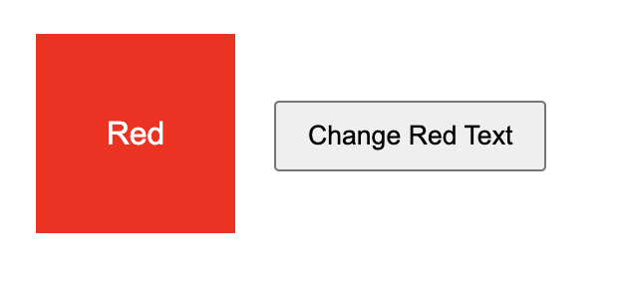
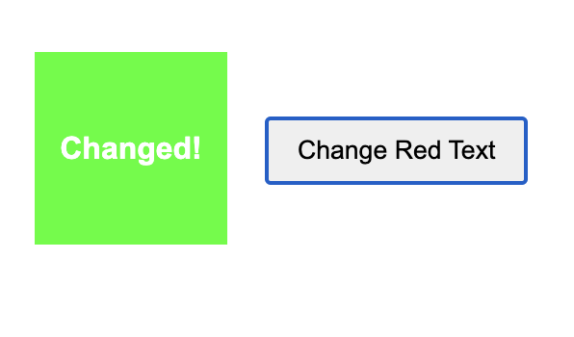
<!DOCTYPE html>
<html lang="en">
<head>
<style>
body { font-family: Arial, sans-serif; max-width: 800px; margin: 0 auto; padding: 20px; }
.box { width: 100px; height: 100px; margin: 10px; display: inline-block; text-align: center; line-height: 100px; color: white;}
.red { background-color: red; }
button { padding: 8px 15px; margin: 5px; cursor: pointer; }
.highlight { background-color: lime; font-weight: bold; }
</style>
</head>
<body>
<div class="exercise">
<div class="box red">Red</div>
<button id="change-red">Change Red Text</button>
</div>
<script src="https://code.jquery.com/jquery-3.6.0.min.js"></script>
<script>
</script>
</body>
</html>
Class Practice

Slide 12
4.1. Traversing. DOM Traversing Methods
jQuery has methods for traversing DOM elements.
”parent()”: returns the immediate parent node of the specified element.
Syntax: $(”elementName").parent().css({"color": "red", "border": "2px solid red"});
”parents()”: returns all ancestor elements of the selected element.
Syntax: $(”elementName").parents().css({"color": "red", "border": "2px solid red"});
”find()”: all descendant elements that match a specified selector..
Syntax: $(”elementName").find(“elementName”).css({"color": "red"});
Market-driven quality education for the future success of our students.

Slide 13
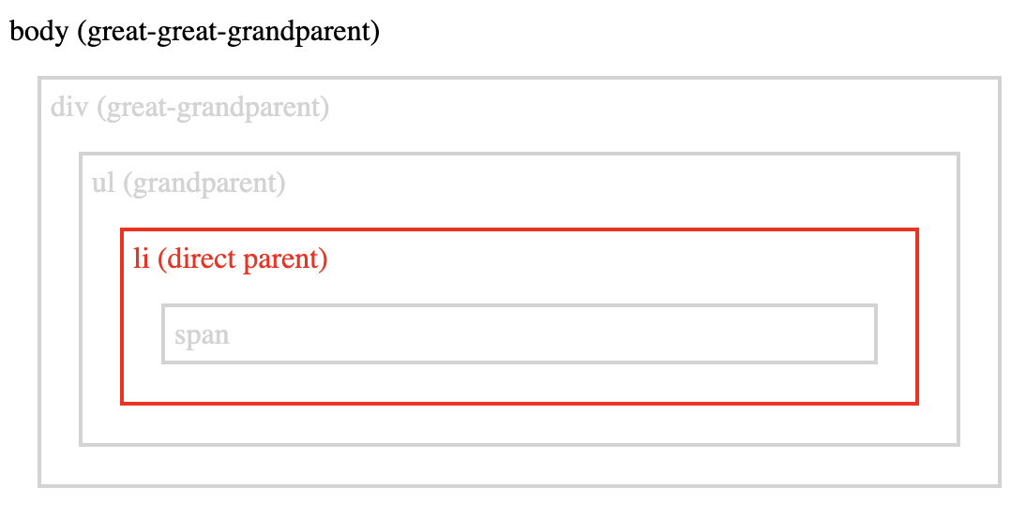
<!DOCTYPE html>
<html>
<head>
<style>.ancestors * { display: block; border: 2px solid lightgrey; color: lightgrey; padding: 5px; margin: 15px;}</style>
<script src="https://ajax.googleapis.com/ajax/libs/jquery/3.7.1/jquery.min.js"></script>
<script>
$(document).ready(function(){
$("#childSpan").parent().css({"color": "red", "border": "2px solid red"});
//$("span").parent().css({"color": "red", "border": "2px solid red"});
//$("span").parents().css({"color": "red", "border": "2px solid red"});
//$("ul").find("span").css({"color": "red", "border": "2px solid red"});
});
</script>
</head>
<body class="ancestors">body (great-great-grandparent)
<div style="width:500px;">div (great-grandparent)
<ul>ul (grandparent)
<li>li (direct parent)
<span id="childSpan">span</span>
</li>
</ul>
</div>
</body></html>

Slide 14
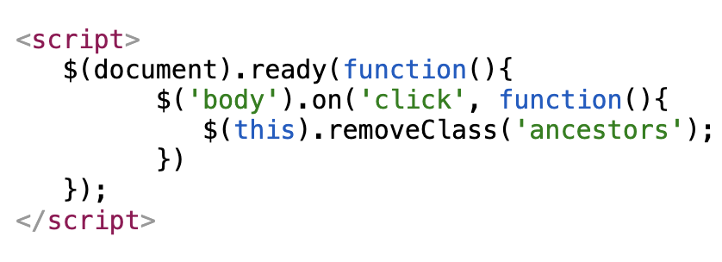
4.2. Event Handling in jQuery
Changes in styles/classes for HTML elements be assigned with handling events. In order to assign an event handler, use the on method:
Syntax: $('selector').on(click, function(){ body function });
$('selector').click( function(){ body function });
Syntax: $('selector').on(mousedown, function(){ body function });
$('selector').mousedown( function(){ body function });
Market-driven quality education for the future success of our students.

Slide 15
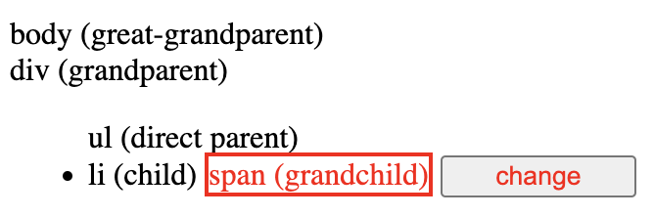
<!DOCTYPE html>
<html>
<head>
<style>.ancestors * { display: block; border: 2px solid lightgrey; color: lightgrey; padding: 5px; margin: 15px;}</style>
<script src="https://ajax.googleapis.com/ajax/libs/jquery/3.7.1/jquery.min.js"></script>
<script>
$(document).ready(function(){
$("ul").find("span").css({"color": "red", "border": "2px solid red"});
$('input').on('click', function(){ $("body").removeClass('ancestors');})
});
</script>
</head>
<body class="ancestors">body (great-great-grandparent)
<div style="width:500px;">div (great-grandparent)
<ul>ul (grandparent)
<li>li (direct parent)
<span id="childSpan">span (grandchild)</span>
<input id="buttonChange" type="button" value="change" style="width:100px; color:red"/>
</li>
</ul>
</div>
</body></html>

Slide 16
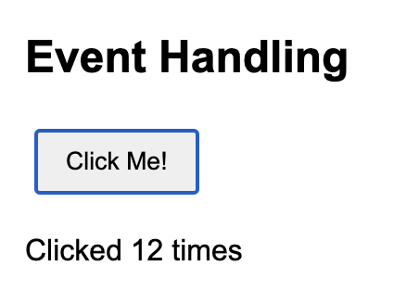
Class Practice
<!DOCTYPE html>
<html lang="en">
<head>
<style>
body {font-family: Arial, sans-serif; max-width: 800px; margin: 0 auto; padding: 20px; }
button {padding: 8px 15px; margin: 5px; cursor: pointer;}
</style>
</head>
<body>
<div class="exercise">
<h2>Event Handling</h2>
<button id="click-me">Click Me!</button>
<p id="click-counter">Clicked 0 times</p>
<!-- Load jQuery -->
<script src="https://code.jquery.com/jquery-3.6.0.min.js"></script>
<script>
</script>
</body>
</html>

Slide 17
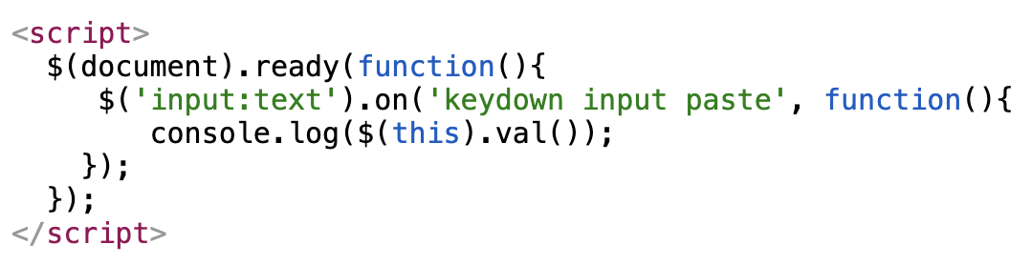
4.3. Assign One Handler for Multiple Events
The on() method can assign one function to handle multiple events at once.
Syntax: $('selector').on(event1 event2 event3',, function(){ body function });
Market-driven quality education for the future success of our students.

Slide 18
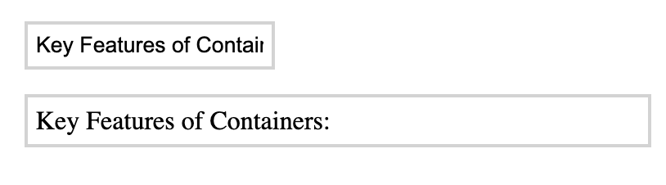
<!DOCTYPE html>
<html>
<head>
<style>.ancestors * { display: block; border: 2px solid lightgrey; color: black; padding: 5px; margin: 15px;}</style>
<script src="https://ajax.googleapis.com/ajax/libs/jquery/3.7.1/jquery.min.js"></script>
<script>
$(document).ready(function(){
$('input:text').on('keydown input paste', function(){
document.getElementById("out").innerHTML = $(this).val();
});
});
</script>
</head>
<body class="ancestors">
<input id="textInput" type="text"/>
<p id="out"></p>
</body>
</html>

Slide 19
4.4. Animation Methods in jQuery
jQuery allows setting animation effects for various elements in a simple way.
show([time])/hide([time]): elements changing their height and width over time to show or hide
toggle([time]): toggles the elements between visible/invisible.
slideUp()/slideDown(): animated hiding/showing of element while changing its height.
fadeIn(time): gradually change the opacity of elements from hidden to visible.
fadeOut(time): gradually change the opacity of elements from visible to hidden.
animate(): create custom animations on elements by changing their CSS properties over a specified duration.
Syntax: $(selector).animate({styles}, [duration], [easing], [complete]);
+ duration: 'fast' (200ms) or 'slow' (600ms). The default duration is 400ms.
+ easing: ‘swing’ or ’linear’
+ complete (optional): a callback function
Market-driven quality education for the future success of our students.

Slide 20
<!DOCTYPE html><html>
<head>
<style>.ancestors * { display: block; border: 2px solid lightgrey; color: black; padding: 5px; margin: 15px;}</style>
<script src="https://ajax.googleapis.com/ajax/libs/jquery/3.7.1/jquery.min.js"></script>
<script>
$(document).ready(function(){
$("#header").css("width", "200px");
$("#header").css("height", "50px");
$("#header").slideUp(1000);
$("#header").hide("slow"); // Animate the hide
$("#header").slideDown(1000);
$("#header").show("slow"); // Animate the show
//$("#header").css("visibility", "visible"); // hidden or visible
// $("#header").fadeOut(1000);
//$("#header").fadeIn(1000,0);
});
</script>
</head>
<body class="ancestors">
<h2 id="header">IT Step Academy</h2>
</body> </html>

Slide 21
<!DOCTYPE html><html>
<head>
<style>.ancestors * { display: block; border: 2px solid lightgrey; color: black; padding: 5px; margin: 15px;}</style>
<script src="https://ajax.googleapis.com/ajax/libs/jquery/3.7.1/jquery.min.js"></script>
<script>
$(document).ready(function(){
$("#myDiv").animate({ left: '50px', opacity: '0.5', height: '+=50px', width: '+=50px' }, 5000, 'linear', function() { alert("Animation complete!"); });
});
</script>
</head>
<body class="ancestors">
<div id="myDiv">IT Step Academy</div>
</body>
</html>

Slide 22
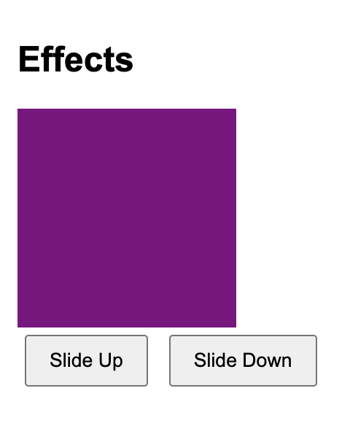
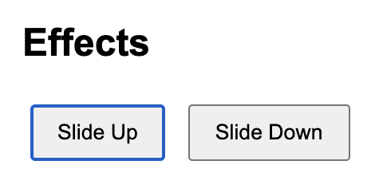
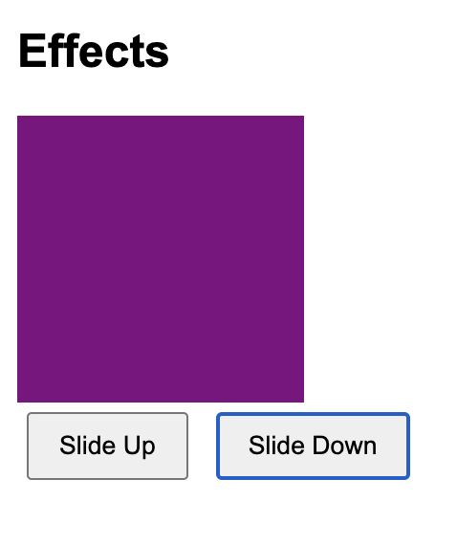
Class Practice
<!DOCTYPE html>
<html lang="en">
<head>
<style>
body { font-family: Arial, sans-serif; max-width: 800px; margin: 0 auto; padding: 20px;}
.box { width: 100px; height: 100px; margin: 10px; display: inline-block; text-align: center; line-height: 100px; color: white; }
button { padding: 8px 15px; margin: 5px; cursor: pointer; }
#animated-box {width: 150px; height: 150px; background-color: purple; }
</style>
</head>
<body>
<div class="exercise">
<h2>Effects</h2>
<div id="animated-box"></div>
<button id="slide-up">Slide Up</button>
<button id="slide-down">Slide Down</button>
</div>
<!-- Load jQuery -->
<script src="https://code.jquery.com/jquery-3.6.0.min.js"></script>
<!-- Your jQuery code -->
<script>
</script>
</body>
</html>

Slide 23
5. Delegating Events
Delegating events: an event handler is assigned to the parent element, and the event is handled by child elements.
Syntax: $('parent selector').on('event', 'child selector', function(){ ... });
Ex: the click handling for elements like <button class="btn-plus"> which can be added to the form:
$('form').on('click', '.btn-plus', function(){
console.log('button clicked');
});
Market-driven quality education for the future success of our students.

Slide 24
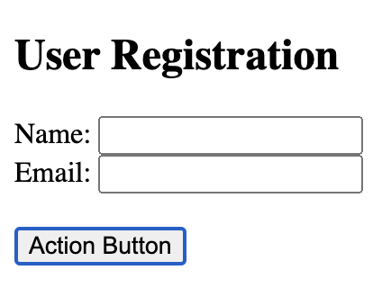
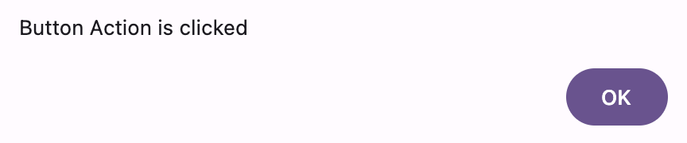
<!DOCTYPE html>
<html lang="en">
<head>
<script src="https://code.jquery.com/jquery-3.6.0.min.js"></script>
</head>
<body>
<div id="form-container">
<form id="main-form" class="user-form">
<h2>User Registration</h2>
Name: <input type="text" id="name" name="name" required> <br>
Email: <input type="email" id="email" name="email" required> <br>
</form>
<button id="add-form" class="btn-action">Action Button</button>
</div>
<script>
$(document).ready(function() {
// Delegated button click to form
$('#form-container').on('click', '.btn-action', function() {
alert("Button Action is clicked");
});
});
</script>
</body></html>

Slide 25
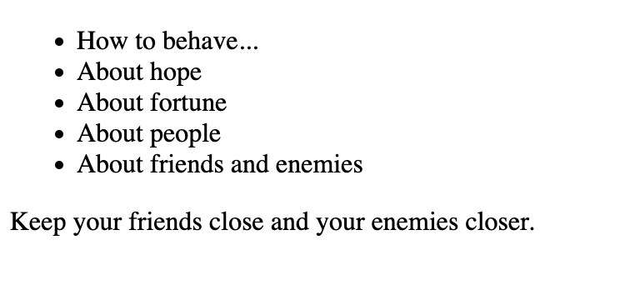
<!DOCTYPE html><html>
<head>
<script src="https://ajax.googleapis.com/ajax/libs/jquery/3.7.1/jquery.min.js"></script>
<script>
$(()=>{
const output = $('#output');
$('ul#proverbs').on('mouseenter', 'li', (event)=>{
//alert($(event.target.value));
output.text($(event.target).data('text'));
}).on('mouseleave', 'li', (event)=>{
output.text('');
});
})
</script>
</head>
<body>
<ul id = "proverbs">
<li data-text="When in Rome, do as the Romans.">How to behave...</li>
<li data-text="Hope for the best, but prepare for the worst.">About hope</li>
<li data-text="Fortune favors the bold.">About fortune</li>
<li data-text="Birds of a feather flock together.">About people</li>
<li data-text="Keep your friends close and your enemies closer.">About friends and enemies</li>
</ul>
<div id="output"/>
</body> </html>

Slide 26
5.1. Canceling Event Handlers
Event handler to be removed at some point, the off() method is used.
Syntax:
// assign an event handler
$('selector').on('event', someFunc);
// cancel the event handler
$('selector').off('event', someFunc);
Market-driven quality education for the future success of our students.

Slide 27
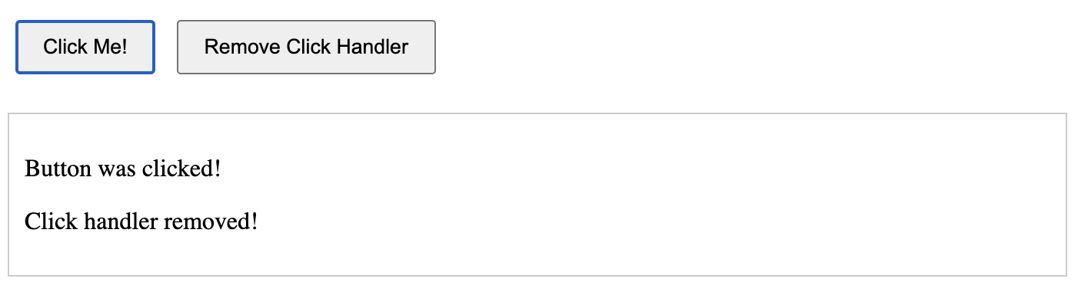
<!DOCTYPE html> <html lang="en">
<head>
<script src="https://code.jquery.com/jquery-3.6.0.min.js"></script>
<style>
button { padding: 8px 16px; margin: 5px; cursor: pointer;}
#message { margin-top: 20px; padding: 10px; border: 1px solid #ccc; min-height: 50px; }
</style>
</head>
<body>
<button id="clickMe">Click Me!</button>
<button id="removeHandler">Remove Click Handler</button>
<div id="message"></div>
<script>
$(document).ready(function() {
const clickHandler = function() {
$('#message').append('<p>Button was clicked!</p>');
};
$('#clickMe').on('click', clickHandler);
$('#removeHandler').on('click', function() {
$('#clickMe').off('click', clickHandler);
$('#message').append('<p>Click handler removed!</p>');
});
});
</script></body></html>

Slide 28
6. jQuery and AJAX
jQuery provides methods for working with AJAX for asynchronous data load and transfer between the server and HTML page using JavaScript.
API (Application Programming Interface) allows users of a website to receive/send information with a server-side.
Syntax:
$.ajax({ url: ’api_url', dataType: "json",}).done(function(data) {
// the code that triggers if the form is successfully submitted to the server ).fail(function() {
// the code that will run in case of error
});
Market-driven quality education for the future success of our students.

Slide 29
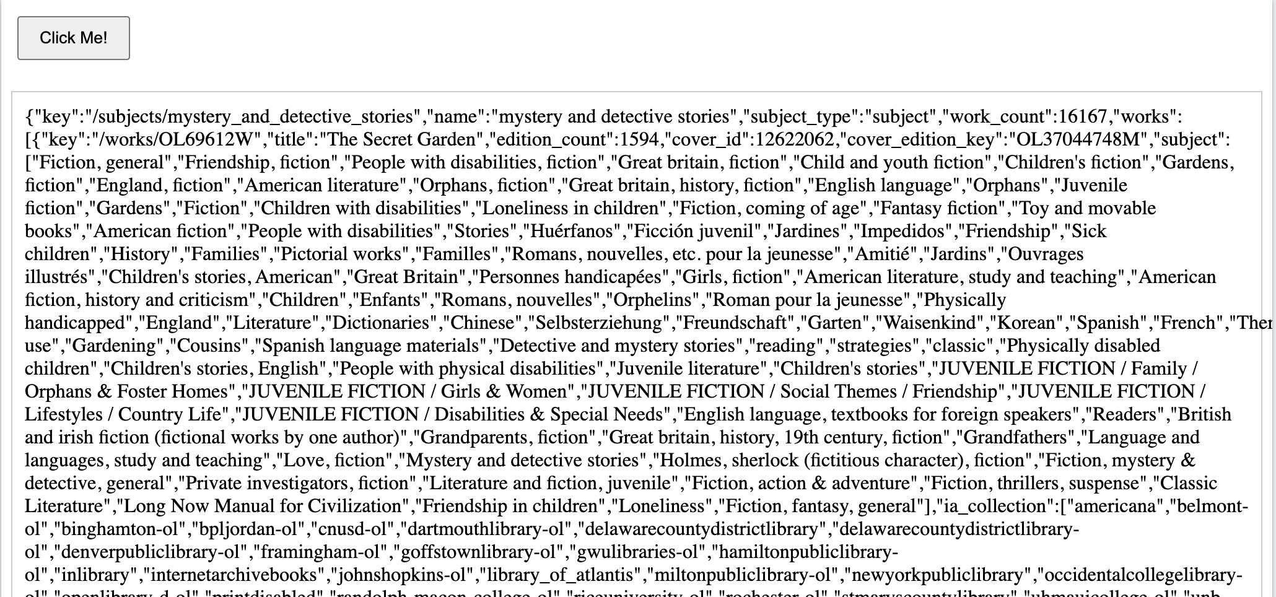
<!DOCTYPE html> <html lang="en">
<head>
<script src="https://code.jquery.com/jquery-3.6.0.min.js"></script>
<style>
button { padding: 8px 16px; margin: 5px; cursor: pointer;}
#message { margin-top: 20px; padding: 10px; border: 1px solid #ccc; min-height: 50px; }
</style>
</head>
<body>
<button id="clickMe">Click Me!</button>
<div id="message"></div>
<script>
$(document).ready(function() {
const clickHandler = function() {
var category_url = "https://openlibrary.org/subjects/mystery_and_detective_stories.json";
$.ajax({url: category_url, dataType: "json"
}).done(function (data) {
$('#message').append(JSON.stringify(data));
}).fail(function(data) {
alert("Error from mail!!!" + JSON.stringify(data));
});
};
$('#clickMe').on('click', clickHandler);
});
</script></body></html>

Slide 30
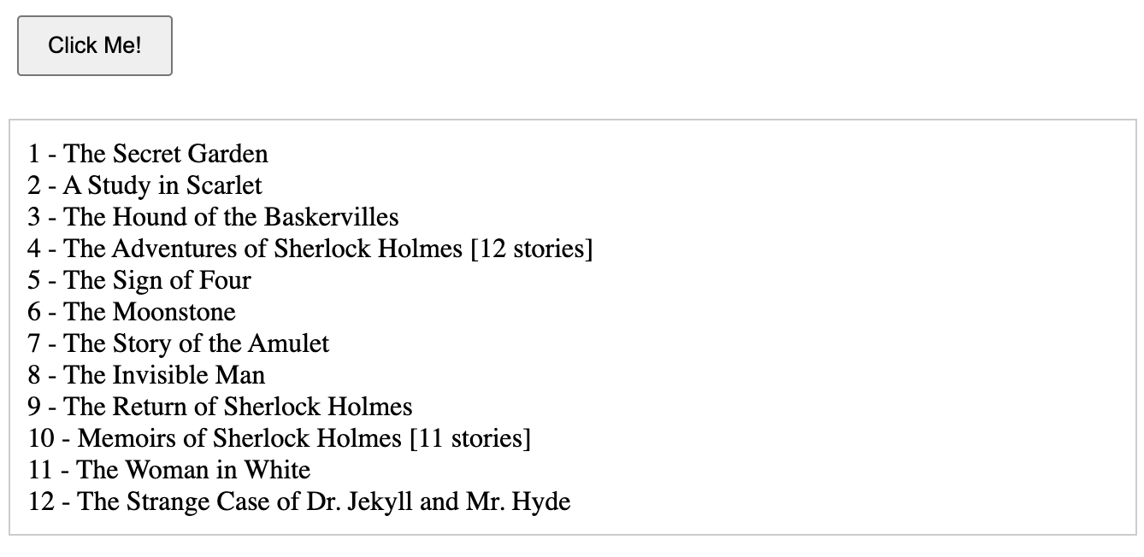
Classwork
Using jQuery to get only book title with API bellow
API: "https://openlibrary.org/subjects/mystery_and_detective_stories.json";
Market-driven quality education for the future success of our students.

