Slide 1
Making a practical VNC client for character terminals
Howard Guo
i@howard.gg
hguo@suse.com

Slide 2
Virtual Network Computing
Much like “Remote Desktop Service” of Microsoft Windows
Simple tasks: move mouse, type keys, see the screen
Cross-platform
  Linux
  Unix/macOS
  Microsoft Windows

Slide 3
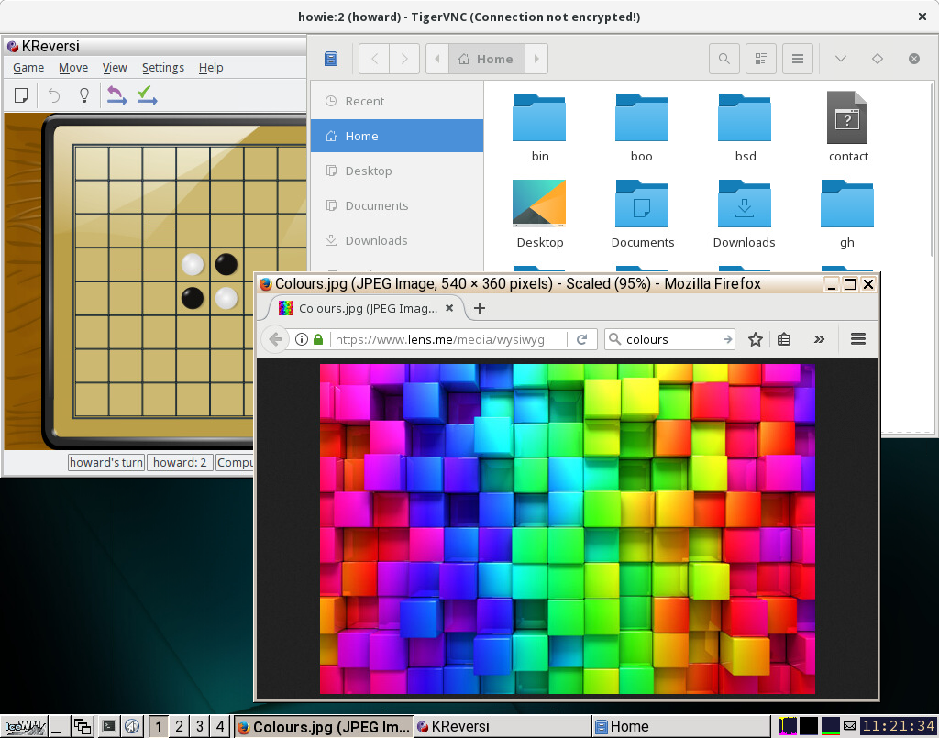

Slide 4
Linux Terminal
One of the first features of Linux kernel
Powerful and efficient
Text-oriented interface loved by geeks
Unfortunately powerless in graphical tasks

Slide 5
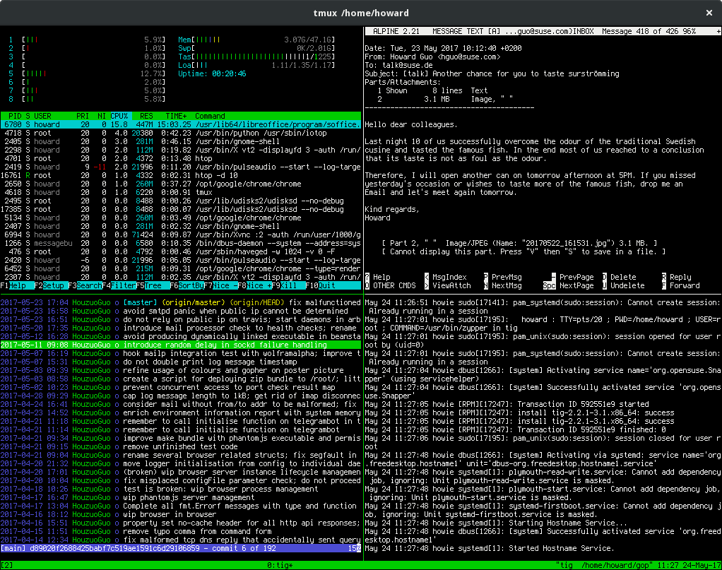

Slide 6
headmore – VNC client for terminal
Zoom in/out and pan around
Move mouse cursor, click buttons, and keyboard input.
Good enough for editing images, watching YouTube, etc
https://github.com/HouzuoGuo/headmore
zypper install headmore (Tumbleweed, PackageHub)
“what drug are you having there, I want some of that 😆”

Slide 7
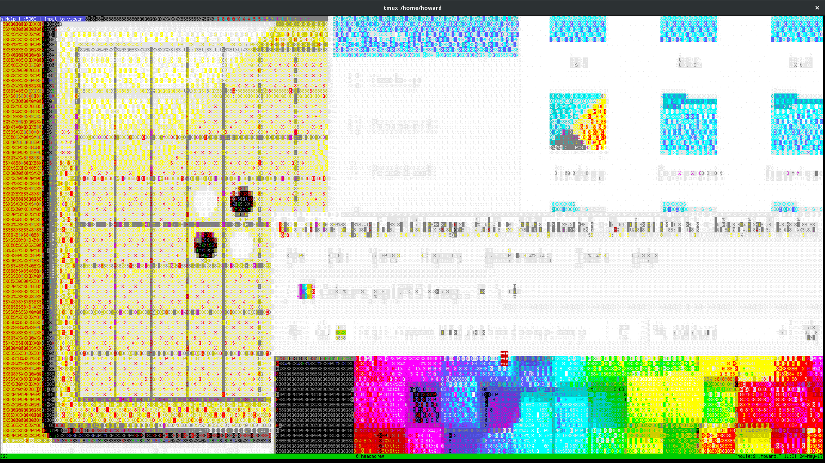

Slide 8

Programming
UTF-8 text and emojis 😉
Rich set of colours
Ordinary keys – letters, numbers, enter
Special keys – modifiers, arrows, escape , F1-12
Programming libraries
  Primitive - ncurses
  Feature rich - libcaca

Slide 9
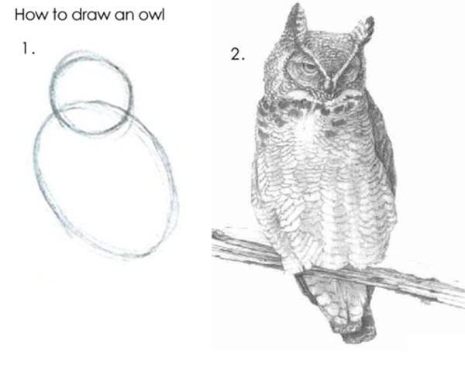
Sample Code
caca_display_t *dp = caca_create_display(NULL);
caca_canvas_t *cv = caca_get_canvas(dp);
caca_set_color_ansi(cv, CACA_BLACK, CACA_WHITE);
while (1) {
caca_event_t ev;
caca_get_event(dp, CACA_EVENT_KEY_PRESS, &ev, -1);
caca_printf(cv, 0, 0, "That key was %c", caca_get_event_key_ch(&ev));
caca_refresh_display(dp);
}
caca_free_display(dp);

Slide 10
Quirks
Alt+Key emits two key codes – escape+key
Ctrl+Key emits one key code
Shift+Key emits one key code

Slide 11
Thank You
Check out my other pet projects in
https://github.com/HouzuoGuo
Use social networks and control your computer via
telephone, SMS, satellite messaging:
https://github.com/HouzuoGuo/laitos

