Slide 1

Probability of default model
Development, independent validation and production decision
A take-home task for Data Scientist position at Ameria Bank
Yerevan 2026

Slide 2







Contents
Problem Statement
Exploratory Data Analysis (EDA)
Data Cleaning and Preprocessing
Model Training and Comparison
Model Validation
Conclusion
2

Slide 3
Problem Statement
№ | Feature | Description
1 | client_history_in_bank | Number of months the client has been with the bank
2 | age | Client age
3 | income | Monthly income
4 | employment_years | Years employed
5 | loan_amount | Loan amount
6 | interest_rate | Loan interest rate
7 | num_loans | Number of active loans
8 | credit_utilization | Credit utilization ratio
9 | past_due_30 | Number of 30+ DPD loans
10 | past_due_60 | Number of 60+ DPD loans
11 | past_due_90 | Number of 90+ DPD loans
12 | past_default | Historical default indicator
13 | recovery_flag_after_90d | Indicator showing whether the client entered recovery after becoming 90+ days past due
14 | dti | Debt-to-income ratio
15 | region_risk | Regional segmentation
16 | default (Target) | Actual observed default outcome
Dataset (data.pkl)
20000 loans, 15 features
Objective
Develop a probability-of-default (PD) model and indepen-dently validate the complete modelling flow.
Assess data quality and integrity and prepare the data for modelling.
Develop and train a credit-risk model.
Compare several candidate models and select the final model.
Independently validate the final model.
Interpret the results from statistical, model-risk, and business perspectives.
Provide a conclusion on whether the model is suitable for production use.
* DPD – day past due
3

Slide 4
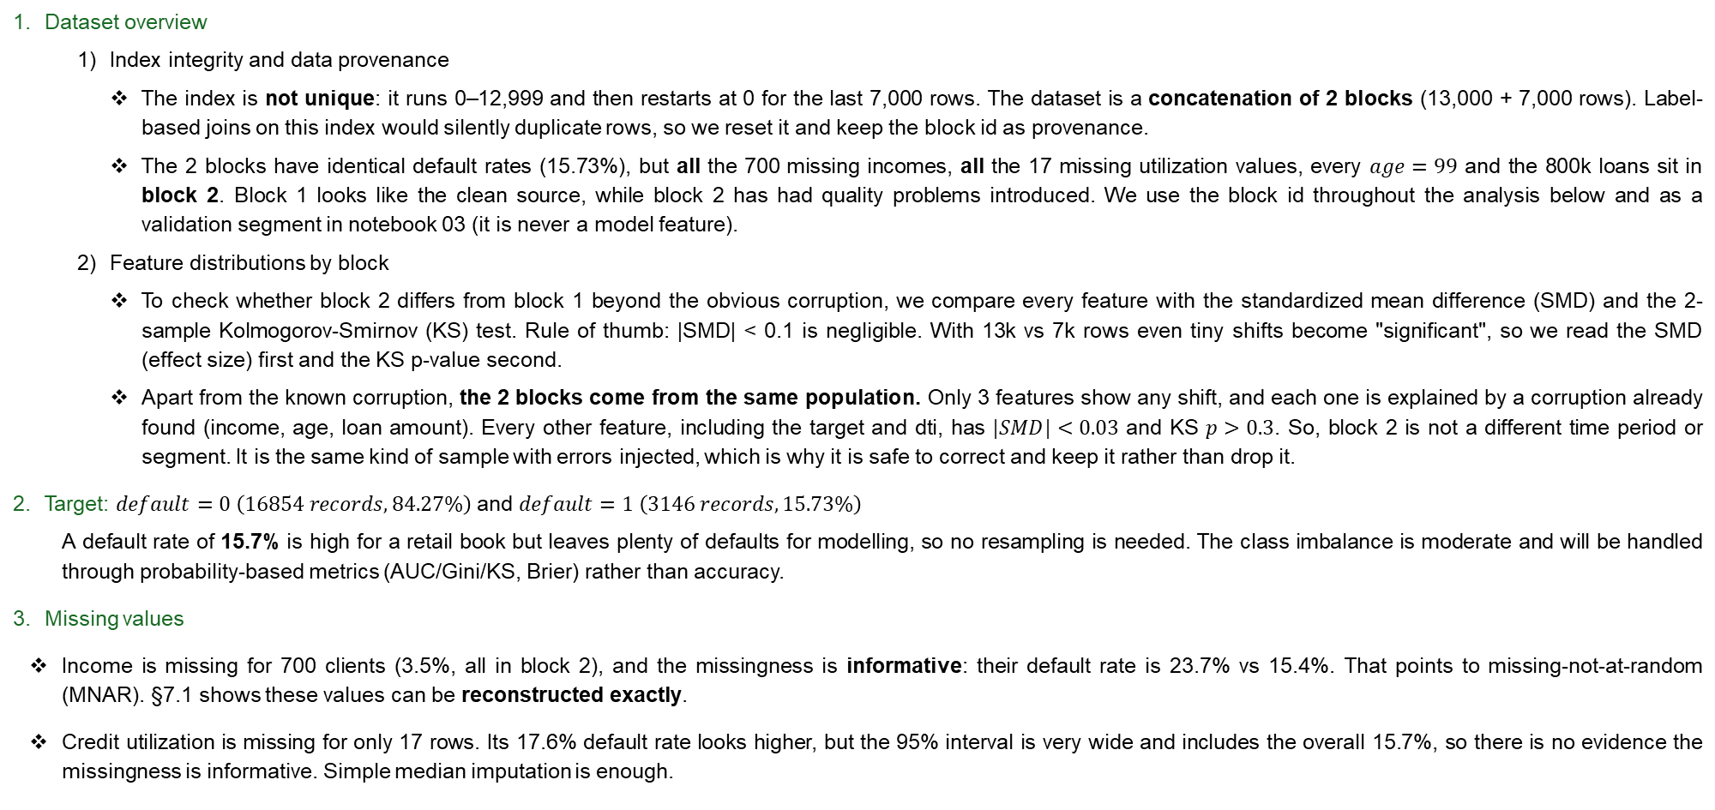
EDA (1)
Goal: understand the dataset, assess data quality and integrity, and list every issue that has to be handled before modelling.
Dataset overview
  Index integrity and data provenance
  The index is not unique: it runs 0–12,999 and then restarts at 0 for the last 7,000 rows. The dataset is a concatenation of 2 blocks (13,000 + 7,000 rows). Label-based joins on this index would silently duplicate rows, so we reset it and keep the block id as provenance.
  The 2 blocks have identical default rates (15.73%), but all the 700 missing incomes, all the 17 missing utilization values, every $age=99$ and the 800k loans sit in block 2. Block 1 looks like the clean source, while block 2 has had quality problems introduced. We use the block id throughout the analysis below and as a validation segment in notebook 03 (it is never a model feature).
  Feature distributions by block
  To check whether block 2 differs from block 1 beyond the obvious corruption, we compare every feature with the standardized mean difference (SMD) and the 2-sample Kolmogorov-Smirnov (KS) test. Rule of thumb: |SMD| < 0.1 is negligible. With 13k vs 7k rows even tiny shifts become "significant", so we read the SMD (effect size) first and the KS p-value second.
  Apart from the known corruption, the 2 blocks come from the same population. Only 3 features show any shift, and each one is explained by a corruption already found (income, age, loan amount). Every other feature, including the target and dti, has $|SMD|<0.03$ and KS $p>0.3$. So, block 2 is not a different time period or segment. It is the same kind of sample with errors injected, which is why it is safe to correct and keep it rather than drop it.
Target: $default=0 \left(16854 records, 84.27\%\right)$ and $default=1 \left(3146 records, 15.73\%\right)$
  A default rate of 15.7% is high for a retail book but leaves plenty of defaults for modelling, so no resampling is needed. The class imbalance is moderate and will be handled through probability-based metrics (AUC/Gini/KS, Brier) rather than accuracy.
Missing values
Income is missing for 700 clients (3.5%, all in block 2), and the missingness is informative: their default rate is 23.7% vs 15.4%. That points to missing-not-at-random (MNAR). §7.1 shows these values can be reconstructed exactly.
Credit utilization is missing for only 17 rows. Its 17.6% default rate looks higher, but the 95% interval is very wide and includes the overall 15.7%, so there is no evidence the missingness is informative. Simple median imputation is enough.
4

Slide 5
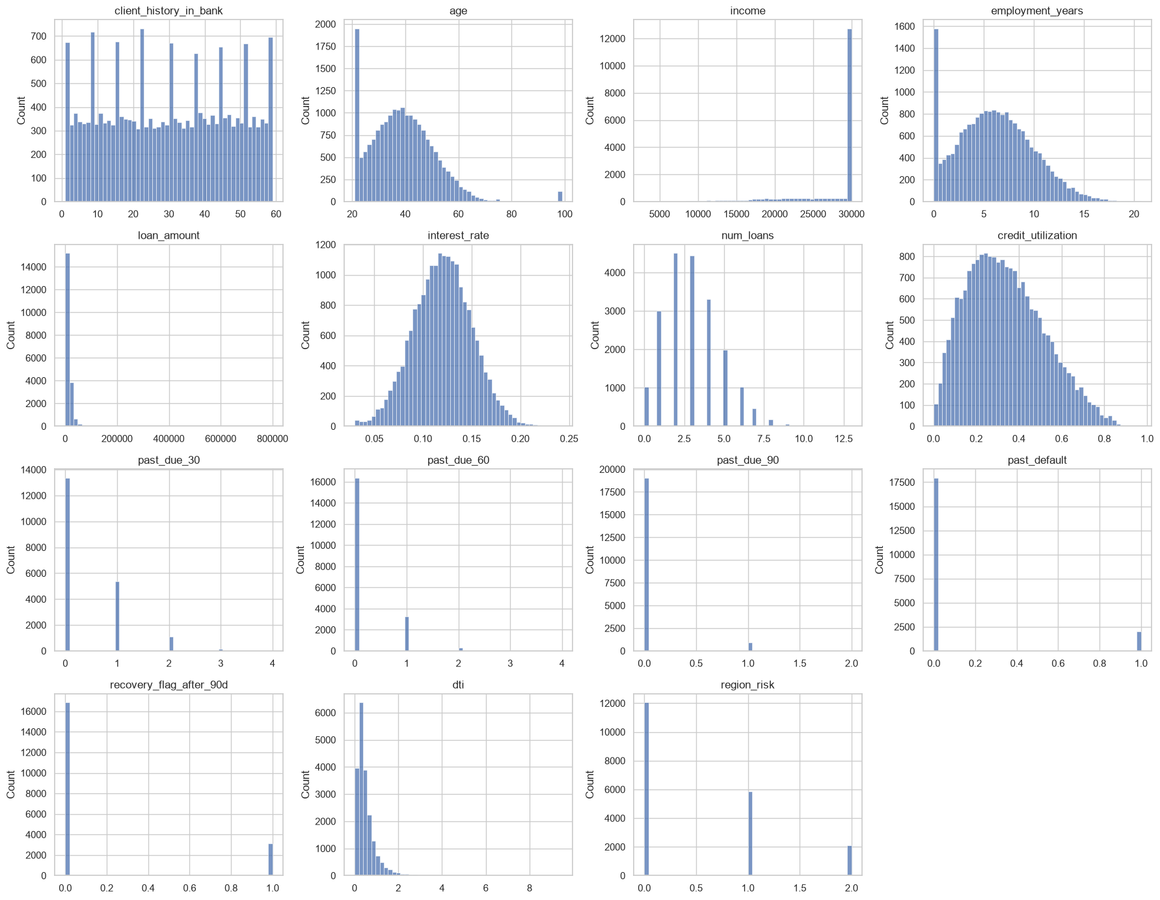
EDA (2)
Feature distributions
Censoring, caps and placeholder values
Income is right-censored at 30,000 for 62.5% of clients, so the median equals the maximum. The variable carries much less information than it appears to, and the derived dti is affected too. Capped clients default less (14.2% vs 18.3%, non-overlapping 95% intervals), so an income_capped flag is informative.
Age is clipped to [21, 75] in both blocks (1,520 rows at 21, 20 at 75), which is part of how the data was generated. 99 is a placeholder (120 rows, block 2 only, nothing between 75 and 99), so we treat it as missing. Its default rate (15.0%) is indistinguishable from the rest (the interval spans roughly 10–23%), so the placeholder is not informative.
Interest rate is floored at 3% (17 rows), which is plausible as a product minimum.
Loan amount has an extreme tail: 2 loans of exactly 800,000 and 21 of exactly 80,000, against a median of about 10k. Block 1 never exceeds 80,000, so 80k is the product cap, and 800k looks like 80k with an extra 0. §7.1 shows exactly which loans were multiplied by 10.
Outliers: loan_amount (max is 13x its 99th percentile) and dti (up to 9.5) have heavy tails.
  The loan tail is mostly a data error (fixed exactly in pd_model.data.cleaning).
  The dti tail is genuine: small incomes combined with large loans. Tree models are robust to it, but logistic regression is not, so dti will be winsorised at the training-set 99.5th percentile.
5

Slide 6
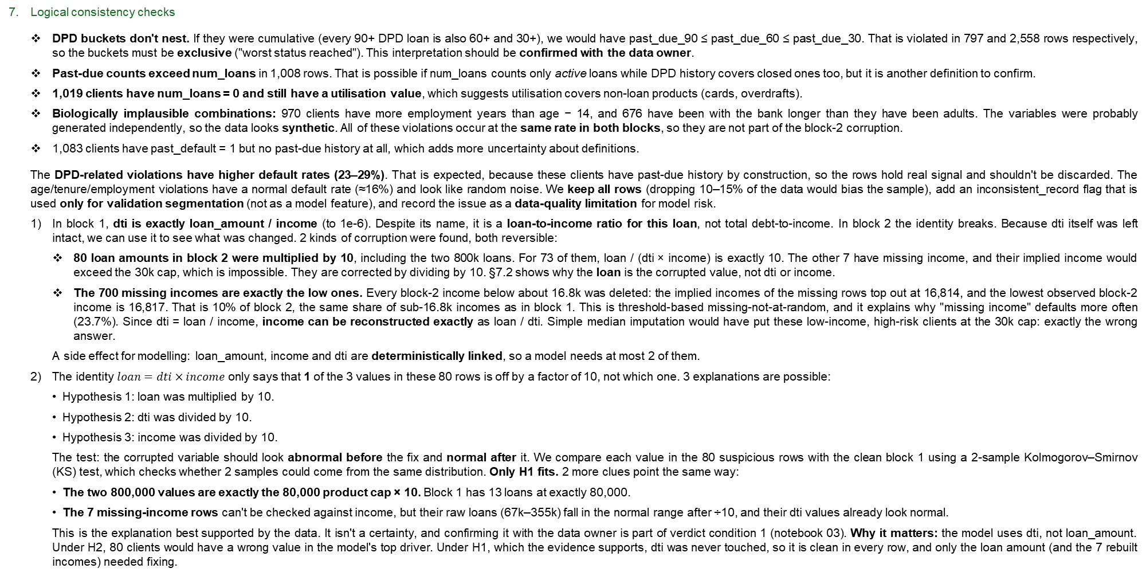
EDA (3)
Logical consistency checks
DPD buckets don't nest. If they were cumulative (every 90+ DPD loan is also 60+ and 30+), we would have past_due_90 ≤ past_due_60 ≤ past_due_30. That is violated in 797 and 2,558 rows respectively, so the buckets must be exclusive ("worst status reached"). This interpretation should be confirmed with the data owner.
Past-due counts exceed num_loans in 1,008 rows. That is possible if num_loans counts only active loans while DPD history covers closed ones too, but it is another definition to confirm.
1,019 clients have num_loans = 0 and still have a utilisation value, which suggests utilisation covers non-loan products (cards, overdrafts).
Biologically implausible combinations: 970 clients have more employment years than age − 14, and 676 have been with the bank longer than they have been adults. The variables were probably generated independently, so the data looks synthetic. All of these violations occur at the same rate in both blocks, so they are not part of the block-2 corruption.
1,083 clients have past_default = 1 but no past-due history at all, which adds more uncertainty about definitions.
The DPD-related violations have higher default rates (23–29%). That is expected, because these clients have past-due history by construction, so the rows hold real signal and shouldn't be discarded. The age/tenure/employment violations have a normal default rate (≈16%) and look like random noise. We keep all rows (dropping 10–15% of the data would bias the sample), add an inconsistent_record flag that is used only for validation segmentation (not as a model feature), and record the issue as a data-quality limitation for model risk.
  In block 1, dti is exactly loan_amount / income (to 1e-6). Despite its name, it is a loan-to-income ratio for this loan, not total debt-to-income. In block 2 the identity breaks. Because dti itself was left intact, we can use it to see what was changed. 2 kinds of corruption were found, both reversible:
    80 loan amounts in block 2 were multiplied by 10, including the two 800k loans. For 73 of them, loan / (dti × income) is exactly 10. The other 7 have missing income, and their implied income would exceed the 30k cap, which is impossible. They are corrected by dividing by 10. §7.2 shows why the loan is the corrupted value, not dti or income.
    The 700 missing incomes are exactly the low ones. Every block-2 income below about 16.8k was deleted: the implied incomes of the missing rows top out at 16,814, and the lowest observed block-2 income is 16,817. That is 10% of block 2, the same share of sub-16.8k incomes as in block 1. This is threshold-based missing-not-at-random, and it explains why "missing income" defaults more often (23.7%). Since dti = loan / income, income can be reconstructed exactly as loan / dti. Simple median imputation would have put these low-income, high-risk clients at the 30k cap: exactly the wrong answer.
    A side effect for modelling: loan_amount, income and dti are deterministically linked, so a model needs at most 2 of them.
  The identity $loan=dti×income$ only says that 1 of the 3 values in these 80 rows is off by a factor of 10, not which one. 3 explanations are possible:
    Hypothesis 1: loan was multiplied by 10.
    Hypothesis 2: dti was divided by 10.
    Hypothesis 3: income was divided by 10.
    The test: the corrupted variable should look abnormal before the fix and normal after it. We compare each value in the 80 suspicious rows with the clean block 1 using a 2-sample Kolmogorov–Smirnov (KS) test, which checks whether 2 samples could come from the same distribution. Only H1 fits. 2 more clues point the same way:
The two 800,000 values are exactly the 80,000 product cap × 10. Block 1 has 13 loans at exactly 80,000.
The 7 missing-income rows can't be checked against income, but their raw loans (67k–355k) fall in the normal range after ÷10, and their dti values already look normal.
This is the explanation best supported by the data. It isn't a certainty, and confirming it with the data owner is part of verdict condition 1 (notebook 03). Why it matters: the model uses dti, not loan_amount. Under H2, 80 clients would have a wrong value in the model's top driver. Under H1, which the evidence supports, dti was never touched, so it is clean in every row, and only the loan amount (and the 7 rebuilt incomes) needed fixing.
6

Slide 7
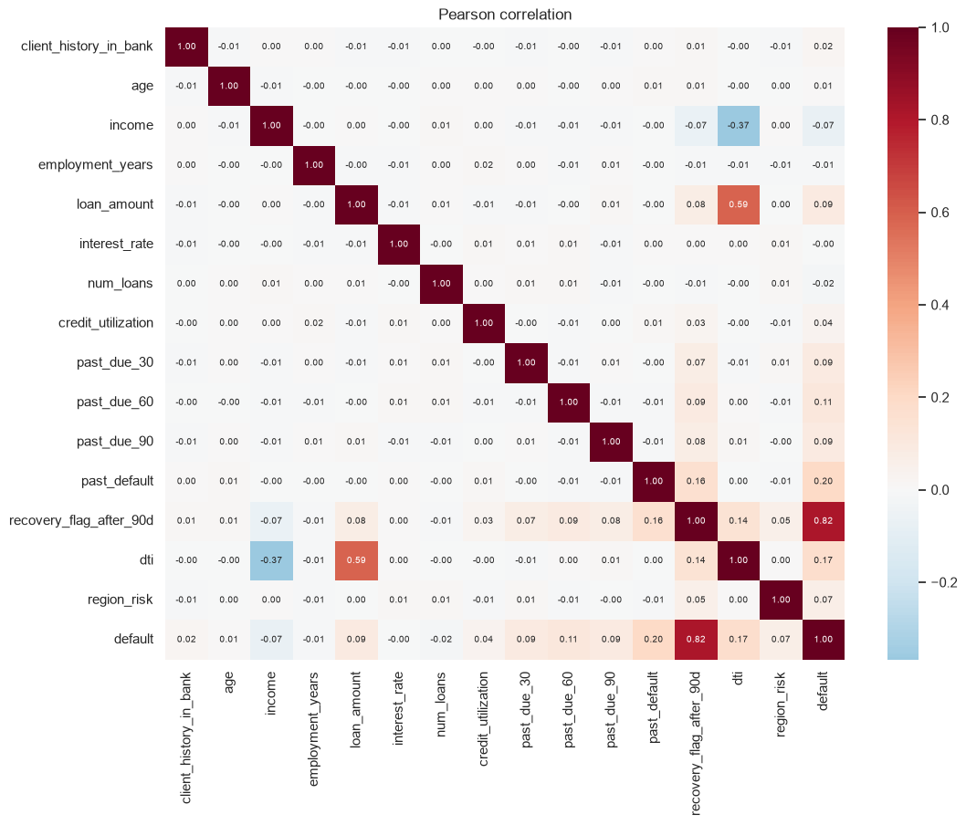
EDA (4)
Target leakage check — recovery_flag_after_90d is target leakage and must be excluded.
Its prevalence (15.74%) is practically the default rate (15.73%). It equals the target in 95.1% of rows (correlation 0.82).
By definition it records an event that happens after the client reaches 90+ DPD, which is after (or at) the default event. It would not be available when a loan application is scored.
It does not match the client's own history either: 2,877 clients have the flag but 0 past_due_90 loans, so it isn't a pre-application feature.
Including it would give an artificially excellent model (AUC ≈ 0.95, Gini ≈ 0.90; quantified in notebook 03) that would collapse in production.
Univariate predictive power
  Interpreting Information Value (IV) with the usual rule of thumb (< 0.02 useless, 0.02–0.1 weak, 0.1–0.3 medium, 0.3–0.5 strong, > 0.5 suspicious):
recovery_flag_after_90d has an IV far above 0.5, which confirms the leakage.
Without it, the strongest drivers are dti, past_default, loan_amount, the DPD counts, income and region_risk.
age, interest_rate, employment_years, num_loans and client_history_in_bank carry almost no signal on their own. In particular, interest rate not being linked to risk is unusual, since lenders normally price for risk.
The default rate rises steadily with dti, loan_amount, DPD counts, past_default and region_risk, and falls with income. These relationships are monotonic and make business sense, which supports monotone constraints in the tree models and a WoE scorecard.
DPD counts and past_default increase the default rate monotonically, and the intervals of neighbouring levels mostly don't overlap. The top levels are tiny (past_due_30 = 4: n = 8, past_due_60 = 4: n = 1, past_due_90 = 2: n = 17), so their point estimates (37–100%) mean little on their own. Tree models and WoE binning group them automatically. A linear model would benefit from capping at 3+ (30/60) and 2+ (90).
num_loans has no clear trend: everything between 1 and 8 loans sits inside 14–17%. Clients with 0 loans are slightly higher (18.7%, CI 16.4–21.2%), and levels ≥ 9 are noise (n ≤ 52).
region_risk: the default rate rises with the code, 13.7% → 18.3% → 20.5%, and the 0-vs-1 intervals are well separated. So risk is ordered by region, but not in equal steps: about +0.34 log-odds from 0→1 and only +0.14 from 1→2. Using the raw code as one linear term would force equal steps, over-predicting region 2 and under-predicting region 1.
  Decision: treat region_risk as categorical and one-hot encode it (region 0 = reference). This removes the equal-step assumption for 1 extra parameter in logistic regression. Trees are unaffected.
  We don't know what the codes mean. Their order is inferred from the data, not from documentation, and needs confirmation.
Correlations between features
Multicollinearity is low: the only notable pairs are dti–loan_amount (0.59) and dti–income (−0.37), both expected since dti = loan / income. Apart from those, the features are nearly uncorrelated with each other, which again suggests a synthetic dataset.
7

Slide 8
Data Cleaning and Preprocessing
Cleaning applies the following actions according to EDA:
drops the leaky recovery_flag_after_90d,
resets the duplicated index (row_id, block),
divides the 80 inflated loans by 10,
rebuilds the 700 deleted incomes as loan / dti,
flags inconsistent records (validation only),
makes a stratified 70/30 train/test split.
Preprocessing
  The preprocessor is fitted on train and saved for validation and the service:
Raw record
Feature Builder (domain rules)
Column Transformer
Winsorizer (dti cap)
numeric: median imputer → Standard Scaler
categorical: most-frequent imputer → One-Hot Encoder
FeatureBuilder: age 99 → missing; income capped at 30k; $dti=loan/income$ if absent; income_capped, total_past_due, any_past_due.
Imputers: every column has one, so a future record missing any field is still scored.
region_risk: one-hot encoded, region 0 as reference (unequal risk steps, EDA §9.1).
8

Slide 9
Model Training and Comparison (1)
8 candidate PD models are trained on the training set only, all on the output of the single preprocessor. They are compared with 5-fold stratified cross-validation, and one is selected. The test set is not touched here; it is reserved for the independent validation.
№ | Models | Why it's in the set?
A | Logistic Regression (all features) | Transparent baseline with every available variable
B | Logistic Regression (parsimonious) | Only statistically significant, economically sensible drivers
C | WoE scorecard | Industry/regulatory standard for retail PD: monotone, interpretable, converts to score points
D | LightGBM (monotone-constrained) | Captures non-linearity and interactions while keeping every driver's direction economically sensible
E | LightGBM (unconstrained) | Upper bound on the discrimination available; shows what the constraints cost
F | XGBoost (monotone-constrained) | 2nd gradient-boosting implementation (level-wise trees, different regularisation), to make sure the result doesn't depend on 1 library
G | XGBoost (unconstrained) | As E, for XGBoost
H | Random Forest | Bagging instead of boosting: a different way to capture non-linearity, to make sure the conclusion doesn't depend on the boosting family
We fit a logistic regression on all preprocessed value features. Engineered features are excluded because they are exact or near-exact combinations of base features, and missing flags are excluded because they are almost constant. A variable is kept only if it passes all 3 tests:
Statistically significant: p < 0.01.
Economically sensible sign: risk rises with delinquency, DTI, utilisation and regional risk.
Material: it improves CV Gini.
Features are standardised, so each coefficient is the change in log-odds per standard deviation (per dummy for region_risk).
7 source variables are clearly significant (p ≈ 0): past_default, past_due_30/60/90, dti, region_risk (both dummies) and credit_utilization. All of them have the expected positive sign.
client_history_in_bank is significant (p ≈ 0.002), but its sign is counter-intuitive: longer relationships with the bank would mean higher risk. It has zero IV (see EDA) and its effect is tiny, so it is excluded on economic grounds. A model must be explainable to credit committee.
income, loan_amount, interest_rate, age, employment_years and num_loans add nothing once dti is in the model. Since dti = loan / income exactly (EDA §7.1), it already carries the income and loan information.
Monotone constraints for the boosting models follow the EDA and credit logic: +1 means risk can only rise with the feature, −1 means it can only fall, and 0 means unconstrained. Both region_risk dummies get +1 (every region is riskier than the reference region 0), and missing flags are unconstrained.
The WoE scorecard leaves out the engineered features, because redundant engineered features caused coefficient sign flips in an earlier iteration.
The boosting grid is small and strongly regularised (shallow trees, large minimum leaf size). Signal in this data is weak, so deep trees overfit.
9

Slide 10
Model Training and Comparison (2)
№ | Models | CV Gini | CV AUC | CV Gini std | CV AUC std | CV KS | CV Brier | Train Gini | Train AUC | Overfit gap (Gini) | Overfit gap (AUC) | n inputs
A | Logistic Regression (all features) | 0.4414 | 0.7207 | 0.0277 | 0.0138 | 0.3382 | 0.1176 | 0.4476 | 0.7238 | 0.0062 | 0.0031 | 20
B | Logistic Regression (parsimonious) | 0.4406 | 0.7203 | 0.0314 | 0.0157 | 0.3362 | 0.1176 | 0.4420 | 0.7210 | 0.0014 | 0.0007 | 8
D | LightGBM (monotone-constrained) | 0.4354 | 0.7177 | 0.0219 | 0.0109 | 0.3321 | 0.1188 | 0.4614 | 0.7307 | 0.0261 | 0.0130 | 20
F | XGBoost (monotone-constrained) | 0.4351 | 0.7175 | 0.0218 | 0.0109 | 0.3307 | 0.1178 | 0.4831 | 0.7415 | 0.0480 | 0.0240 | 20
E | LightGBM (unconstrained) | 0.4347 | 0.7174 | 0.0202 | 0.0101 | 0.3300 | 0.1186 | 0.4673 | 0.7336 | 0.0326 | 0.0163 | 20
G | XGBoost (unconstrained) | 0.4335 | 0.7168 | 0.0227 | 0.0113 | 0.3332 | 0.1183 | 0.4839 | 0.7420 | 0.0504 | 0.0252 | 20
H | Random Forest | 0.4222 | 0.7111 | 0.0144 | 0.0072 | 0.3268 | 0.1213 | 0.4899 | 0.7449 | 0.0677 | 0.0339 | 20
C | WoE scorecard | 0.4162 | 0.7081 | 0.0220 | 0.0110 | 0.3247 | 0.1202 | 0.4230 | 0.7115 | 0.0069 | 0.0034 | 8
Selection - Criteria, in priority order (typical for a bank PD model under model-risk governance):
Discrimination (CV Gini). Models within 0.01 Gini of the best are treated as practically equivalent, since that is well inside the fold-to-fold spread (std ≈ 0.02–0.03).
Simplicity / interpretability: among equivalent models, choose the simplest. It is easier to explain to credit committee, auditors and the regulator, it gives clear reason codes for declined applicants, and it is cheaper to implement and monitor.
Stability: a small train–CV gap.
Calibration: checked on the test set in notebook 03.
Summary - All 8 candidates land in a narrow band, CV Gini 0.42–0.44: the information in the data is limited.
Neither gradient boosting (LightGBM or XGBoost, constrained or not), nor a random forest, nor WoE binning beats the parsimonious logistic regression. The relationships are essentially linear in the logit and additive. The WoE scorecard is now further behind (0.416). It is binned on the imputed values, so it no longer gets the separate "missing age" bin it had before, and it is the only candidate that is statistically worse than B (p = 0.01).
The random forest (H) reaches CV Gini 0.422 (AUC 0.711), 0.018 below B. That is outside the 0.01 equivalence margin, though not significant fold by fold (p = 0.09). It also overfits the most of any candidate (train–CV gap 0.068). Bagging, like boosting, finds no extra signal, so the conclusion doesn't depend on the family of tree models.
Selected: B, the parsimonious logistic regression. It has 7 source drivers (8 inputs, with region one-hot encoded), ties for the best discrimination (CV Gini 0.441 / AUC 0.720), has the smallest overfit gap (0.001), and its drivers are significant, correctly signed and independent.
Challenger: D, monotone LightGBM. It is retained for benchmarking in validation and future monitoring.
10

Slide 11
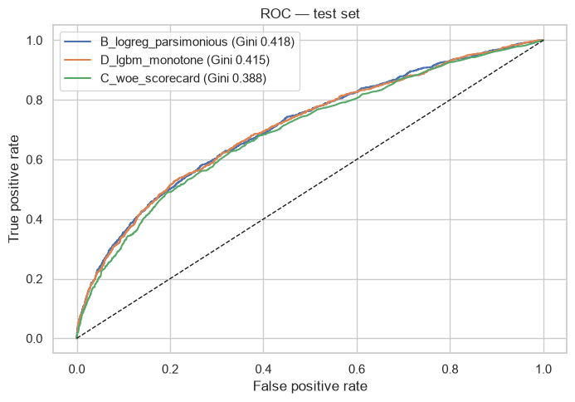
Model Validation (1)
Discrimination - Does the model rank-order risk on unseen data, and does performance hold up out of sample?
For the selected model (B, the parsimonious logistic regression):
Test Gini 0.418 (95% CI 0.380–0.458), i.e. AUC 0.709 (CI 0.690–0.729), and KS 0.314 (CI 0.286–0.353). That is acceptable discrimination for an application model, though not strong.
The development → test drop is 5.3% relative (0.442 → 0.418), inside the green zone. The CV estimate (0.440) sits inside the test confidence interval, so there is no sign of overfitting.
Calibration - Are the PD levels accurate, overall and by grade?
The line chart uses the 10 equal-sized bins in notebook 03.
Calibration-in-the-large: mean PD 15.69% vs observed 15.73% (941.4 expected defaults vs 944 observed).
Hosmer–Lemeshow: p = 0.44, so no evidence of miscalibration.
Binomial tests: no decile binomial test has p<0.05 for underestimation.
Calibration is good across the whole range, from about 5% PD in the best decile to about 45% in the worst.
Segments - Does it work across sub-populations, including data-quality segments?
The data-quality segments are especially important: block = 2 (the corrupted source), income_reconstructed (repaired incomes) and inconsistent_record (rows breaking logical rules). If the model only worked on clean rows, the data-quality issues would be material.
Segment | n | Mean PD | Observed rate
Data block 1 | 3,870 | 15.70% | 16.12%
Data block 2 | 2,130 | 15.67% | 15.02%
Region risk 0 | 3,567 | 13.77% | 13.82%
Region risk 1 | 1,805 | 17.97% | 17.84%
Region risk 2 | 628 | 20.05% | 20.54%
Inconsistent records | 714 | 20.04% | 22.83%
Reconstructed income | 211 | 22.14% | 25.12%
11

Slide 12
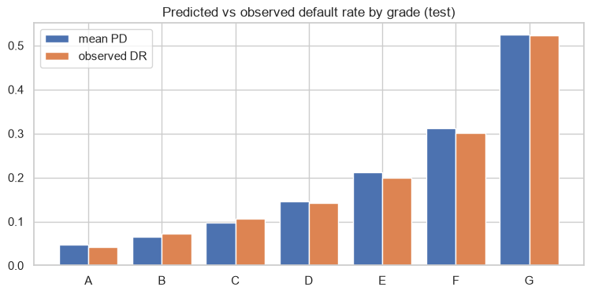
Model Validation (2)
12
Business - How would it be used: rating grades, cut-offs, expected loss?
Rating grades (master scale)
Observed default rates rise steadily from grade A to G (4.2% → 52.2%), and each grade's mean PD matches its observed DR closely. The scale rank-orders well, though grade A is thin (2.8% of clients): the data contains very few truly low-risk borrowers.
Grade | n | defaults | mean_PD | observed_DR | share | PD range
A | 168 | 7 | 0.0471 | 0.0417 | 0.0280 | 0%–5%
B | 1455 | 106 | 0.0657 | 0.0729 | 0.2425 | 5%–8%
C | 1667 | 177 | 0.0981 | 0.1062 | 0.2778 | 8%–12%
D | 1092 | 156 | 0.1460 | 0.1429 | 0.1820 | 12%–18%
E | 619 | 123 | 0.2126 | 0.1987 | 0.1032 | 18%–25%
F | 662 | 199 | 0.3121 | 0.3006 | 0.1103 | 25%–40%
G | 337 | 176 | 0.5245 | 0.5223 | 0.0562 | 40%–100%
Cut-off strategy
For a lender, the model decides who gets approved. Below, applicants are approved from the safest PD upwards, and the table shows the trade-off between volume and losses.
approval rate | PD cut-off | bad rate approved | bad rate reduction | defaults avoided | goods lost | realised loss avoided
1.0000 | 1.0000 | 0.1573 | 0.0000 | 0.0000 | 0.0000 | 0.0000
0.9500 | 0.4166 | 0.1377 | 0.1247 | 0.1684 | 0.0279 | 0.2591
0.9000 | 0.3184 | 0.1256 | 0.2020 | 0.2818 | 0.0661 | 0.4074
0.8500 | 0.2630 | 0.1167 | 0.2585 | 0.3697 | 0.1090 | 0.4921
0.8000 | 0.2235 | 0.1085 | 0.3101 | 0.4481 | 0.1537 | 0.5791
0.7000 | 0.1670 | 0.0995 | 0.3674 | 0.5572 | 0.2520 | 0.6930
0.6000 | 0.1326 | 0.0911 | 0.4209 | 0.6525 | 0.3528 | 0.7735
Business reading:
Declining the riskiest 10% (PD > 32%) avoids 28% of defaults and about 41% of realised losses, at the cost of 6.6% of good clients. The approved book's bad rate falls from 15.7% to 12.6%.
Declining 20% (PD > 22%) avoids 45% of defaults and about 58% of losses, losing 15% of goods.
Losses fall faster than default counts because riskier clients also borrow more relative to income (high dti).
Portfolio expected loss from the model matches realised loss within 0.4% (at the assumed LGD), so the PDs are usable for pricing and provisioning inputs, subject to the long-run calibration caveat.
The PDs also support risk-based pricing. Today interest_rate has no relation to risk (IV ≈ 0), which means low-risk clients currently subsidise high-risk ones. This is an immediate business opportunity.
Where to set the cut-off is a business decision: it trades margin on good clients against credit losses, and needs the bank's LGD, funding cost and risk appetite.

Slide 13
Conclusion
The model is CONDITIONALLY SUITABLE for production use as an application-scoring PD model (credit decisioning and risk-based pricing support).
The model itself is sound. It is simple, transparent, statistically significant in every driver, free of overfitting, well calibrated on hold-out data, and matched by a much more flexible challenger. Its discriminatory power (Gini ≈ 0.42) is moderate, but it reflects the limited information in the data rather than a modelling failure: no technique extracted more.
The remaining risks are in the data and the validation evidence, not the model.
Before go-live:
Confirm definitions with the data owner: the default definition and horizon, the DPD bucket semantics, num_loans, and dti. Re-test the inconsistent_record segment afterwards.
Lock the production data contract: recovery_flag_after_90d must be excluded, and input validation rules must catch the block-2 error types.
Out-of-time validation on the most recent vintage, with the same criteria (Gini drop < 10% relative, PSI < 0.10, binomial tests per grade).
Recalibrate the intercept to the bank's long-run central-tendency default rate.
After go-live
Monthly PSI/CSI monitoring (alert at PSI > 0.10, action at > 0.25).
Quarterly Gini and calibration backtests (trigger a review if Gini < 0.35 or any grade fails the binomial test).
Keep the LightGBM challenger running in parallel.
Annual re-validation.
13

Slide 14
Thank you!

