Slide 1
影像處理、電腦視覺及深度學習概論 (Introduction to Image Processing, Computer Vision and Deep Learning) Homework 1
TA:
少鈞: nckubot65904@gmail.com
Office Hour: 14:00~16:00, Mon.
10:00~12:00, Fri.
At CSIE 9F Robotics Lab.

Slide 2
Notice (1/2)
Copying homework is strictly prohibited!! Penalty: Score will be zero for both persons!!
Due date => 08:30:00, 2022/10/17 (Mon.)
No delay. Penalties for late homework:
Up to 7 days late, loss of 50% of the score awarded
After 7 days, the score will be marked as 0.
You must attend the demonstration, or your score will be 0. The demonstration schedule will be announced on NCKU moodle.
You must make a GUI, or you will get some penalties.
Upload to => 140.116.154.1 -> Upload/Homework/Hw1_1
User ID: opencvdl2022 Password: opencvdl2022
Format
Filename: Hw1_1_StudentID_Name_Version.rar
Ex: Hw1_1_F71234567_林小明_V1.rar
If you want to update your file, you should update your version to be V2, ex: Hw1_1_F71234567_林小明_V2.rar
Content: project folder*( excluding the pictures ) *note: remove your “Debug” folder to reduce file size

Slide 3
Notice (2/2)
Python (recommended)
Python 3.7 (https://www.python.org/downloads/)
opencv-contrib-python (3.4.2.17)
Matplotlib 3.1.1
UI framework: pyqt5 (5.15.1)
C++ (check MFC guide in ftp)
OpenCV 3.3.1 (https://opencv.org/release.html)
Visual Studio 2015 (download from http://www.cc.ncku.edu.tw/download/)
UI framework: MFC

Slide 4
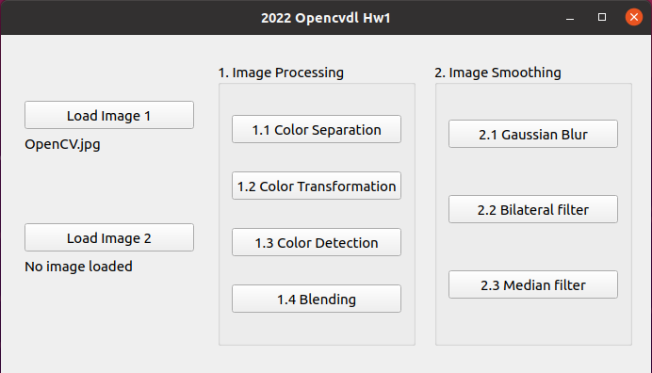
Assignment scoring (Total: 100%)
1. (20%) Image Processing
1.1 (5%) Color Separation
1.2 (5%) Color Transformation
1.3 (5%) Color Detection
1.4 (5%) Blending
2. (20%) Image Smoothing
2.1 (6%) Gaussian blur
2.2 (7%) Bilateral filter
2.3 (7%) Median filter
3. (20%)
4. (20%)
5. (20%) Training Cifar10 Classifier Using Resnet101
(出題：Sam)
(出題：Jack)
(出題：)
Don’t fix your image path
(There is another dataset for demonstration)
(出題：)
(出題：Wen)

Slide 5
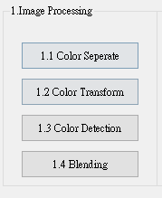
1. Image Processing (20%)
(出題：Sam)
1.1 (5%) Color Separation
1.2 (5%) Color Transformation
1.3 (5%) Color Detection
1.4 (5%) Blending

Slide 6


1.1 Color Separation (5%)
(出題：Sam)
Given: a color image, “OpenCV.jpg”
Q: 1) Extract 3 channels of the image BGR to 3 separated channels and show the result images.
Hint:
Textbook Chapter 3, p.31 ~ p.49
cv2.split(), cv2.merge()
OpenCV.jpg
B channel
G channel
R channel

Slide 7
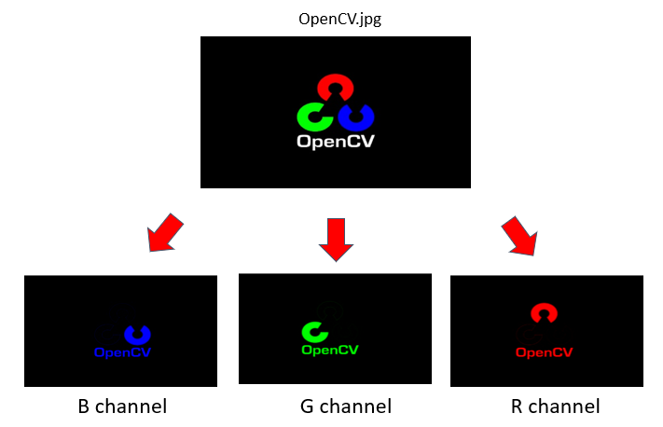

1.2 Color Transformation (5%)
(出題：Sam)
Given: 1 color image: “OpenCV. jpg”
Q: 1) Transform “OpenCV.jpg” into grayscale image I₁ by calling OpenCV function directly.
2) Merge BGR separated channel images from problem 1.2 into grayscale image I₂ by I₂ = (R+G+B)/3.
3) Show the above 2 results.
Hint:
Textbook Chapter 3, p.56 ~ p.59
cv2.cvtColor(…, cv2.COLOR_BGR2GRAY)
1) OpenCV function
2) Average weighted
I₁
I₂
Perceptually weighted formula:
I₁ = 0.07*B + 0.72*G + 0.21*R
Average weighted formula:
I₂ = (R+G+B)/3

Slide 8
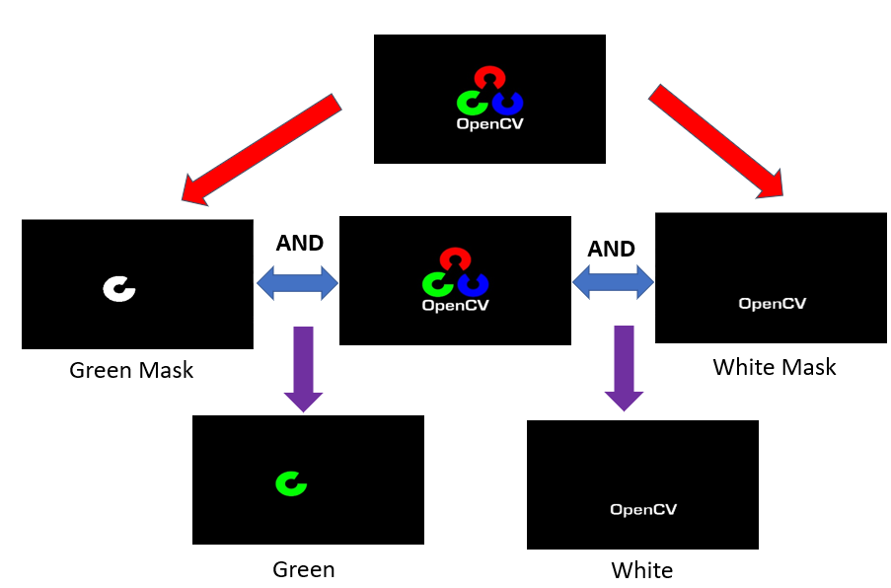
(出題：Sam)
1.3 Color Detection (5%)
Given: 1 color image: “OpenCV. jpg”
Q: 1) Transform “OpenCV.jpg” from BGR format to HSV format.
2) Generate mask by calling :
cv2.inRange(hsv_img , lower_bound , upper_bound)
3) Detect Green and White color in the image by calling :
cv2.bitwise_and(bgr_img , bgr_img , mask)
4) Show the result

Slide 9
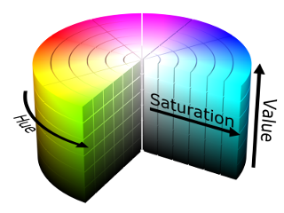
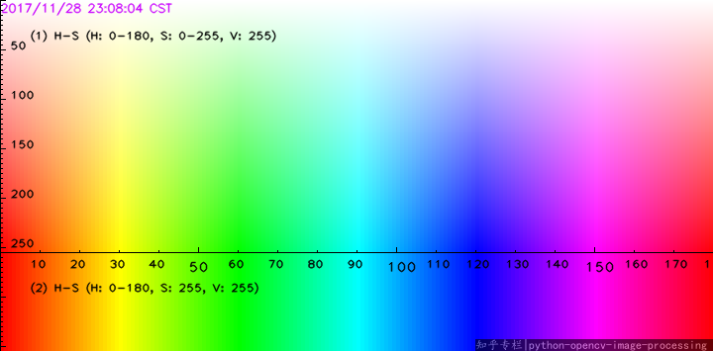
(出題：Sam)
1.3 Color Detection (5%)
Hint:
cv2.cvtColor(…, cv2.COLOR_BGR2HSV)
cv2.inRange(hsv_img , lower_bound , upper_bound)
cv2.bitwise_and(bgr_img , bgr_img , mask)
HSV values ranges between (0–180, 0–255, 0–255)
H(Hue) : x axis
S(Saturation) : y axis
V(Value) : 255
Using this range should be fine
Green Range : (40-80,50-255,20-255)
White Range : (0-180,0-20,200-255)
REF: https://medium.com/@gowtham180502/how-to-detect-colors-using-opencv-python-98aa0241e713

Slide 10
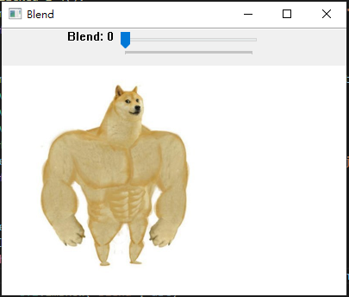
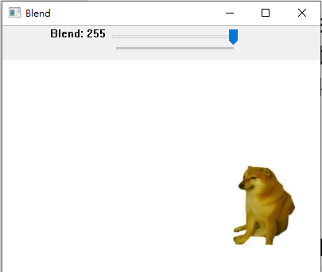
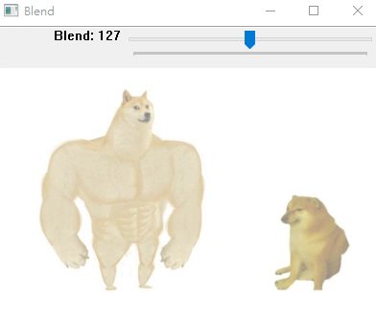
1.4 Blending (5%)
(出題：Sam)
Given: 2 images, “Dog_Strong.jpg” and “Dog_Weak.jpg”
Q: 1) Combine two images (Dog_Strong.jpg and Dog_Weak.jpg). 2) Use Trackbar to change the weights and show the result in the new window.
Hint:
Textbook Chapter 3, p. 50 ~ 52
cv2.addWeighted(), cv2.createTrackbar()
Demo:

Slide 11
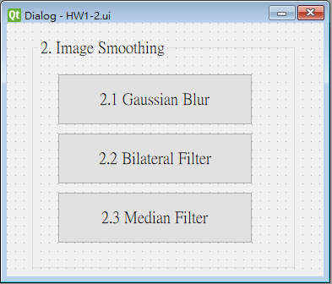
2. Image Smoothing (20%)
(出題：Jack)
2.1 (6%) Gaussian blur
2.2 (7%) Bilateral filter
2.3 (7%) Median filter

Slide 12
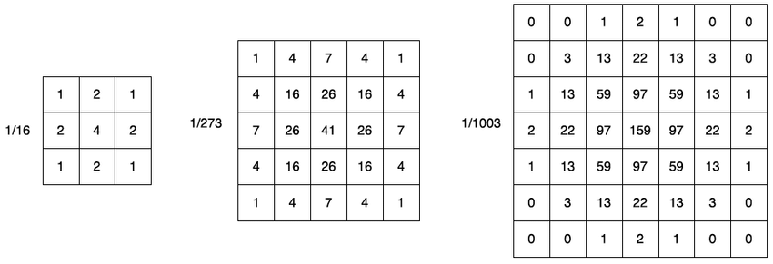
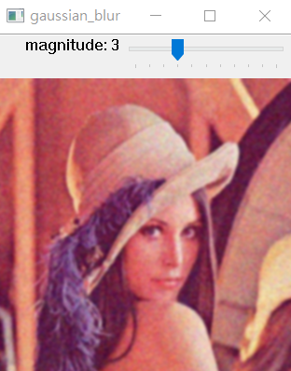
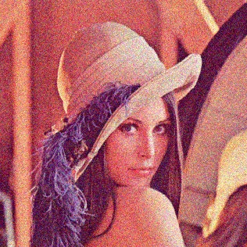
2.1 Gaussian Blur
(出題：Jack)
Given: “image1.jpg
Define: gaussian magnitude 0 ~ 10,
Condition1. magnitude = m > 0 then Apply gaussian filter k x k to “image1.jpg” (k=2m+1)
Condition2. magnitude = m = 0 then output “image1.jpg”
Q: Use Trackbar to change the magnitude and show the result in the popup window.
Hint:
Textbook Chapter 3, p. 50 ~ 52, p.109~115
cv2.GaussianBlur(), cv2.createTrackbar()
image1.jpg

Slide 13
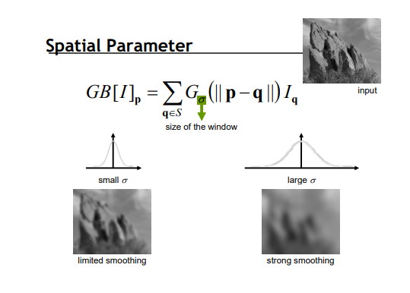
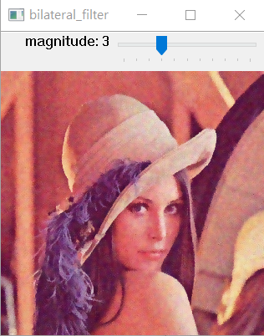
2.2 Bilateral Filter
(出題：Jack)
Given: “image1.jpg
Define: Bilateral magnitude 0 ~ 10, sigmaColor = 90 and sigmaSpace = 90.
Condition1. magnitude = m > 0 then Apply bilateral filter k x k to “image1.jpg” (k=2m+1)
Condition2. magnitude = m = 0 then output “image1.jpg”
Q: Use Trackbar to change the magnitude and show the result in the popup window.
Hint:
Textbook Chapter 3, p. 50 ~ 52, p.109~115
cv2.bilateralFilter(), cv2.createTrackbar()
image1.jpg

Slide 14
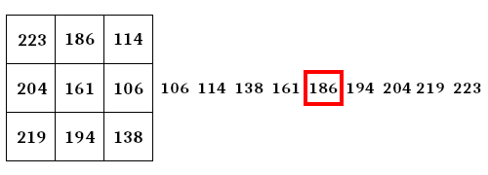
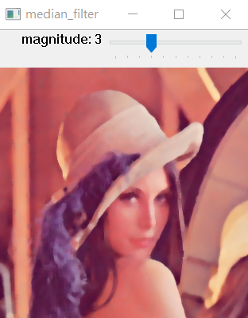
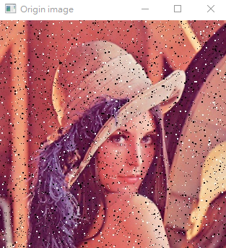
2.3 Median Filter
(出題：Jack)
Given: “image2.jpg
Define: Median magnitude 0 ~ 10,
Condition1. magnitude = m > 0 then Apply median filter k x k to “image2.jpg” (k = 2m+1)
Condition2. magnitude = m = 0 then output “image2.jpg”
Q: Use Trackbar to change the magnitude and show the result in the popup window.
Hint:
Textbook Chapter 3, p. 50 ~ 52, p.109~115
cv2.medianBlur(), cv2.createTrackbar()
Median filter example

