Slide 1
影像處理、電腦視覺及深度學習概論 (Introduction to Image Processing, Computer Vision and Deep Learning) Homework 1
TA:
少鈞: nckubot65904@gmail.com
Office Hour: 14:00~16:00, Mon.
10:00~12:00, Fri.
At CSIE 9F Robotics Lab.

Slide 2
Notice (1/2)
Copying homework is strictly prohibited!! Penalty: Score will be zero for both persons!!
Due date => 08:00:00, 2022/10/31 (Mon.)
No delay. Penalties for late homework:
Up to 7 days late, loss of 50% of the score awarded
After 7 days, the score will be marked as 0.
You must attend the demonstration, or your score will be 0. The demonstration schedule will be announced on NCKU moodle.
You must make a GUI and follow the format, or you will get some penalties.
Upload to => 140.116.154.1 -> Upload/Homework/Hw1_2
Upload/Homework/Hw1_05
User ID: cvdl2022 Password: cvdl2022
Format
Filename: Hw1_2_StudentID_Name_Version.rar
Hw1_05_StudentID_Name_Version.rar
Ex: Hw1_2_F71234567_林小明_V1.rar
If you want to update your file, you should update your version to be V2.
Ex: Hw1_2_F71234567_林小明_V2.rar
Content: project folder*( excluding the pictures, only source code ) *note: remove your “Debug” folder to reduce file size

Slide 3
Notice (2/2)
Python (recommended)
Python 3.7 (https://www.python.org/downloads/)
opencv-contrib-python (3.4.2.17)
Matplotlib 3.1.1
UI framework: pyqt5 (5.15.1)
C++ (check MFC guide in ftp)
OpenCV 3.3.1 (https://opencv.org/release.html)
Visual Studio 2015 (download from http://www.cc.ncku.edu.tw/download/)
UI framework: MFC

Slide 4
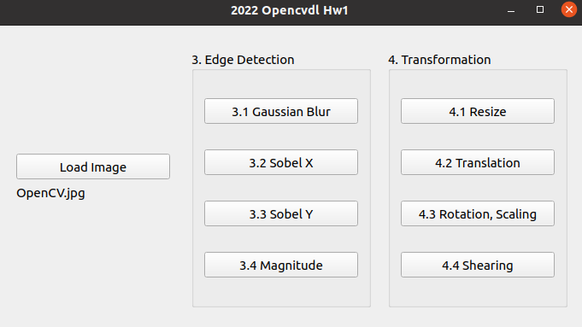
Assignment scoring (Total: 100%)
(出題：Sam)
1. (20%) Image Processing
1.1 (5%) Color Separation
1.2 (5%) Color Transformation
1.3 (5%) Color Detection
1.4 (5%) Blending
2. (20%) Image Smoothing
2.1 (6%) Gaussian blur
2.2 (7%) Bilateral filter
2.3 (7%) Median filter
3. (20%) Edge Detection
3.1 (5%) Gaussian Blur
3.2 (5%) Sobel X
3.3 (5%) Sobel Y
3.4 (5%) Magnitude
4. (20%) Transforms
4.1 (5%) Resize
4.2 (5%) Translation
4.3 (5%) Rotation, Scaling
4.4 (5%) Shearing
5. (20%) Training Cifar10 Classifier Using VGG19
5.1 (2%) Load Image and Show 9 Training Images with Different Label
5.2 (2%) Show Model Structure
5.3 (2%) Show Data Augmentation Result
5.4 (2%) Show Accuracy and Loss
5.5 (12%) Inference
(出題：Jack)
(出題：Chong)
(出題：Jeffin)
(出題：Wen)

Slide 5
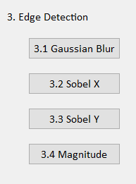
3. Edge Detection (20%)
(出題: Chong)
3.1 Gaussian Blur (5%)
3.2 Sobel X (5%)
3.3 Sobel Y (5%)
3.4 Magnitude (5%)

Slide 6
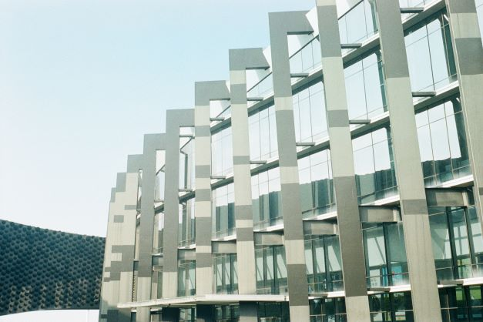
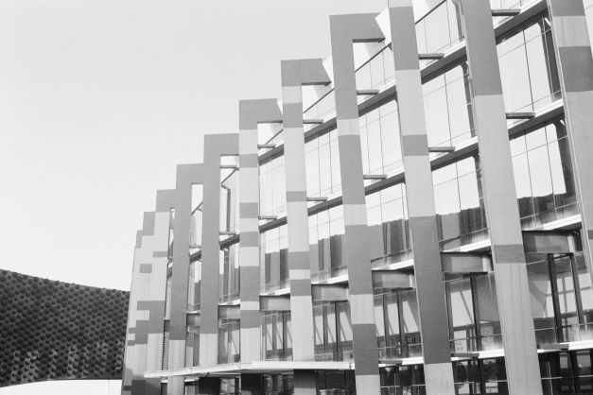

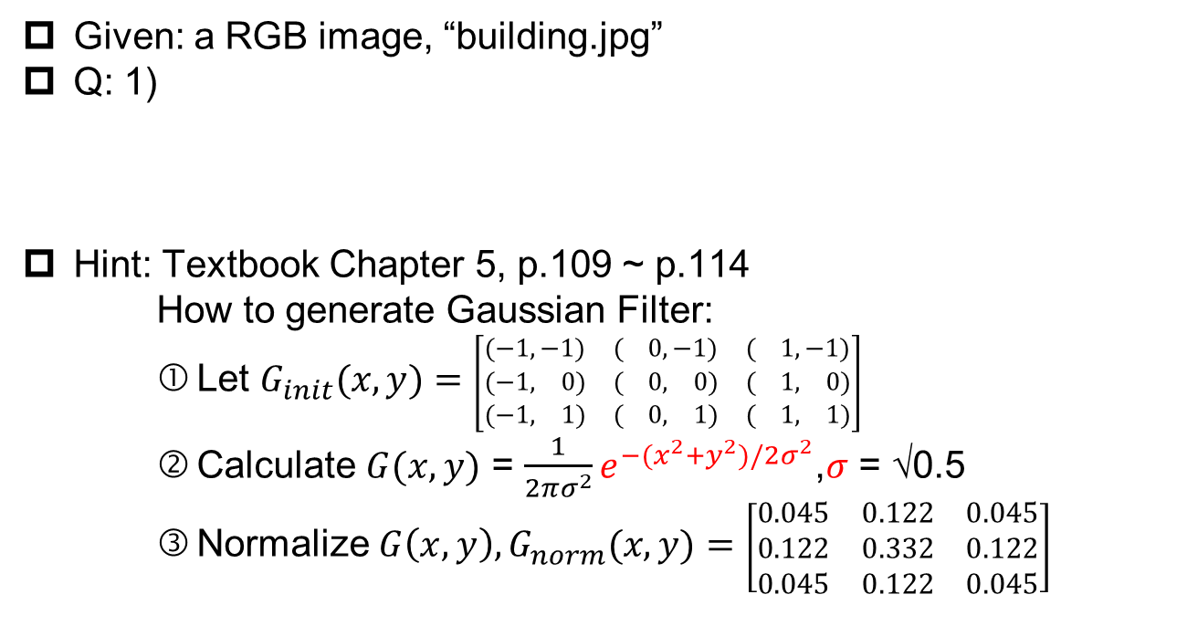
3.1 Gaussian Blur (5%)
(出題：Chong)
Given: a RGB image, “building.jpg”
Q: 1)
Hint: Textbook Chapter 5, p.109 ~ p.114
How to generate Gaussian Filter:
Let $G_{init}(x, y)=$ $\left[\begin{matrix}(−1,−1) & ( 0,−1) & ( 1,−1) \\ (−1, 0) & ( 0, 0) & ( 1, 0) \\ (−1, 1) & ( 0, 1) & ( 1, 1)\end{matrix}\right]$
Calculate $G(x, y)$ = $\frac{1}{2πσ^{2}}e^{−(x^{2}+y^{2})/2σ^{2}}$,$σ$ = √0.5
Normalize $G\left(x, y\right),G_{norm}(x, y)=$ $\left[\begin{matrix}0.045 & 0.122 & 0.045 \\ 0.122 & 0.332 & 0.122 \\ 0.045 & 0.122 & 0.045\end{matrix}\right]$
Gaussian Blur: Convert the RGB image into a grayscale image, then smooth it by your own 3x3 Gaussian smoothing filter (Can not use OpenCV Function, Sobel, GaussianBlur and conv2d). Please show the result.
building.jpg
Grayscale
Gaussian Blur

Slide 7
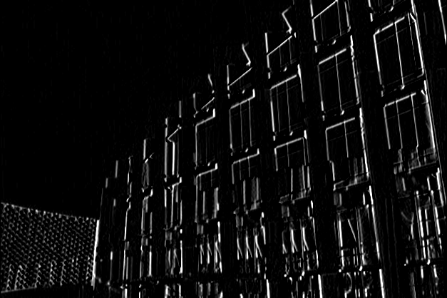
3.2 Sobel X (5%)
(出題：Chong)
Given: the result of 3.1) Gaussian Blur
Q: 2)
Hint: Textbook Chapter 6, p.148 ~ 149
Sobel X: Use Sobel edge detection to detect vertical edge by your own 3x3 Sobel X operator (Can not use OpenCV Function, Sobel, GaussianBlur and conv2d). Please show the result.
-1 | 0 | 1
-2 | 0 | 2
-1 | 0 | 1
Sobel X Filter
Gaussian Blur
Sobel X

Slide 8
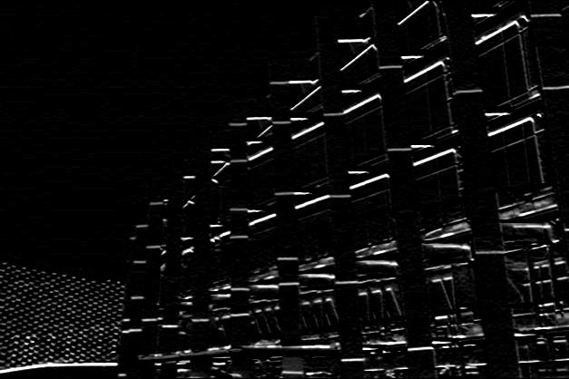
3.3 Sobel Y (5%)
(出題：Chong)
Given: the result of 3.1) Gaussian Blur
Q: 3)
Hint: Textbook Chapter 6, p.148 ~ 149
Sobel Y: Use Sobel edge detection to detect horizontal edge by your own 3x3 Sobel Y operator (Can not use OpenCV Function, Sobel, GaussianBlur and conv2d). Please show the result.
1 | 2 | 1
0 | 0 | 0
-1 | -2 | -1
Sobel Y Filter
Gaussian Blur
Sobel Y

Slide 9
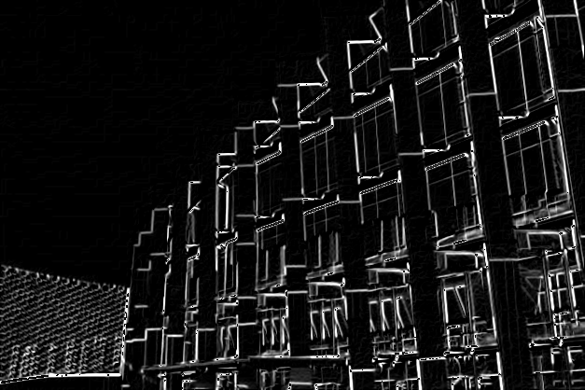
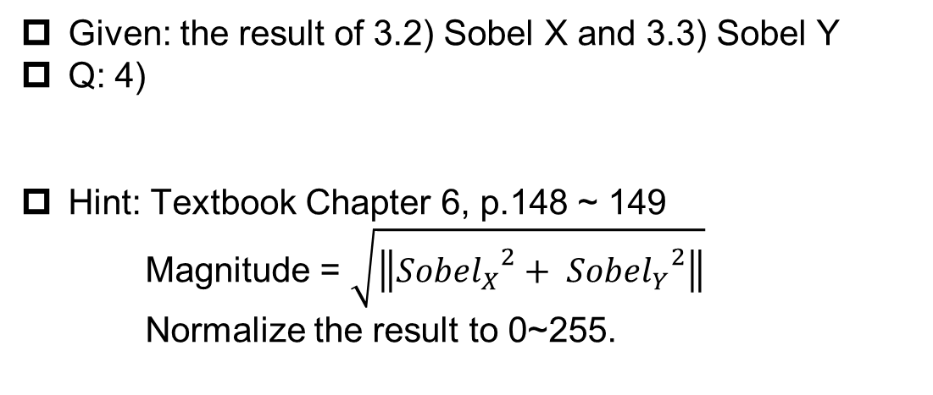
3.4 Magnitude (5%)
(出題：Chong)
Given: the result of 3.2) Sobel X and 3.3) Sobel Y
Q: 4)
Hint: Textbook Chapter 6, p.148 ~ 149
Magnitude = $\sqrt{\left\|{{Sobel}_{X}}^{2}+ {{Sobel}_{Y}}^{2}\right\|}$
Normalize the result to 0~255.
Magnitude: Use the results of 3.2) Sobel X and 3.3) Sobel Y to calculate the magnitude. Please show the result.
Sobel X
Magnitude
Sobel Y

Slide 10
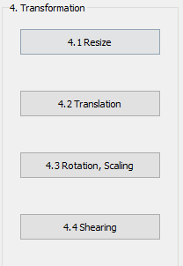
4. Transforms (20%)
(出題: Jeffin)
4.1 Resize (5%)
4.2 Translation(5%)
4.3 Rotation, Scaling (5%)
4.4 Shearing (5%)

Slide 11

4.1 Transforms: Resize, Translation, Rotation, Scaling, Shearing(20%)
Given: “Microsoft.png”, Image Size (430, 430)
Q:Please resize, translate , rotate, scale and shearing the picture (Microsoft.png)
4.1) Resize:
From (430,430) to (215,215)
and cv2.imshow with (430, 430) window (image center: (108, 108)
top left of window)
4.2) Image Translation:
Xnew = Xold + 215 pixels = 108 + 215 = 323
Ynew = Yold + 215 pixels = 108 + 215 = 323
Point C (108, 108) is center of resized image Point C’(323, 323) is new center of image (bottom right of window)
(Then overlay with result image of 4.1))
4.3) Rotation, Scaling:
Center: Center of Image
Angle = 45º (counter-clockwise)
Scale = 0.5 , window size (430,430)
4.4) Shearing:
Old location: ([[50,50],[200,50],[50,200]])
New location: ([[10,100],[100,50],[100,250]])
(Note: Please save your image after each section)
Hint: Textbook Chapter 12, (p.407 ~ 412) python: cv2.warpAffine(),
Textbook Chapter 3, (p.50 ~ 52)
cv2.addWeighted()
(出題: Jeffin)
W:430
H:430
Microsoft.png

Slide 12




4.2 Transforms: Resize, Translation, Rotation, Scaling, Shearing(20%)
EX: Given: “Microsoft.png”, image size (430, 430)
Hint: Textbook Chapter 12, (p.407 ~ 412) python: cv2.warpAffine(),
Textbook Chapter 3, (p.50 ~ 52)
cv2.addWeighted()
(出題: Jeffin)
Microsoft.png
4.1) Resized Image
4.2) Translate + Overlay
4.3) Rotate and Scale
4.4) Shearing
(0,0)
(0,0)
C ‘(108, 108)
45º
C’ (323, 323)

Slide 13
5. Training Cifar10 Classifier Using VGG19 (20%)
5.1 Load Image and Show 9 Training Images with Different Label(4%)
5.2 Show Model Structure (4%)
5.3 Show Data Augmentation Result (4%)
5.4 Show Accuracy and Loss (4%)
5.5 Inference (4%)

Slide 14
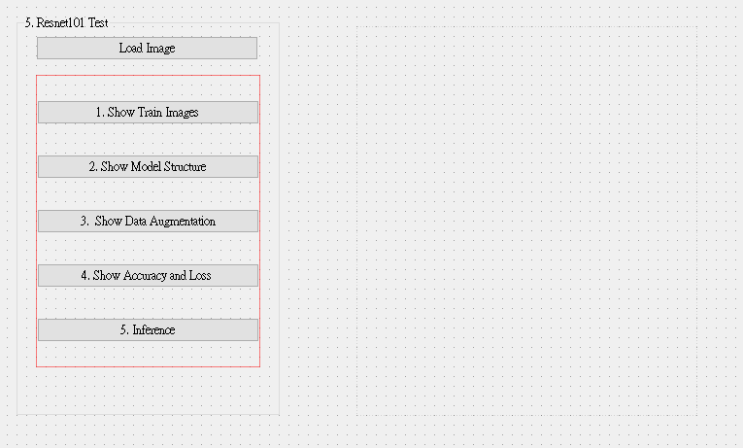
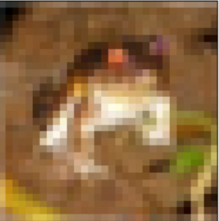
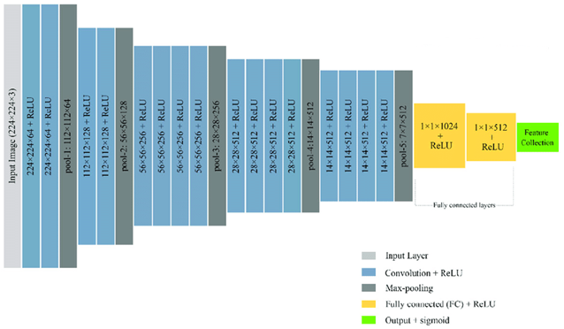
5.0 Training Cifar10 Classifier Using VGG19
Learn how to construct VGG19 and train it on Cifar10.
Environment Requirement
Python
Tensorflow / PyTorch (Can choose the one)
opencv-python
Matplotlib
Reference
https://pytorch.org/vision/0.12/generated/torchvision.models.vgg19.html(Source Code)
https://www.cs.toronto.edu/~kriz/cifar.html (Cifar10 Dataset)
MaxPool2d window size = 2
GUI example
Flatten Here
Resize Image from 32*32 ➔224*224
VGG19 framework

Slide 15
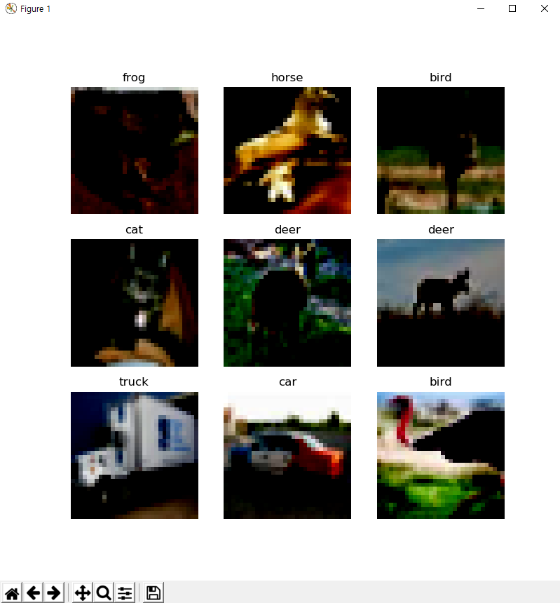
5.1 Load Cifar10 training dataset, and then show 9 Images and Labels respectively (4%)
Class
Label
0 airplane
1 automobile
2 bird
3 cat
4 deer
5 dog
6 frog
7 horse
8 ship
9 truck
Image
10 Class of CIFAR 10 Dataset
◆ Hint
Use Matplotlib 4 function
figure()
title()
Axis()
imshow()
Can refer by tutorial at the Matplotlib library official web-site
https://matplotlib.org/stable/tutorials/index.html

Slide 16
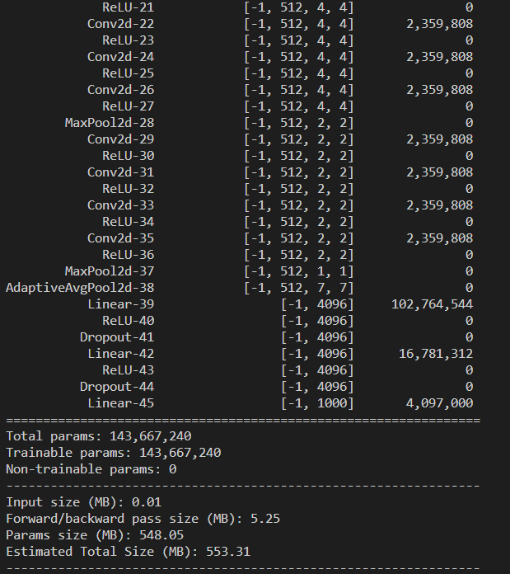
5.2 Construct and show your model structure by print out on the terminal (You can use available architecture provided by ML framework to build your model) (4%)
◆ Hint
Pytorch API
Use the two option
Summary function
from torchsummary import summary
-> import the package
summary(Model name, (Input Channel, Input Width, Input Height))
-> run the function and print on the terminal
Print function
From torchvision import models
-> import the package
model = torchvision.models.vgg19()
-> Make the mode data
Print(Model)
Can refer this web-site
https://pypi.org/project/pytorch-model-summary/
Layers List of
Model
After processing
each layer
Change of input
data type
Number of
trainable
parameters

Slide 17
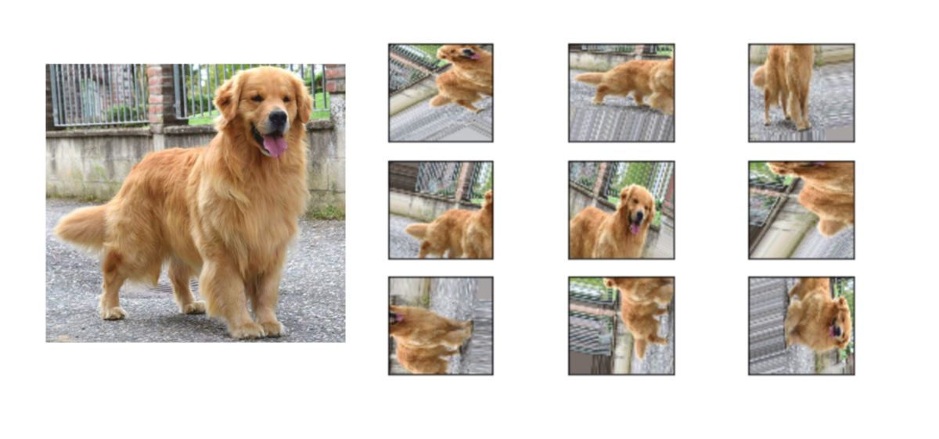
5.3 Show Data Augmentation Result (4%)
Show three kinds of augmentation methods and show the results as example.
Transforms on PIL Image and torch.*Tensor
CenterCrop(size)
ColorJitter([brightness, contrast, ...])
FiveCrop(size)
Grayscale([num_output_channels])
Pad(padding[, fill, padding_mode])
RandomAffine(degrees[, translate, scale, ...])
RandomApply(transforms[, p])
RandomCrop(size[, padding, pad_if_needed, ...])
RandomGrayscale([p])
RandomHorizontalFlip([p])
RandomPerspective([distortion_scale, p, ...])
RandomResizedCrop(size[, scale, ratio, ...])

Slide 18
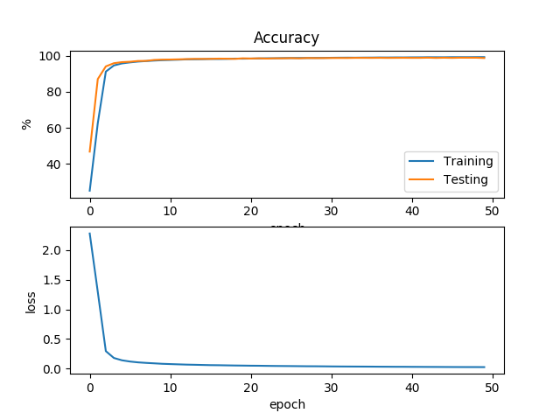
5.4 Training your model at least 30 epochs by your own computer, then save your model and take a screenshot of your training loss and accuracy. No saved images no points (4%)
◆ Hint
There are two option.
Just use the normal method(Above image used this way)
https://www.pyimagesearch.com/2021/07/19/pytorch-training-your-first-convolutional-neural-network-cnn/
2) Use tensorboard in Tensorflow API or tensorboard in pytorch
https://pytorch.org/tutorials/intermediate/tensorboard_tutorial.html
(record accuracy/loss per epoch)

Slide 19

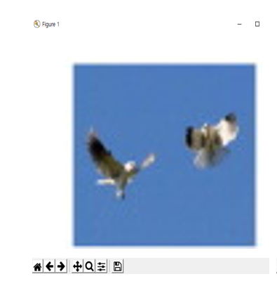

5.5 Load your model trained at 5.4, inference them and show the result image and class (4%)
1. Choose the any data
3. Show the prediction label, confidence score
Confidence = 0.98
Prediction Label: bird
2. Run Inference
◆ Hint
https://towardsdatascience.com/understanding-pytorch-with-an-example-a-step-by-step-tutorial-81fc5f8c4e8e#5017
https://pytorch.org/tutorials/
https://yanwei-liu.medium.com/pytorch-with-grad-cam-6a92a54bfaad

