Slide 1

how U doing?
10170437
Mark Taylor

Slide 2
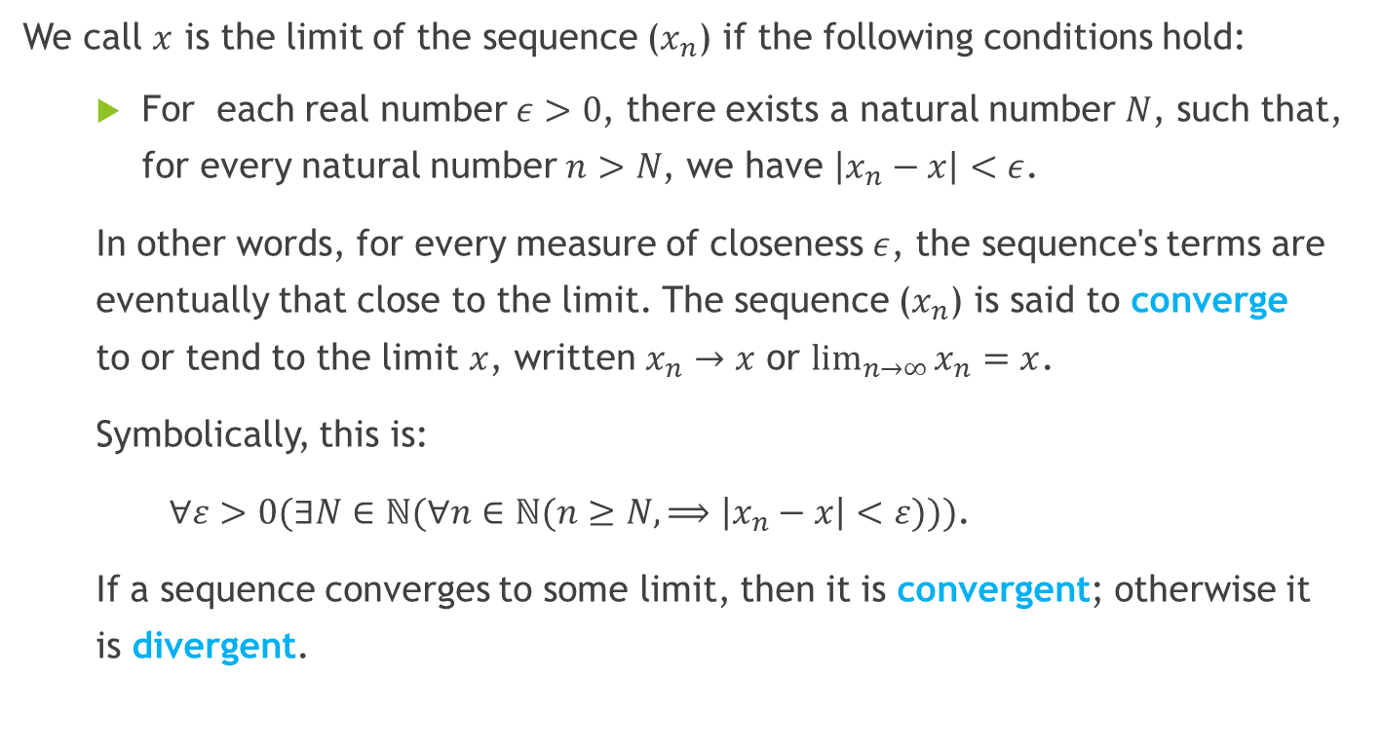
1. Limit of a sequence
We call $x$ is the limit of the sequence ($x_{n}$) if the following conditions hold:
For each real number $ε>0$, there exists a natural number $N$, such that, for every natural number $n>N$, we have $\left|x_{n}−x\right|<ε$.
In other words, for every measure of closeness $ε$, the sequence's terms are eventually that close to the limit. The sequence ($x_{n}$) is said to converge to or tend to the limit $x$, written $x_{n}→x$ or $\lim_{n→∞}{x_{n}=x}$.
Symbolically, this is:
$∀ε>0(∃N∈ℕ(∀n∈ℕ(n≥N, ⟹\left|x_{n}−x\right|<ε)))$.
If a sequence converges to some limit, then it is convergent; otherwise it is divergent.

Slide 3
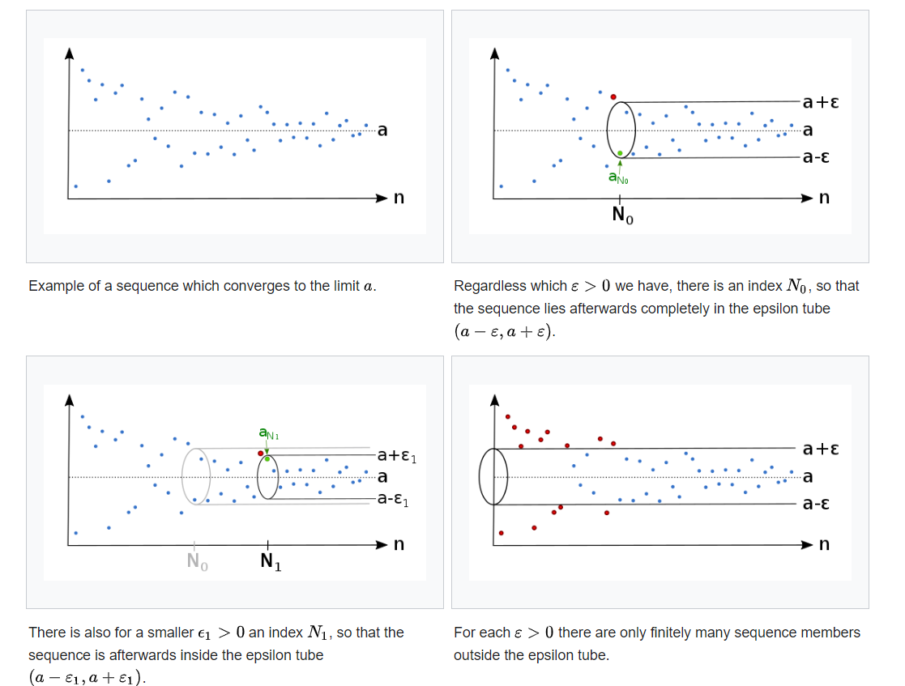

Slide 4
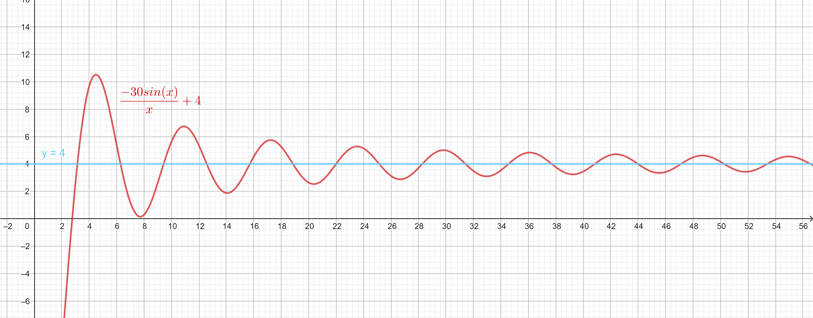

2. Limit of a function
Let $f$: $ℝ→ℝ$. We say that $\lim_{n→∞}{f\left(x\right)}$ exists and is equal to some $L<∞$, iff for any $δ>0$, there is some $M_{δ}>0$ such that if $x>M_{δ}$, then $\left|f\left(x\right)−L\right|<δ$.

Slide 5
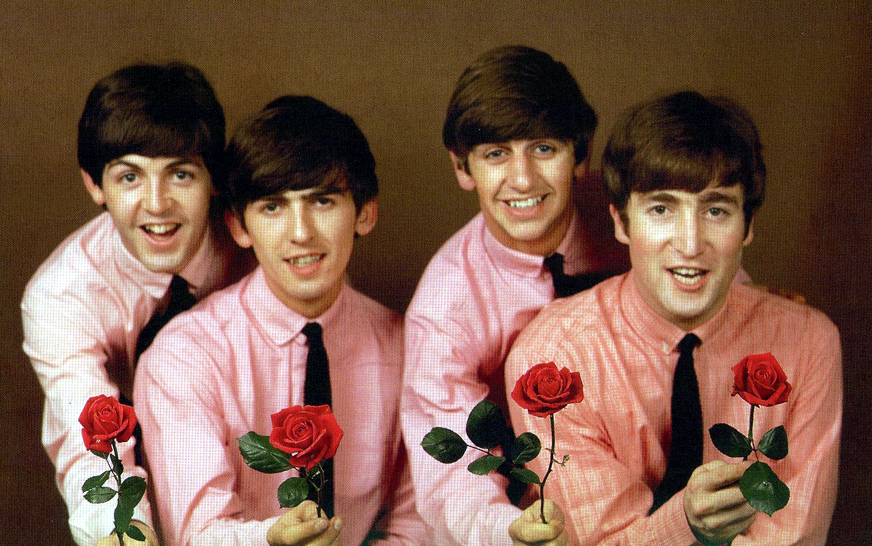
Hello from the Beatles

