Slide 1
數位IC設計 Tool安裝&作業模擬教學
NCKU CSIE DICLAB

Slide 2
The simulation process
The simulation process and the necessary tools in this class
The tools can be downloaded from :
https://www.intel.com/content/www/us/en/software/programmable/quartus-prime/download.html#
Functional simulation
Synthesis
Pre-Layout simulation
ModelSim
Quartus
ModelSim

Slide 3
Download and install Quartus

Slide 4
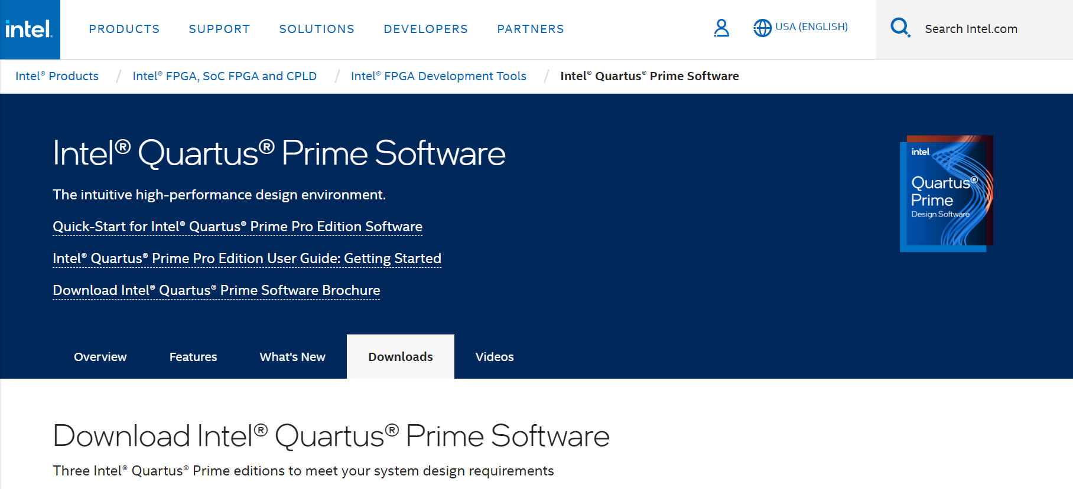
Download and install Quartus
Step 1: Register and sign in
Click here to create an account and sign in

Slide 5
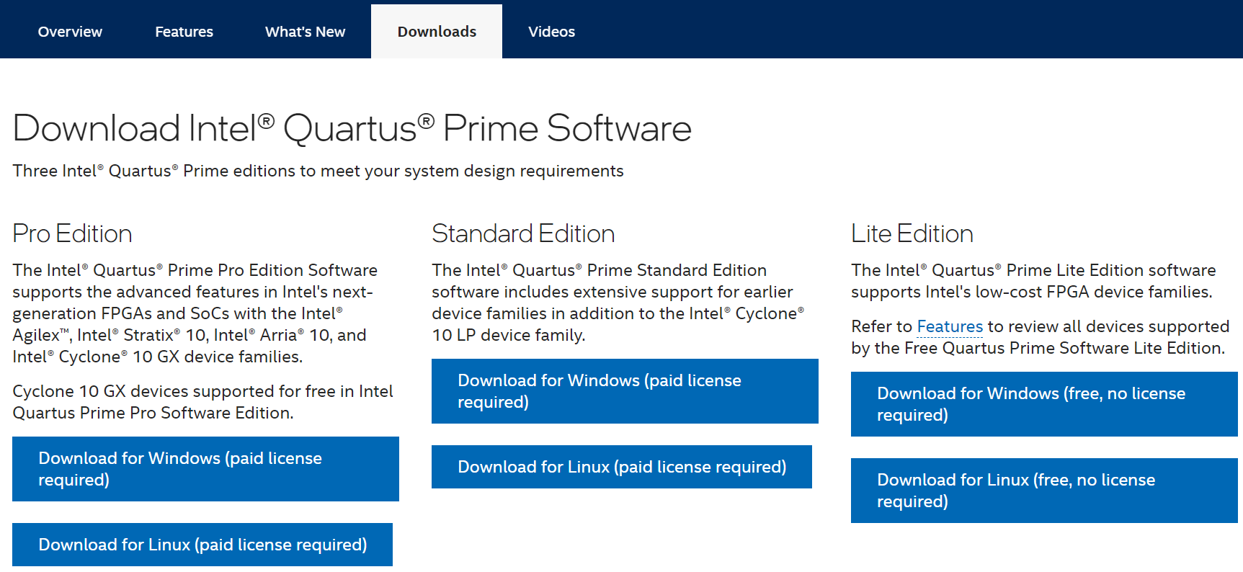
Download and install Quartus
Step 2: Click “ Download for Windows(free, no license required)“
Click Here

Slide 6
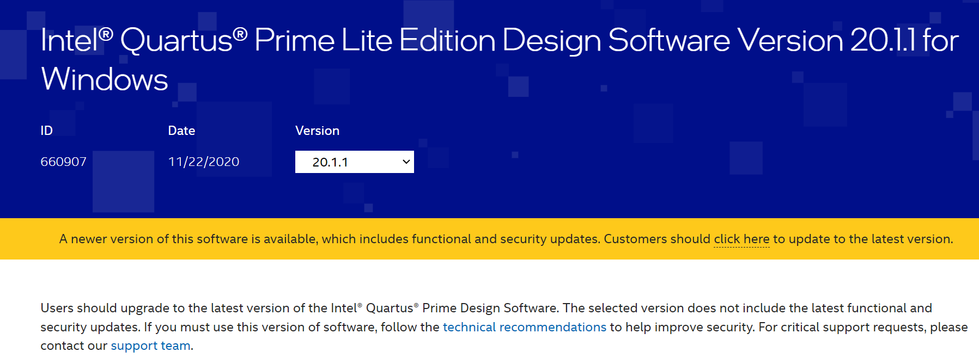
Download and install Quartus
Step 3: Select software version (20.1.1)
Select version 20.1.1

Slide 7
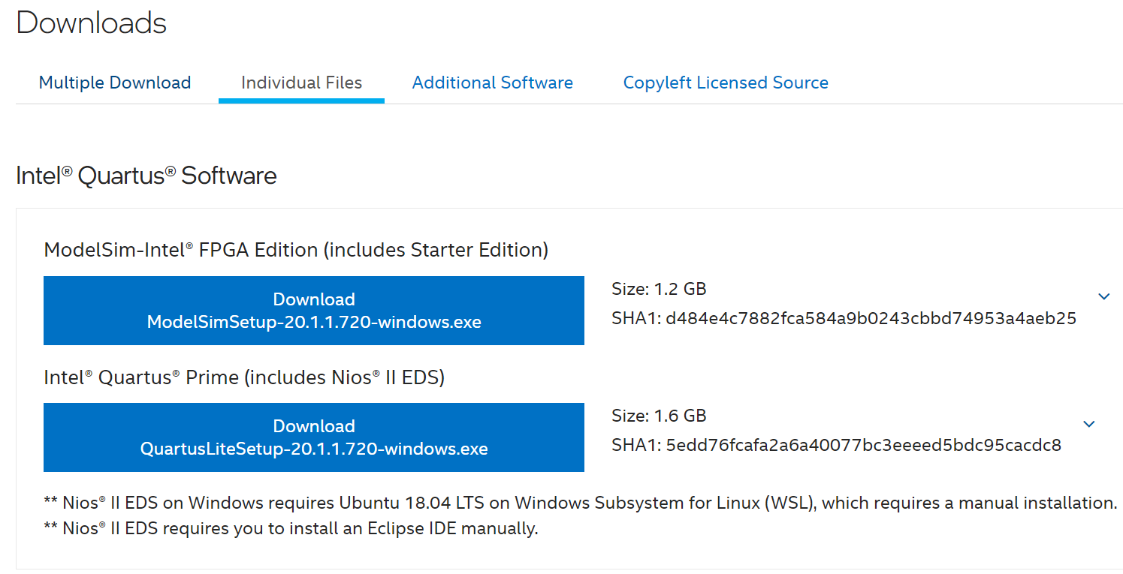
Download and install Quartus
Step 4: Download Quartus setup execution file
1. Click the ‘Individual Files’ tab
2. Download Quartus

Slide 8
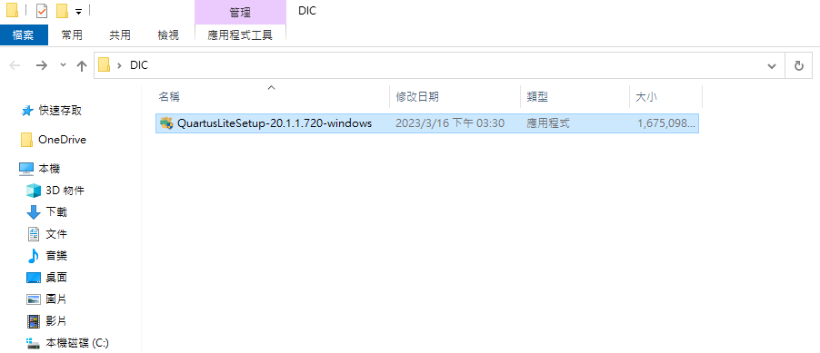
Download and install Quartus
Step 5: Installation

Slide 9
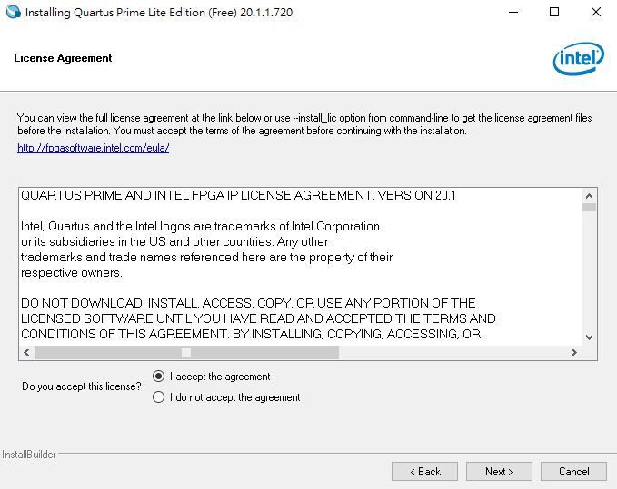
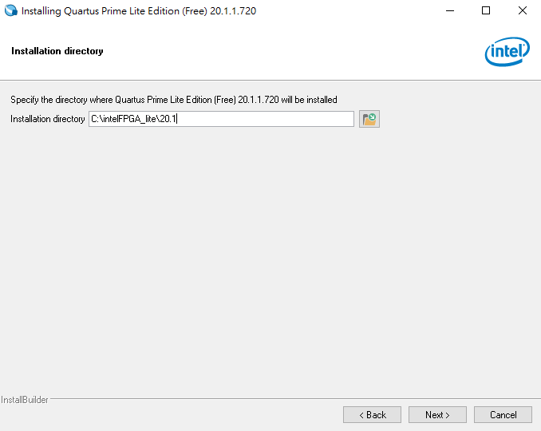
Download and install Quartus
Step 5: Installation
3. Set installation path
1. Accept the agreement
2. Click
4. Click

Slide 10
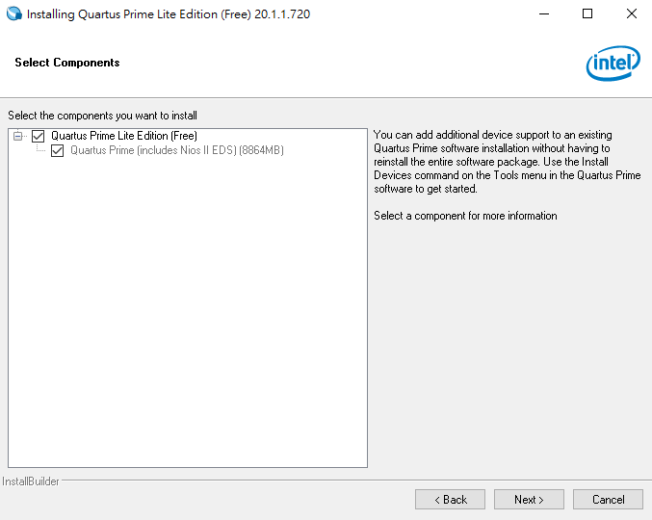
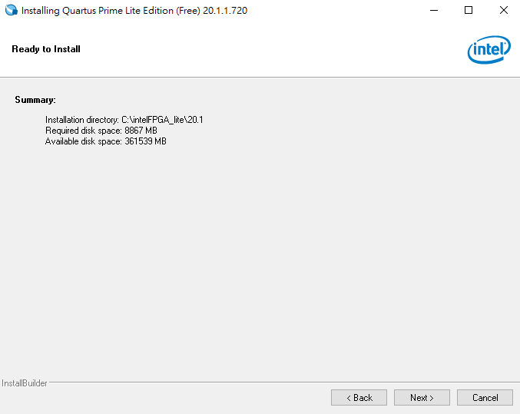
Download and install Quartus
Step 5: Installation
1. Select Quartus Prime Lite Edition (Free)
3. Check available disk space
2. Click
4. Click

Slide 11
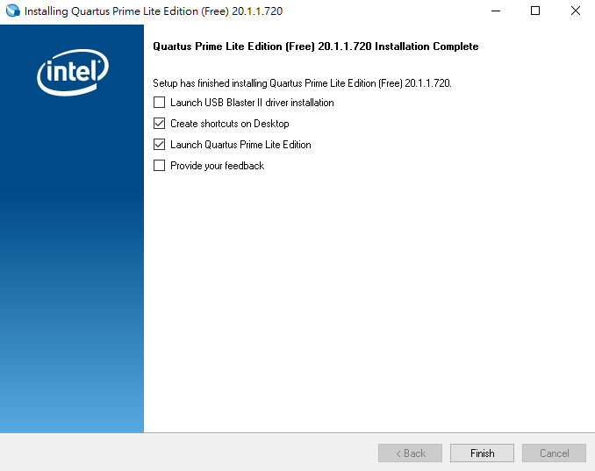
Download and install Quartus
Step 5: Installation
1. Cancel check driver installation
2.Click

Slide 12
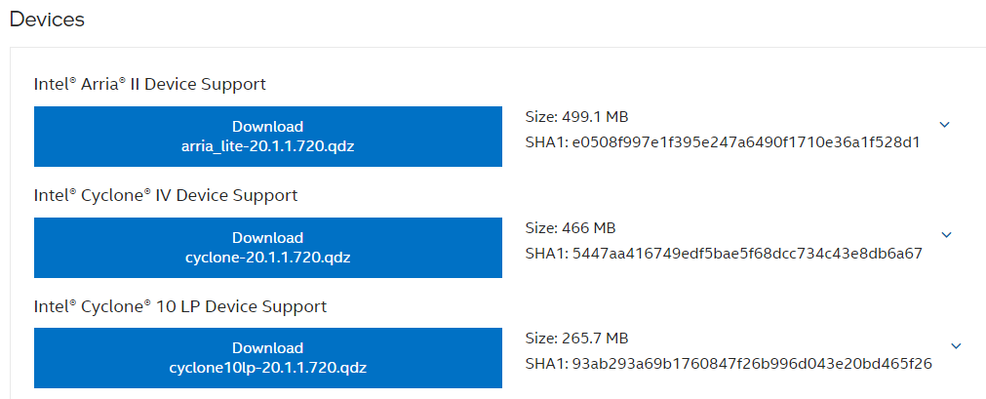
Download and install Quartus
Step 6: Download device support file
Download Cyclone IV Device Support

Slide 13
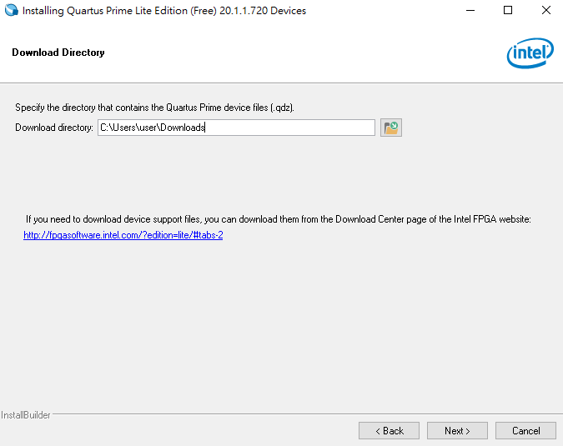
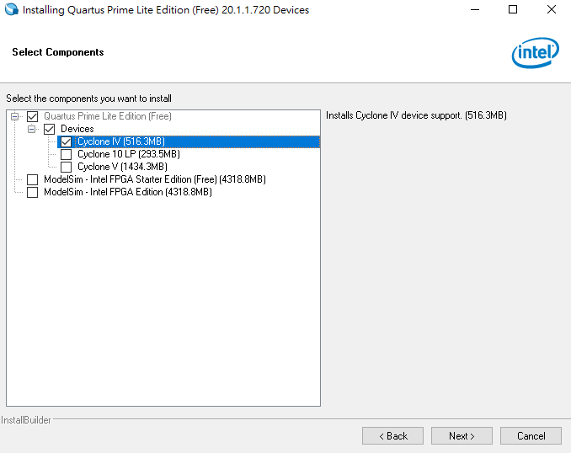
Download and install Quartus
Step 7: Install Device
Windows搜尋 > Device Installer
1. Select path of device support file
3. Check Devices & Cyclone IV
2. Click
4. Click

Slide 14
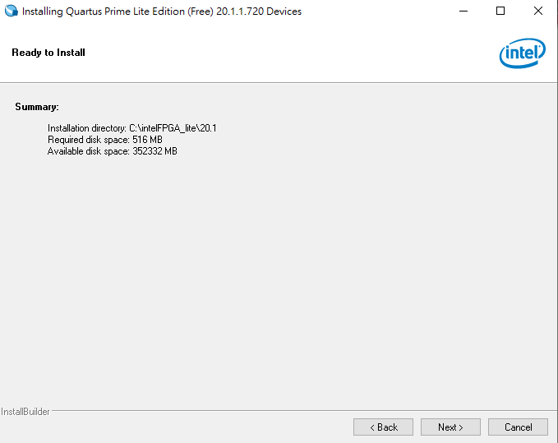
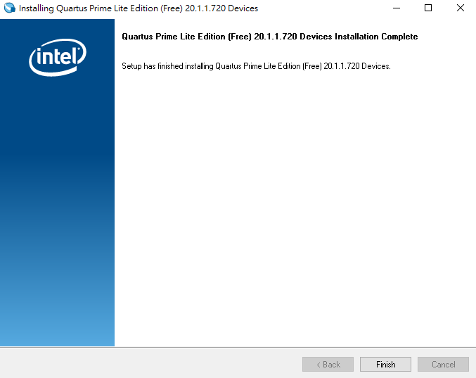
Download and install Quartus
Step 7: Install Device
1. Check available disk space
2. Click
3. Click

Slide 15
Synthesis by Quartus

Slide 16
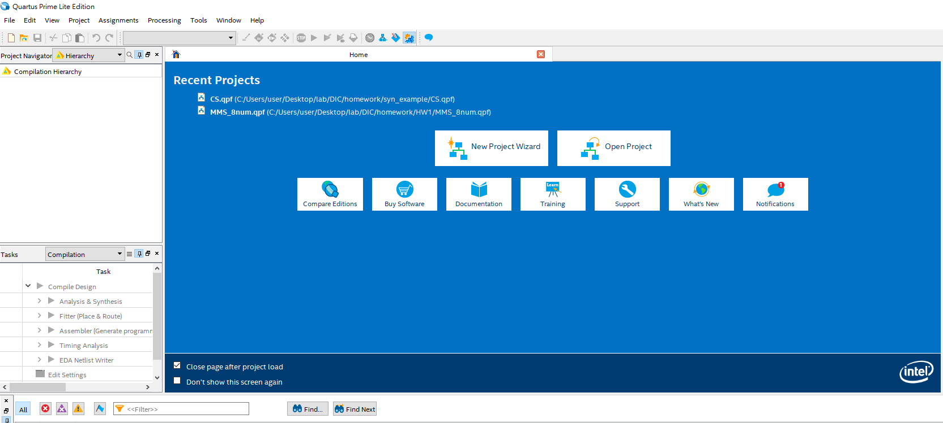
Synthesis by Quartus
Step1: Create a new project
File -> new project wizard
Click here

Slide 17
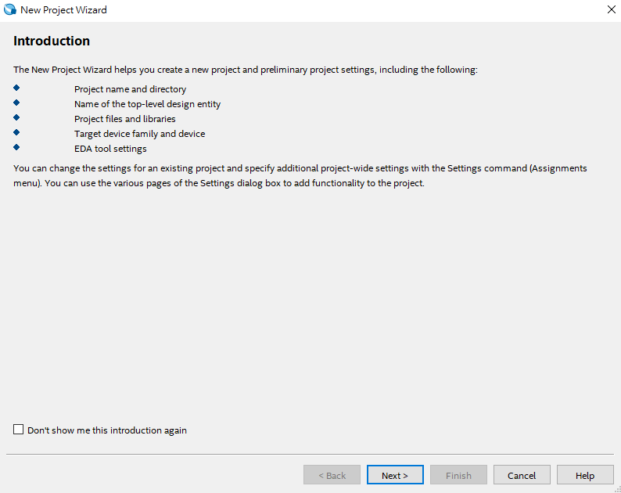
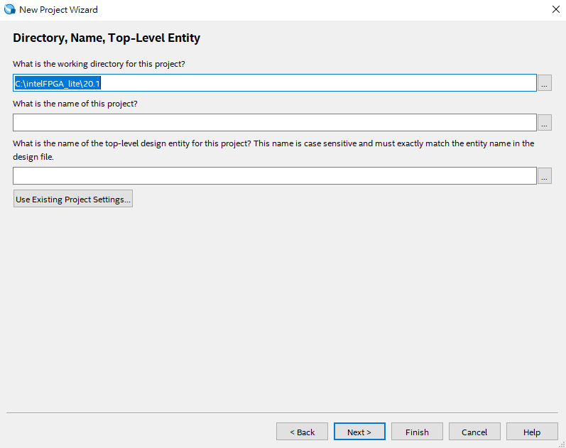
Synthesis by Quartus
Step1: Create a new project
Modify the project path
Don’t use the default path
The project name should be
as same as the name of top module
Click here

Slide 18
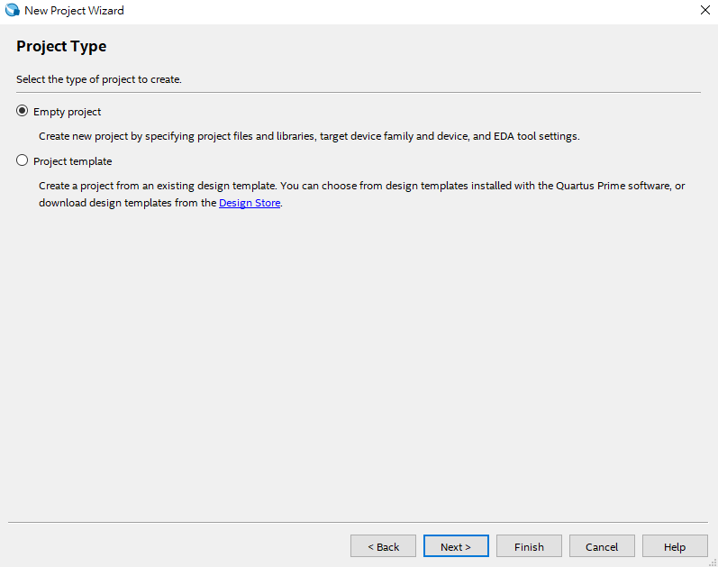
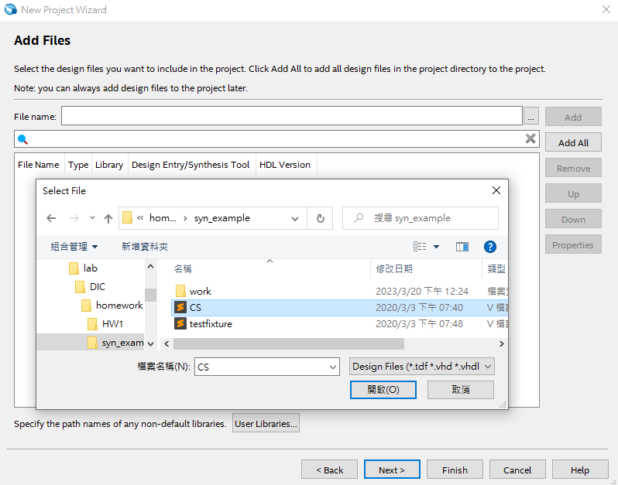
Synthesis by Quartus
Step1: Create a new project
Add the file excepting the testbench
1. Select Empty project
3. Click here
4. Select all .v files except the testbench
2. Click here
5. Click here

Slide 19
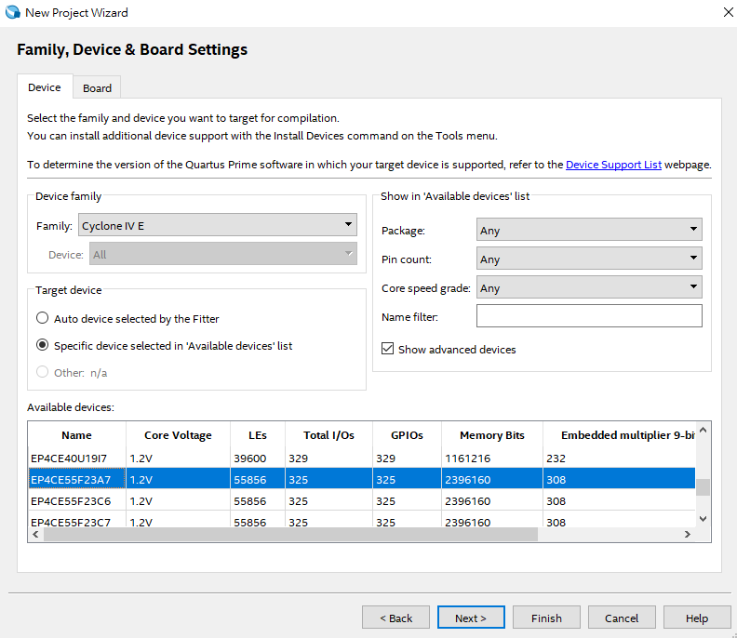
Synthesis by Quartus
Step2: Select the device : EP4CE55F23A7
1. Select device family (Cyclone IV E)
2. Select device
3. Click here

Slide 20
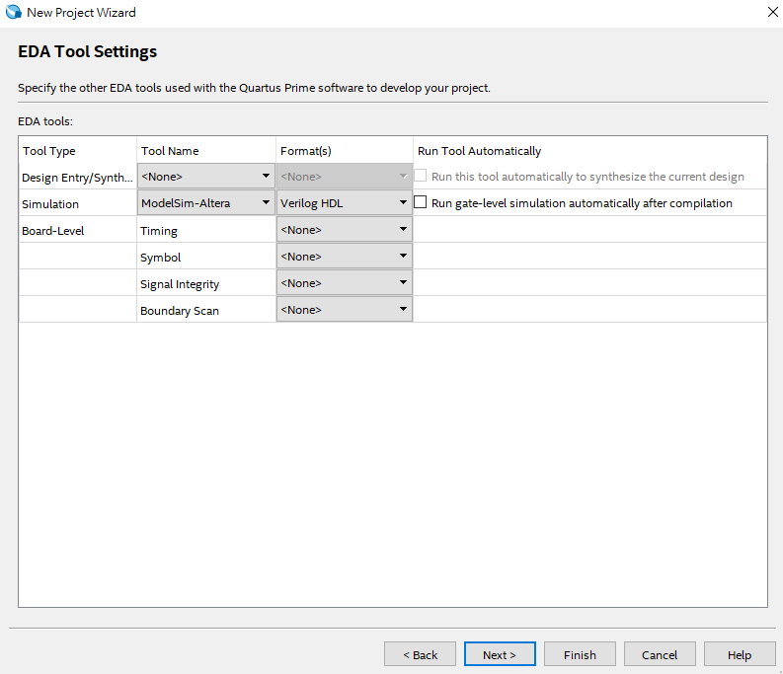
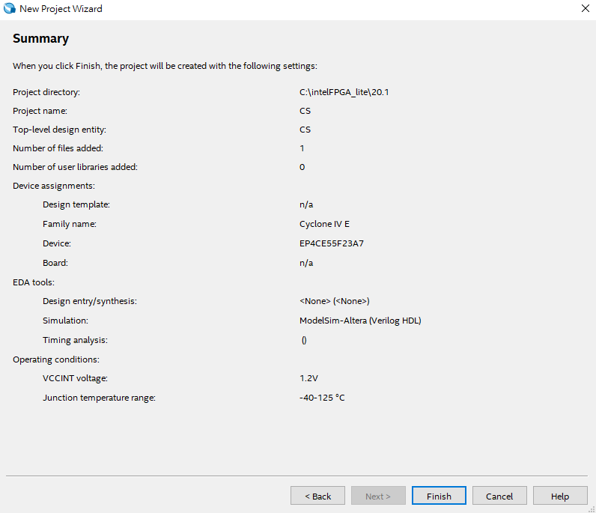
Synthesis by Quartus
Step 3 : Gate level simulation configuration
select ModelSim-Altera and Verilog HDL
Click
Click

Slide 21
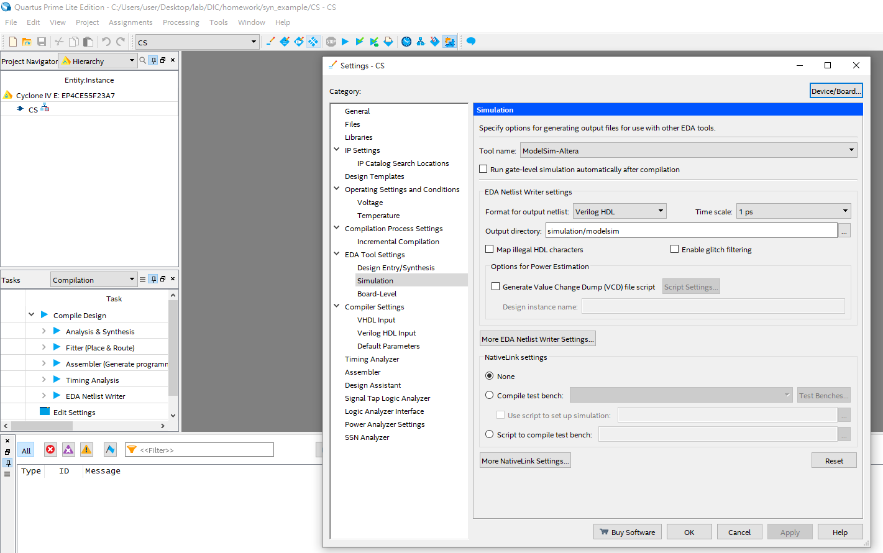
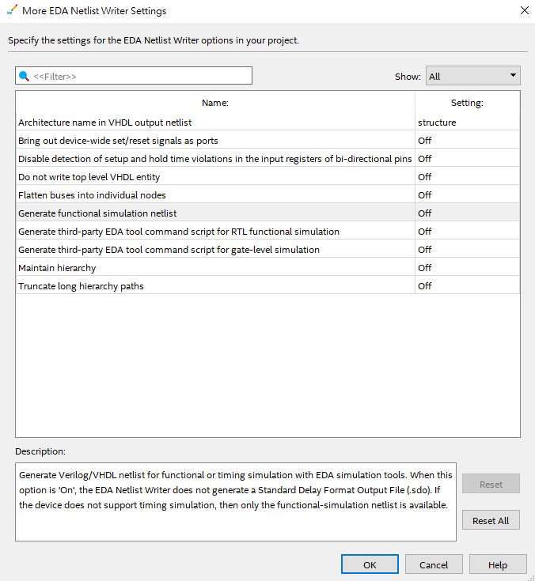
Synthesis by Quartus
Step 4 : compile
Assignment > Settings > Simulation > More EDA Writer Settings
Off

Slide 22
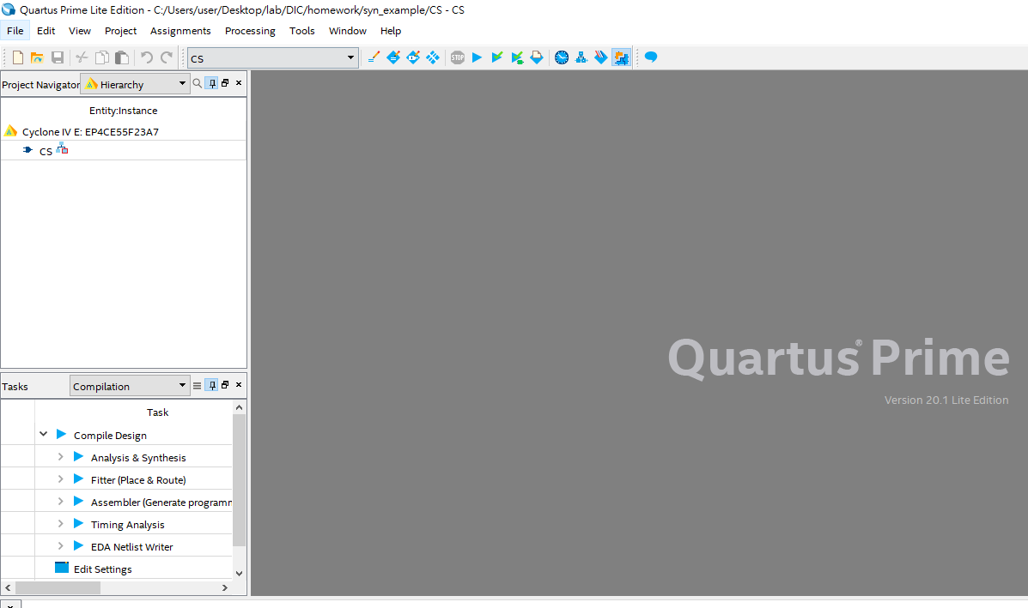
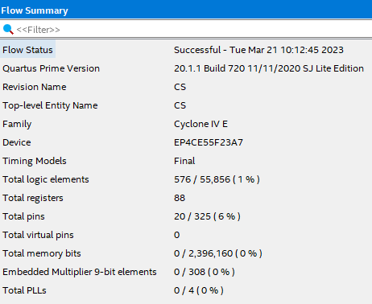
Synthesis by Quartus
Step 4 : compile
Click

Slide 23
Pre-Layout Simulation by ModelSim

Slide 24
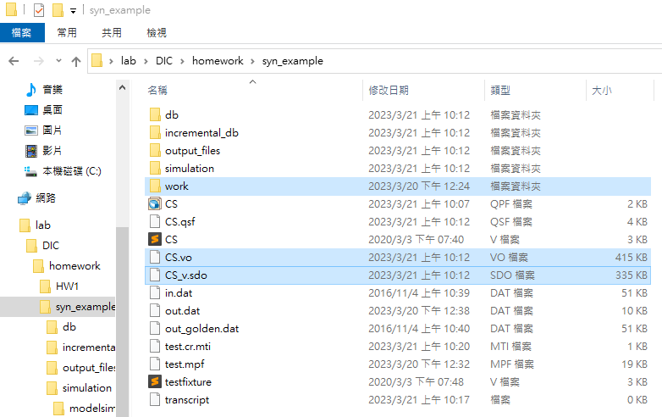
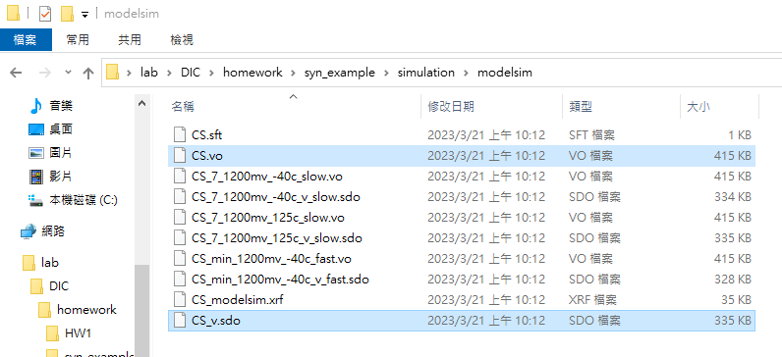
Pre-Layout Simulation by ModelSim
Step 1 : the gate level file (*.vo,*.sdo) can be found in simulation/modelsim folder, and put them into modelsim project directory created in functional simulation section.
Simulation folder is in the Quartus project directory created in the synthesis section.

Slide 25
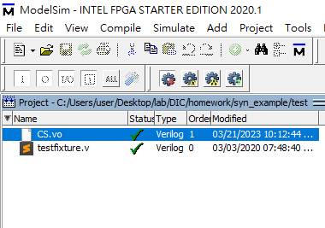
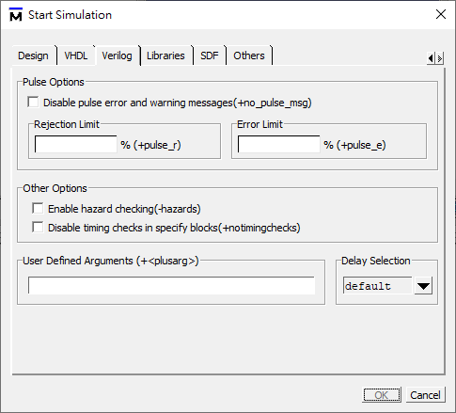
Pre-Layout Simulation by ModelSim
Step 2 : Pre-Layout simulation
(Simulate -> Start Simulation Window)
This time, use the *.vo for simulation ( Replace the original top_module.v with *.vo )
Repeat the steps of functional simulation. ( Need to cancel the no timingchecks. )

Slide 26
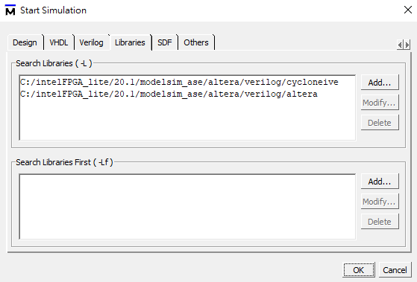
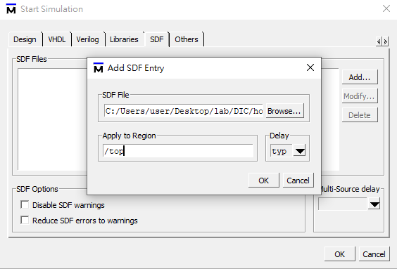

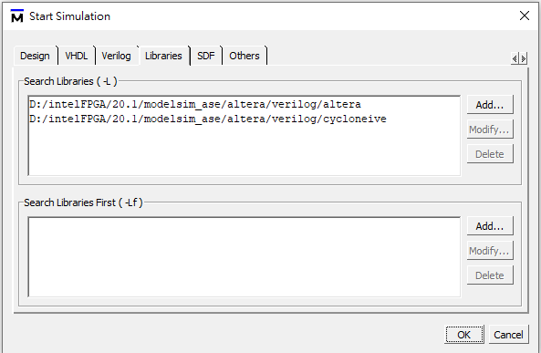
Pre-Layout Simulation by ModelSim
Step 2: Pre-Layout Simulation
Add cycloneive and altera library to search libraries ( click Libraries to add )
your quartus installation disk/altera/13.0sp1/modelsim_ase/altera/Verilog/cycloneii
Add *.sdo to SDF Files and fill the instance name of your design in testbench.v in “apply to region” (click SDF to add)
Testbench file

