Slide 1

SMART INDIA HACKATHON 2026
TITLE PAGE
Problem Statement ID – 26153
Problem Statement Title – AI based Network Attack Forecasting from Network Traffic Data
Theme – Blockchain & Cybersecurity
PS Category – Software
Organisation – National Technical Research Organisation (NTRO)
Team ID – 261
Team Name – Git with It

Slide 2
PREDICTIVE CYBER DEFENCE
Git with It
We do not classify traffic - we learn how a network's state evolves, then run that model forward to see where a host is heading.
AttackForecast - what it is made of
How it addresses the problem
Observe
60-second host windows
Cut the traffic off
model sees nothing more
Score each state
risk + ATT&CK stage
Flow features
Forecasting
- 39 per 60-second window
- bytes, ports, entropy
- 10 states imagined ahead
- uncertainty band
1
2
3
4
5
Packet features
AttackForecast
RSSM world model - 138k parameters
ATT&CK mapping
Learn transitions
what state follows this state
Imagine 10 steps
it generates the future itself
- 23 from raw PCAP
- TTL variance, TCP window
- 5 kill-chain stages
- technique IDs attached
Innovation and uniqueness
World model
Explainability
World model, not a classifier
Falsifiable by construction
Runs offline on a CPU
- encoder + GRU + prior
- learns state transitions
- integrated gradients
- temporal attention
heads read the latent state, so they work on imagined states
imagination-only loss gives zero encoder gradient - in our tests
no cloud, no GPU, no external API - air-gap ready for CII networks
Working prototype today - 258,229 network states from all 13 CTU-13 captures - 28 of 30 infected hosts flagged at 4.9% false alarms

Slide 3
TECHNICAL APPROACH
Git with It
Architecture - traffic in, forecast out
Tech stack used
INGEST
NetFlow / .binetflow - raw PCAP via Scapy
Language
Python 3.13
Deep learning
PyTorch (CPU-only)
FEATURE EXTRACTION
39 flow features + 23 packet features
Packet parsing
Scapy - raw PCAP, flow rebuild
NETWORK STATE
one cell per (host, 60-second window)
Data pipeline
pandas + NumPy, vectorised
Baselines & metrics
scikit-learn
ENCODER + GRU
latent state carrying the host's history
Backend
FastAPI + Uvicorn
PRIOR ROLLOUT
10 states imagined with no traffic observed
Frontend
Single-file HTML, zero CDN
Explainability
Integrated Gradients + attention
PREDICTION HEADS
infiltration risk - ATT&CK stage - surprise
Dataset
CTU-13 - 13 real captures, CC BY
DECISION SUPPORT
dashboard, replay, three explanation channels
Deployment
Fully offline, no external API
Validation: split by time, never randomly - baselines given identical features, scaler and labels - seeded rollouts, so the benchmark reproduces byte for byte

Slide 4
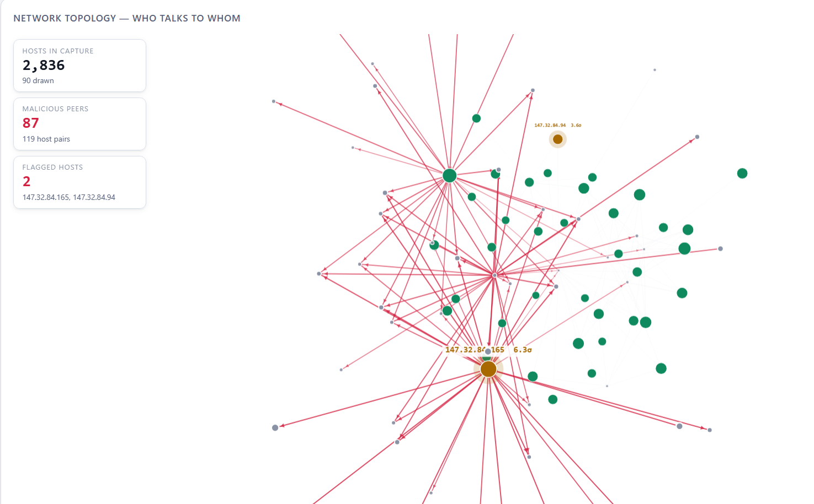
FEASIBILITY AND VIABILITY
Git with It
Feasibility of AttackForecast
Potential challenges and risks
Technical
CPU-only, 138k params
Financial
zero licence cost
Operational
consumes NetFlow already exported
Legal
data never leaves the network
Social
analyst keeps the decision
Label leak
Detection is only a tie
Short-burst compromise
Stages do not cross families
a metadata flag became a perfect label proxy
0.979 against 0.977 for logistic regression
the risk head needs sustained activity
progression did not transfer
Live output from the running prototype
Strategies for overcoming these
Found and removed
caught in our own audit; F1 0.23 to 0.98
Compete on forecasting
beats persistence at 9 of 10 horizons
Second channel
unsupervised surprise covers the gap
Reported, not hidden
detection transfers; progression does not
Stage forecast macro-F1 by horizon
Horizon | +2 | +4 | +6 | +10
World model (ours) | 0.583 | 0.642 | 0.624 | 0.524
“nothing changes” baseline | 0.473 | 0.474 | 0.455 | 0.436
3D topology - the compromised host and its malicious fan-out

Slide 5
IMPACT AND BENEFITS
Git with It
Shifting the defender from reacting after compromise to acting during the kill chain
Potential impact on the target audience
Benefits of AttackForecast
SOC analysts
a ranked queue, not an alert flood
Early warning
up to 10 minutes before the chain closes
Playbook-ready
ATT&CK stage names map onto what SOCs already use
Low noise
4.9% false alarms across 13 captures
1
Auditors
every alert is challengeable
AttackForecast
10 minutes of warning
Critical infrastructure
power, banking, telecom, transport
6
2
5
3
Zero licence cost
open source, runs on existing hardware
4
Auditable
replay shows what the model knew, minute by minute
Enterprises
no new hardware to buy
CERT-In
national response teams
Air-gap ready
nothing leaves the network
Every claim on this deck is reproducible from the repository: one command prepares the data, one trains, one benchmarks.

Slide 6
RESEARCH AND REFERENCES
Git with It
Datasets, standards and prior work
1
2
3
4
5
CTU-13 Dataset
Stratosphere IPS, CTU Prague
13 real botnet captures, CC BY
Garcia et al., Computers &
Security, 2014
MITRE ATT&CK
Enterprise Matrix
TA0043 Reconnaissance
TA0001 / TA0008 / TA0011
TA0010 Exfiltration
World models
Ha & Schmidhuber,
World Models, NeurIPS 2018
Hafner et al., PlaNet, ICML 2019
Hafner et al., Dreamer, ICLR 2020
Explainability
Sundararajan et al.,
Integrated Gradients, ICML 2017
Vaswani et al., Attention Is
All You Need, NeurIPS 2017
National context
NCIIPC - nciipc.gov.in
CIC-IDS2017 / CSE-CIC-IDS2018
reviewed; access now gated
behind registration
Team - Git with It
Suyash Shukla
Team Leader
Tanmay Kumar Sinha
Member
Shivam Kumar Tripathi
Member
Tanay
Member
Yuvan Laxmanan
Member
Vaishnavi Tripathi
Member
Problem Statement 26153 (NTRO) - AI based Network Attack Forecasting from Network Traffic Data - Blockchain & Cybersecurity
Source, data preparation and benchmark: github.com/HowSuyash/AttackForecast

