Slide 1
Gravity Search Algorithm Implementation
by Nataliia Zubareva
inspired by
GSA: a gravitational search algorithm by Rashedi, Nezamabadi-pour, Saryazdi, 2009
Applications of gravitational search algorithm in engineering by Siddique, Nazmul & Adelib, Hojjat, 2016
Optimal power flow using gravitational search algorithm by Duman, Güvenç, Sönmez, Yörükeren, 2012

Slide 2
Provided solution:
An implementation of GSA with
optimizations and features:
elitism - gravity influence only from k best agents, k is calculated dynamically
decaying gravity constant - transition from exploration to exploitation
dimensionality - unlimited
additional option of difference between iterations exit criterium
logging of convergence and best values by iterations, written to files
easy repeat of calculation from the interface
functions
simple y = x function to test
square y = x**2 function - from the original paper, test purposes as well
quadratic cost curve with valve point loadings - from the paper on optimal power flow, solution for a real-life problem
technical details: console app, written in c++ in the OOP paradigm using standard c++ libraries, can be deployed on a PC with a c++ compiler, txt scripts for inputs

Slide 3
Problem: real life statement
Optimal power flow
- how to operate a grid of generators in the most efficient way? For example, we have buses with demand for power and generators attached to them, how much power should we generate at each generator?
Reduction to mathematical statement
how = with what parameters
and what values for them
a grid of generators = {P1, P2, … Pn} - power output of each generator in power units of choice
constraints Pi_min <= Pi <= Pi_max for i in 1...n, based on power demand, safety requirements, etc.
in the most efficient way = with the smallest costs based on
the fuel costs {c1, c2, … cn} for each generator, money/power_unit - possibly different fuels
other effects of electric grid, i.e. valve point effects

Slide 4
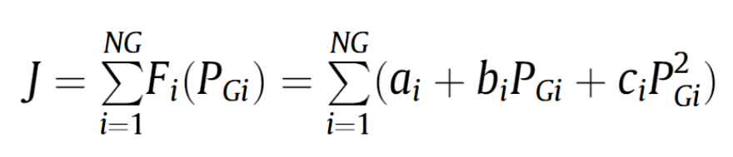



Problem: mathematical statement
- cost function of fuel of i-th generator defined as quadratic function of power output (PGi) with cost coefficients (ai, bi, ci), NG - number of all generators in the system
also: valve point effect calculated on several buses with addition of
Final objective function: where j is the number of buses with valve-point effect, di and ei are additional cost coefficients
Task:
minimize the objective function J - quadratic cost curve with valve point loadings
by finding optimal PGi for i in 1…NG
with given NG, number of VP buses, ai, bi, ci, dj, ej, PGi_min, PGi_max for i in 1…NG, j in 1… number of VP buses
j
j

Slide 5
Problem: GSA adaptation
Each agent’s position is represented as {PG1, PG2, ... PGn},
n is the number of dimensions - and the number of generators\buses in the grid,
the population is generated randomly with constraints of Pi_min <= Pi <= Pi_max for i in 1...n,
agents move in each dimension between these min and max constraints,
the fitness function is calculated as J,
the algorithm is set to find the minimum of the fitness function.

Slide 6
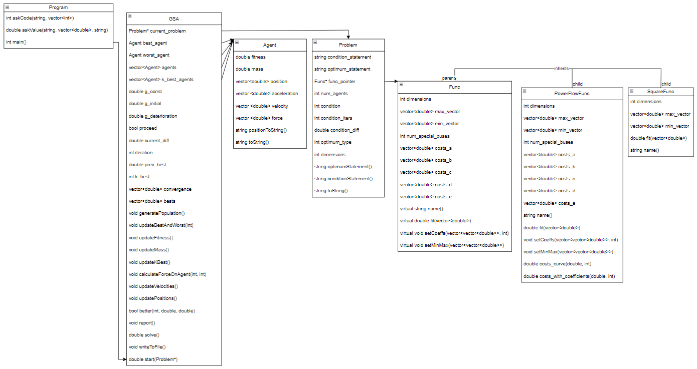
Structure: classes

Slide 7
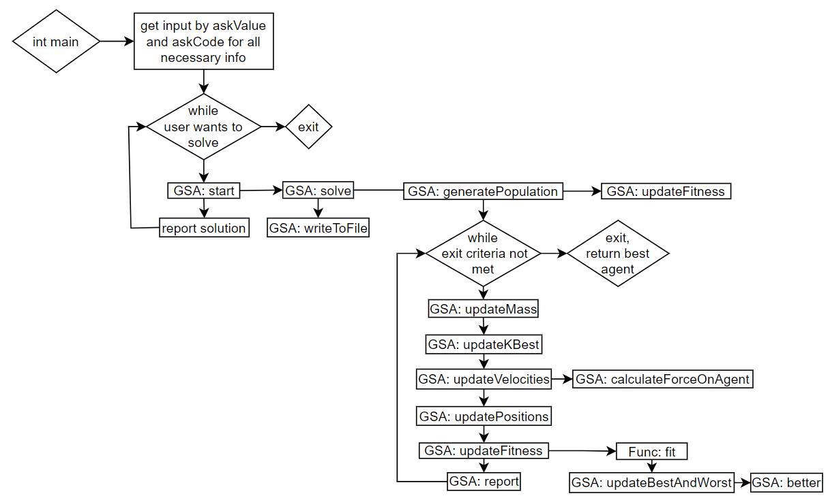
Structure: process

Slide 8
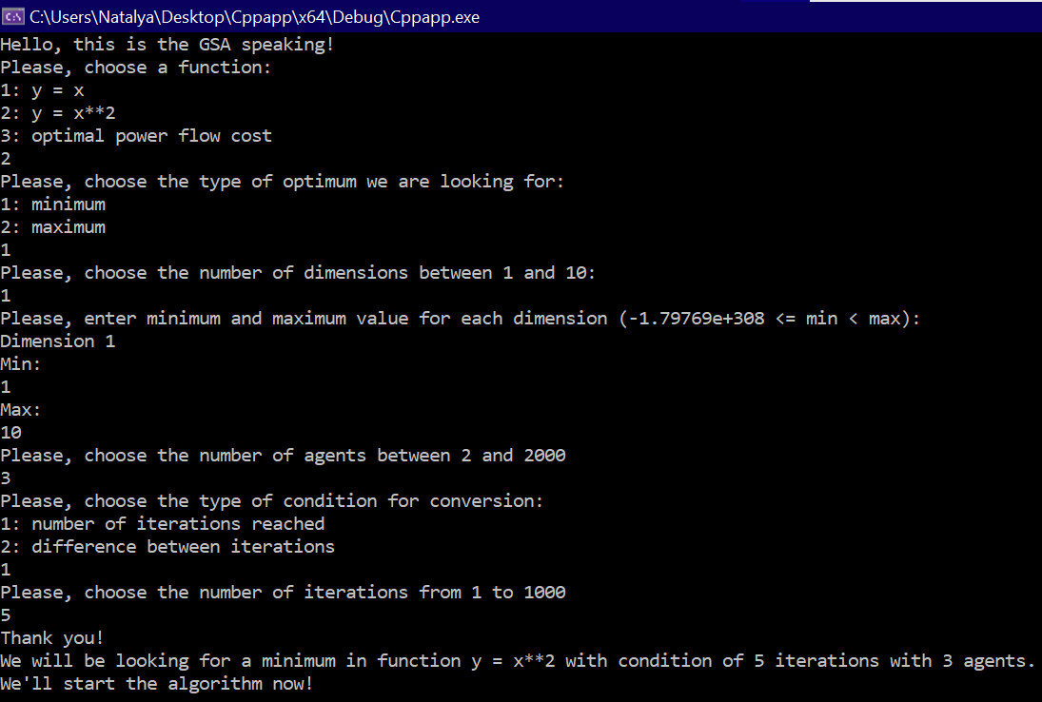
Input
type of function to optimize
y = x
y = x**2
quadratic cost curve with vp loadings
type of optimum to find
minimum
maximum
number of dimensions between 1 and 10
min and max value for each dimension
number of agents between 2 and 2000
type of condition for conversion
by number of iterations
by difference between iterations
criterion for conversion according to previous choice
number of iterations between 1 and 1000
difference between iterations between 0.0001 and 10
console input example

Slide 9
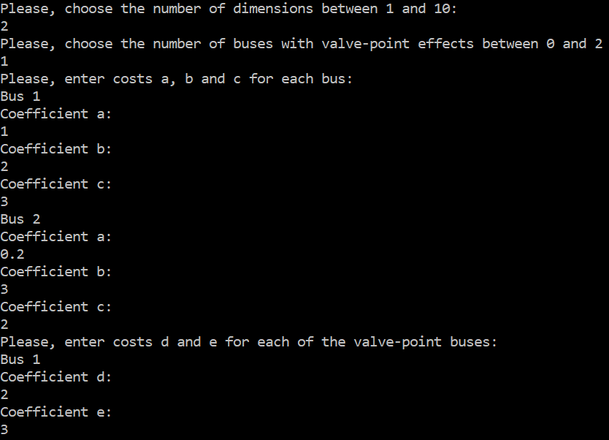
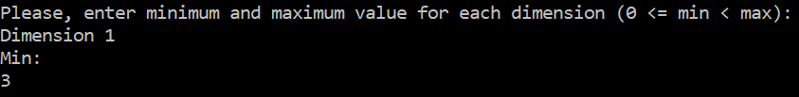
Input
additionally in case of quadratic cost function:
number of buses with valve-point effect between 0 and the number of dimensions
coefficients a, b, c for all buses
coefficients d and e for valve-point effect buses
also, the min value for a dimension cannot be less than 0
console input examples for optimal flow calculation

Slide 10
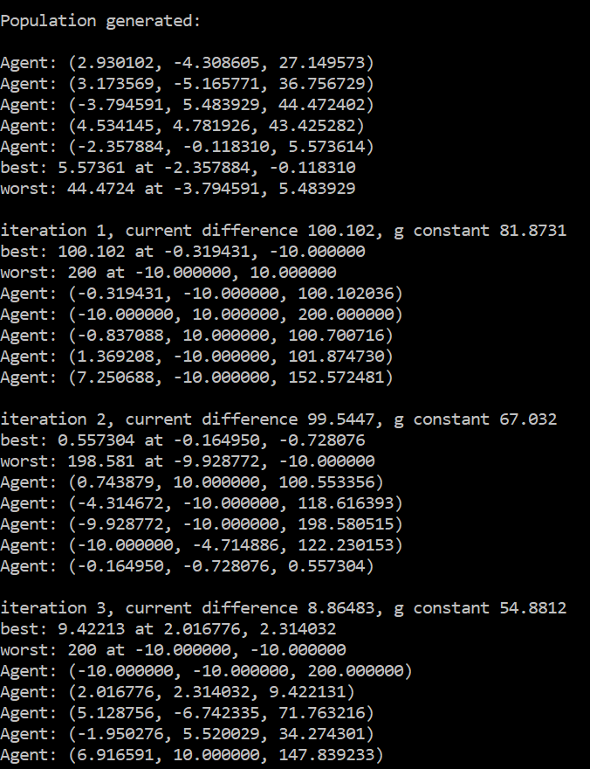
During execution
initial listing of agents’ positions
best and worst agents
after each iteration:
difference with the previous iteration
current g constant value
best and worst agents
positions of all agents
behind the curtains:
mass, gravity force, acceleration, velocity, new position, fitness is calculated for each agent
difference between iterations is computed and logged
best fitness of each iteration is computed and logged

Slide 11
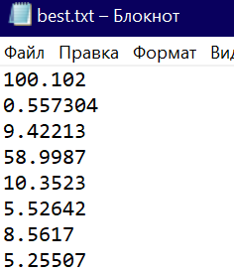
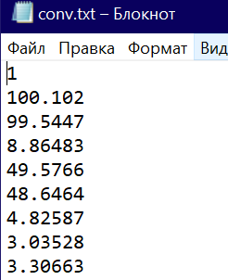

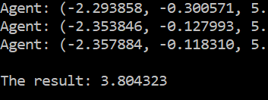
Output
final best value
files in the directory of the cpp file:
txt file with data on difference between iterations
txt file with data on best value of each iteration
possibility to run the calculation with the same parameters again

Slide 12
Demo

Slide 13
References
Rashedi E., Nezamabadi-Pour H., Saryazdi S., GSA: a gravitational search algorithm //Information sciences. – 2009. – Т. 179. – №. 13. – С. 2232-2248.
Gravitational-Search-Algorithm // Github URL: https://github.com/himanshuRepo/Gravitational-Search-Algorithm (дата обращения: 01.12.2022).
Siddique, Nazmul & Adelib, Hojjat. (2016). Applications of gravitational search algorithm in engineering. Journal of Civil Engineering and Management. 22. 981-990. 10.3846/13923730.2016.1232306.
Serhat Duman, Uğur Güvenç, Yusuf Sönmez, Nuran Yörükeren, Optimal power flow using gravitational search algorithm, Energy Conversion and Management, Volume 59, 2012, Pages 86-95, ISSN 0196-8904, https://doi.org/10.1016/j.enconman.2012.02.024.

Slide 14
Thank you for your attention!

