Slide 1
Git and Github
Courtney Kearney & Candace maurice

Slide 2
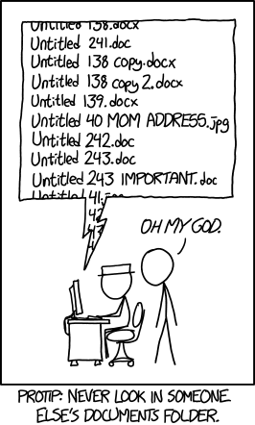
Notes:
Track changes and version history of Google Docs and Dropbox not true version controls which mean they are limited in their capabilities.

Slide 3
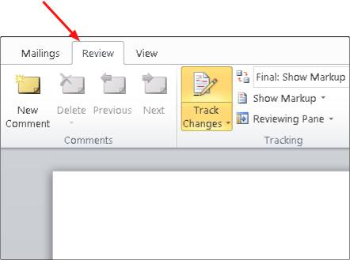
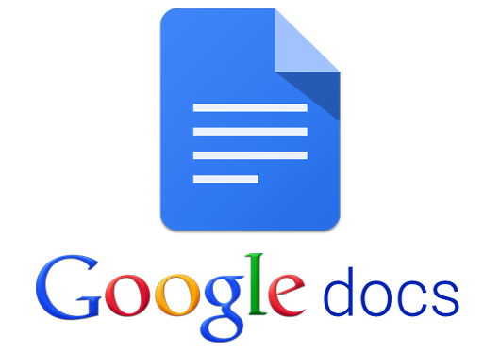
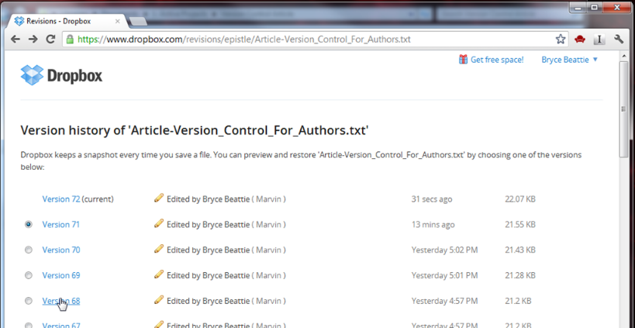


Microsoft Track Changes
Notes:
Track changes and version history of Google Docs and Dropbox not true version controls which mean they are limited in their capabilities.

Slide 4
Git (version control system)
2005
Free
Open Source
Comments
True Version Control
Collaborative
Archive
Text Files
Notes:
Almost all Microsoft’s 4000 engineers now use Git.
Developed for software engineers.
Only for text files.

Slide 5
Github (version control repository)
2008
Free if public
Social Network
Web-based; Desktop
20 m users
57 m repositories
Website hosting
Store all file types
Notes:
-Robustness of Github: Archives history of a project, records comments and thoughts as changes are made, transparent, collaborative, public facing interface that promotes sharing and open source material.
One of the 100 most visited websites in the world
Host all file types but only handles changes to text files
1 gb per repository
100 mb file size max
Can be used via Slack
Open source projects by Facebook and Twitter hosted on Github

Slide 6
Github Examples
Open Source DNA:
https://scotch.io/bar-talk/announcing-the-open-sourcing-of-my-dna-on-github
https://github.com/whatnickcodes/dna
NYSenate.gov:
https://www.nysenate.gov/
https://github.com/nysenate/NYSenate.gov
Course website/textbook:
http://pushpullfork.com/musicianshipResources/
https://github.com/kshaffer/musicianshipResources
http://blogs.lse.ac.uk/impactofsocialsciences/2013/06/04/github-for-academics/
2017 Digital Scholarship Workshop (Knowlton):
https://github.com/tech-at-arl/Digital-Scholarship-Institute

Slide 7
Github for Libraries
Emphasis on transparency, open access, collaboration and sharing
Archive of research/design process
Collaboration with colleagues
Share workshop material
Source of information

Slide 8
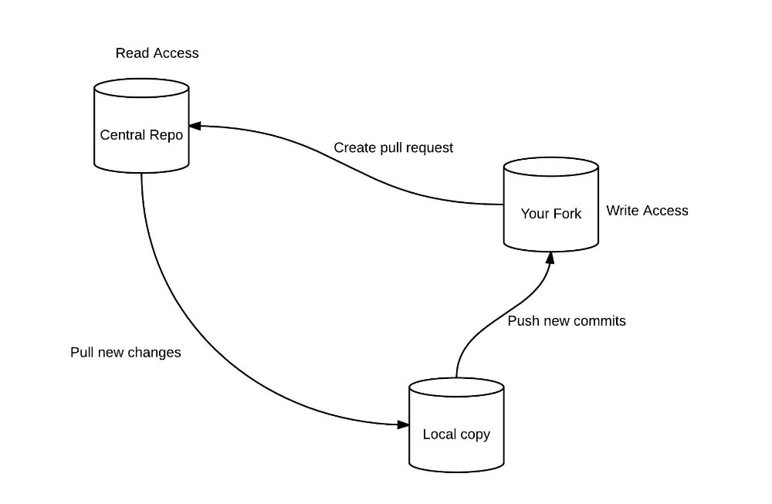
Github: Cheatsheat
Readme: A text file that tells other people why your project is useful, what they can do with your project, and how they can use it.
Fork: A copy of a repository within your Github account.
Clone: A copy (download) of a repository to your local computer.
Commit: Records changes to the local repository.
Push: Records changes made in your local repository to the forked repository.
Pull request: Requests changes made in your fork to be included in the central repository.

Slide 9
Github: Cheatsheat
Create Github account
Join the Howard-Tilton-Library organization
Explore the Github web-based interface
Fork GitGithub-Intro repository from H-T-L

Slide 10
How it works:
Create Github account
Join the Howard-Tilton-Library organization
Explore the Github web-based interface
Fork GitGithub-Intro repository from H-T-L

Slide 11
“In a GitHub for science, each “paper” that researchers produce would reflect the complete and full record of an experiment—every lab note, every statistical script, every audio file, and every bit of computer code. ”
-Markus Banks http://www.slate.com/articles/technology/future_tense/2017/04/we_need_a_github_for_academic_research.html
Notes:
Supports reproducibility, transparency, discovery through collaboration and sharing

Slide 12
Manuscript Examples
Manuscripts:
https://github.com/greenelab/deep-review
https://github.com/greenelab/scihub
https://github.com/jdblischak/git-for-science

