Slide 1
Git and Github
Courtney Kearney & Candace maurice

Slide 2
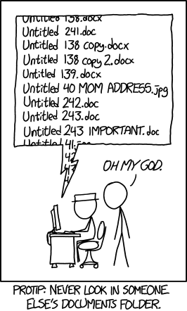

Slide 3
Git
noun \ˈgit\
British
: a foolish or worthless person
That git of a brother of yours has ruined everything!
Oh, don't be such a silly git, of course your mates want you around.

Slide 4

Git
noun \ˈgit\
: a version control system (VCS) for tracking changes in computer files and coordinating work on those files among multiple people.

Slide 5
Git
2005
Free
Open Source

Slide 6
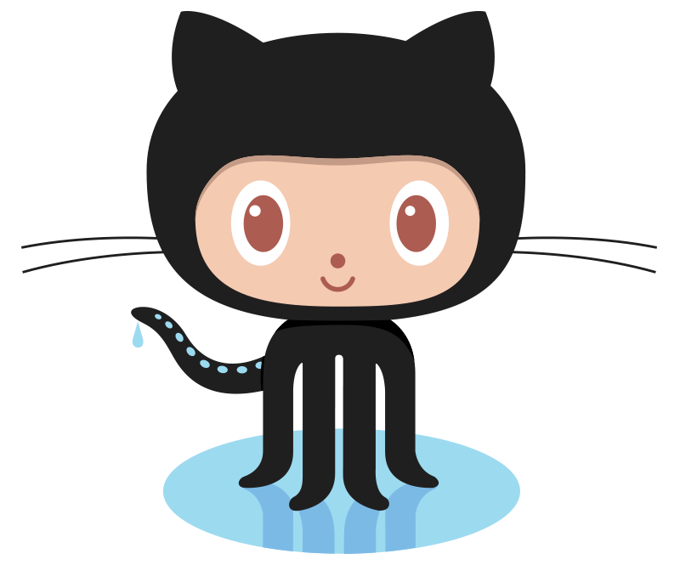
Github
web-based Git or version control repository and Internet hosting service
As of April 2017, GitHub reports having almost 20 million users and 57 million repositories,[6] making it the largest host of source code in the world.[7]

Slide 7
Cookbooks, syllabi,
Fork the Recipe: http://forkthecookbook.com/
Open Source DNA: https://scotch.io/bar-talk/announcing-the-open-sourcing-of-my-dna-on-github
NYSenate.gove: https://github.com/nysenate/NYSenate.gov

