Slide 1
利用model output 偷取 Machine Learning-as-a-Service 平台 model
網路多媒體實驗
組員：林承德、趙冠豪、李羚毓
指導助教：曾煒傑
指導老師：林宗男教授

Slide 2
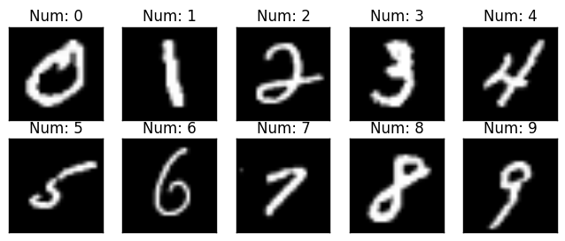
Motivation
classes | 0 | 1 | 2 | 3 | 4 | 5 | 6 | 7 | 8 | 9
label | 0 | 1 | 0 | 0 | 0 | 0 | 0 | 0 | 0 | 0
probability | 0.005 | 0.8 | 0.005 | 0.005 | 0.005 | 0.005 | 0.005 | 0.16 | 0.005 | 0.005

Slide 3
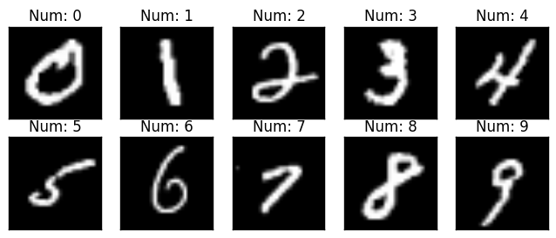
Datasets
MNIST 資料集

Slide 4
實驗目的
1. 實作論文 ”Stealing Machine Learning Models via Prediction APIs” neural network 的方法，偷取ML model
2. 利用 neural network 的方式實際嘗試偷取各種不同Model

Slide 5
實驗步驟
Choose Target Model
Prediction for Stealing
Testing (Evaluate the result)

Slide 6
Target Model 建立
Upload data to BigML
Train Model
Deepnet
Decision Tree
Target Model Available
Local :
Model parameters
BigML Server :
Available for prediction

Slide 7
Copy Model VS Control Model
( X_training_data )
Target model (pre-trained)
( Y_target_probability , Y_target_label )
train
train
Copy Model
Control Model
Accuracy Evaluation (vs Target Model)

Slide 8
Training of Control / Copy Model
Training Data
Size : 500、1000、3000、5000、7000、9000
Model
Fully-Connected（784x100）
Optimizer
Adam
Learning rate : 1e-5, 5e-5, 1e-4
ReLU
Back
propagation
Fully-Connected（100x100）
Loss
ReLU
Loss function
Control Model : CorssEntropy
Copy Model : BCEloss
Fully-Connected（100x10）
Softmax
Control Model : label from target model
Copy Model : probability of each data given by target model

Slide 9
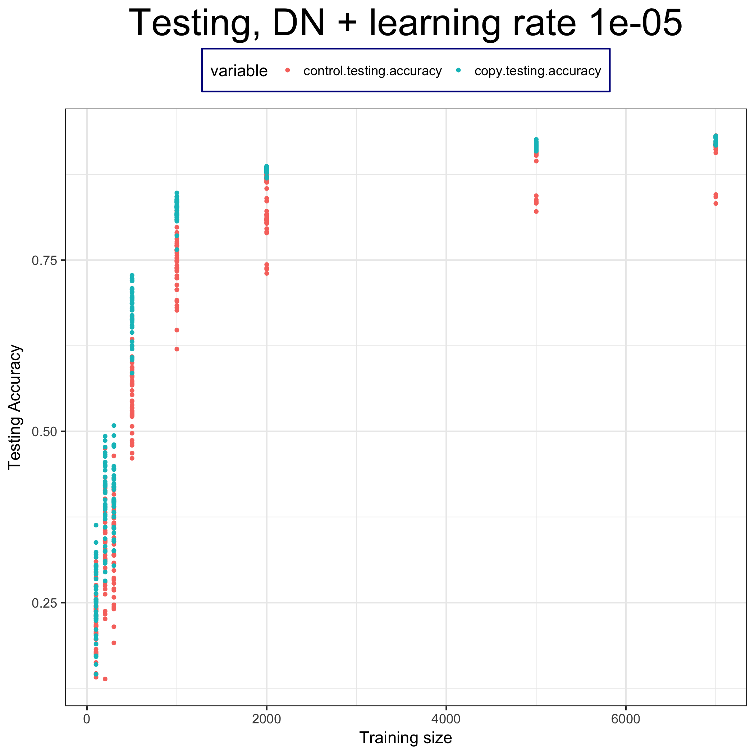
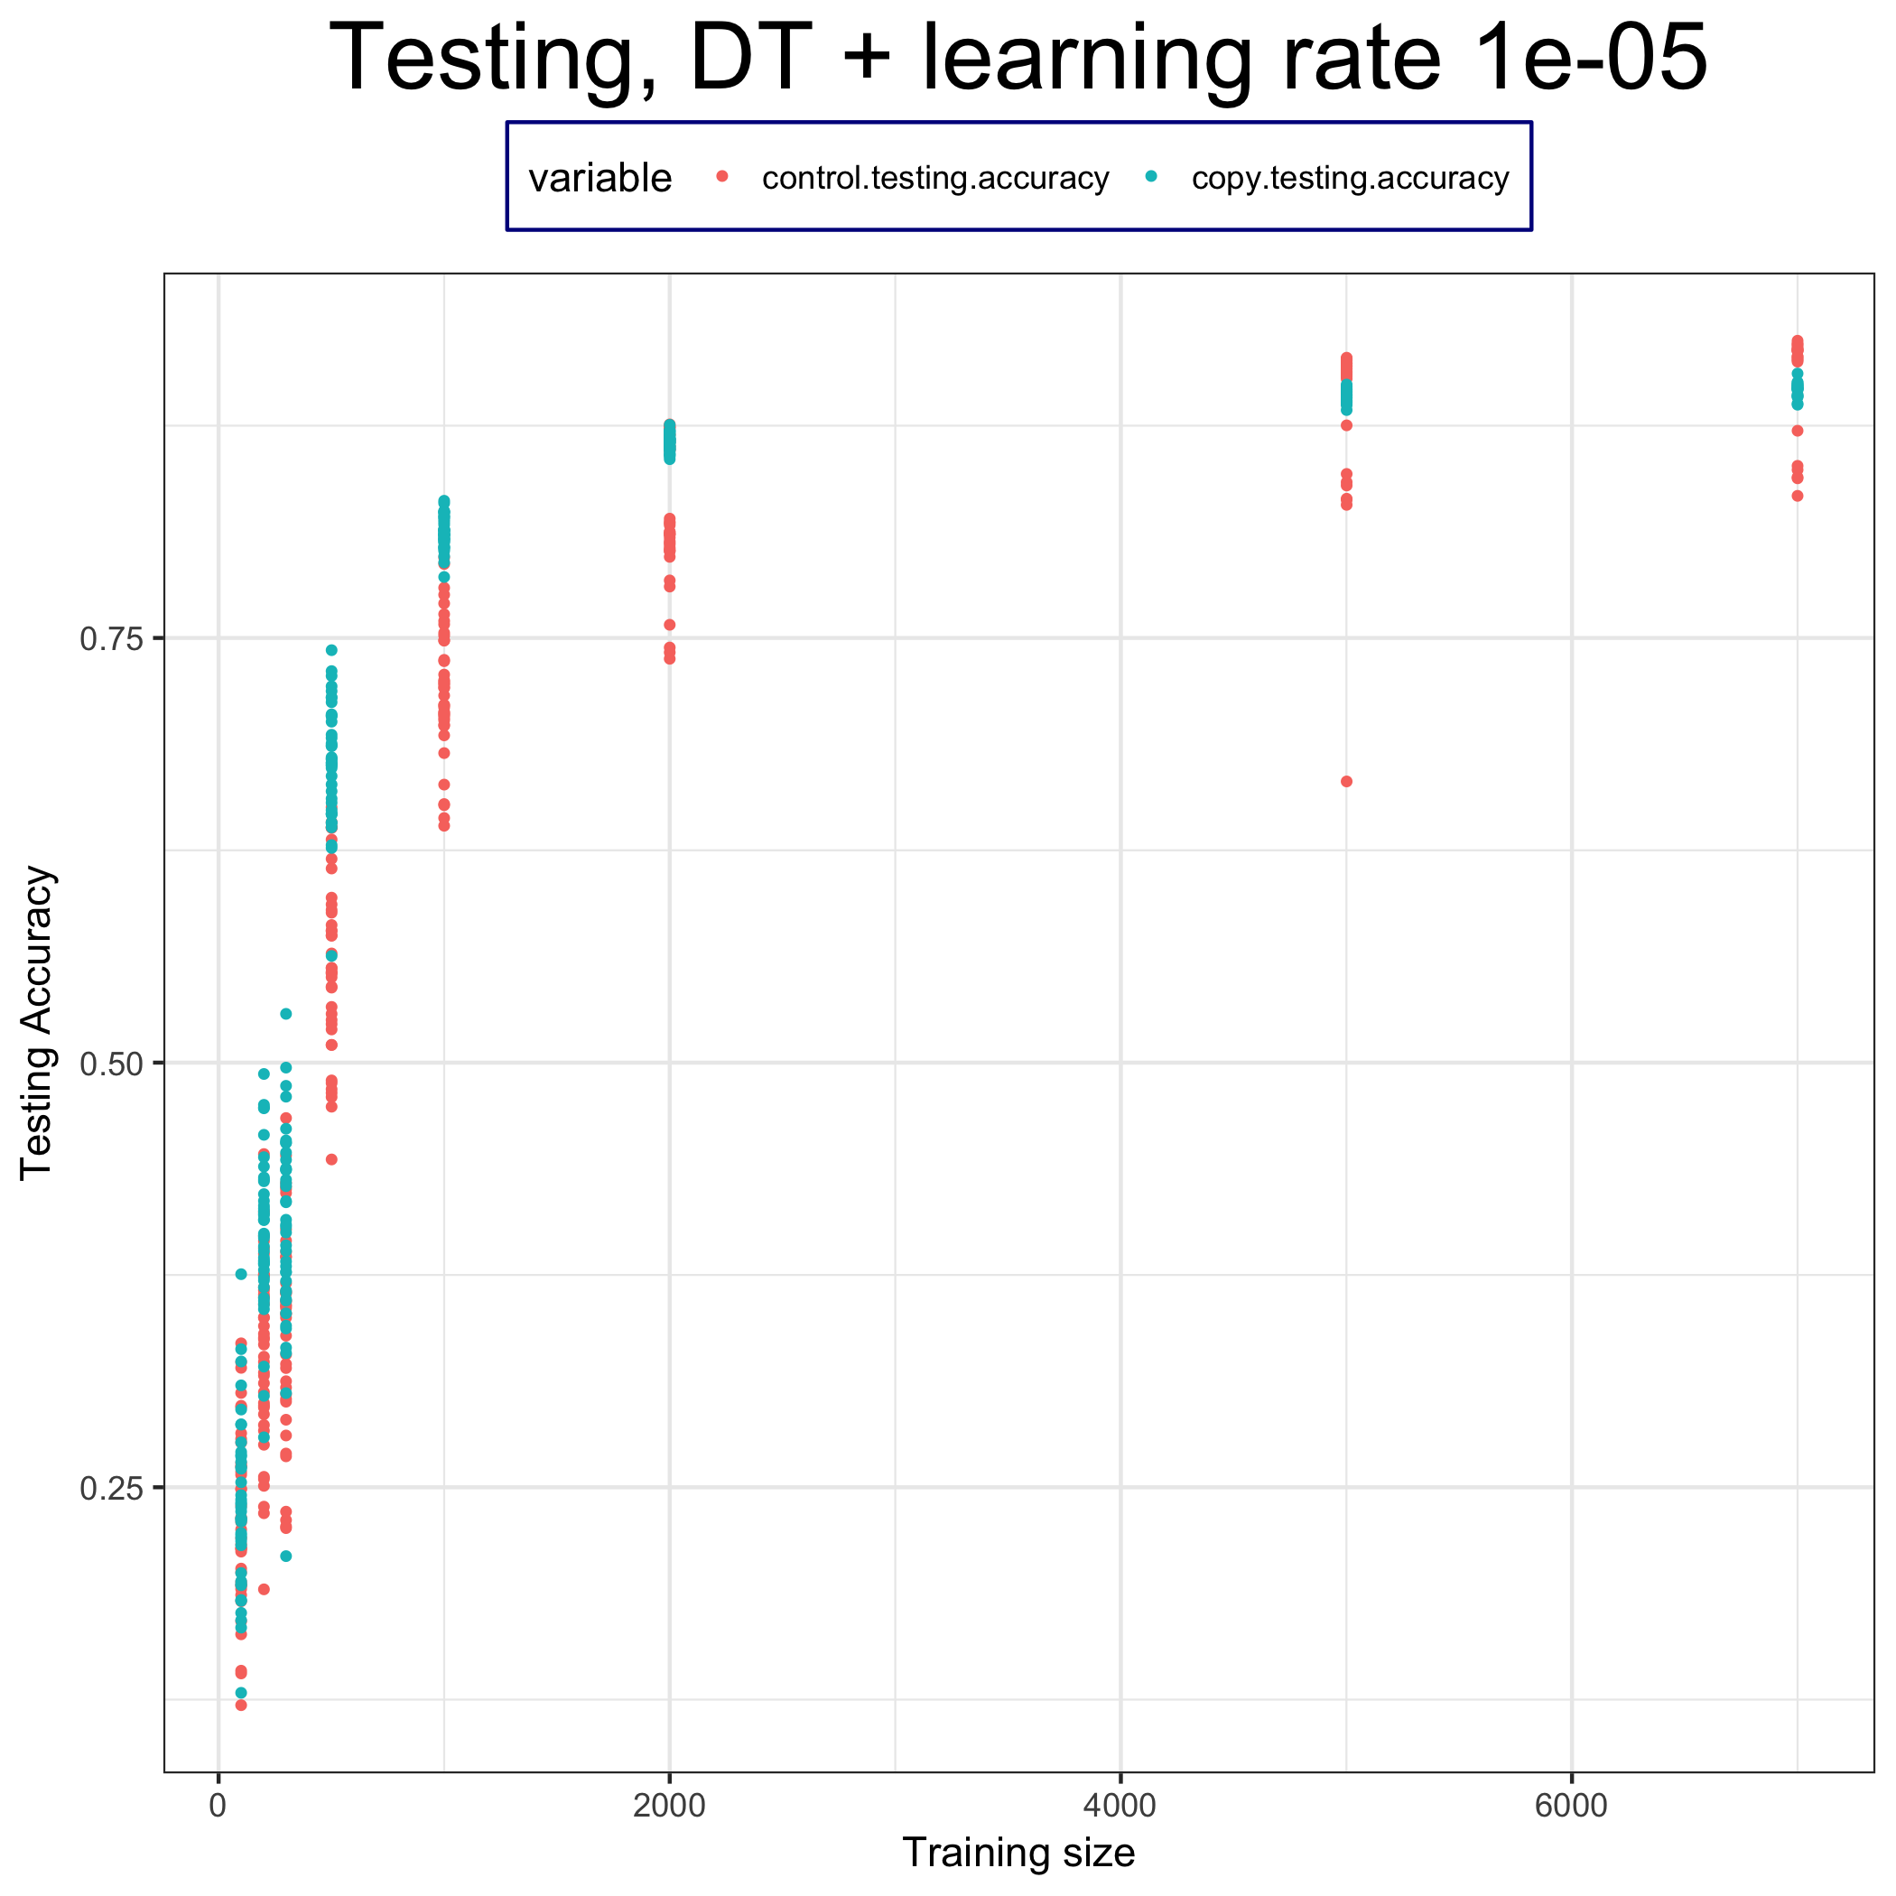
Conclusion

Slide 10
Thanks for your listening

Slide 11
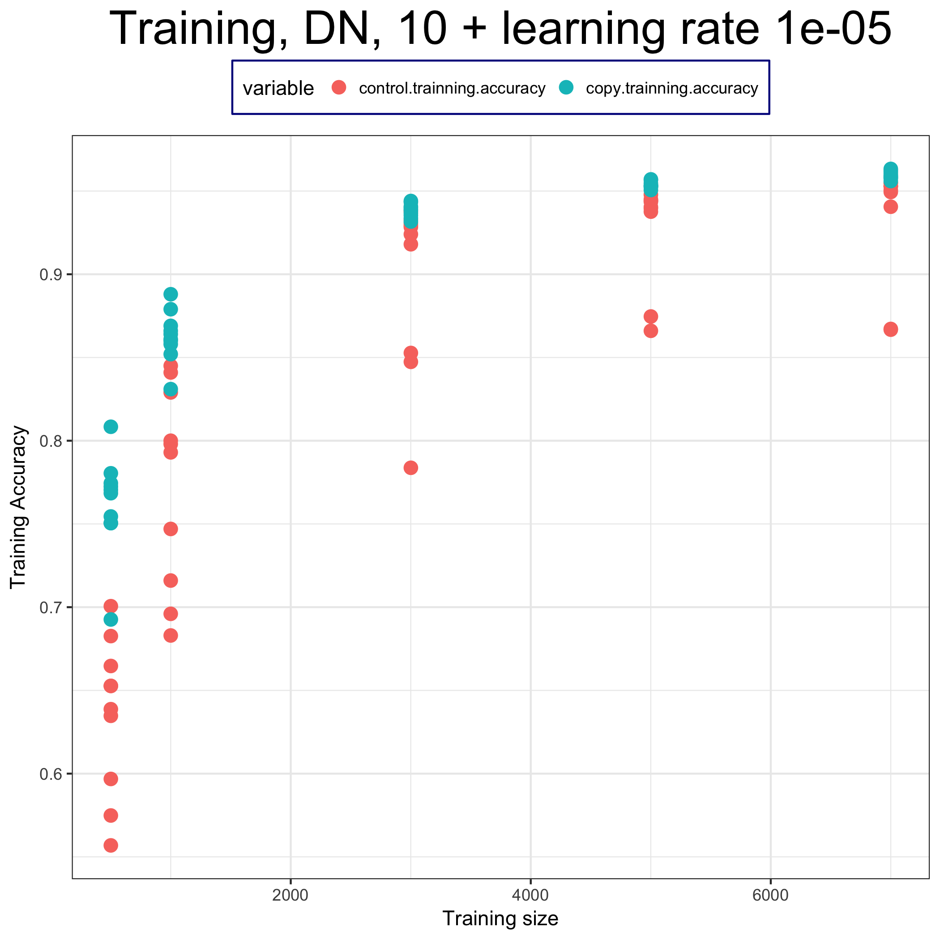
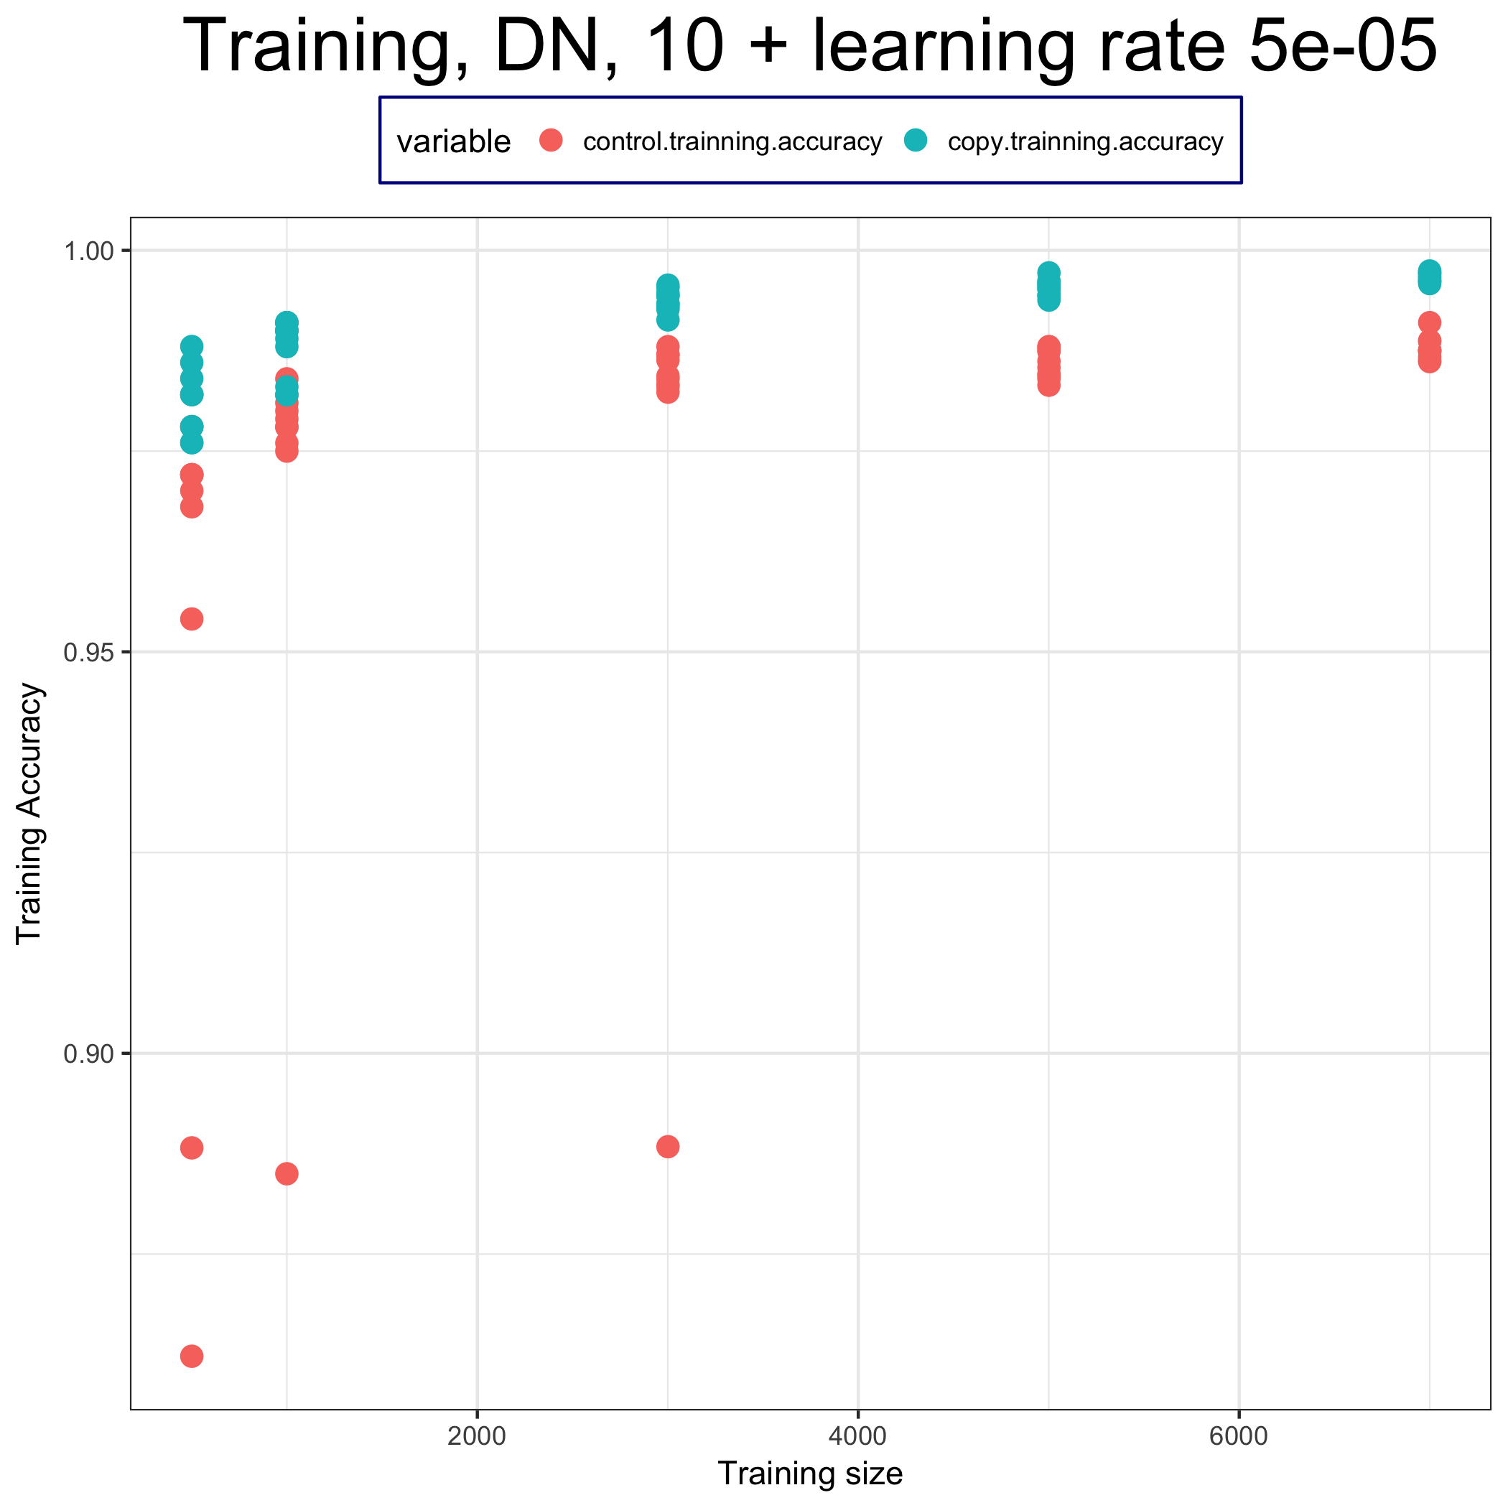
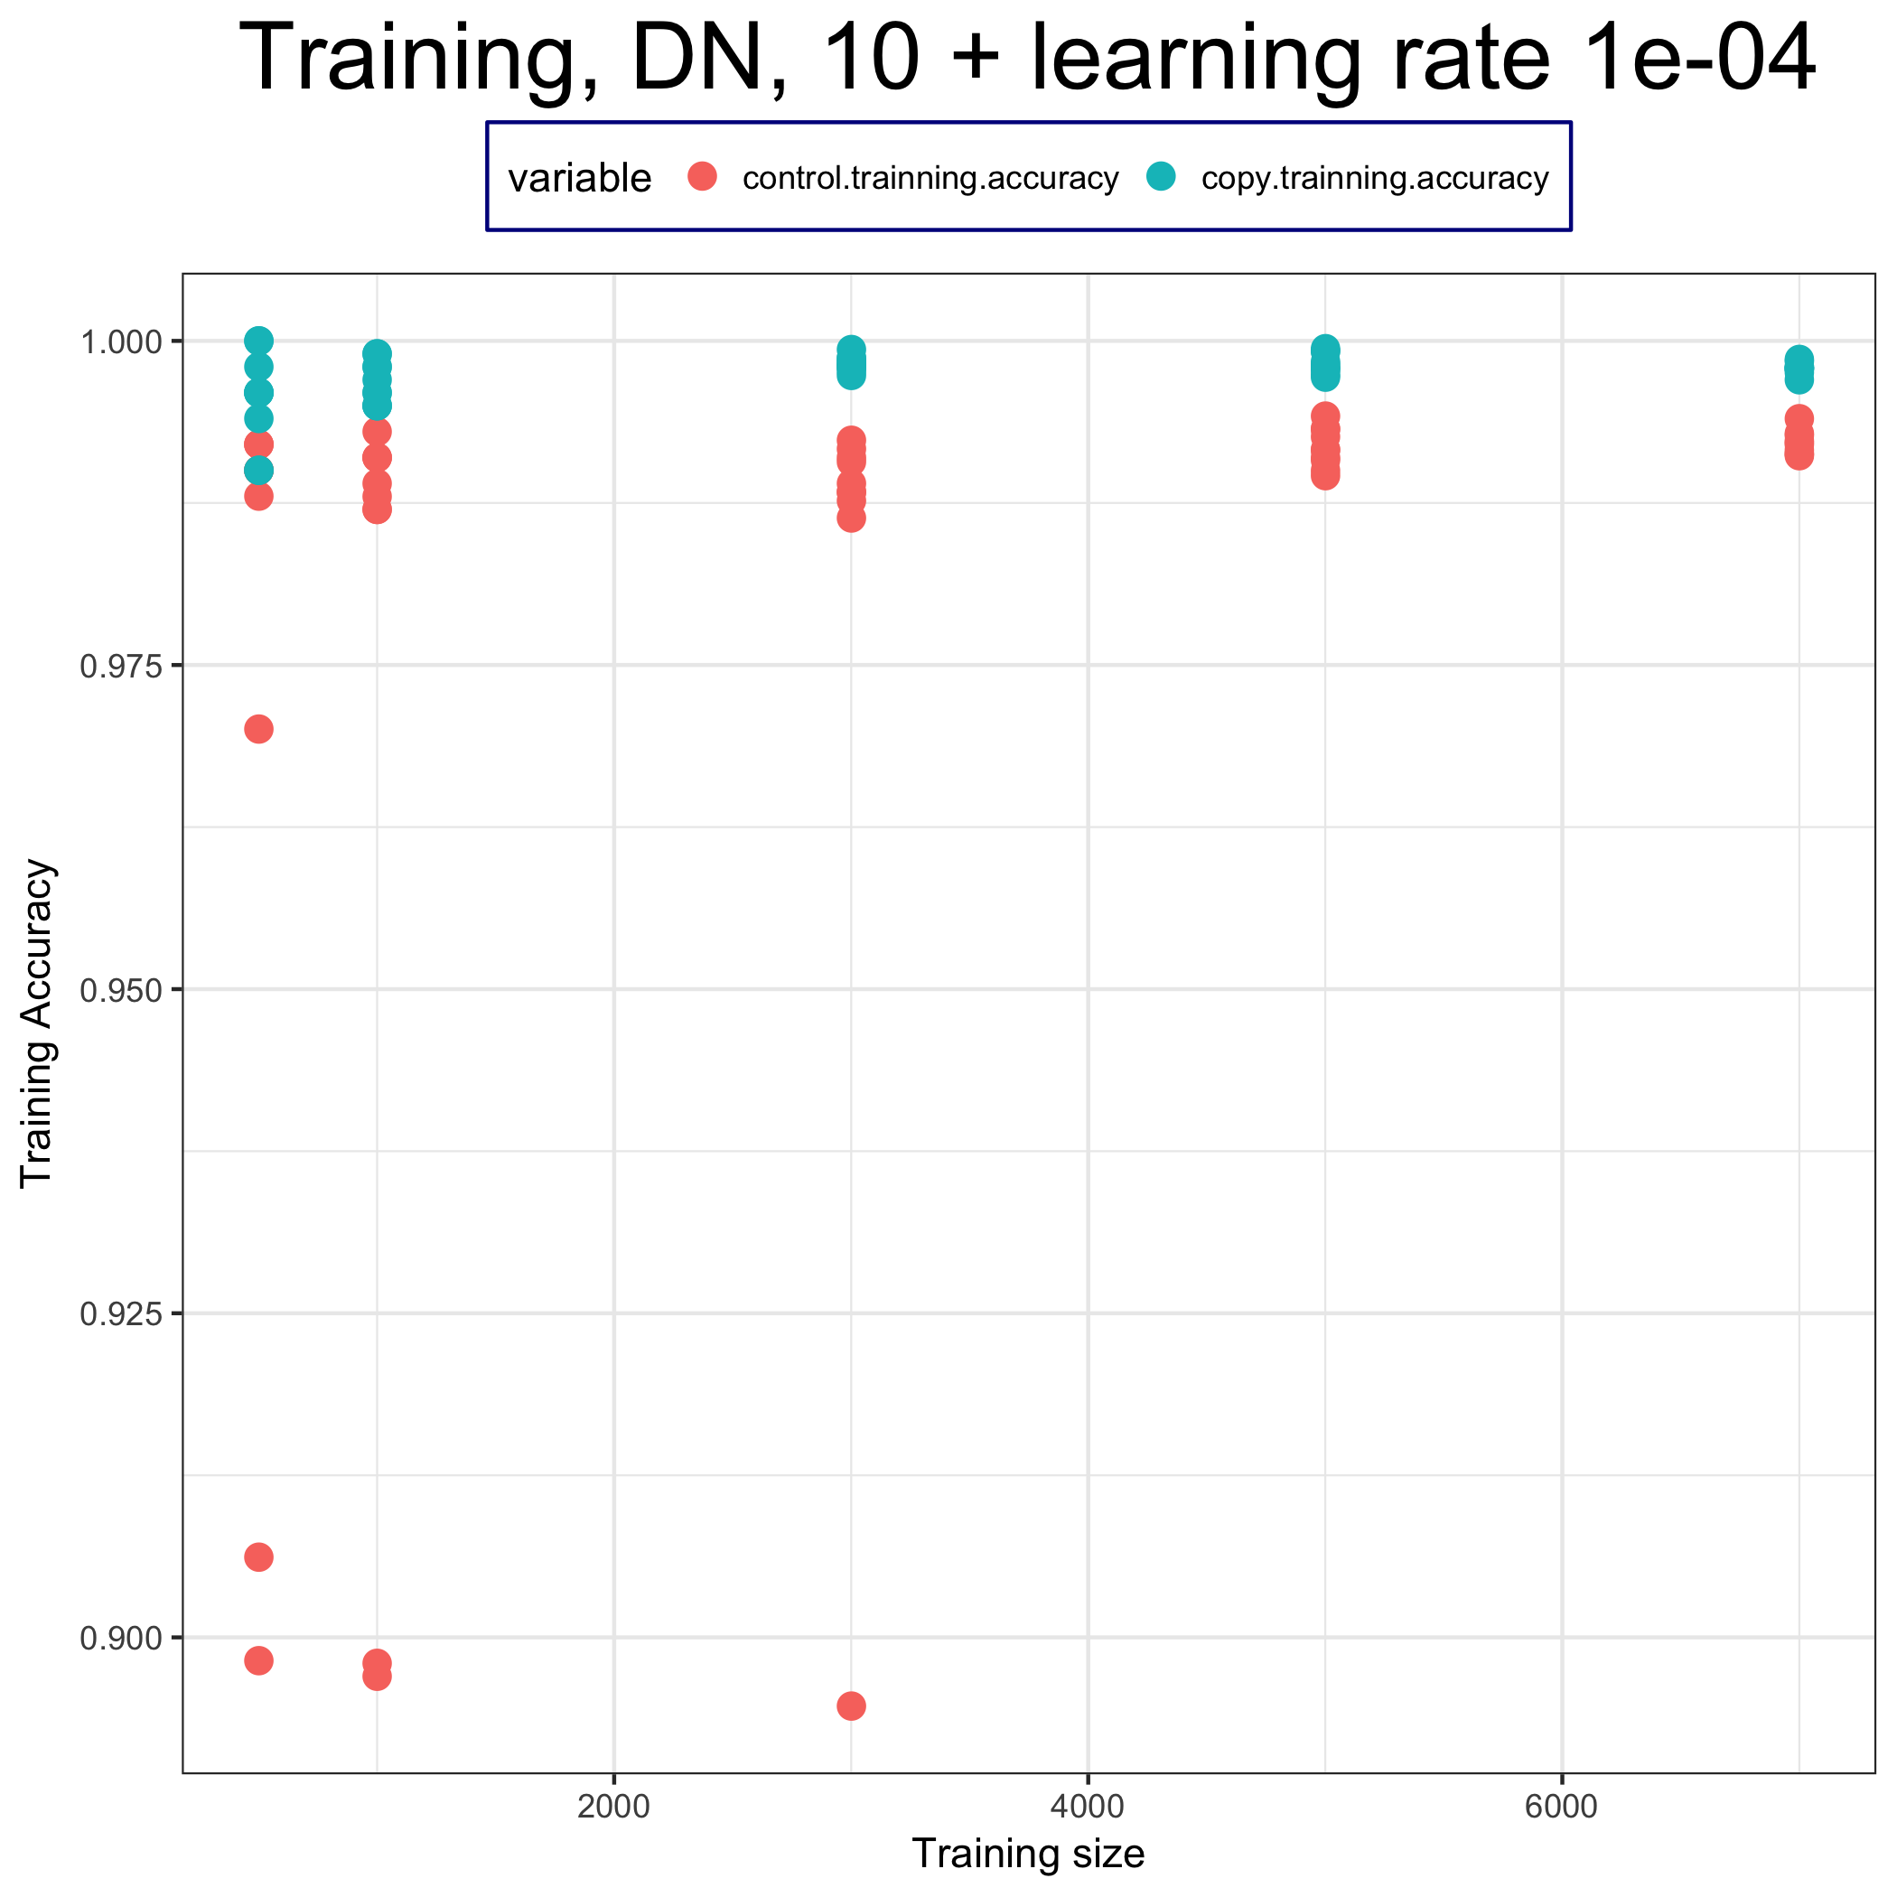
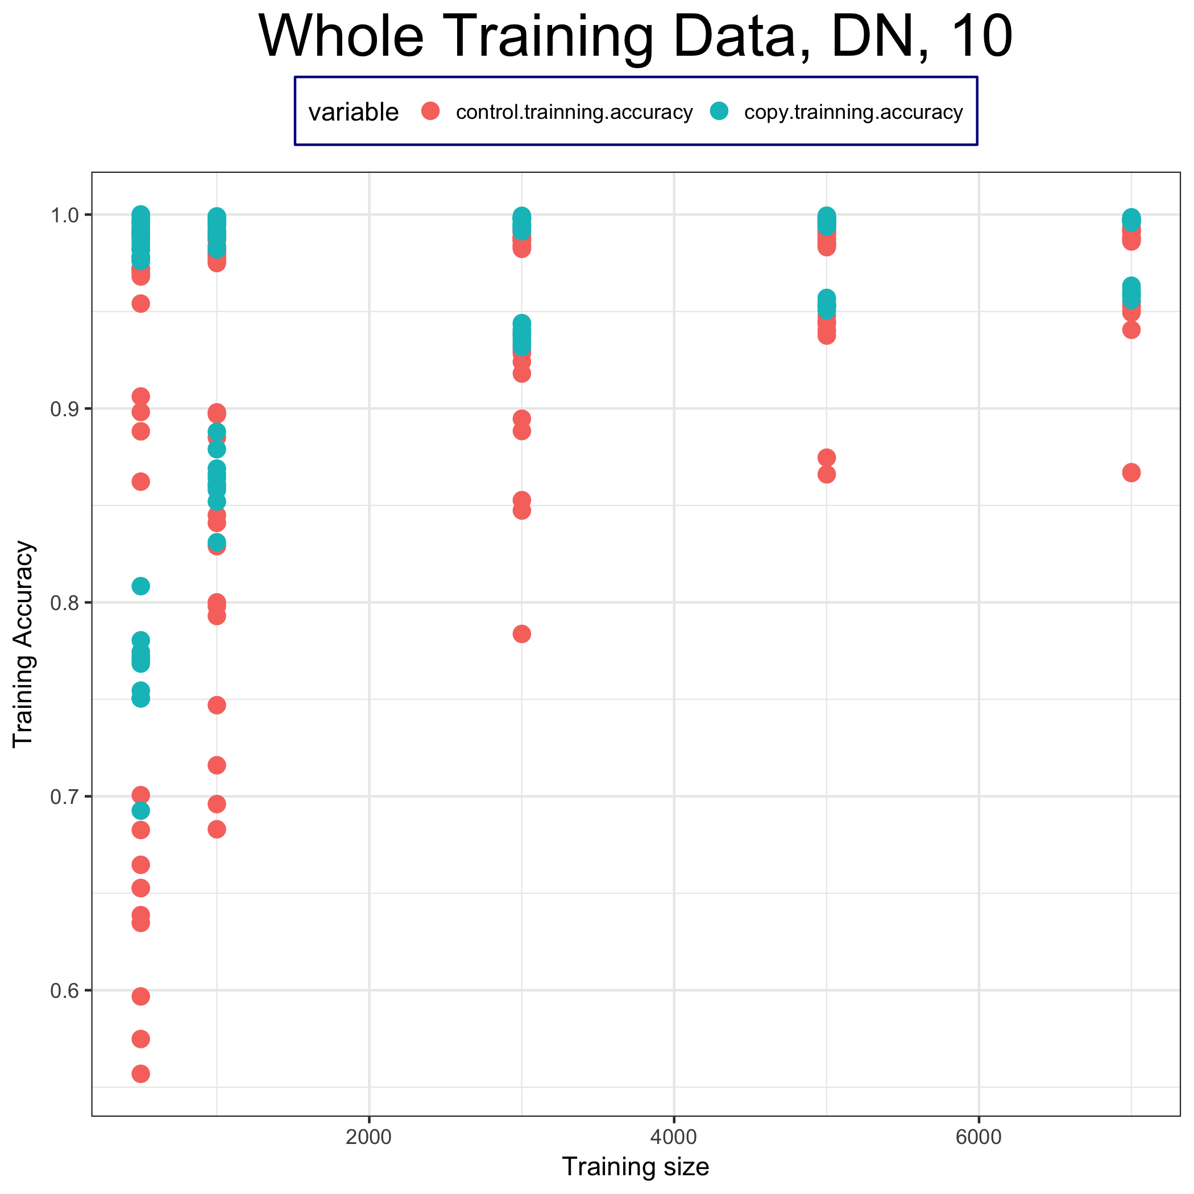
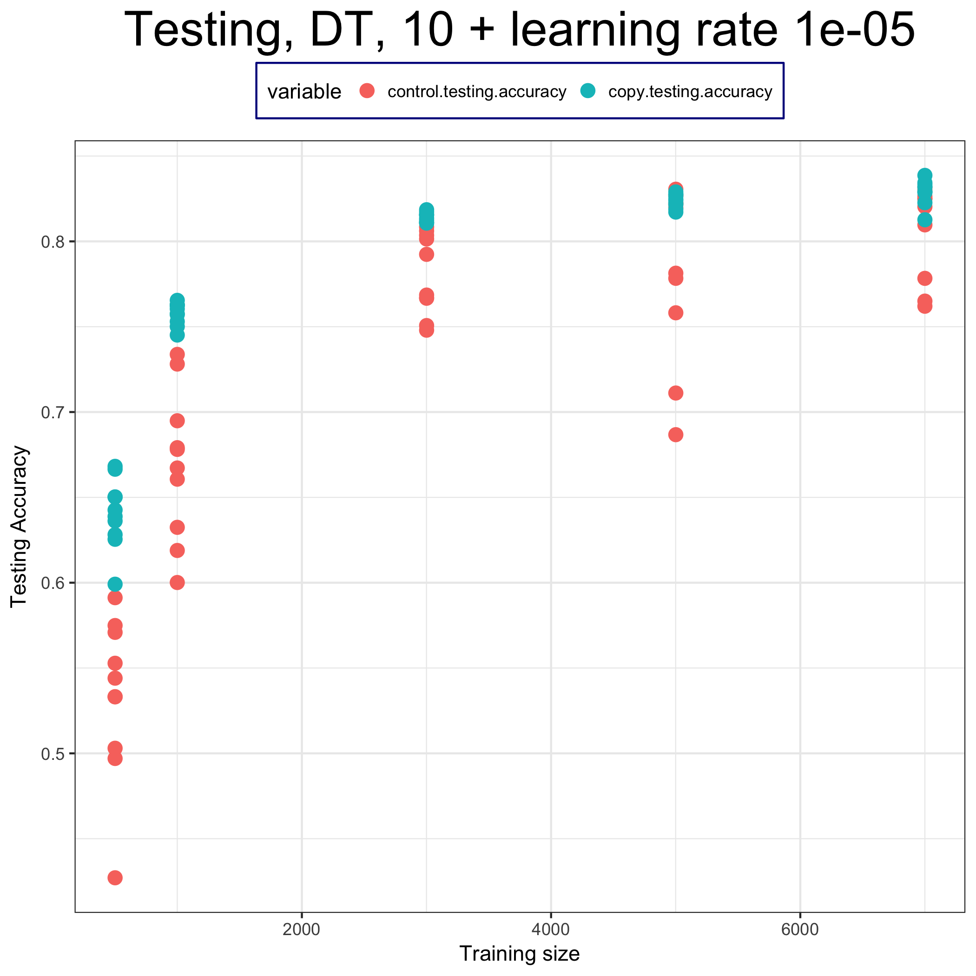
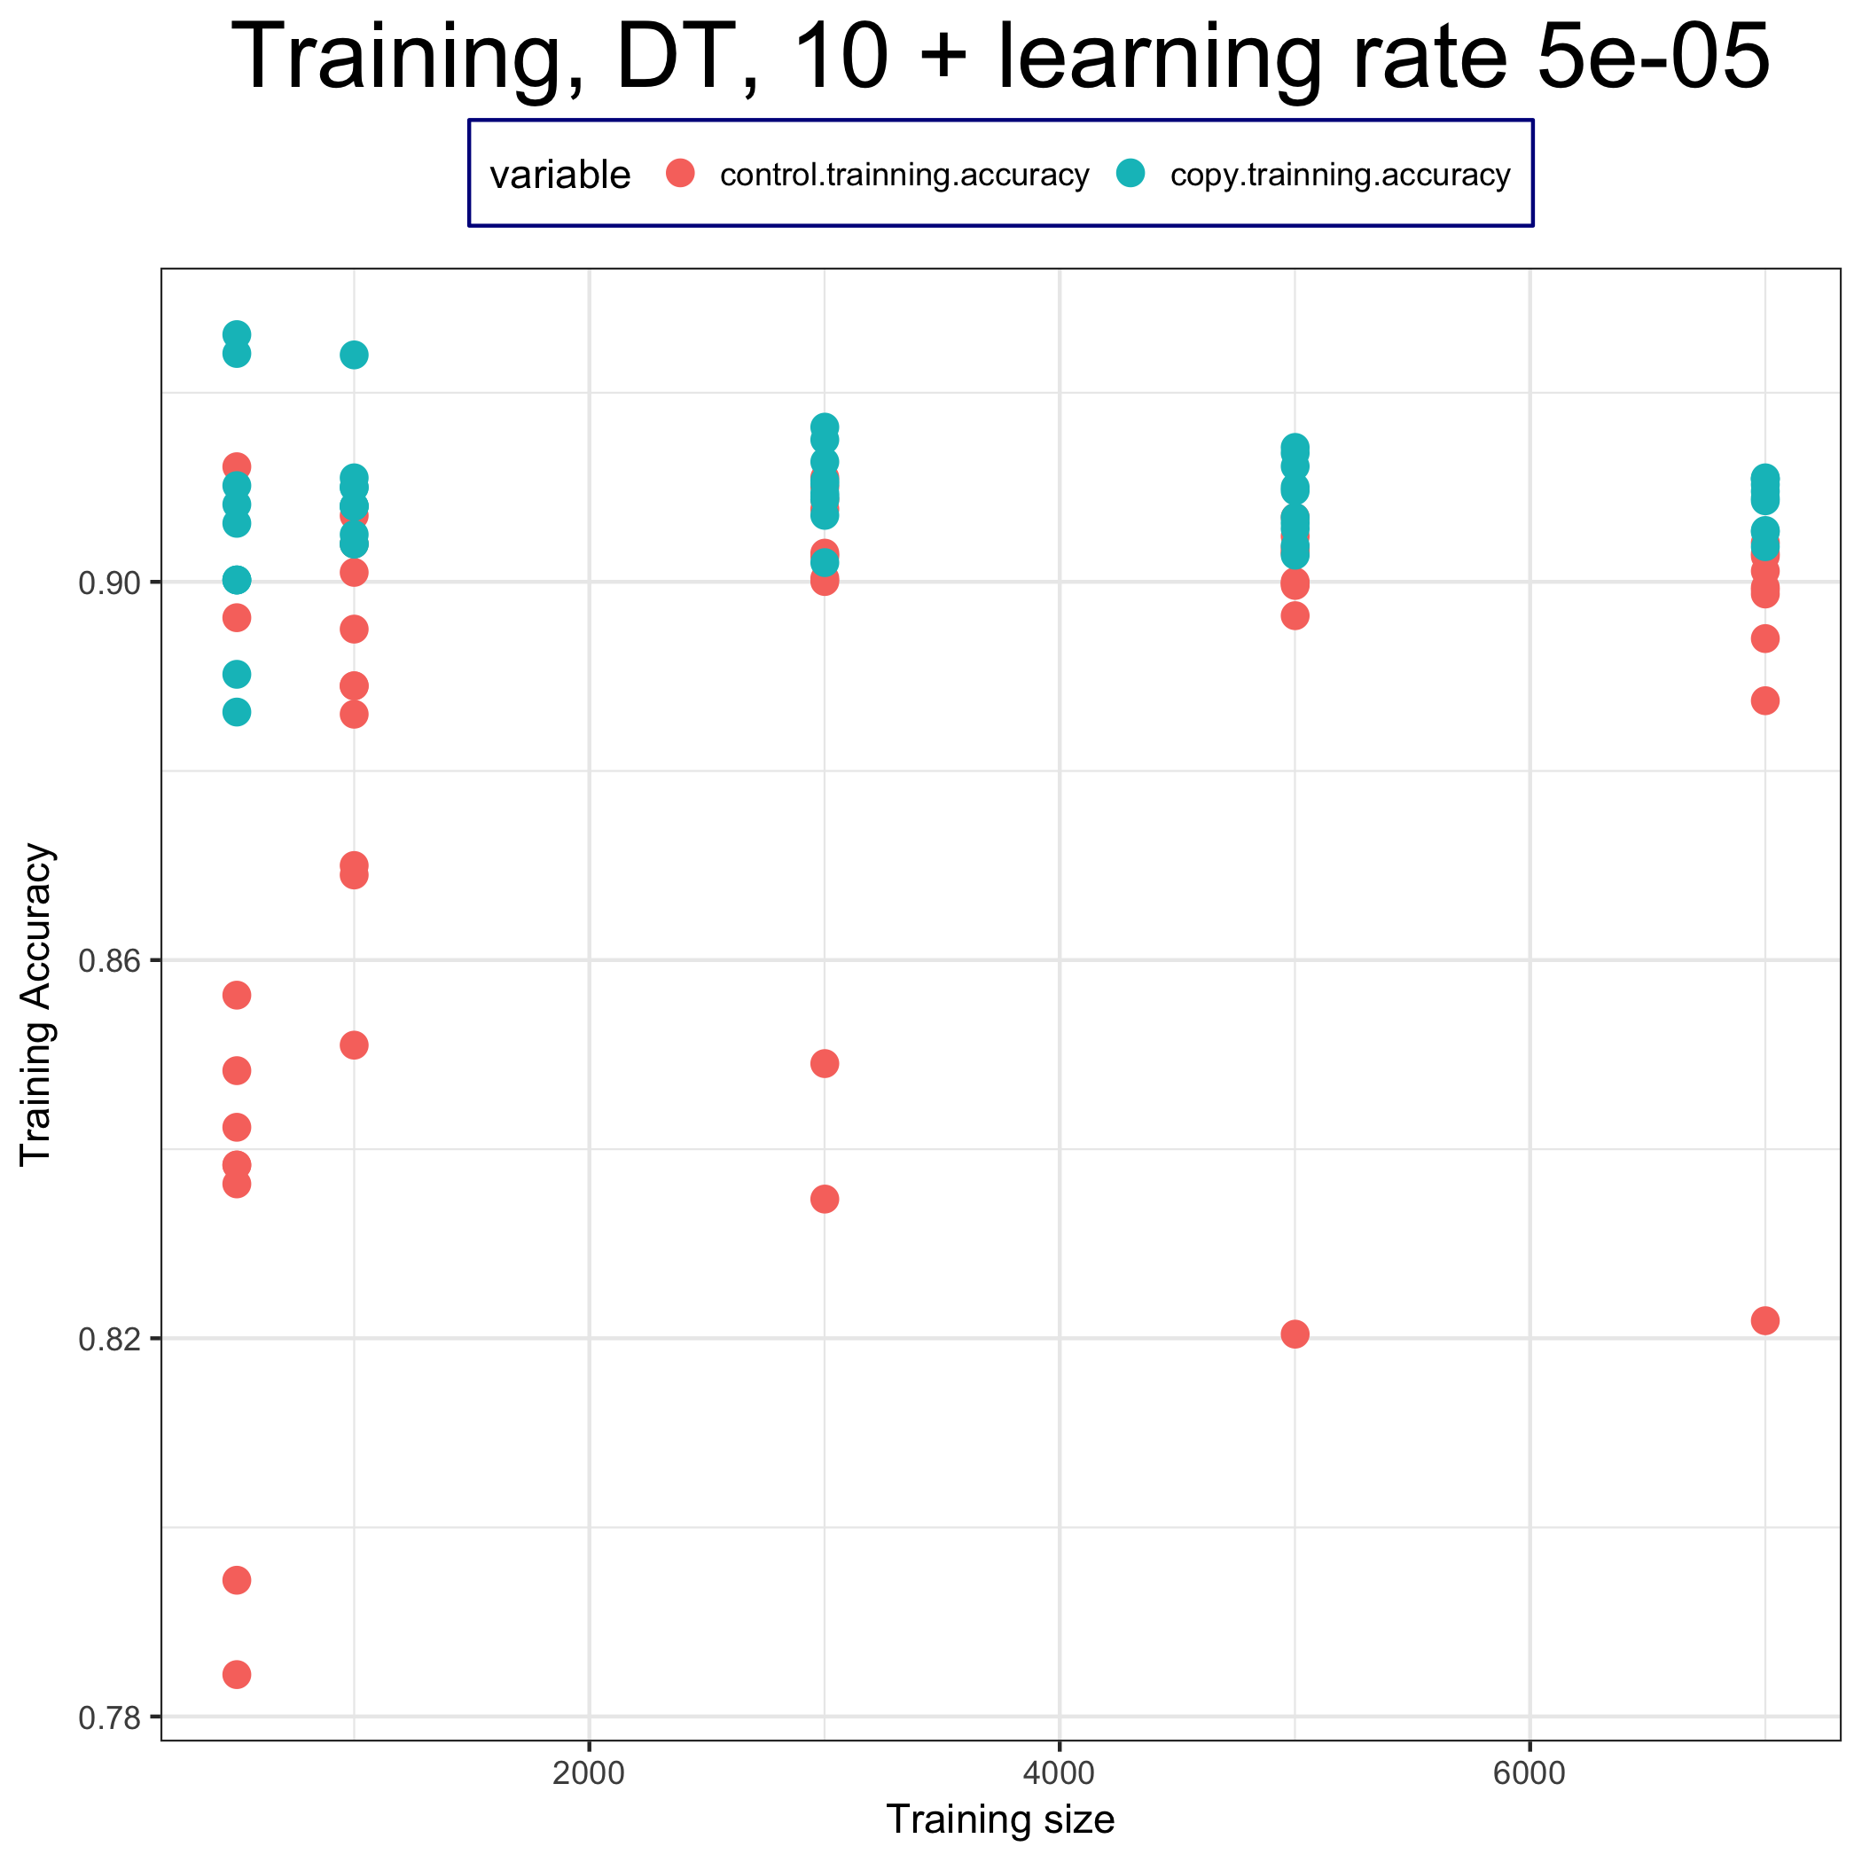
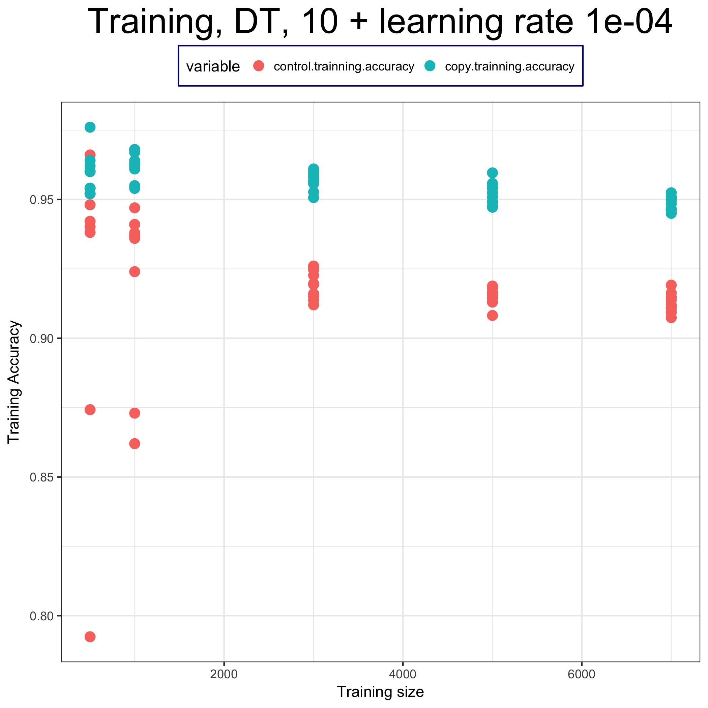
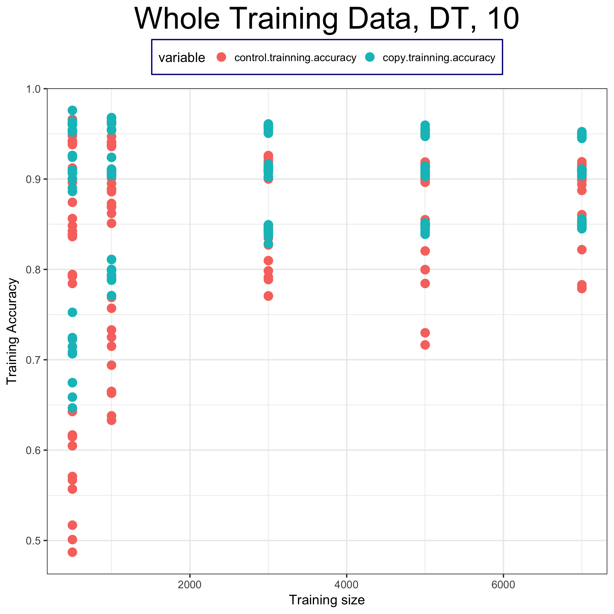
Training accuracy

Slide 12
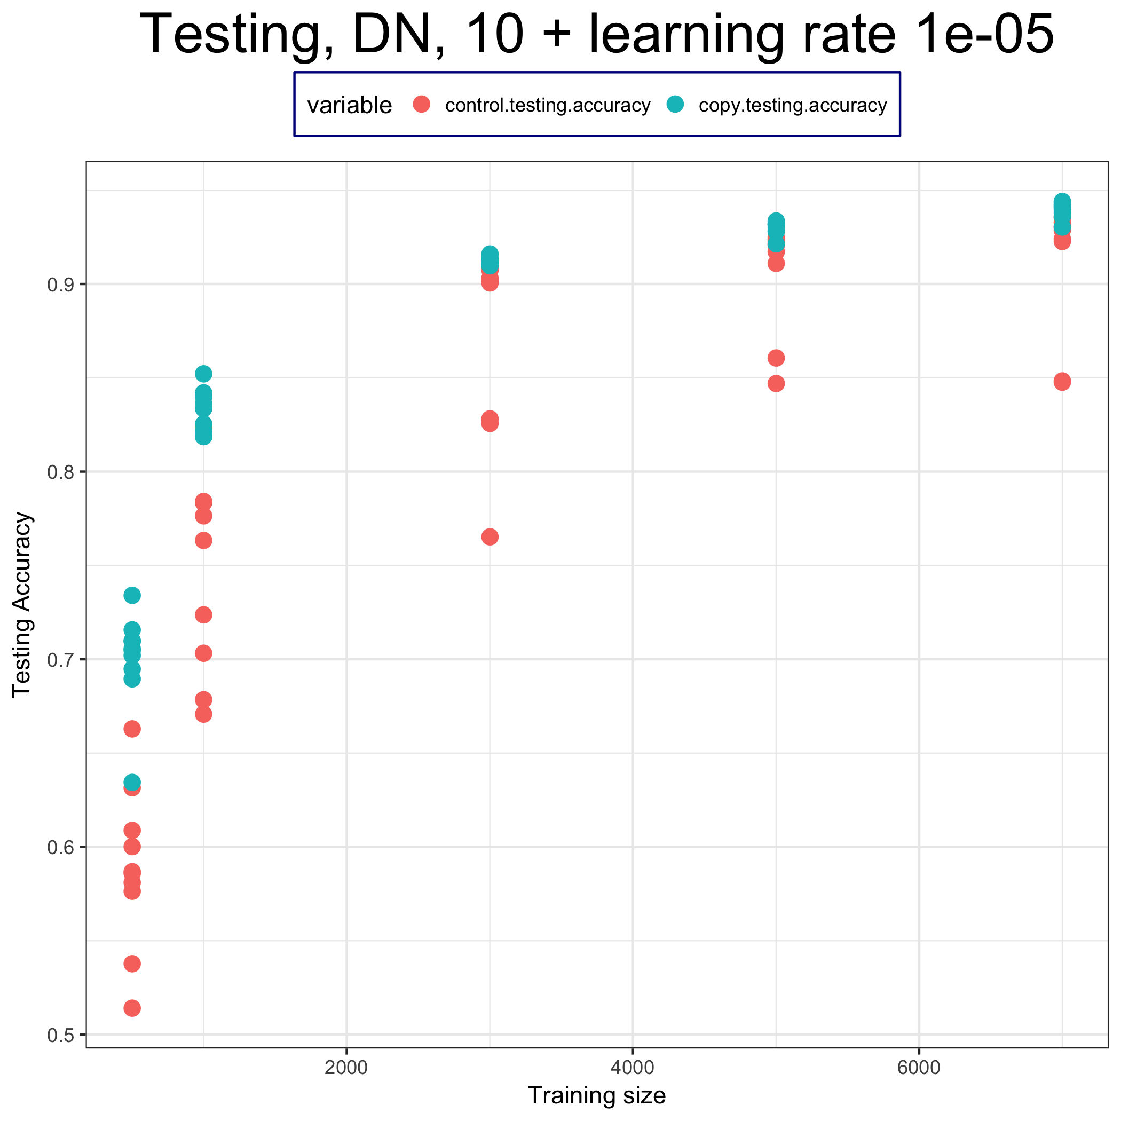
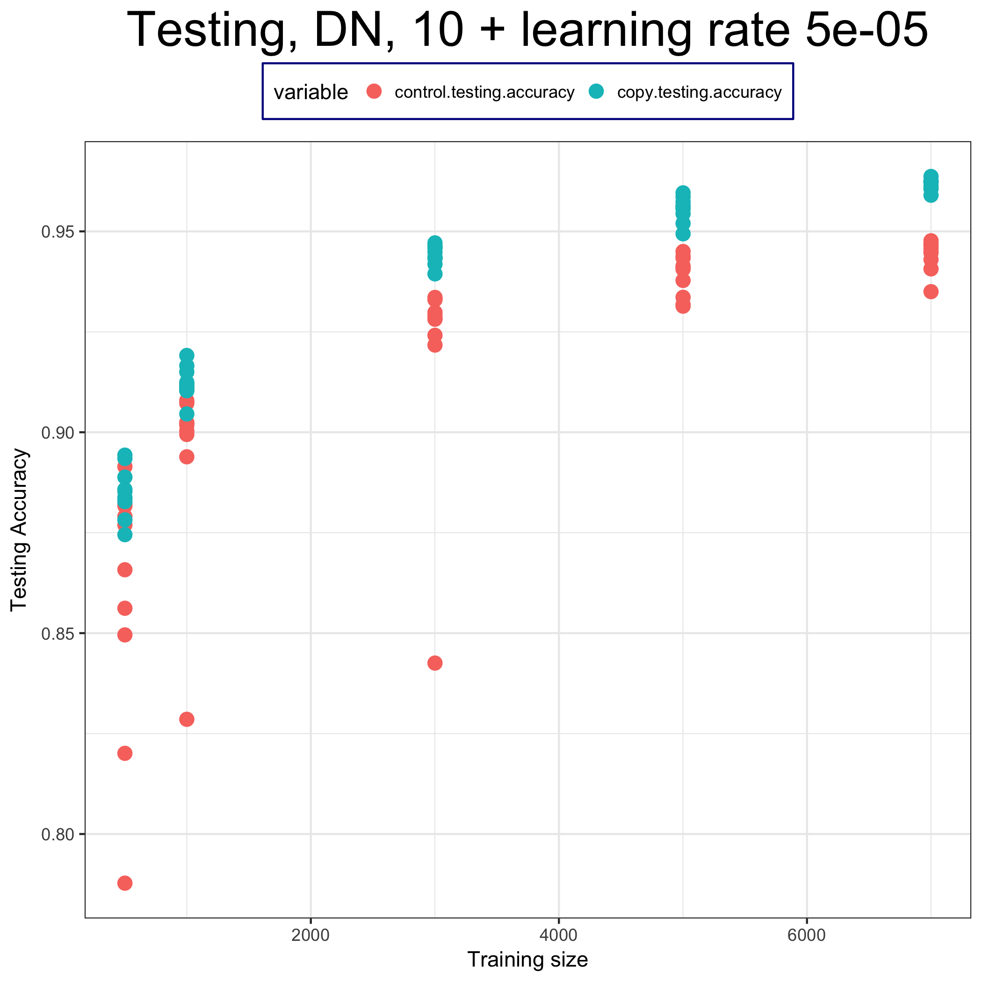
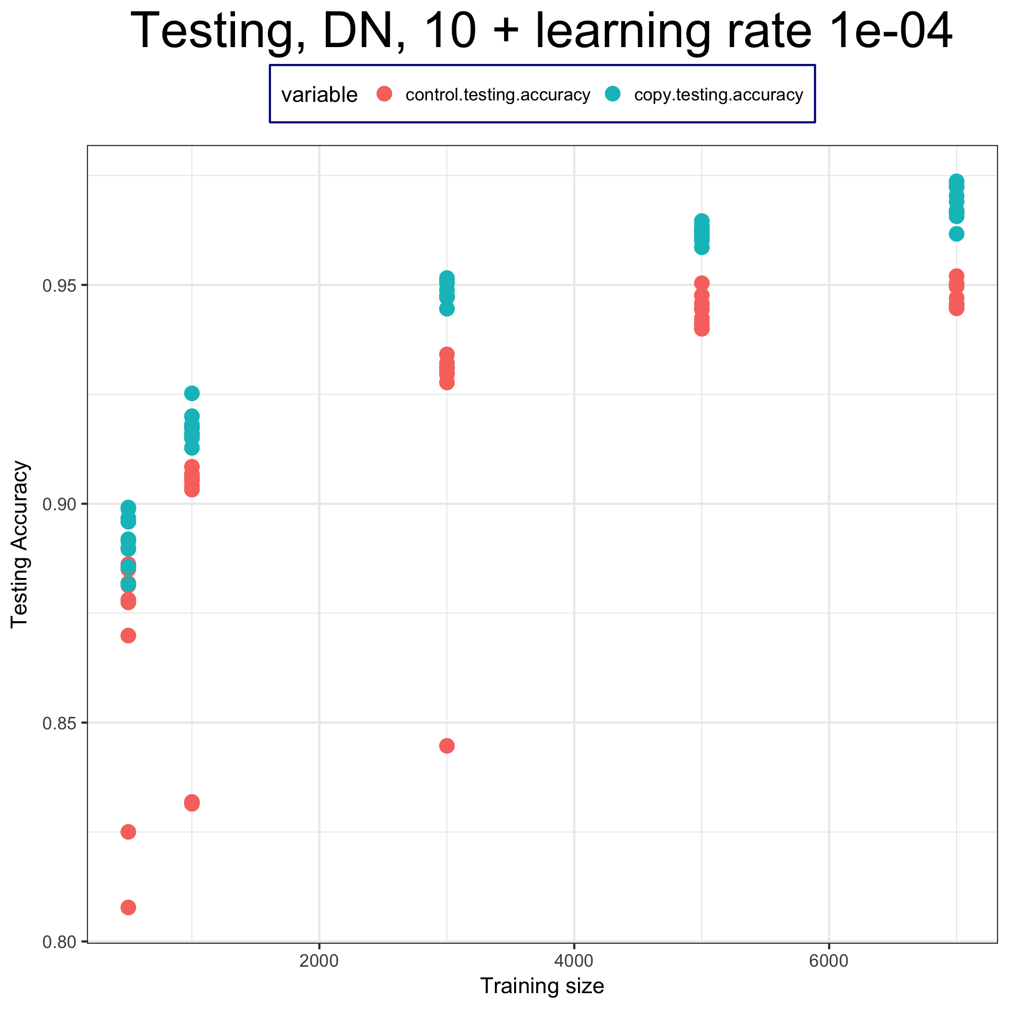
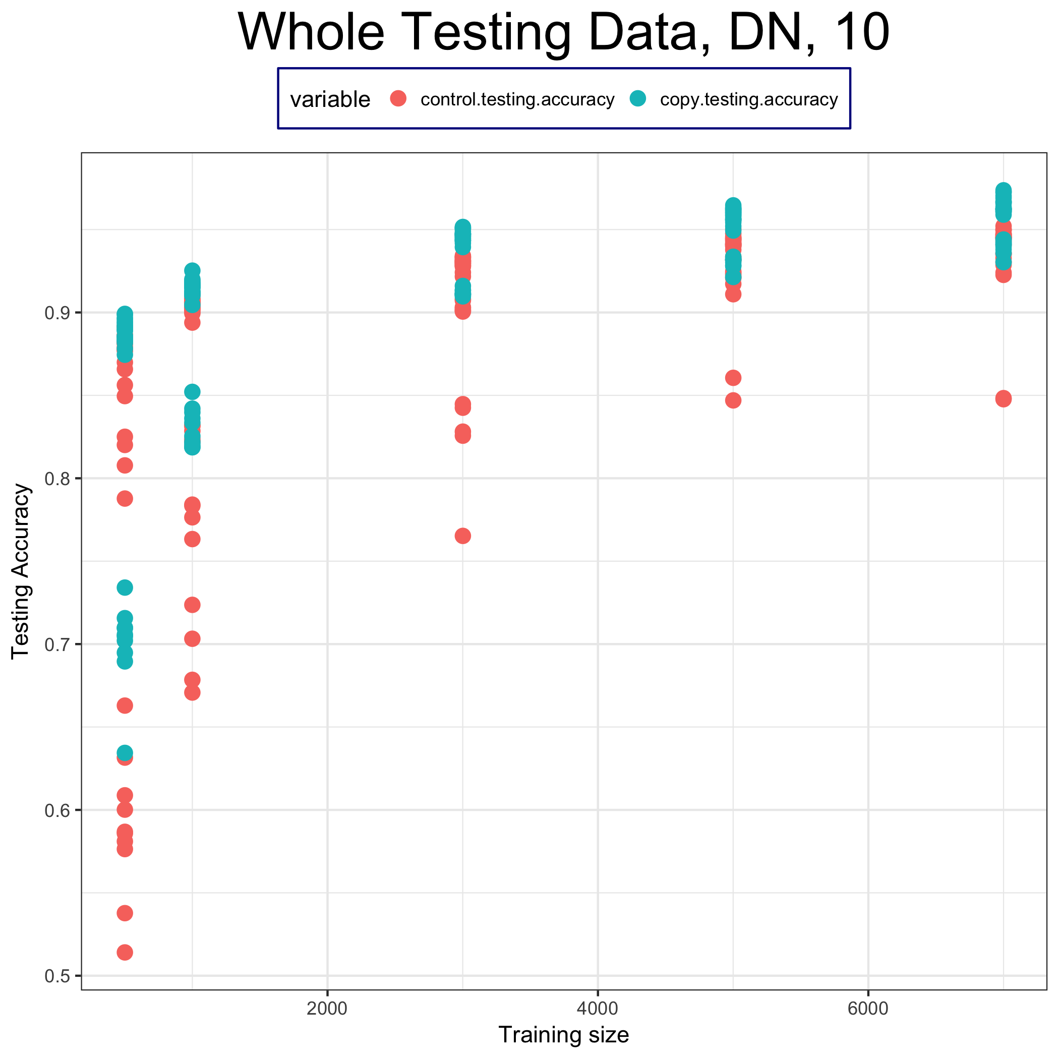
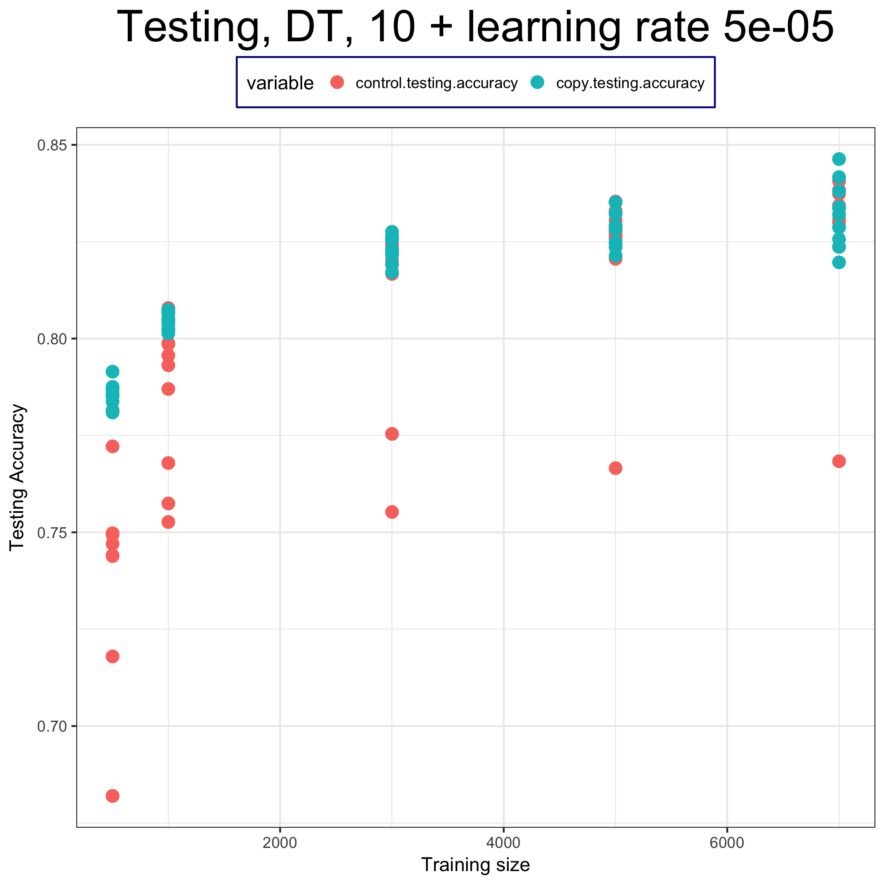
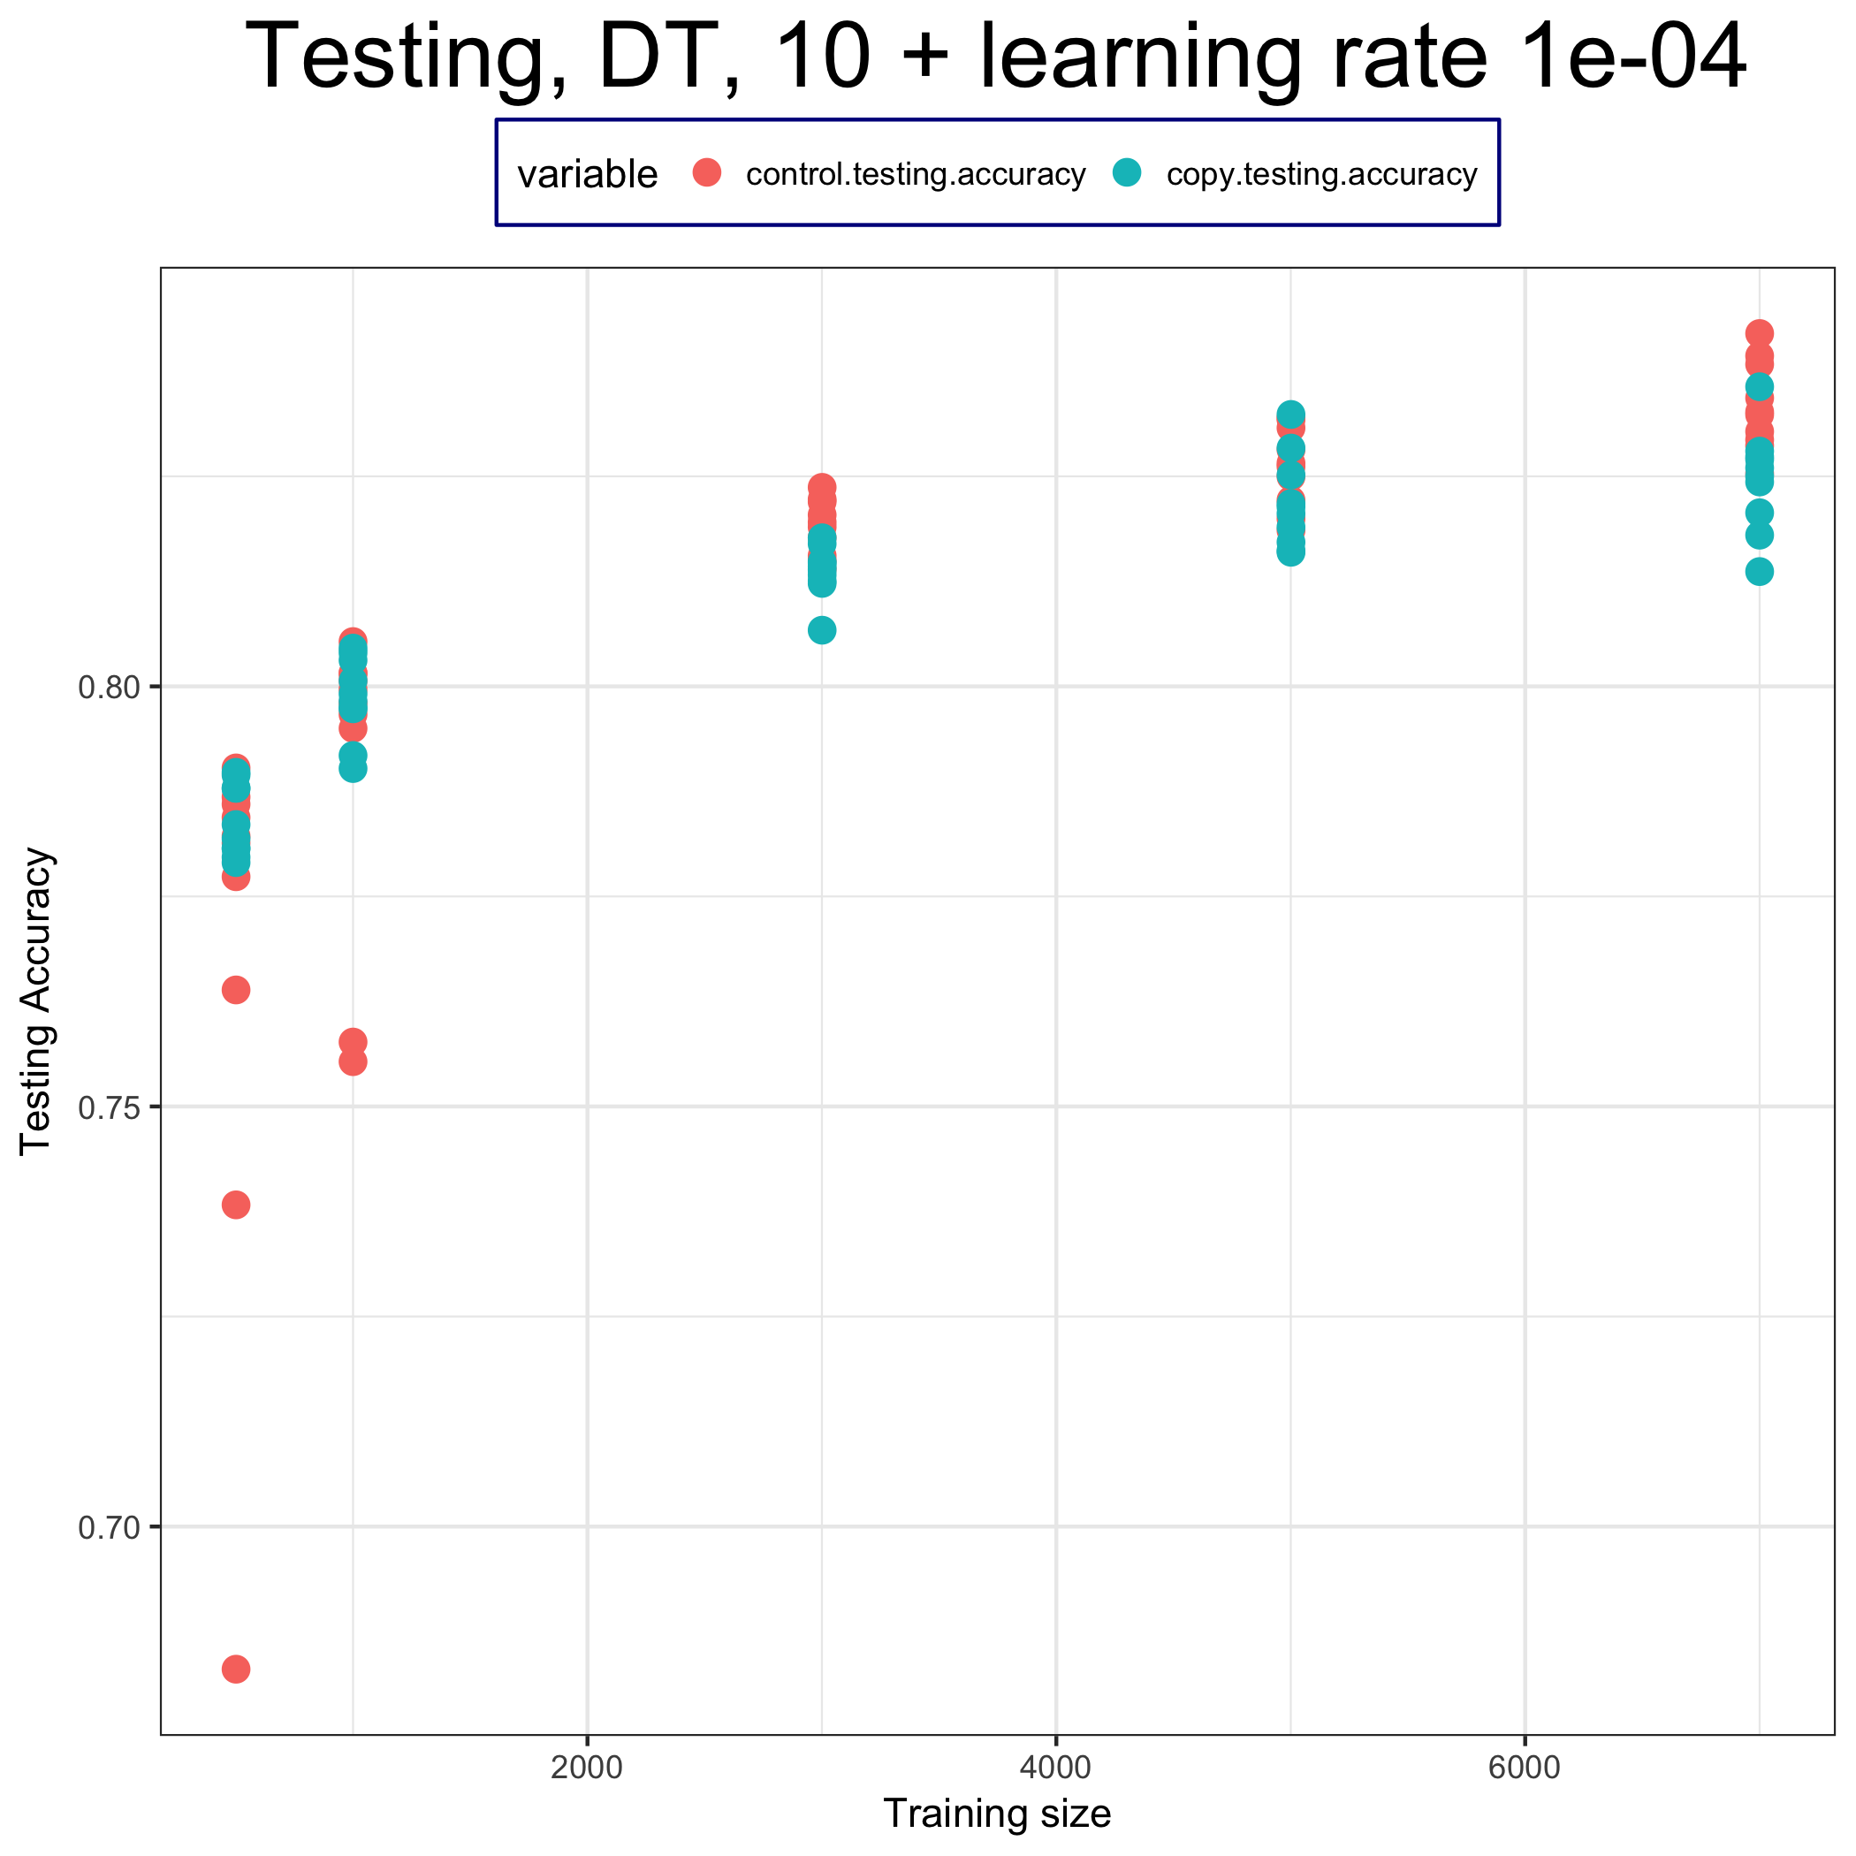
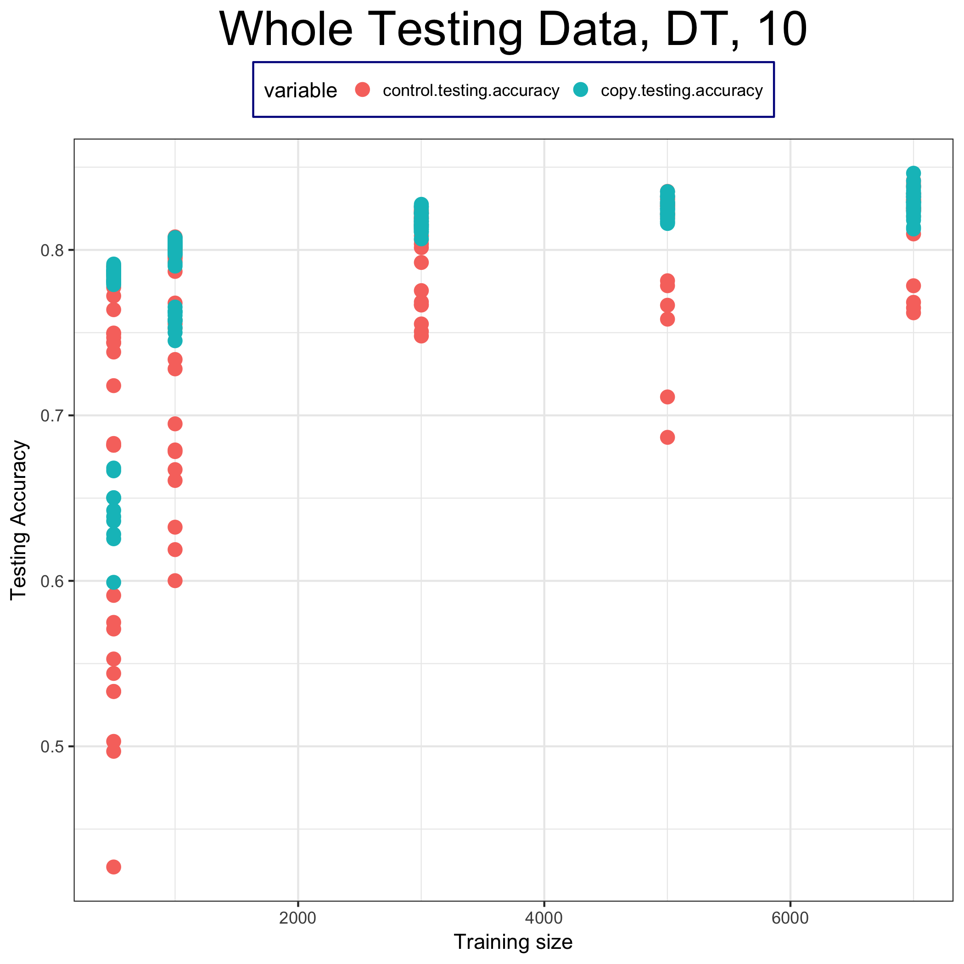
Testing Accuracy

