Slide 1
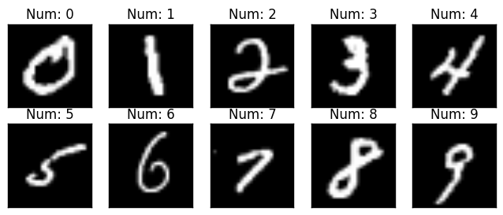
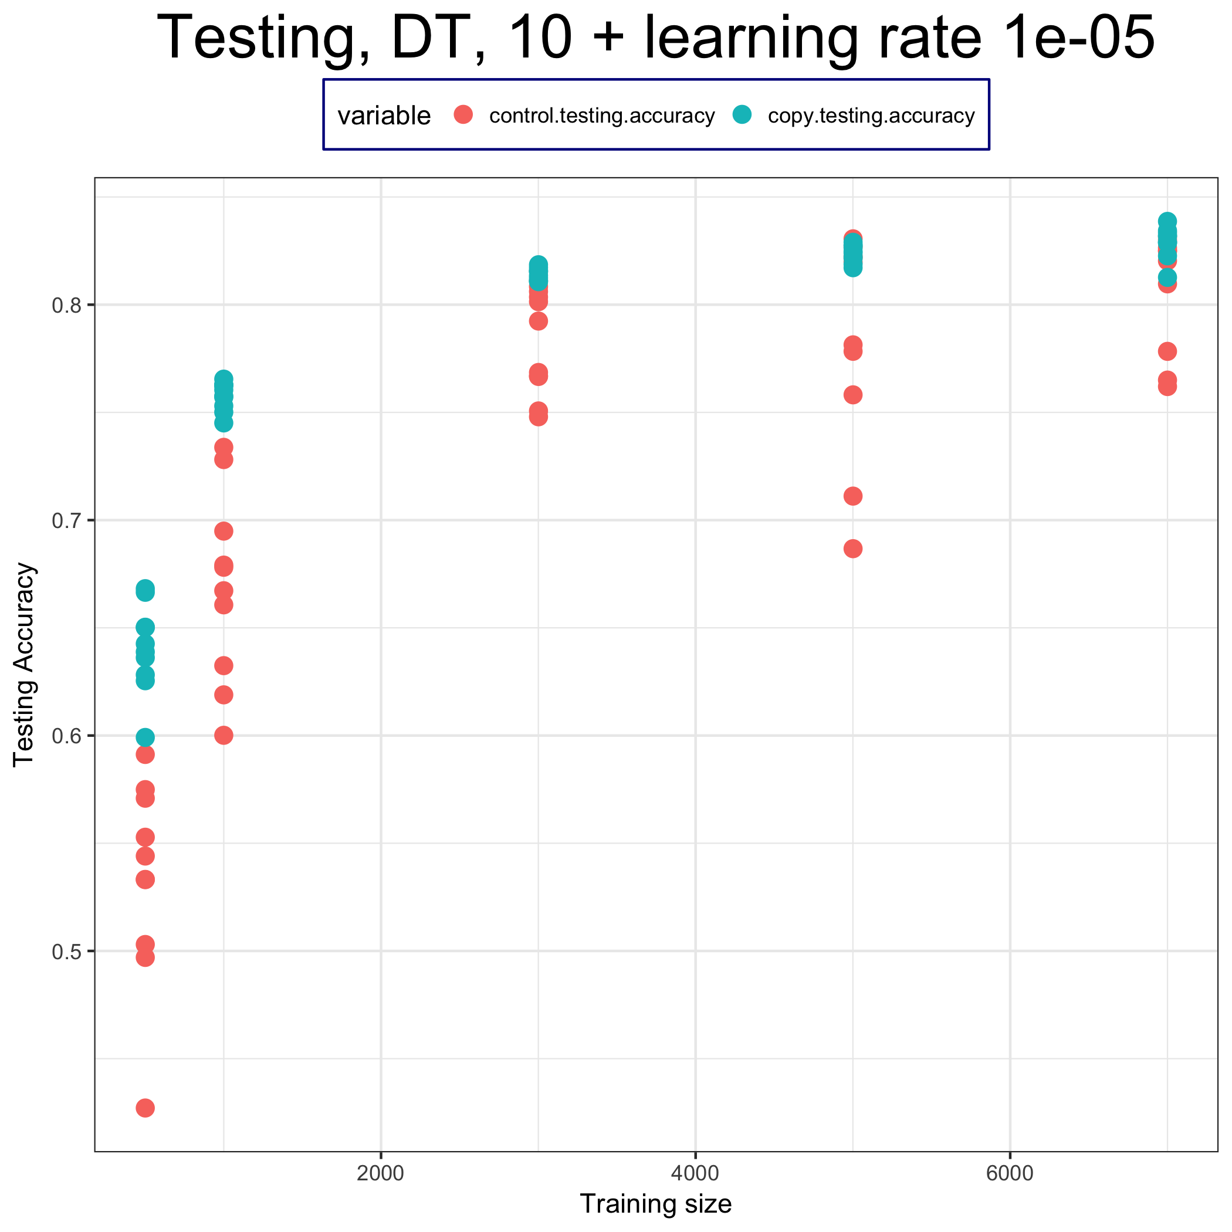
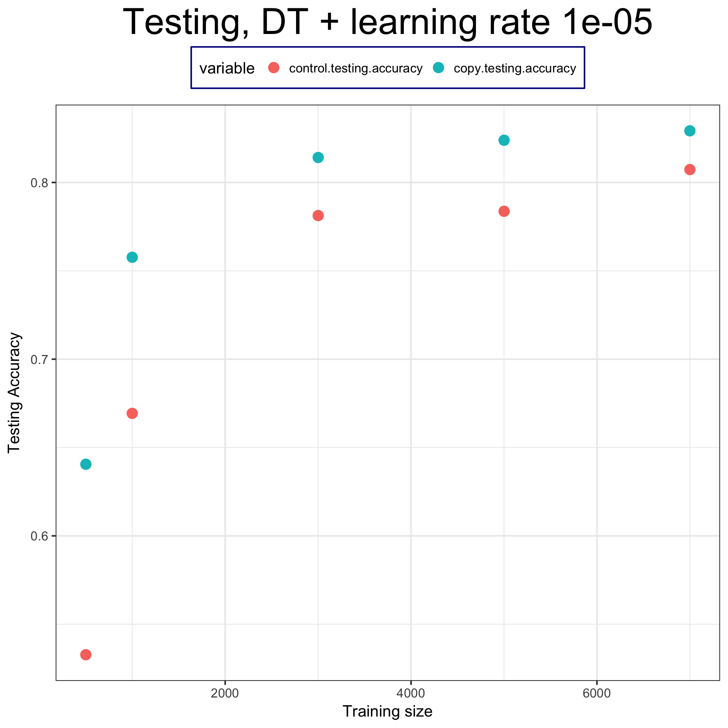
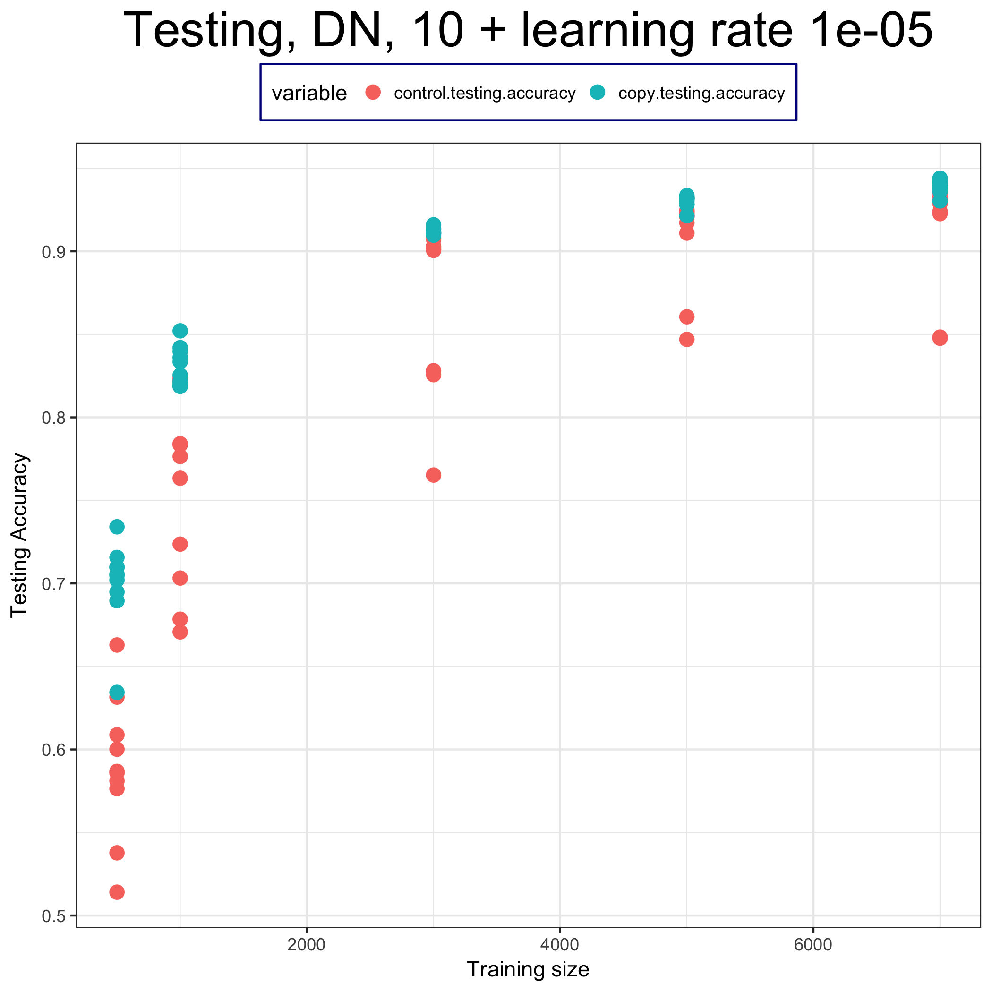
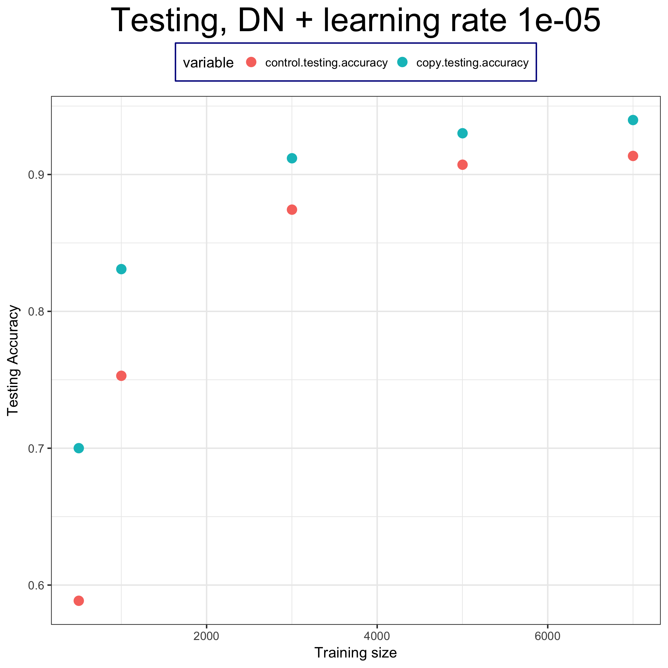
網路多媒體實驗：Using model output to steal model from Machine Learning-as-a-Service platform
組員：林承德、趙冠豪、李羚毓 指導助教：曾煒傑 指導老師：林宗男教授
1. Aim：
Step2 & Step3 : Steal Model & Testing
Implement the method in ”Stealing Machine
Learning Models via Prediction APIs” to steal model.
Training Data
Size : 500、1000、3000、5000、7000、9000
2) Try to steal different kinds of models using
neural network.
Model
Optimizer
Adam
Learning rate : 1e-5, 5e-5, 1e-4
Fully-Connected（784x100）
2. Introduction：
ReLU
Back
propagation
Fully-Connected（100x100）
Loss
Data：MNIST dataset
ReLU
Loss function
Control Model : CrossEntropy
Copy Model : BCEloss
Workflow：
Fully-Connected（100x10）
Choose Target Model
Softmax
Prediction for Stealing
Control Model : label from target model
Copy Model : probability of each data given by target model
Testing (Evaluate the result)
4.Results
3. Implementation：
Decision Tree :
Step1 – BigML Model Creation：
Upload data to BigML
Train Model
Deepnet
Decision Tree
Deepnet :
Target Model Available
Local :
Model parameters
BigML Server :
Available for prediction
Step2 & Step3 : Steal Model & Testing
( X_training_data )
Target model (pre-trained)
5. Conclusion
( Y_target_probability , Y_target_label )
1. In different training size, learning rate with fixed loss function, BCEloss as well as 200 epoch, the precision of copy model is higher than control model
train
train
2. Neural Network is a good way to steal both decision tree model and deepnet model created by BigML.
Copy Model
Control Model
Accuracy Evaluation (vs Target Model)
3. The precision of copy model is higher than control model in limited training data (about 10% higher).

