Slide 1
利用model output 偷取 Machine Learning-as-a-Service 平台 model
網路多媒體實驗

Slide 2
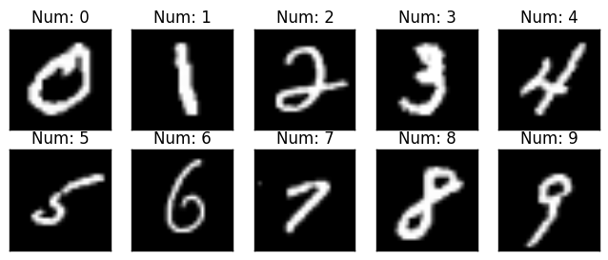
Motivation
classes | 0 | 1 | 2 | 3 | 4 | 5 | 6 | 7 | 8 | 9
label | 0 | 1 | 0 | 0 | 0 | 0 | 0 | 0 | 0 | 0
probability | 0.005 | 0.8 | 0.005 | 0.005 | 0.005 | 0.005 | 0.005 | 0.16 | 0.005 | 0.005

Slide 3
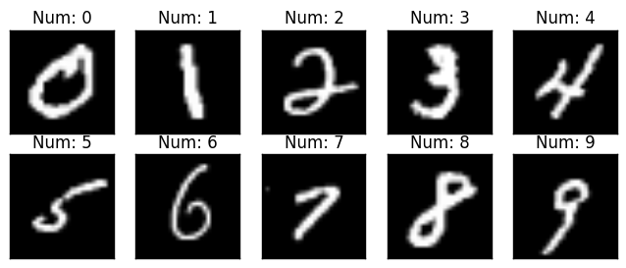
Datasets
MNIST 資料集

Slide 4
Choose Target Model
Prediction for Stealing
Testing (Evaluate the result)

Slide 5
Target Model 建立
Upload data to BigML
Train Model
Deepnet
Decision Tree
Ensemble
Target Model Available
Local :
Model parameters
BigML Server :
Available for prediction

Slide 6
Copy Model VS Control Model
( X_copy_testing, Y_copy_training_label )
Target model (pre-trained)
Y_copy_training_probability
train
train
Copy Model
Control Model
Accuracy Evaluation (vs Target Model)

Slide 7
Trainning of Contorl/Copy Model
Training Data
Size : 100、200、500、1000、2000、5000、7000
Model
Fully-Connected（784x100）
Optimizar
Adam
Learning rate : 1e-5, 5e-5, 1e-4
ReLU
Back
propagation
Fully-Connected（100x100）
Loss
ReLU
Loss function
Control Model : CorssEntropy
Copy Model : BCEloss, MSELoss
Fully-Connected（100x10）
Softmax
Control Model : label of each data
Copy Model : probability of each data given by target model

Slide 8
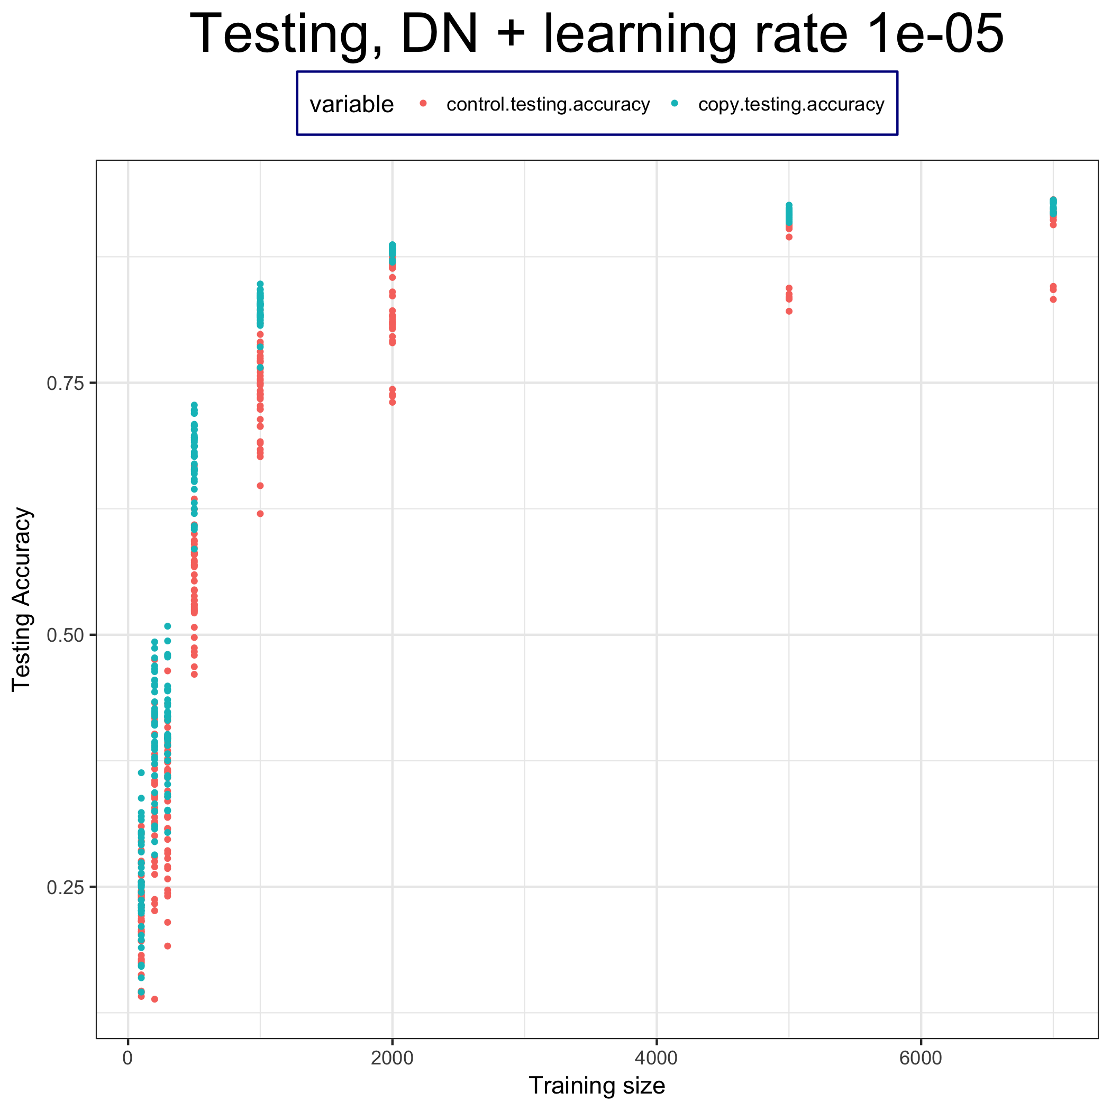
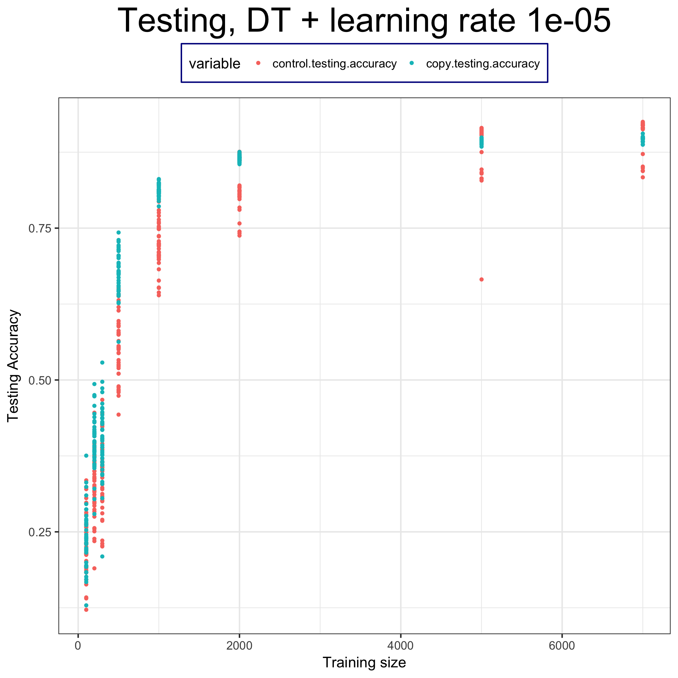
Conclusion

Slide 9
Thanks for your listening

Slide 10
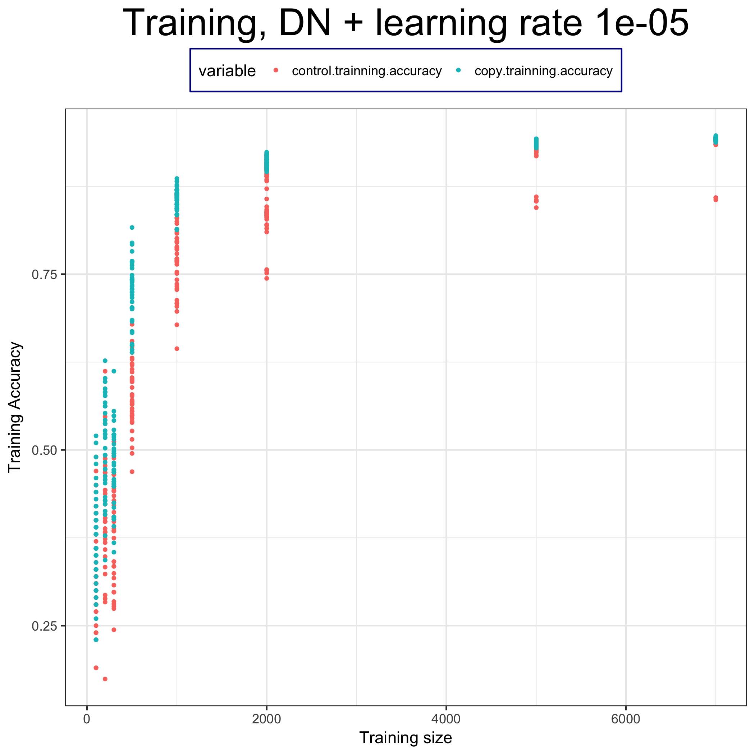
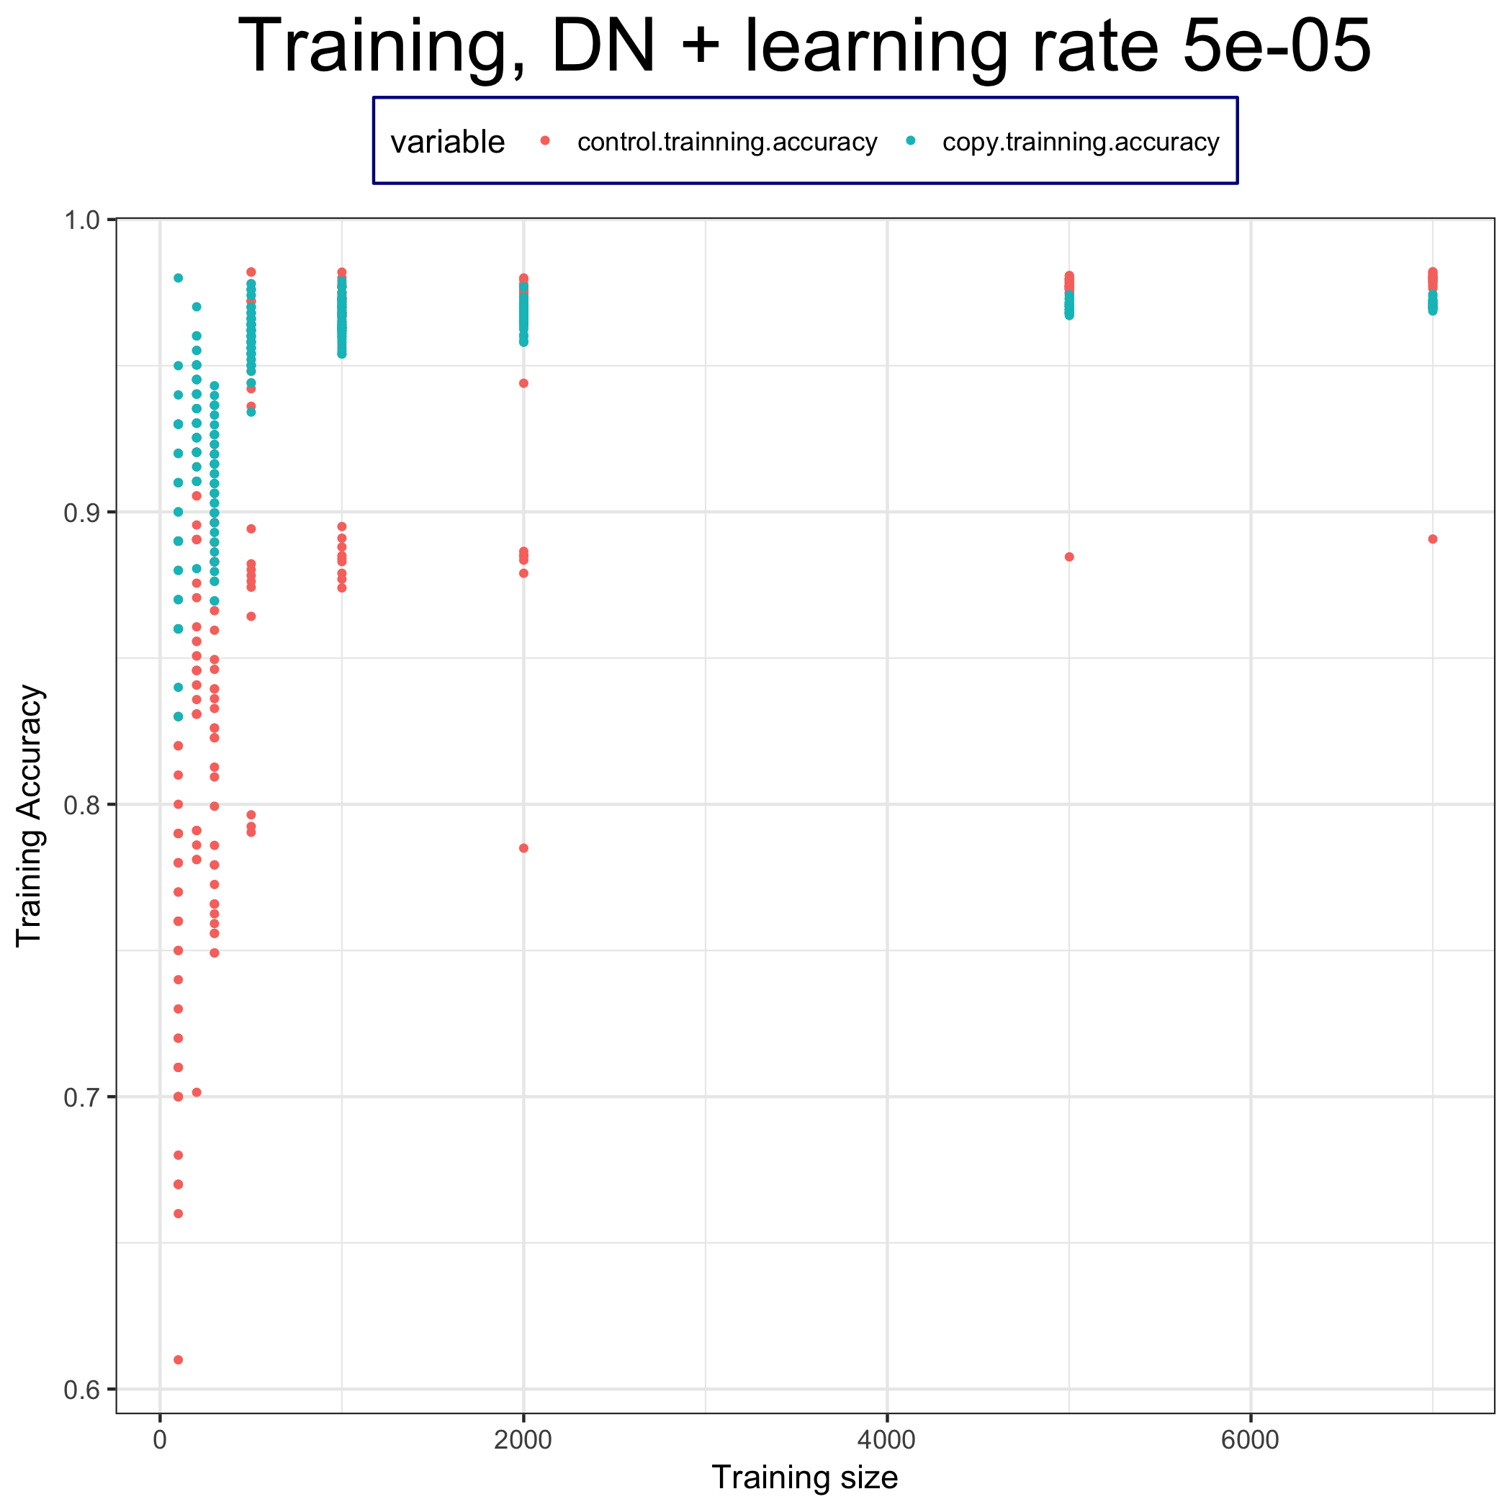
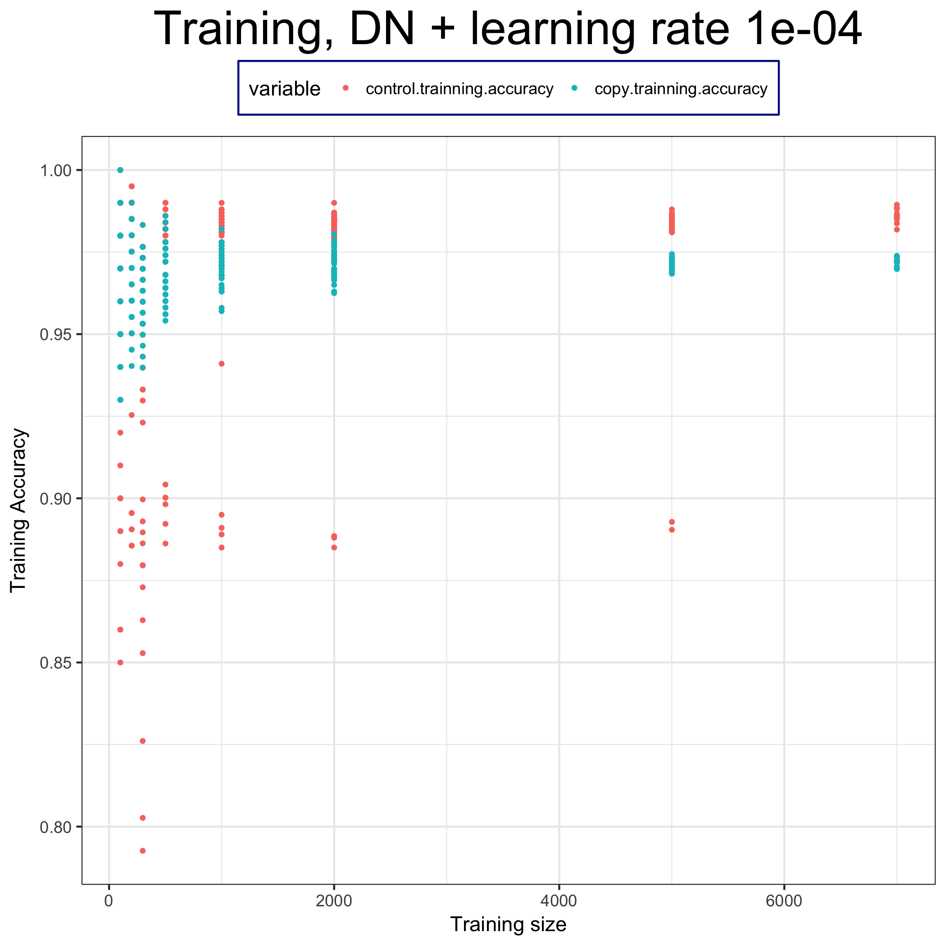
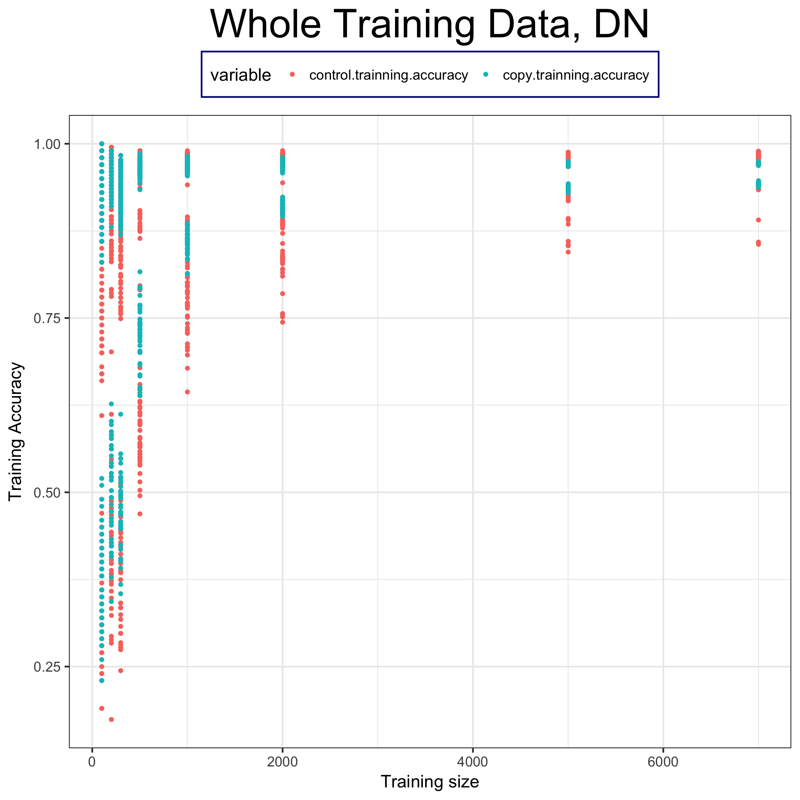
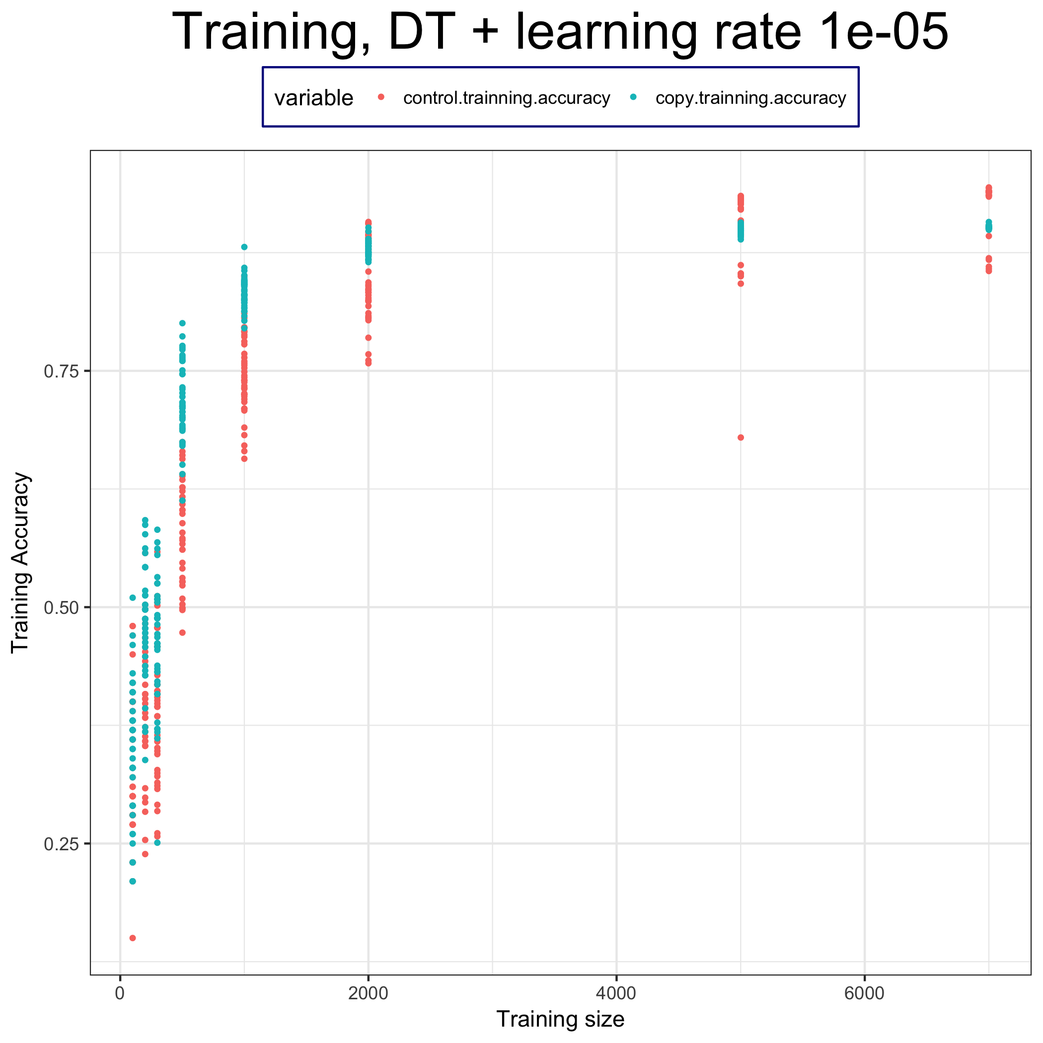
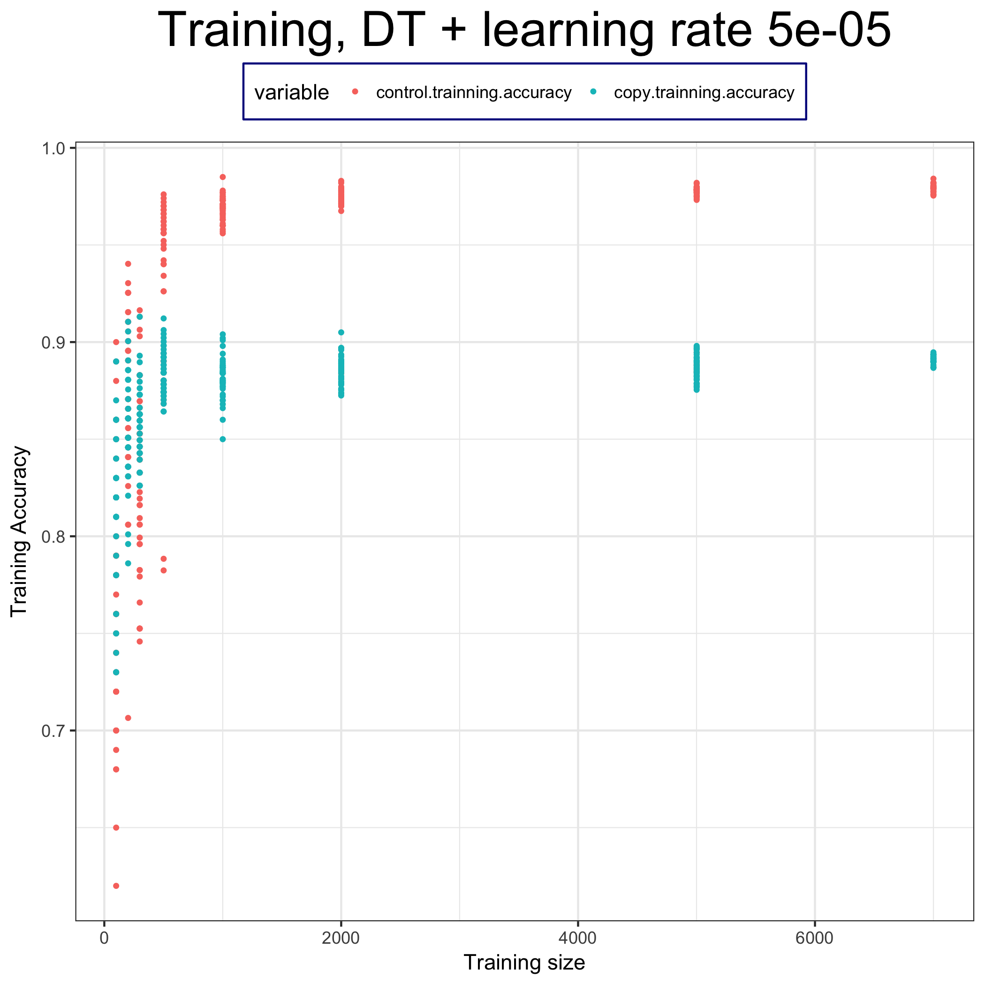
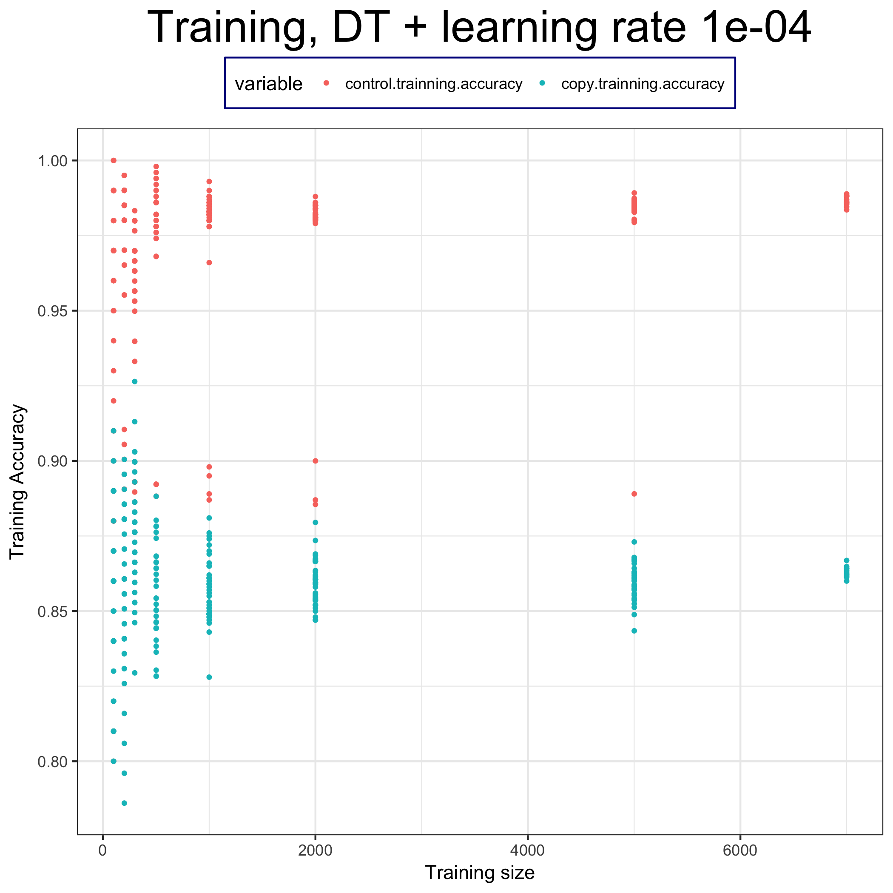
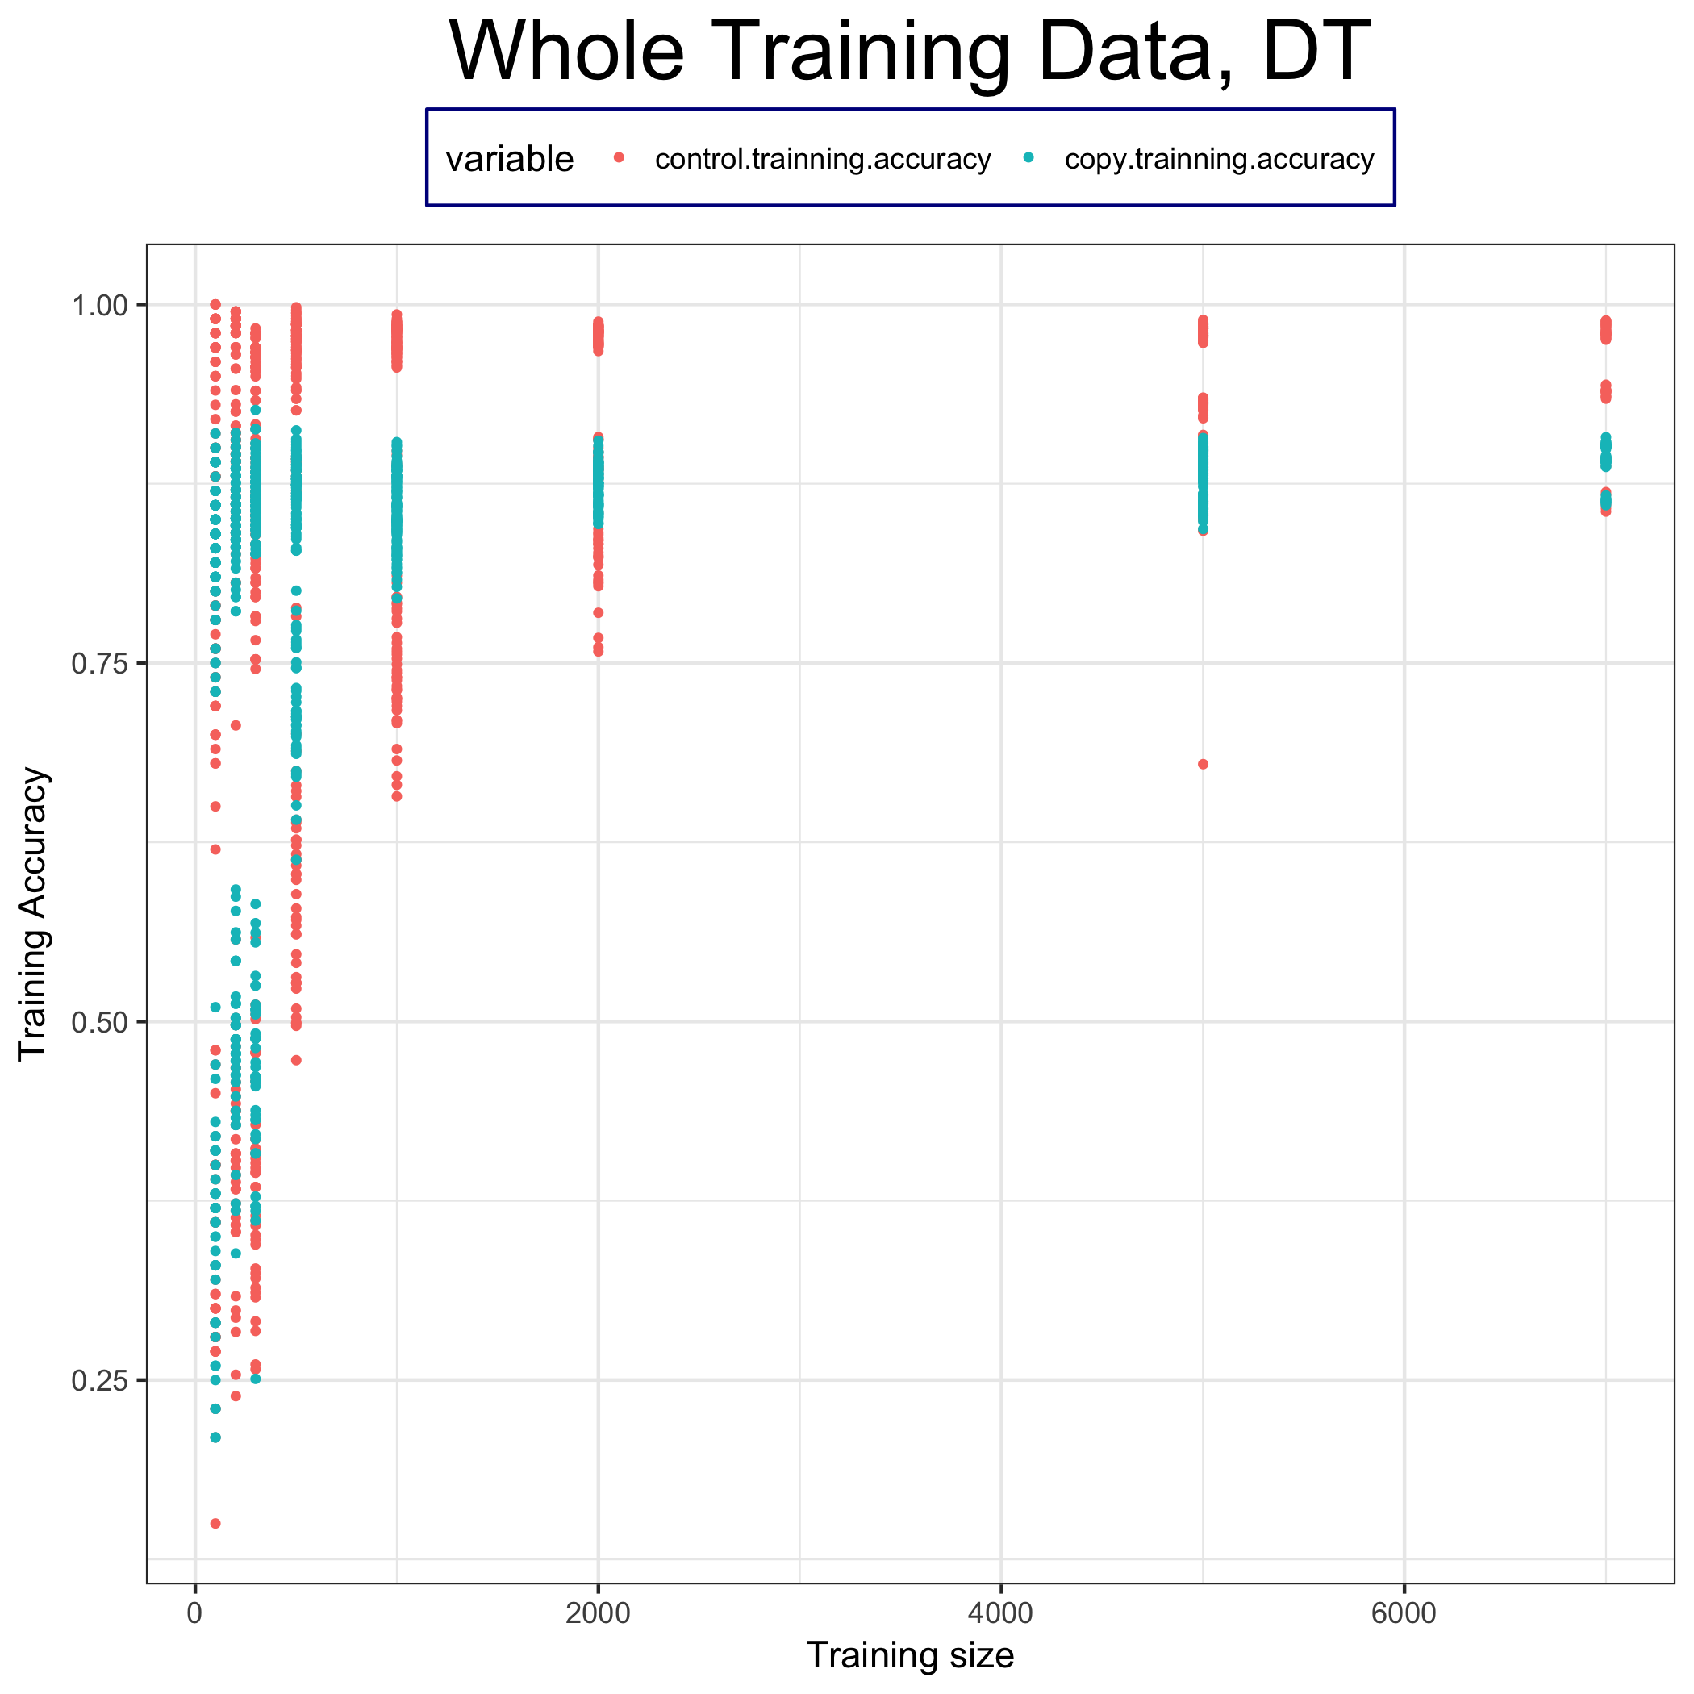
Training accuracy

Slide 11
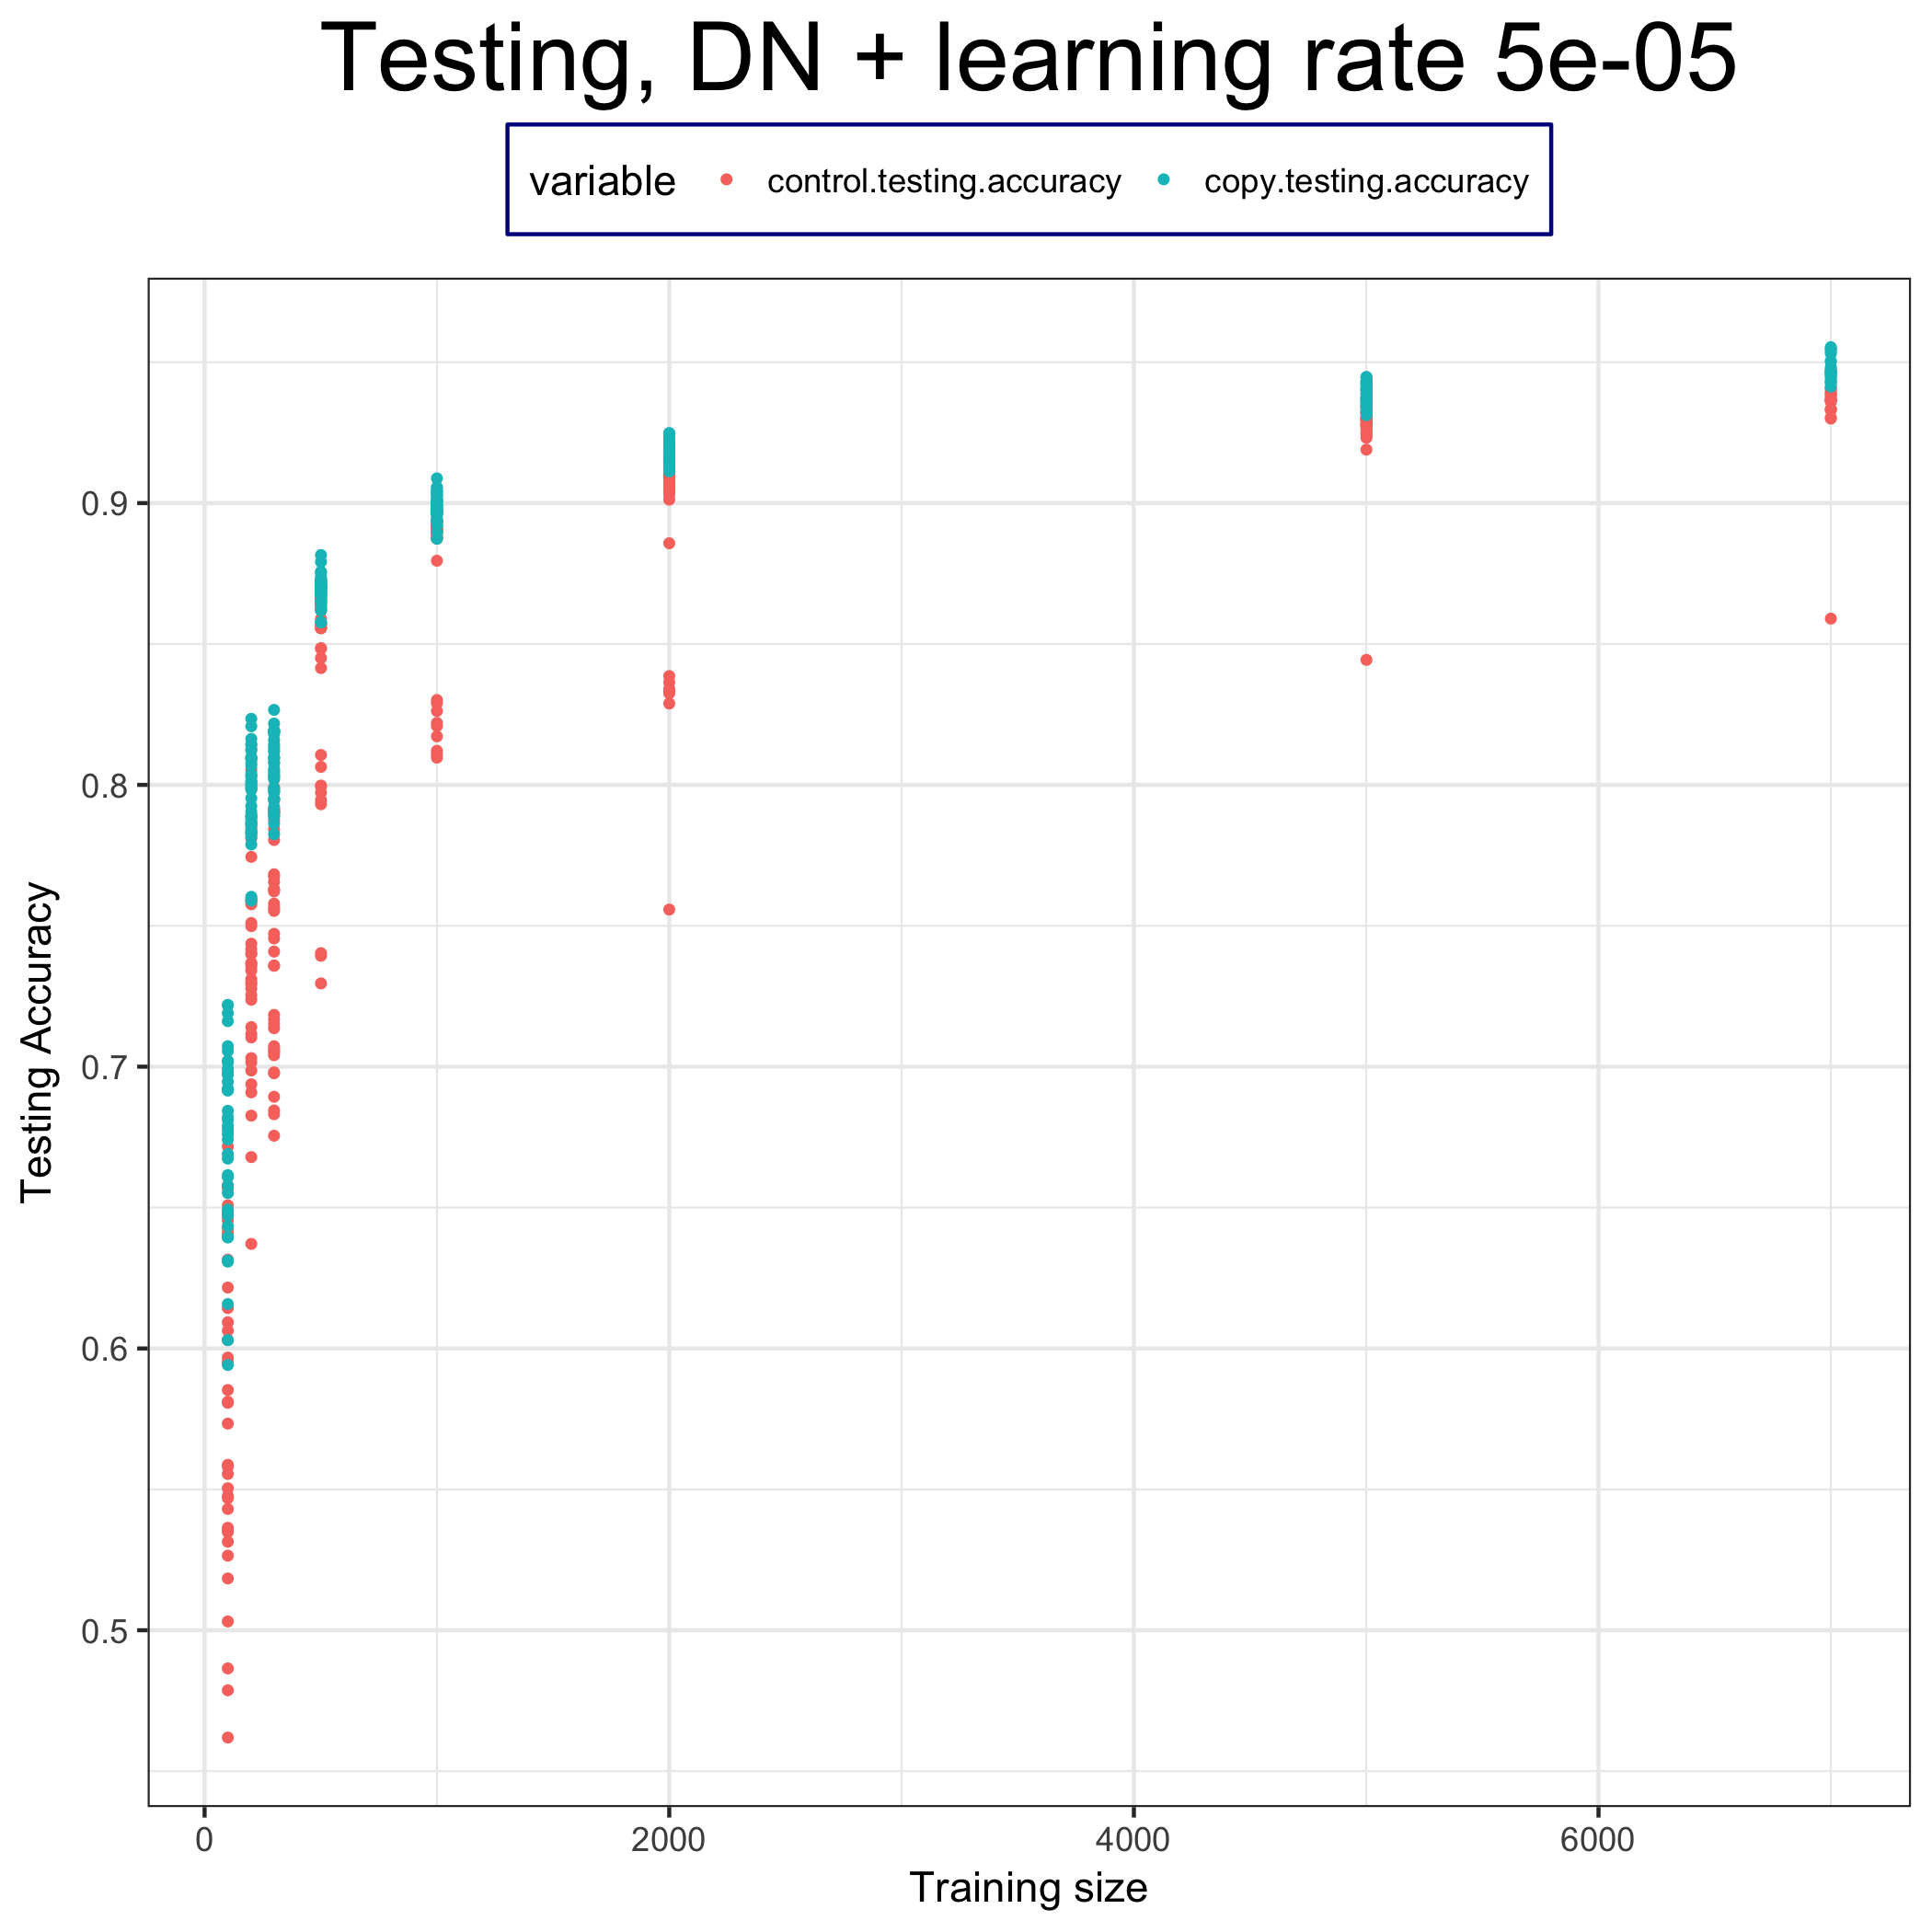
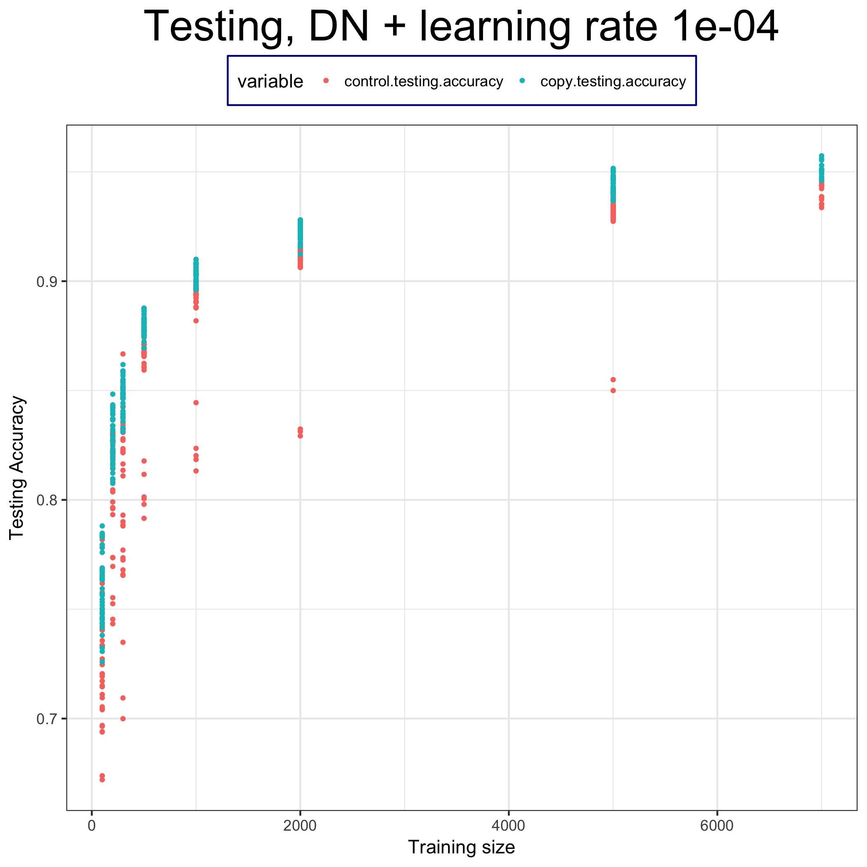
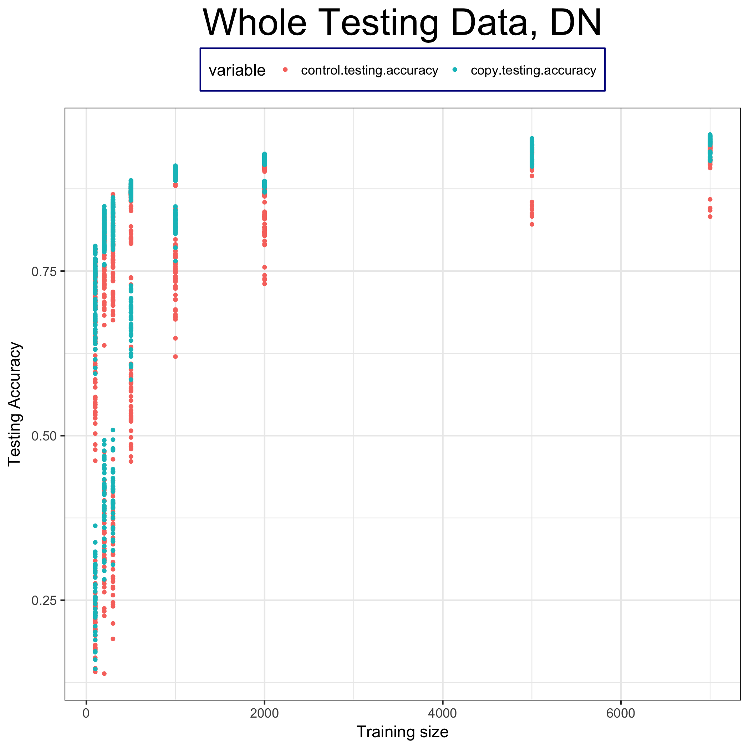
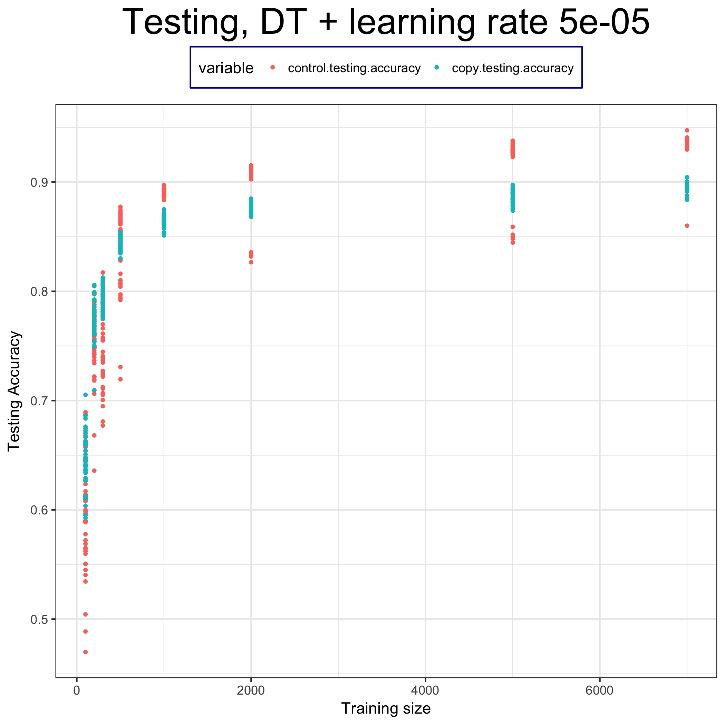
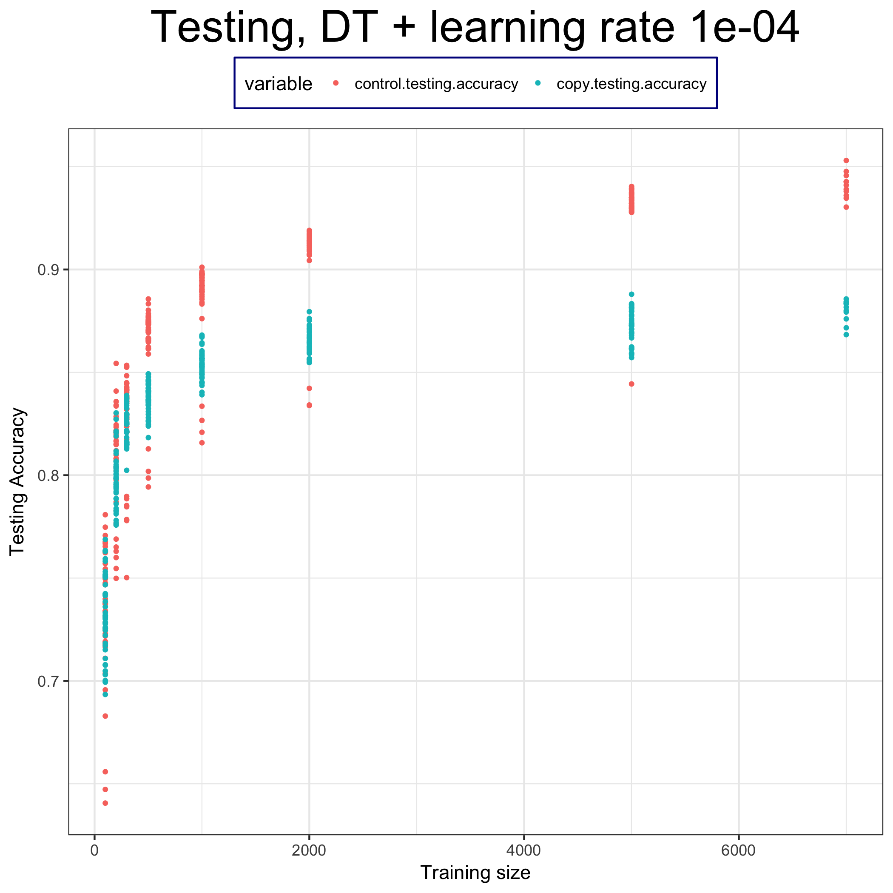
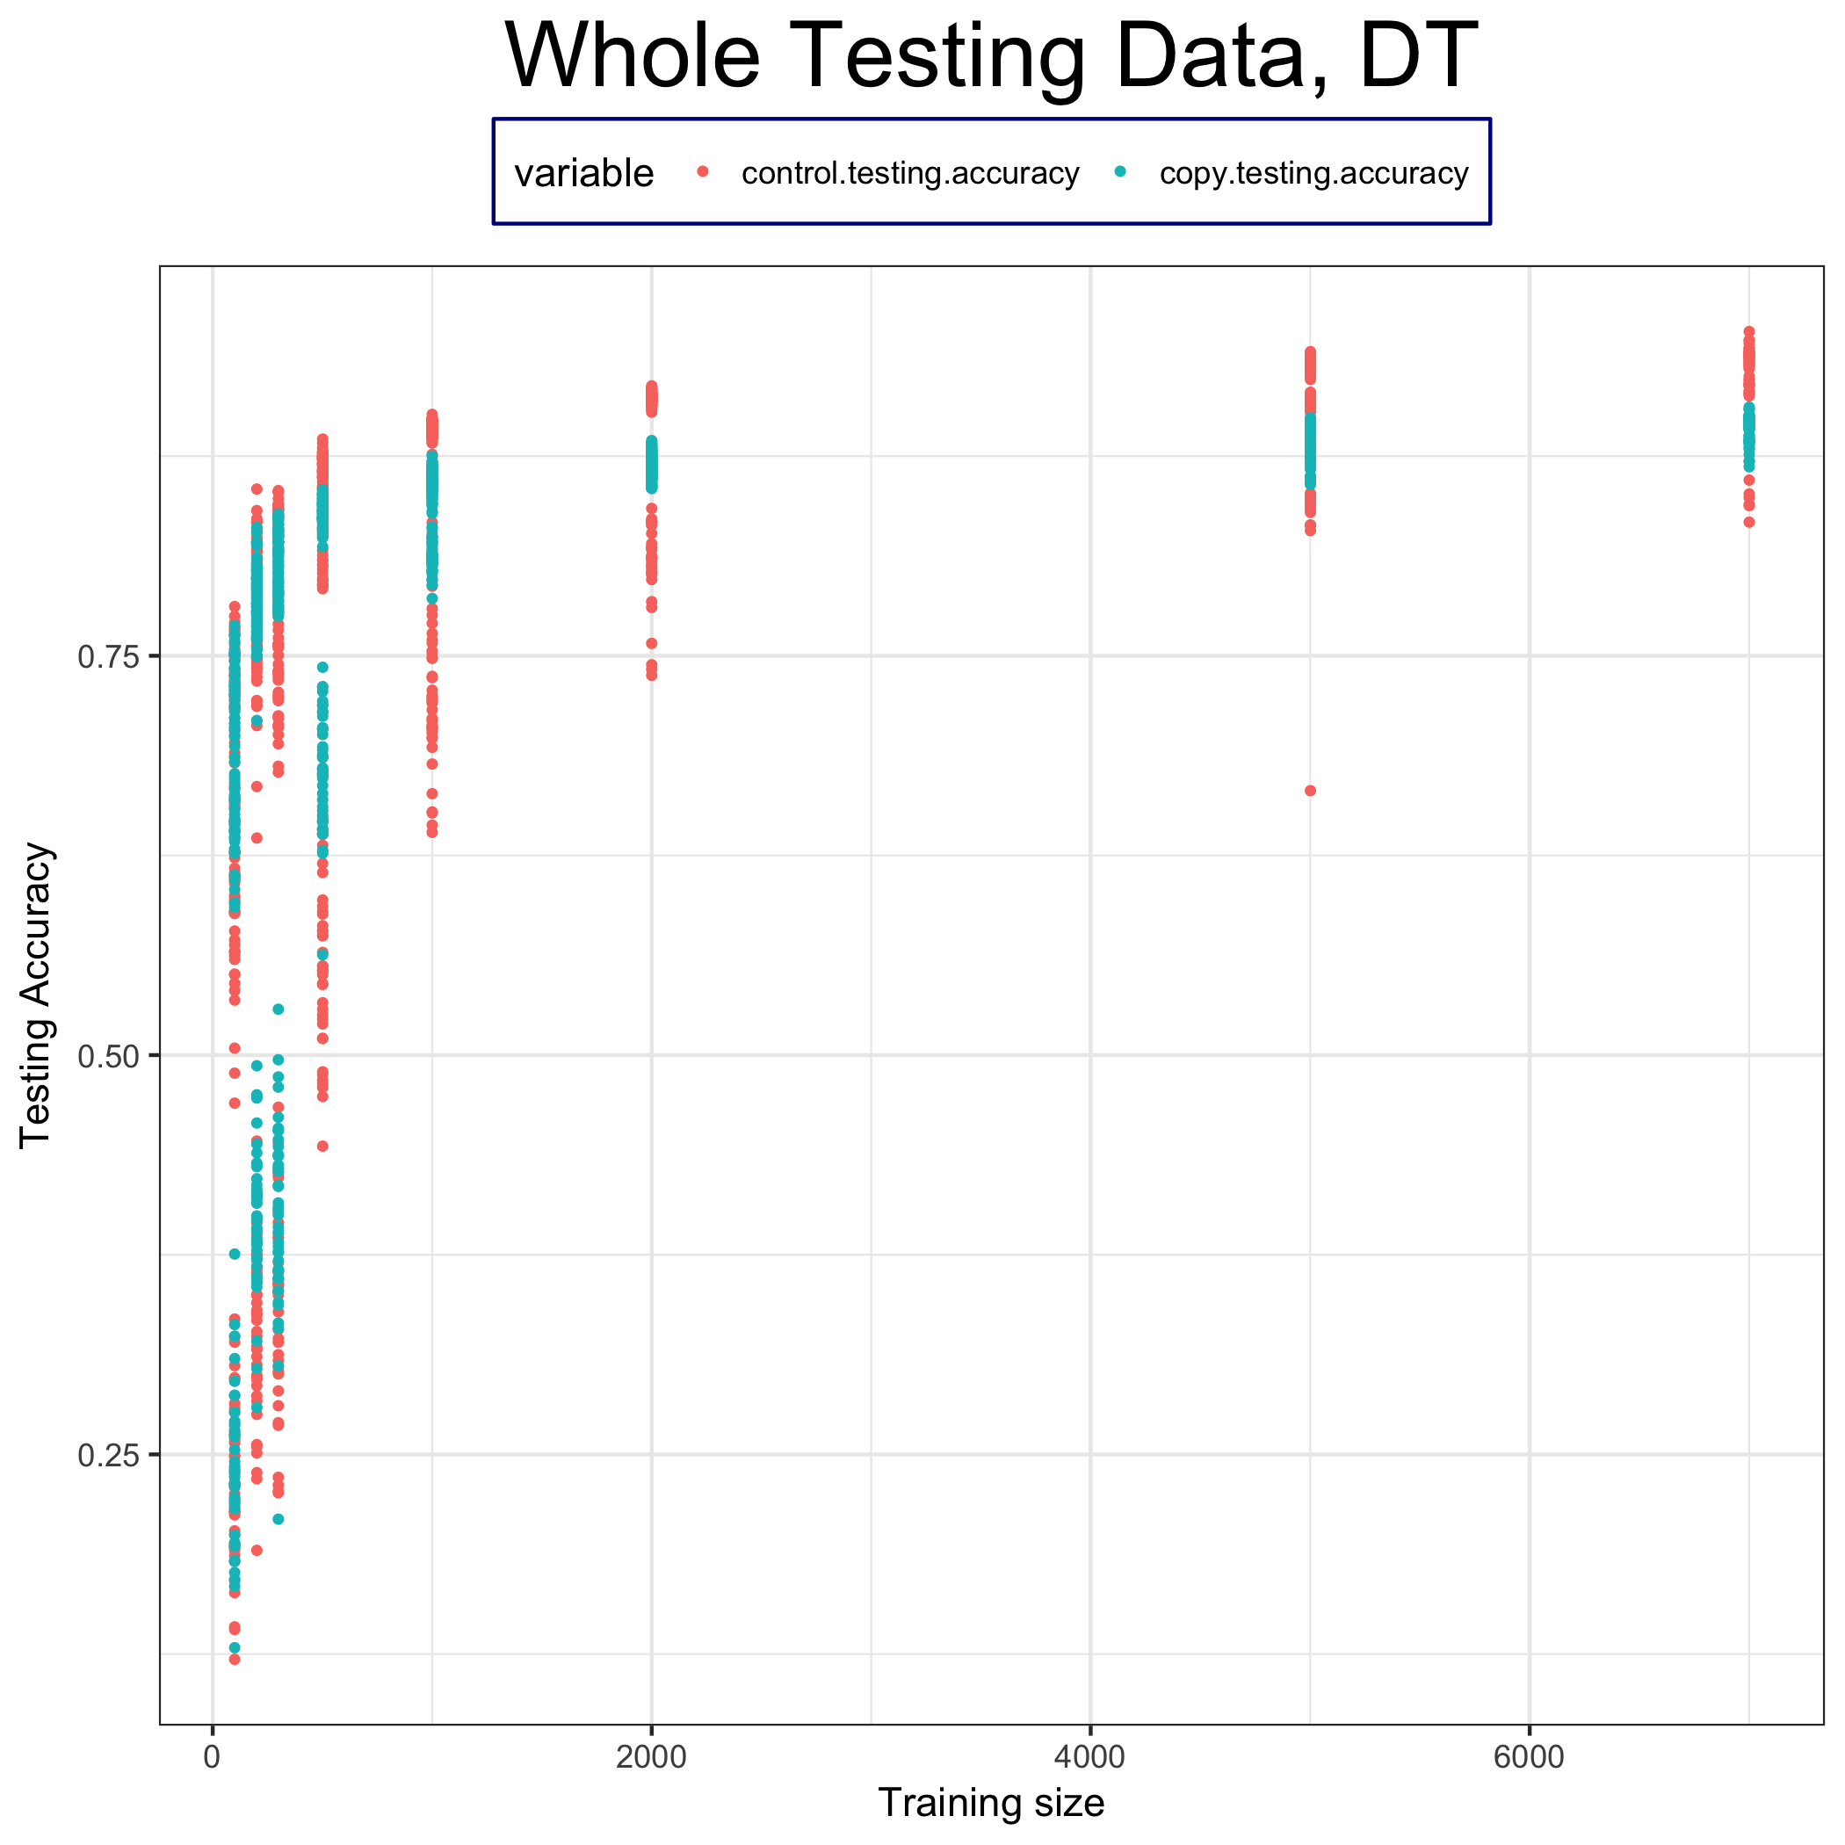
Testing Accuracy

