Slide 2
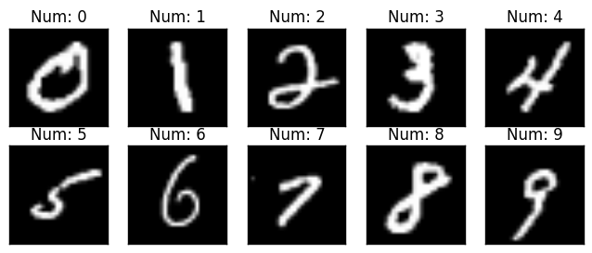

Slide 3
Choose Target Model
Prediction for Stealing
Testing (Evaluate the result)

Slide 4
( X_copy_testing, Y_copy_training_label )
Prediction of Target model (pre-trained)
Y_copy_training_probability
train
train
Copy Model
Control Model
Accuracy Evaluation (vs Target Model)

Slide 5
Training Data
Size : 100、200、500、1000、2000、5000、7000
Model
Fully-Connected（784x100）
Optimizar
Adam
Learning rate : 1e-5, 5e-5, 1e-4
ReLU
Back
propagation
Fully-Connected（100x100）
Loss
ReLU
Loss function
Control Model : CorssEntropy
Copy Model : BCEloss, MSELoss
Fully-Connected（100x10）
Softmax
Control Model : label of each data
Copy Model : probability of each data given by target model

