Slide 1
FHIR API for .Net programmers Introduction
Howard S. Edidin
Value-Based Care FHIR Mini-Connectathon
April 11, 2017

Slide 2
Who am I?
Name: Howard S. Edidin
Background:
Microsoft P-TSP for Healthcare Integration
Microsoft MVP – Data Platform
Been working with FHIR for over three years
Author
Contact: hedidin@edidingroup.net

Slide 3
HL7.Fhir API
Using the Reference Implementation
Notes:
Time: 40:00-50:00 (10 minutes)

Slide 4
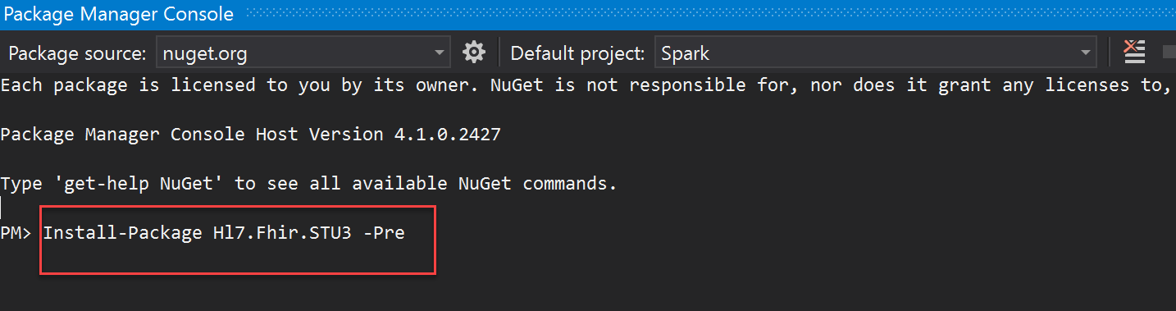
First step
Adding the Hl7.Fhir package to your solution
NuGet Package manager, Hl7.Fhir.STU3 package

Slide 5
Hl7.Fhir.DSTU3
Core contents
Model – classes generated from the spec
REST functionality – FhirClient
Parsers and Serializers
Source on GitHub: http://github.com/ewoutkramer/fhir-net-api

Slide 6
The Model using Hl7.Fhir.Model;

Slide 7
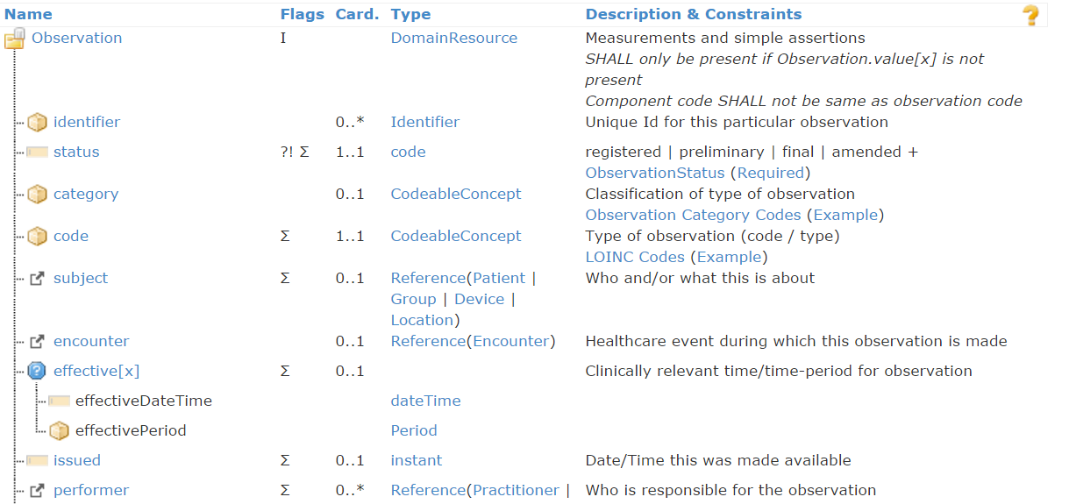
A FHIR Resource

Slide 8
A FHIR Resource in C#
public partial class Observation : Hl7.Fhir.Model.DomainResource
/// <summary>
/// Codes providing the status of an observation.
/// (url: http://hl7.org/fhir/ValueSet/observation-status)
/// </summary>
public enum ObservationStatus {Registered, Preliminary, Final, …}
Notes:
Enums are generated for coded types with required, fixed, valuesets
Nested classes are defined for each component in a Resource, all nested directly within the Resource
Cardinality > 1 => becomes a List<>
Cardinality 1 => Not expressed in model, but done in validation
All classes are partial so you can add code them in another code file (keeping generated+handcrafted code separate)

Slide 9
A FHIR Resource in C#
public CodeableConcept Code { get; set; }
public List<Identifier> Identifier{ get; set; }
Notes:
Enums are generated for coded types with required, fixed, valuesets
Nested classes are defined for each component in a Resource, all nested directly within the Resource
Cardinality > 1 => becomes a List<>
Cardinality 1 => Not expressed in model, but done in validation
All classes are partial so you can add code them in another code file (keeping generated+handcrafted code separate)

Slide 10
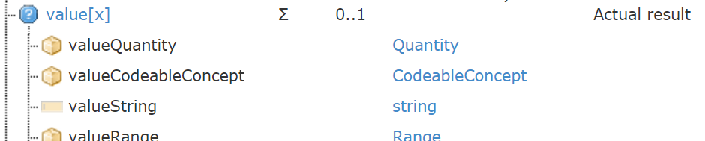
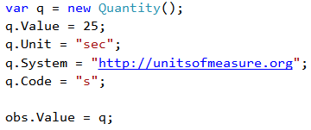
A FHIR Resource in C#
public Element Value { get; set;}
Notes:
Enums are generated for coded types with required, fixed, valuesets
Nested classes are defined for each component in a Resource, all nested directly within the Resource
Cardinality > 1 => becomes a List<>
Cardinality 1 => Not expressed in model, but done in validation
All classes are partial so you can add code them in another code file (keeping generated+handcrafted code separate)

Slide 11
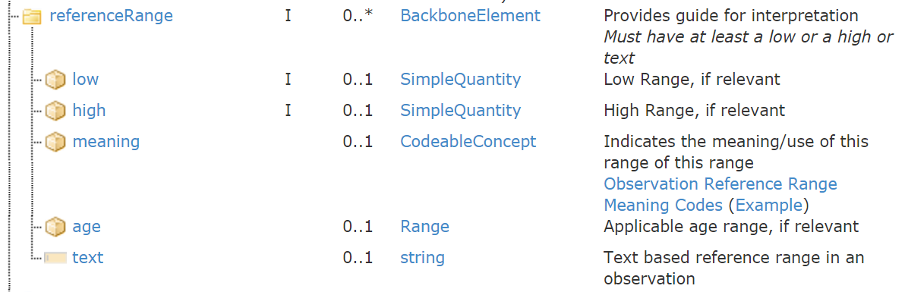
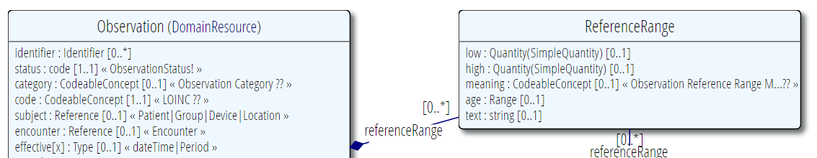

A FHIR Resource in C#
public partial class ReferenceRangeComponent : BackboneElement { … }
Notes:
Enums are generated for coded types with required, fixed, valuesets
Nested classes are defined for each component in a Resource, all nested directly within the Resource
Cardinality > 1 => becomes a List<>
Cardinality 1 => Not expressed in model, but done in validation
All classes are partial so you can add code them in another code file (keeping generated+handcrafted code separate)

Slide 12
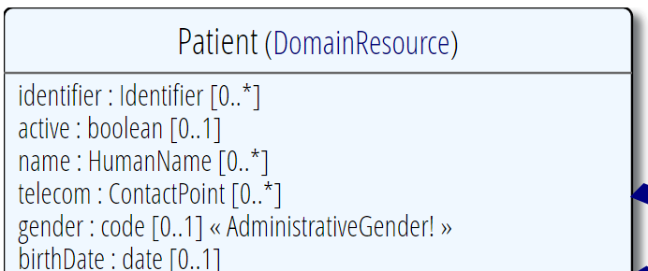
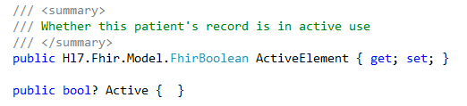
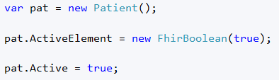
Primitives are not really primitive…

Slide 13
Rest interactions using Hl7.Fhir.Rest;

Slide 14
Using the FHIR Client
See Publicly Available FHIR Servers for available test servers
var client = new FhirClient("http://acme.org/fhir");
// client options
client.PreferredFormat = ResourceFormat.Xml;
client.ReturnFullResource = true;

Slide 15
Adding headers to request
client.OnBeforeRequest +=
(object sender, BeforeRequestEventArgs e) =>
{
e.RawRequest.Headers.Add("some_key", "some_value");
};
client.OnAfterResponse += (object sender, AfterResponseEventArgs e) =>
{ ... };

Slide 16
C(RUD)
var obs = new Observation();
obs.Status = Observation.ObservationStatus.Preliminary;
obs.Code = new CodeableConcept("http://example.org",
"my-example-code");
var result = client.Create<Observation>(obs);
// note that error handling should be added to catch exceptions

Slide 17
(C)RUD
var pat = client.Read<Patient>("Patient/1");
pat.Name.Add(HumanName.ForFamily("Kramer")
.WithGiven("Ewout"));
client.Update<Patient>(pat);
client.Delete(pat);
client.Delete("Patient/12345");

Slide 18
Resource Identity
Hl7.Fhir.Rest.ResourceIdentity
pat.ResourceIdentity().HasBaseUri
pat.ResourceIdentity().HasVersion
pat.ResourceIdentity().BaseUri
pat.ResourceIdentity().ResourceType
var id = new ResourceIdentity("Patient/3")
.WithBase("http://example.org/fhir");
ResourceIdentity.Build(UrnType.OID, "1.2.3.4.5.6");

Slide 19
Search and bundles

Slide 20
Making queries
var q = new SearchParams()
.Where("name=Ewout")
.Include("Patient:organization")
.LimitTo(10)
.SummaryOnly()
.OrderBy("birthdate",
Hl7.Fhir.Rest.SortOrder.Descending);
q.Add("gender", "male");
Bundle result = client.Search<Patient>(q);

Slide 21
Paging through Bundle
while (result != null)
{
foreach (var e in result.Entry)
{
Patient p = (Patient)e.Resource;
// do something with the resource
}
result = client.Continue(result, PageDirection.Next);
}

Slide 22
Transaction builder
var b = new TransactionBuilder("http://example.org/fhir")
.Create(pat)
.ResourceHistory("Patient","7")
.Delete("Patient","8")
.Read("Patient","9")
.Search(q, "Patient")
.ToBundle();
var t_result = client.Transaction(b);

Slide 23
Parsing/serializing using Hl7.Fhir.Serialization;

Slide 24
Parsing/Serializing
// Create a file-based reader for JSON
JsonTextReader reader =
new JsonTextReader(new StreamReader(@"input.json"));
var parser = new FhirJsonParser();
var new_obs = parser.Parse<Observation>(reader);
// Serialize an in-memory observation to a JSON string
var jsonText = FhirSerializer.SerializeResourceToJson(new_obs);

Slide 25
Demo

Slide 26


Next Steps for you
Try the Beginners Track during the hands-on session
See https://github.com/furore-fhir/fhirstarters for the track exercises and some .Net examples
Java - http://hapifhir.io/
For questions during the track, consult me or use https://chat.fhir.org/

Slide 27
The End –
Questions?

