Slide 1
TI DSP, MCU, Xilinx Zynq FPGA 기반의 프로그래밍 전문가 과정
강사 – Innova Lee(이상훈)
gcccompil3r@gmail.com
학생 – 김형주
mihaelkel@naver.com

Slide 2
What I leanred (18.03.02)
The reasons why we use function pointer
Quiz for function pointer
Data Structure : stack

Slide 3
Why we use function pointer?
We use function pointer to make asynchronous handling. If You open Linux OS code, you’ll see a lot of System call. But these are in ‘kernel space’, not in ‘user space’. So you can’t access system call, but you can by using function pointer. For example, writing code for avr system, you can use interrupt function in kernel space.

Slide 4
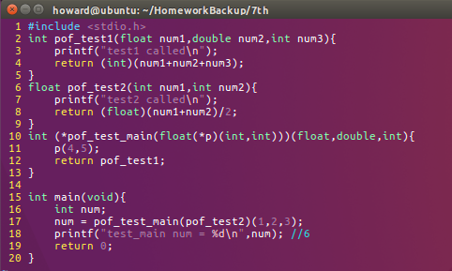
Quiz for function pointer
Quiz 1.

Slide 5
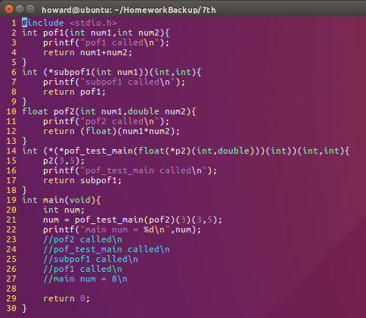
Quiz for function pointer
Quiz 2.

Slide 6
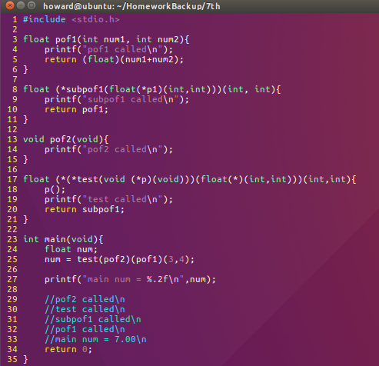
Quiz for function pointer
Quiz 3.

Slide 7
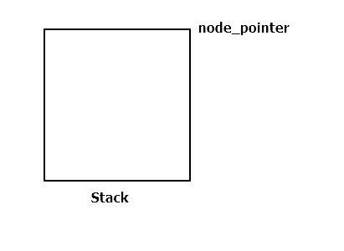
Data Structure : Stack
Stack : FILO structure
Methode : push, pop

Slide 8
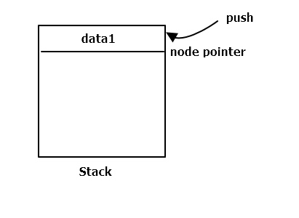
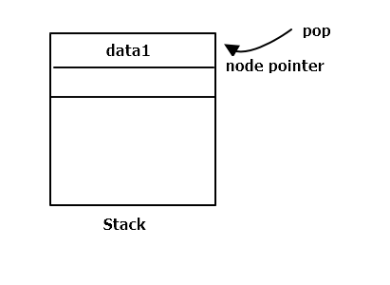
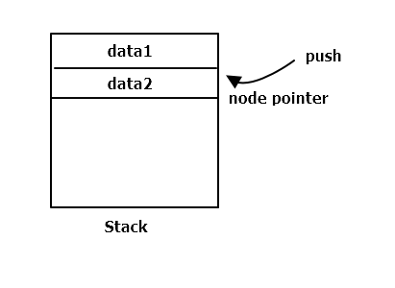
Data Structure : Stack

Slide 9
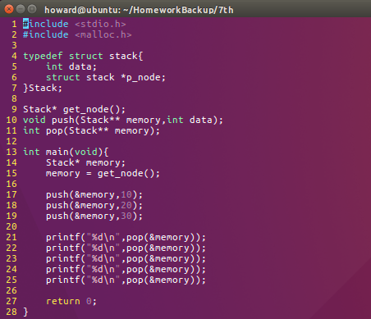
Data Structure : Stack
Consist of main(), get_node(), pop(), push()

Slide 10

Data Structure : Stack
Stack* get_node()
This fuction returns Stack type pointer initialized data = 0, p_node = NULL

Slide 11
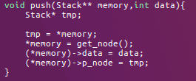
Data Structure : Stack
void push(Stack** memory, int data)
This fuction accumulates data on memory. Current memory address becomes new p_node address.

Slide 12
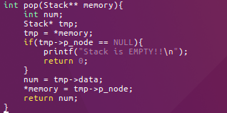
Data Structure : Stack
void pop(Stack** memory)
This fuction returns data on memory. p_node address become new memory address.
If there’s no data in stack(p_node == NULL), warnning

