Slide 1
TI DSP, MCU, Xilinx Zynq FPGA 기반의 프로그래밍 전문가 과정
강사 – Innova Lee(이상훈)
gcccompil3r@gmail.com
학생 – 김형주
mihaelkel@naver.com

Slide 2
What I leanred (18.03.05)
Data Structure : queue

Slide 3
Data Structure : Queue
Stack : FIFO structure
Methode : enqueue, deque

Slide 4
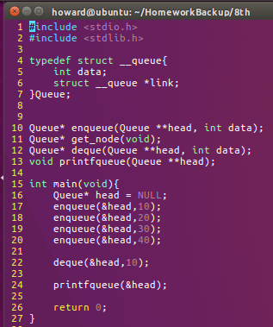
Data Structure : Queue
Consist of main(), get_node(), enqueue(), deque()

Slide 5

Data Structure : Queue
Queue* get_node()
This fuction returns Queue type pointer initialized link = NULL

Slide 6
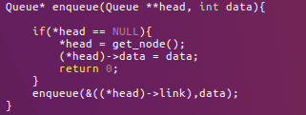
Data Structure : Queue
Queue* enqueue(Queue **head, int data)
This fuction accumulates data on memory. It finds the next memory space be used through recursive function.

Slide 7
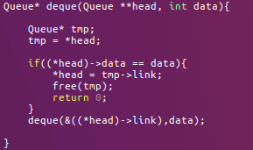
Data Structure : Queue
Queue* deque(Queue **head, int data)
This function searches where the data is, and deletes that.

