Slide 1
TI DSP, MCU, Xilinx Zynq FPGA 기반의 프로그래밍 전문가 과정
강사 – Innova Lee(이상훈)
gcccompil3r@gmail.com
학생 – 김형주
mihaelkel@naver.com

Slide 2
What I leanred (18.02.28)
How to use some functions typedef, malloc(), calloc(), free(), struct
Stack memory, Heap memory
function pointer

Slide 3
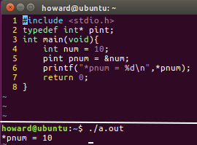
How to use typedef
Declare : typedef type customed_type;
Description : You can use typedef when you want to transform type name to other name. especially, declaring struct type.

Slide 4
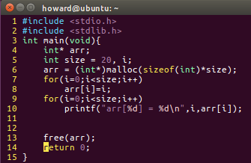
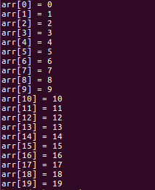
How to use malloc()
Use : arr = (type*)malloc(sizeof(type)*num);
Description : You can use malloc(),free() when you allocate memory dynamically. Assumming that you don’t know how many data will come in. if you allocated memory statically, The data could be lost.

Slide 5
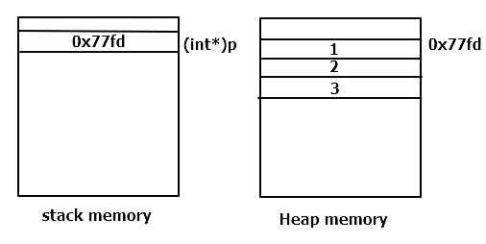
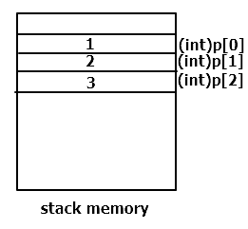
Stack memory&Heap memory
Both are in virtual memory in CPU
Description : Declaring data statically, The data be allocated like figure 1. Dynamically, figure 2. Using dynamic allocation In Embedded Stytem, You should consider how much heap memory in cpu.

Slide 6
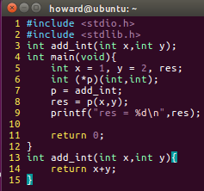
Function pointer
Use : returntype (*functionname)(factor, factor);
Description : remind that all variable(including dynamic variable, array variable) has address. A function alse does. The function’s name is an address as array and pointer’s are. A function’s prototype consists of ‘return value’, ‘fuction name’, ‘factor’. In oop(object oriented programming), there ar method, object, and class, etc.. Using function pointer and struct, you can make those in C. So, If you are an expert in C, learning other language be a piece of cake.

Slide 7
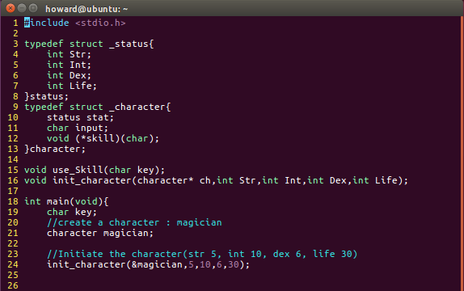
Make class in C
Entire code

Slide 8
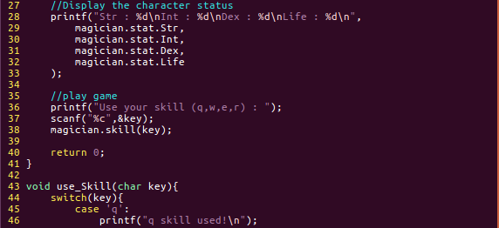
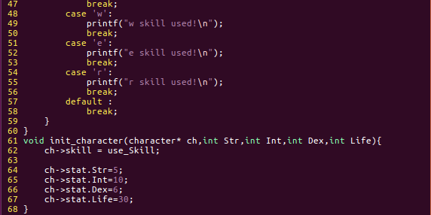
Make class in C

Slide 9

Make class in C
Result
Class : character
Method in character class : skill(key)
Object in character class : status

