Slide 1
Ch5. Non-inertial frame Analytical Mechanics.7th(Grant R. Fowles. George L. Cassiday)
정상용

Slide 2
Contents
A frame of reference
Translation
Rotation
Translation & Rotation

Slide 3
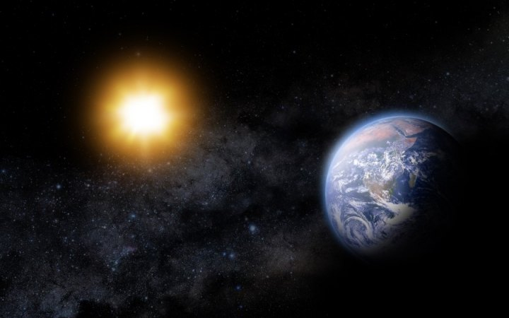
A frame of reference
Inertial frame.
Non – inertial frame.

Slide 4
Check this video which is about coordinate system illustrated on robot arm.
Video

Slide 5
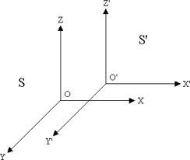
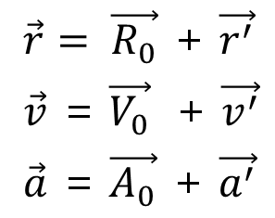
Translation motion

Slide 6
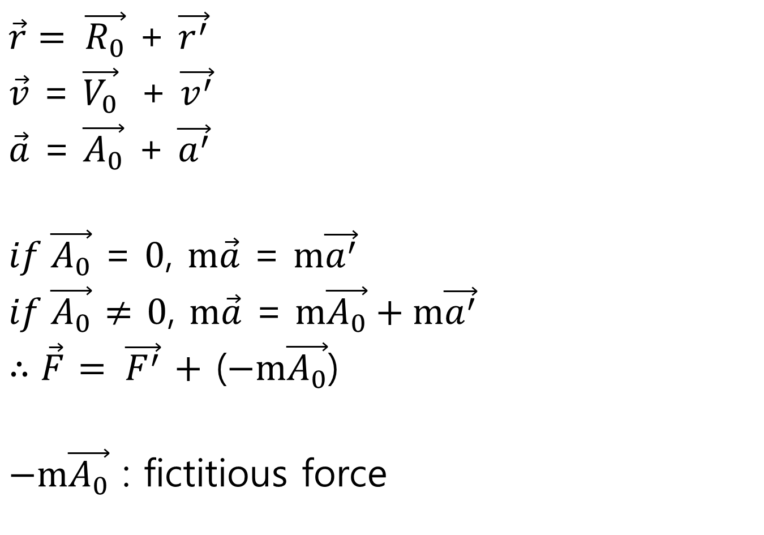
$\vec{r}= \vec{R_{0}}$ + $\vec{r^{′}}$
$\vec{v}$ = $\vec{V_{0}}$ + $\vec{v^{′}}$
$\vec{a}$ = $\vec{A_{0}}$ + $\vec{a^{′}}$
$if \vec{A_{0}}$ = $0$, $m\vec{a}$ = $m\vec{a^{′}}$
$if \vec{A_{0}}$ $≠$ $0$, $m\vec{a}$ = $m\vec{A_{0}}+m\vec{a^{′}}$
$∴\vec{F}$ $= \vec{F^{′}}$ $+$ ($−m\vec{A_{0}}$)
$−m\vec{A_{0}}$ : fictitious force

Slide 7
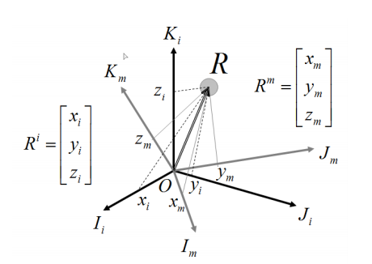
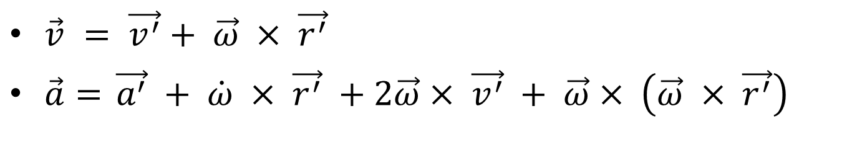
Rotation motion
$\vec{v} = \vec{v^{′}}+ \vec{ω} × \vec{r^{′}}$
$\vec{a}=$ $\vec{a^{′}} + \dot{ω} × \vec{r^{′}} +2\vec{ω}× \vec{v^{′}} + \vec{ω}× \left(\vec{ω} × \vec{r^{′}}\right)$

Slide 8

Translation & Rotation
$$\vec{v} = \vec{v^{′}}+ \vec{ω} × \vec{r^{′}}+ \vec{V_{0}}$$
$\vec{a}=$ $\vec{a^{′}} + \dot{ω} × \vec{r^{′}} +2\vec{ω}× \vec{v^{′}} + \vec{ω}× \left(\vec{ω} × \vec{r^{′}}\right) + \vec{A_{0}}$

Slide 9
Reference
1.https://www.youtube.com/watch?v=LBGEGilB3iU
2.http://physicsrebel.blogspot.com/2012/02/inertial-frame-of-reference.html
3. http://nisl.kau.ac.kr/easy1.pdf

