Slide 1
臺大黑客松-Demo Day 使用AutoEncoder製作推薦系統演算法
時間：2017/6/15 週四
地點：台灣大學
報告人：鍾皓軒
組員：鍾皓軒
github ： https://github.com/HowardNTUST/Hackntu2017_demo

Slide 2
Table of Contents
Brief introduction to pytorch
Intuitive Concept of AutoEncoder
Business Application of AutoEncoder
Training demo and result
Notes:
Brief introduction to pytorch
why pytorch: place speed
easy to use
Dataset used in Stacked AutoEncoders

Slide 3

Brief introduction to pytorch Why pytorch-speed
使用GPU
Tesla K80, CUDA: 8.0 CUDNN: v5.1 CUDA_DRIVER: 367.48
NN (batch size) | Caffe | cntk | TensorFlow | MxNet | Torch
FCN5 (1024) | (151.994s) | (205.680s) | (159.047s) | (144.837s) | (135.299s)
AlexNet (256) | (311.379s) | (217.514s) | (818.209s) | (229.586s) | (315.710s)
ResNet (32) | (9561.758s) | (5112.876s) | (11365.723s) | (5287.561s) | (6021.554s)
LSTM (256) (v7 benchmark) | NAN | (3187.478s) | NAN | (1381.371s) | (3408.770s)
Source: http://dlbench.comp.hkbu.edu.hk/#rnn

Slide 4
Brief introduction to pytorch Why pytorch-speed
使用GPU
Tesla K80, CUDA: 8.0 CUDNN: v5.1 CUDA_DRIVER: 367.48
NN (batch size) | Caffe | cntk | TensorFlow | MxNet | Torch
FCN5 (1024) | (151.994s) | (205.680s) | (159.047s) | (144.837s) | (135.299s)
AlexNet (256) | (311.379s) | (217.514s) | (818.209s) | (229.586s) | (315.710s)
ResNet (32) | (9561.758s) | (5112.876s) | (11365.723s) | (5287.561s) | (6021.554s)
LSTM (256) (v7 benchmark) | NAN | (3187.478s) | NAN | (1381.371s) | (3408.770s)
http://dlbench.comp.hkbu.edu.hk/#rnn
快tf 1.17倍
快tf 2.6倍
快tf 2.01倍
Source: http://dlbench.comp.hkbu.edu.hk/#rnn
Notes:
Cntk則是因為

Slide 5
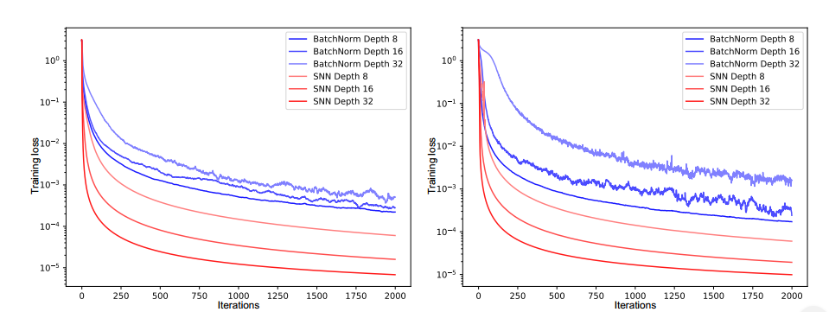
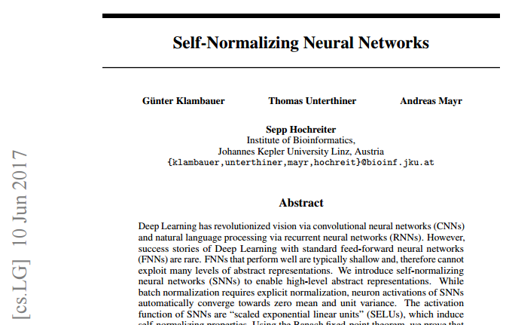
Brief introduction to pytorch Why pytorch-fast searchable result
New activation function Selu published on 10th, June, 2017
Source: https://arxiv.org/pdf/1706.02515.pdf

Slide 6
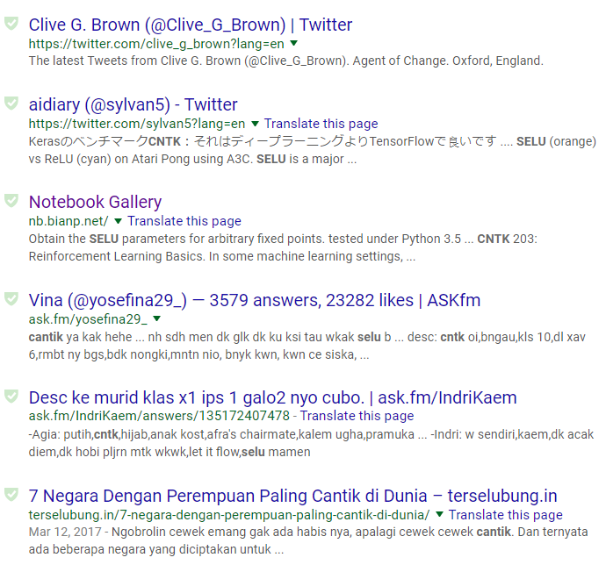
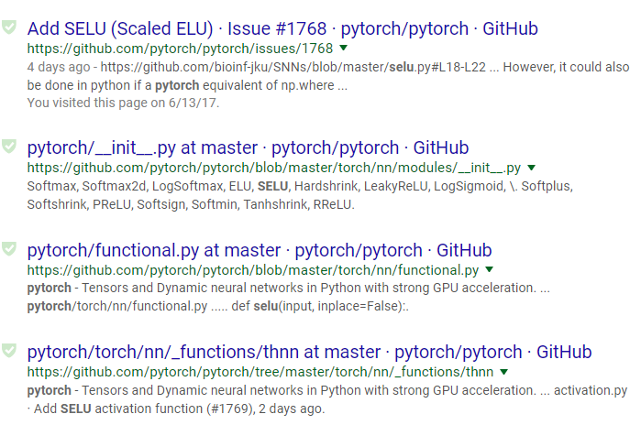
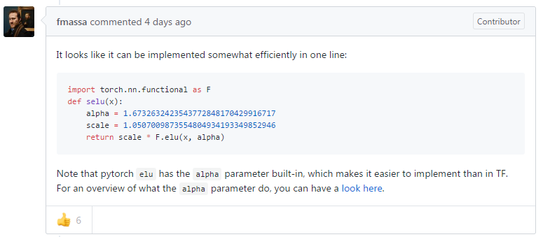
Brief introduction to pytorch Why pytorch-fast searchable result
cntk
pytorch
Still no result
Codes released on the day when paper was published

Slide 7
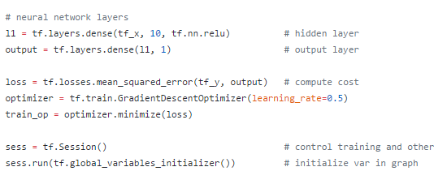
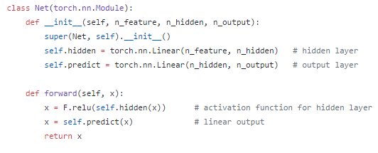
Brief introduction to pytorch Why pytorch-Easy to use
tensorflow
pytorch
不太直覺
直覺

Slide 8
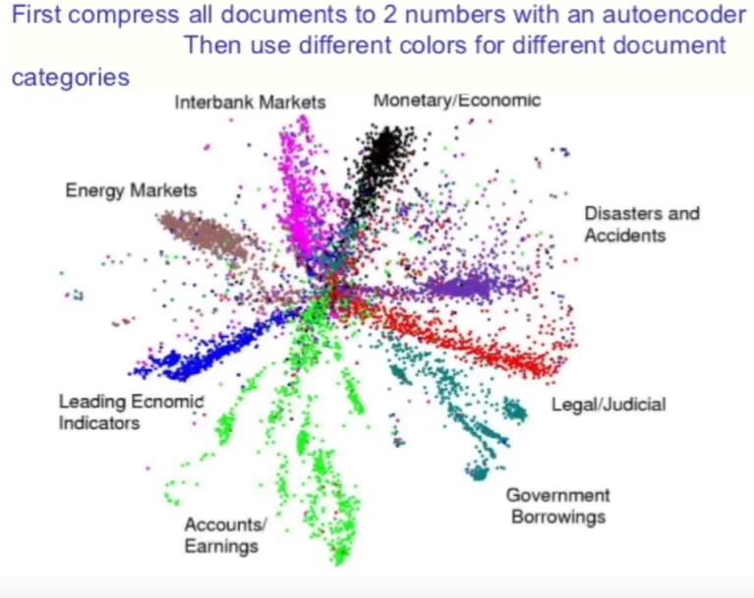
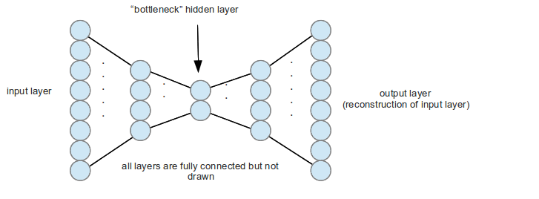
Intuitive Concept of AutoEncoder Designed for feature extraction
Source: https://morvanzhou.github.io/tutorials/machine-learning/ML-intro/2-5-autoencoder/
Notes:
所以從這邊就可以聽出來，我一個sample的維度其時就很大

Slide 9
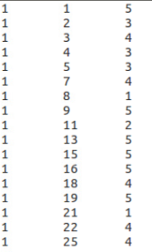
Business Application of AutoEncoder How dataset looks like?
Dataset
Ratings
(max=5; min=1; none=0)
ID
prod
ratings
 | Prod A | Prod B | Prod C | Prod D
ID01 | 0 | 4 | 3 | 5
ID02 | 0 | 1 | 2 | 4
ID03 | 3 | 1 | 1 | 3
ID04 | 2 | 3 | 5 | 2
…
1682 types of products in total
…
943 users in total
Notes:
補圖

Slide 10



Business Application of AutoEncoder Stacked AutoEncoder to make core algorithms of recommendation system
Activation function=Sigmoid
Loss function
1682 types of products in total
1682 types of products in total
Predict ratings of other movies
Optimizer=RMSprop
Neurons=20
Neurons=10
Neurons=20

Slide 11

Training demo and result
Dem
https://github.com/HowardNTUST/Hackntu2017_demo

