Slide 1
Mod 2 Project
Howard Stanley

Slide 2
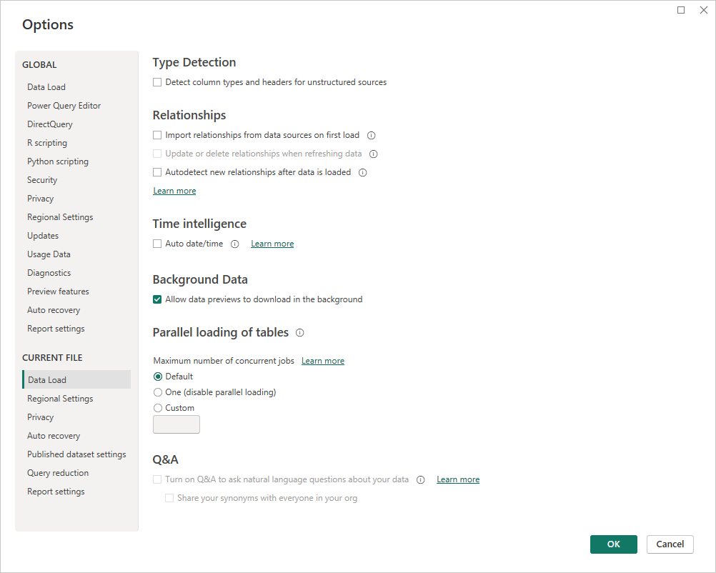

Slide 4
