Slide 1
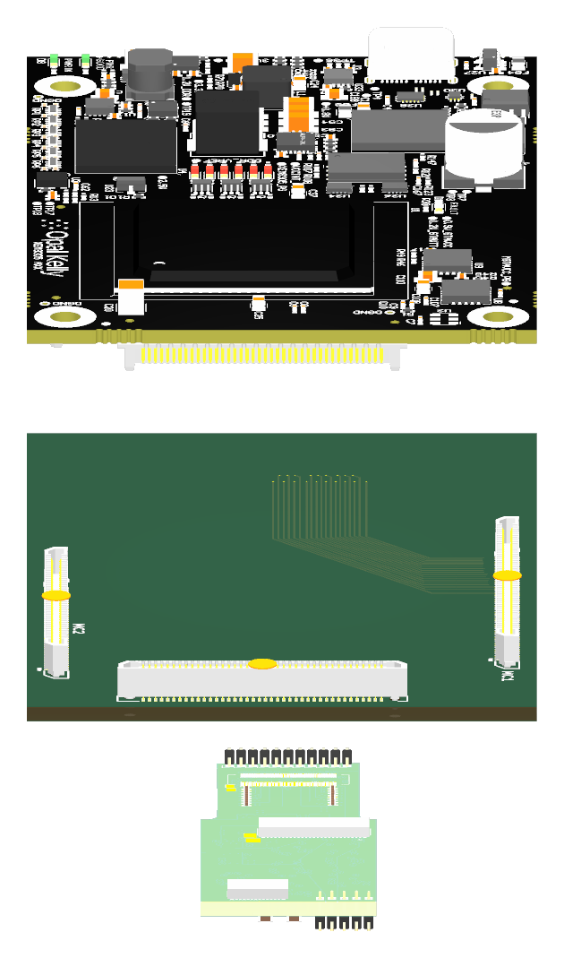
XEM8305, carrier and LDO
7 October 2026 · Howard Wang and Zitong
XEM8305
Carrier board
Current LDO
Exploded preview; open 3D for the connected view. Connector envelopes and seating are nominal.
01 / 11
Notes:
Begin with the complete intended physical arrangement: XEM8305 on the received Board_Howard carrier, with the existing original LDO mated to the carrier through J1 and J19. The source PCB and supplier module geometry are assembled for visualization. The carrier remains a draft; this view is not an operating-hardware photograph or a completed fit test. The next slide identifies both connector pairs. The static preview is exploded for visibility. Its separation is for presentation only; the rotatable model shows the nominal assembled position. The source J1/J19 housing geometry is represented by drawing-based outer envelopes, not detailed contact/cavity models.
Sources: Board_Howard native carrier; Original LDO native PCB; Official Opal Kelly XEM8305 mechanical model; https://www.opalkelly.com/products/models/; https://docs.opalkelly.com/xem8305/expansion-connectors/.
Source files and provenance: https://howardwhsrun.github.io/FPGA_4K/presentation/meetings/2026-10-07.html#files

Slide 2
Major updates on 10/7
1. FPGA PCB update
Material list complete. Finalizing schematic and layout; routing has not started.
2. Alternative method: LDO → XEM8305 module
Working on schematic and routing; confirming dimensions.
3. Moving forward
Next week: finish design review, confirm connector fit and dimensions, then begin FPGA routing.
02 / 11
Notes:
The material list is complete. Howard and Zitong are working toward a final schematic and placement; the custom FPGA PCB has not started routing. The alternative method connects the existing LDO directly to the XEM8305 FPGA module through the carrier. Its schematic and routing are in progress and dimensions need confirmation. Next week’s proposed work is to close schematic/placement review and mechanical dimensions, then begin the FPGA routing work. These are current work items and a plan, not a fabrication or operation claim.
Sources: Howard’s 7 October meeting-update wording; Current M1 and received carrier native sources.
Source files and provenance: https://howardwhsrun.github.io/FPGA_4K/presentation/meetings/2026-10-07.html#files

Slide 3
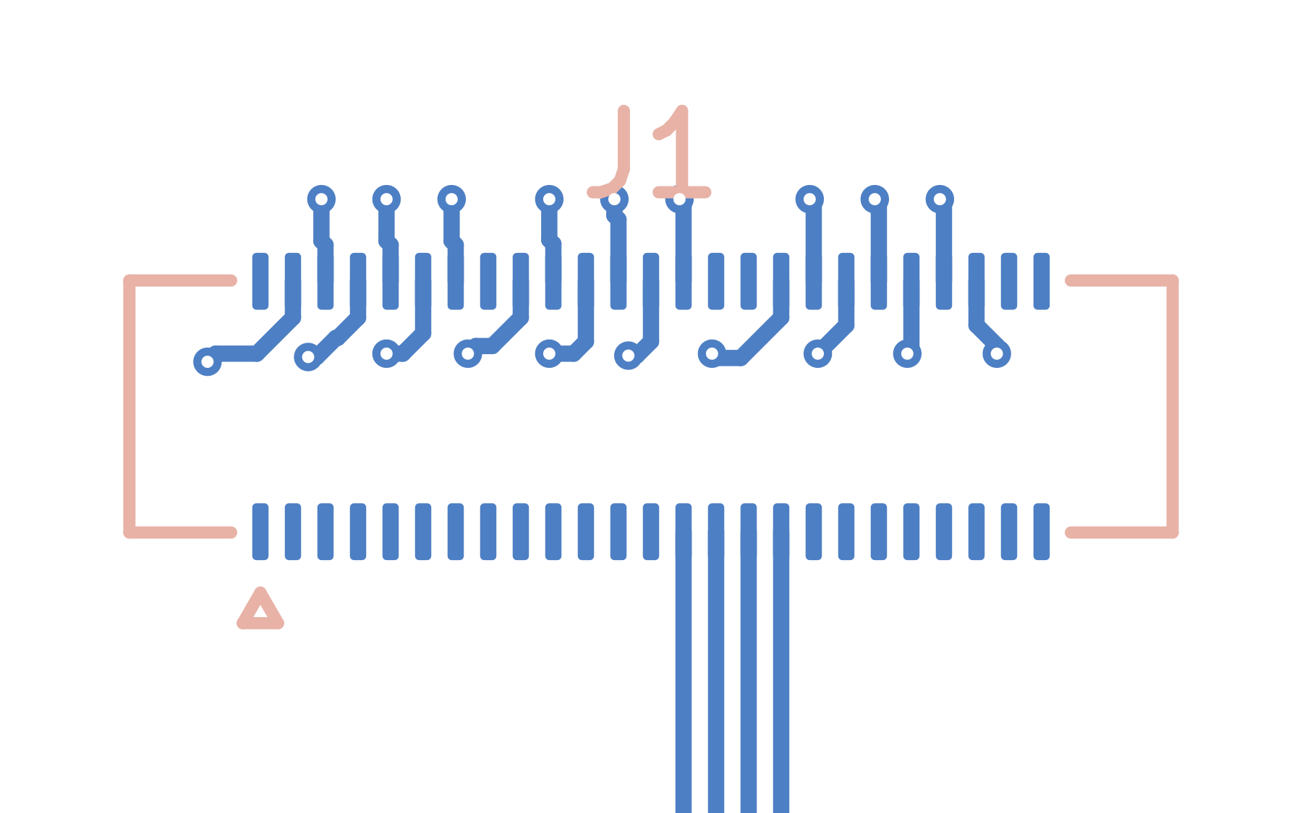
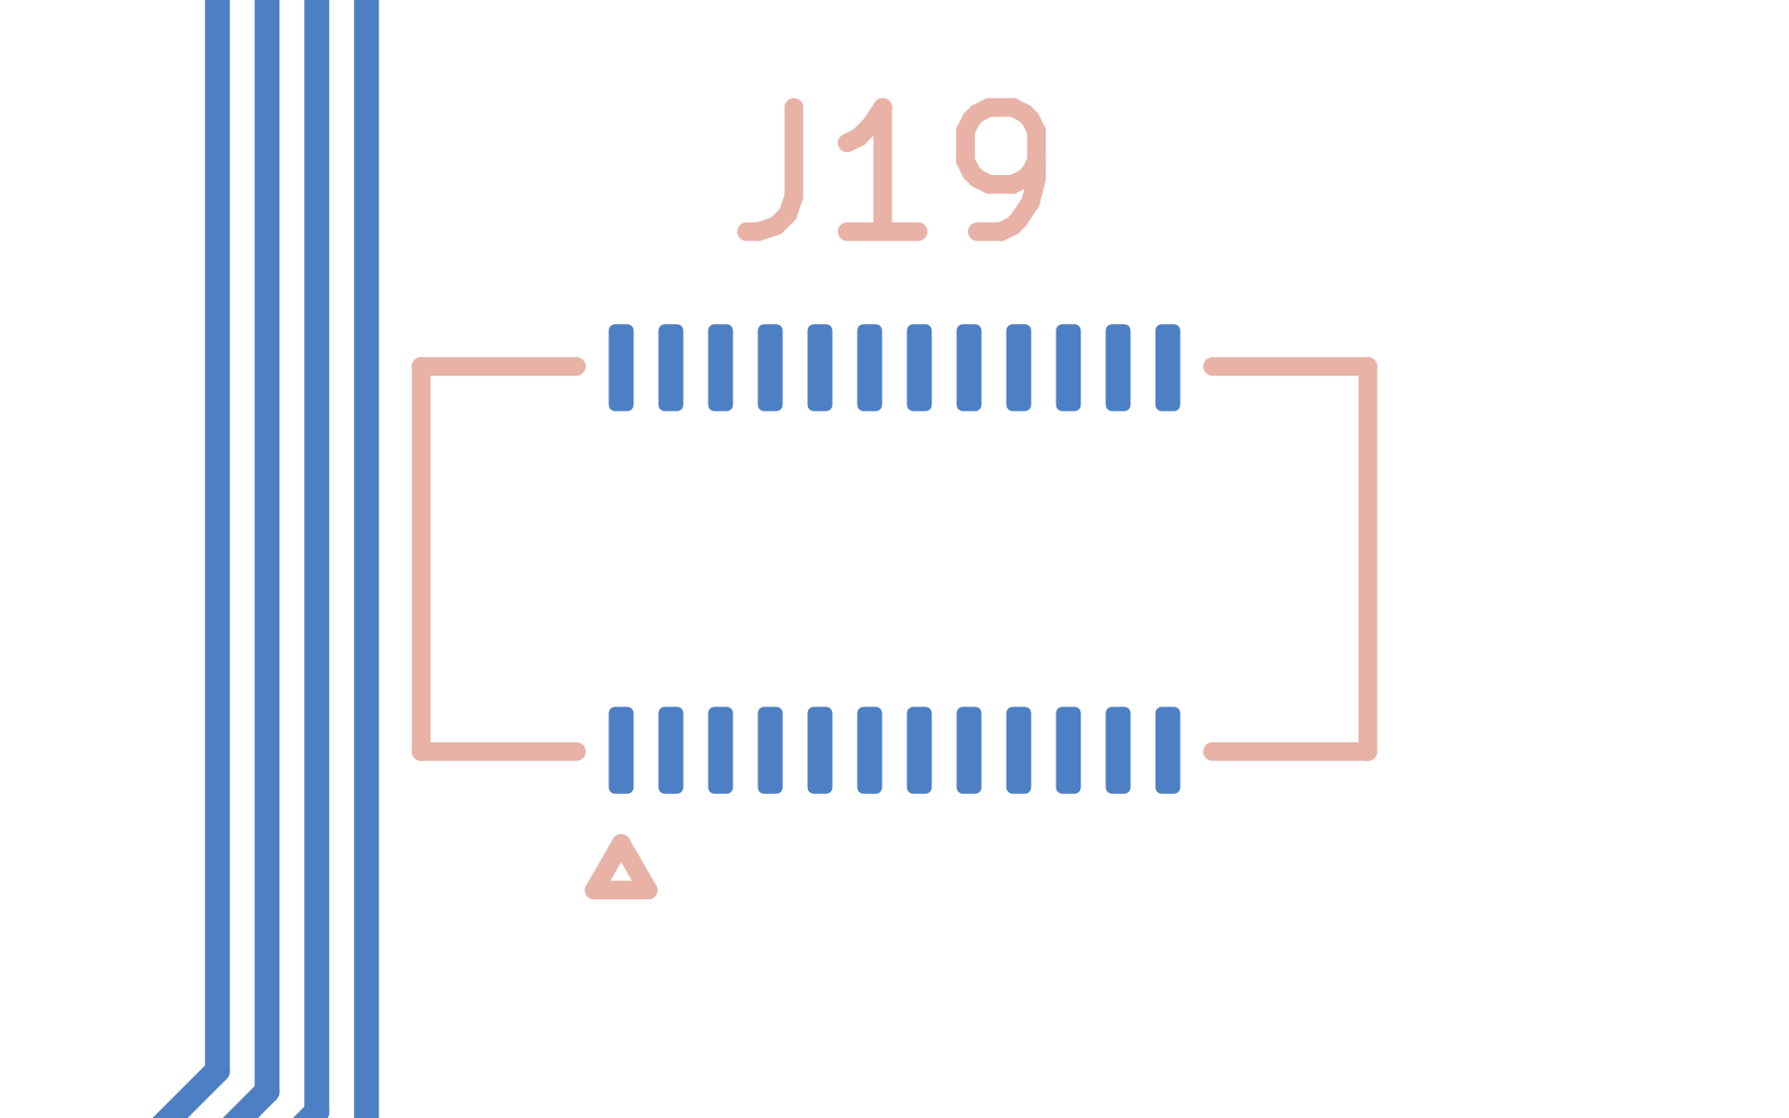
J1 and J19 connections
J1 · native carrier connector footprint
J19 · native carrier connector footprint
Carrier J1 and J19 mate with matching LDO connectors. J19 has no assigned source nets.
03 / 11
Notes:
Show the LDO and carrier sides of each connector pair. J1 provides the defined LDO circuit interface. J19 remains a required physical mating point even though its source contacts are electrically unassigned. The native pad positions register in plan; final connector seating and board clearance are still to be confirmed against populated hardware and supplier mechanical data. The original J19 has 24 signal-pad positions and four additional numbered end pads. The end-pad function and numbering remain to be confirmed; 28 CAD pads should not be described as 28 electrical connector contacts.
Sources: Original LDO and received carrier connector footprints; Hirose DF40C connector mechanical references; https://www.hirose.com/en/product/p/CL0684-4011-1-58.
Source files and provenance: https://howardwhsrun.github.io/FPGA_4K/presentation/meetings/2026-10-07.html#files

Slide 4
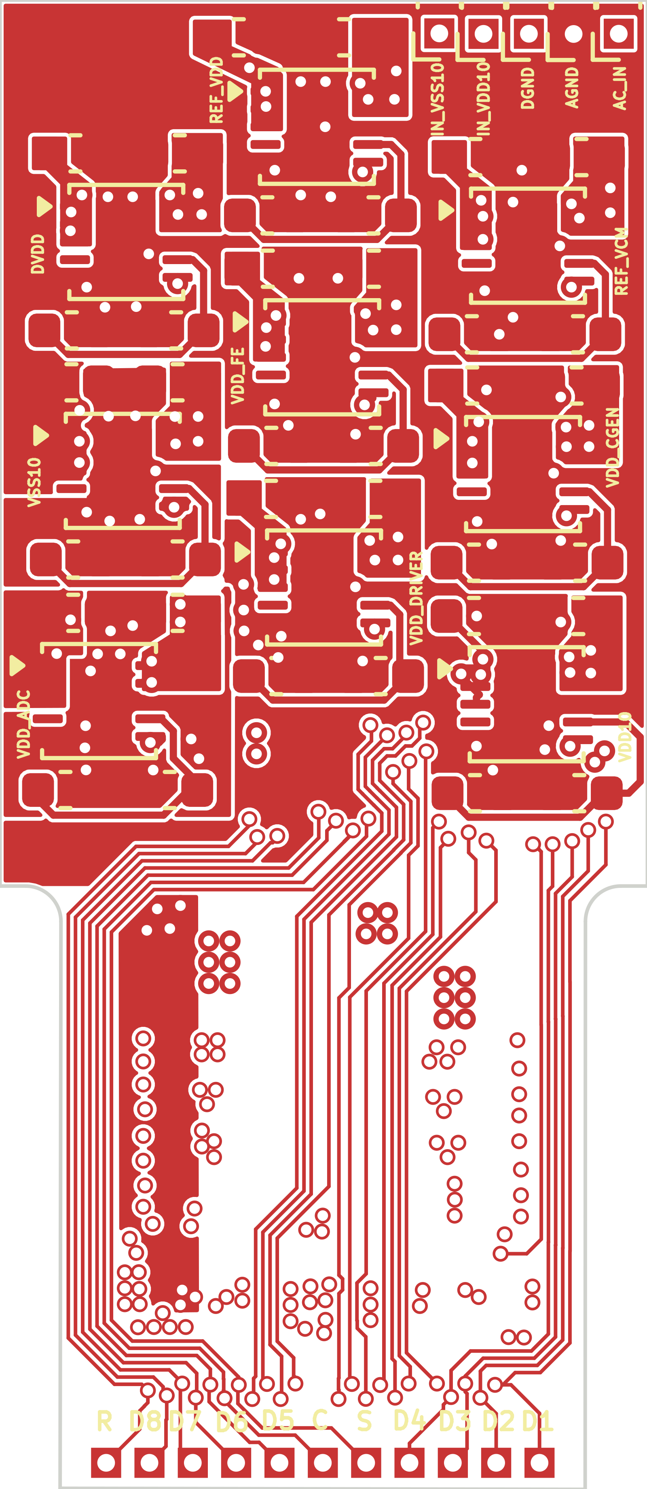
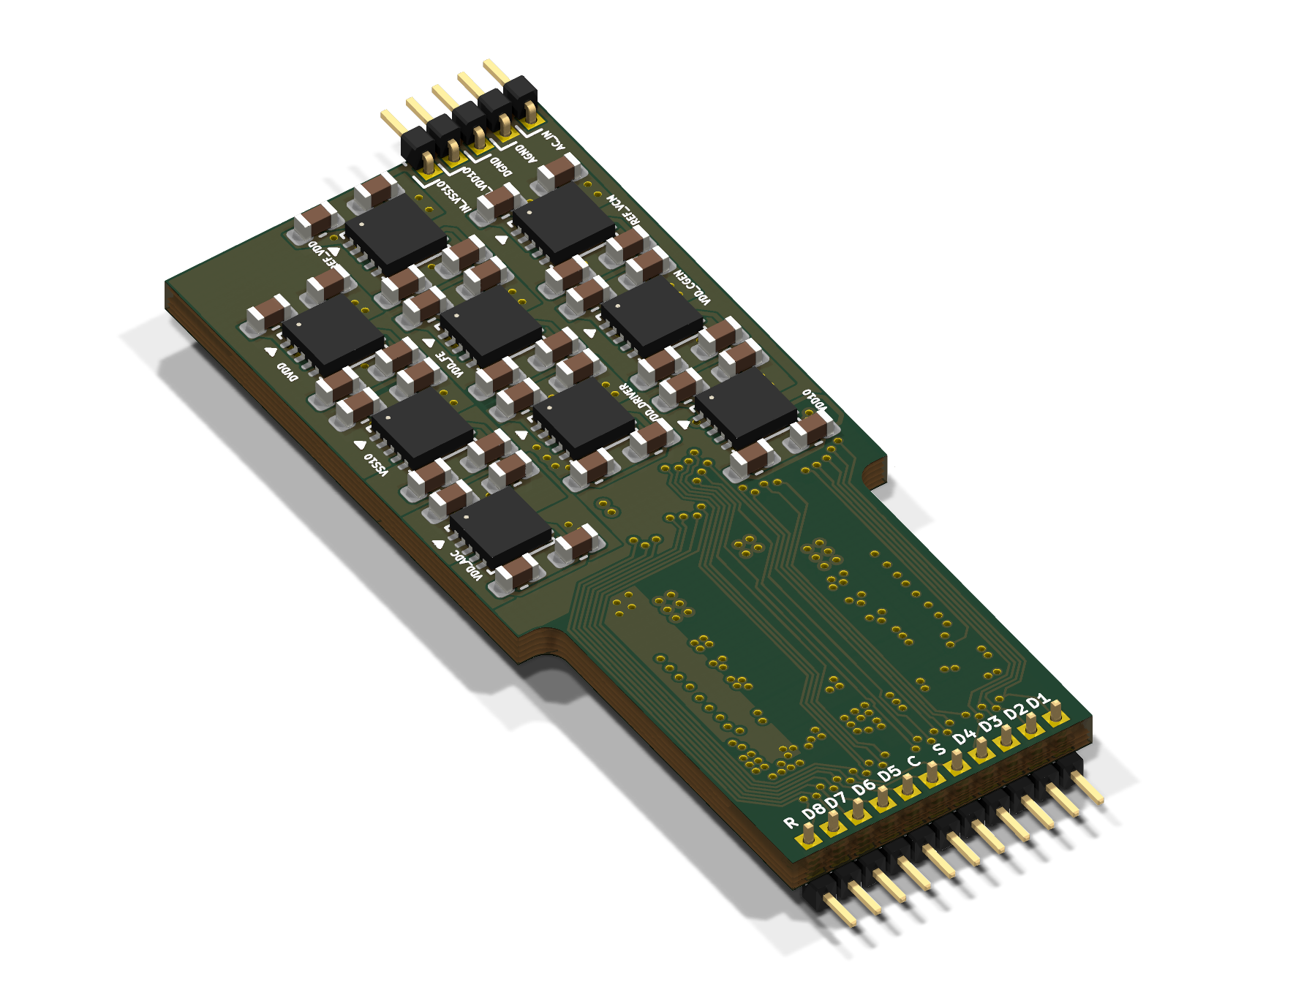
Existing ASIC LDO board
Actual native board layout
Native KiCad 3D view
Nine regulator stages · 23 direct digital paths · rail and power-order checks remain open.
04 / 11
Notes:
This is Gerald’s existing LDO design. Its 23 digital signals pass directly between the connectors. The rail intents include separate nominal 1.5 V domains, 1.6 V, 0.75 V and two high-stage circuits. The high-stage sign and reference must stay explicit. All nine LDO power-good outputs are unused in the saved circuit, so a raw-input monitor does not establish that every ASIC rail is ready. Actual fitted parts, currents, return bonding and power order remain to be checked.
Sources: Original LDO PCB and schematic; ASIC_REFERENCE rail matrix and unknowns; LDO direct-path review.
Source files and provenance: https://howardwhsrun.github.io/FPGA_4K/presentation/meetings/2026-10-07.html#files

Slide 5
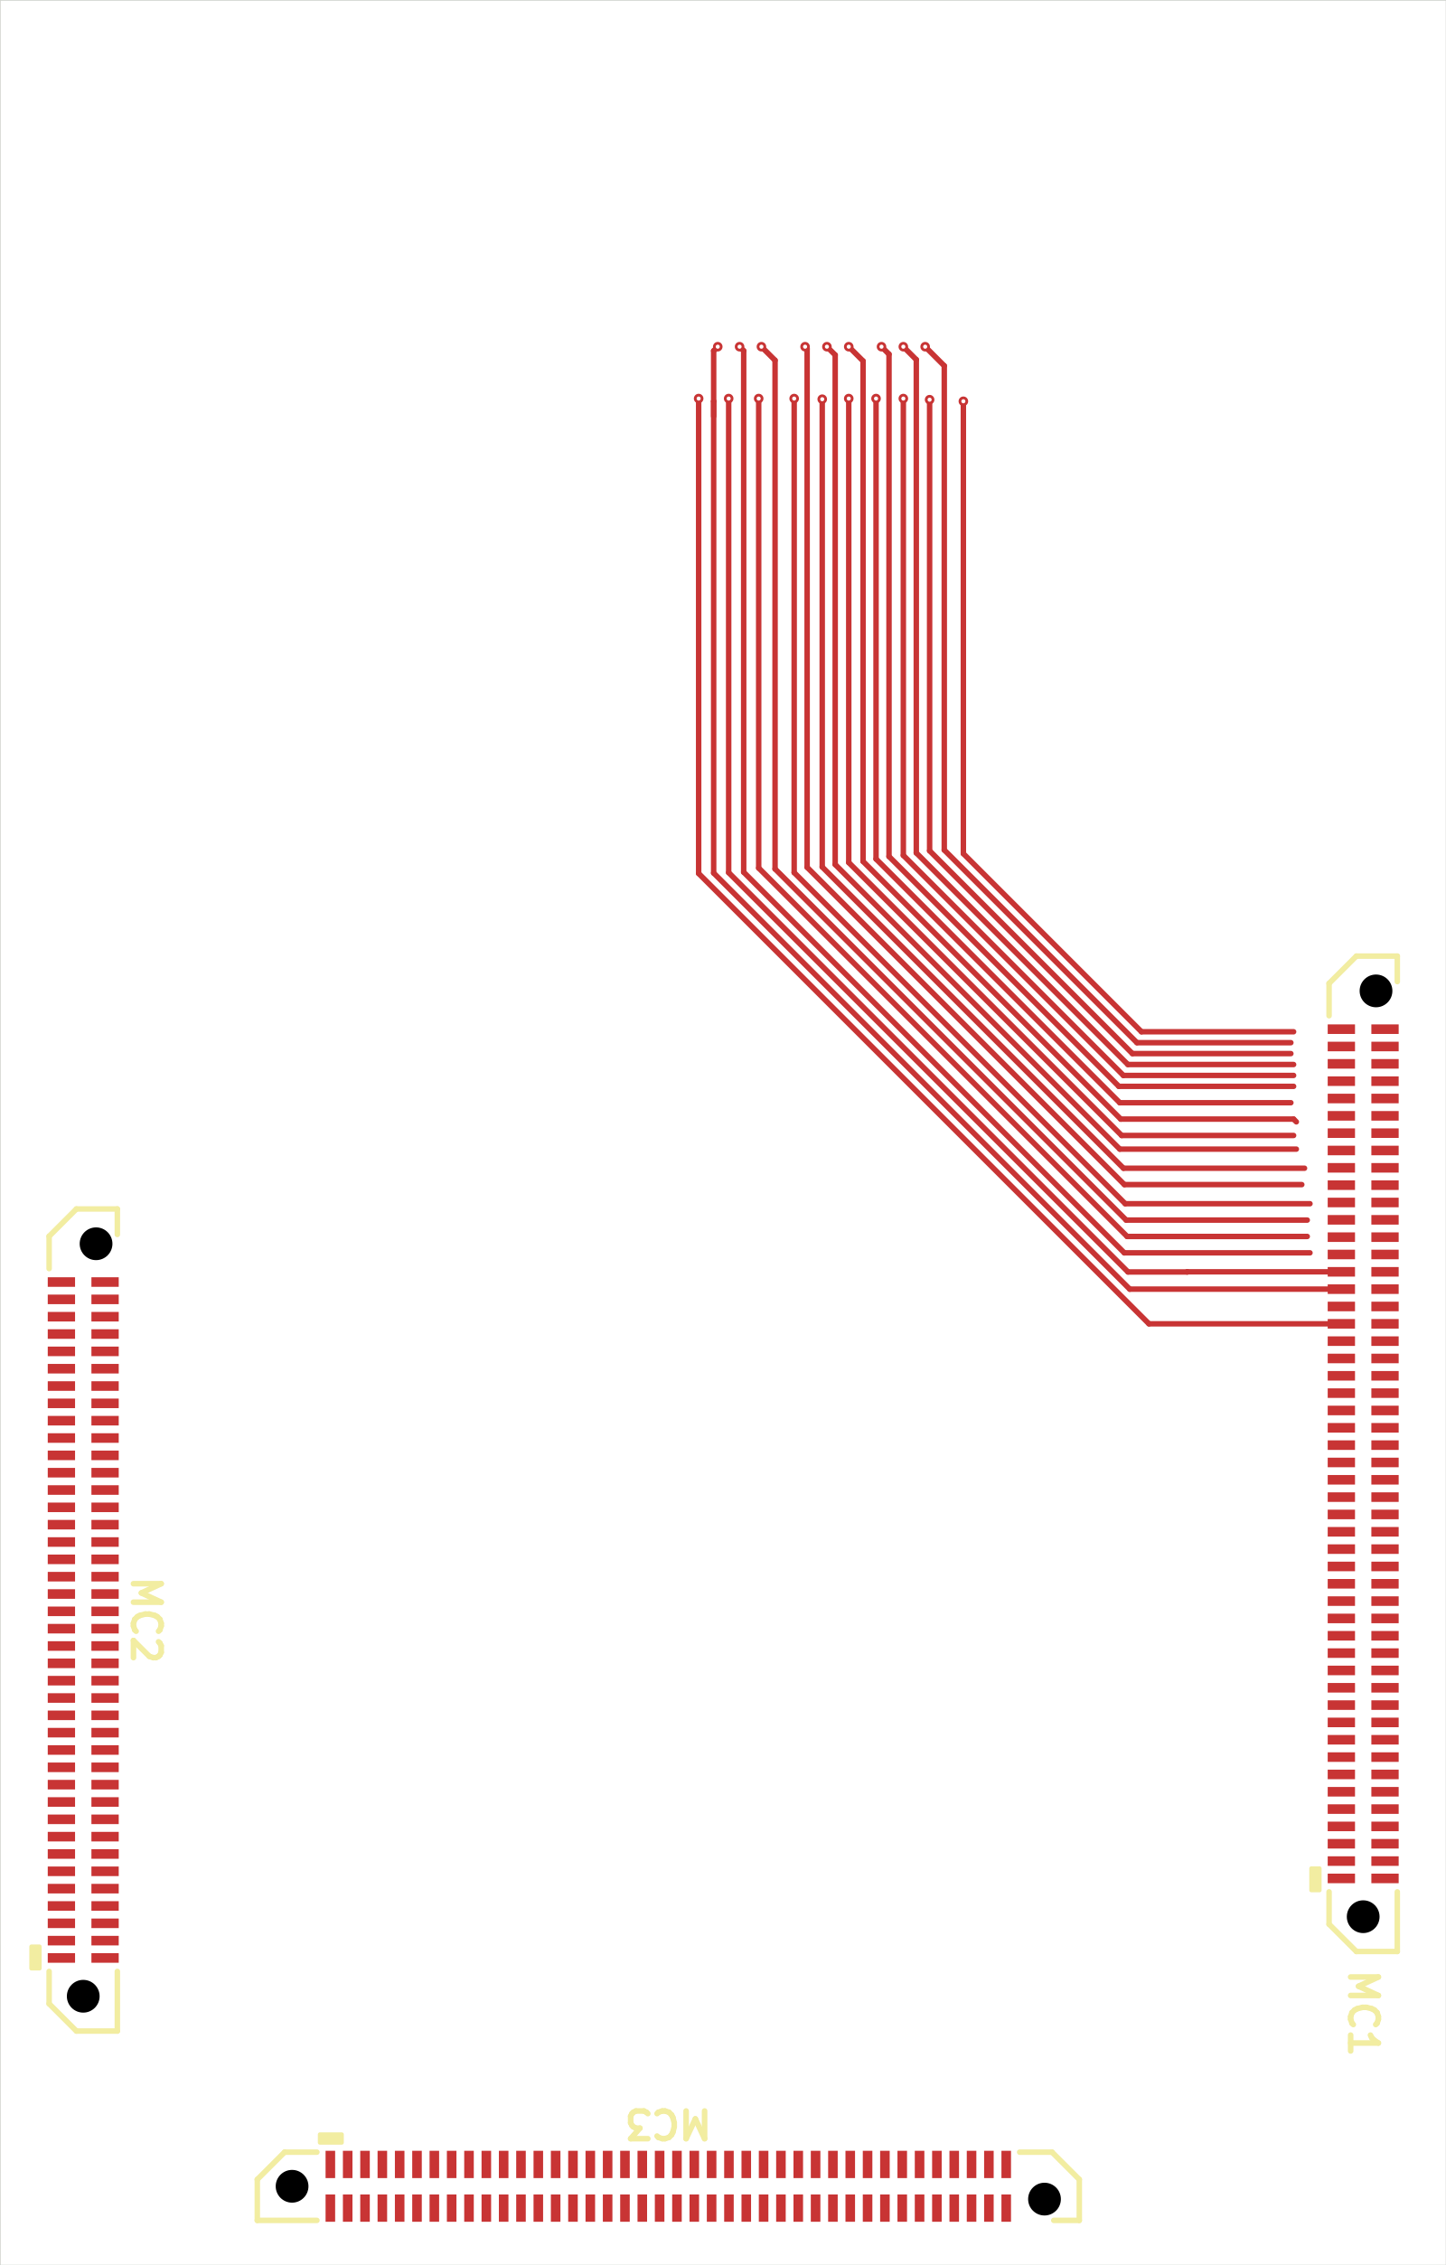
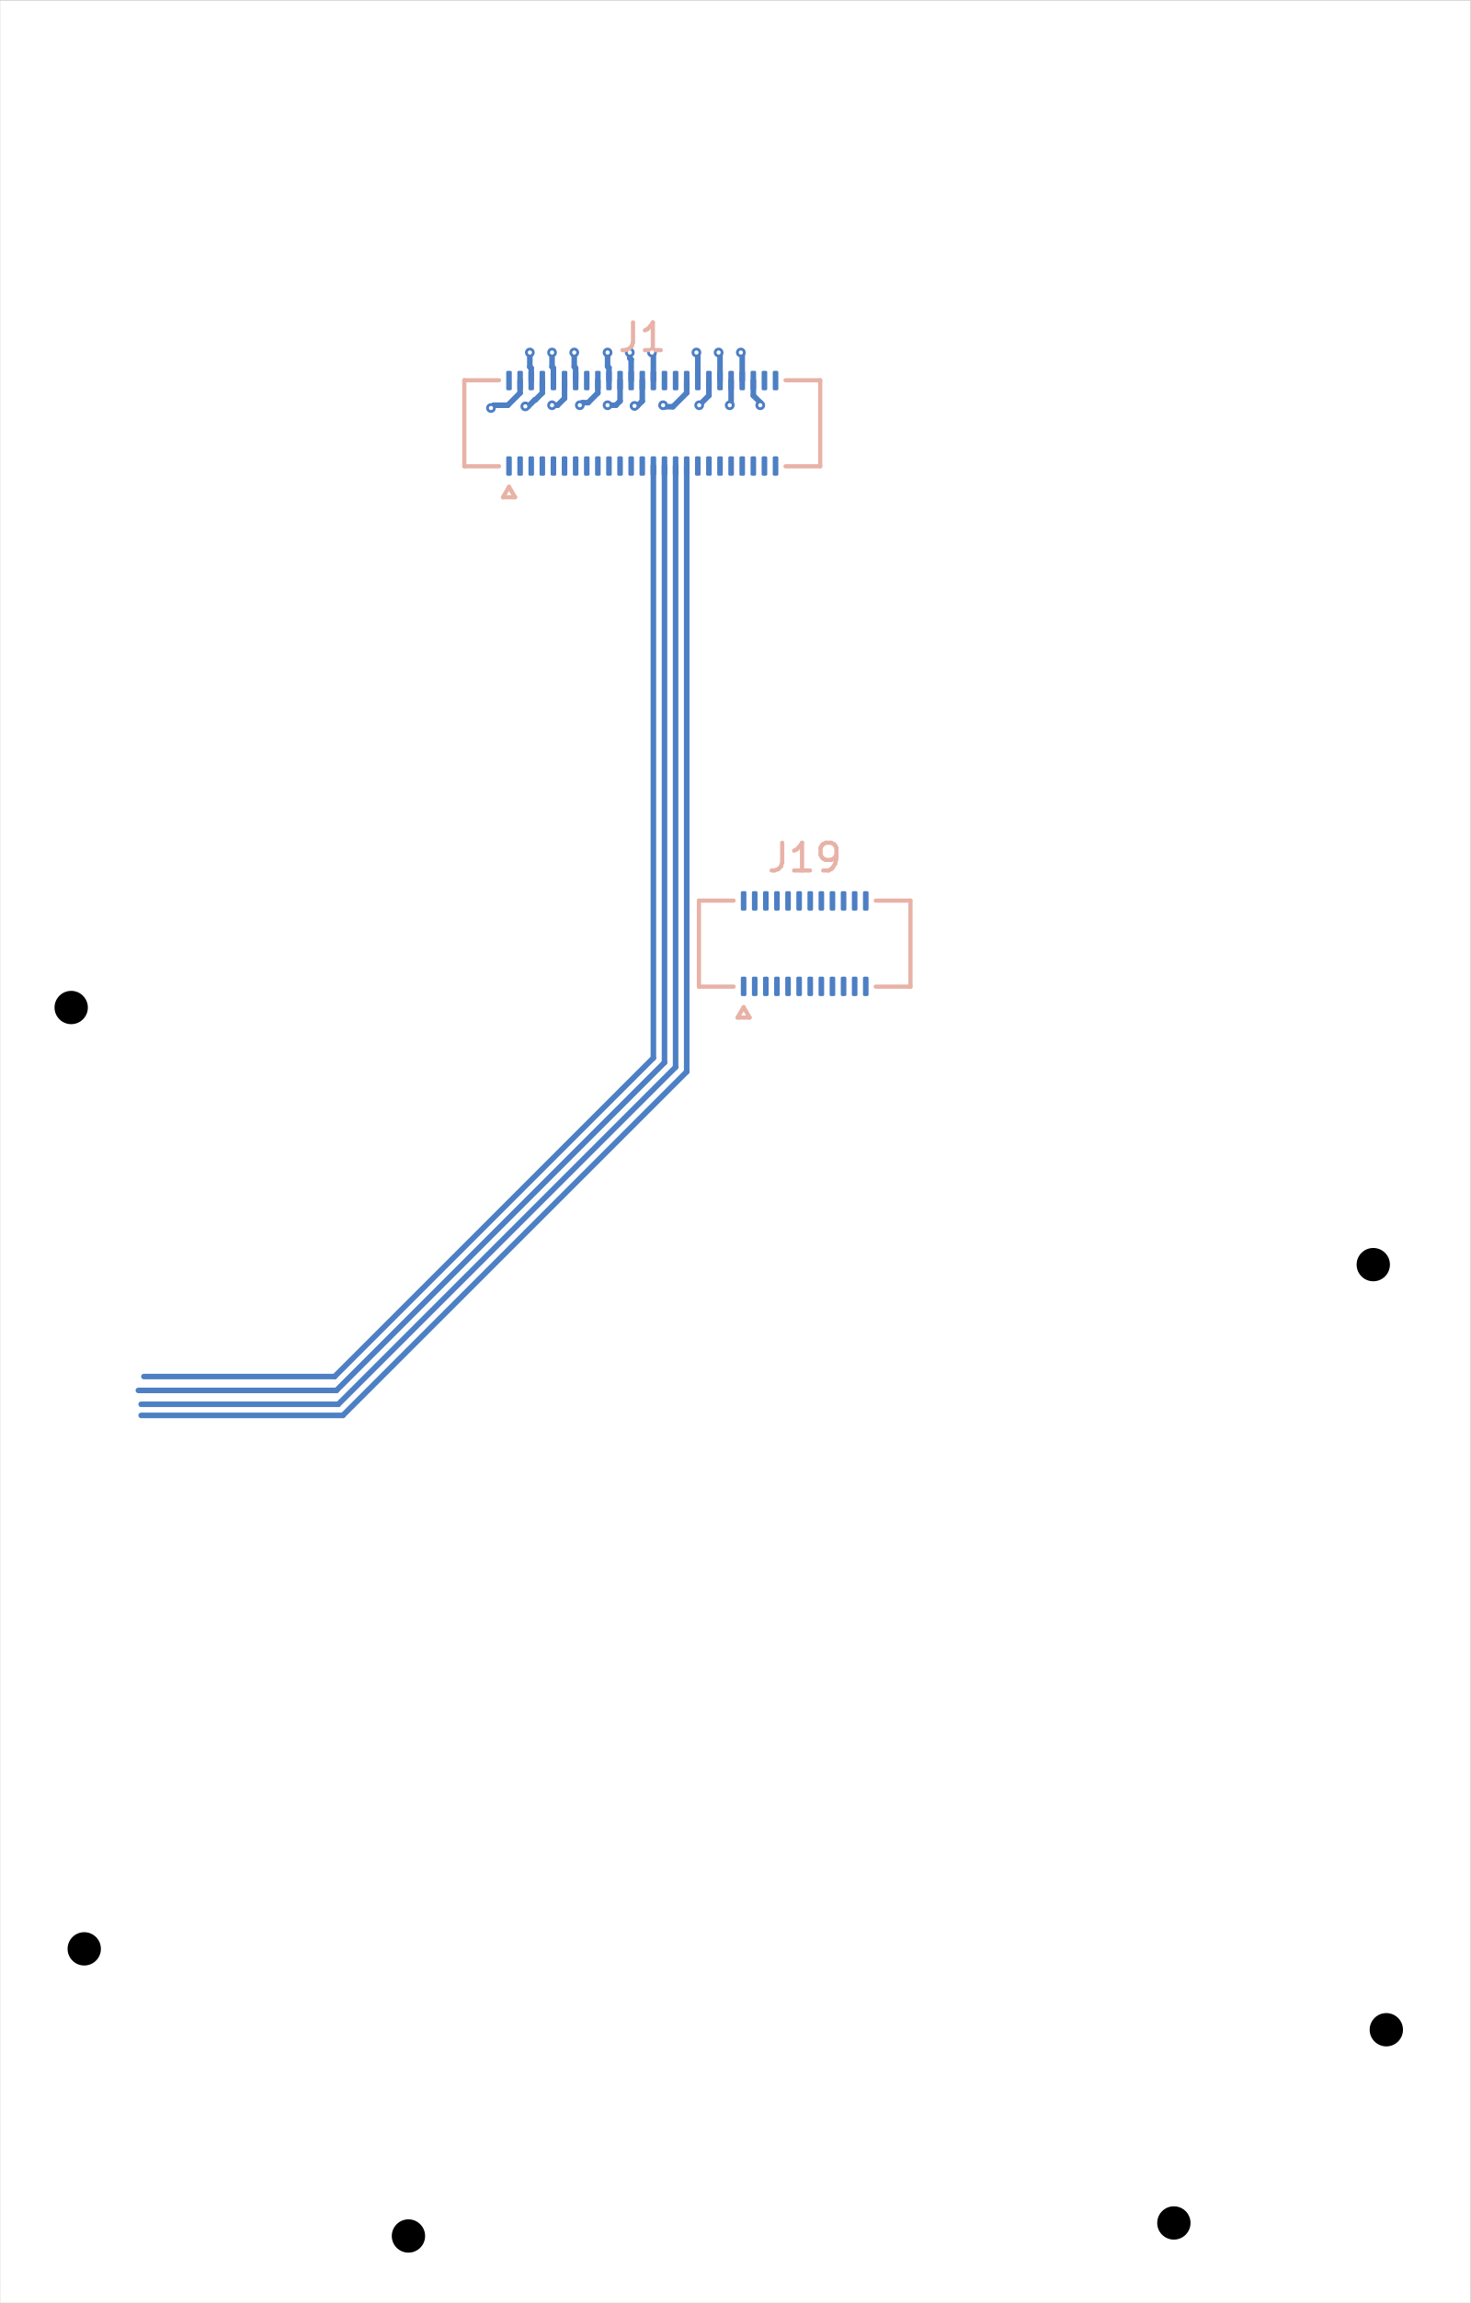
Current carrier PCB
New Desktop carrier, top layout
New Desktop carrier, underside layout
Received routing draft · 20 assigned open connections · power/startup circuit pending.
05 / 11
Notes:
The new Desktop package contains the connector-foundation carrier. Show where the LDO and XEM sockets sit and how the recording bus runs between them. Do not call this a complete powered carrier. The older R3 and R5 circuits remain different revisions, and the R3 manufacturing hold remains in place. The received board uses two copper layers and has no ground plane. The saved Step 8 uses four copper layers and a dedicated In1.Cu DGND plane.
Sources: Board_Howard.zip and native Desktop project; Saved Step 8 connector foundation.
Source files and provenance: https://howardwhsrun.github.io/FPGA_4K/presentation/meetings/2026-10-07.html#files

Slide 6
Zitong’s FPGA and LEDs
XC7A35T-2CSG325I: four GTP lanes and 150 user I/Os.
Eight ASICs need 117 user I/Os; four chips can stimulate.
Two LEDs: power and FPGA DONE, in different colors.
Selected FPGA and LEDs from Zitong’s 7 October list.
06 / 11
Notes:
Zitong's source calls XC7A35T-2CSG325I the final FPGA decision. Its requirements are XC7A series, at least two GTP lanes, more than 120 user I/Os, more than 100 units in stock, authorized AMD distributors and the smallest suitable package. It reports 122 units at JLCPCB and says packages smaller than 15 × 15 mm do not provide enough I/Os for this design. These are Zitong's dated selection claims, rather than current purchasing verification. M1 retains this FPGA and both indicators. The eight-chip statement describes the intended system, rather than demonstrated operation.
Sources: Zitong_1007_Original.pptx, slide 1: FPGA + Package and LEDs.
Source files and provenance: https://howardwhsrun.github.io/FPGA_4K/presentation/meetings/2026-10-07.html#files

Slide 7
Zitong’s reference clock
AX3DCF1-125.0000T3: 125 MHz, 1.8 V LVDS oscillator.
100 nF external AC-coupling capacitors.
LMK1D2102LRGTR: split the clock to MGTREFCLK and MRCC.
Component proposal from Zitong’s original 7 October list.
07 / 11
Notes:
This slide preserves Zitong's proposed clock list and order. The source says Jiaao confirmed that one oscillator can serve the FPGA and GTP clock domains. The oscillator is described as 3.2 × 2.5 mm, ±25 ppm and 186 fs RMS phase jitter typical. The splitter is described as 1:2 LVDS, 1.8 V, up to 2 GHz and VQFN-16 at 3 × 3 mm. Review comments belong here: the source asks for better than ±20 ppm while listing ±25 ppm, and RMS phase jitter does not establish its <10 ps peak-to-peak cycle-to-cycle jitter request. The reported oscillator characterization uses 3.3 V rather than M1's selected 1.8 V. The typed LMK1D2102LRGTR suffix differs from the source's linked LMK1D2102RGTR. M1 adopts the oscillator and AC coupling, but provisionally omits the LMK while the GTP ODIV2 fabric-clock route awaits Vivado verification. Listing the LMK here records Zitong's proposal, rather than claiming it is fitted in M1.
Sources: Zitong_1007_Original.pptx, slide 1: Reference clock.
Source files and provenance: https://howardwhsrun.github.io/FPGA_4K/presentation/meetings/2026-10-07.html#files

Slide 8
Zitong’s flash and level translation
IS25WP128F-JKLE: 128 Mbit SPI NOR flash, 6 × 5 mm.
NVT4858HKZ: FPGA 1.5 V to flash 1.8 V translation.
Programming path: MCU → JTAG → FPGA → SPI → Flash.
Component proposal from Zitong’s original 7 October list.
08 / 11
Notes:
This slide preserves Zitong's flash section and programming workflow. Its requirements are small size, a single SPI interface, Vivado recognition and Artix-7 support. The source gives the ISSI flash a 1.65–1.95 V supply and up to 166 MHz operation. It gives the NXP translator 1.08–1.95 V A-side, 1.65–3.6 V B-side, up to 208 MHz and XQFN-16 at 2.6 × 1.8 mm. Reported inventory and future distributor arrival dates are dated source claims and stay out of the slide body. The source explicitly says NVT4858 was designed for SD/SDIO and that FPGA boot/configuration behavior still needs validation. M1 adopts these exact parts with SPI x1, adapted idle biases and separate boot holds. Physical boot and brownout behavior remain open. The displayed programming path is the source's intended workflow, rather than a completed software demonstration.
Sources: Zitong_1007_Original.pptx, slide 1: Flash.
Source files and provenance: https://howardwhsrun.github.io/FPGA_4K/presentation/meetings/2026-10-07.html#files

Slide 9
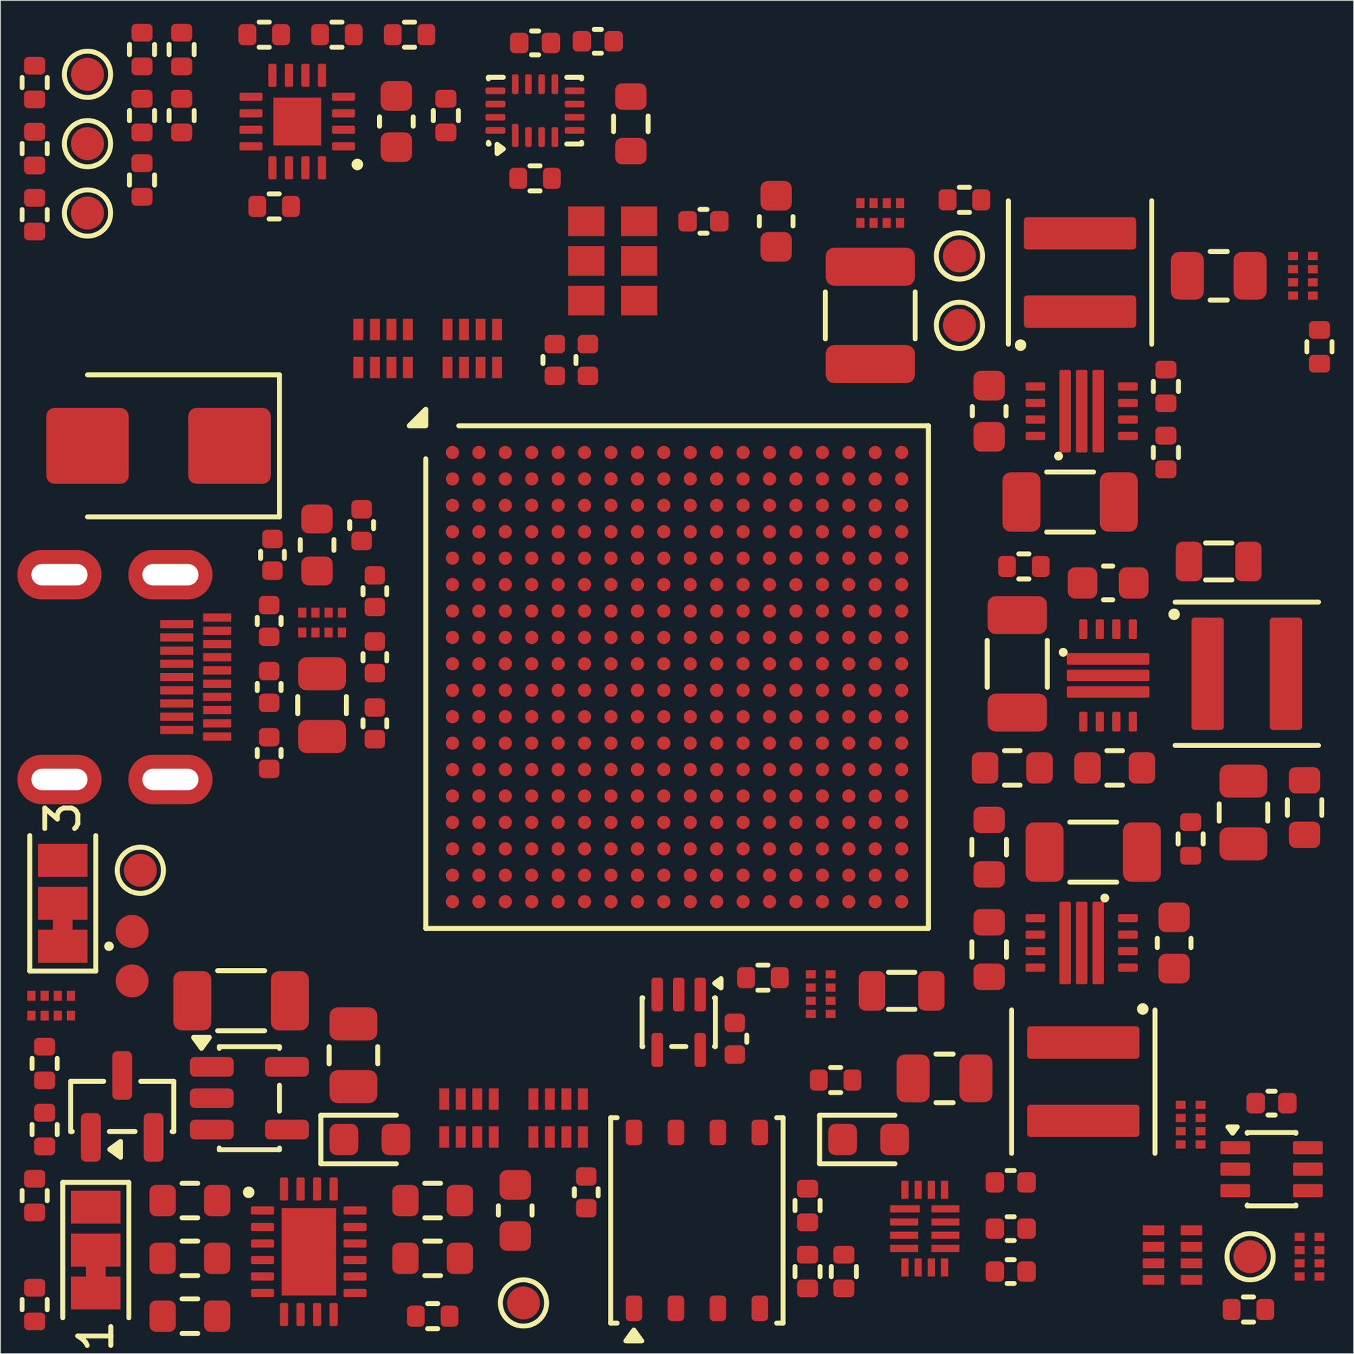
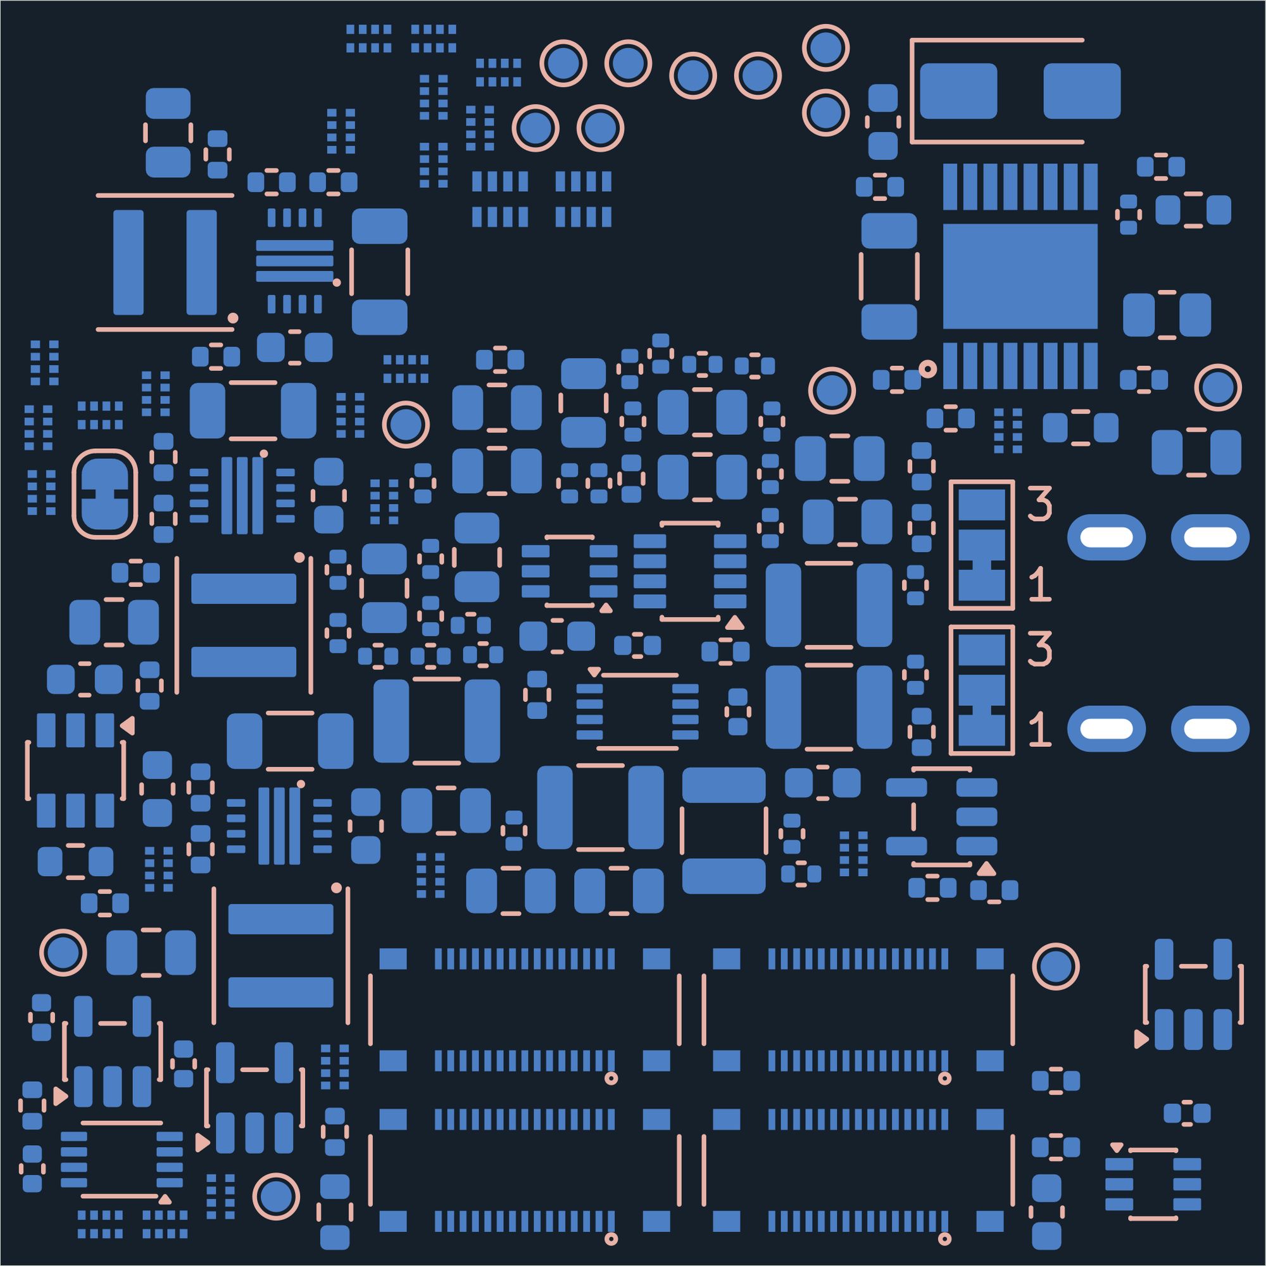
Current FPGA PCB
Component side
Underside · four mezzanine connectors
41 × 41 mm · 287 parts · 1,091 connections await routing.
09 / 11
Notes:
The board size stays at 41 by 41 millimeters. We have removed parts and regrouped clock and flash support, but freed placement space does not automatically make the board smaller. The four floating mezzanine connectors remain on the bottom. This is the actual M1 PCB, with expected unrouted connections. The earlier README lists 40 × 40 mm, but fresh native centerline geometry measures 41 × 41 mm. Use the measured outline here. The CLI lists only 499 of the 1,091 actual pending PCB connections.
Sources: FPGA35T_M1.kicad_pcb; M1 native validation and snapshot manifest.
Source files and provenance: https://howardwhsrun.github.io/FPGA_4K/presentation/meetings/2026-10-07.html#files

Slide 10
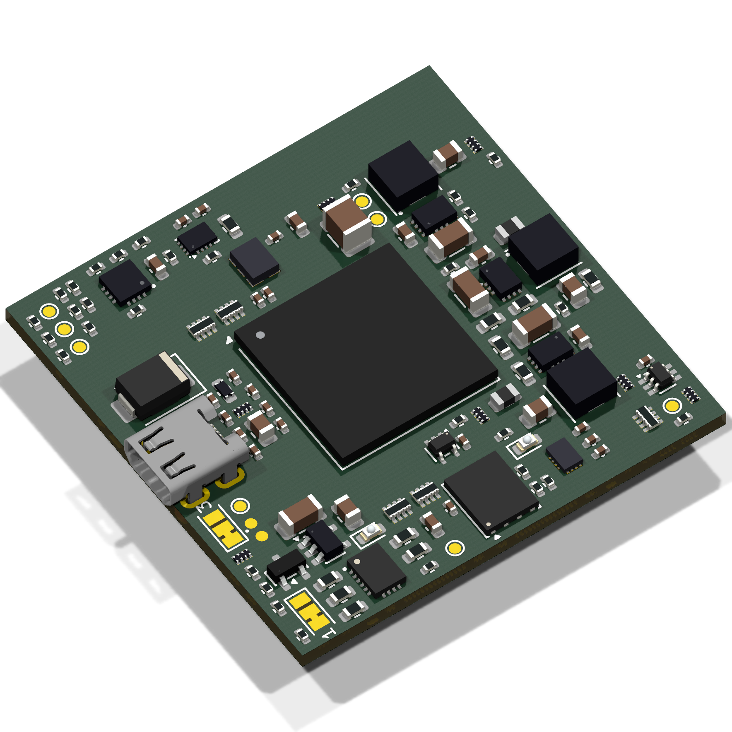
Current FPGA board in 3D
Native KiCad model. Oscillator and translator bodies are nominal envelopes.
10 / 11
Notes:
Rotate the model to show the component side and the four bottom connector locations. The geometry comes from the native PCB. Some bodies are explicitly labeled nominal envelopes, including the new oscillator and translator. This model supports review of placement and side, but cannot establish a populated fit result.
Sources: M1 native 3D export; M1 3D model provenance.
Source files and provenance: https://howardwhsrun.github.io/FPGA_4K/presentation/meetings/2026-10-07.html#files

Slide 11
Gerald’s board-design guidance
Keep related clock and data paths short and matched.
Place bypass capacitors close to ICs and keep continuous ground returns.
Use compact, regular placement and manufacturer-approved FPGA escapes.
Next: clock and boot checks, carrier routing, and assembled connector fit.
11 / 11
Notes:
The October 6 feedback highlighted routing quality, regular placement and unmatched delays. The earlier directions also call for power-distribution checks, practical blind-via escapes, compact placement and bottom connectors. Our engineering application is to review the full signal and return path, not only visual symmetry. A factory stackup and guaranteed ASIC timing still need evidence. Our next concrete review should use the native two-sheet FPGA drawing and the new carrier PCB. The requirements that still need ASIC-side evidence are pad levels, recording data-valid timing, rail currents and power-loss behavior. The fabrication stackup and mechanical seating need supplier or physical evidence. The one-chip XEM path is the first integration step, with eight-chip scaling following verified results.
Sources: 6 October recorded Gerald feedback and routing plan; 4 October recorded routing directions.
Source files and provenance: https://howardwhsrun.github.io/FPGA_4K/presentation/meetings/2026-10-07.html#files

