Slide 1
Team Project Phase II
M124020029 黃政曦
M124020033 毛天楷
M124020044 林聖皓

Slide 2
Dataset
We choose：Jobs and Salaries in Data field
Reason：
Compared with the spotify data set, this data set has more years of data.
Compared with the spotify data set, this data set is better visualized
The multi-dimensional information provided by this dataset.
We are more interested in this data set than the spotify data set

Slide 3
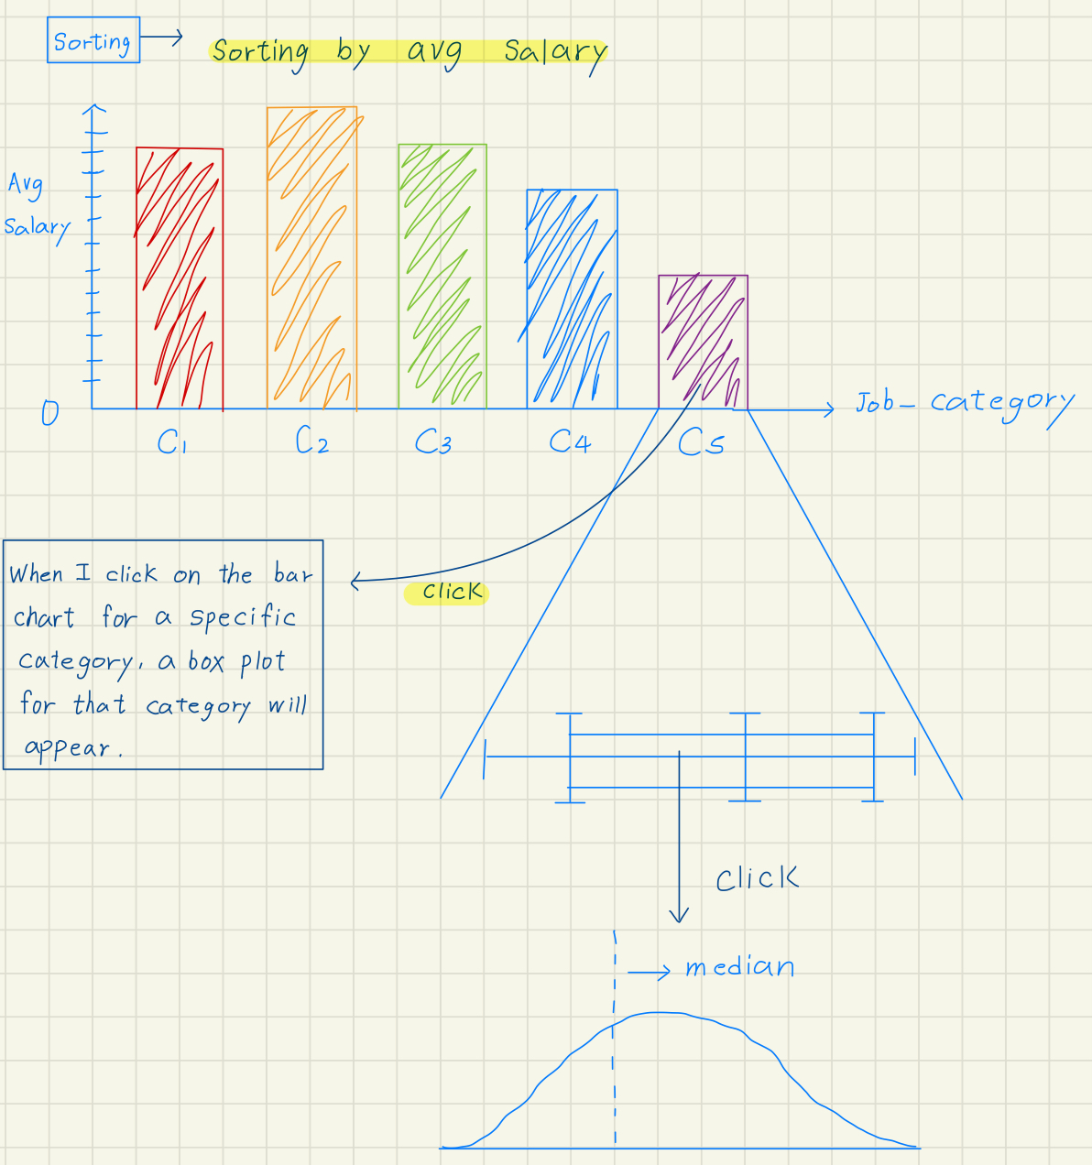
Q：Display the average salary and median salary for each Job_category.
Critique：
pro：Using box plots can help ensure that outliers do not affect the results.
Con：Additional space is required to display box plots.

Slide 4
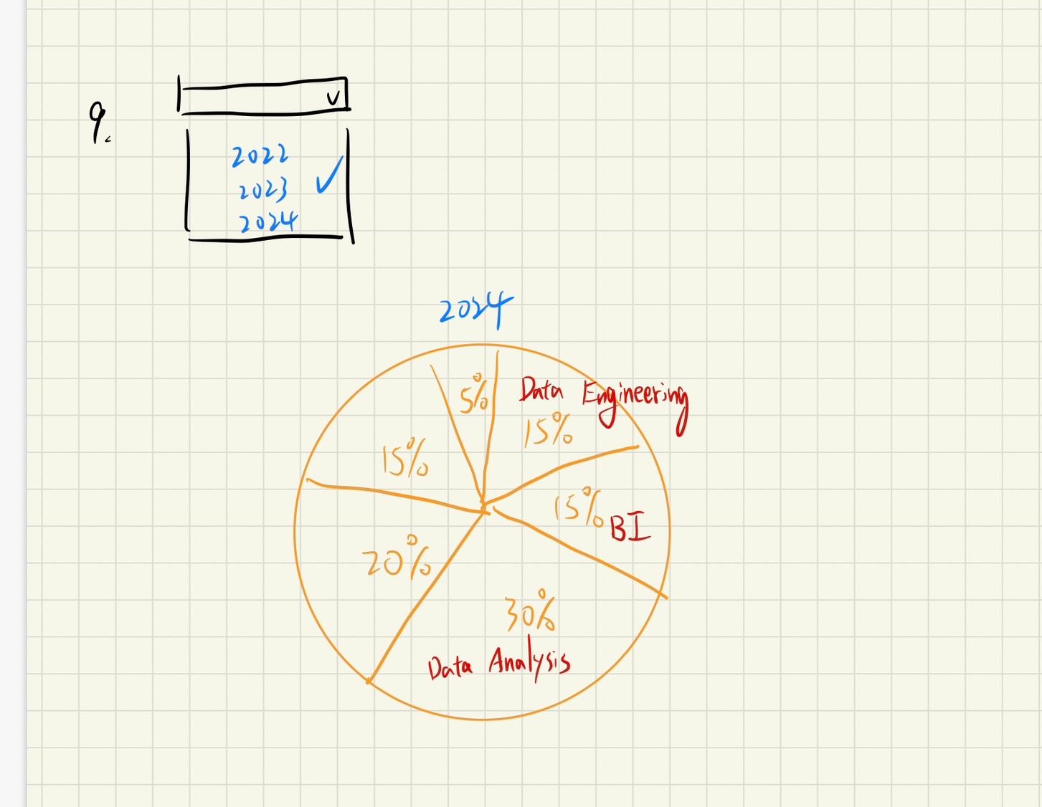
Q. To show how job_category changes with different work_year
Critique：
pro：Using pie chart is easy for comprehending the propotions of job categories based on different years
con：If there isn’t enough data, then there may be some bias through this proportion

Slide 5
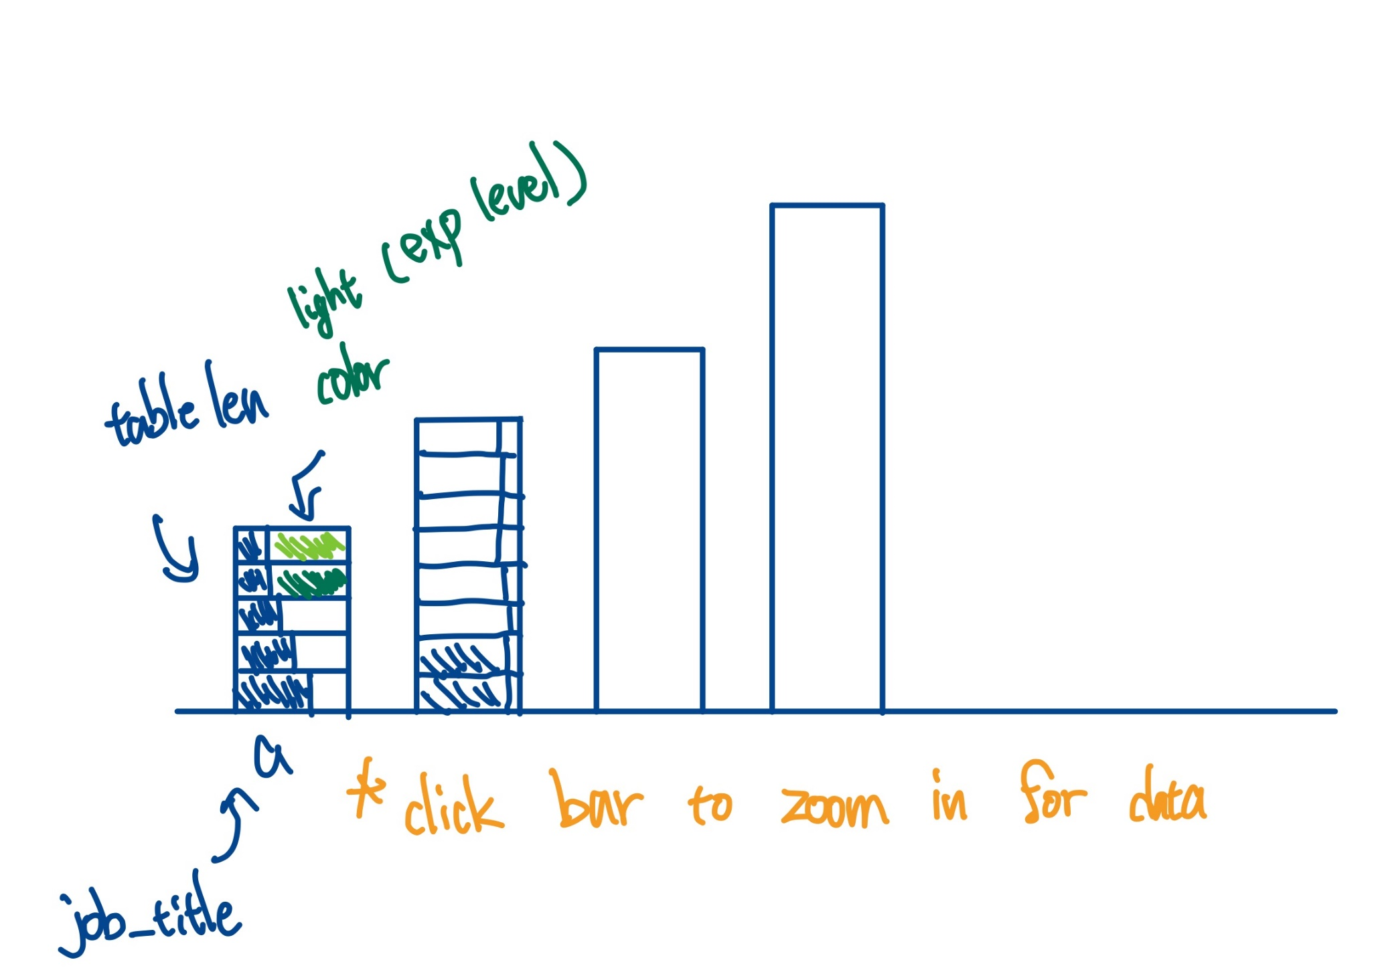
Q. What the job_title distribution in a single job_category
Visualization：
x axis - job_title
(table lens with a categorical variable)
y axis – number of people

Slide 6
Members’ Contribution
Each member has to figure 3 visualization designs in detail and indicate which questions they can answer.
Choose three appropriate designs from these 9 version of figures.
jobs | loading
Explain this topic we chose | 1 member
3 version of designs | 3 members
Finish the ppt | 1 member

Slide 7
References
Data:
https://www.kaggle.com/datasets/murilozangari/jobs-and-salaries-in-data-field-2024

