Slide 1
HW2
M124020044 林聖皓

Slide 2
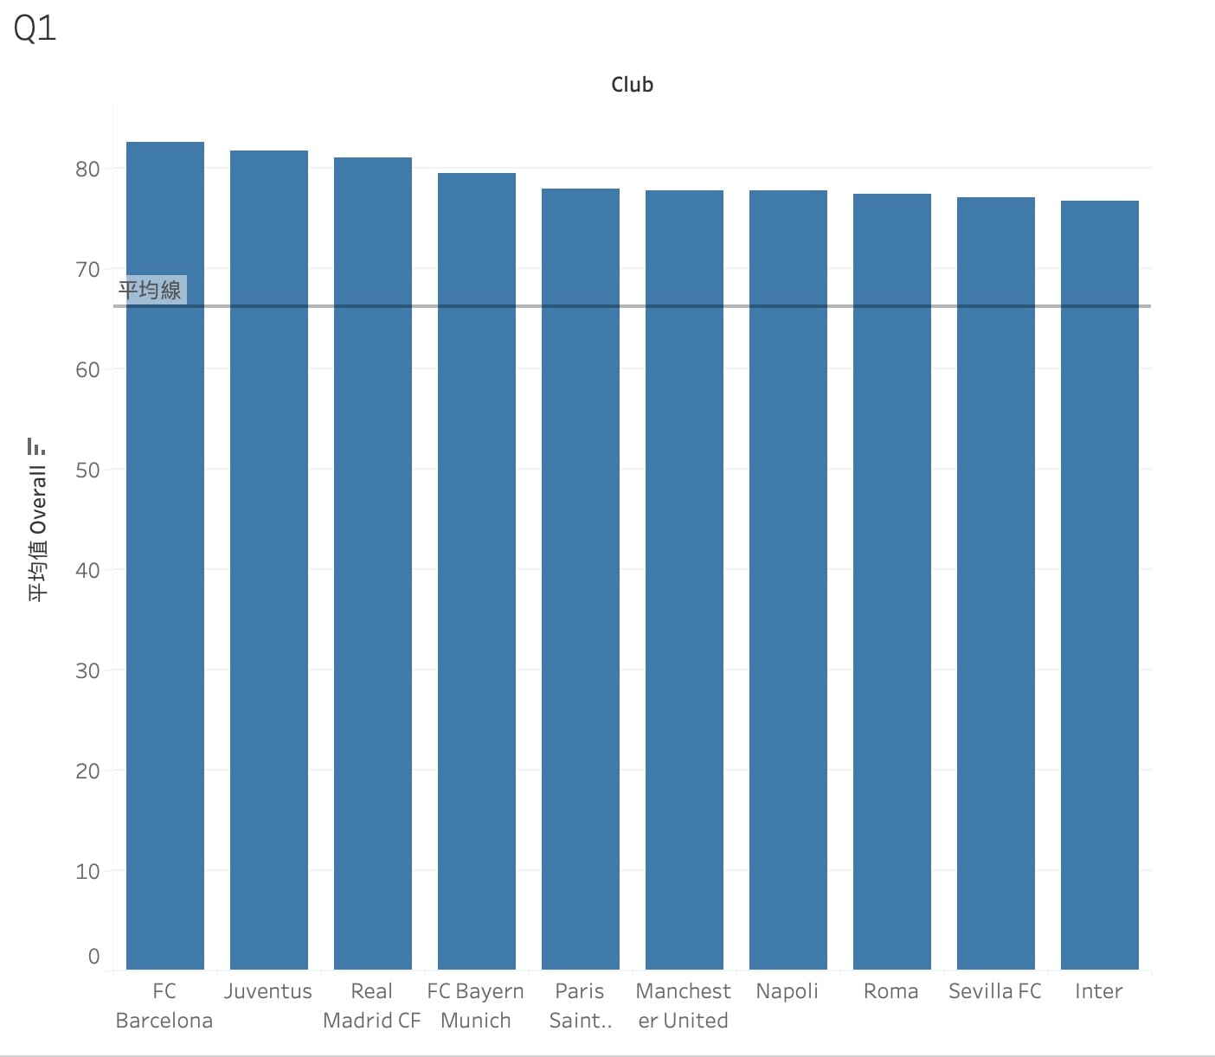
Q1. Which teams have the best players?
It is a bar chart displaying the top 10 teams with the highest average overall rating of players.
There is a line representing the average overall of all players
Why this plot?
Choosing a bar chart allows you to intuitively see the players with the highest values.
Add a average line can easily see the comparison between these 20 players and average player.

Slide 3
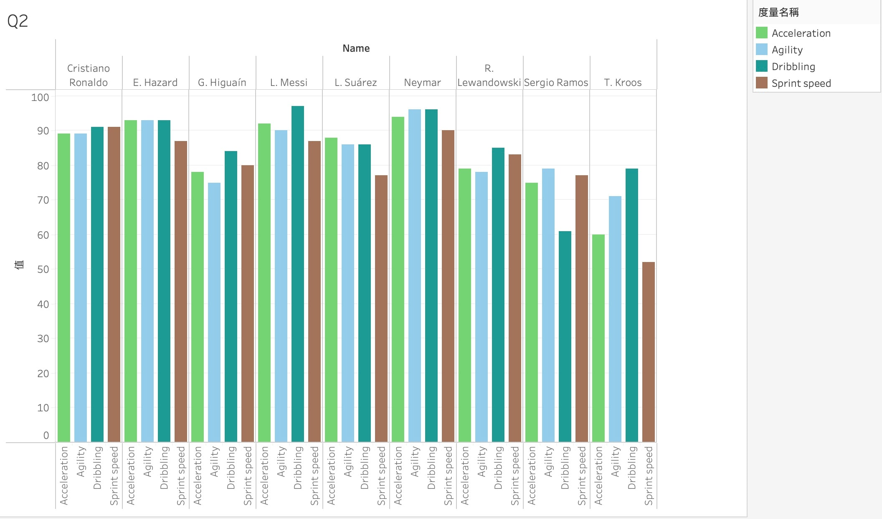
Q2. How do players with overall ratings of at least 90 compare?
1. Use filter to filter the players(except GK) with at least 90 overall.
2. Select acceleration, agility, dribbling, sprint speed as variables.
Why this plot?
Choosing a bar chart allows you to intuitively see the players with their value of skills.
It’s easily to know the value of each skills of a player.

Slide 4
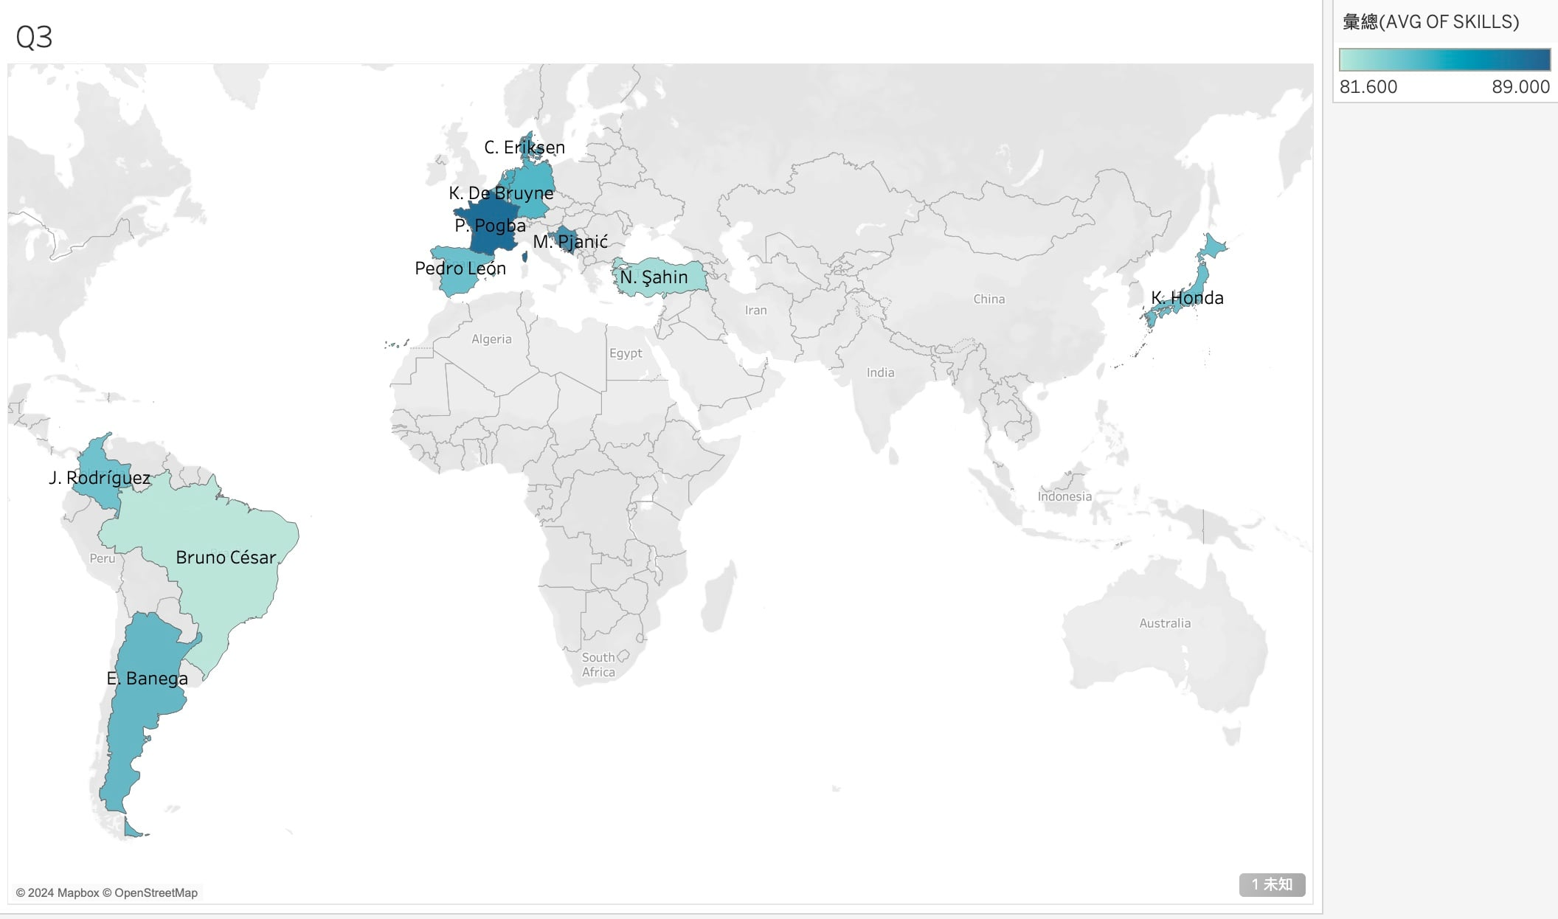
Q3. Where do players with the best skills came from?
Average the skills of(Dribbling, Curve, Free kick accuracy, Long passing, Ball control)
Use map to show these players’ born Nation
Why this plot?
Drawing in a map can easily know the born countries of these players
Average the skills of these players and use the depth of colors to know their skills

Slide 5
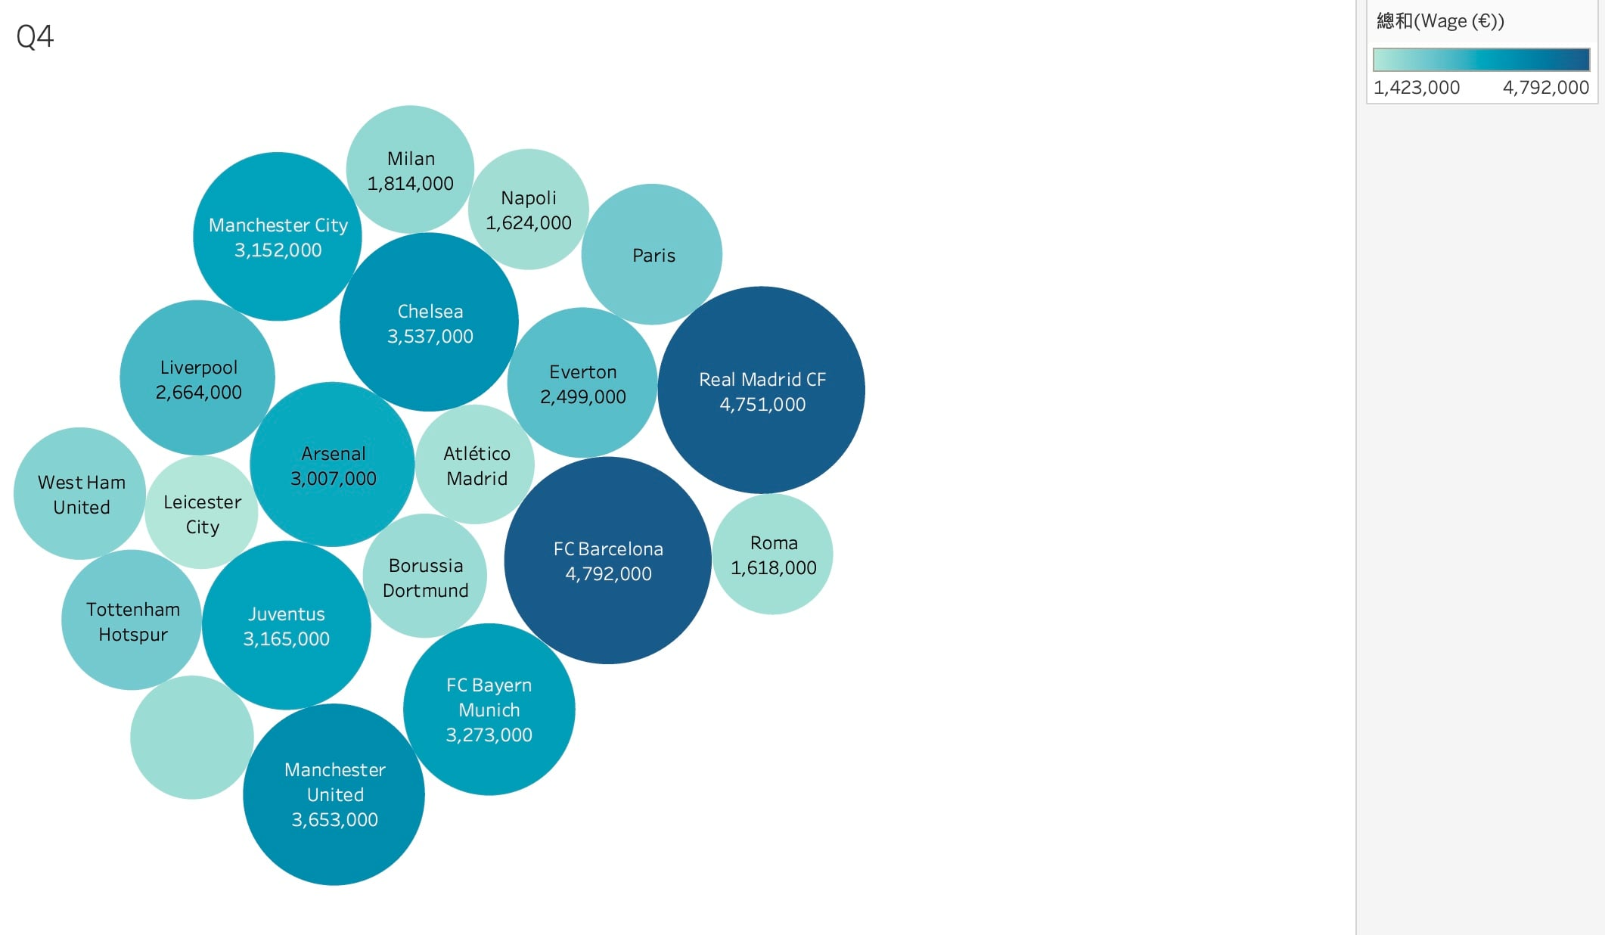
Q4. Which teams offer the most wages?
Filter the 20 most total wages team
The size of bubble means the wages value.
Also the depth of color represents the amount of wages
Why this plot?
Bubble plot can easily show the value by sizes of circle
It is intuitively to know which teams offer the most wages by circle size or the depth of colors

Slide 6
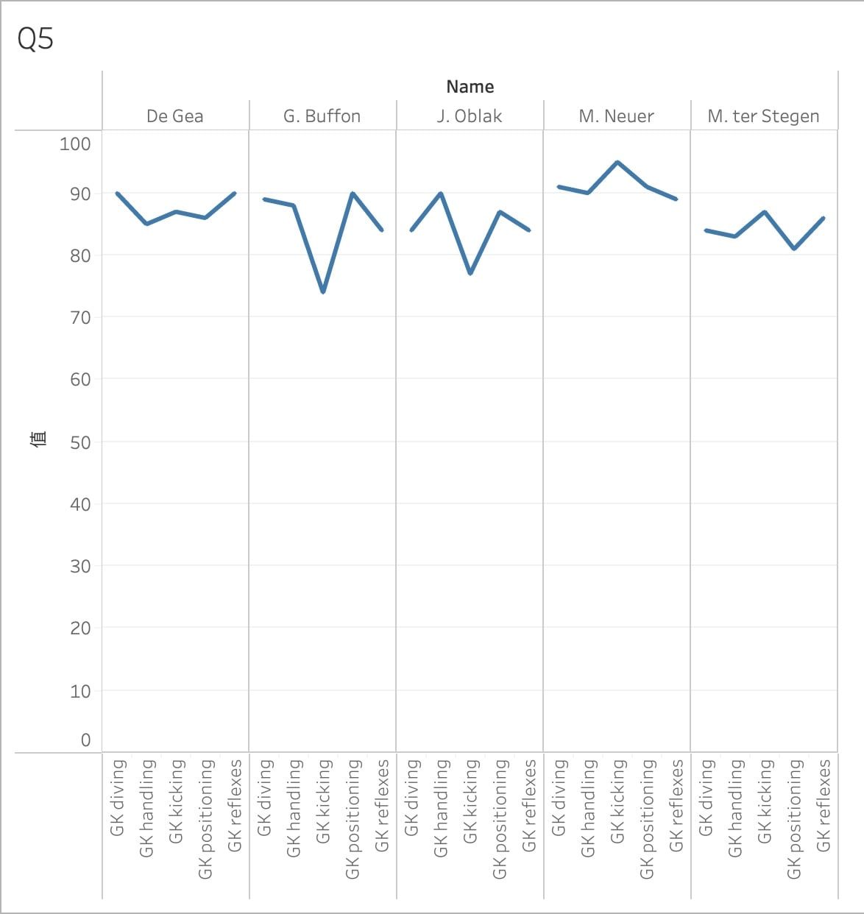
Q5. Which GK has the best GK skills?
Filter the GK with the top 5 overall rating
Select 5 skills about GK
Why this plot?
A line chart can clearly compare the values of different GK skills for each goalkeeper.

Slide 7
Critique of Tableau
Cons
1.Cost
2. Performance Issues with Large Datasets
3. Complexity for Advanced Customizations
Pros
1. User-Friendly Interface
2. Powerful Data Visualization Capabilities
3. Strong Data Handling
4. Integration with Multiple Data Sources

Slide 8
Reference
Data https://public.tableau.com/app/sampledata/fifa18_clean.csv
I’ve used tableau before

