Slide 1
HTML5 Tags

Slide 2

Video

Slide 3
The grateful death of video plug-ins
Before HTML5, a video could only be played in a browser with a plug-in (like flash).
The HTML5 <video> element specifies a standard way to embed a video in a web page.
In modern browsers, adding a video to your page is as easy as adding an image. No longer do you need to deal with special plug-ins or require crazy markup, you can do it with a single element.

Slide 4
Supported formats
MP4
WebM
Ogg

Slide 5
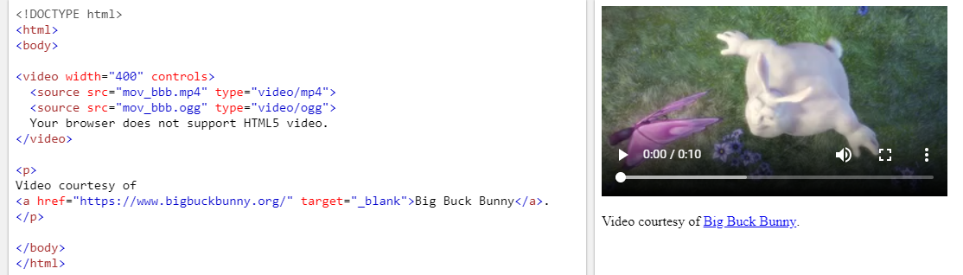
Important attributes and tag
controls | width/height | source

Slide 6
Video display and media fragments
https://www.w3schools.com/html/tryit.asp?filename=tryhtml5_video_js_prop
#t=[start_time][,end_time]
hours:minutes:seconds, such as #t=00:01:05
<source src="devstories.webm#t=10,20" type='video/webm;codecs="vp8, vorbis"' />

Slide 7

Audio

Slide 8
Supported formats
MP3
WAV
Ogg

Slide 9
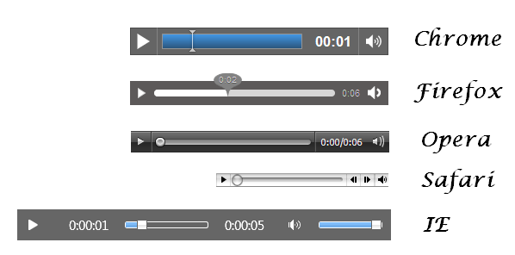
Default browser styles

Slide 10
canvas

Slide 11
Let’s see how canvas works
https://www.w3schools.com/html/html5_canvas.asp
http://cheatsheetworld.com/programming/html5-canvas-cheat-sheet/

Slide 12
Practice
http://www.williammalone.com/articles/create-html5-canvas-javascript-drawing-app/
https://github.com/nitishdayal/JavaScript30/tree/master/exercises/08%20-%20Fun%20with%20HTML5%20Canvas
http://www.zsoltnagy.eu/javascript-tech-interview-exercise-7-painting-on-an-html5-canvas/
http://bencentra.com/2017-07-11-basic-html5-canvas-games.html
http://www.zsoltnagy.eu/javascript-tech-interview-exercise-8-video-player/

Slide 13
References
https://developer.mozilla.org/en-US/docs/Web/HTML/Element/video
https://www.html5rocks.com/en/tutorials/video/basics/
https://www.w3schools.com/html/html5_audio.asp
https://developer.mozilla.org/en-US/docs/Web/HTML/Element/audio
https://html5tutorial.info/html5-audio.php
https://www.w3schools.com/html/html5_canvas.asp
https://www.w3schools.com/graphics/canvas_intro.asp
http://cheatsheetworld.com/programming/html5-canvas-cheat-sheet/
https://developer.mozilla.org/en-US/docs/Learn/HTML/Multimedia_and_embedding/Video_and_audio_content
https://www.w3schools.com/tags/ref_av_dom.asp
https://www.w3schools.com/html/html5_video.asp

