Slide 1
DOM

Slide 2

Document
Object
Model

Slide 3
The DOM is not a programming language.
Virtual map of the web page.
Jump around the map to do dynamic effects with JavaScript or other languages.
Browser uses DOM to know how to display webpages.
API (HTML or XML page) = DOM + JS (scripting language)

Slide 4
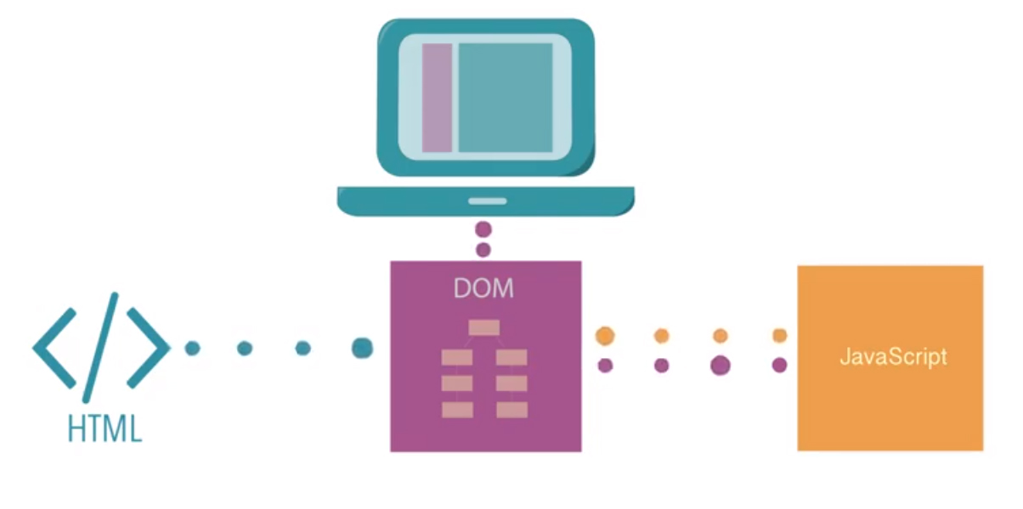

Slide 5
api
Application Programing Interface
allows 2 computer software programs to communicate with each other. Defines the correct way for a developer to write a program that requests services from an OS or other application

Slide 6
Node Types
Document[9]
DocumentType[10]
Element[1]
Text [3] Comments[8]
DocumentFragments[11]

Slide 7
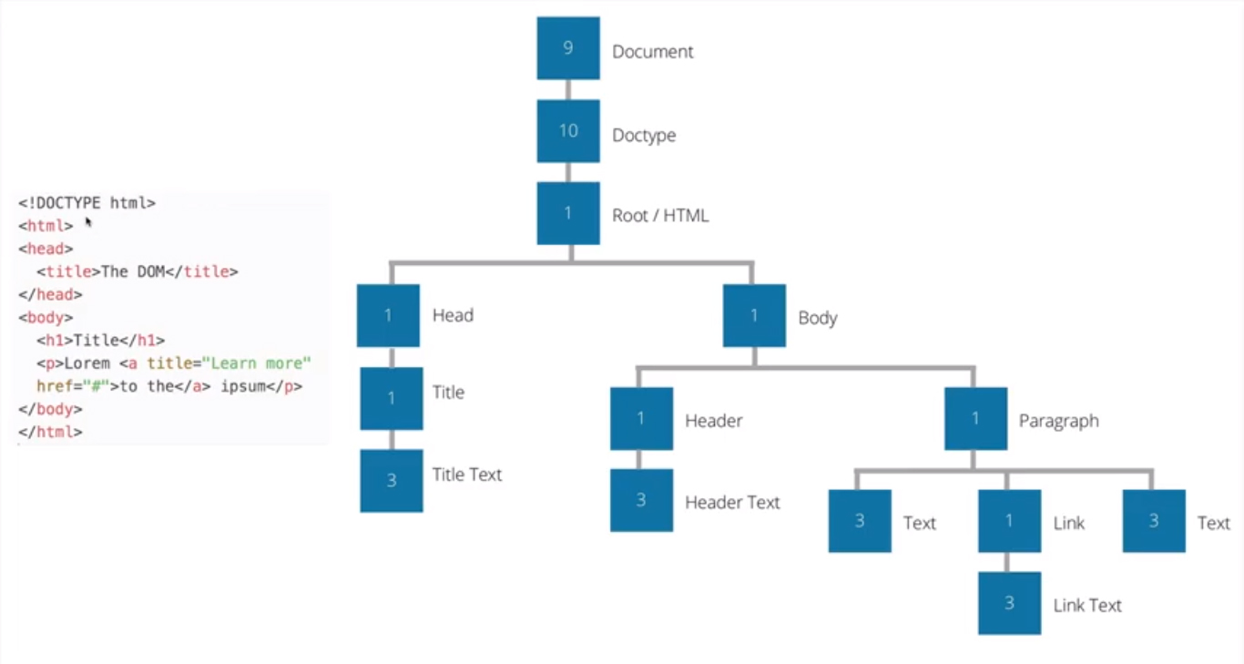

Slide 8
Data types
Document
Element
Nodelist
Attribute
NamedNodeMap

Slide 9
Important methods
createElement()
createTextNode()
appendChild()
insertBefore()
removeChild()

Slide 10
Method Examples
createElement()
https://glitch.com/edit/#!/domdomdom?path=index.html:7:48
appendChild()
https://www.w3schools.com/jsref/tryit.asp?filename=tryjsref_node_appendchild
insertBefore()
https://www.w3schools.com/jsref/tryit.asp?filename=tryjsref_node_insertbefore2
removeChild()
https://www.w3schools.com/jsref/tryit.asp?filename=tryjsref_node_removechild

Slide 11
Practice websites
https://www.w3resource.com/javascript-exercises/javascript-dom-exercises.php
https://medium.freecodecamp.org/learn-how-to-manipulate-the-dom-by-building-a-simple-javascript-color-game-1a3aec1d109a
https://www.theodinproject.com/courses/web-development-101/lessons/dom-manipulation
https://www.teaching-materials.org/jsweb/exercises/dom_manipulation_advanced

Slide 12
references
https://www.youtube.com/watch?v=l-0nPnSvbX8
https://developer.mozilla.org/en-US/docs/Web/API/Document_Object_Model/Introduction
https://www.w3schools.com/jsref/met_node_removechild.asp

