Slide 1


Slide 2

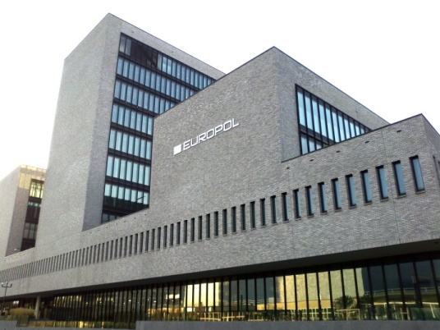
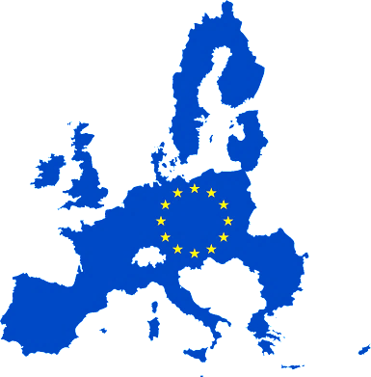

European Union Agency for Law Enforcement Cooperation- EUROPOL
Law enforcement agency of EU
Coordinates the activities of police agencies of all 27 EU member states
Headquarter – The Hague, Kingdom of Netherlands
Has a number of strategic and operational partners

Slide 3
Mandate
Europol listens to what EU Member States need and analyses crime trends in the EU. The Agency supports investigations initiated by Member States, though Europol officers never arrest citizens or instigate investigations. Europol’s work usually consists of dealing with crimes that require an international approach and cooperation between several countries, inside and outside the EU.

Slide 4
Facts and figures on Europol
- More than 1400 staff
- 264 Europol Liaison Officers
- Thousands of international investigations supported each year
- Became an official EU agency on 1 January 2010

Slide 5
Europol’s operational activities focus on:
Illicit drugs
trafficking in human beings
facilitated illegal immigration
cybercrime
euro counterfeiting
VAT fraud
money laundering and asset tracing
intellectual property crimes
cigarette smuggling
outlawing motorcycle gangs
Terrosism

Slide 6
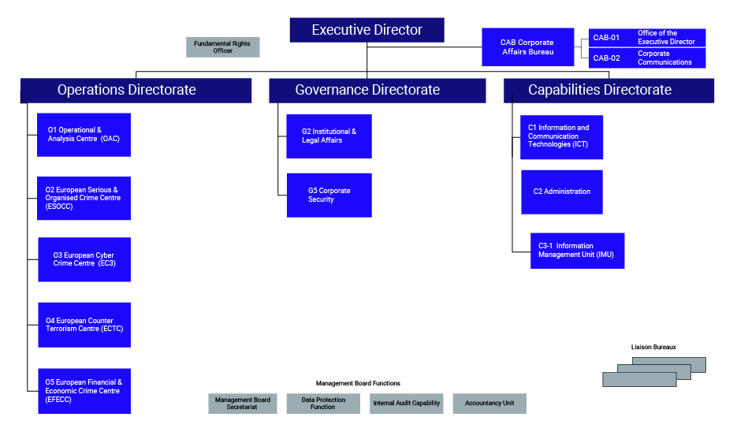
Strategic information:
Trends and ways of committing crimes;
Observations and data obtained as a result of the successful application of new law enforcement methods and tools; Використання нових технологій у правоохоронній діяльності;
Threat assessment and criminal situation reports;
New ways of committing crimes;
Other

Slide 7


Standard model of cooperation between countries and Europol
- Europol national offices (for non-EU countries - National Contact Points)
- Country Liaison Office at Europol Headquarters in The Hague
- Contact Points (or contact persons) for interaction between law enforcement units and Europol National Contact Point

Slide 8







Europol partners
In addition to countries, Europol has a number of strategic and operational partners among other EU agencies and international organizations

Slide 9



Europol primarily provides for the exchange of strategic and operational information
Strategic information:
Trends and ways of committing crimes;
Observations and data obtained as a result of the successful application of new law enforcement methods and tools;
Use of new technologies in law enforcement activities;
Threat assessment and criminal situation reports;
New ways of committing crimes;
Other

Slide 10



Operational information
“Operational information” includes exchange and processing:
Personal data of individuals and other identifying characteristics;
Detailed information about legal entities;
Information obtained in the course of investigative or detective activities;
Examination results;
Other

Slide 11


SIENA
(Secure Information Exchange Network Application)
provides a fast and easy exchange of operational and strategic information on crime prevention:
Europol liaison officers, analysts and experts;
EU member states ;
Third parties with whom Europol has entered into the necessary agreements.

Slide 12
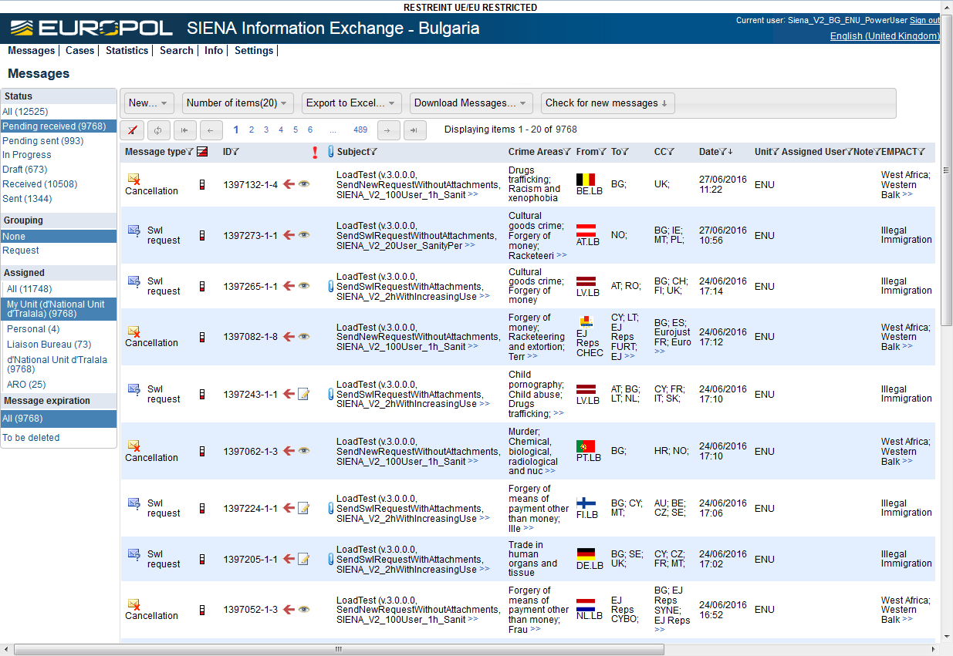
Exchange of information through SIENA

Slide 13
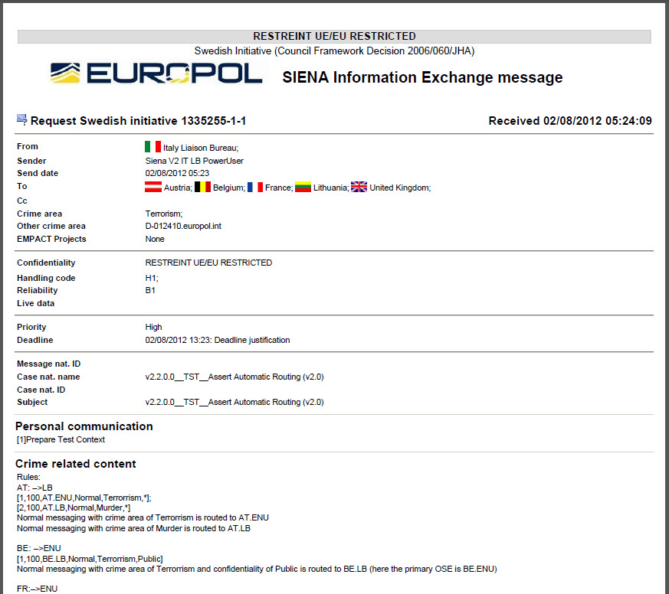
SIENA

Slide 14



Analytical projects of Europol
Projects coordinated by Europol Serious and Organized Crime – SOC);
Provide support for investigations and coordinate operations in the areas of activity;
Promote international and interagency cooperation;
They carry out analytics and checks on Europol's internal records

Slide 15

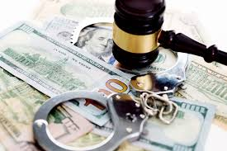

Some Europol analytical projects
AP “FURTUM” – serious and organized property crimes;
AP “EEOC” Eastern European Organized Crime;
AP “ENVICRIME” – crimes against the environment;
AP “COPY” – violation of intellectual property rights;
AP “SUSTRANS” – money laundering;
AP “TWINS” – combating sexual exploitation of children;
AP “PHOENIX” – combating human trafficking;
AP “COLA” – illegal cocaine trafficking;
AP “SOYA” – money counterfeiting;

Slide 16
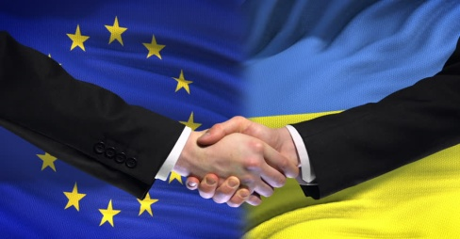
Ukraine and Europol
Before 2009 – negotiations
2010 - Agreement on Strategic Cooperation and Establishment of a National Contact Point
2017 – Agreement on operational cooperation
2018 – Establishment of a Europol operation support unit in Ukraine
2019 –Resolution of the Cabinet of Ministers of Ukraine on Sending Liaison Officers from the National Police of Ukraine to Europol Headquarters
2021 – Ratification of the Memorandum of Understanding on Confidentiality and Security of Information

Slide 17
Competent authorities regarding using of Europol channels
National contact point– International police cooperation Department of the National Police of Ukraine
Competent authorities :
National Police of Ukraine;
State Border Guard Service of Ukraine;
State Security Service;
General Prosecutors Office;
State Tax Service;
National Anticorruption Bureau of Ukraine;
State Bureau of Investigation ;
Ministry of Internal Affairs;
Economic Security Bureau of Ukraine;

Slide 18
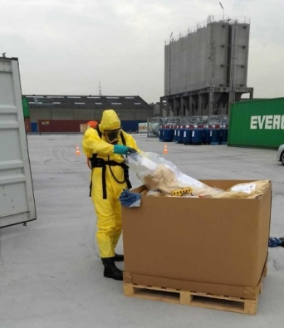
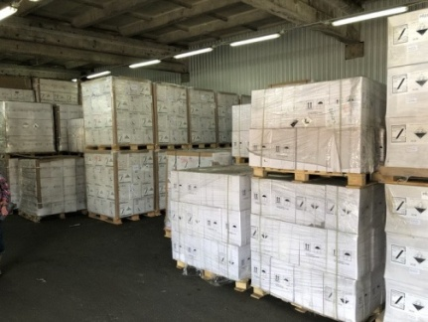
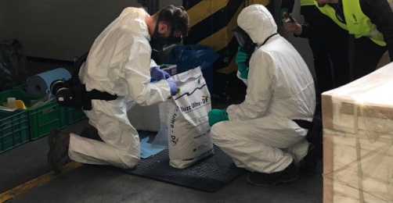
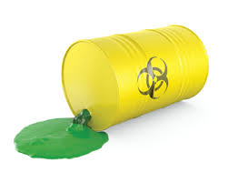

Examples of international operations coordinated by Europol
OPERATION «SILVER AXE»
annual operation of the Europol analytical project “COPY” to combat illicit trafficking of plant protection products
*in 2018, Ukraine ranked first among the countries participating in the operation, seizing 139 tons of illegal pesticides

Slide 19

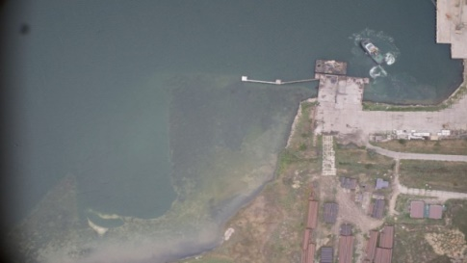

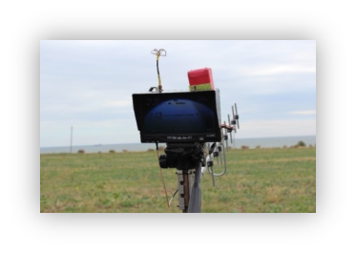
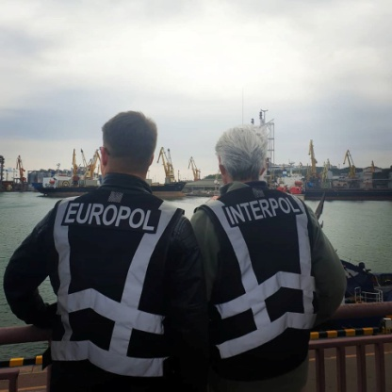
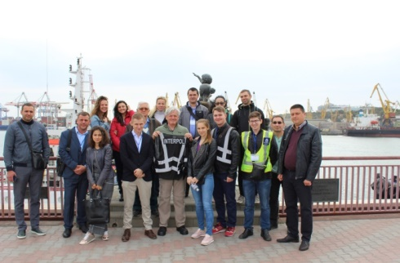
Examples of international operations coordinated by Europol
OPERATION «30 DAYS AT SEA»
joint operation of Interpol and Europol to combat
water pollution

Slide 20
Europol support of Ukraine in framework of ongoing russian aggression against Ukraine

Slide 21
Communication and intelligence gathering
Gathering intelligence and carrying out operational monitoring of violent extremists travelling to Ukraine and streams of communication, financing or recruitment.
Responding to operational requests (including from Ukraine and Moldova) to take down specific Telegram channels used for pro-Russian disinformation and fake news (EC3 and EU Internet Referral Unit).
Europol supported the activation of the Law Enforcement Emergency Response Protocol (LE ERP) for major cross-border cyberattacks.
Europol ensures enhanced monitoring of cyber threats through constant contact with Member States, the Cybercrime Action Taskforce (J-CAT) and open source monitoring.

Slide 22
Combating trafficking of human beings
Set up a dedicated Virtual Command Post for THB (SPRING) to facilitate real-time operational exchange between Ukraine, Romania, Austria, Hungary, Germany, Slovak Republic, Moldova and Poland.
Established a temporary THB task management group to discuss operational matters at the earliest stage and strengthen cooperation with trusted NGOs in this field.

Slide 23
Supporting investigations into war crimes
Supporting investigations into war crimes through the Analysis Project Core International Crimes (AP CIC).
Established an Operational Task Force of OSINT experts to assist investigations conducted by Ukraine, other countries, as well as the ICC, into war crimes committed in Ukraine.

Slide 24
Tackling organised crime
Launched Operation OSCAR to cross-check EU sanctions lists against available operational data, identify links to organised crime and money laundering, and support the tracing and seizure of criminal assets.
Europol is working closely together with Ukraine to lower the risk of weapons trafficking during and after the war.

Slide 25
Supporting European Commission-led initiatives
The European Commission has established the ‘Freeze and Seize’ Task Force, which seeks to ensure the effective freezing & confiscation of assets of sanctioned individuals and entities. This task force is in cooperation with Eurojust and the 27 Member States.
Europol is also supporting the Common Anti-trafficking Plan, Solidarity Platform and Blueprint meetings.

Slide 26
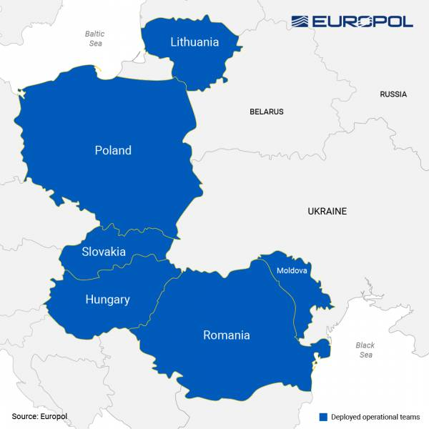
Europol has deployed operational teams to the frontline European countries neighbouring Ukraine within the framework of the Agency’s response to the ongoing conflict.

Slide 27
Thank you for attention!

