Slide 1
GP2 Vulkan Project
Jonas Christiaens - DAEGD11
2024 - 2025

Slide 2
Project video

Slide 3
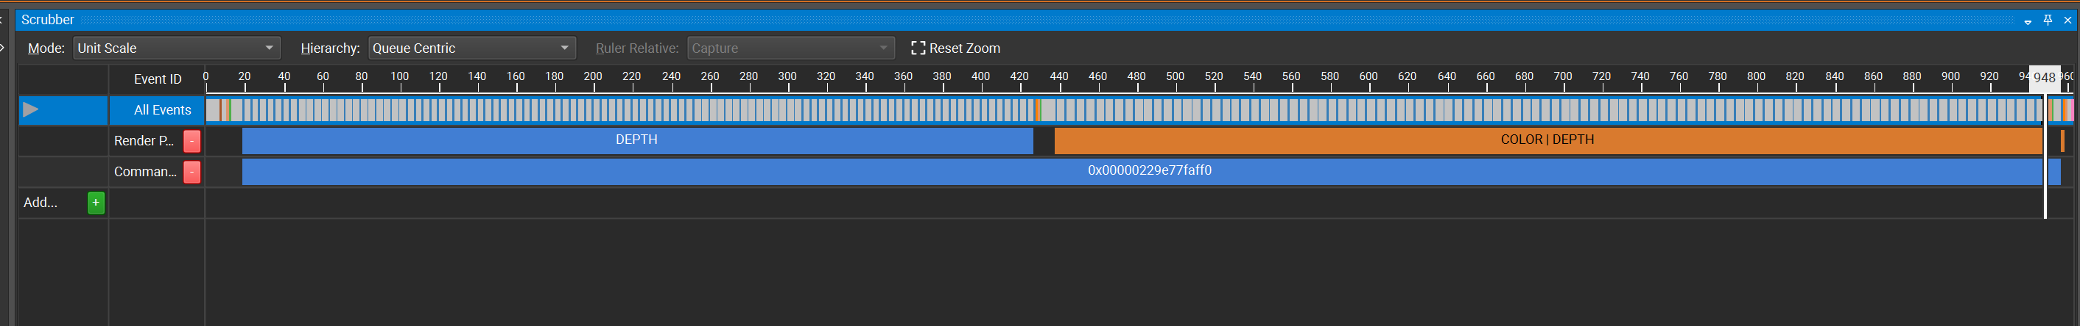
Nsight Graphics Capture
3 passes
Depth Prepass
Deferred Rendering Pass
Lighting Pass

Slide 4
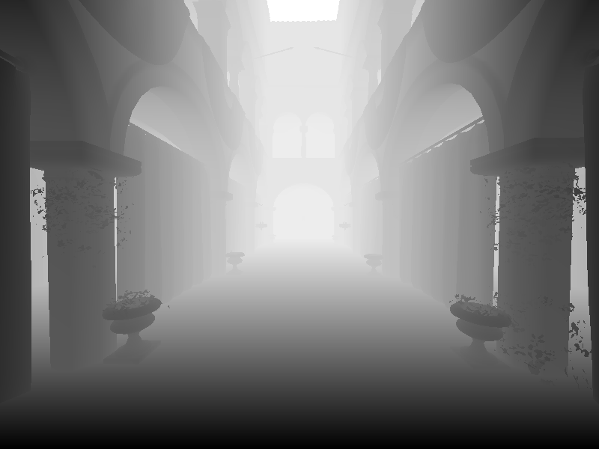
Depth Prepass
Purpose:
Renders scene geometry to depth buffer
Discards pixels based on alpha for correct occlusion
Key Details:
Makes use of fragment & vertex shader
Pipeline only writes to depth buffer
Use:
Output depth buffer is used in subsequent passes for occlusion and effects such as shadows

Slide 5
Deferred Rendering Pass
sdasdaadwa

