Slide 1
GP2 Exam: Vulkan Sponza Scene
By: Jonas Christiaens

Slide 2
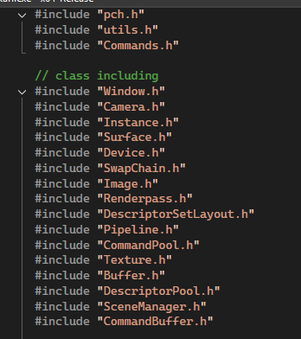


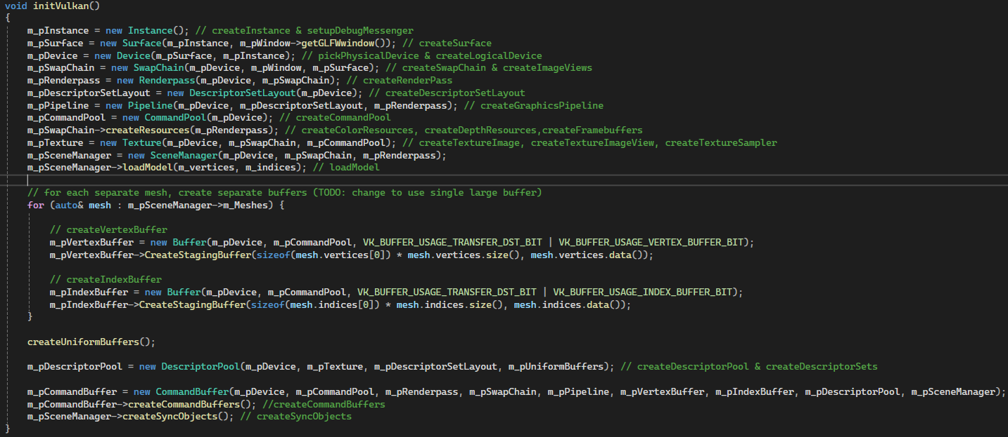
Project structure

Slide 3
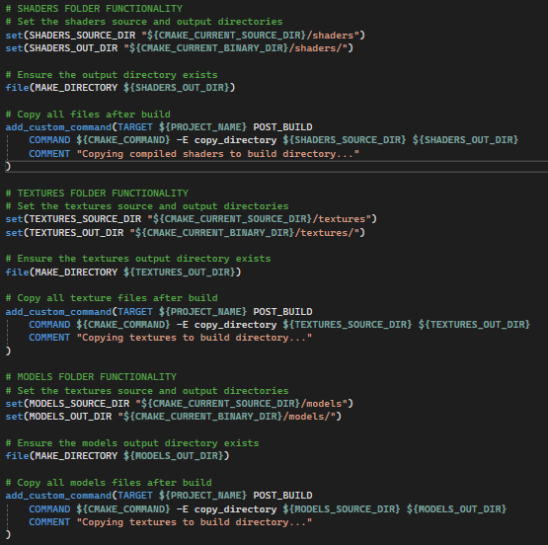

Project automatization

