Slide 1
Adaptive Focus Studio
An offline study timer with SQLite, SharedPreferences and a small rule-based helper
Howard Fletcher, Mobile App Development, Project 1 (solo, undergraduate)
Notes:
Intro: who I am, what the app is, and what I'll cover. Solo project.

Slide 2
The problem
- Study sessions get planned too long or too short
- Most timer apps want an account or a connection
- I wanted presets, a timer I can pause, and a record of what I actually did
- Offline first: SQLite for the data, SharedPreferences for settings, no network code
Notes:
Students plan study blocks but don't know how long they really finish. Everything stays on the phone: no accounts, no cloud.

Slide 3
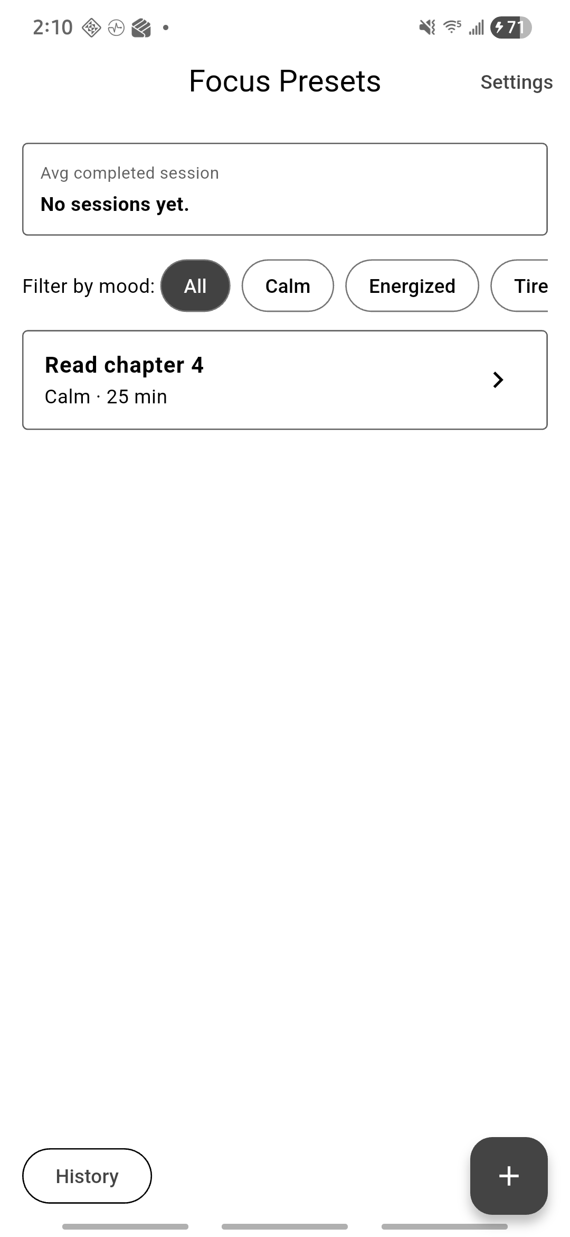
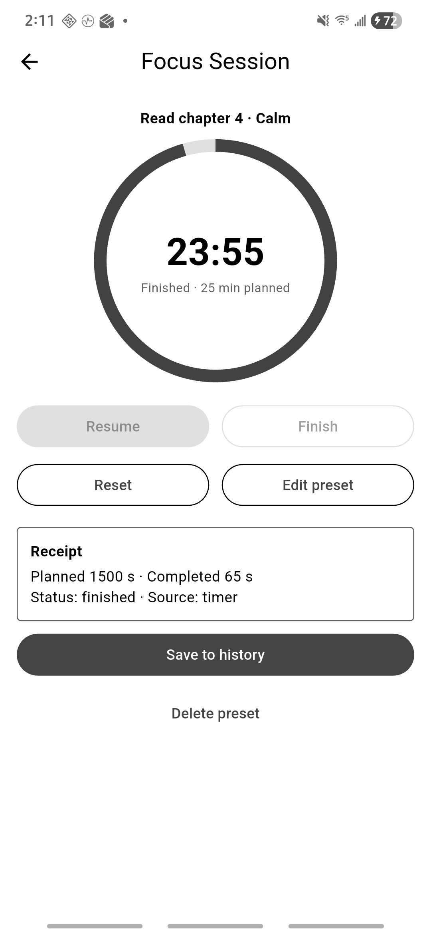
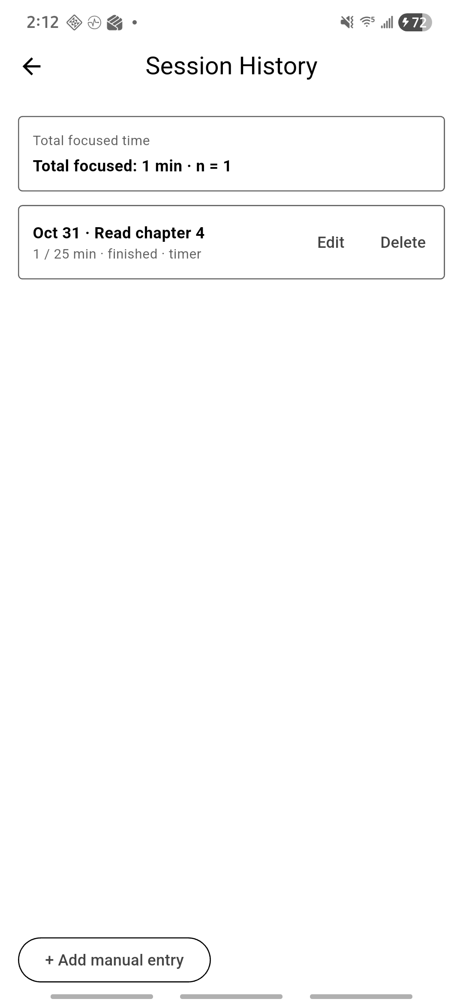
The app: five screens
Presets with mood filter and average | Focus session and receipt | History with total
Notes:
Walk through presets, editor, session with receipt, history, settings. These are screenshots from my Galaxy S22.

Slide 4
Two tables and a settings store
FocusPreset (parent) | SessionLog (child)
id, label (1 to 40), moodTag, plannedSeconds (300 to 7200) | id, presetId (FK), startedAt, plannedSecondsSnapshot, completedSeconds, moodTagSnapshot, status, source, note
- Full create, read, update, delete on both tables
- Deleting a preset deletes its logs in one transaction, after a dialog that shows how many
- Queries use ? placeholders. Models validate themselves before anything is written
- SharedPreferences: default duration, reduce motion, sound effects, confirm before reset
Notes:
Parent/child tables, foreign keys on, delete policy, validation. Settings are four key/value pairs so SharedPreferences fits.

Slide 5
How it's built
- Screens and widgets on top, plain Dart helpers in the middle, database and settings at the bottom
- StatefulWidget + setState. The database is the source of truth and screens reload after changes
- SessionTimer works out time from timestamps, so pausing and late ticks can't throw it off
- Timer is cancelled in dispose() and every async callback checks mounted
- Save is guarded so five quick taps make one log
Notes:
Layers, no state management package. Timer rules are plain Dart with a fake clock in tests.

Slide 6
Session Scout: the smart helper
- Rule-based, runs on the phone, no network and no API
- Takes the last 3 finished sessions in the same mood and suggests the median, kept between 10 and 60 min
- Fewer than 3: it says "Not enough history yet (N of 3)" and suggests nothing
- Baseline to beat: a fixed 25 minutes
- Apply only fills the slider. Nothing saves until I press Save. Dismiss hides it
Notes:
Rule-based, not generative AI. Median of the last 3 finished sessions in the same mood. Apply only moves the slider.

Slide 7
Does it help? A small test
Last 3 sessions | Next | Scout | Scout error | Baseline error
20, 30, 25 | 22 | 25 | 3 | 3
40, 45, 50 | 48 | 45 | 3 | 23
15, 20, 25 | 20 | 20 | 0 | 5
30, 35, 30 | 33 | 30 | 3 | 8
55, 60, 50 | 52 | 55 | 3 | 27
20, 25, 58 | 55 | 25 | 30 | 30
Mean absolute error
Scout: 7.0 min
Baseline: 16.0 min
Counterexample: 20, 25, 58 gives 25. If the next one is 55, it's off by 30. A median of three can't see a trend.
I wrote the cases myself, so they aren't independent.
Notes:
Six made-up cases. This only shows the rule behaves as expected, it is not proof for real users.

Slide 8
Testing
- 56 automated tests pass and flutter analyze is clean (database, timer with a fake clock, Scout cases, widget flows)
- Manual run on a Galaxy S22 and an Android 15 emulator in airplane mode: preset, saved session and a setting all survive a force-stop
- Found a real bug that way: in the release APK settings never saved
- Cause: R8 shrinking broke the shared_preferences plugin. Turning it off for release fixed it (PR 10)
- Not tested: a second physical phone. No peer observation (solo project)
Notes:
56 automated tests; manual S22 and emulator runs; the R8 bug the tests could not see.

Slide 9
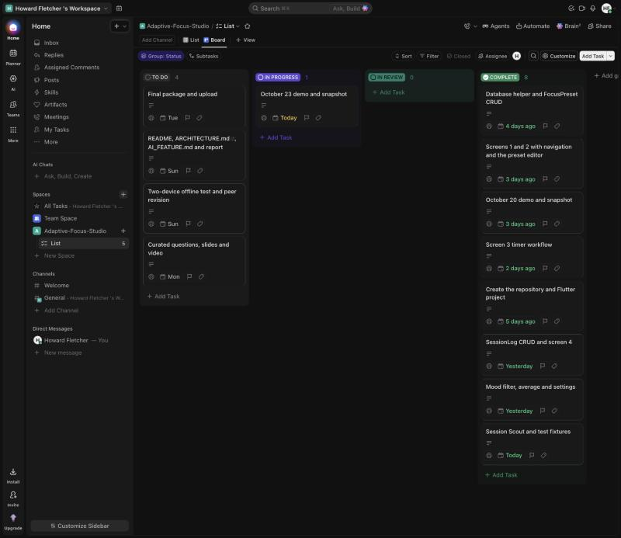
Workflow and one task-to-code-to-test trace
ClickUp card: Session Scout and test fixtures
Branch feature/session-scout, pull request 7
Code: 644406d Scout function, c2b4e4b Scout card
Tests: 744e868 cases C1 to C6 + evaluation, bc72c28 editor tests
Result: all pass; card moved to Complete after the merge
Board: columns To Do, In Progress, In Review, Complete. Limit 2 in progress and 2 in review.
Honest part: the first two cards were late, 43 of 52 commits are on Oct 20 and Oct 23.
Board on Oct 23
Notes:
Show the ClickUp card, PR 7, the commits and the tests for Session Scout. Be honest that the board dates drifted.

Slide 10
Known issues and what I learned
- Scout can't see trends and only looks at 3 sessions
- A running timer isn't restored if the app is killed
- Landscape and large text sizes aren't verified
- Passing tests isn't the same as a working app: I only found the settings bug on the phone
- Keeping rules out of widgets made them easy to test
- Next time: smaller cards, update the board when the PR merges, test the release build early
Notes:
Be upfront about limits. Tests passing didn't mean the release app worked.

Slide 11
Questions
github.com/Howflet/Adaptive-Focus-Studio

