Slide 1
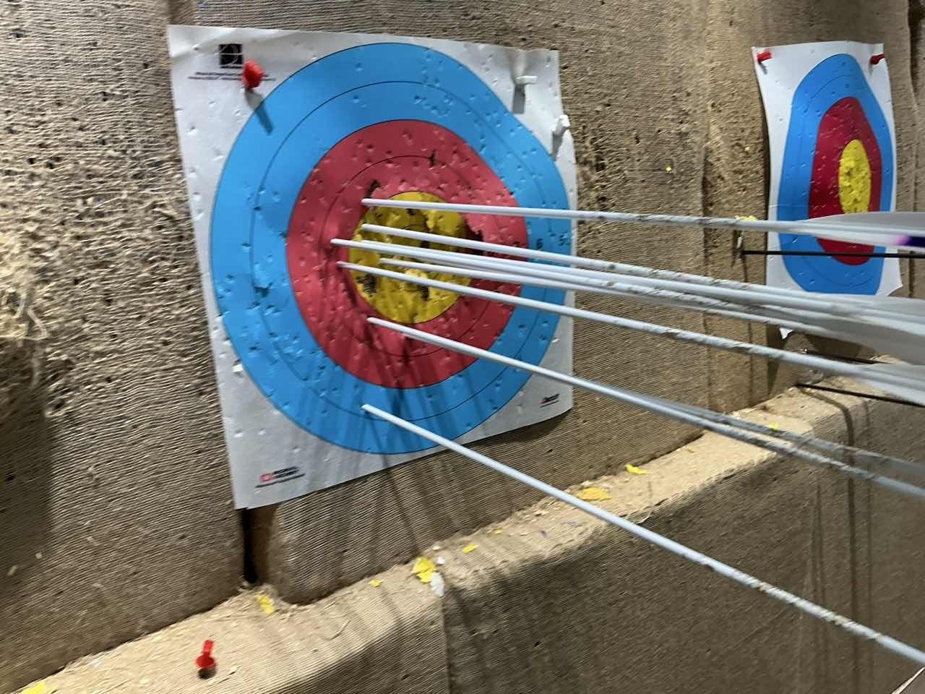
High School Research-Based Learning Project Defense
Neural Network-Based
Archery Entry-Point Detection
and Automatic Scoring
From Whole-Arrow Detection to Entry-Point Localization
October 2026
Notes:
Good day, teachers. My project is "Neural Network-Based Entry-Point Detection and Automatic Scoring for Archery". In short, the goal is to let a computer look at a photo of an archery target, find where each arrow entered the target face, and compute the score automatically. In about ten minutes I will present how I did it, the results, and the remaining limitations.

Slide 2
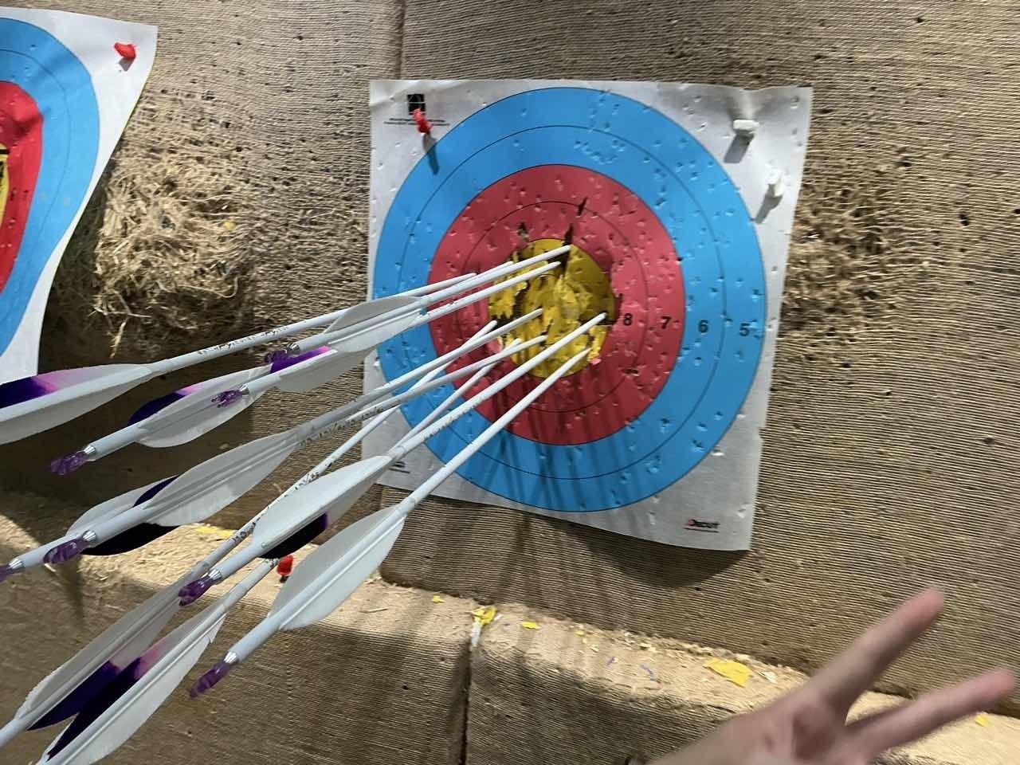
Starting from One Need: Can a Photo Score Automatically?
Data
Heatmap
Baseline
Scoring
1
Take a photo of the target face
After training, shoot directly with a phone
2
The computer finds every arrow
Including tilted and overlapping arrows
3
The score is computed automatically
And entered into training records
Original software: scores entered manually, or arrows clicked one by one on a virtual target
Real training photo: many arrows, tilted angles, and other targets nearby
2
Notes:
I practice archery regularly. My training software only allows entering scores manually, or clicking arrow positions one by one on a virtual target, which is cumbersome. So I wondered: could I take one photo of the target face and let the computer find every arrow and compute the score? That is the starting point of this project. The photo on the right is a real training photo: many arrows, tilted angles, and neighboring targets — all of which make recognition harder.

Slide 3
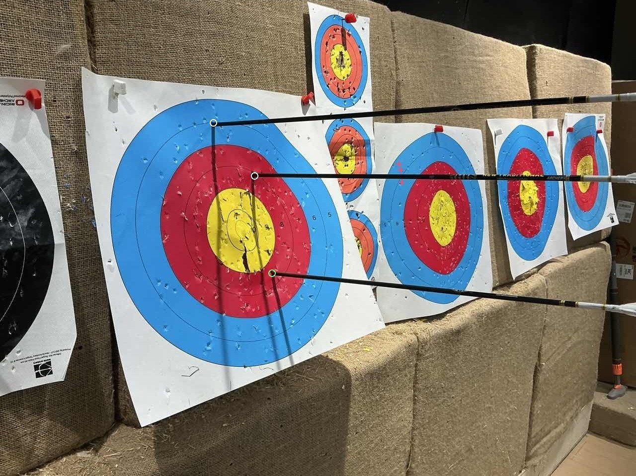
First Attempt: Arrows Detected, but No Entry-Point Found
Data
Heatmap
Baseline
Scoring
Whole-arrow box + offset rule to infer the entry-point
16 / 1018
Across 144 photos, only 16 of the reference entry-points matched within an 8-pixel tolerance
The box center often falls in the middle of the shaft
Tilted and overlapping arrows do not fit a fixed offset
New task: locate the entry-point where the arrow shaft enters the target face
Entry-points inferred by the old approach (circles) matched none of the references in this image (0/3)
3
Notes:
Before using AI tools, I manually annotated a batch of photos and trained a YOLOX whole-arrow detection model. It can box each arrow, but the box center often falls in the middle of the shaft, while the score is determined by where the arrow enters the target face. The software had to infer the entry-point with a fixed offset; on 144 photos, only 16 of 1018 reference points matched within 8 pixels. Note that this mainly reflects a flaw of the offset rule, not that the detection boxes failed to find the arrows. So I changed the task to: locate the entry-point directly.

Slide 4
Research Questions and Technical Roadmap
Data
Heatmap
Baseline
Scoring
Three questions: How to annotate reliably? How to train and evaluate the localization model? How to convert entry-points into scores?
1 Data and Annotation
2 Heatmap Model
3 YOLO-NAS Baseline
4 Automatic Scoring
Manual annotation as the basis
Reviewed and supplemented by a large model
116 photos
829 reference points
Trained from scratch
Background padding, augmentation, and a verifier
Improved step by step
Off-the-shelf model rebuilt as a trainable network
Compared on the same images
Two rounds of fine-tuning
Target-face calibration
Scores computed geometrically
Manually verified before storing
4
Notes:
The project revolves around three questions: how to annotate reliably; how to train the model and evaluate it on unseen photos; and how to convert entry-points into scores. The roadmap has four steps: build the data, train my own heatmap model, introduce an off-the-shelf YOLO-NAS model as a baseline, and finally implement automatic scoring. The labels at the top right indicate which step we are on.

Slide 5
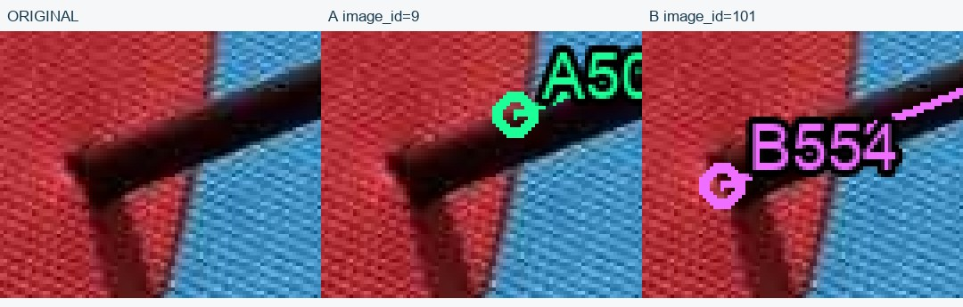
Data: Getting the "Answers" Right First
Data
Heatmap
Baseline
Scoring
205 → 172
205 image files, only 172 distinct photos after deduplication
Photos with arrows but incomplete labels
They cannot be treated as empty targets, or the model learns wrong answers
Two annotations of the same black arrow (A50 and B554 are label IDs), about 38 pixels apart
Two labels pointing to the same arrow
After zooming into the original image and checking item by item, B554 was adopted.
Photos are questions, annotations are answers — if the answer is wrong, the model diligently learns the wrong thing.
They must be merged, or one arrow is counted twice
5
Notes:
In supervised learning, photos are the questions and annotations are the answers. While organizing my annotations, I found that 205 image files contained only 172 distinct photos; some were duplicates. Some photos with arrows were incompletely labeled; if treated as empty targets, the model would learn wrong answers. The example on the right: two annotations of the same black arrow differ by about 38 pixels; after zooming into the original image I adopted B554. Another time, two labels were actually the same arrow and had to be merged. If the answer is wrong, the model will very diligently learn the wrong thing.

Slide 6
Human–AI Collaboration: A Large Model Reviews, Humans Decide
Data
Heatmap
Baseline
Scoring
Review outcomes for 418 manual labels on 61 photos
Each arrow is counted only once
Duplicate labels must be merged
Mark "unknown" when occluded
Never guess a point along the shaft
"Unknown" ≠ "no arrow"
Unknown regions are not treated as background
AI review ≠ human confirmation
The two states are recorded separately
Additionally, 28 missed arrows were annotated
Expanded training data: 116 photos · 829 reference points · 79 unknown
6
Notes:
Annotating from scratch is time-consuming, so I had a vision-capable large model review my old annotations and propose candidates for incompletely labeled photos; disagreements were judged by me against the original images. Taking 418 manual labels on 61 photos as an example: 348 kept unchanged, 22 corrected, 27 changed to unknown due to occlusion, 20 removed, and 28 missed arrows additionally annotated. I set four principles, the most important being: unknown does not mean no arrow, and AI review does not equal human confirmation. The result is training data of 116 photos and 829 reference points.

Slide 7
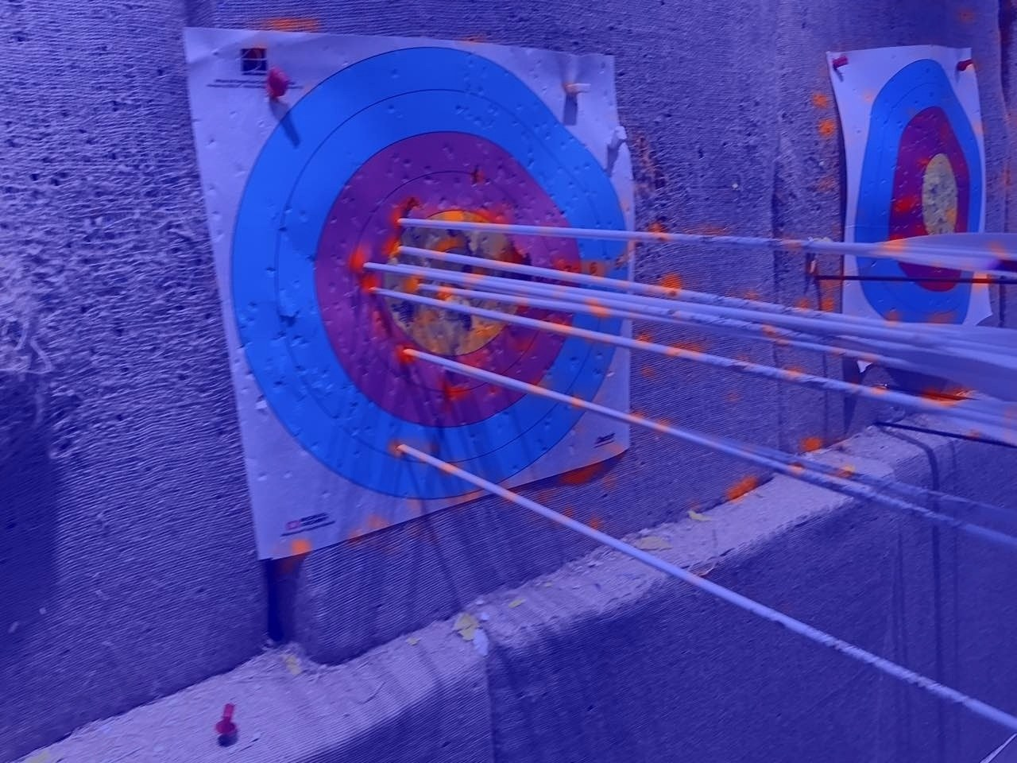
Heatmap Model: Scoring Every Location
Data
Heatmap
Baseline
Scoring
Original image
Heatmap (red = more likely an entry-point)
YOLOX Nano feature network + heatmap head, about 0.83M parameters Each arrow forms a peak at its entry-point, which is then mapped back to photo coordinates
7
Notes:
I first trained a relatively small model: the feature network of YOLOX Nano extracts image features, followed by a heatmap head — about 0.83M parameters in total. The heatmap can be understood as scoring every location in the photo: the more likely a location is an entry-point, the higher the score; the red regions in the right image are high-score areas. Ideally, each arrow forms a separate peak at its entry-point, which is then mapped back to photo coordinates.

Slide 8
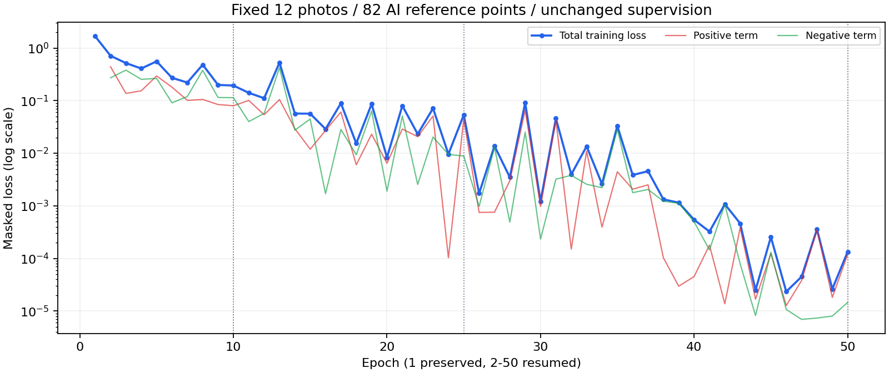
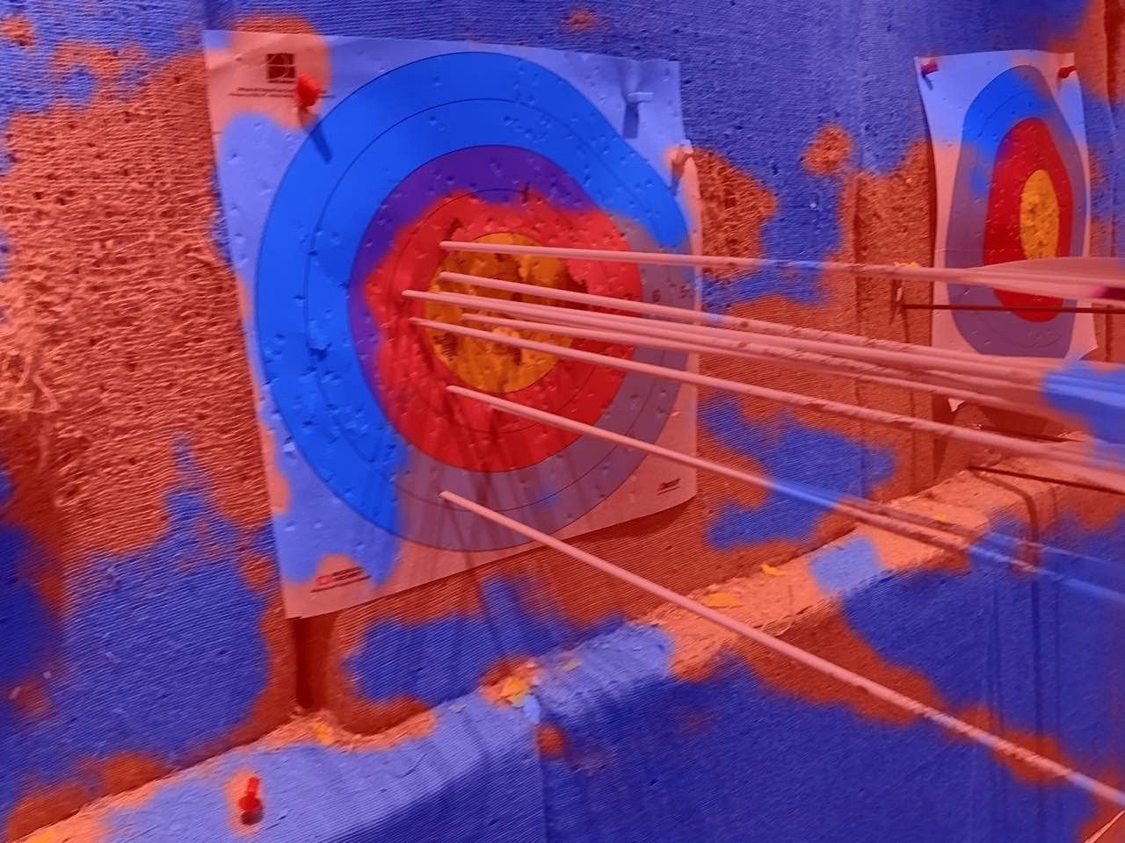
Loss Fell Very Low, yet the Model Missed the Target
Data
Heatmap
Baseline
Scoring
Before adding background 28/82
After adding background 75/82
Training loss dropped to the order of one ten-thousandth
Cause: the model was told where entry-points are, but never where they are not
Fix: add confirmed arrow-free background, and constrain the heatmap to form local peaks
But only 28 / 82 matched
And it marked large regions as high response
Still not enough: 1107 candidates reported; only 21/49 matched on 8 unseen photos → generalization needs attention
8
Notes:
At first I only watched whether the loss decreased. The left chart shows the loss curve — it fell extremely low, but on the 12 training photos the model matched only 28 of 82 points, and large areas of the heatmap were red. The reason: I only told the model where entry-points are, not where they are not, so predicting entry-points everywhere also reduced the loss. After adding confirmed arrow-free background, matching improved to 75/82. But it still reported 1107 candidates and matched only 21/49 on 8 unseen photos, so generalization needed attention next.

Slide 9
How to Evaluate: Recall and Precision
Data
Heatmap
Baseline
Scoring
10
12
8
Effect of data augmentation
48 training photos · 20 development photos
Reference points
Model predictions
Matched
Recall
69.3% → 85.0%
Recall = 8 / 10 = 80%
How many reference points were recovered
Candidate points
263 → 622
Precision = 8 / 12 ≈ 66.7%
How many reported points were correct
Rotation, scaling, and brightness/contrast changes, with entry-point coordinates transformed accordingly
Reporting more points reduces missed arrows, but is not the same as being more accurate
9
Notes:
At this point I learned to look at two metrics together. Recall is how many reference points were recovered; Precision is how many reported points are correct. For example, with 10 entry-points, the model reports 12 and matches 8: Recall 80%, Precision about 66.7%. Viewed this way, data augmentation — adding rotation, scaling, and brightness changes on 48 training photos — raised Recall from 69.3% to 85.0%, but candidates also rose from 263 to 622. More recovered, but also more reported: reporting more is not the same as being more accurate.

Slide 10
Optimization: Adding a Candidate Verifier, "One More Look"
Data
Heatmap
Baseline
Scoring
Photo
Heatmap model
finds candidate points
Verifier
examines local patches
Keep / discard
1087 → 721
127 / 140
Fewer candidate points (20 development photos)
Matched count unchanged
A verifier can only filter candidates: it cannot recover missed points or move coordinates.
Problem: too many redundant candidates remain → look for another model as a baseline
10
Notes:
To reduce redundant candidates, I kept the heatmap model unchanged and trained a small verifier that re-examines the local patch around each candidate and decides keep or discard. On 20 development photos, the matched count stayed at 127/140 while candidates dropped from 1087 to 721. But note: a verifier can only filter candidates; it cannot recover missed points or move coordinates. Redundant candidates remained numerous, so I looked for another model as a baseline.

Slide 11
Further Optimization: Introducing an Off-the-Shelf YOLO-NAS Model
Data
Heatmap
Baseline
Scoring
Source
Comparison | Heatmap Model | YOLO-NAS
Network | YOLOX Nano + heatmap head | YOLO-NAS-S detection network
Location representation | Local peaks in the heatmap | Center of the predicted box
Parameters | ~0.83M | ~12.13M
Weight source | Trained from scratch | Fine-tuned from the official open-source model
Based on the pretrained YOLO-NAS model
Rebuild
Converted into a network that runs and trains in PyTorch; outputs match on 144 photos, coordinate difference < 0.001 px
The Name
NAS = Neural Architecture Search, a method developers use to design networks; I did not perform architecture search
Parameter count reflects capacity, not capability
11
Notes:
I must be honest here: YOLO-NAS was not trained by me from scratch. It is a pretrained model bundled in the installer of the archery app; its training data and process are unknown. What I did was rebuild it into a network that runs and trains in PyTorch, verified on 144 photos to output identical results. Also, NAS stands for Neural Architecture Search, a method developers use to design networks; I did not perform architecture search. The table on the right compares the two approaches; the biggest difference is that the heatmap model is trained by me, while YOLO-NAS is off-the-shelf.

Slide 12
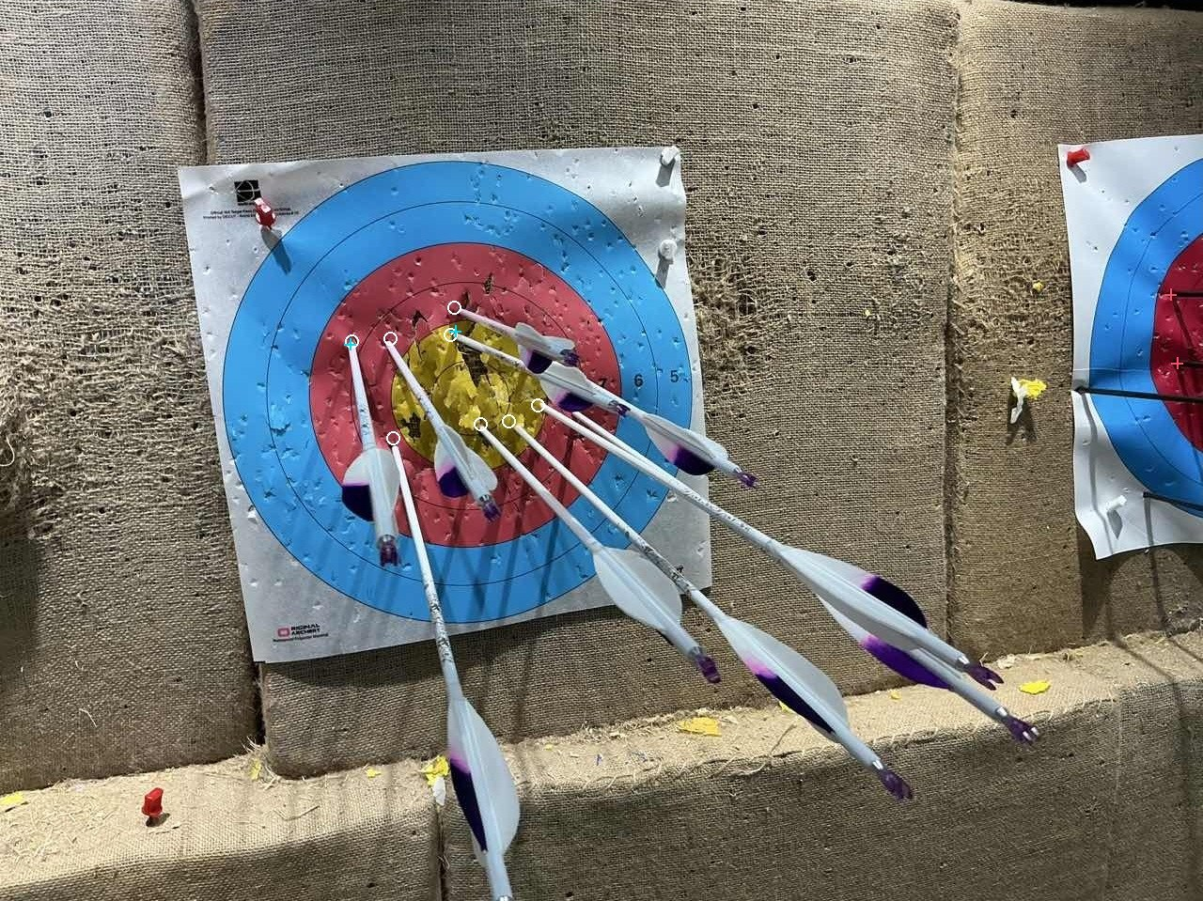

The Same 28 Photos: Each Has Its Strengths
Data
Heatmap
Baseline
Scoring
YOLO-NAS: 2/8
Heatmap + verifier: 8/8
Counter-example: with dense arrows, YOLO-NAS misses many
Interpret with caution
Of 30 "false detections" re-checked, 22 were actually unlabeled true arrows
Architecture, training data, and post-processing all differ; the gap cannot be attributed to architecture alone
Mean localization error: YOLO-NAS 2.15 px, heatmap approach 3.15 px
28 development photos · 189 reference points · 8-pixel tolerance at 640 scale
12
Notes:
I compared the original YOLO-NAS with "heatmap + verifier" on the same 28 development photos. The missed reference points were similar, 17 vs 18; but YOLO-NAS had far fewer redundant candidates, 87 vs 784, and a smaller mean localization error. Yet it is not better on every photo: on the right, a photo with very dense arrows, YOLO-NAS matched only 2 arrows while the heatmap approach matched all 8. Interpretation also needs caution: of 30 suspected false detections I re-checked, 22 were actually unlabeled true arrows; and the two approaches differ in architecture, training data, and post-processing, so the gap cannot be attributed to architecture alone.

Slide 13
Fine-Tuning YOLO-NAS: Experiencing the Power of Learning
Data
Heatmap
Baseline
Scoring
Original
First fine-tuning round
Second fine-tuning round
—
9 photos · 11 human-confirmed points
59 photos · 57 entry-points + 8 false detections (I manually confirmed 60 hard cases)
Missed / 189
Unmatched candidates
Missed / 189
Unmatched candidates
Missed / 189
Unmatched candidates
17
87
17
88
13
56
A "teacher" constraint during training: in regions without manual labels, keep the original model’s output as much as possible (similar in spirit to knowledge distillation)
Conclusion: after fine-tuning, both Recall and Precision improved markedly, and the second-round model was integrated into the software.
13
Notes:
Then I asked whether fine-tuning YOLO-NAS with my own confirmed entry-points could improve it further. The first round used only 9 photos and 11 human-confirmed points; results barely changed. Before the second round, I manually confirmed 60 hard cases; after fine-tuning, 4 more points were recovered, but redundant candidates increased by 25. During training I also added a "teacher" constraint: regions without manual labels should stay close to the original model’s output, similar in spirit to knowledge distillation. Neither round clearly outperformed the original, so the software ultimately uses the original YOLO-NAS. This negative result shows that further improvement requires more and more complete annotations.

Slide 14
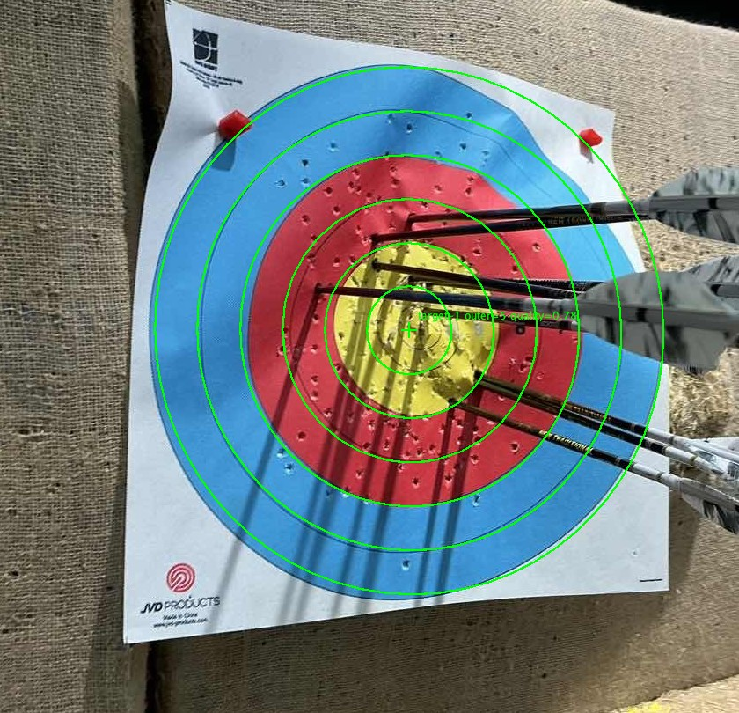
From Entry-Point to Score
Data
Heatmap
Baseline
Scoring
1
Identify the main target and target type
2
Calibrate the center and ring lines
3
Correct rotation and aspect ratio
4
Assign scores by distance to the center
Points near a ring line → yellow prompt for manual check; points can be added, dragged, or re-scored
Green rings show the target-face calibration result
14
Notes:
After finding the entry-points, they must be converted into scores. The model’s score only indicates how likely a point is an entry-point and is unrelated to the ring value; the score depends on the geometry between the entry-point and the target rings. The software first identifies the main target and target type, then calibrates the center and ring lines — the green circles in the left image — then corrects rotation and aspect ratio, and assigns scores by distance to the center. Points near a ring line are highlighted in yellow for manual checking. Note that I have not yet validated scoring accuracy against arrow-by-arrow live results.

Slide 15
Limitations and Next Steps
Data
Heatmap
Baseline
Scoring
Limitations
Next Steps
1
Reference annotations are incomplete, so Precision is only indicative
1
Complete full-image manual annotations
To make Precision trustworthy
2
No independent test set; the 28 development photos were reused many times
2
Collect new photos by shooting session
3
Most experiments used only one random seed
To build an independent test set
4
Fine-tuning of the YOLO-NAS model still needs optimization
3
Convert errors to millimeters and compare with live results
5
Errors not converted to millimeters; scores not compared with live results
To validate the accuracy of automatic scoring
15
Notes:
This project still has several limitations. Reference annotations are incomplete, so Precision is only indicative; there is no independent test set — the 28 development photos were reused many times; most experiments used only one random seed; the fine-tuning of YOLO-NAS still needs work — its training data is unknown, so comparisons cannot be attributed; localization errors are not yet converted to millimeters, and scores have not been compared with live results. Next, I plan to complete full-image manual annotations, collect new photos by shooting session as an independent test set, and validate automatic scoring against live arrow-by-arrow results.

Slide 16
Three Takeaways
01
02
03
Annotation quality determines what the model learns
Falling loss ≠ task completed
A better approach ≠ knowing why
If the answer is wrong, the model diligently learns the wrong thing
Go back to the photos to check Recall, Precision, and localization error
Proving a factor requires single-factor comparison
Thank you! Comments and suggestions are welcome
AI use statement: photos, manual annotations, and the first whole-arrow detection model were completed by the author; annotation review, script writing, model rebuilding, and experiment statistics were completed with AI assistance. The YOLO-NAS model was taken from the official open-source collection, for research comparison only.
Notes:
Finally, three takeaways. First, annotation quality determines what the model learns — if the answer is wrong, the model will diligently learn the wrong thing. Second, a falling loss does not mean the task is done; always go back to the photos and check Recall, Precision, and localization error. Third, one approach being better overall does not mean knowing why; proving the role of a factor requires single-factor comparison. Also, annotation review, script writing, and model rebuilding in this project were assisted by AI tools. Thank you, teachers — comments and suggestions are welcome.

