Slide 1
测试报告
Yanhua Li

Slide 2
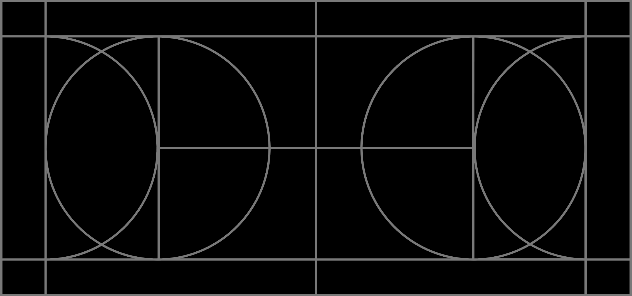
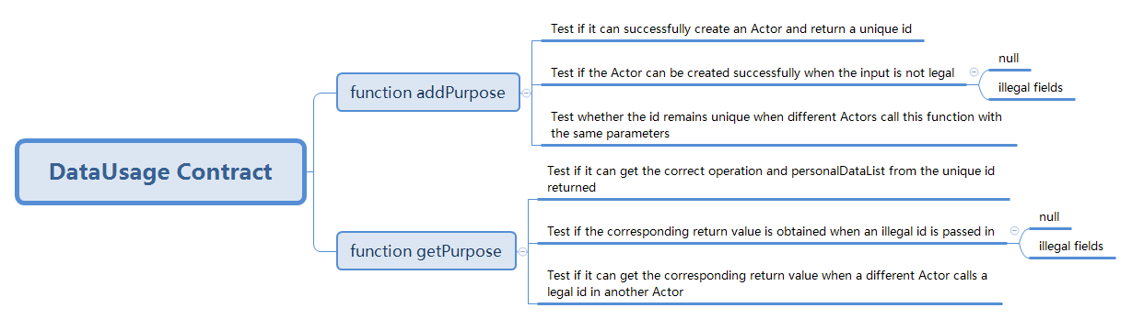
单元测试 —— DataUsage Contract
The addPurposeTest() function tests the ability of DataUsageContract to add a new purpose to the contract, while the getPurposeTest() function tests the ability of the DataUsageContract contract to retrieve the details of an existing purpose.
The VerificationContract is also imported and used to compare the stored data to the personal data provided to ensure that the data being stored in the contract is correct.
编号 | 业务类型 | 功能 | 测试数据 | 预期结果 | 实际结果 | 案例类型 | 测试状态
1 | Purpose ID is correct | addPurpose | Service Name: "healthcare" Service Purpose: "data collection" Personal Data List: ["John", "Newcastle", "24"] | 0xf04ee76b95208a6a04ef537cc0d42127b1ca2d62c084ff0bec90d00c17974a78 | 0xf04ee76b95208a6a04ef537cc0d42127b1ca2d62c084ff0bec90d00c17974a78 | 正向案例 | PASS
2 | Purpose ID is correct | addPurpose | Service Name: "healthcare" Service Purpose: "data collection" Personal Data List: ["John", "Newcastle", "24"] | 0x0d61b59efe8d58f008ca3ab22d549a164a3ce09eb43581773a472e0504987d79 | 0x2423b9c0c81e6196c22058f39963d6fb39d50169d7362d486473a62663bbf0f9 | 反向案例 | NOT PASS
3 | Operator is correct | getPurpose | Service Name: "banking" Service Purpose: "transaction monitoring" Personal Data List: ["310 456 789", "2023-03-20 : 30 pounds"] | TRUE | TRUE | 正向案例 | PASS
4 | Operator is correct | getPurpose | Service Name: "banking" Service Purpose: "transaction monitoring" Personal Data List: ["310 456 789", "2023-03-20 : 30 pounds"] | TRUE | FALSE | 反向案例 | NOT PASS
5 | Data list length is correct | getPurpose | Service Name: "banking" Service Purpose: "transaction monitoring" Personal Data List: ["310 456 789", "2023-03-20 : 30 pounds"] | TRUE | TRUE | 正向案例 | PASS
6 | Data list length is correct | getPurpose | Service Name: "banking" Service Purpose: "transaction monitoring" Personal Data List: ["310 456 789", "2023-03-20 : 30 pounds"] | TRUE | FALSE | 反向案例 | NOT PASS
7 | Stored data is correct | getPurpose | Service Name: "banking" Service Purpose: "transaction monitoring" Personal Data List: ["310 456 789", "2023-03-20 : 30 pounds"] | TRUE | TRUE | 正向案例 | PASS
8 | Stored data is correct | getPurpose | Service Name: "banking" Service Purpose: "transaction monitoring" Personal Data List: ["310 456 789", "2023-03-20 : 30 pounds"] | TRUE | FALSE | 反向案例 | NOT PASS

Slide 3
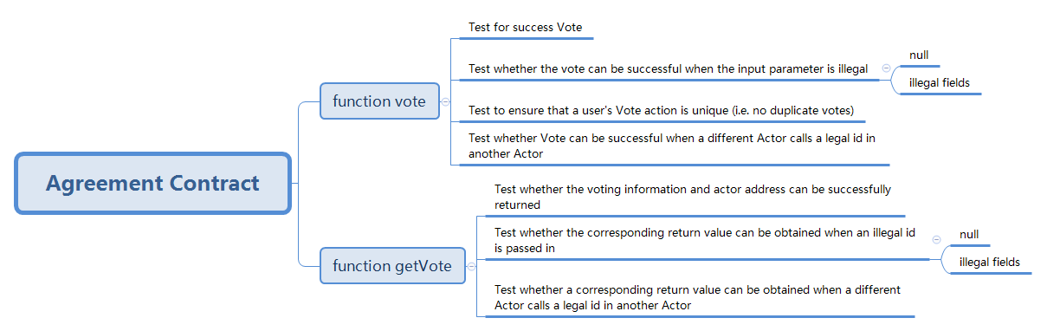
单元测试 —— Agreement Contract
The voteTest() function first creates a purposeId by calling the addPurpose() function of the DataUsageContract. It then calls the vote() function of the AgreementContract with the created purposeId, hashAddress, actorAddress, and userConsent. It then calls the getVote() function of the AgreementContract to retrieve the actorAddress and userConsent that were previously set in the vote() function, and compares them to the expected values.
The voteTwiceTest() function is similar to the voteTest() function, but it attempts to call the vote() function twice with the same purposeId, which should fail since a user can only vote once. The test checks that the second vote fails.
编号 | 业务类型 | 功能 | 测试数据 | 预期结果 | 实际结果 | 案例类型 | 测试状态
1 | Actor address is correct | vote | Service Name: "banking" Service Purpose: "transaction monitoring" Personal Data List: ["310 456 789", "2023-03-20 : 30 pounds"] | 0x5B38Da6a701c568545dCfcB03FcB875f56beddC4 | 0x5B38Da6a701c568545dCfcB03FcB875f56beddC4 | 正向案例 | PASS
2 | Actor address is correct | vote | Service Name: "banking" Service Purpose: "transaction monitoring" Personal Data List: ["310 123 456", "2023-03-20 : 10 pounds"] | Unable to execute normally. | Unable to execute normally. | 反向案例 | NOT PASS
3 | User consent is correct | vote | Service Name: "banking" Service Purpose: "transaction monitoring" Personal Data List: ["310 456 789", "2023-03-20 : 30 pounds"] | TRUE | TRUE | 正向案例 | PASS
4 | Should not be able to vote twice | voteTwice | Service Name: "banking" Service Purpose: "transaction monitoring" Personal Data List: ["310 456 789", "2023-03-20 : 30 pounds"] | FALSE | FALSE | 反向案例 | NOT PASS

Slide 4
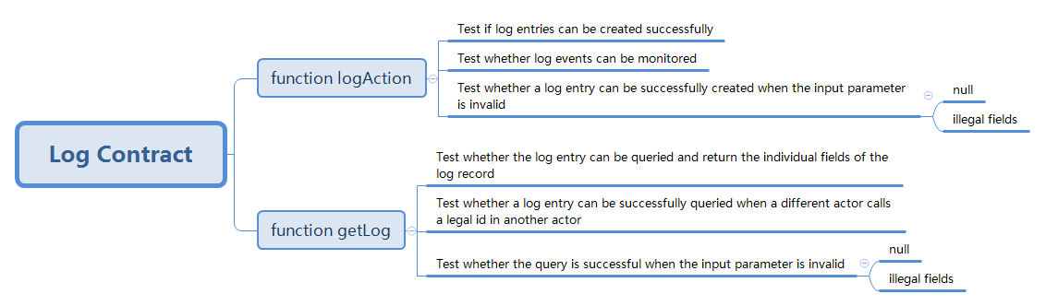
单元测试 —— Log Contract
In the testLogAction() function, the code creates an instance of the LogContract and then logs an action with some processed data. It then retrieves the log and checks that the correct data was logged.
In the testLogActionMaxDataLength() function, the code attempts to log an action with processed data that exceeds the maximum allowed length of 256 characters, and checks that the logging fails.
In the testLogGetNonExistingLog() function, the code attempts to retrieve a log that does not exist and checks that the retrieval fails.
编号 | 业务类型 | 功能 | 测试数据 | 预期结果 | 实际结果 | 案例类型 | 测试状态
1 | Actor address is correct | logAction | Service Name: "healthcare" Service Purpose: "data collection" Personal Data List: ["Jason", "Newcastle", "30"] | 0xd5649c595D092a81d7f26739b45E6B01CFD5352d | 0xd5649c595D092a81d7f26739b45E6B01CFD5352d | 正向案例 | PASS
2 | Operator is correct | logAction | Service Name: "healthcare" Service Purpose: "data collection" Personal Data List: ["Jason", "Newcastle", "30"] | 0 | 0 | 正向案例 | PASS
3 | Processed data is correct | logAction | Service Name: "healthcare" Service Purpose: "data collection" Personal Data List: ["Jason", "Newcastle", "30"] | TRUE | TRUE | 正向案例 | PASS
4 | Contract ID is correct | logAction | Service Name: "healthcare" Service Purpose: "data collection" Personal Data List: ["Jason", "Newcastle", "30"] | 0xda65e898898c9b97743a3d0d08d3d8181e753bdbd504ee0a68fe74273dae276b | 0xda65e898898c9b97743a3d0d08d3d8181e753bdbd504ee0a68fe74273dae276b | 正向案例 | PASS
5 | Should not be able to log with processed data length exceeds 256 | logActionMaxDataLength | Service Name: "healthcare" Service Purpose: "data collection" Personal Data List: ["Jason", "Newcastle", "30"] | TRUE | TRUE | 正向案例 | PASS
6 | Should not be able to get non-existing log | logGetNonExistingLog | Service Name: "healthcare" Service Purpose: "data collection" Personal Data List: ["Jason", "Newcastle", "30"] | FALSE | FALSE | 反向案例 | NOT PASS

Slide 5
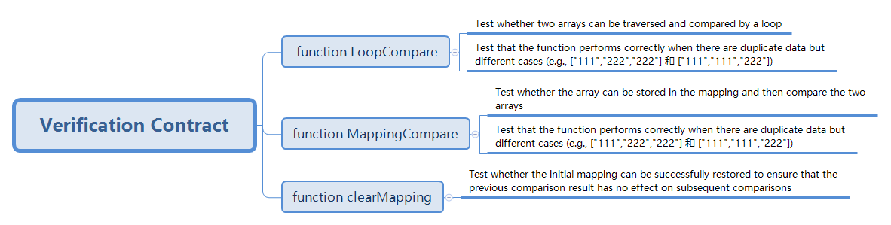
单元测试 —— Verification Contract
VerificationContract: LoopCompare and MappingCompare. The purpose of these functions is to compare two arrays of strings to check if they contain the same elements in the same order.
The clearMapping method cannot be tested. Because of the particularity of this method, it cannot be made public, which makes it impossible to test.
编号 | 业务类型 | 功能 | 测试数据 | 预期结果 | 实际结果 | 案例类型 | 测试状态
1 | LoopCompare succeed | loopCompare | Service Name: "healthcare" Service Purpose: "data collection" Personal Data List: ["Jason", "Newcastle", "30"] | TRUE | TRUE | 正向案例 | PASS
2 | LoopCompare succeed | loopCompare | Service Name: "banking" Service Purpose: "transaction monitoring" Personal Data List: ["310 456 789", "2023-03-20 : 30 pounds"] | TRUE | FALSE | 反向案例 | NOT PASS
3 | MappingCompare succeed | mappingCompare | Service Name: "healthcare" Service Purpose: "data collection" Personal Data List: ["Jason", "Newcastle", "30"] | TRUE | TRUE | 正向案例 | PASS
4 | MappingCompare succeed | mappingCompare | Service Name: "banking" Service Purpose: "transaction monitoring" Personal Data List: ["310 456 789", "2023-03-20 : 30 pounds"] | TRUE | FALSE | 反向案例 | NOT PASS

Slide 6
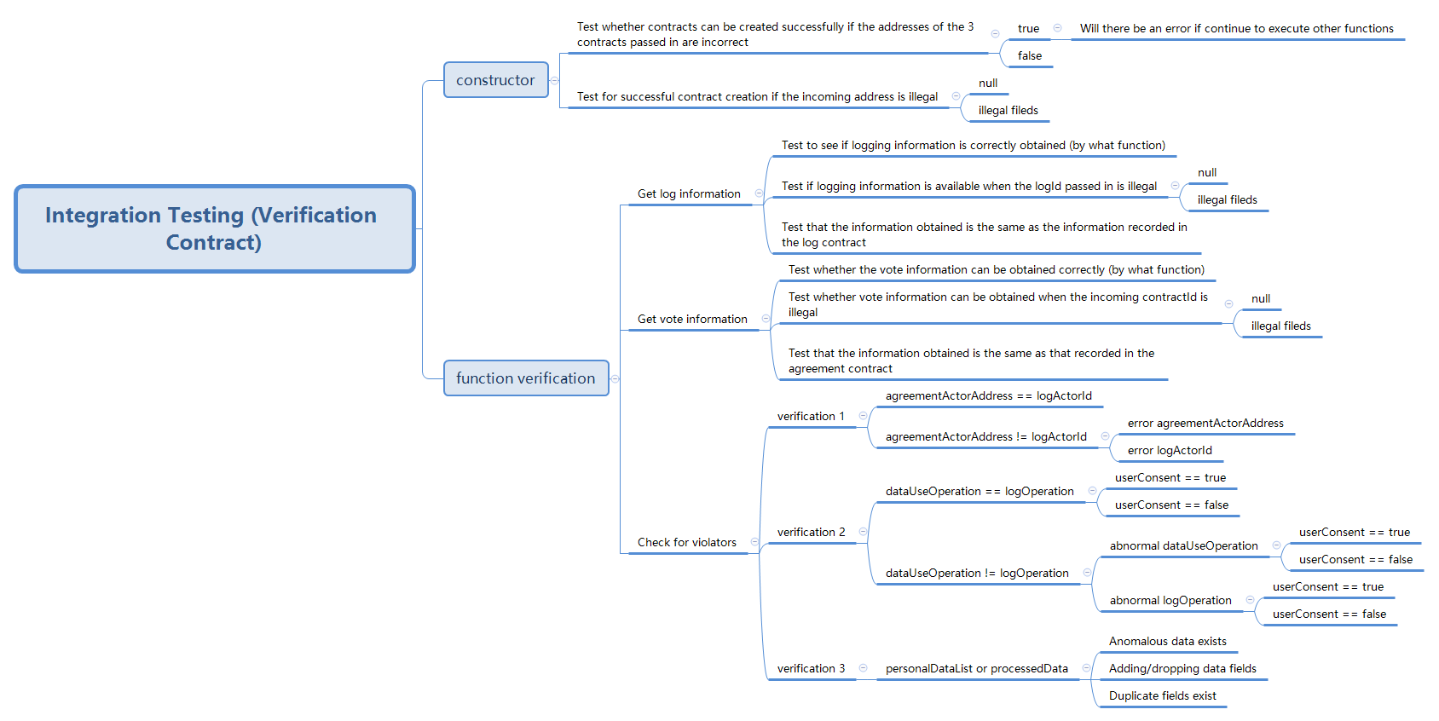
集成测试 —— Intergration Test
This is an integration test for verifying the functionality of multiple smart contracts that together form a data usage consent management system.
There are also several negative test cases to check if contract creation fails with invalid addresses or illegal fields.
编号 | 业务类型 | 功能 | 测试数据 | 预期结果 | 实际结果 | 案例类型 | 测试状态
1 | Invalid contract addresses | checkContractCreation | Service Name: "healthcare" Service Purpose: "data collection" Personal Data List: ["John", "Newcastle", "24"] | 0x0000000000000000000000000000000000000000 | 0x0000000000000000000000000000000000000000 | 正向案例 | PASS
2 | Invalid contract addresses | checkContractCreation | Service Name: "healthcare" Service Purpose: "data collection" Personal Data List: ["John", "Newcastle", "24"] | 0x0000000000000000000000000000000000000000 | 0x0A9487ea04c197DbF5606a1620d69E058CF2f819 | 反向案例 | NOT PASS
3 | Invalid agreement contract address | checkContractCreation | Service Name: "healthcare" Service Purpose: "data collection" Personal Data List: ["John", "Newcastle", "24"] | 0x0000000000000000000000000000000000000000 | 0x0000000000000000000000000000000000000000 | 正向案例 | PASS
4 | Invalid agreement contract address | checkContractCreation | Service Name: "healthcare" Service Purpose: "data collection" Personal Data List: ["John", "Newcastle", "24"] | 0x0000000000000000000000000000000000000000 | 0x9c563C6FC3C0fBea7f05041100F0C6FAd89053ea | 反向案例 | NOT PASS
5 | Invalid data usage contract address | checkContractCreation | Service Name: "healthcare" Service Purpose: "data collection" Personal Data List: ["John", "Newcastle", "24"] | 0x0000000000000000000000000000000000000000 | 0x0000000000000000000000000000000000000000 | 正向案例 | PASS
6 | Invalid data usage contract address | checkContractCreation | Service Name: "healthcare" Service Purpose: "data collection" Personal Data List: ["John", "Newcastle", "24"] | 0x0000000000000000000000000000000000000000 | 0x2108Ce050B0Ef82b1F8B1580229eEf76294646e7 | 反向案例 | NOT PASS
7 | Invalid log contract field | checkContractCreation | Service Name: "healthcare" Service Purpose: "data collection" Personal Data List: ["John", "Newcastle", "24"] | 0x0000000000000000000000000000000000000000 | 0x0000000000000000000000000000000000000000 | 正向案例 | PASS
8 | Invalid log contract field | checkContractCreation | Service Name: "healthcare" Service Purpose: "data collection" Personal Data List: ["John", "Newcastle", "24"] | 0x0000000000000000000000000000000000000000 | 0x8322fcBCA71e8E3c5f19d0c45eF93724d5773949 | 反向案例 | NOT PASS

Slide 7
编号 | 业务类型 | 功能 | 测试数据 | 预期结果 | 实际结果 | 案例类型 | 测试状态
9 | Log actor address should be equal to agreement actor address | testVerify | Service Name: "healthcare" Service Purpose: "data collection" Personal Data List: ["John", "Newcastle", "24"] | 0x5B38Da6a701c568545dCfcB03FcB875f56beddC4 | 0x5B38Da6a701c568545dCfcB03FcB875f56beddC4 | 正向案例 | PASS
10 | Log actor address should be equal to agreement actor address | testVerify | Service Name: "healthcare" Service Purpose: "data collection" Personal Data List: ["John", "Newcastle", "24"] | 0x5B38Da6a701c568545dCfcB03FcB875f56beddC4 | 0x5B38Da6a701c568545dCfcB03FcB870945dnbf52 | 反向案例 | NOT PASS
11 | Log operation should be equal to the one set in data usage contract | testVerify | Service Name: "healthcare" Service Purpose: "data collection" Personal Data List: ["John", "Newcastle", "24"] | TRUE | TRUE | 正向案例 | PASS
12 | Log operation should be equal to the one set in data usage contract | testVerify | Service Name: "healthcare" Service Purpose: "data collection" Personal Data List: ["John", "Newcastle", "24"] | TRUE | FALSE | 反向案例 | NOT PASS
13 | Log contract ID should be equal to agreement ID | testVerify | Service Name: "healthcare" Service Purpose: "data collection" Personal Data List: ["John", "Newcastle", "24"] | 0x72c3b3978085435fb37ce6b693eaae2644d37a1af525aec01cff897a87252b83 | 0x72c3b3978085435fb37ce6b693eaae2644d37a1af525aec01cff897a87252b83 | 正向案例 | PASS
14 | Log contract ID should be equal to agreement ID | testVerify | Service Name: "healthcare" Service Purpose: "data collection" Personal Data List: ["John", "Newcastle", "24"] | 0x72c3b3978085435fb37ce6b693eaae2644d37a1af525aec01cff897a87252b83 | 0x72c3b3978085435fb37ce6b693eaae13579abs45f525aec01cff89a123b54860 | 反向案例 | NOT PASS
15 | Agreement actor address should be equal to the one set during agreement creation | testVerify | Service Name: "healthcare" Service Purpose: "data collection" Personal Data List: ["John", "Newcastle", "24"] | 0x5B38Da6a701c568545dCfcB03FcB875f56beddC4 | 0x5B38Da6a701c568545dCfcB03FcB875f56beddC4 | 正向案例 | PASS
16 | Agreement actor address should be equal to the one set during agreement creation | testVerify | Service Name: "healthcare" Service Purpose: "data collection" Personal Data List: ["John", "Newcastle", "24"] | 0x5B38Da6a701c568545dCfcB03FcB875f56beddC4 | 0x5B38Da6a701c568545dCfcB03FcB87hg487smg12 | 反向案例 | NOT PASS
17 | User should have given consent | testVerify | Service Name: "healthcare" Service Purpose: "data collection" Personal Data List: ["John", "Newcastle", "24"] | TRUE | TRUE | 正向案例 | PASS
18 | User should have given consent | testVerify | Service Name: "healthcare" Service Purpose: "data collection" Personal Data List: ["John", "Newcastle", "24"] | TRUE | FALSE | 反向案例 | NOT PASS
19 | Data use operation should be equal to the one set during data usage contract creation | testVerify | Service Name: "healthcare" Service Purpose: "data collection" Personal Data List: ["John", "Newcastle", "24"] | TRUE | TRUE | 正向案例 | PASS
20 | Data use operation should be equal to the one set during data usage contract creation | testVerify | Service Name: "healthcare" Service Purpose: "data collection" Personal Data List: ["John", "Newcastle", "24"] | TRUE | FALSE | 反向案例 | NOT PASS
21 | Number of personal data fields should be equal to the one set during data usage contract creation | testVerify | Service Name: "healthcare" Service Purpose: "data collection" Personal Data List: ["John", "Newcastle", "24"] | 3 | 3 | 正向案例 | PASS
22 | Number of personal data fields should be equal to the one set during data usage contract creation | testVerify | Service Name: "healthcare" Service Purpose: "data collection" Personal Data List: ["John", "Newcastle", "24"] | 3 | 0 | 反向案例 | NOT PASS
23 | Verification should return 0 address when all checks pass | testVerify | Service Name: "healthcare" Service Purpose: "data collection" Personal Data List: ["John", "Newcastle", "24"] | TRUE | TRUE | 正向案例 | PASS
24 | Verification should return 0 address when all checks pass | testVerify | Service Name: "healthcare" Service Purpose: "data collection" Personal Data List: ["John", "Newcastle", "24"] | TRUE | FALSE | 反向案例 | NOT PASS
25 | Contract creation should fail with incorrect addresses | testVerify | Service Name: "healthcare" Service Purpose: "data collection" Personal Data List: ["John", "Newcastle", "24"] | 0x0000000000000000000000000000000000000000 | 0x0000000000000000000000000000000000000000 | 正向案例 | PASS
26 | Contract creation should fail with incorrect addresses | testVerify | Service Name: "healthcare" Service Purpose: "data collection" Personal Data List: ["John", "Newcastle", "24"] | 0x0000000000000000000000000000000000000000 | 0x1966E45D8131896c0f03F31B9D3933EEC1ACD963 | 反向案例 | NOT PASS
27 | Contract creation should fail with illegal addresses | testVerify | Service Name: "healthcare" Service Purpose: "data collection" Personal Data List: ["John", "Newcastle", "24"] | 0x0000000000000000000000000000000000000000 | 0x0000000000000000000000000000000000000000 | 正向案例 | PASS
28 | Contract creation should fail with illegal addresses | testVerify | Service Name: "healthcare" Service Purpose: "data collection" Personal Data List: ["John", "Newcastle", "24"] | 0x0000000000000000000000000000000000000000 | 0xbA6e07DdF4c7345f717C0c8Ba0b97a62CD76f9C7 | 反向案例 | NOT PASS
29 | Contract creation should fail with null addresses | testVerify | Service Name: "healthcare" Service Purpose: "data collection" Personal Data List: ["John", "Newcastle", "24"] | 0x0000000000000000000000000000000000000000 | 0x0000000000000000000000000000000000000000 | 正向案例 | PASS
30 | Contract creation should fail with null addresses | testVerify | Service Name: "healthcare" Service Purpose: "data collection" Personal Data List: ["John", "Newcastle", "24"] | 0x0000000000000000000000000000000000000000 | 0x8F478CfbC7Bd09BaA69A6cd2B648A768BAeD8434 | 反向案例 | NOT PASS
31 | Contract creation should succeed with legal fields | testVerify | Service Name: "healthcare" Service Purpose: "data collection" Personal Data List: ["John", "Newcastle", "24"] | 0x440cD6978e7adc67a331f23b2290f10cD3967fD0 | 0x440cD6978e7adc67a331f23b2290f10cD3967fD0 | 正向案例 | PASS
32 | Contract creation should succeed with legal fields | testVerify | Service Name: "healthcare" Service Purpose: "data collection" Personal Data List: ["John", "Newcastle", "24"] | 0x440cD6978e7adc67a331f23b2290f10cD3967fD0 | 0xb4BE0Ff8f701b854BE961c0870742Bc3a2de56C9 | 反向案例 | NOT PASS
33 | Invalid actor | testVerifyInvalidActor | Service Name: "healthcare" Service Purpose: "data collection" Personal Data List: ["John", "Newcastle", "24"] | 0x440cD6978e7adc67a331f23b2290f10cD3967fD0 | 0x440cD6978e7adc67a331f23b2290f10cD3967fD0 | 正向案例 | PASS
34 | Invalid actor | testVerifyInvalidActor | Service Name: "healthcare" Service Purpose: "data collection" Personal Data List: ["John", "Newcastle", "24"] | 0x440cD6978e7adc67a331f23b2290f10cD3967fD0 | 0x5B38Da6a701c568545dCfcB03FcB875f56beddC4 | 反向案例 | NOT PASS
35 | Invalid data | testVerifyInvalidData | Service Name: "healthcare" Service Purpose: "data collection" Personal Data List: ["John", "Newcastle", "24"] | 0x440cD6978e7adc67a331f23b2290f10cD3967fD0 | 0x440cD6978e7adc67a331f23b2290f10cD3967fD0 | 正向案例 | PASS
36 | Invalid data | testVerifyInvalidData | Service Name: "healthcare" Service Purpose: "data collection" Personal Data List: ["John", "Newcastle", "24"] | 0x440cD6978e7adc67a331f23b2290f10cD3967fD0 | 0x5B38Da6a701c568545dCfcB03FcB875f56beddC4 | 反向案例 | NOT PASS
37 | Invalid data usage | testVerifyInvalidDataUsage | Service Name: "healthcare" Service Purpose: "data collection" Personal Data List: ["John", "Newcastle", "24"] | 0x440cD6978e7adc67a331f23b2290f10cD3967fD0 | 0x440cD6978e7adc67a331f23b2290f10cD3967fD0 | 正向案例 | PASS
38 | Invalid data usage | testVerifyInvalidDataUsage | Service Name: "healthcare" Service Purpose: "data collection" Personal Data List: ["John", "Newcastle", "24"] | 0x440cD6978e7adc67a331f23b2290f10cD3967fD0 | 0x5B38Da6a701c568545dCfcB03FcB875f56beddC4 | 反向案例 | NOT PASS

