Slide 1
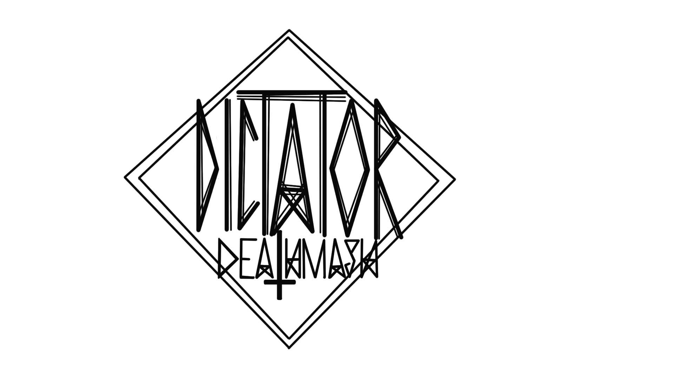

Slide 2
Video

Slide 3
Intro
The game will be a chaotic and fast paced fighting game featuring famous historical dictators. Up to four players will be able to battle at a time across a multi-platform level controlling characters like; Hitler, Stalin, and Fidel Castro. Players will have to punch, kick, and throw their opponents around the arena, and off ledges until one player is left standing after the best of three rounds.

Slide 4
Selling Points
Fast paced action for two to four players.
Play as your favourite Dictator.
Devastating abilities to turn the tide of battle.
Fight in arenas filled with platforms and pick-ups.

Slide 5
General Mechanics
The game will be 2D and be a one screen level with platforms of varying heights
All players will start with 100 health points
All players will start with 0 energy, this bar will fill slightly with every hit the player lands
The player will have the ability to punch, kick, jump and throw their opponents
When their energy bar fills up the player may use one of two special moves; a close range attack and a long range attack
These special attacks cause significantly more damage than normal attacks

Slide 6
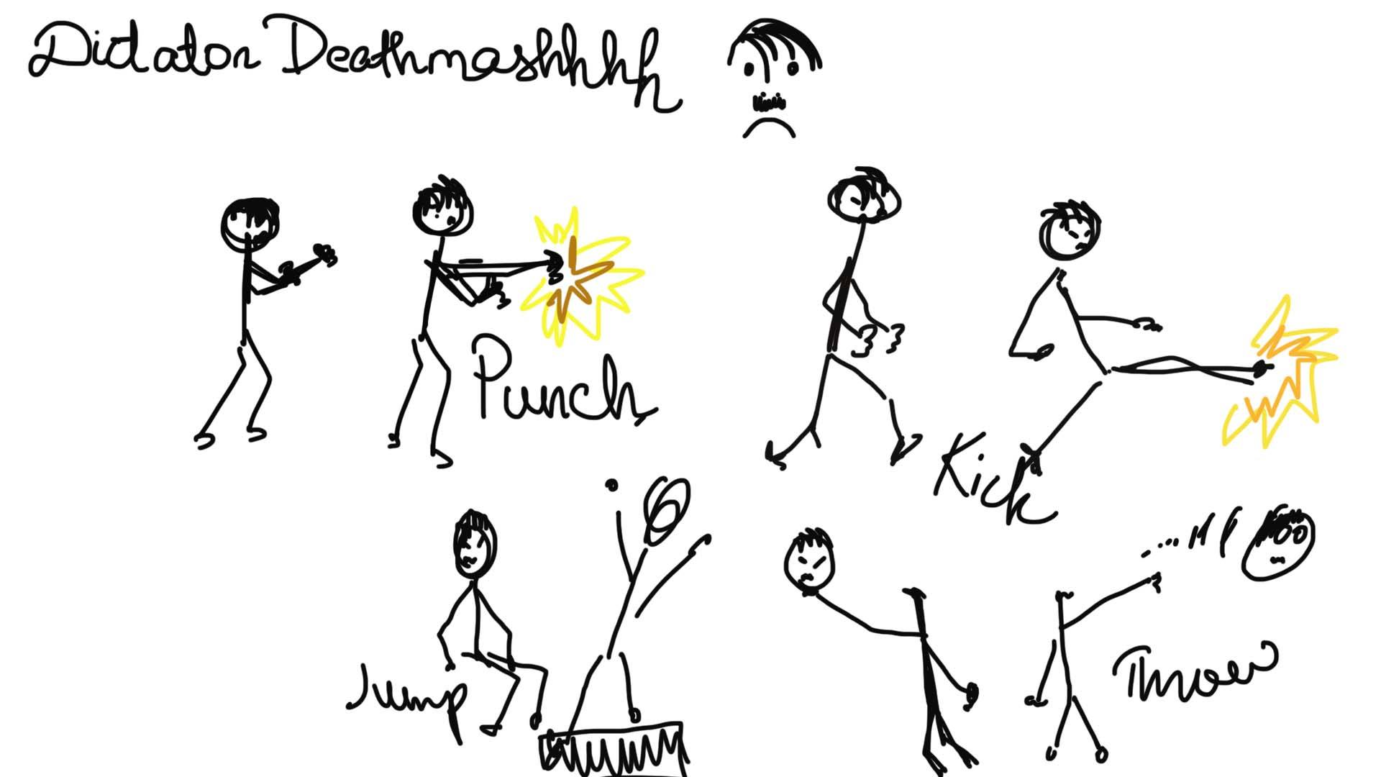

Slide 7
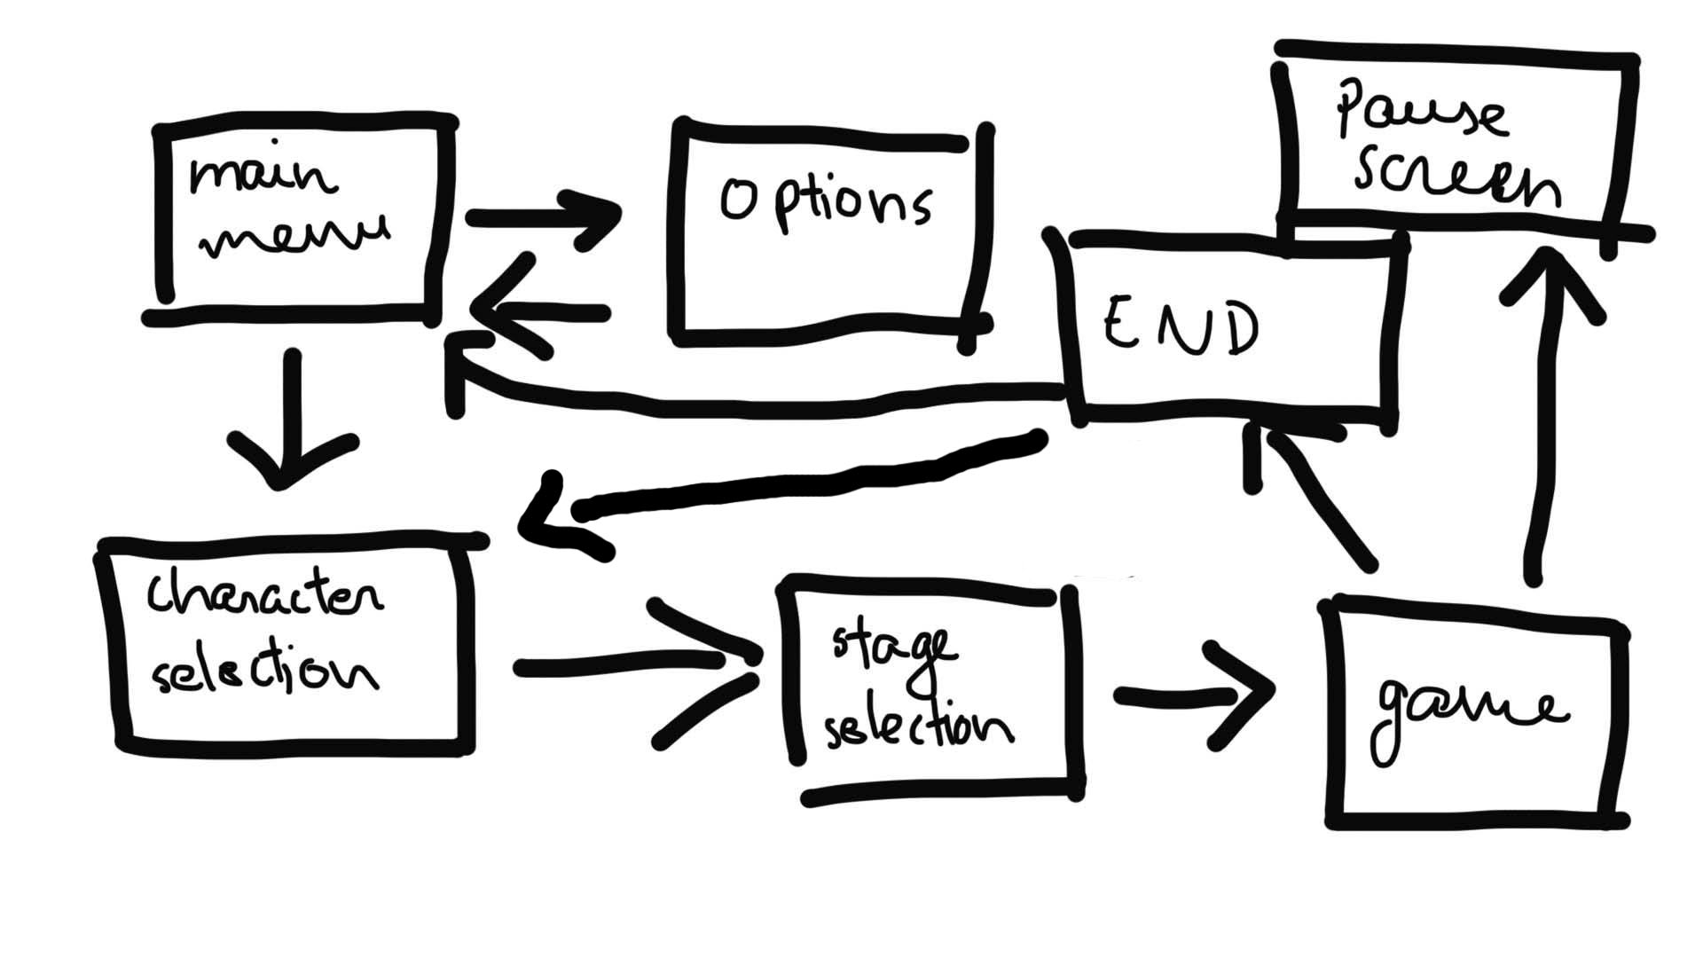
Menu System

Slide 8
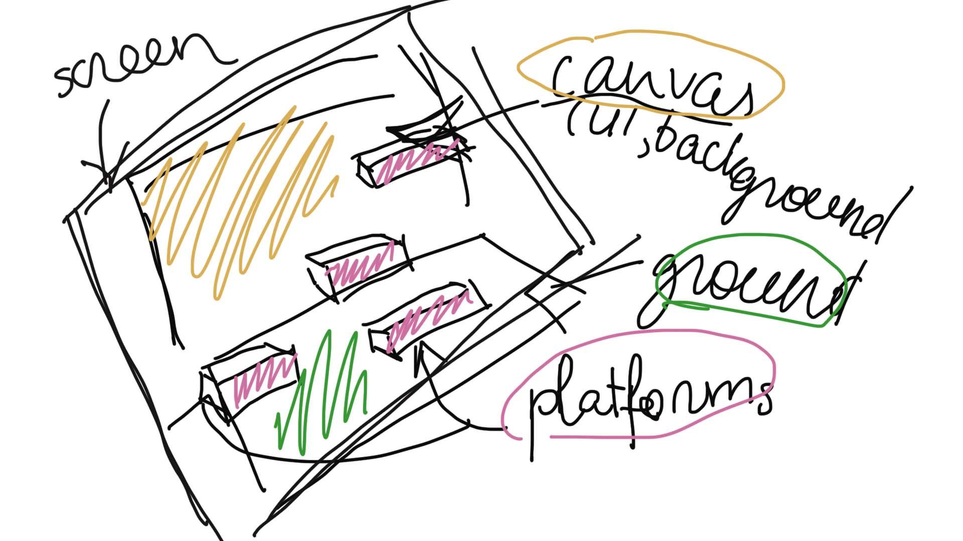
Game Layout

Slide 9
Art Style
The game is going to be in 2D and have the structure – background – platforms-floor. There going to be a selection of three different backgrounds to choose from. They will be based on historical places and will be associated with dictators or historical events. The style of backgrounds is sketchy, panting-like with dark, faded colours. The characters will have brighter colour palette to stand out from the background. The animations will be done using bone based technique and will have various movements.

Slide 10
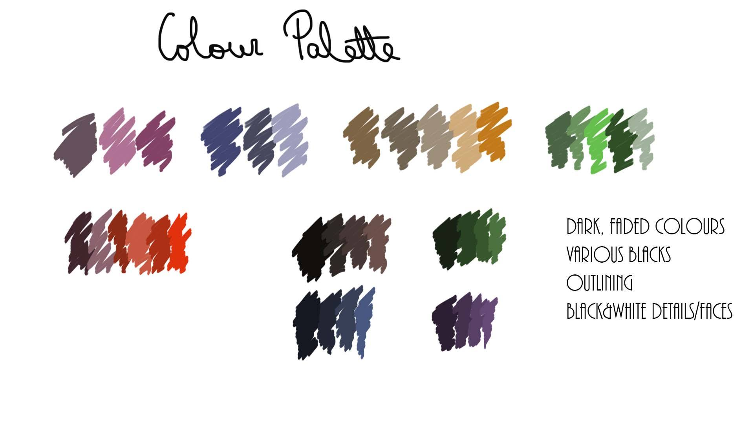

Slide 11
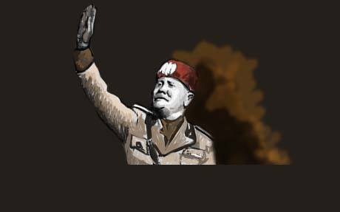
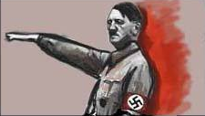

Slide 12
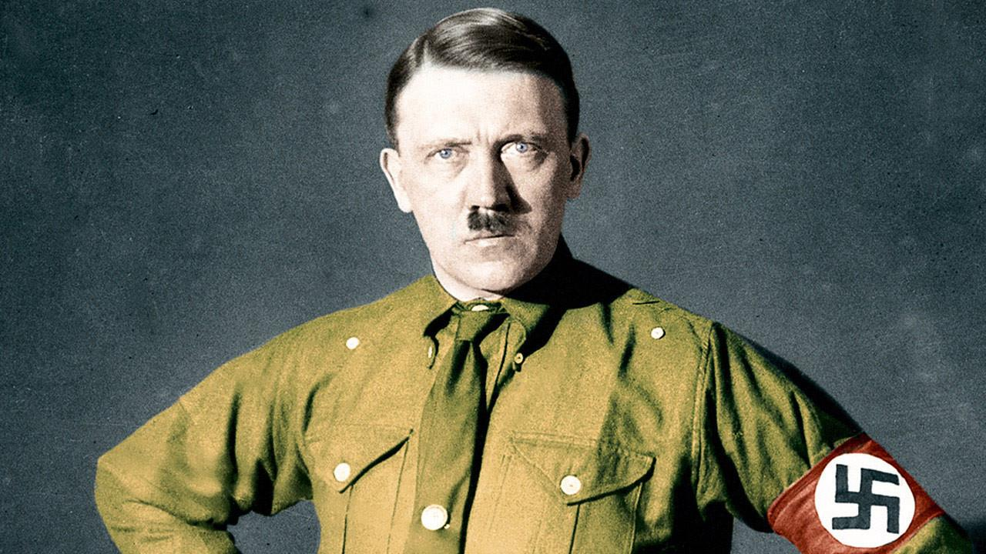

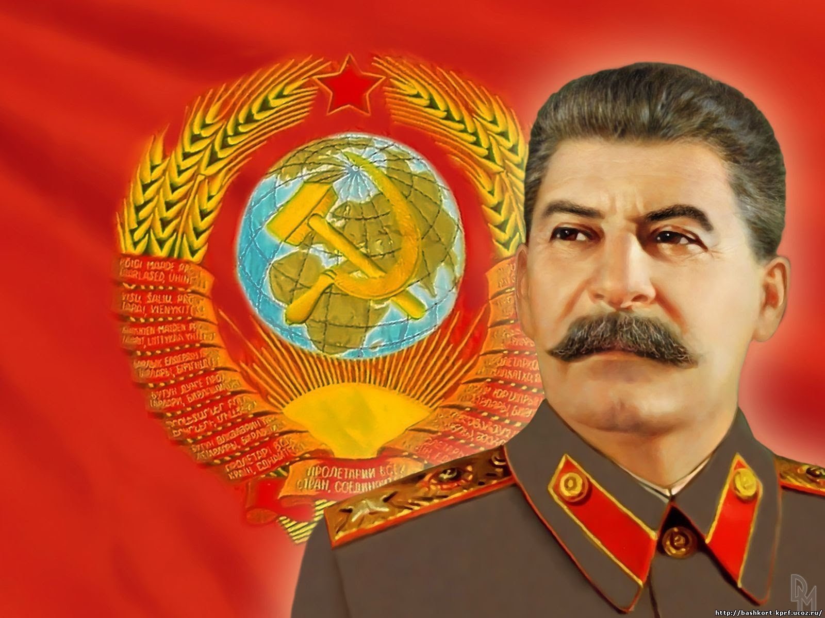
Dictators

Slide 13
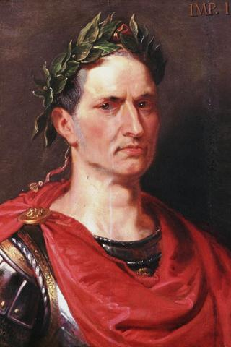
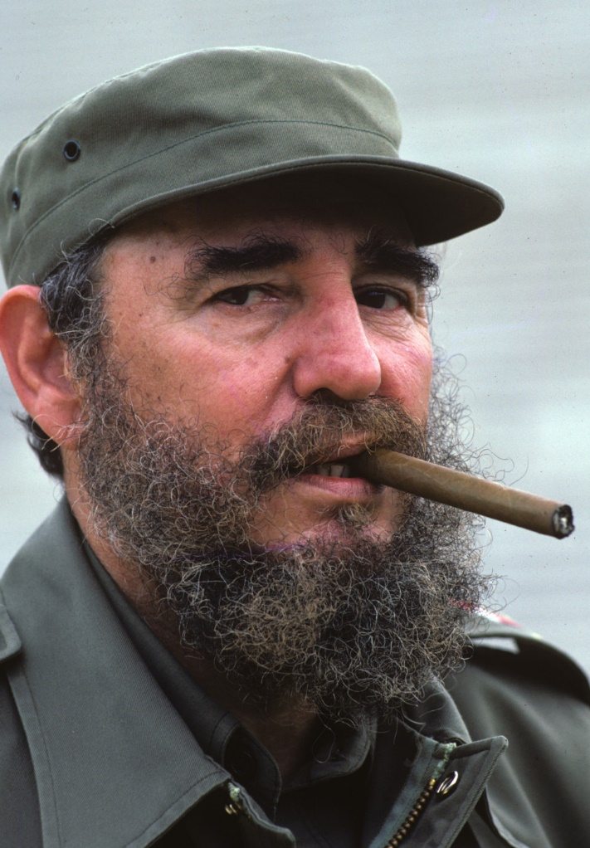
Dictators

Slide 14
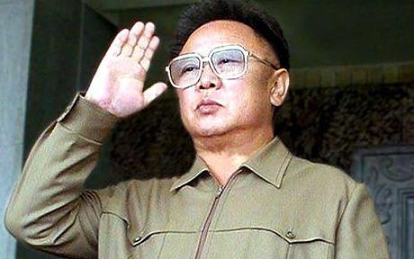
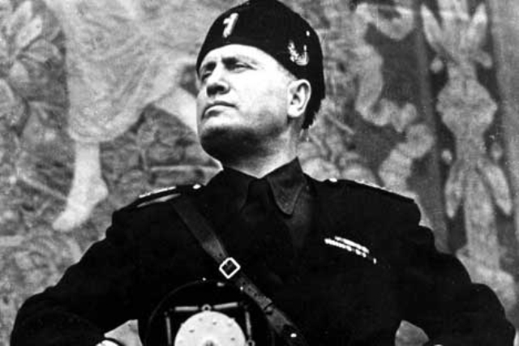
Dictators

Slide 15
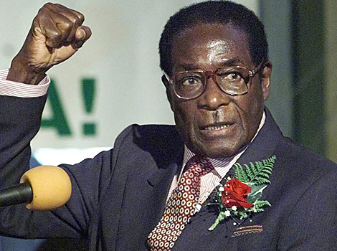
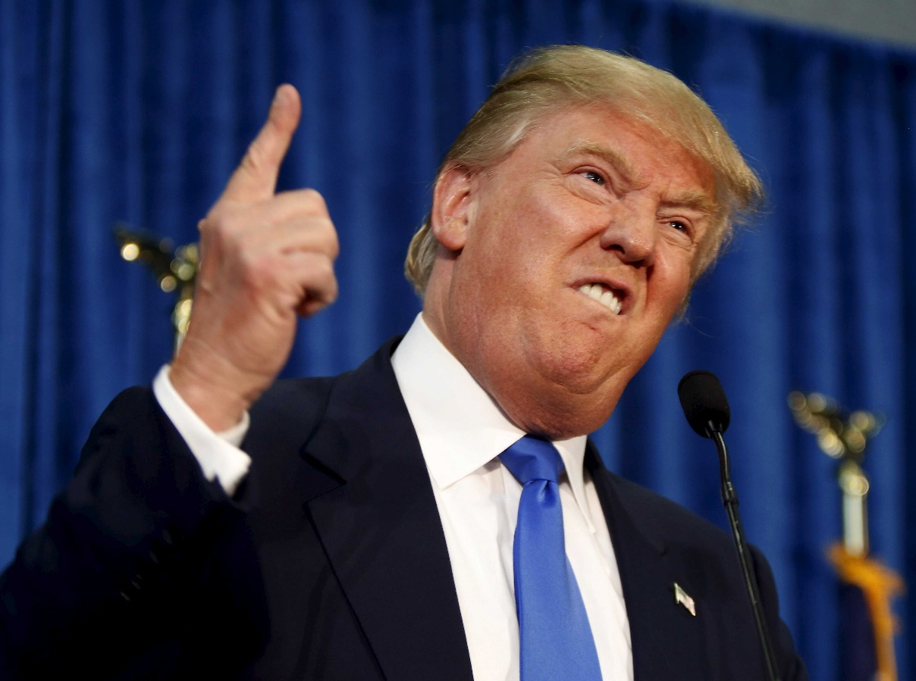
Dictators

