Slide 1
Project Road Map
VAERS 2021-2022 Gap Analysis
Missing Value and Outlier Correlation
Identify the gap between the current and ideal US Vaccine Adverse Event Reporting System during pandemics and times of extreme heightened public awareness.
Created by: Jared White
Last Updated: March 3rd, 2024
Created by: Jared White
Last Updated: March 18th, 2024

Slide 2
UNDERSTAND THE DATA BEFORE COMING TO CONCLUSIONS.
Read the Project Documentation and The Data Use Guide Included in the GitHub
UNDERSTAND
ANALYZE

Slide 3
Immediate Focus and Scope:
What is the current state of completeness for the dataset?
Do missing and outlying key data points correlate with other categories or attributes within the dataset?
Geographic and Demographic information
Length of freetext self-reported symptom descriptions
Reported fatalities and life-threatening reactions
Long Term Goals:
Consult Domain Experts to develop criteria for determining reliability of a report.
Deploy NLP to use freetext symptom descriptions to estimate report source.
Investigate possible correlations of incomplete & unreliable reports with pandemic new cycles & density of publications on mRNA vaccines.

Slide 4
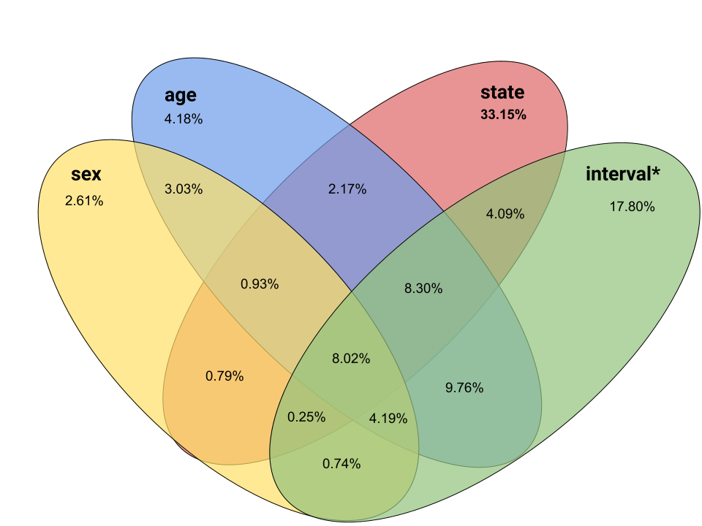
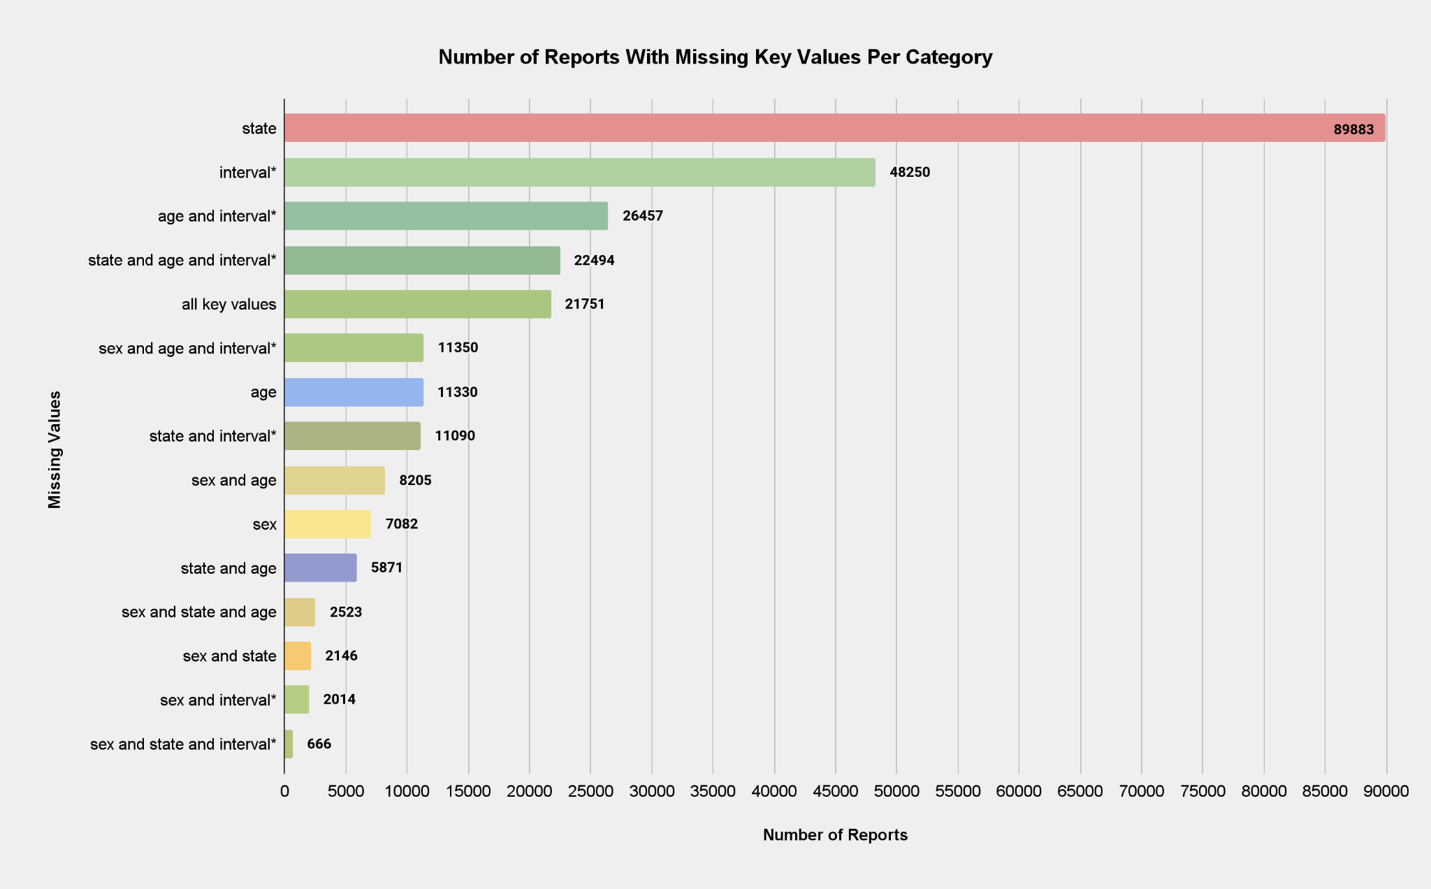
Initial Exploratory Analysis
(Not Indicative of Final Results. VAERS is an Anonymous, Passive Reporting System)
UNCLEANED DATA: USED ONLY TO INFORM DIRECTION OF ANALYSIS
992,513 Adverse Event Reports were filed in years 2021 and 2022 collectively.
898,551 (90.53% of total) reports were filed after the subject received a COVID-19 Vaccination.
271,112 (27.32%) of Reports Missing Key Data Fields
Percents of Total Reports Missing Key Data
*interval = number of days between vaccination and symptom onset

Slide 5
High Level Process Overview
Prepare
(Complete)
Process
(Complete)
Analyze
(First Phase Complete)
Visualize
(First Phase Complete)
Publish
(Iterative)
Create the Analysis Environment & Import the Raw Data
Manipulate the Data to be Conducive to Analysis
Descriptive Statistics Completeness of Individual Attributes and Whole Dataset
Create Visualizations of Analysis Findings
Updated on GitHub Upon Completion of Major Phases
Documentation
(Entire Project is Extensively Documented in MarkDown on GitHub)
Prepare
Process
Analyze
Visualize
Publish
Build a Webscraper in Python and Gather Historical News Headlines From Selected News Sites
Quantize Density & Concentration of News Headlines Regarding mRNA Vaccine over Time
Correlate Headline Quantitations with Propensity for Incomplete & Unreliable VAERS Reports
Incorporate Into Existing Time-Series Graphs to Inform Possible Causation
Stretch Goals will Likely be Dependent on Community Interest & Contribution

Slide 6
Prepare the Environment for Data Manipulation and Analysis
(Main Goals Complete)
GET THE DATA
Download the VAERS Archives for 2021 & 2022
CREATE THE DATABASE
Create a SQLite3 Database that Mirrors the Original Archives with Proper Data Types and Relational Keys
IMPORT THE DATA FROM ARCHIVES
Import the VAERS Archive Datasets to the Created Database. Verify Row and Bit Counts for Accuracy
BUILD WEBSCRAPER
Use Python to Build Webscraper(s) to for pulling mRNA-Related Headlines from Selected News Archives
SCRAPE VACCINE-RELATED HEADLINES
Get the Headlines of relevant news reports and the dates published from the most popular & reputable new agencies.
Also get the total number of news reports published per selected platform to inform subject newscycle domination.

Slide 7
Preprocess, Organize, and Format the Data to Enable Analysis
(Main Goals In Progress)
COMBINE REDUNDANT METRICS
Similar Report Fields between Forms 1.0 & 2.0 Must be Combined.
REMOVE REDUNDANT & IRRELEVANT FIELDS
Information from the Archives that are not within Scope of this Project will be Removed.
ADDRESS MISSING & OUTLYING VALUES WHERE POSSIBLE
Due to the nature of VAERS, some missing and inaccurate points of data can be informed from free-text descriptions.
Minimal Cleaning will be done due to focus on missing data and outlier correlation.
VERIFY DATA INTEGRITY AND SEPARATE COVID-19 RELATED REPORTS
Verify that the Remaining Cleaned Reports Constitute an Acceptable Sample Size of the Full Archived Data.
Copy Only Reports that were filed post COVID Vaccination to New Working Database (Approx. 90% of full dataset).
QUANTIZE HEADLINE DATA
Calculate the Density & Concentration of mRNA-related news reports over time per selected agency.
IMPORT QUANTIZED DATA TO THE DATABASE
Create a table for the quantized headline metrics and relate it to VAERS tables using ‘date of metic’ -> ‘report date’.

Slide 8
Analyze the COVID-Related Missing and Outlying Values
(Not Started)
STATISTICS ON COMPLETENESS
Find the Proportion of Missing Values and Extreme Outliers for each Key Report Attribute.
ANALYZE CORRELATIONS TO OTHER REPORT ATTRIBUTES
Are reports from certain States more likely to have missing/outlying key information?
What about reports with a higher number of Days Between Vaccination and Symptom Onset?
Length of Freetext Symptom Descriptions? Symptom Severity?
Are Fatalities & Life-Threatening Reports more or less likely to include all key information and conform to
normal distribution?
ANALYZE CORRELATION OF NEWS REPORTS TO VAERS DATA
Distribution of headline metrics over time vs proportion of incomplete/unreliable reports per day.
Does mRNA newscycle domination strongly correlate with VAERS missing and outlying data?
SEEK DOMAIN EXPERTISE TO FURTHER DEVELOP CRITERIA FOR RELIABILITY
What do Vaccine Experts and high-level healthcare workers think is the most useful set of metrics to determine the likelihood that a report is reliable & contains all necessary information?
BUILD A NLP MODEL TO ANALYZE FREETEXT SYMPTOM DESCRIPTIONS ACCORDING TO DOMAIN EXPERTISE
The dataset is too large for this task to be completed manually.
Circle back to beginning of analysis phase, and recalculate statistics for ‘reliability’ of reports with informed metrics.

Slide 9
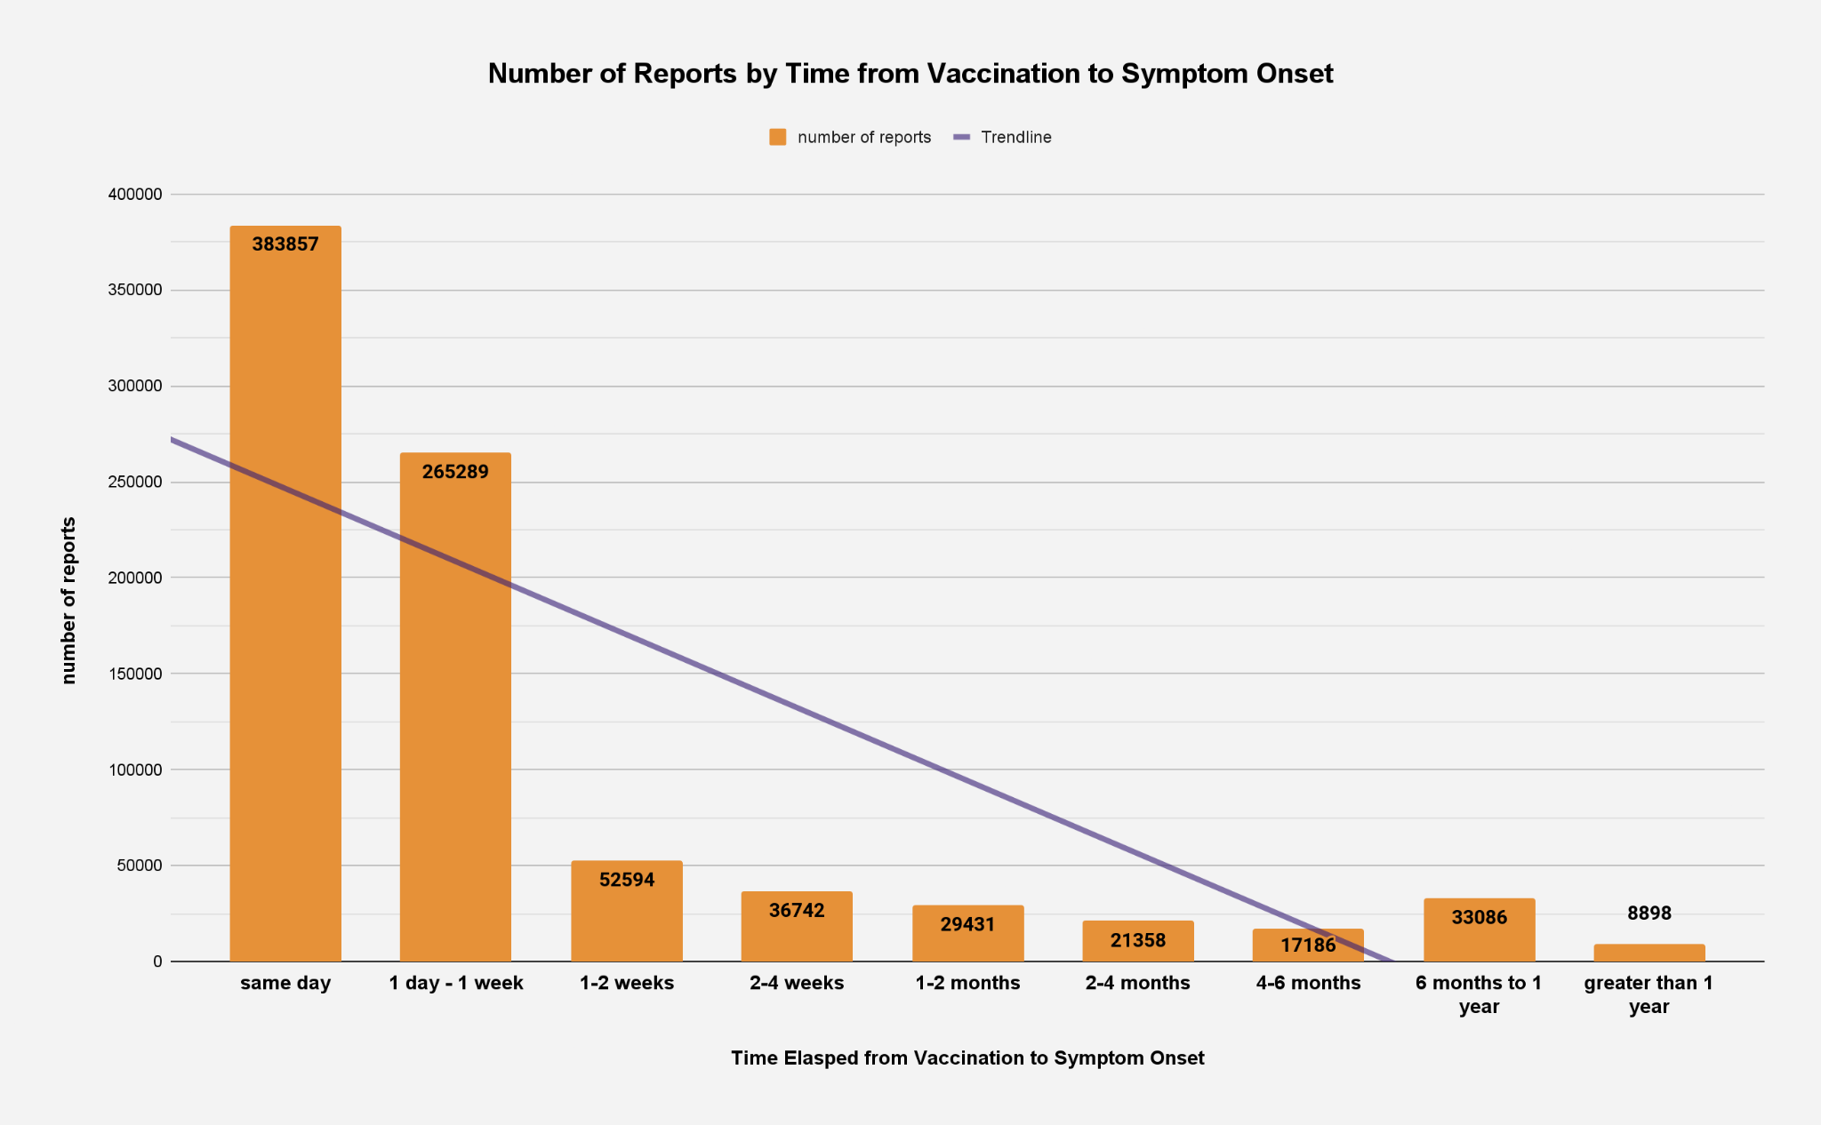
Visualize & Publish (Iterative)
UPDATES WILL BE PUBLISHED ON GITHUB UPON COMPLETION OF MILESTONES
Time-series Graphs of cleaned post-COVID Vaccination Reports. Focus on reports with missing data & outliers.
NEW VISUALIZATIONS UPON COMPLETION OF STRETCH GOALS
Visualize possible correlation between inaccurate or less reliable reports, and mRNA domination of newscycles.
Increase in Outliers after 6 month Interval
Likely entry errors and miscalculations

Slide 10

Six Month Timeline
Visualize & Report
Begin NLP Training
Time-series and
Correlation Charts.
Full Report and Documentation.
Develop Model - Likely LLaMa
Train on Annotated Sample
Quantize between 1 and 3 Bits
Evaluate & Iterate
Prepare the Data
COMPLETE
Feb
Mar
March - April
Early June
June - July
September
Project Start
Analysis
(breath)
Pivot to Long Term Goals
Initial Preparation.
Exploring & Understanding the Data.
COMPLETE
Answer Main Scope Questions.
Missing Data & Outlier Correlation.
Phase 1 Complete
Build Python Webscraper.
Begin Headline Scraping & Quantization.
Develop extensive Report Reliability Criteria from Domain Expert Consultation.
Manually Annotate a Statistically Significant Sample of Free Text Symptom Descriptions.

