Slide 1
VAERS 2021 - 2022 Gap Analysis
Descriptive Statistics, Missing Values & Outlier Correlations
Identify the gap between the current and ideal State of VAERS.
Reliability to provide accurate information to vaccine manufacturers and the public during pandemics.
Provide recommendations to improve report quality and completeness.
Created by: Jared White
Last Updated: March 18th, 2024
Notes:
I am Jared White, an entry-level data analysts with a background in statistics, LLM Q&A Annotation, and technical writing.
This presentation will Identify the gap between the current and ideal states of VAERS' ability to provide important and accurate information to public safety and vaccine R&D initiatives during pandemics and times of heightened public awareness.
By identifying correlations with incomplete and outlying reports, actionable recommendations are made to improve the usefulness of VAERS to the public and to vaccine manufacturers.

Slide 2
UNDERSTAND THE DATA
Read the Project Documentation and The Data Use Guide Included in the GitHub
VAERS is the Vaccine Adverse Event Reporting System.
Likely Under-reported
Unrestricted & Completely Anonymous
Uncleaned Archives
Correlation, not Causation
Notes:
VAERS is the Vaccine Adverse Event Reporting System. It is a passive, anonymous, and public-facing reporting system developed and maintained by the CDC for people who experience adverse events or symptoms following vaccination.
Private citizens are not required to report to VAERS, but many healthcare providers are. Under-reporting is a major factor of all passive reporting systems.
Anyone can easily file a VAERS report online. It is a federal crime to knowingly file a false VAERS report.
The public VAERS archives are completely anonymized, but otherwise uncleaned.
Any given VAERS report cannot prove a causal link between an adverse event and a vaccine or manufacturer, but trends in reporting can show correlations between a vaccine and an increase in adverse events.

Slide 3
Key Information
14,469 Duplicates & Errors Removed.
54% of Analyzed Reports Were Complete and Non-outlying.
+400% Reports
2020
2021
Dates of: Vaccination, Symptom Onset, and Report Filing
54,823 Missing / Outlying Values
Demographics: Age, Sex, State of Residence
226,058 Missing / Outlying Values
Vaccine Lot Number: Identifies specific vaccine batch
280,844 Missing / Outlying Values
Symptom Descriptions: Free-text reports
Highly unstructured and not delineated
Notes:
Why does it matter?
Accurate and complete records of post vaccination adverse events and symptoms are essential for informing public safety and vaccine R&D.
From 2020 to 2021, the number of post-vaccination adverse event reports increased by over 400%.
Approximately 92% of all VAERS reports made during 2021 & 2022 were filed after the subject received a COVID-19 vaccination.
What is the key information in the data?
Dates: Vaccination, symptom onset, and report filing, as well as interval between vaccination and symptom onset.
54,823 Reports with missing / Outlying Information.
Demographic & Geographic: subject age, sex, and state of residence
226,058 Reports with missing / outlying values.
Lot Number of the vaccine the subject received.
280,844 Reports with missing / outlying values.
Symptom Description: These are free-text fields describing the event, the length of which is analyzed in correlation to other factors. These are highly unstructured and concatenated between self-experience descriptions, healthcare provider comments, vaccine manufacture comments, and follow-up notes from subsequent processing and contacts by VAERS employees.
How did you verify the data?
This analysis focuses solely on COVID-19 vax related reports.
10,830 duplicates, and 3,638 obvious entry errors (dates before first EUA) were removed.
After cleaning, 899,423 post COVID-19 Vaccination reports were analyzed.
Approximately 56% of these reports contain no outlying or missing key pieces of information.

Slide 4
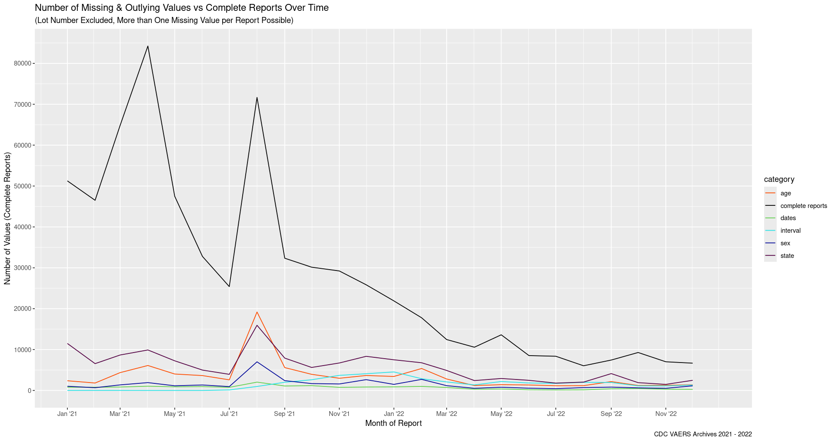
Second Spike, Larger Correlation
First Spike, Fewer ‘bad’ Reports
Relative Change in Slope
Notes:
PAUSE FOR 5 SECONDS
What am I looking at?
This is a time-series chart that shows the monthly number of missing values as well as complete reports.
Due to the drastically large number of reports missing the vaccine lot number, this category is not included in this time series, and these missing values are included in the 'complete reports' category.
It's important to note that the colored lines represent counts of individual missing or outlying values, and the black line, for complete reports, represents a number of reports.
There can be more than one missing value per report.
The complete reports line is used to give context to the overall trend of reporting.
What should I be noticing?
The first spike of reports (April of '21) show a much lower number of incomplete and outlying information than the second spike (July of '21)
The second spike also coincides with the first noticeable number of illogical date time time-lines and outlying intervals between vaccination and first experience of adverse symptoms.
This second spike could suggest a negative correlation between report quality and public sentiment.
Following the second spike, the number of complete and accurate reports decreases more quickly than the missing & outlying values.
Overall, complete reports trend downward while ‘bad’ reports remain relatively constant.
Smaller spikes in spring and fall of ‘22 show similar correlation on a much larger scale.

Slide 5
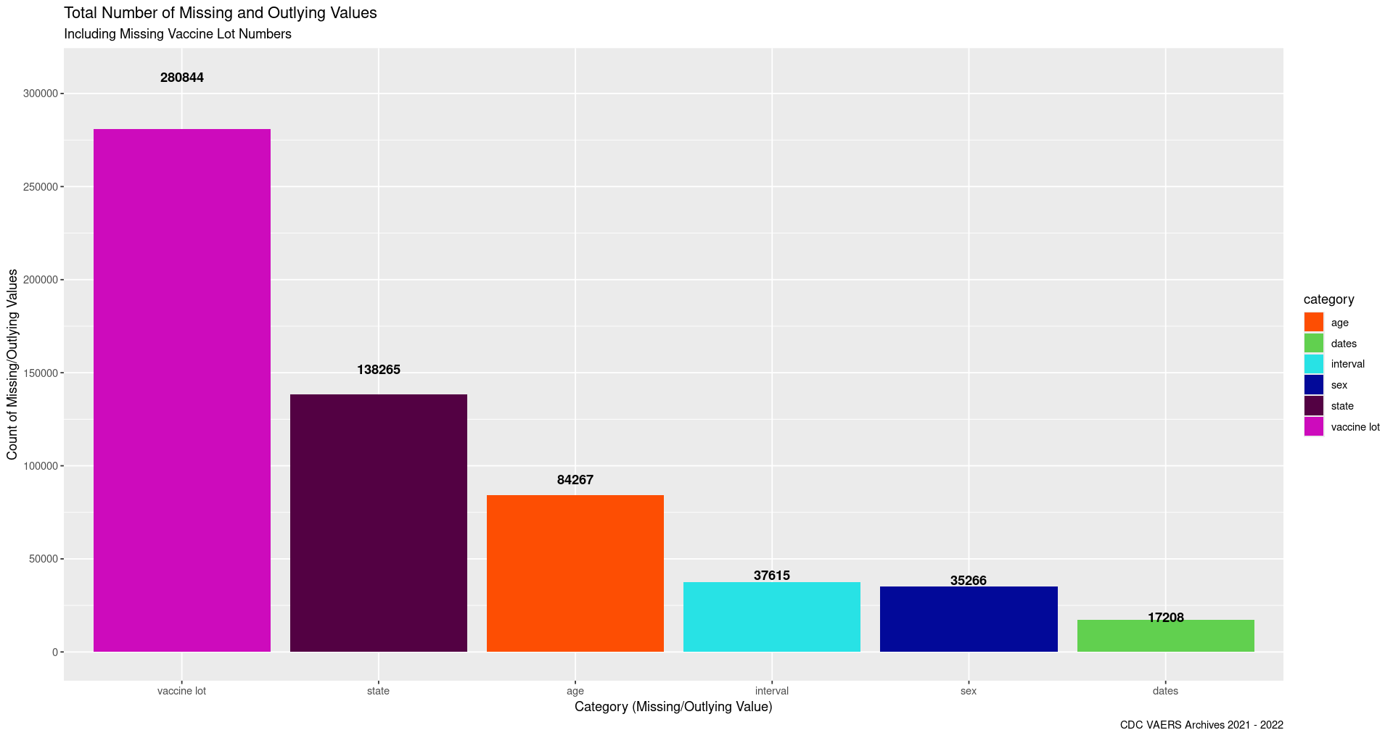
Only Information Capable of Identifying Specific Vaccine Batches
Notes:
PAUSE FOR 5 SECONDS
What am I looking at?
These columns display the proportion of missing & outlying values between the categories.
The completeness of the dataset changes drastically once Vaccine Lot Number is taken into account.
What should I be noticing?
The number of reports missing Lot Number is twice that of the next largest category.
The ability to link an increase in adverse events to a specific vaccine lot or manufacturing batch is essential to informing quality control and further research for vaccine manufacturers.
The two two key pieces of information in identifying whether a specific vaccine batch may have quality control issues (lot number and state) account for approximately 70% of the missing or outlying information.
The vaccine lot number is specified on the individual's proof of vaccination card.
This information can also be informed from the records of the facility where the vaccination was received.
Age of the reported, the next most medically significant piece of information, is the third largest category of outlying and missing information.

Slide 6
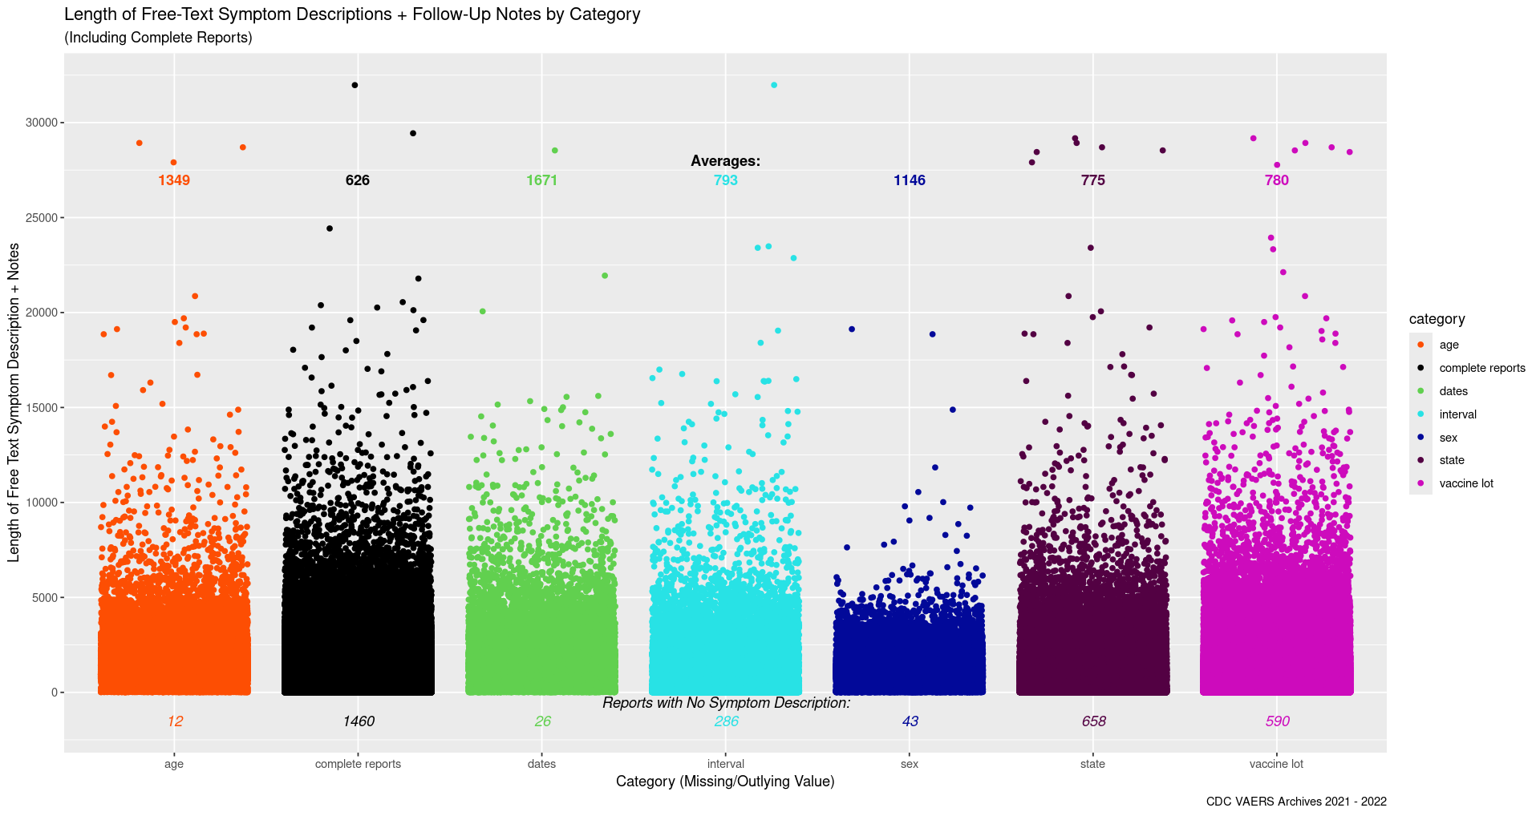
Negative Corr.
between Symp-Desc length & Completeness of other fields
Similar Outlier Clusters
Similar Dissipation Zones, Different Rates
Notes:
PAUSE FOR 5 SECONDS
What is that?
This chart plots the character length of each reports' free-text symptom descriptions with its category of incomplete or outlying information.
Each point represents either one missing value or one complete report, and that point's height shows how long the symptom description field is for that report.
As with the other charts, there may be more than one missing value per report, and that will result in a point in each of the corresponding categories, except for the category of each report.
Its pretty, but what does it mean?
The vast majority of all reports fall underneath the 5,000 character range.
Reports missing the sex of the reporter are much less likely to contain a symptom description greater than 5,000 characters.
Interestingly, otherwise complete and non-outlying reports contain the shortest average symptom descriptions, and have drastically more reports with no description than all other categories.
This could be due to the presence of separate fields for symptom information in MedDRA terms. This is used by healthcare providers to quickly and concisely record medical descriptions in a proprietary linguistic encoding system.
This could suggest that healthcare facilities are more likely to provide complete and accurate reports than individuals.
The symptom description field is also concatenated between multiple sources of information, is highly unstructured, and not clearly delineated. It may also be repetitive due to automating processing.
As it may include additional notes from subsequent correspondence with the subject, this suggest minimal effectiveness of these follow-up notes in addressing key pieces of outlying and missing information.
A distinct cluster of outliers forms at the 27,000 to 30,000 character range. This could be a starting point for further investigation into effectiveness of automated text processing on the symptom descriptions.

Slide 7
Immediate Recommendations
Further Investigation
Incorporate a ‘Reported By’ Field
Clearly identify source of a report
Standardize Follow-Up & Report Update Procedures
Update missing / outlying fields with reporter or healthcare facility
API integration with healthcare providers
Automatically update Lot Number & other key pieces of information
Fall-Back QA Protocols during spikes in reporting
Commonsense checks on dates/numeric values & required information fields
Subject News-Cycle domination correlation analysis
NLP processing of Free-Text Description Fields
Further outlier & missing value analysis
Notes:
Immediate Improvements:
Incorporate a simple 'Reported By' field, wherein the source of the report is either selected or generated. This will clearly delineate reports filed online by individuals, by qualified healthcare officials, or other sources implemented as needed.
Develop standardized procedures for follow-ups with subjects or healthcare providers to inform/confirm missing & possibly incorrect values. Separate the notes from these follow-ups from the initial symptom descriptions. This will make the database more usefully structured and easily searchable. If new information on a report is gained, add it to the appropriate field.
Develop an API system integrated with healthcare facility records to automatically inform key pieces of information such as vaccine lot number. This can be done securely with pre-anonymized information. This will drastically cut the amount of missing key information needed to inform the public and manufacturers on vaccine safety.
Develop fall-back quality assurance protocols to be implemented during times of peak reporting to maintain report quality and completeness. This includes commonsense checks on dates and numeric values and required key information fields.
Further Investigation (Next Steps of the Project):
Develop quantitative data on the density of COVID-19 Vaccine subject reporting in the news cycles during the later phase of the pandemic. Analyze this alongside time-series of incomplete & outlying reports to further inform correlations.
Build and train a NLP model to process free-text symptom description fields to further inform the reliability of any given report.

