Slide 1
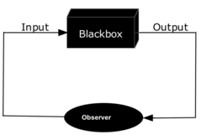
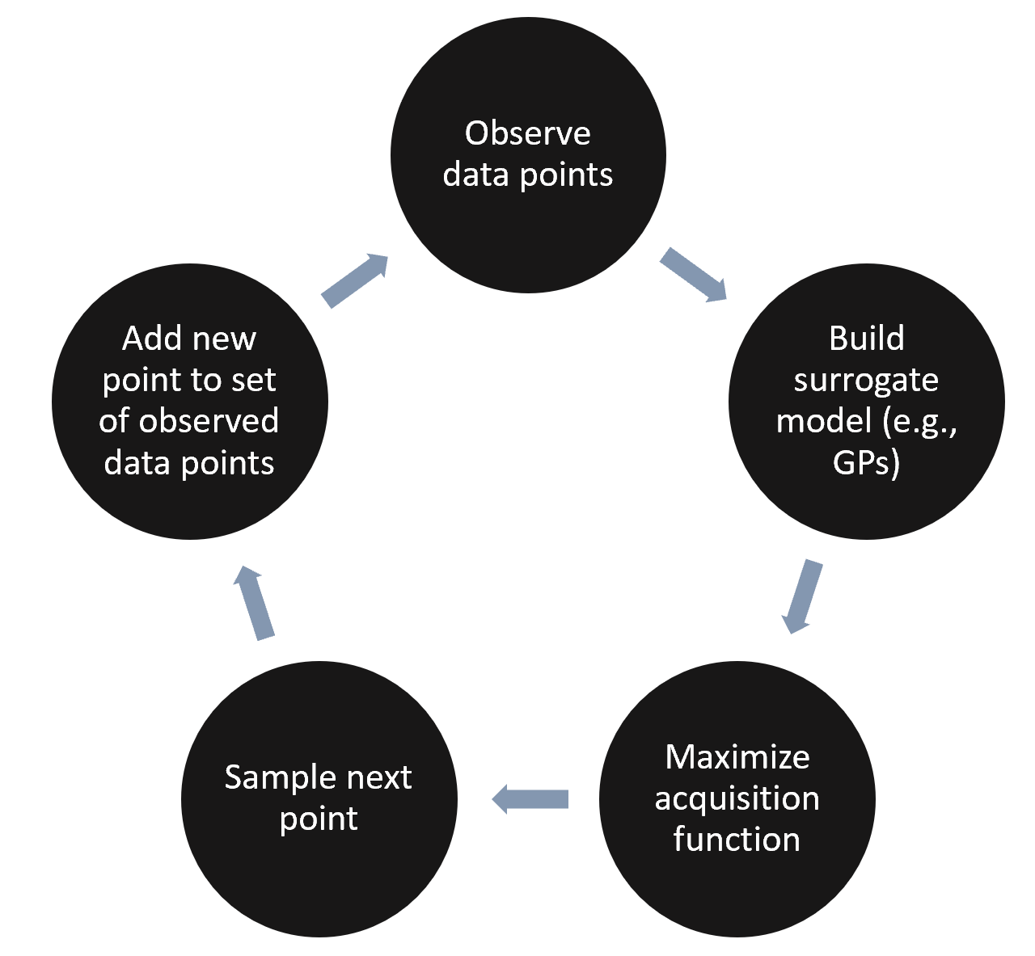
공학분야 연구/개발에서 흔히 나타나는 탐색 과정
1. 입력 결정: 조성, 온도, 공정 시간, 형태, 강도… → 연속적, 다변수: ‘차원의 저주‘
2. 물성 측정: 점도, 강성, 저항, 반응률, 속도 … → 물성/성능 ‘최적화’
3. 평가 및 실험 재설계 → 요구 물성/성능 만족 여부 판단, 실험 ‘반복’
Grid search
Model-based
Heuristic / physics / insight
(Input) Parameter Searching
Q. 물리적/경험적 통찰이 없을 때, 측정된 데이터로부터 다음 실험을 어떻게 설계하는가?
Grid search보다 효율적
문제의 종류에 비의존적 (일관성)
데이터의 경향성 파악 가능
Ans: 데이터 기반 모델링!

Slide 2
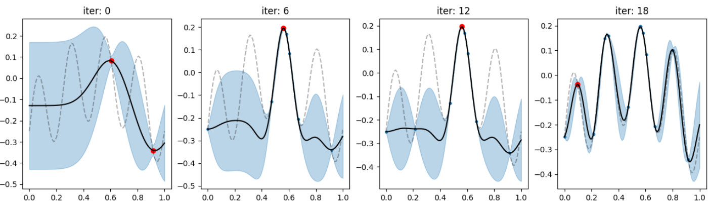
Bayesian optimization
Procedure
Given observed data (score vs. parameter)
Conduct GPR (mean & variance)
Calculate acquisition function (expected improvement, EI) : exploring & exploiting issue
Sample maximum EI point
Measure score for suggested point
Repeat 1-5
Expected improvement
Score
Iteration
Cumulative normal distribution
Normal distribution
Multi-objective problem?
- Weighted sum of each score (Field knowledge)
- Multi-objective optimization (Pareto front)

Slide 3
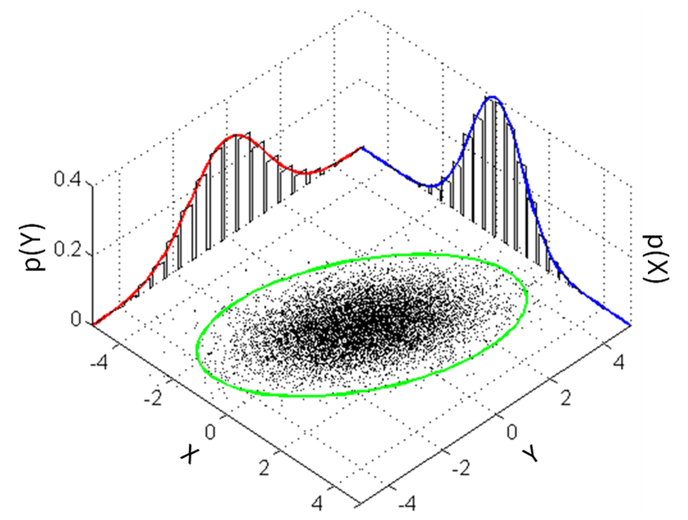
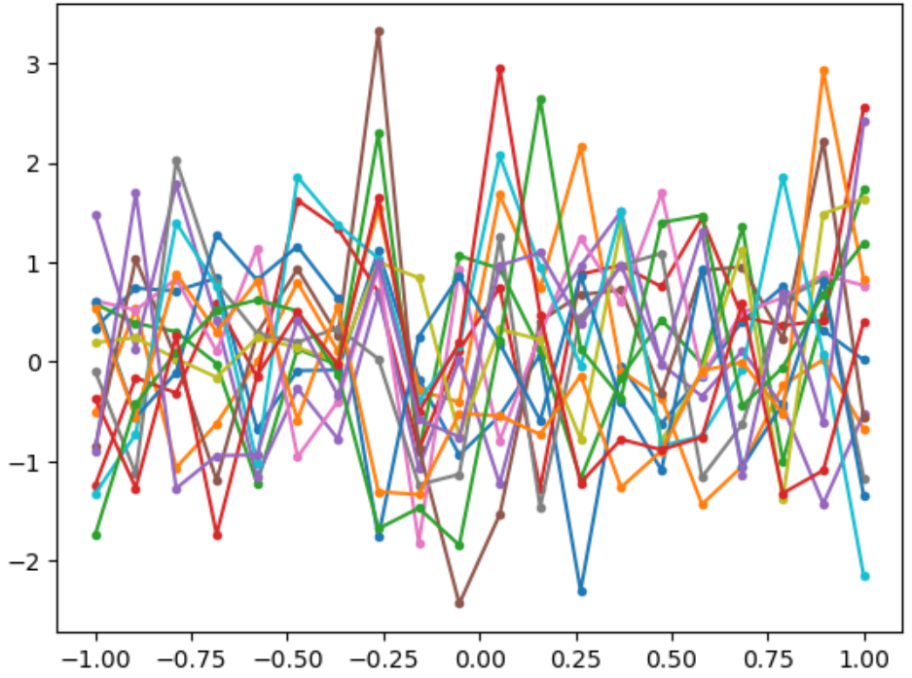
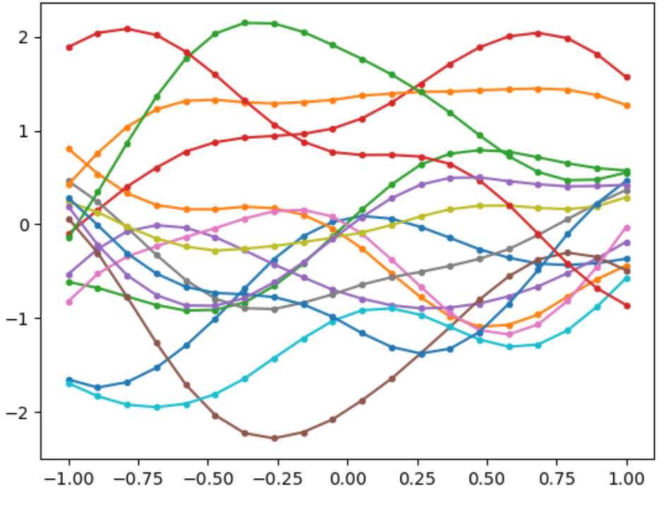
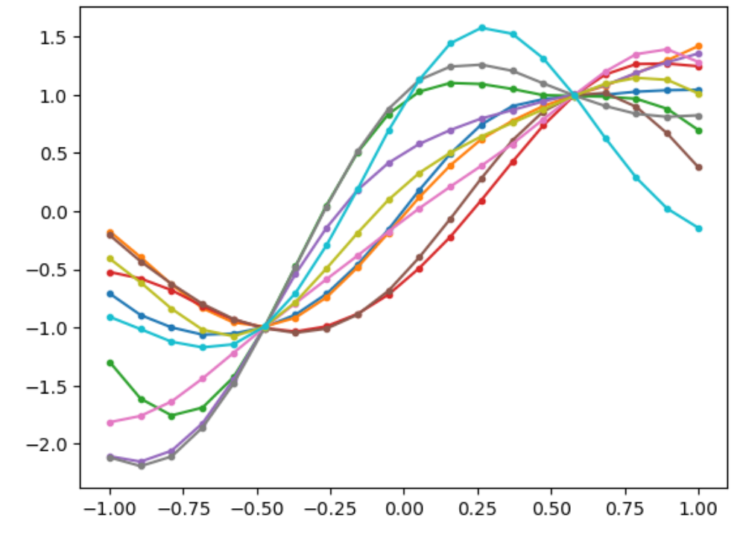
Gaussian process regression
Multivariate normal distribution
Function sampling
Sampling from infinite dimensional distribution
Covariance based on distance → smooth function
Observed data → conditional sampling
→ Prediction w/ mean & variance
15 samples of X

Slide 4
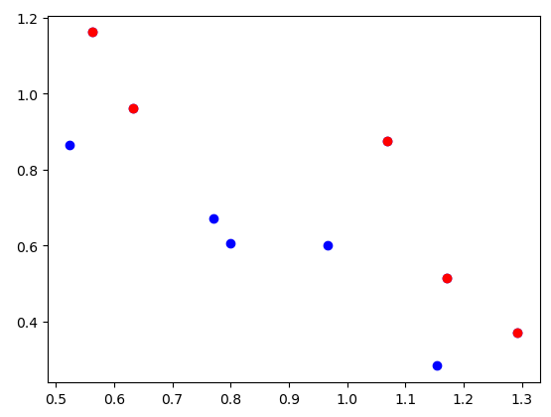
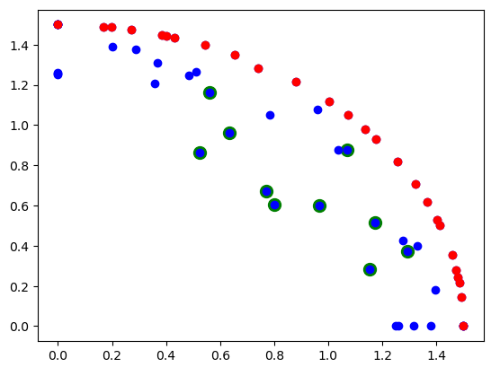
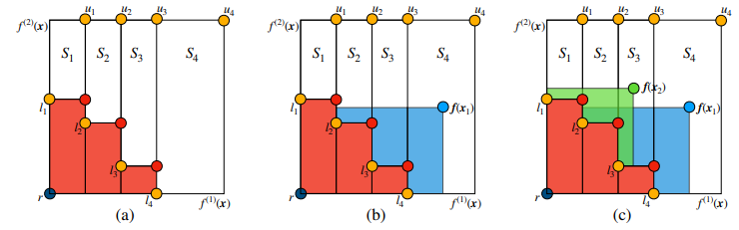


Multi objective Bayesian optimization
Pareto front
Procedure
Given observed data (score vs. parameter)
Conduct GPR for every score
Calculate acquisition function :EHVI
Sample maximum EHVI point
Measure scores for suggested point
Repeat 1-5
Score2($θ$)
Score2($θ$)
Score1($θ$)
Score1($θ$)
Expected Hyper Volume Improvement (EHVI)

