Slide 1
Causality

Slide 2
Problems with stats
People doesn’t know what correlation means
Stat term are hard to think in
People assume wrong causes

Slide 3
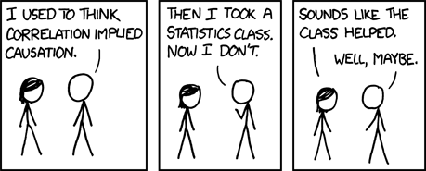
Correlation isn’t causation

Slide 4
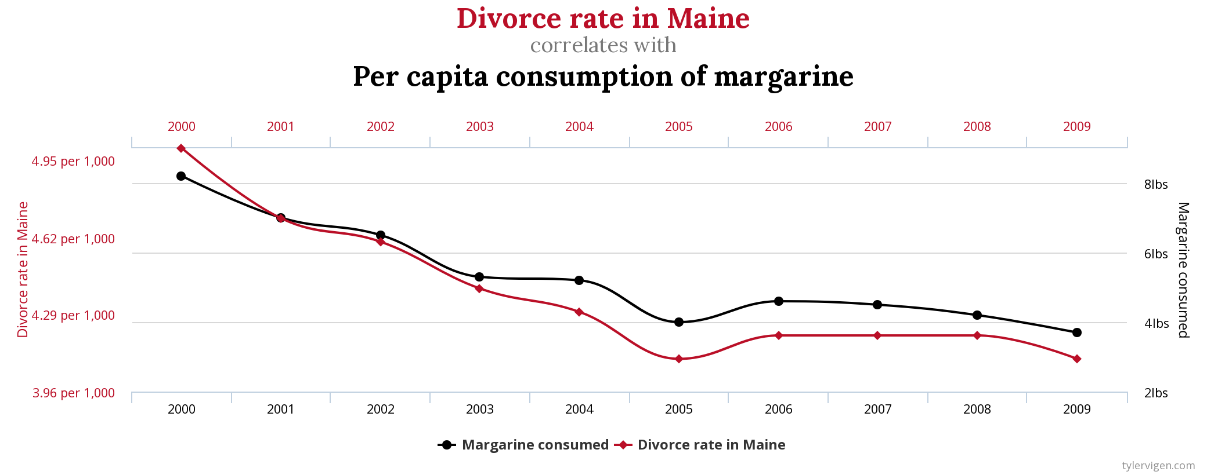
Correlation isn’t causation

Slide 5
Correlation isn’t causation
Endless list of news: meat causes X, fruits cause Y, sleep cause Z
Double check them!!

Slide 6
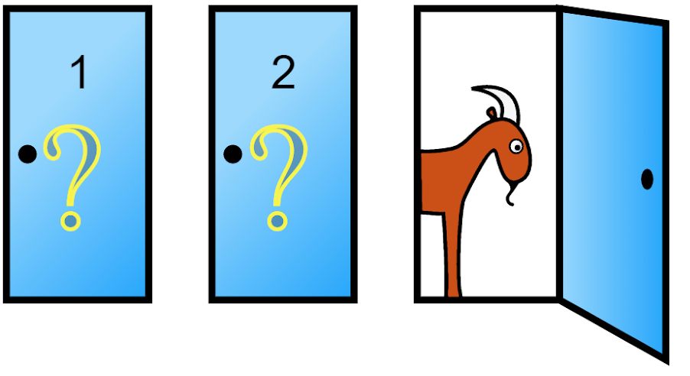
Monty Hall problem

Slide 7
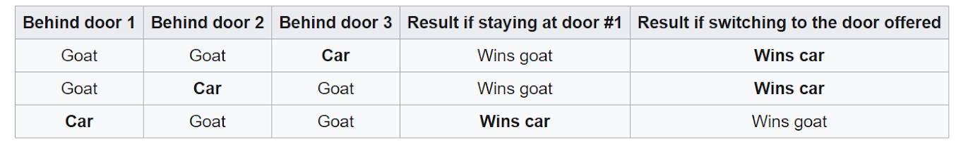
Monty Hall problem

Slide 8
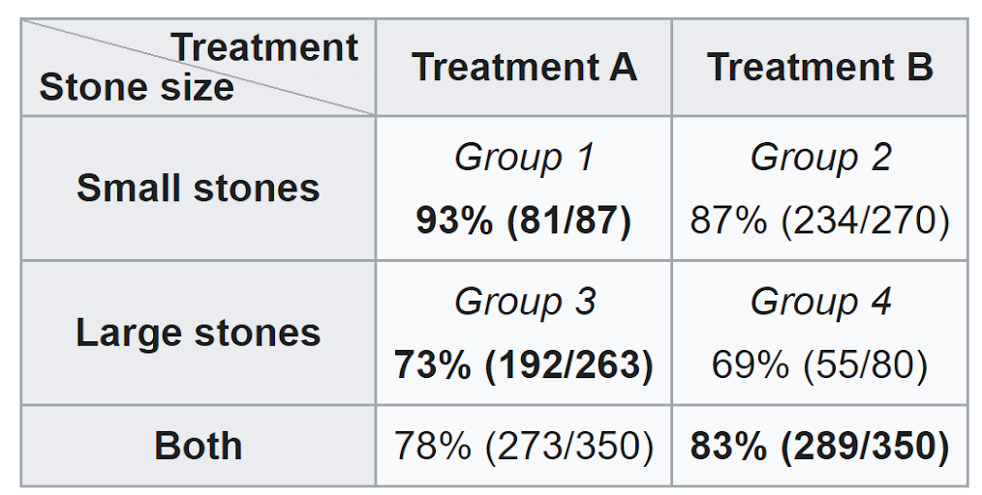
Simpson's paradox

Slide 9
Simpson's paradox
A or B?

Slide 10
Simpson's paradox

Slide 11
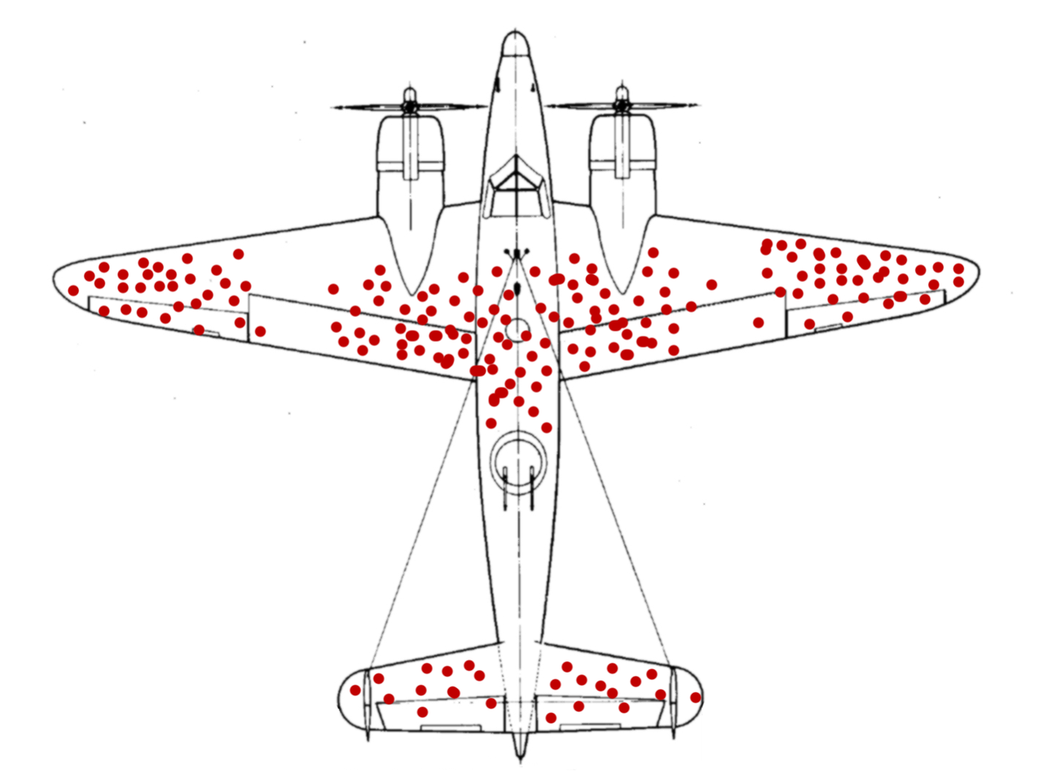
Survivorship bias

Slide 12
Causality use cases
Choosing treatment
Any time you have only observational data
To eliminate network effects
etc

Slide 13
Prediction Versus Causation
P(Y ∈ A|X = x)
the probability that Y ∈ A given that we observe that X is equal to x
P(Y ∈ A|set X = x)
the probability that Y ∈ A given that we set X equal to x

Slide 14
Correlation isn’t causation
P(Y ∈ A|X = x) ≠ P(Y ∈ A|set X = x)

Slide 15
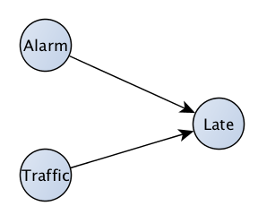
Causal graphs

Slide 16
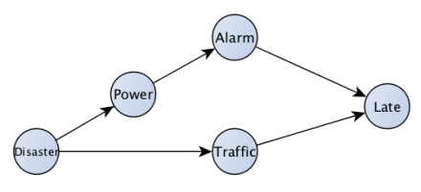
Common cause

Slide 17
Correlation
Causes correlation
Correlated

Slide 18
“There is no correlation without causation”

Slide 19
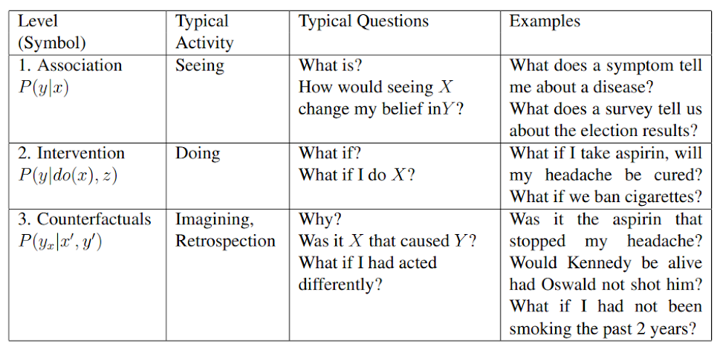
The Three Layer Causal Hierarchy

Slide 20
Difference in differences
https://www.pravda.com.ua/cdn/covid-19/cpa/

Slide 21
Thank you

