Slide 1
Linear and Logistic Regression recap

Slide 2
I. Linear Regression

Slide 3
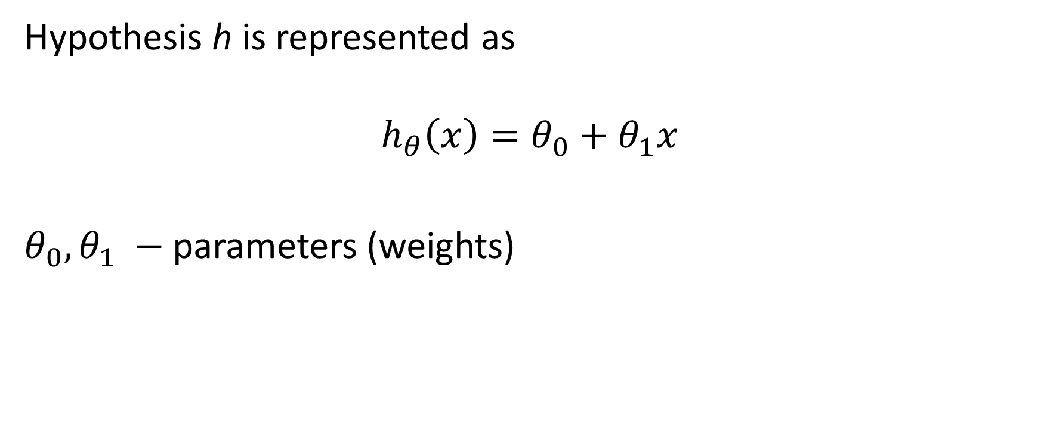
1.Univariate Linear Regression

Slide 4
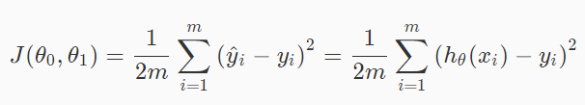
2. Cost Function

Slide 5
2. Cost Function
Why 2 in denominator?

Slide 6
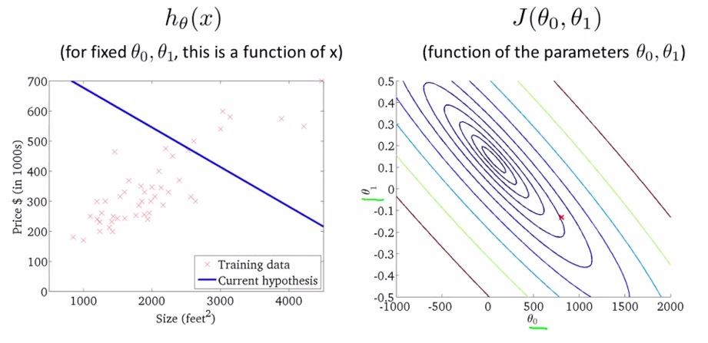
2. Cost Function: plots

Slide 7
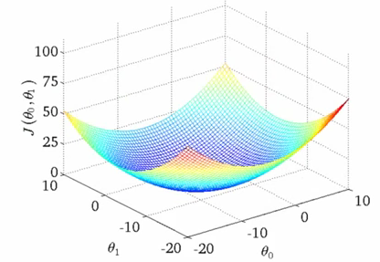
2. Cost Function: plots

Slide 8
3. Gradient Descent
Having some cost function J(θ₀, θ₁) We want to find minJ(θ₀,θ₁)
Start with random θ₀, θ₁
Keep changing θ₀, θ₁ to reduce J(θ₀, θ₁) until we find minimum

Slide 9
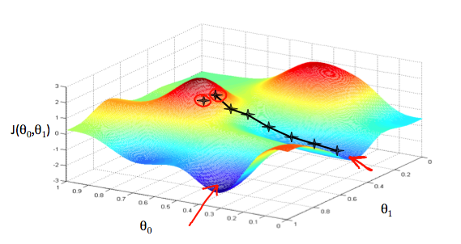
3. Gradient Descent

Slide 10

3. Gradient Descent: algorithm
Repeat until convergence:
j=0, 1 - feature index number
α – learning rate
Correct way to do GD is by simultaneous update

Slide 11
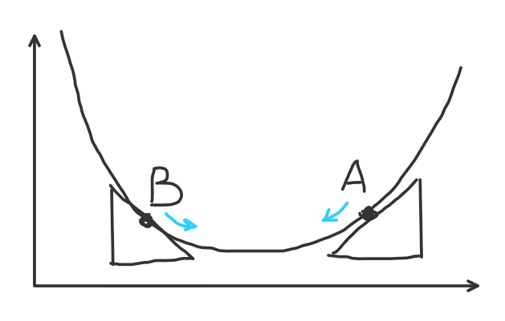
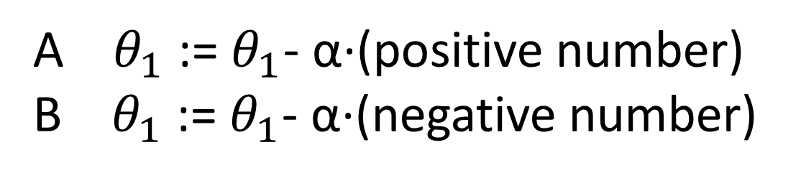
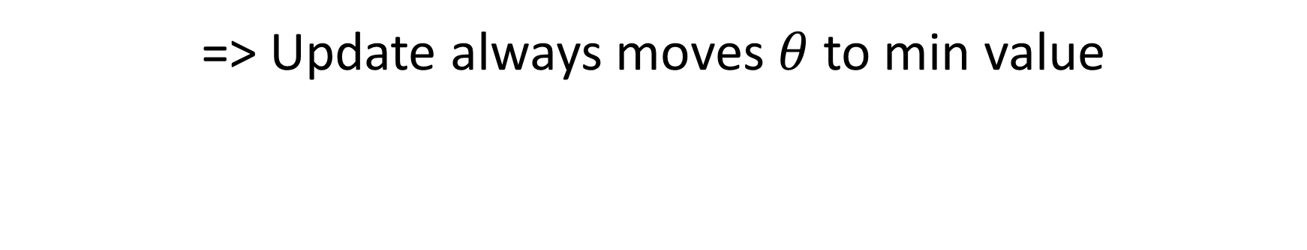
3. Gradient Descent: how it works

Slide 12
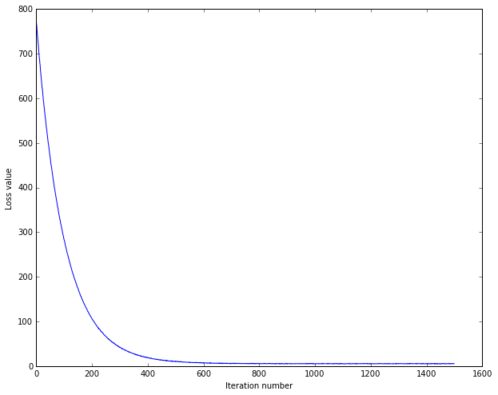
3. Gradient Descent: learning rate
α too small => GD is too slow
α too big => GD overshoots min, won’t converge
We can adjust α online, but GD will converge with fixed α, too – it will take smaller steps near local minimum
Image: bruceoutdoors.wordpress.com/tag/machine-learning/

Slide 13
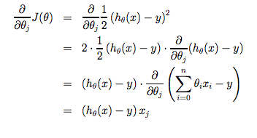
3. Gradient Descent: update rules
Gradient for single example:

Slide 14
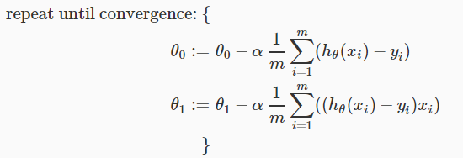
3. Gradient Descent: update rules
=> Update rules for univariate GD:

Slide 15
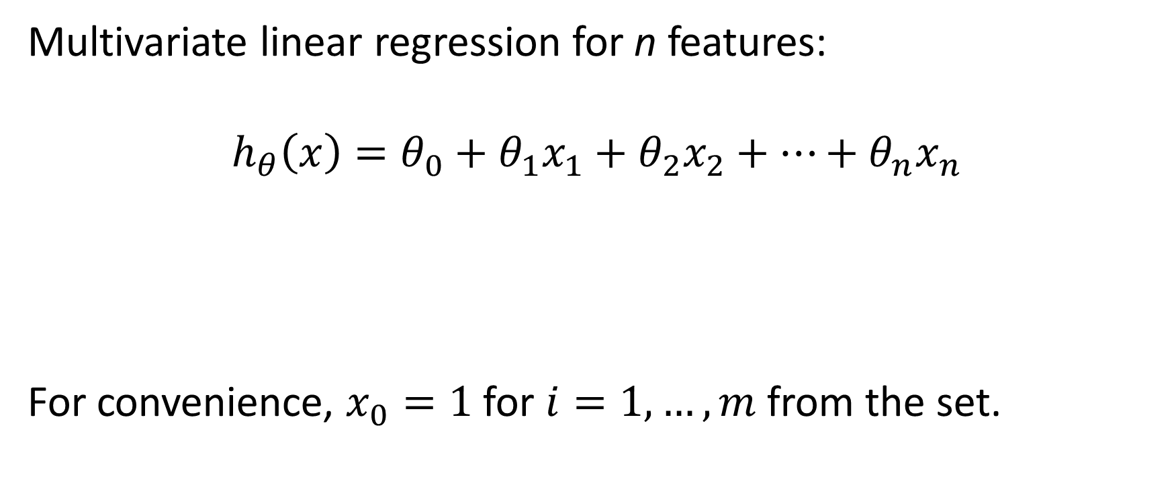
4. Multiple Features

Slide 16
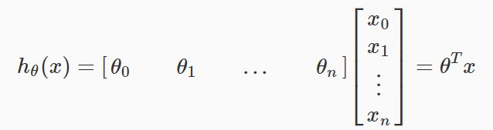
4. Multiple Features: vectorization
Multivariate LR in Vectorized form:

Slide 17
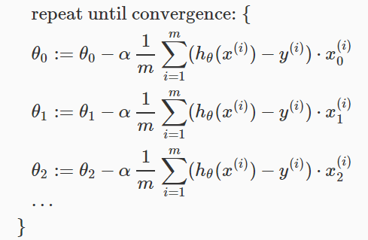
4. Multiple Features: update rules

Slide 18
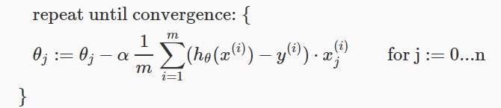
4. Multiple Features: update rules
Or simply

Slide 19
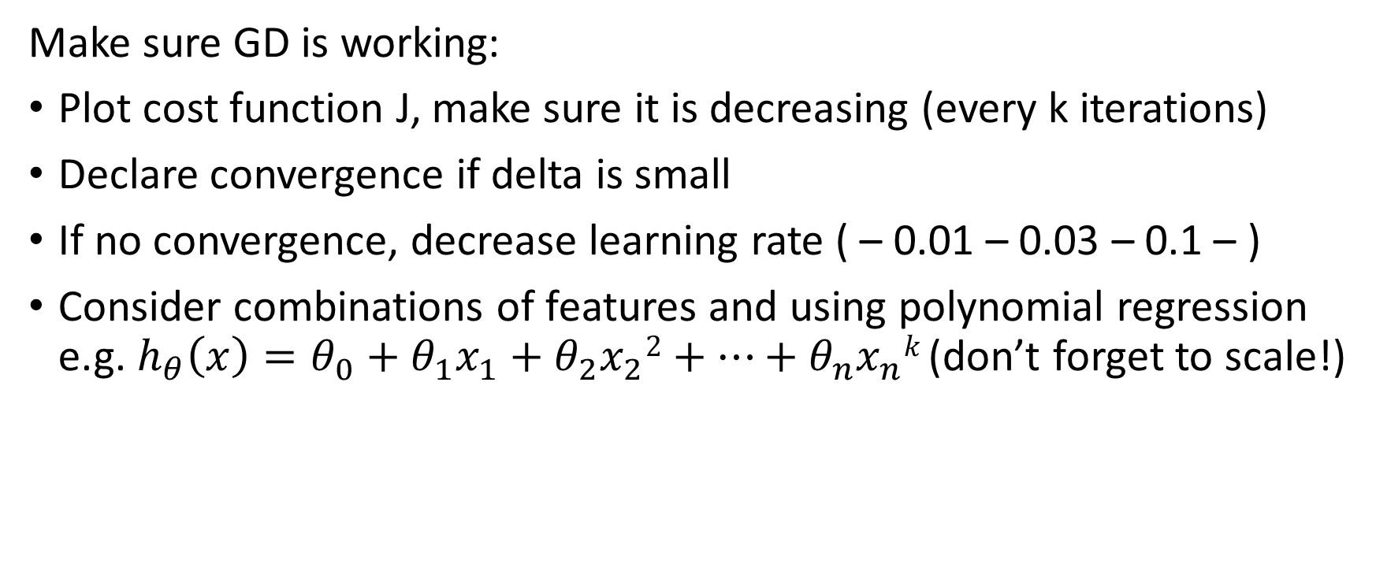
5. Practical considerations: Gradient Descent

Slide 20
II. Logistic Regression

Slide 21
1. Regression vs Classification
Regression: find real values for data.
>>> Linear regression
Classification: find discrete values (classes, categories, labels) for data.
>>> Logistic regression

Slide 22
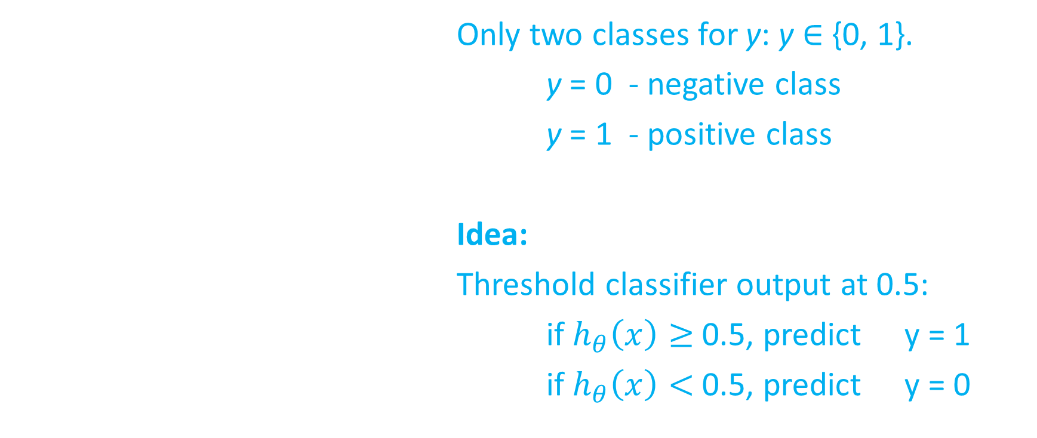
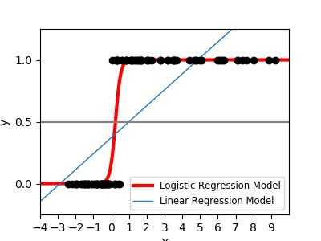
1. Binary Classification

Slide 23
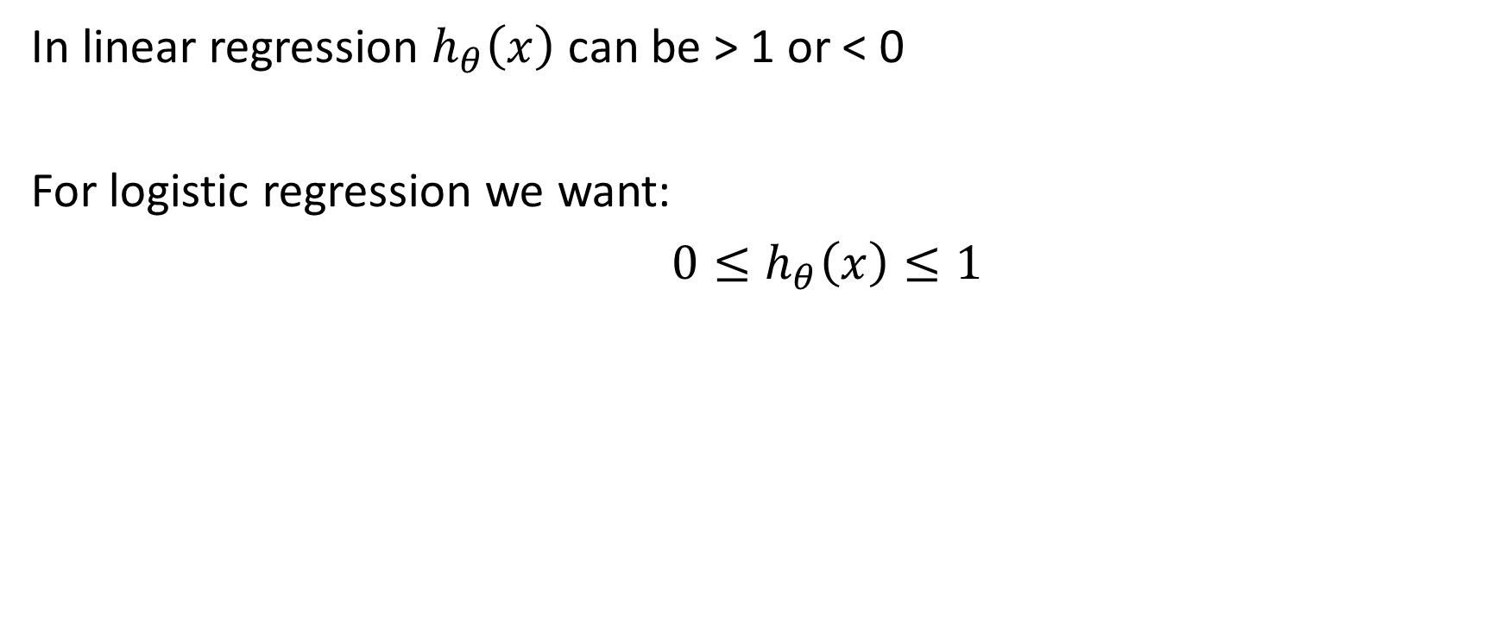
1. Binary Classification

Slide 24
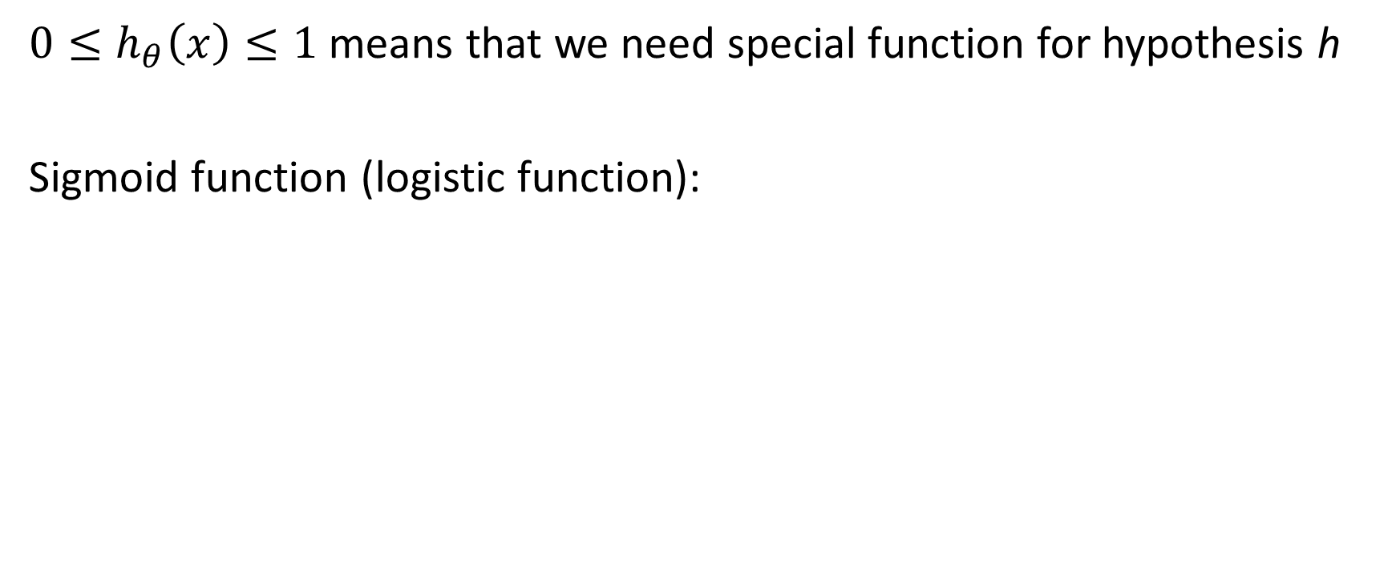
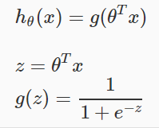
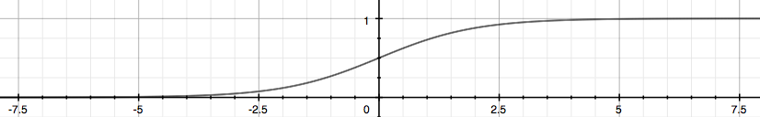
2. Representation

Slide 25
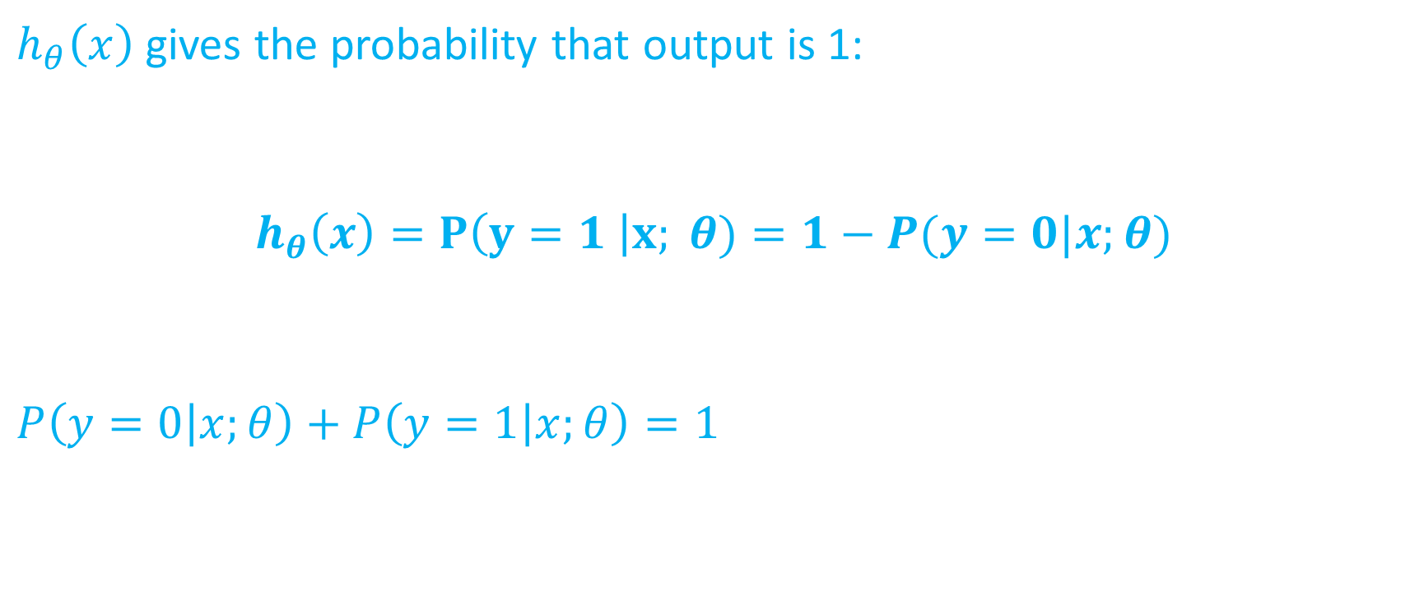
2. Representation

Slide 26
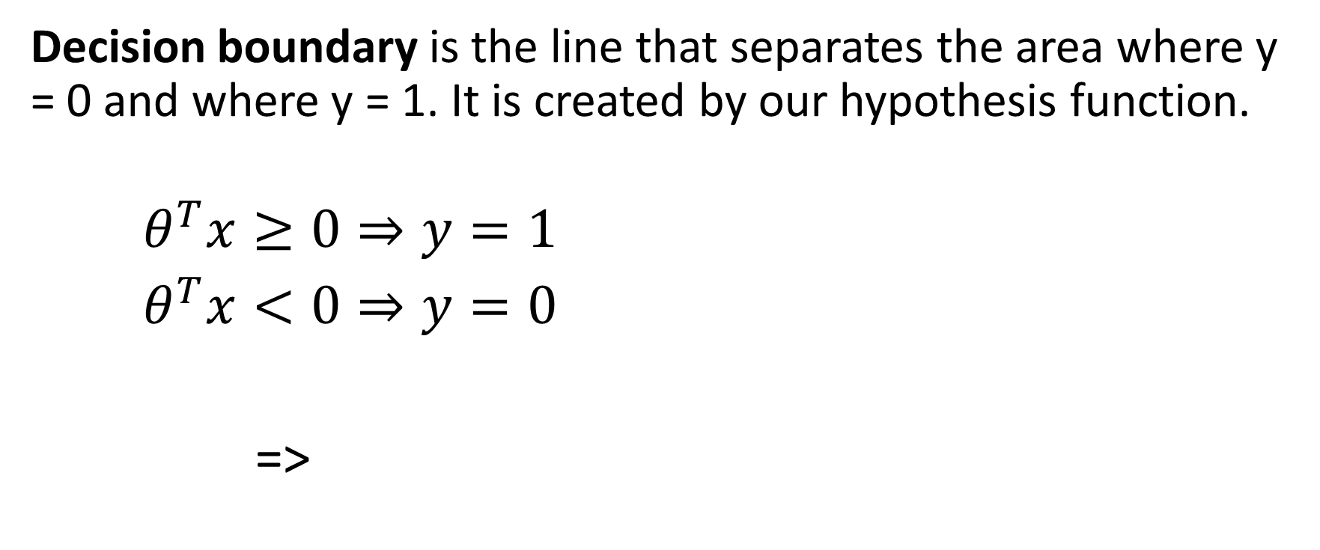

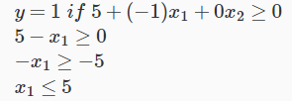
2. Decision Boundary

Slide 27
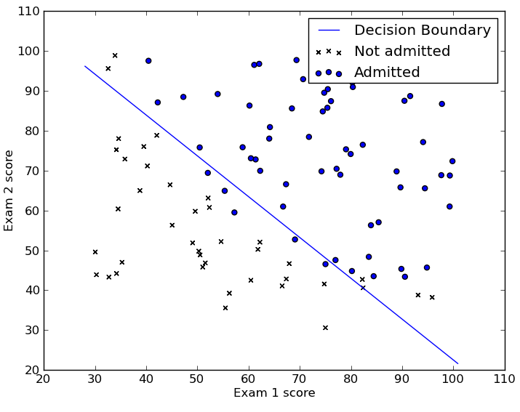
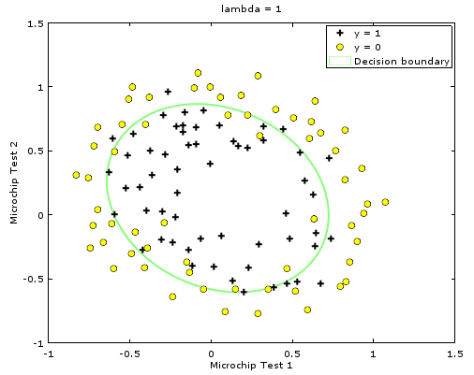
2. Decision Boundary
With linear regression we had only linear boundaries (or hyperplanes).
Logistic regression allows for non-linear decision boundaries, depending on the parameters and polynomial order.

Slide 28
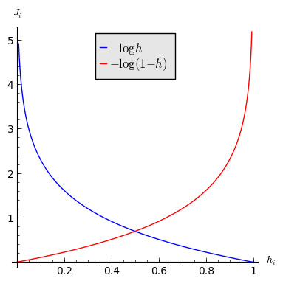
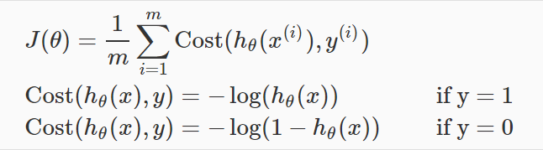
3. Cost Function
Linear regression cost function will not be convex for sigmoid.
Better cost function:

Slide 29
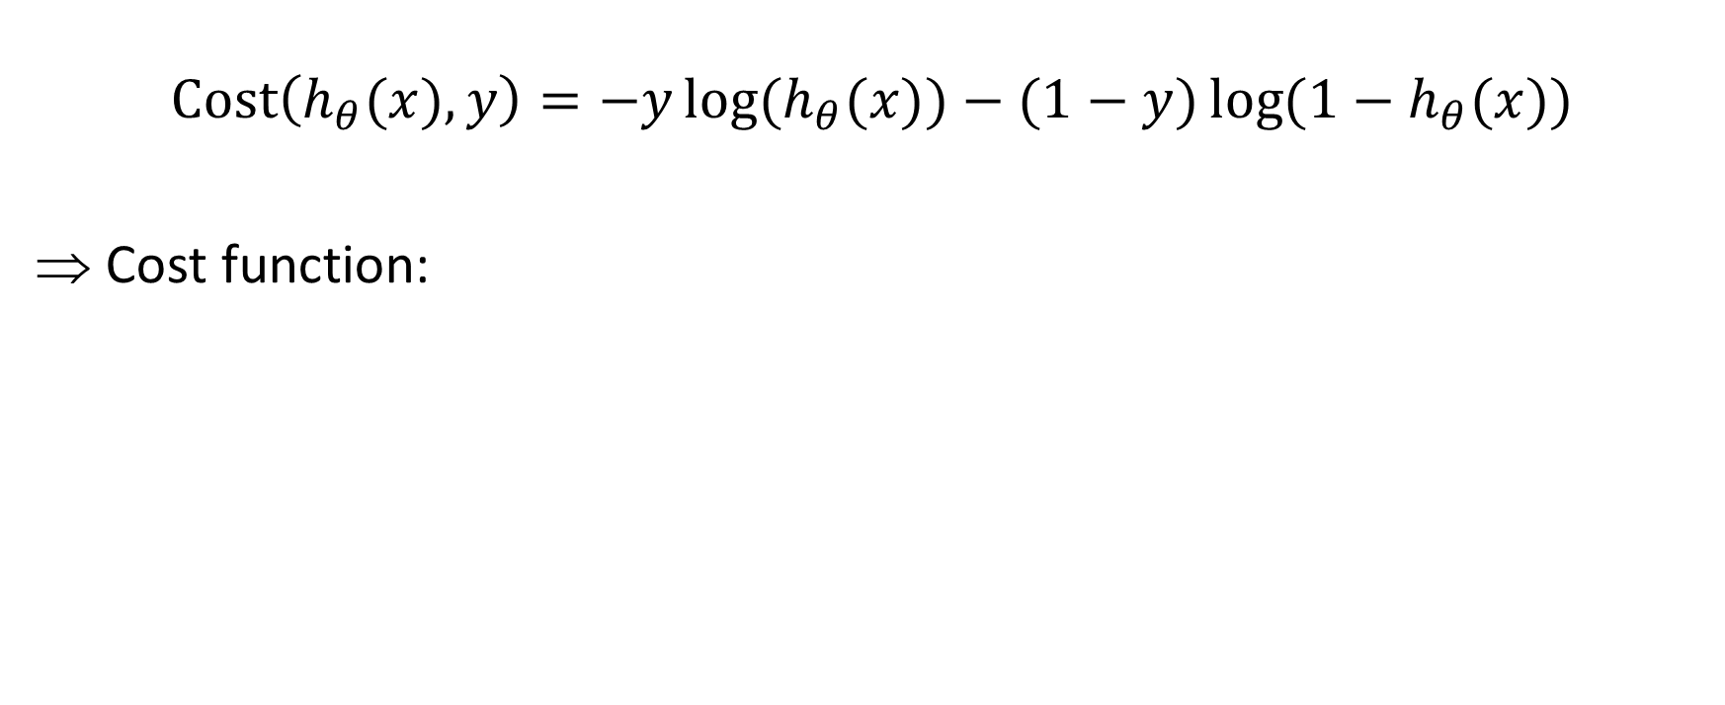

3. Cost Function: combined

Slide 30
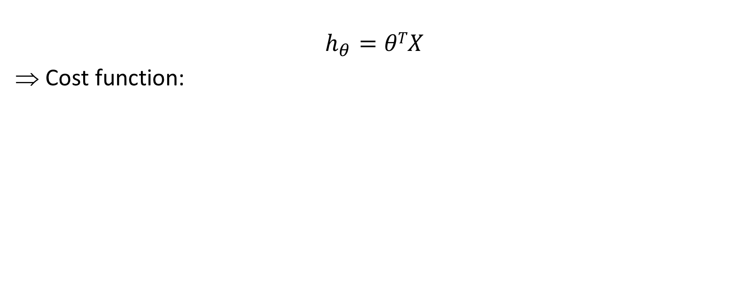

3. Cost Function: vectorization

Slide 31
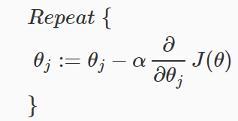
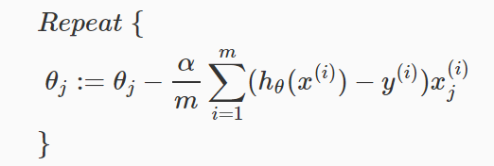
4. Gradient Descent
General update rule:
=> for logistic regression:
Note: update rule identical to linear regression case!

Slide 32

4. Gradient Descent: Vectorization
Update rule for logistic regression in vector form:

Slide 33
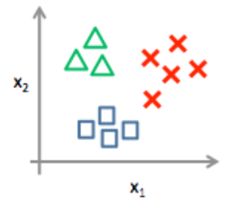
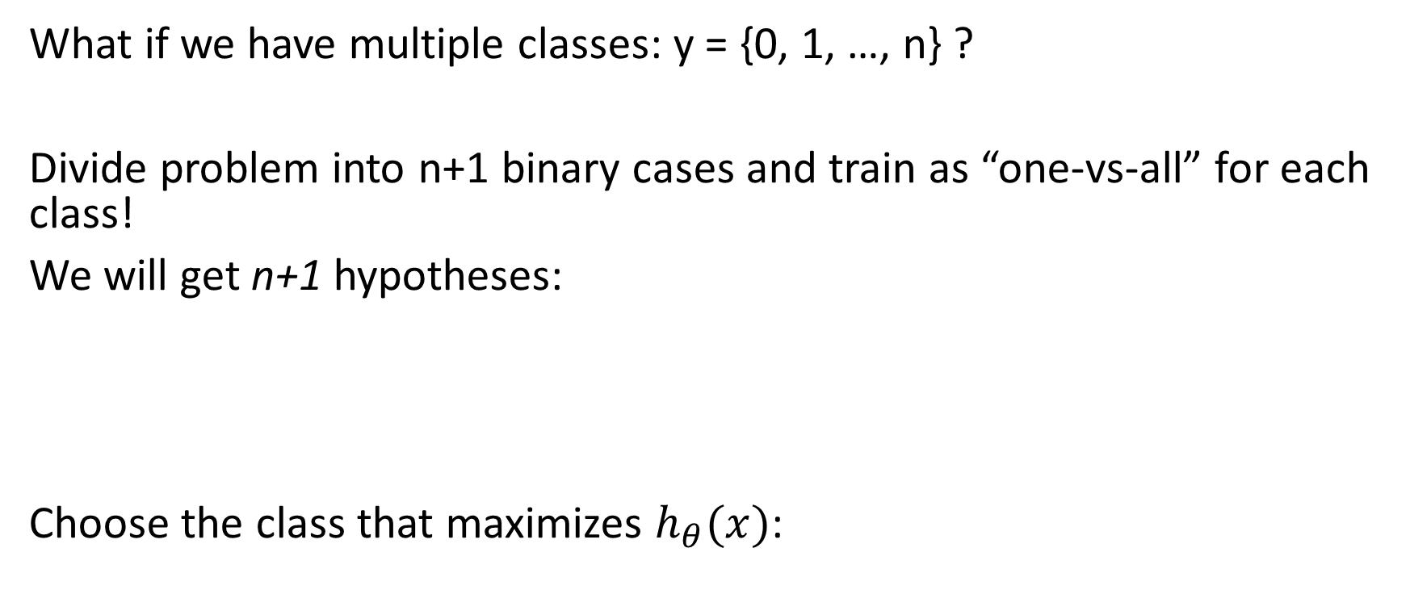
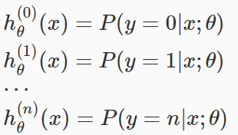

5. Multi-class Classification

Slide 34
III. Overfitting

Slide 35
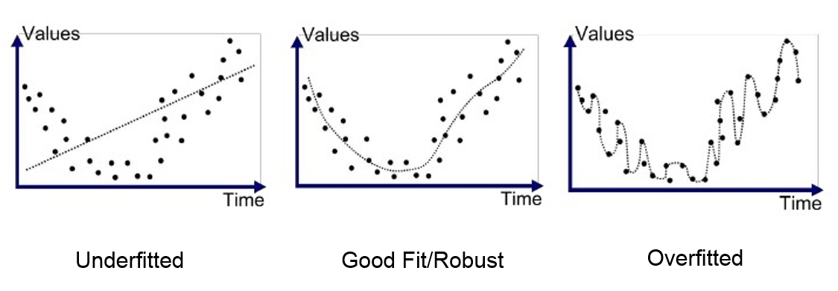
1. Poor models

Slide 36
2. Overfitting
1. Reduce the number of features
Manually select which features to keep.
Use a model selection algorithm.
2. Regularization
Keep all the features, but reduce the magnitude of parameters
Regularization works well when we have a lot of slightly useful features.

Slide 37


3. Modifying the Cost Function
To reduce weight of some terms, increase their cost:
Let’s get rid of high weight for last two terms:

Slide 38

4. Regularization
We could also regularize all of our theta parameters:
λ – regularization parameter (example of hyperparams, together with learning rate)

Slide 39
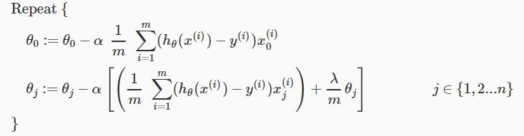

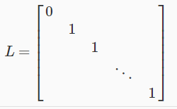

5. Regularized Linear Regression
Update rules for GD with regularization:
Or:
(1−αλ/m) is always < 1
Normal equation:

