Slide 1
Recommender systems

Slide 2
Causal recap
P(Y ∈ A|X = x) ≠ P(Y ∈ A|set X = x)
Statistics can be confusing(Simpson's paradox)
Causal graphs
The Three Layer Causal Hierarchy
Difference in difference

Slide 3
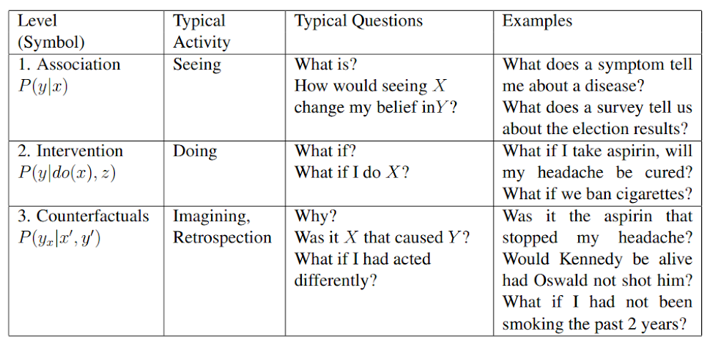
The Three Layer Causal Hierarchy

Slide 4
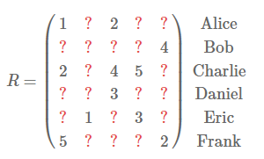
Recommender systems
Predict ?

Slide 5
Approaches
Collaborative filtering - get recommendations based on historical data of user-item interactions
Content-based

Slide 6
Collaborative filtering
Memory-based - mainly knn
Model-based - assume some underlying model of interaction

Slide 7
Collaborative filtering
Advantages:
No need for additional information about users
Disadvantages:
Cold start problem

Slide 8
Content-based methods
Build model based on available features(i.e. profile)
No cold start problem

Slide 9
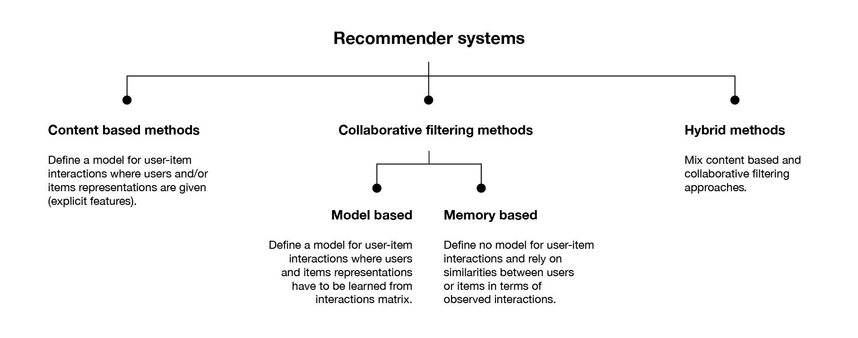

Slide 10
User-user collaborative filtering
Identify user with the most similar “interaction” profile
Keep k closest users
Use best items in the group as recommendation for user
Keep in mind
Good distance metric(no 100% closeness if one item is the same)

Slide 11
Item-item collaborative filtering
Find best item for the user
Identify items with the most similar “interaction” profile(same users interact the same) to the best item
Recommend those items
As an improvement:
Recommend only item that are similar to K best items of a user

Slide 12
Memory based collaborative filtering problems
KNN algorithm has a complexity of O(ndk) with n the number of users, d the number of items and k the number of considered neighbours
Time consuming to generate new recommendations
Cold start problem
Rich-get-reacher

Slide 13
Model based collaborative approaches
Matrix factorisation(user-factor and item-factor matrixes)

Slide 14
Metrics
MSE
recall@K, precision@K, F1@K
cost per recommendation
Model size
Average precision@k - in case you need position relevance

Slide 15
SVD
R - rating matrix, of size |U|*|D|
U - set of users, D - set of items
|K| - number of latent features we want to discover
P=|U|*K and Q=|D|*K

Slide 16
SVD
i - item
j - user

Slide 17
SVD

Slide 18
SVD regularization

Slide 19
Final note
Content based vs Collaborative filtering
Memory based vs model based collaborative filtering
Cold start problem
Rich get richer

Slide 20
Thank you

