Slide 1
Recurrent neural networks

Slide 2
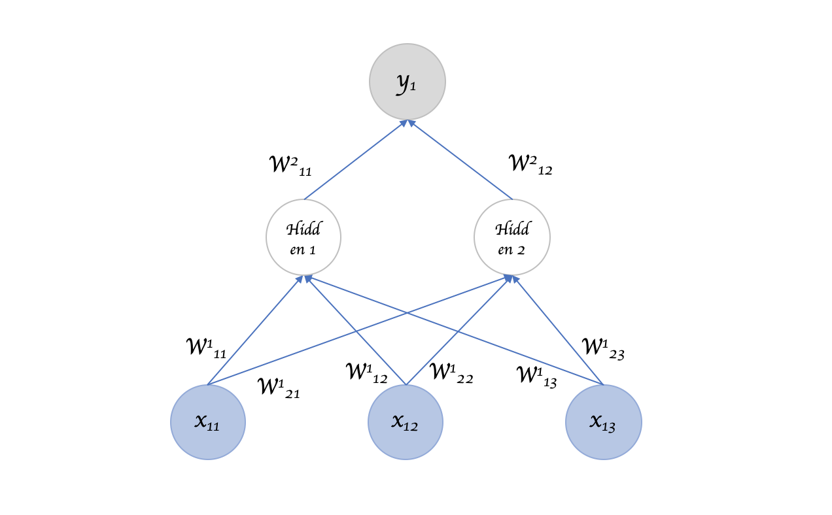

Slide 3
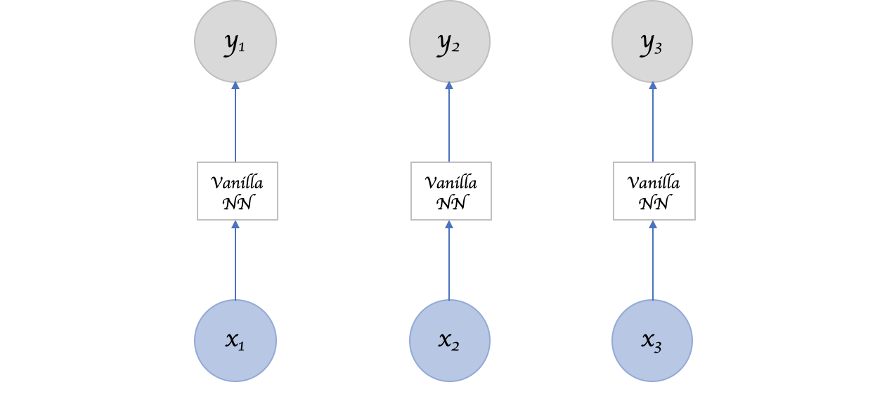

Slide 4
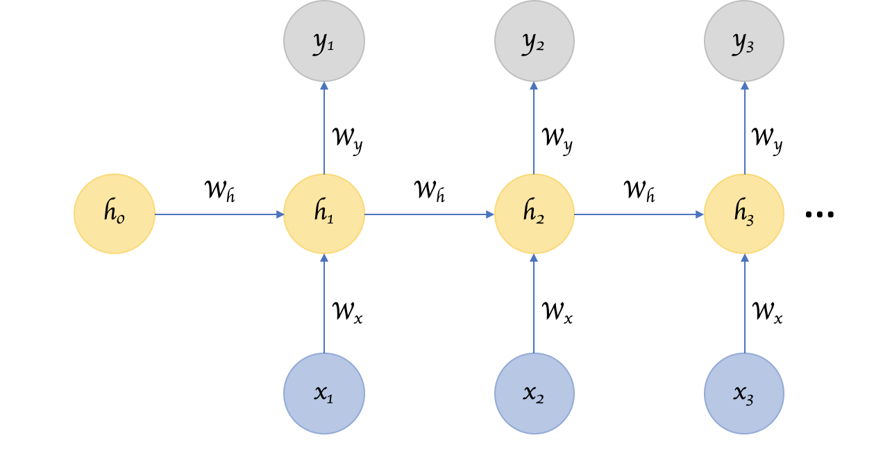

Slide 5
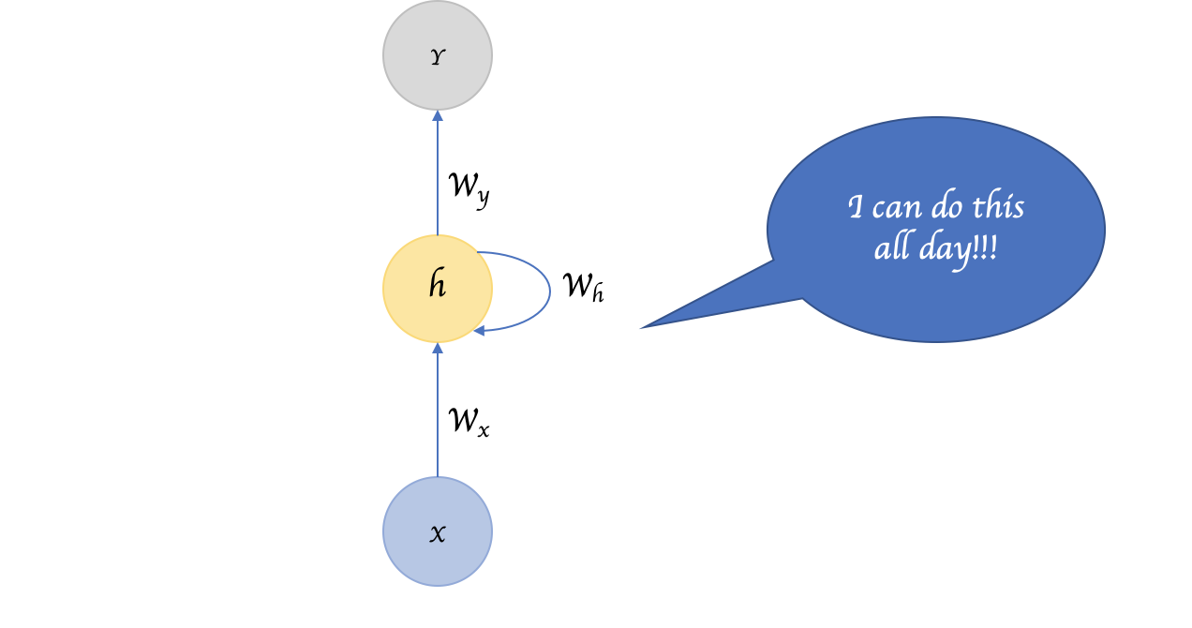

Slide 6
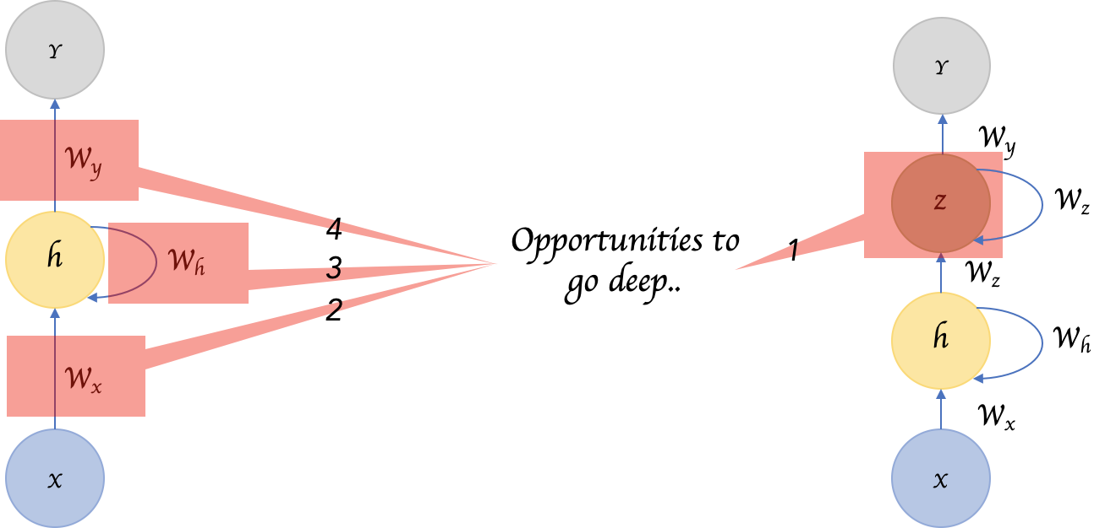

Slide 7
Advantages
No pre-set limitations to the size of input data
No scaling with size
Works good for series data

Slide 8
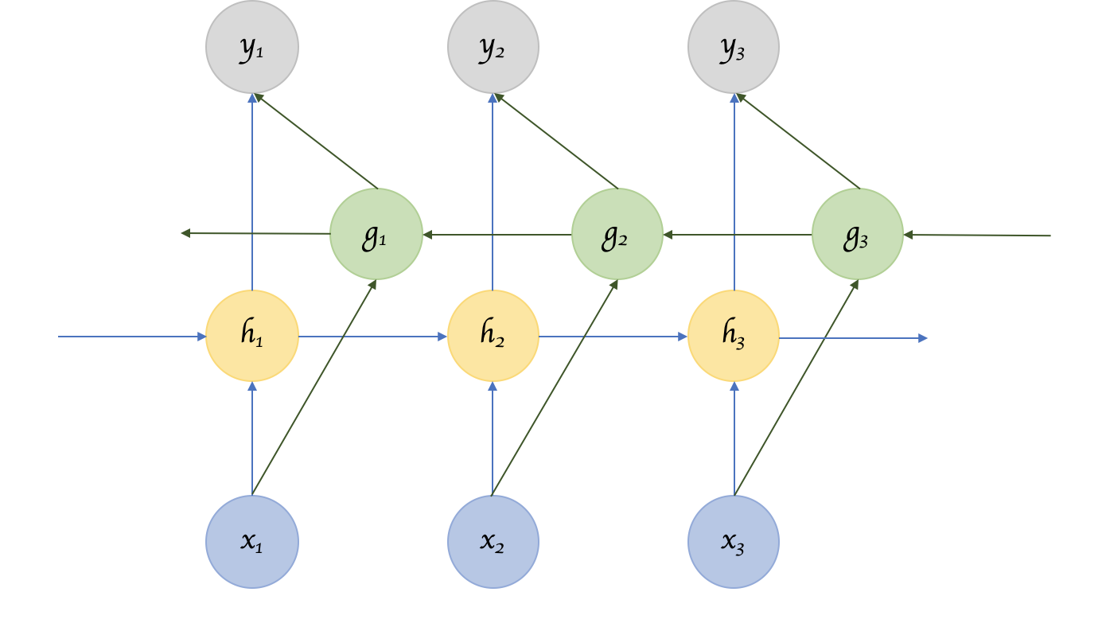
Bidirectional RNN

Slide 9
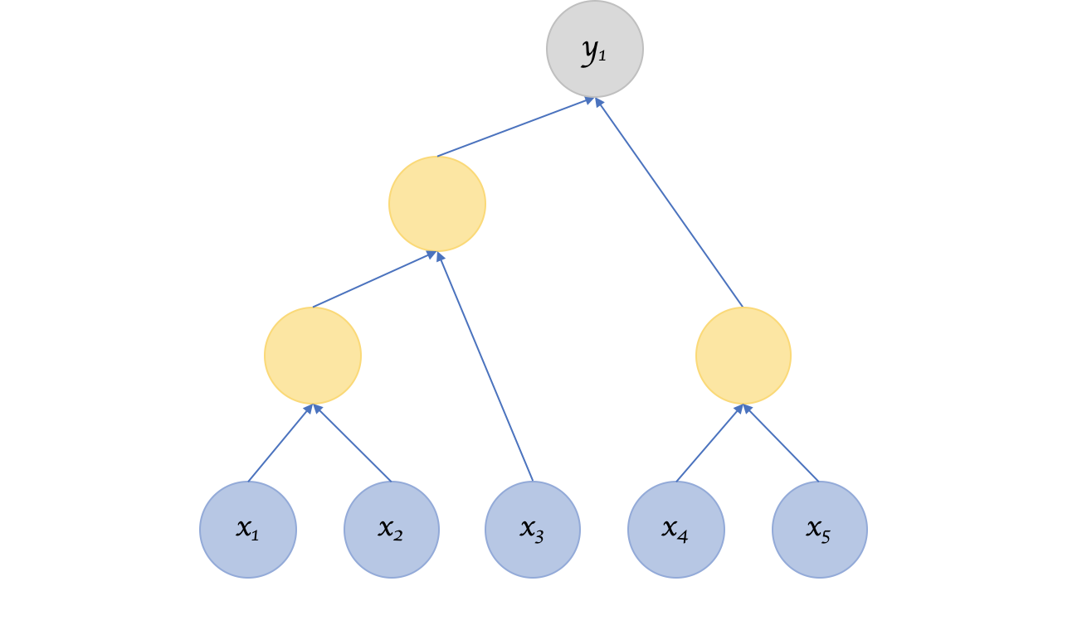
Recursive NN

Slide 10
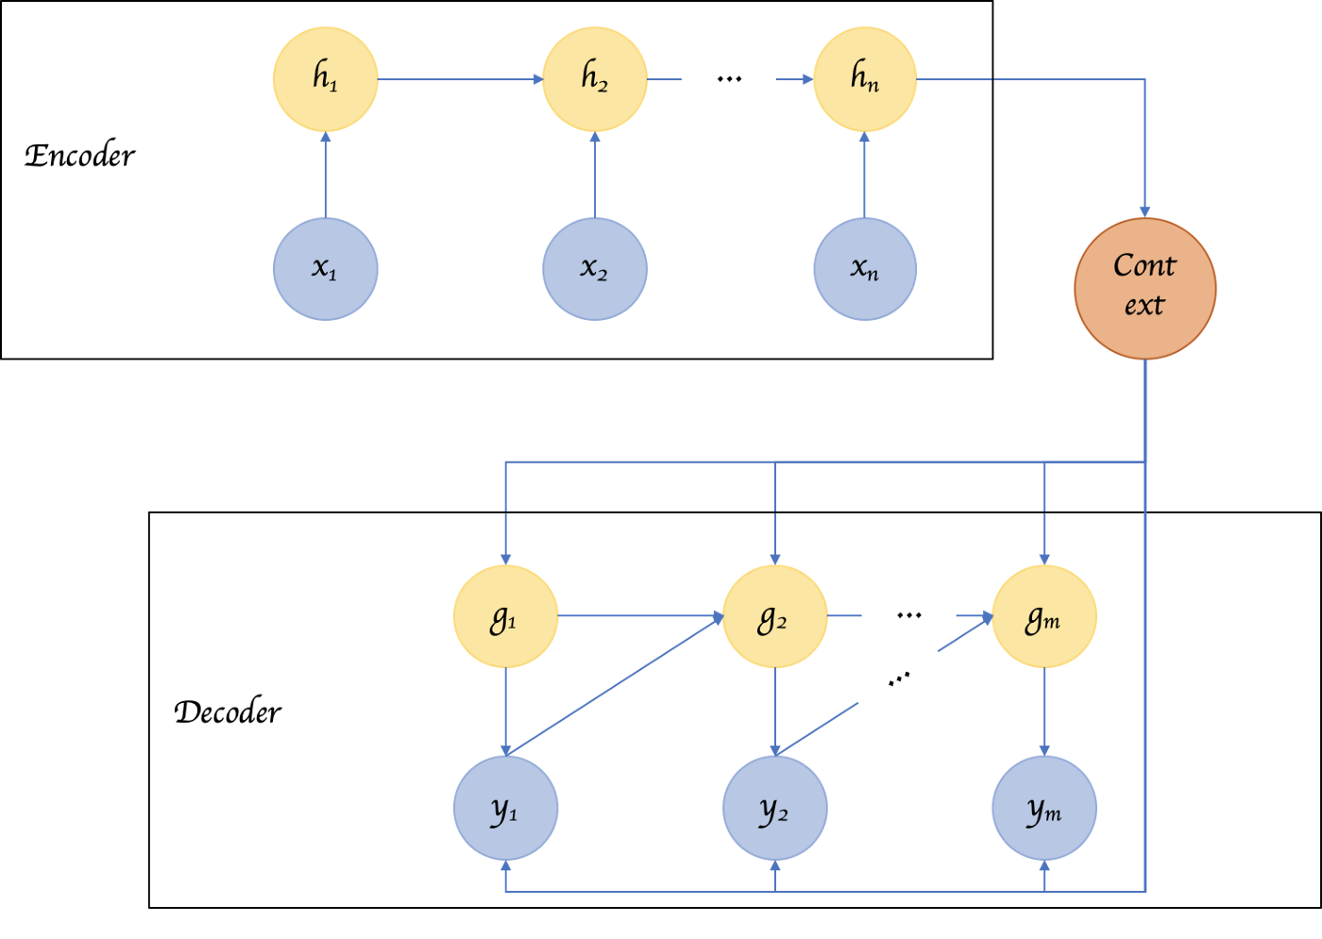

Slide 11
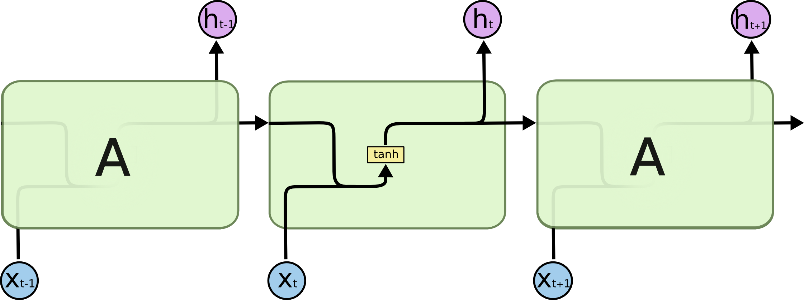
RNN

Slide 12


LSTM

Slide 13


Slide 14
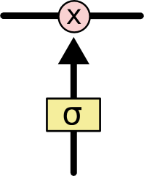

Slide 15


Slide 16


Slide 17


Slide 18


Slide 19
References
https://towardsdatascience.com/recurrent-neural-networks-d4642c9bc7ce
http://colah.github.io/posts/2015-08-Understanding-LSTMs/

