Slide 1
Bachelor Thesis: Visual Question Answering based on VisProg
Instructor: Keze Wang
Presenter: Hao Xu
Major: Computer Science and Technology
2024/05/08

Slide 2
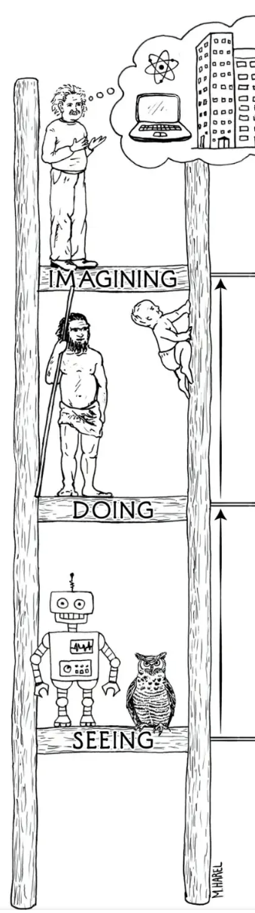
1.Intro: What is Visual Question Answering(VQA) all about?
The ever evolving Computer Vision tasks
3. Counterfactuals :
Imagining, Understanding
Image Creation, Story Telling…..
P(B | do(A))
2. Intervention :
Inferring, Intervening
Visual Question Answering, Image Editing…..
P(B | A)
Association :
seeing, observing
Image Classification, Object Detection….
A?B?
Fig: The ladder of
casual inference [1]
[1] From “The Book of Why”(2019. May. 12) by Judea Pearl

Slide 3
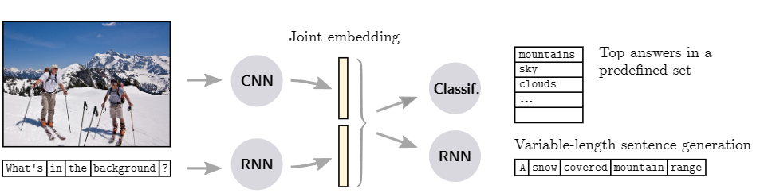
1.Intro: Milestones in VQA
1. Joint embedding approaches
Fig: First Example of a Joint embedding approach[1]
Cons: Black Box, low interpretability, low controllability, answer limited
[1] M. Malinowski, M. Rohrbach, and M. Fritz. Ask Your Neurons: A Neural-based Approach to Answering Questions about Images. In Proc. IEEE Int. Conf. Comp. Vis., 2015.

Slide 4
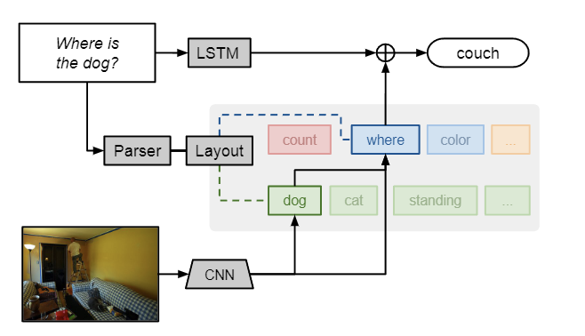
1.Intro: Milestones in VQA
2. Compositional approaches
Pros: Learn to parse complex question
Cons: bottleneck formed during the parsing of the question, over simplified questions
Fig: First example of a compositional approach[1]
[1] J. Andreas, M. Rohrbach, T. Darrell, and D. Klein. Neural Module Networks. In Proc. IEEE Conf. Comp. Vis. Patt. Recogn., 2016.

Slide 5
1.Intro: What’s new in my work?
Adopting Visual Programming[1] on VQA Task
Prediction
In-context
instruction-program
pairs
Program Generator
High- Level Program
Program Interpreter
Visual Rationale
Natural Language Instruction
Inputs
Image(s)
VisProg[1] is a new concept pipeline to deal with various vision tasks. My work is to explore its potential on VQA task.
Implemented 2 extra vqa modules
Conducted 3 performance experiments
In pursuit of better analyzing prompt questions and increasing interpretability.
[1] GUPTA T, KEMBHAVI A. Visual programming: Compositional visual reasoning without training[A]. 2022. arXiv: 2211.11559.

Slide 6
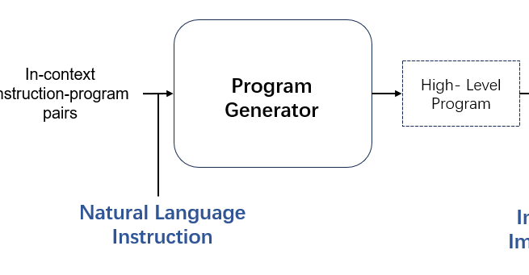
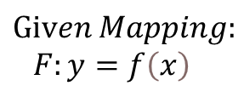


2.Methods: Why VisProg?
Program Generator: Driven by in-contextual learning ability from LLMs
$$Given Mapping:$$
$$F:y=f\left(x\right)$$
$$Output y$$
$$Input x.$$
To analyze questions more systematically, with help from LLMs
2. Break down the prompt question into subtasks/programs, each of which is solved by a certain module

Slide 7
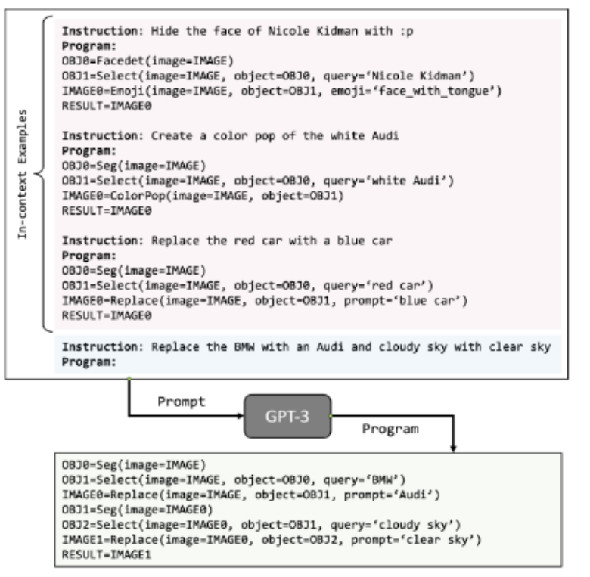
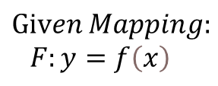

Fig: Hello, my name is Example~
$$Given Mapping:$$
$$F:y=f\left(x\right)$$
$Input x.$ Prompt Question
$Output y$, Corresponding subtasks/programs

Slide 8
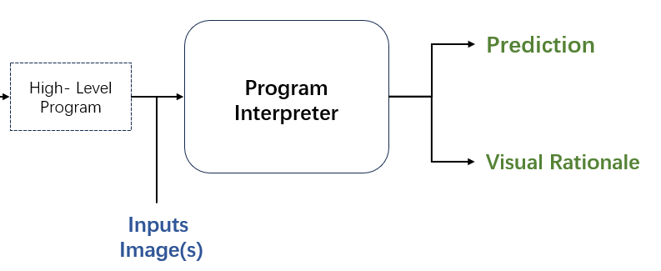
2.Methods: Why VisProg?
Program Interpreter: Driven by high-level programs, call modules to function.
1. Execute subtasks step by step and produce visual rationales, increasing controllability and interpretability.

Slide 9
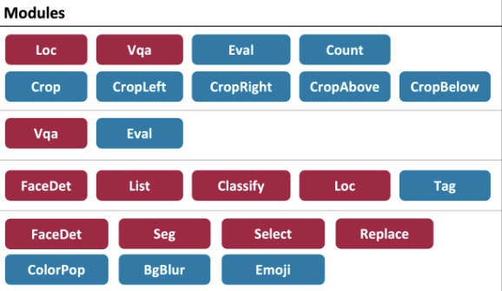
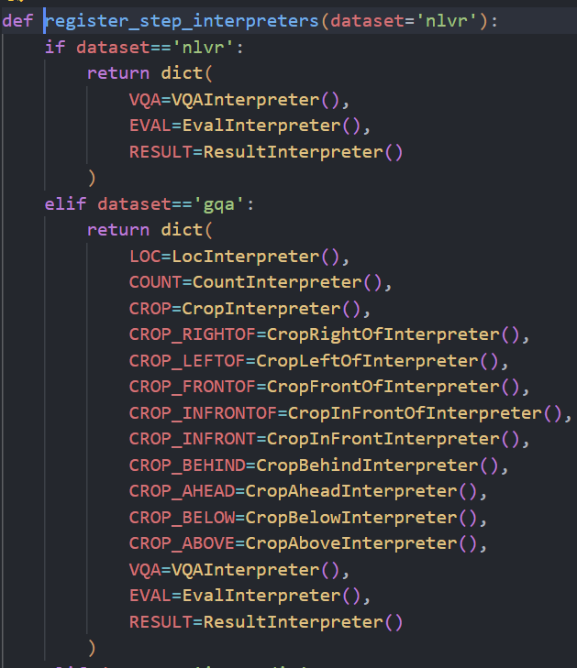
Fig: Current demo modules in VisProg(Not including 2 vqa modules implemented by me.)
Fig: Code Implementations: What does VQA task consist of?

Slide 10
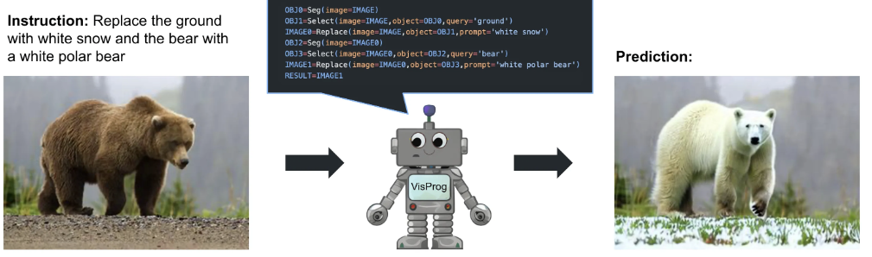
2.Methods: Overview Example

Slide 11
3.Implements: My Implementations
1. Loc Module: Locate certain object with a bounding box. Adopted OwlViT [1]
2. Count Module: Count how many certain objects are in the image. Just: len(boxes).
3. Crop Module: img.crop() from opencv
4. Eval Module: Simple logic computations.
5. VQA Module: Key part in charge of answering meta –uestion.
Implemented: ViLT[2], CLIP-ViLT, BLIP-VQA.
About ViLT, CLIP[3], BLIP[4]
[1] HEIGOLD G, MINDERER M, GRITSENKO A, et al. Video owl-vit: Temporally-consistent open-world localization in video[A]. 2023. arXiv: 2308.11093
[2] KIM W, SON B, KIM I. Vilt: Vision-and-language transformer without convolution or region supervision[A]. 2021. arXiv: 2102.03334.
[3] NORCLIFFE-BROWN W, VAFEIAS E, PARISOT S. Learning conditioned graph structures for interpretable visual question answering[A]. 2018. arXiv: 1806.07243
[4] Junnan Li and Dongxu Li and Caiming Xiong and Steven Hoi: BLIP: Bootstrapping Language-Image Pre-training for Unified Vision-Language Understanding and Generation 2022. arXiv: 2201.12086

Slide 12
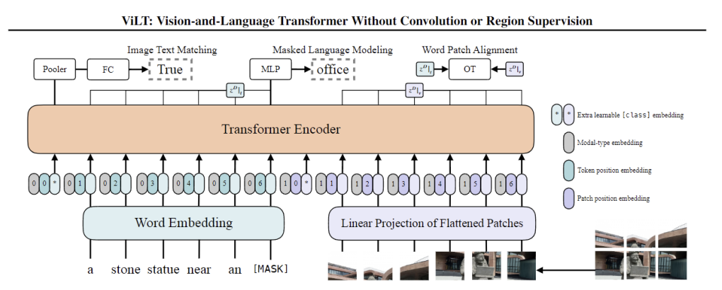
3.Implements: My Implementations
Simplest Words to say what they are...
Simplest, quickest VLP benchmark
convolution-free, linear patch instead
focuses on modality interaction.
ViLT: Simplest Vision-Language Transformer Benchmark
Pros:
Transformer is a tool you use to transit information between different forms of information.
Eg: Chinese-English, Text-Image, image-3D, etc...

Slide 13
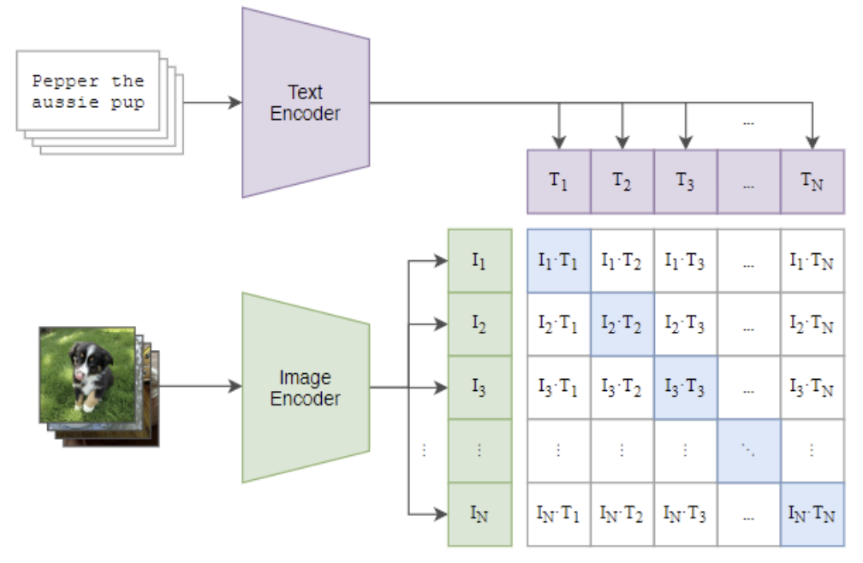
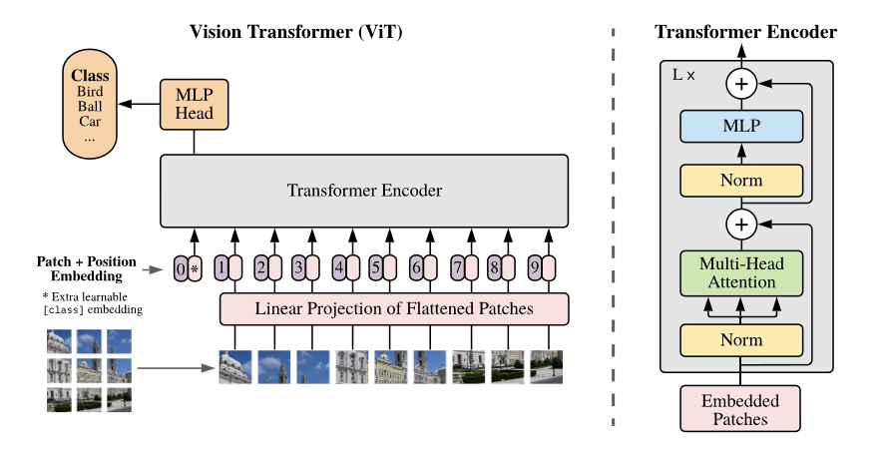
3.Implements: My Implementations
Simplest Words to say what they are...
Fig : ViT
Fig : CLIP
ViT: Vision Transformer is a kind of image encoder.
CLIP: Contrastive Language-Image Pre-training.
Used for Representation Alignment between modalities
CLIP-ViLT: Instead of Linear Patching. Use CLIP pretrained ViT as image encoder.
Pros: Better performance.

Slide 14
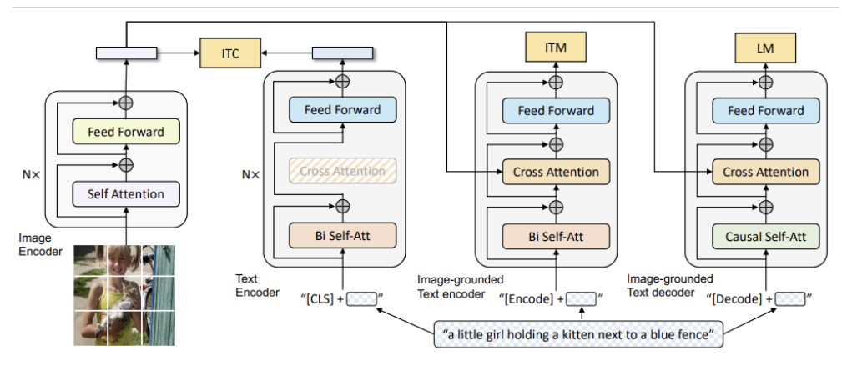
3.Implements: My Implementations
BLIP is a little bit more complicated
BLIP for Pretraining
Pros: SOTA model for current both research/industry in multi-modal tasks.

Slide 15
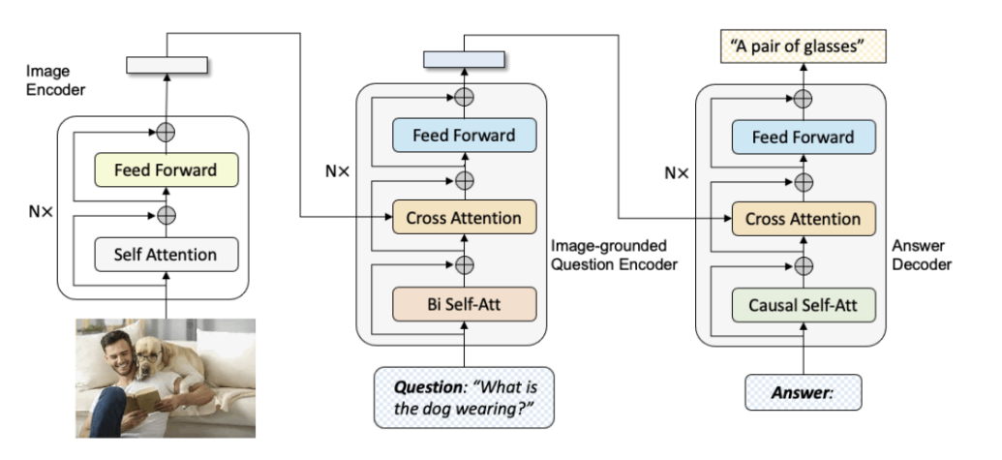
3.Implements: My Implementations
BLIP is a little bit more complicated
BLIP-VQA: No need for Separate Text Encoder, but image-grounded-text encoder/decoder.

Slide 16
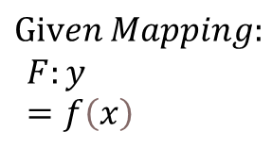
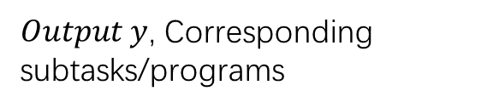
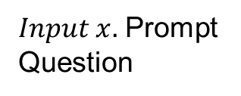
4.Experiments:Prompt Generator
How does number of Prompts influence performance of VISPROG on VQA task?
Hypothesis: number of Prompts will influence the
quality of generated programs,
thus influence quality of the VQA task performance！
$$Given Mapping:$$
$$F:y=f\left(x\right)$$
$Input x.$ Prompt Question
$Output y$, Corresponding subtasks/programs

Slide 17
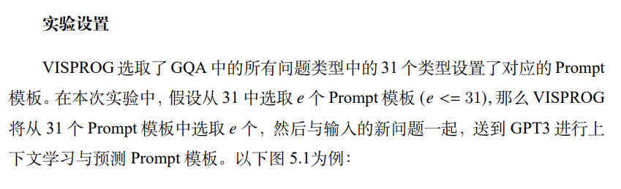
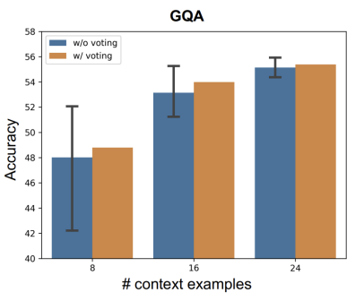
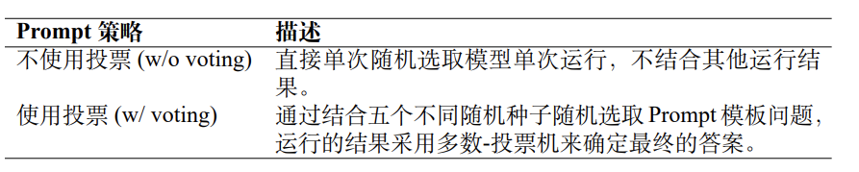
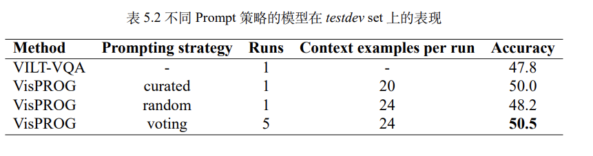
4.Experiments:Prompt Generator
Jump to the conclusion: increase of prompts enhance model performance, while voting tricks increase reliability

Slide 18
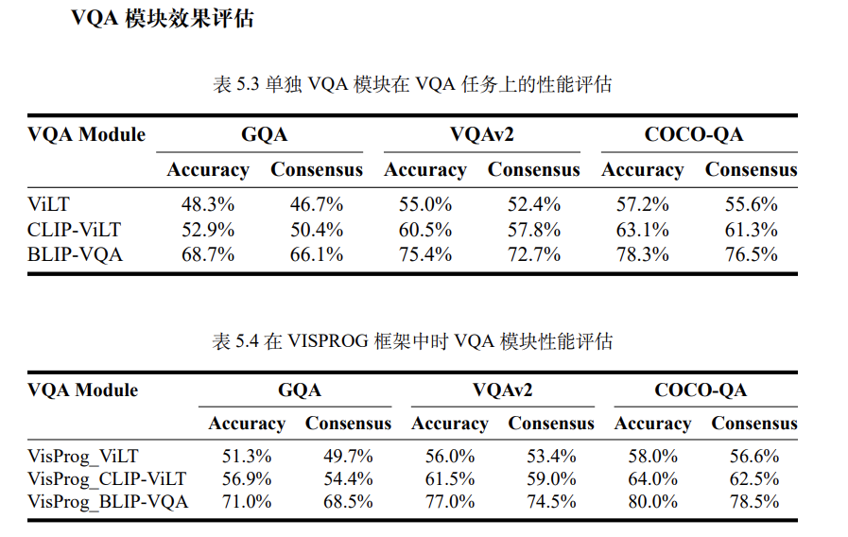
4.Experiments:Prompt Interpreter
1.How do different VQA modules’ performance vary from each other?
Jump to the conclusion:
VisProg does increase accuracy & Consensus a little by 3%-5%
CLIP-ViLT perform better than demo ViLT
BLIP-VQA as the SOTA model, stands out among all the VQA modules.

Slide 19
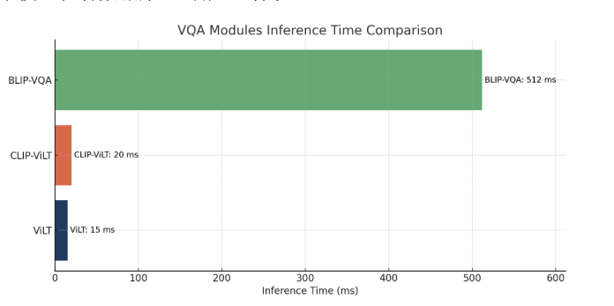
4.Experiments:Prompt Interpreter
2.How do different VQA modules’ respond speed vary from each other?
Jump to the conclusion:
Though BLIP-VQA is good, but it’s too slow.
Simple ViLT and CLIP-ViLT may fit in more time-limited occasions.

Slide 20
5.Limitations of VisProg & Current VQA models
1. Large scale training, testing, applying are limited due to dependence of OpenAI LLM api.
2. Current VQA modules are still not good at imagination and creative thinking!

Slide 21
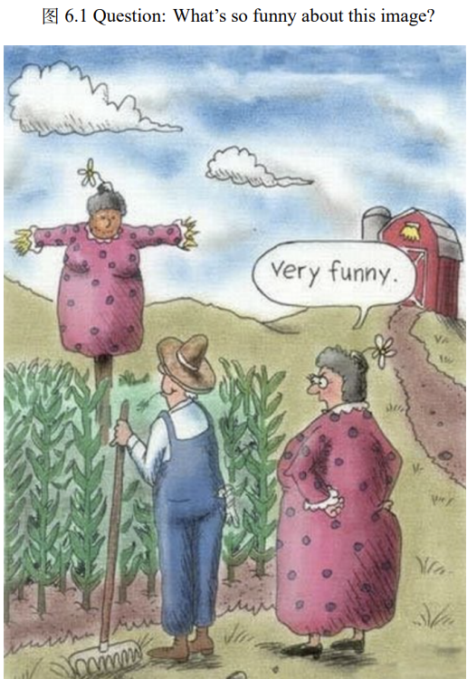
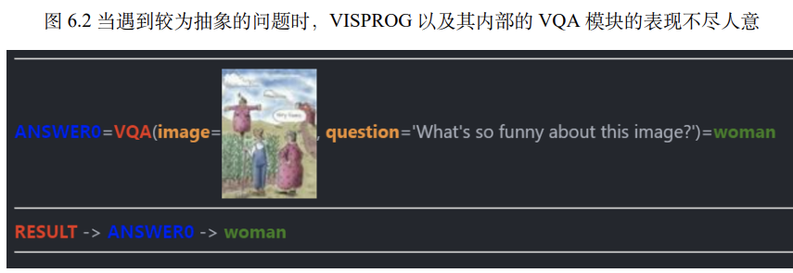
5.Limitations of VisProg & Current VQA models
3. Counterfactuals :
Imagining, Understanding
P(B | do(A))
2. Intervention :
Inferring, Intervening
P(B | A)
Association :
seeing, observing
A?B?
How can we teach computers to imagine and creative thinking in Computer Vision remains a challenge!

Slide 22
6.Conclusion: Visual Question Answering based on VisProg
I adopt VisProg on VQA Task, Implemented 1 demo ViLT module and 2 extra vqa modules
Conducted 3 performance experiments
Prediction
In-context
instruction-program
pairs
Program Generator
High- Level Program
Program Interpreter
Visual Rationale
Natural Language Instruction
Inputs
Image(s)
In pursuit of better analyzing prompt questions and increasing interpretability.

