Slide 1
SDC HACKATHON 2026 · DOMAIN 2 · ORBYTE SMART SME CHALLENGE
KiraOrder
for Orbyte
A complete solution dossier: the problem, the product, the architecture, the evidence, and the business.
FALCONS · XIAMEN UNIVERSITY MALAYSIA
Zhou Jingxi · He Minghao · Xiong Peicheng · Ye Lianghui · Zhan Zhengrong
1 November 2026
Notes:
Submission / documentation deck. Not the 3-minute pitch: this one is meant to be read, and to answer every technical question a judge or an Orbyte reviewer might open the repository to check.

Slide 2
ONE PAGE, THE WHOLE THING
02 / 28
Everything in this deck, in four sentences.
01 · PROBLEM
02 · PRODUCT
03 · EVIDENCE
04 · BUSINESS
The order is not the hard part.
Stop where a guess costs money.
Measured, and bounded.
One codebase, many shops.
A WhatsApp-style message contains none of the six facts an order needs: pack size, tier price, stock, conditions, price floor, grade.
The model proposes. Rules settle every number from the merchant's own catalogue. A named person approves. Anything unsettled blocks at a desk.
23 development cases with an answer key we wrote; 8 pass all six fields. 24 of 31 units correct. 41 permission checks pass. Limits are named, not hidden.
Changing merchant is configuration, not code. Charged per approved delivery order, never per seat. Cost side measured: about US$0.4 per 1,000 orders.
A wrong delivery costs a wholesaler more trust than a slow one.
Notes:
If a reader only has one minute, this is the page. The four quadrants map to the four sections that follow.

Slide 3
01 · THE PROBLEM
03 / 28
The order is not the hard part. The missing facts are.
18:04 — one message, on a wholesaler's phone
SIX FACTS THAT MUST BE SETTLED BEFORE PICKING
“2 bag Gula 1kg, telur 10 papan kalau ada”
1
Which pack size — 1 kg or 2 kg?
2
Which tier price does this customer buy on?
Malay, Chinese and English mixed. One line, four products, one condition. The text is complete as a message — and empty as an order.
3
How much onion is actually in stock?
4
Does “kalau ada” reduce the line, or drop it?
5
Is RM2.80 below her tier price?
6
Which egg grade — A, B or C?
None of the six is in the text. The message is not the order.
Notes:
The six questions are the product's entire specification. Every design decision downstream exists to answer one of them honestly.

Slide 4
02 · WHO THIS IS FOR
04 / 28
One clerk. One owner. A phone.
01
02
03
04
One clerk
One owner
One phone
20–80 a day
Takes the order, resolves what she can, escalates the rest.
Holds the price floor. Signs every exception, in writing.
The message lands here — WhatsApp-shaped, three languages.
Orders per merchant. Six unsettled facts each.
No ERP. No integration. No IT person.
And no one to configure it. Every field the product asks her to fill is a reason to stop using it.
WHAT THIS RULES OUT
Onboarding wizards. Seat licences. Per-field configuration. Any workflow that requires a second login to finish one order.
Notes:
This audience constraint is what makes the product narrow on purpose: no setup, no configuration, no IT.

Slide 5
03 · WHY EXISTING ANSWERS ARE NOT ENOUGH
05 / 28
All three optimise the message. The facts live somewhere else.
01
02
03
By hand
A translating bot
A flag-everything checker
Accurate, and slow.
Fast, and still wrong.
Careful, and unfinished.
Ask the customer, read the price file, walk to the whiteboard, type the delivery order.
Malay, Chinese and English become a clean, structured order list.
Suspicious lines turn red and the flow stops for a human.
Nothing is wrong except the time — and it collapses when eleven messages land at once.
The list looks perfect and the pack size is still wrong. Pack size is not a language problem.
A red flag is a question, not an answer. The work still ends with the same clerk.
Each one improves the sentence. None of them can supply a fact the sentence does not contain.
Notes:
The gap is not language, not caution, and not speed. It is that the facts are held in the merchant's own catalogue, not in the message.

Slide 6
04 · THE PRODUCT, IN ONE RULE
06 / 28
The model proposes. Rules settle. A named person decides.
01 · THE MODEL
02 · THE RULES
03 · THE PEOPLE
It proposes. It never prices.
Facts are computed, not generated.
A named person signs.
Product candidates, quantities, units, pack sizes, source spans — restricted to the tenant catalogue, or an explicit UNKNOWN.
Tier price, stock and pack size are read from the merchant's own catalogue and price file.
A clerk clears the routine. The owner decides a below-tier price and can reject with a reason.
IN ONE LINE
Cannot set a price. Cannot approve. Cannot issue a delivery order.
A field the data cannot evidence becomes a blocking issue, never a plausible guess.
The warehouse sees picking detail with no prices and no contact numbers.
Notes:
Three rules, one sentence. Every section that follows is an implementation of one of them.

Slide 7
05 · ORDER LIFECYCLE
07 / 28
One order, five states, two exits.
DRAFT
clerk editing
DISAMBIGUATION
REQUIRED
READY FOR
APPROVAL
APPROVED
→ delivery order
below tier price · discount · override
owner rejects, with a reason
DISCARDED
by clerk
PENDING
OWNER
REJECTED
order closed
clerk ends the draft
Every transition is version-bound
Approval writes a snapshot
A stale tab cannot approve a newer draft.
The DO is issued from the approved version only.
One DO per approved version
Audit and activity on every action
Six concurrent approval runs produced exactly six DOs.
Who did what, when — readable in the same screen.
Notes:
States are the contract. Approval is only reachable from READY_FOR_APPROVAL; a below-tier price diverts to PENDING_OWNER; both REJECTED and DISCARDED are terminal and leave no delivery order.

Slide 8
06 · ROLES AND VISIBILITY
08 / 28
Three roles, three different truths about the same order.
CLERK
OWNER
WAREHOUSE
Clears the routine.
Holds the price floor.
Picks, and sees nothing else.
Can: create drafts, resolve issues, pick candidates, approve a routine order, send an exception to the owner, discard with a reason.
Can: approve or reject a pending exception, with a mandatory reason; see every line's tier price and margin.
Can: find a delivery order by number; read four picking fields; print the list.
CANNOT
CANNOT
CANNOT
Cannot: price below tier, override stock, see another tenant.
Cannot: approve an unresolved stock issue or an unsaved edit.
Cannot: see prices, totals, customer contact, or the message.
Roles are enforced at the API, not on the page. A warehouse token asking for a price receives 403 FORBIDDEN_ACTION.
Notes:
The visibility difference is the product: the same delivery order renders three different documents for three different people, and the API enforces which.

Slide 9
07 · SYSTEM ARCHITECTURE
09 / 28
Four layers, one direction of trust.
01
CLIENT
Two modes: Local Demo (browser-only, synthetic, no backend) and API mode (Bearer session, real tenant).
React 19 SPA · GitHub Pages
02
EDGE
Every request resolves identity → role → tenant before touching business logic. PII mask runs before anything leaves.
FastAPI · Bearer auth · role gate
03
DOMAIN
Pure business rules: resolve candidates, compute tier price and stock, raise blocking issues, bind approvals to versions.
Resolver · Checks · Approvals · Delivery
04
STATE
Postgres holds orders, drafts, DOs, audit. The model is a stateless dependency that can fail without stopping the order.
PostgreSQL 17 · vLLM on RunPod
The model sits at the bottom of the trust stack: it can be removed and the order still closes.
Notes:
The direction of trust matters: the client is untrusted, the API decides identity, the domain decides facts, and the model is the only component allowed to be wrong.

Slide 10
08 · TECHNOLOGY STACK
10 / 28
Every dependency, and why it is there.
BACKEND / DATA | WHY
Python 3.13 | pinned; ruff targets py313
FastAPI 0.158.1 | ASGI, OpenAPI as the contract
Pydantic 2.14 | typed config, no secrets in code
PostgreSQL 17 | Neon; 18 base tables
psycopg 3.3.6 | raw SQL, explicit transactions
pglast 7.21 | SQL statement splitting (migrations)
rapidfuzz 3.14.6 | catalogue and alias matching
pytest 9.1 + ruff | CI gate on every PR
FRONTEND / AI | WHY
React 19.1 | three role views, one workspace
TypeScript 5.8 | types generated from OpenAPI
Vite 6.4 + Tailwind 4.3 | static build for GitHub Pages
three.js + GSAP | intro only; business UI is plain
openapi-typescript 7.6 | contract drift caught at build
ajv 8.20 | runtime schema validation
vLLM 0.32 | OpenAI-compatible on RunPod
Qwen2.5-7B-Instruct-AWQ | 24 GB, single worker
DELIBERATE OMISSIONS
No ORM. No Redis. No message queue. No Kubernetes. Each would add a failure mode the merchant cannot debug and the team cannot staff.
No auth provider. Sessions are Bearer tokens issued by the backend, so role and tenant are decided server-side, not in the token's claims.
Notes:
Two tables, all pinned versions. If a judge asks 'why no ORM', the answer is on this slide: explicit SQL so the resolver's reads are inspectable and migrations can be hashed.

Slide 11
09 · DATA LAYER AND MULTI-TENANCY
11 / 28
One build, many tenants — separated in the API, not the UI.
public
18 base tables
kiraorder_meta
schema_migrations ledger
6 trigger objects · 12 UPDATE/DELETE events
MIGRATION INVARIANTS
—
Hash-pinned
—
Parser-split
Original SQL bytes and the manifest are checked against a frozen SHA-256 before connecting.
pglast splits the script at real statement boundaries; no hand-rolled semicolon logic.
—
Ledger-first
—
Idempotent
Creation, DDL and registration share one transaction and an advisory lock.
First run returns applied; a repeat returns already_applied and changes nothing.
—
Refuses adoption
Tables without a ledger entry are never taken over automatically.
Tenant isolation is a 404, not a hidden button: a T2 token asking for a T1 delivery order receives RESOURCE_NOT_FOUND, with or without a tenant header.
Notes:
The migration story is unusual and worth explaining: migrations are hashed and run through a real PostgreSQL parser, so the database state is reproducible rather than trusted.

Slide 12
10 · API SURFACE
12 / 28
Six groups of endpoints. The order is one path through them.
SESSION & OPS
ORDER INTAKE
GET /me · GET /healthz · GET /readyz
POST /orders/parse-draft
Identity, liveness, readiness.
Message in, draft out. CLERK/OWNER only; WAREHOUSE gets 403.
DRAFT
APPROVAL
GET/PUT /orders/drafts/{id}/lines · POST discard · POST clarification-copied
POST /orders/{id}/approve · GET /approvals · POST /approvals/{id}/decide
Version-bound edits; no silent overwrite.
Routine vs exception; rejection reason required.
DELIVERY ORDER
WAREHOUSE
GET /delivery-orders/{do_number} · GET /orders/{do_number}/audit-detail
GET /warehouse/delivery-orders/{do_number}
Customer copy, change record, audit trail.
Four fields. No price, no total, no contact.
There is no /extract endpoint. AI is called in-process by parse-draft, so no client can ask the model a question the rules did not authorise.
Notes:
The absence of an extraction endpoint is a design decision: the model is not a public service, it is an internal dependency of one endpoint.

Slide 13
11 · THE AI LAYER
13 / 28
A closed-set extractor that is not allowed to finish the job.
MESSAGE
EXTRACT
VALIDATE
SETTLE
DRAFT
masked text
LLM → candidate spans
contract + catalogue
rules compute facts
lines or blocking issues
WHEN THE MODEL IS UNAVAILABLE
rules path only — ai_mode = FALLBACK
The draft is still produced, and the interface states which mode produced it. A successful call is never reported as an accuracy figure.
THE MODEL MAY RETURN
THE MODEL MAY NEVER RETURN
Product candidates (tenant-restricted) · quantity · unit · pack size · source span · conditions · an explicit UNKNOWN.
sku_id · price · tier price · stock · approval decision · delivery order number · customer contact.
The extracted span is kept, so a clerk can see which words the candidate came from — and disagree with it.
Notes:
Closed-set means the model chooses from the tenant's catalogue rather than writing a product name. The source span is kept as evidence, which is what makes the 'it asked me' claim checkable.

Slide 14
12 · THE RULES LAYER
14 / 28
Where an unsure answer becomes a blocking issue.
RESOLVE
DECIDE
BLOCK
ASK
Candidates, not guesses.
Every number is computed.
An issue is a stop, not a warning.
A message back, in her language.
Family and alias matching over the tenant catalogue with rapidfuzz; ties above a threshold still require a human pick.
Tier price from the customer's tier, stock from inventory movements, pack size from the catalogue row.
Insufficient stock, below-tier price, ambiguous unit, missing pack size, same-day duplicate.
Clarification draft in ms / en / zh, listing only unresolved issue ids.
Output: NO_CANDIDATE when nothing clears the bar.
The model's opinion is never used for a number.
Each issue carries a code and a reason a clerk can act on.
No PII, no claimed price, no claimed SKU.
Seven known unit gaps still block rather than guess. Blocking stops a wrong order; it does not mean the model is fixed.
Notes:
The rules layer is the part that can be audited. It is deterministic, it is tested, and its failures are visible as issue codes rather than as a plausible wrong price.

Slide 15
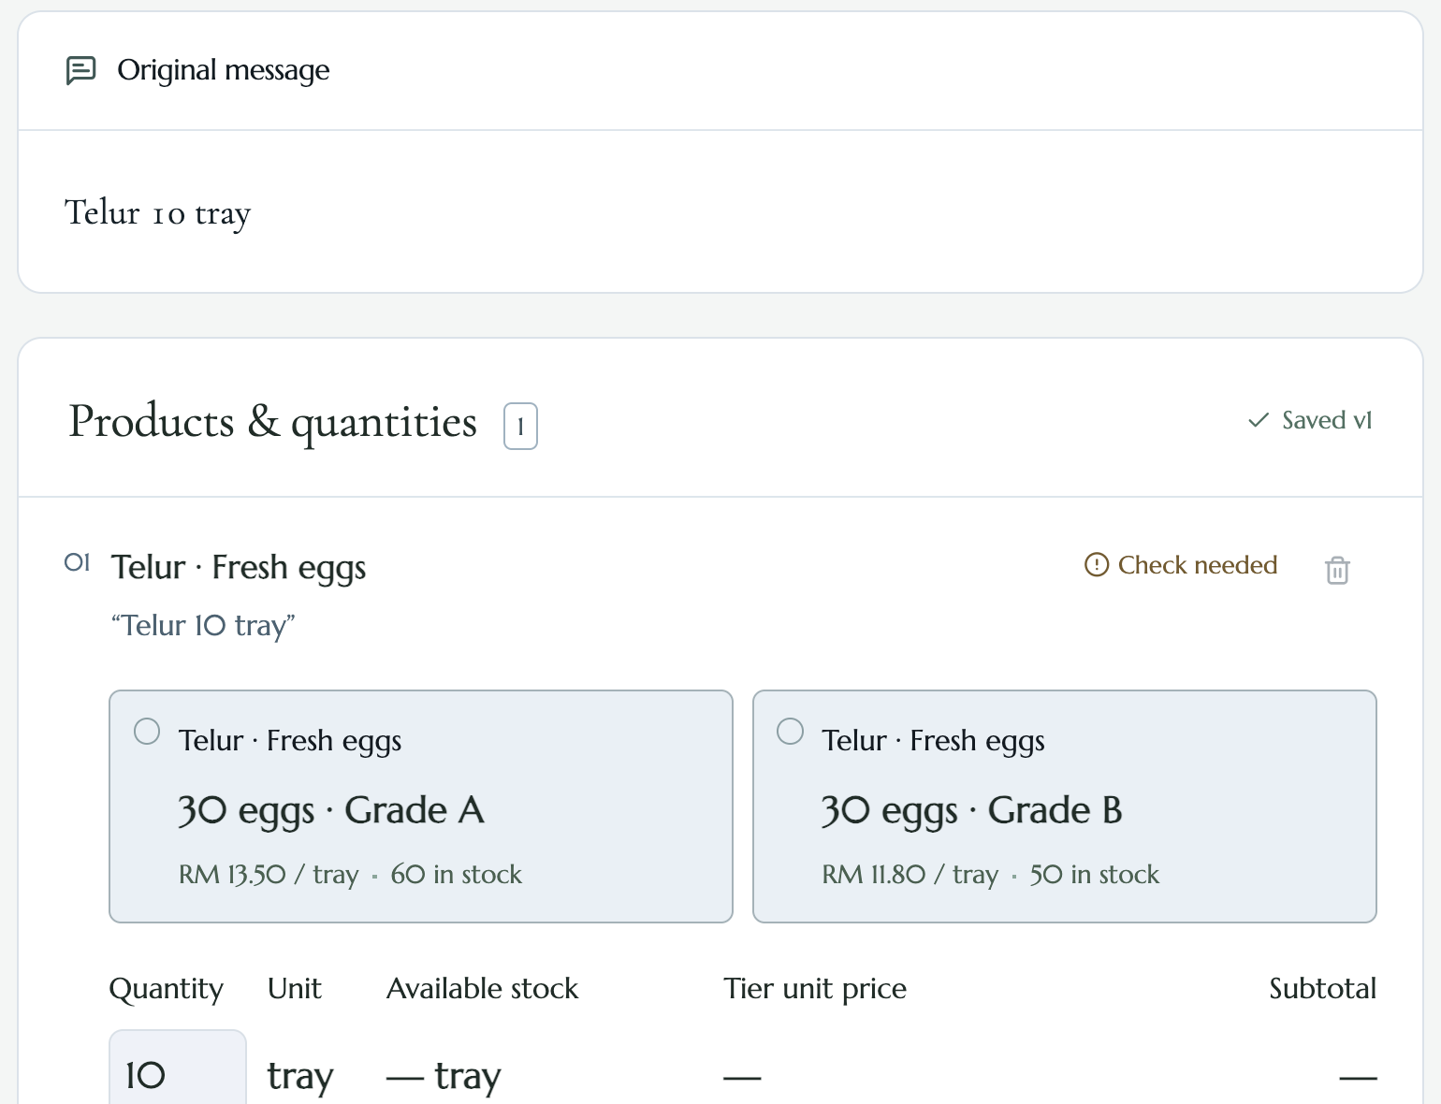
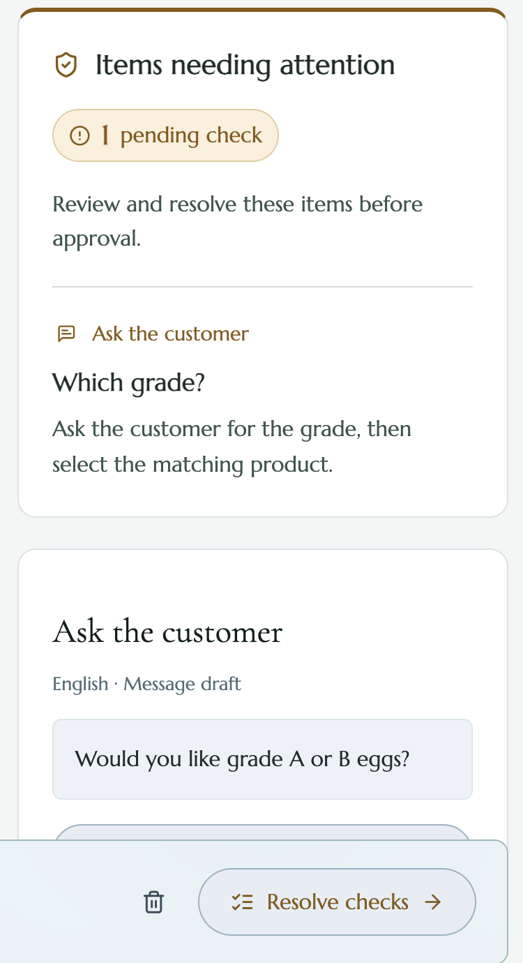
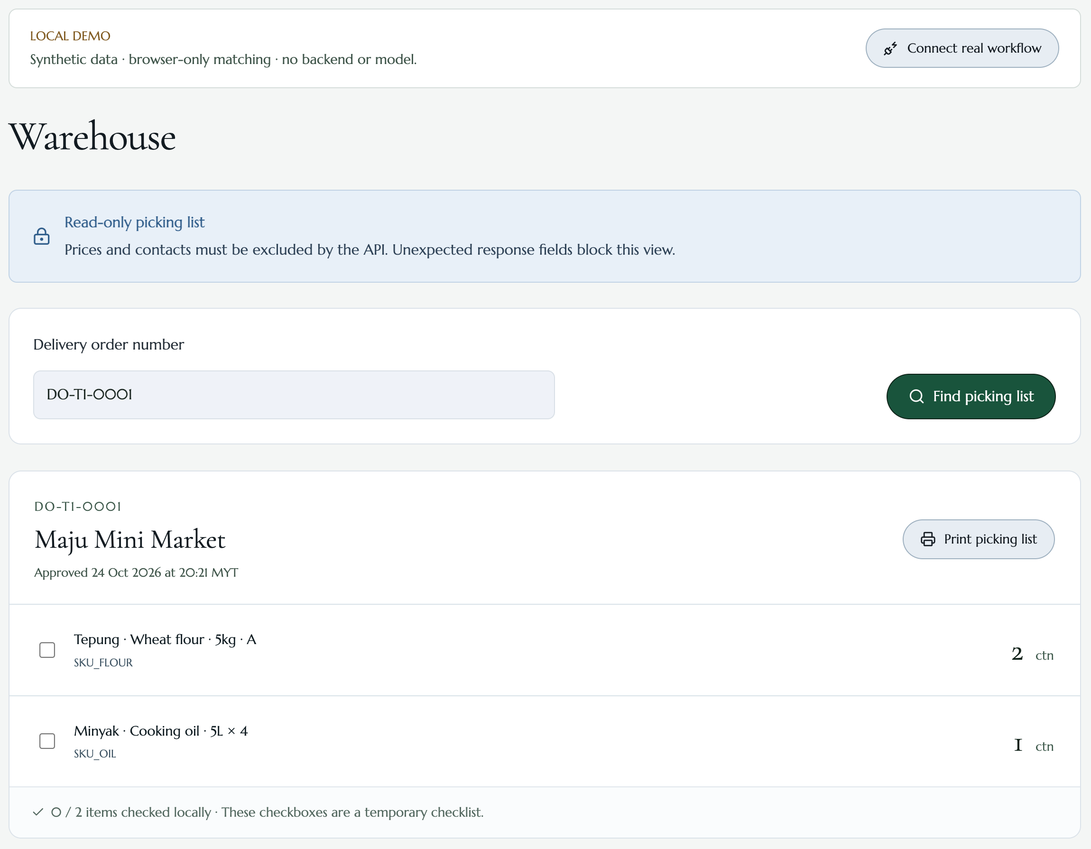
13 · THE INTERFACE, IN THREE SCREENS
15 / 28
The same order, read by three different people.
One line that will not settle, the question drafted back to the customer, and the warehouse view that carries no prices.
01 · a line that will not settle
02 · the question, drafted
03 · warehouse, four fields
Each role sees only its half — and the API, not the page, decides which half that is.
Notes:
Three screens, one order. Left: the clerk cannot settle the line, so it becomes a card carrying the source span. Middle: the question is drafted for the customer, not sent automatically. Right: the warehouse sees four fields and no prices.

Slide 16
14 · APPROVAL AND DELIVERY ORDER
16 / 28
An approval is a fact about a version, not a click.
VERSION-BOUND
ESCALATION
REASON REQUIRED
SNAPSHOT
Every write carries expected_version. A tab that has been open for ten minutes cannot approve a draft someone else changed.
A below-tier price or an override diverts the draft to PENDING_OWNER and locks it. The clerk cannot approve past the owner.
The owner cannot reject without a non-empty reason. A rejection closes the order; there is no delivery order to recover.
The delivery order is issued from the approved version's snapshot, so printing later cannot drift from what was signed.
THE ONE TRANSACTION THAT MATTERS
A legacy client may still post confirmed_items. The backend then saves a new version, revalidates stock and escalation, approves it — and rolls the whole thing back if any step fails.
The response names the version actually approved. Unsaved details are never silently approved, and the path is marked deprecated rather than quietly removed.
Notes:
This is the least glamorous and most important engineering decision in the project: approval is transactional and version-bound, so 'who approved what' is always answerable.

Slide 17
15 · SECURITY AND PRIVACY
17 / 28
Customer data never leaves the merchant's tenant.
PII MASKING
NO RAW MESSAGE
SIZE GUARD
Only three tokens exist: [REDACTED_PHONE], [REDACTED_MYKAD], [REDACTED_EMAIL]. Empty rejection, no others.
message_text is not logged, not stored, and not sent to the provider. Only masked_text crosses the boundary.
A masked message over 4,000 code points is refused with 422 MESSAGE_TOO_LONG, before any model call.
IDENTITY
TENANT
SECRETS
Bearer session resolved server-side; GET /me returns workspace and role. The page cannot grant a role.
Every business row carries tenant_id. Cross-tenant reads return 404, indistinguishable from missing.
Environment only. .env.example ships empty. No key appears in code, docs, screenshots, or responses.
All demonstration data is synthetic and written by the team. No real customer message appears in this project.
Notes:
The privacy story is mostly about what is absent: no raw text storage, no free-form PII tokens, no client-side role claims.

Slide 18
16 · DEPLOYMENT AND CI
18 / 28
Four managed services, one static frontend.
GITHUB PAGES
REPLIT AUTOSCALE
NEON
RUNPOD SERVERLESS
Frontend
API
Database
Model
Static React build. No server for the demo to fall over.
2 vCPU / 4 GiB, Asia region. Scales to zero when idle.
PostgreSQL 17. Branchable; credentials private.
vLLM + Qwen2.5-7B-AWQ on 24 GB. Zero workers when not recording.
CONTINUOUS INTEGRATION
Backend
GitHub Actions runs pytest against an isolated PostgreSQL 17.10 service, plus ruff lint and format checks.
Frontend
types:check regenerates the client from OpenAPI and fails on drift; then tests and a production build.
Contract
openapi-typescript and ajv mean a backend field rename breaks the build, not the demo.
Recorded
307 non-integration tests and a 407-test full suite at the last checkpoint; both are re-runnable.
Nothing on stage depends on a laptop: the tab is pre-opened, and every claim has a recorded run behind it.
Notes:
Deployment is deliberately boring: static frontend, one small API, one managed Postgres, one GPU endpoint that can be off.

Slide 19
17 · HOW WE EVALUATE
19 / 28
The answer key was written against the business rules, not the model.
23
6
31
development cases
fields per case
unit lines
Six fields each. Written and frozen by the team before scoring.
Product, pack size, unit, quantity, tier price, condition. All six or nothing.
Official unit evaluation. 24 correct, 7 known gaps, each blocks.
41
34
SHA-256
permission checks
HTTPS requests
per frozen file
Seven categories: read, write, cross-tenant, override, method matrix.
Concurrency suite over six runs; five approvals each produced one DO.
A re-run can be checked rather than trusted.
Scoring is strict by construction: a case that gets five fields right scores the same as one that gets none.
Notes:
The strict scoring is a deliberate handicap. It makes our own number look worse and makes the claim impossible to inflate.

Slide 20
18 · RECORDED RESULTS
20 / 28
Six numbers we measured. One we can only model.
8/23
24/31
41
cases pass all six fields at once
lines with a correct unit
permission checks passed
independent answer key, 23 cases, 2026-10-30
7 known gaps; every one blocks instead of guessing
seven categories, including cross-tenant and override
34
1.93 s
US$0.4
real HTTPS requests
p50 parse latency
per 1,000 orders
6 concurrency runs, 5 approvals, exactly 5 delivery orders
p95 3.63 s · production run 2026-10-30; call success, not accuracy
model time only, at US$0.00019 per GPU-second
What these are not: not an accuracy percentage, not an end-to-end handling time, and not a user study.
Notes:
Say the caveat before a judge says it. 8/23 is a small self-built set; 1.93 s is model time, not the clerk's handling time.

Slide 21
19 · BOUNDARIES
21 / 28
What is not finished, named before you find it.
12 workflow cases
No independent UAT
No measured handling time
TEST32 cases remain NOT_RUN. We do not claim an end-to-end acceptance suite.
No third-party user acceptance testing and no real merchant trial. We do not claim adoption.
Net-minutes-per-day is a formula. t₀ and t₁ are unmeasured; the pilot fills them.
Reproducibility
Seven unit gaps
Cold start
C13 did not pass in test; C10 (AI unavailable) is partial.
Known and open. Each one blocks in the business layer rather than guessing.
The live model can cold-start into fallback. The interface says so when it happens.
A team that cannot name its limits has not measured them. Every line above has a record behind it.
Notes:
Read this page calmly, without apology. It is the page that makes the other nineteen credible.

Slide 22
20 · COMMERCIAL VALUE
22 / 28
A different shop, the same build.
Changing merchant means changing configuration — seed data, catalogue, aliases, policy. Not code. That is what lets one build sell to a hundred shops.
 | SINARAN FOOD SUPPLY (T1) | KILAT HARDWARE & CLEANING (T2)
Category | Food wholesale | Hardware and cleaning supplies
Products | 40 | 16
Inventory | 795 units | 450 units
Customers | 8 | 5
Application code changed | — | None
Same code path. Two catalogues, two alias sets, two policies, two price files.
Tenant isolation is enforced at the API: a T2 token asking for a T1 delivery order receives 404.
Notes:
This is the commercial argument in one table: the marginal cost of the hundredth shop is configuration, not engineering.

Slide 23
21 · BUSINESS MODEL
23 / 28
Charged per approved order. Never per seat.
BILLING UNIT
FREE TIER
COST SIDE
PRICE
One approved delivery order. Parsing, fallback, rejection and discard are free — we charge only when the merchant got a delivery order she approved.
Runs on the rules path with no model call. A merchant adopts the discipline of approval and audit before paying anything.
Measured, not estimated: US$0.00019 per GPU-second on one 24 GB card; at p50 1.93 s that is about US$0.4 per 1,000 orders, model time only.
Not set. Freemium — N free orders a month, then per order — to be validated by interview in the pilot. We will not print a number we cannot defend.
TWO PAYERS, ONE CAPABILITY
The merchant, per approved order — revenue follows work she actually accepted, not seats she hopes to fill.
Orbyte, as a channel: order intake becomes one more capability it could sell to the SMEs it already serves.
Notes:
Be explicit that the price is unset. In a judged setting, a made-up price is a bigger liability than an honest blank.

Slide 24
22 · NEXT TWELVE MONTHS
24 / 28
Three things, in order.
NOW
Recorded, not accepted
Everything in this deck is reproducible; none of it is a third-party acceptance. The gap is evidence, not features.
Q1–Q2
One measured merchant pilot
A real shop, a real week. It measures t₀ and t₁ and fills the net-minutes formula — the one number we currently only model.
Q2–Q3
Finish the workflow suite
The twelve NOT_RUN cases, plus independent UAT. Acceptance from someone who did not write the product.
Q3–Q4
WhatsApp ingestion
Business API and business verification. A real dependency, not a weekend job — today the message is pasted in.
We would rather ship the pilot than the feature list.
Notes:
Roadmap is ordered by risk: the measured pilot de-risks the only unmeasured number, and WhatsApp ingestion is deliberately last because it is the most external.

Slide 25
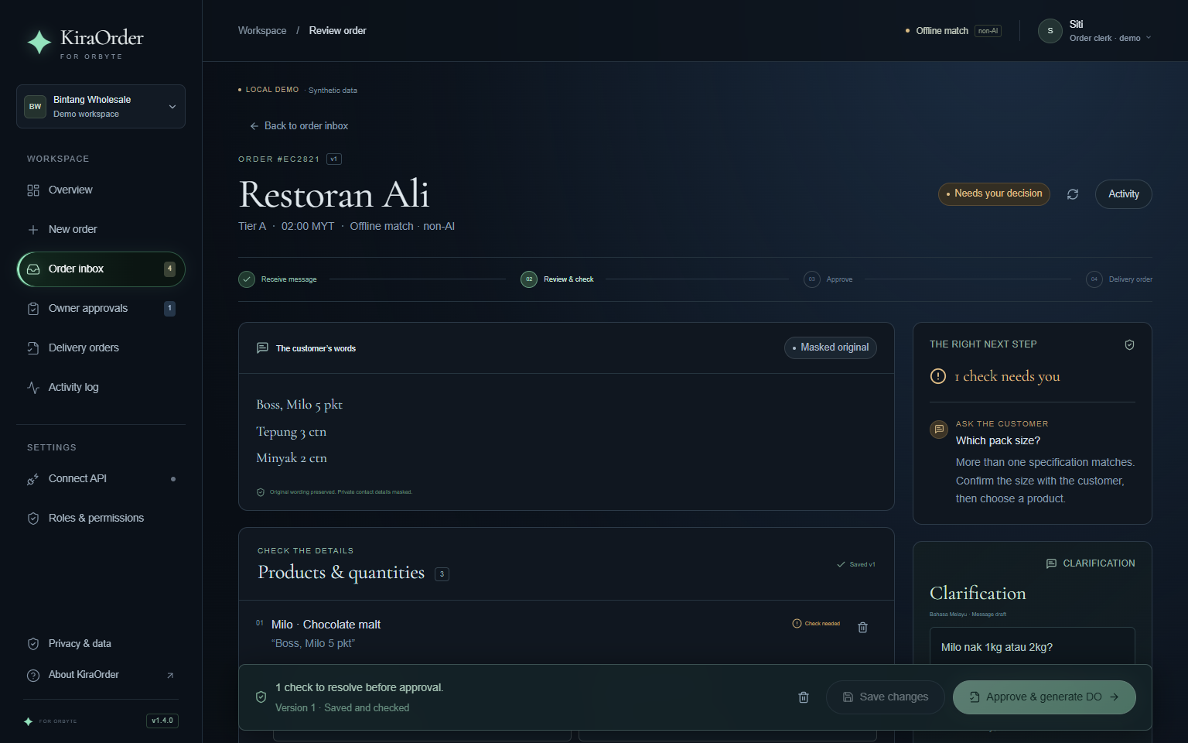
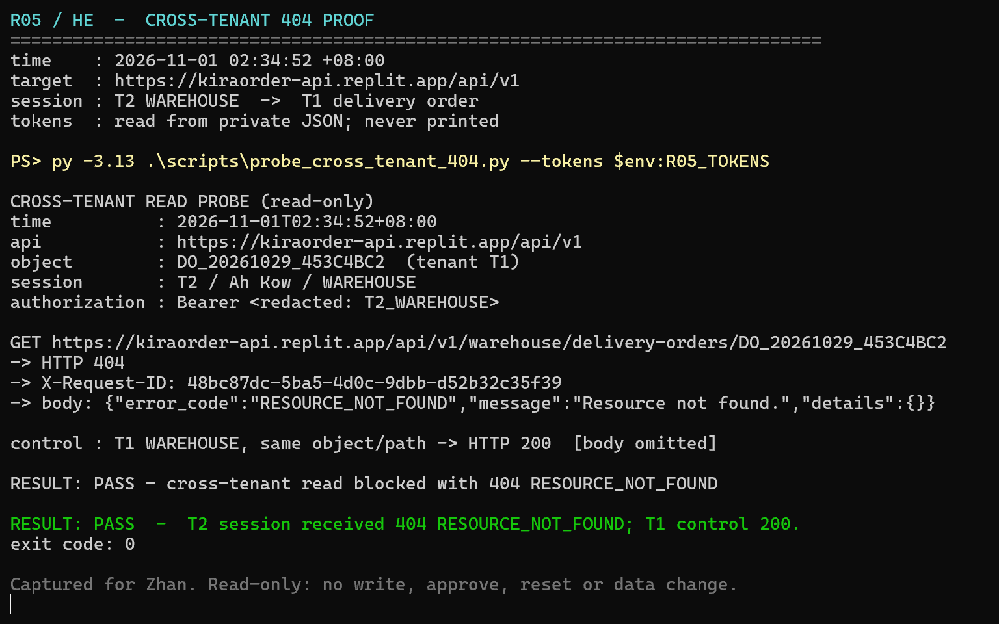
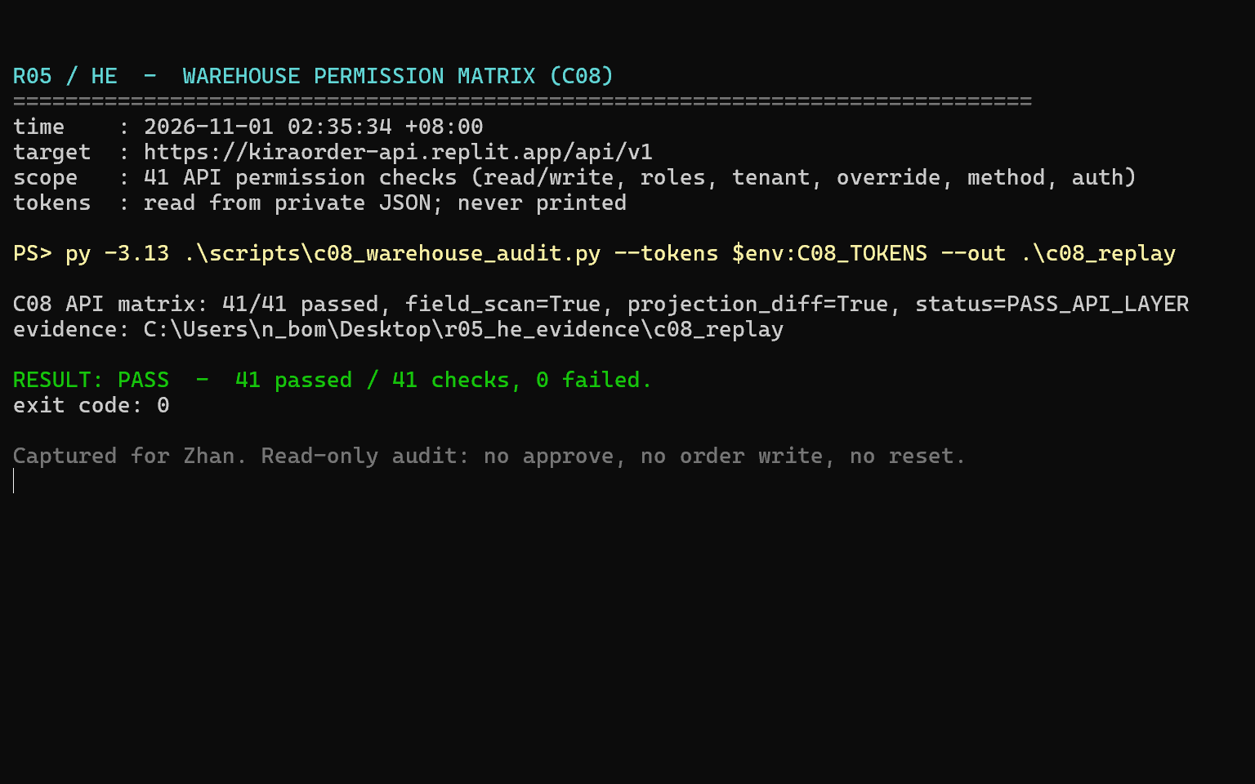
23 · EVIDENCE, CAPTURED READ-ONLY
25 / 28
Three screenshots, three claims we can defend.
Captured 2026-11-01 at 02:34 MYT against the deployed API. Read-only: no write, no approve, no reset.
01 · approval blocked, v1.4.0
02 · T2 reads T1 · 404
03 · 41 / 41 permission checks
The 404 is a fresh run, not a reused 403 or 409. The same script shows a T1 session reading the same object and receiving 200.
Session tokens are redacted before printing. No password and no real customer record appears in any frame.
Notes:
Evidence page. Each screenshot carries a claim exactly one line above it, and each was captured read-only. If a judge asks whether the 404 is real, this is the page that answers it.

Slide 26
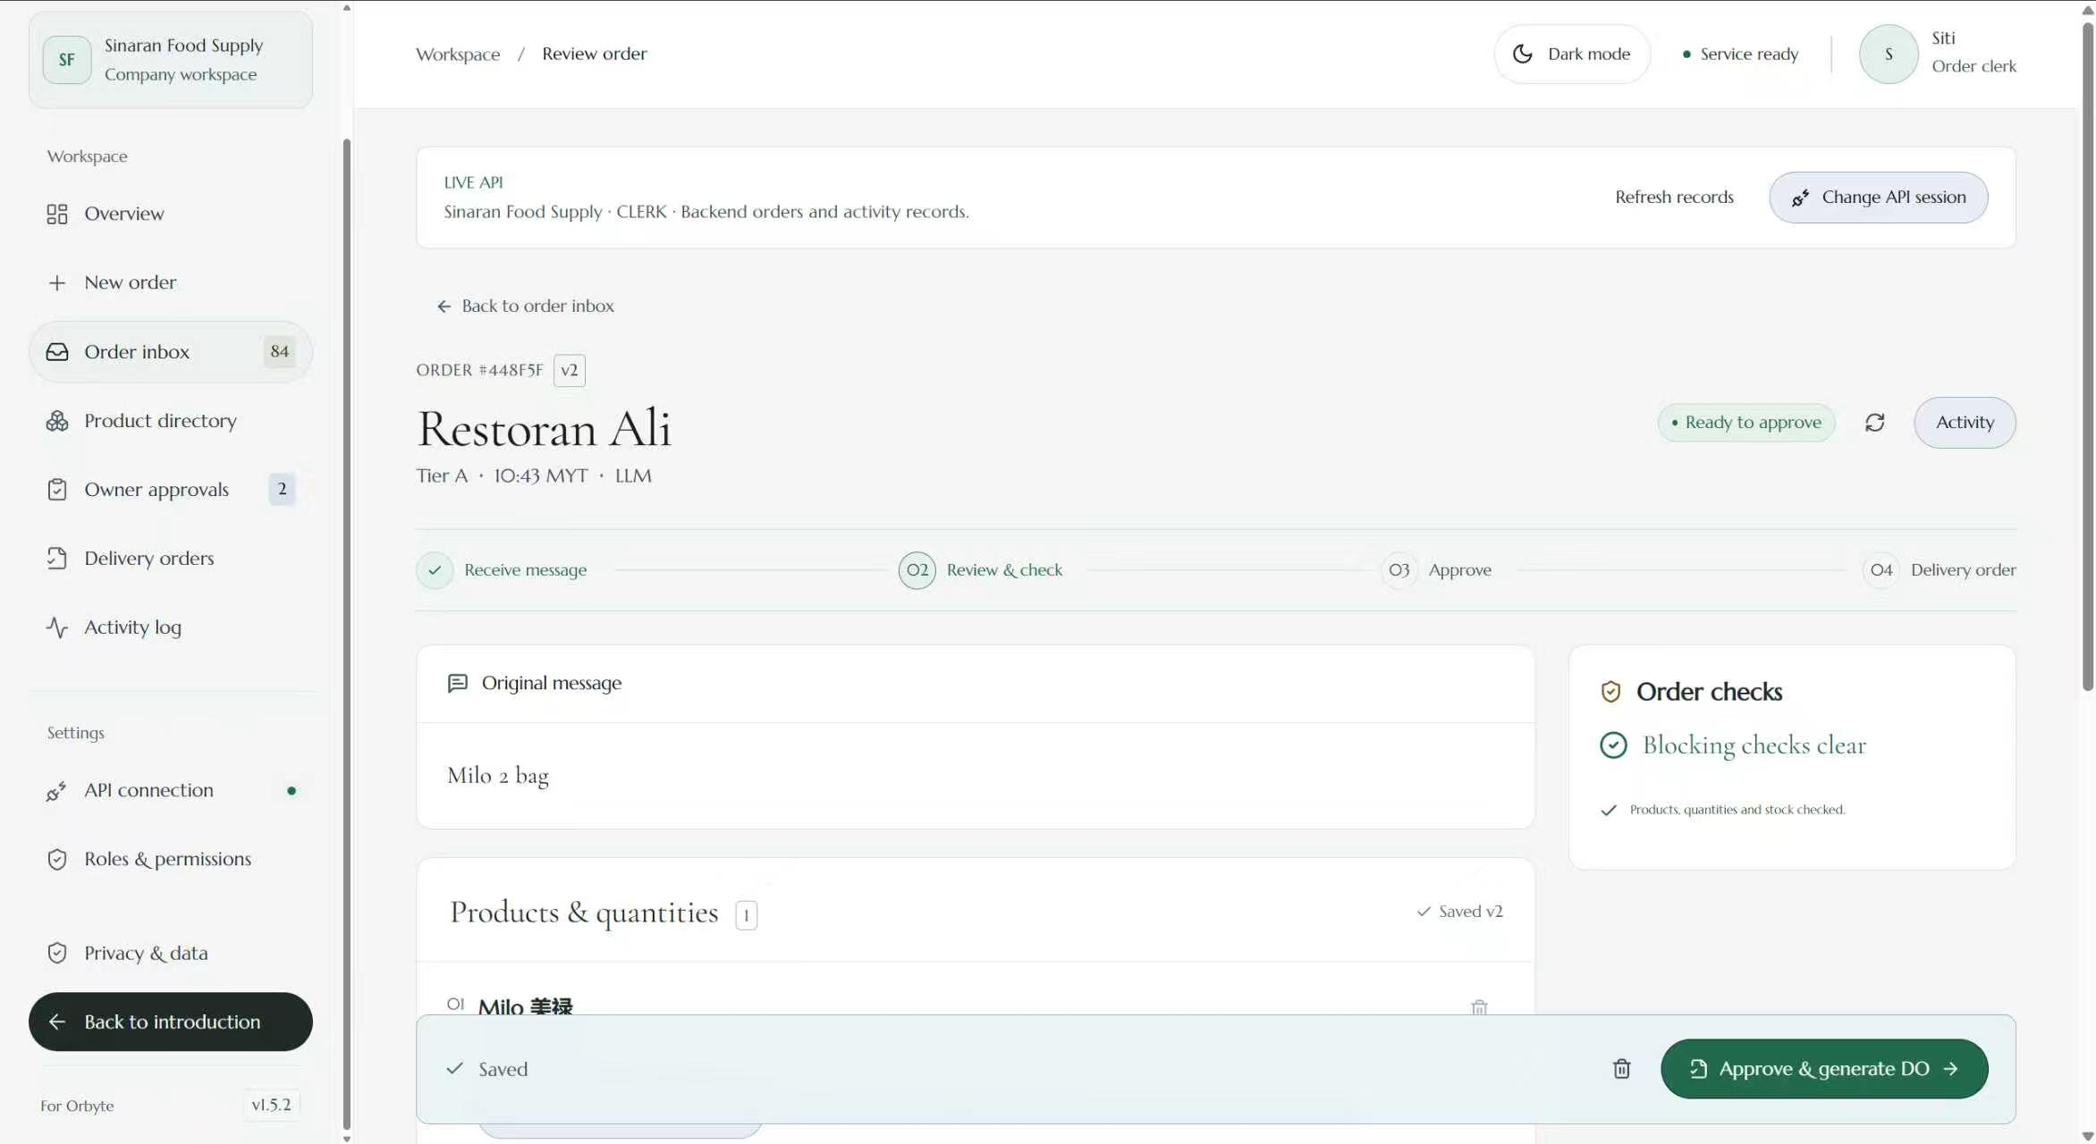
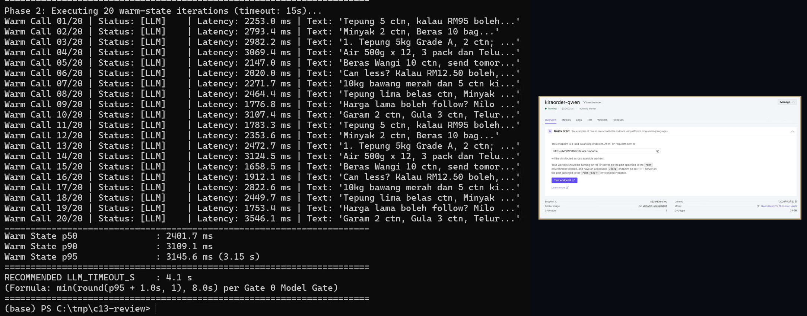
24 · EVIDENCE, THE MODEL MEASURED
26 / 28
A 4.1-second timeout, derived from a measured p95.
Endpoint benchmark, 2026-11-01: twenty warm calls, all LLM, zero fallbacks. The RunPod console is shown in the same frame — not as a standalone claim.
live API · v1.5.2 · happy path
benchmark + console, one frame
198.5 s
3.15 s
20 · 0
historical true cold start
warm p95 · timeout 4.1 = round(p95 + 1 s)
warm calls · fallbacks
198.5 s is the historical scale-from-zero cold start, kept apart from this twenty-call benchmark. Reliability, not accuracy.
Notes:
Two things a judge will test: is the timeout derived or picked, and is the console real. The terminal shows the p95 that produced 4.1 s; the console sits inside the same frame, showing one running worker on the same endpoint.

Slide 27
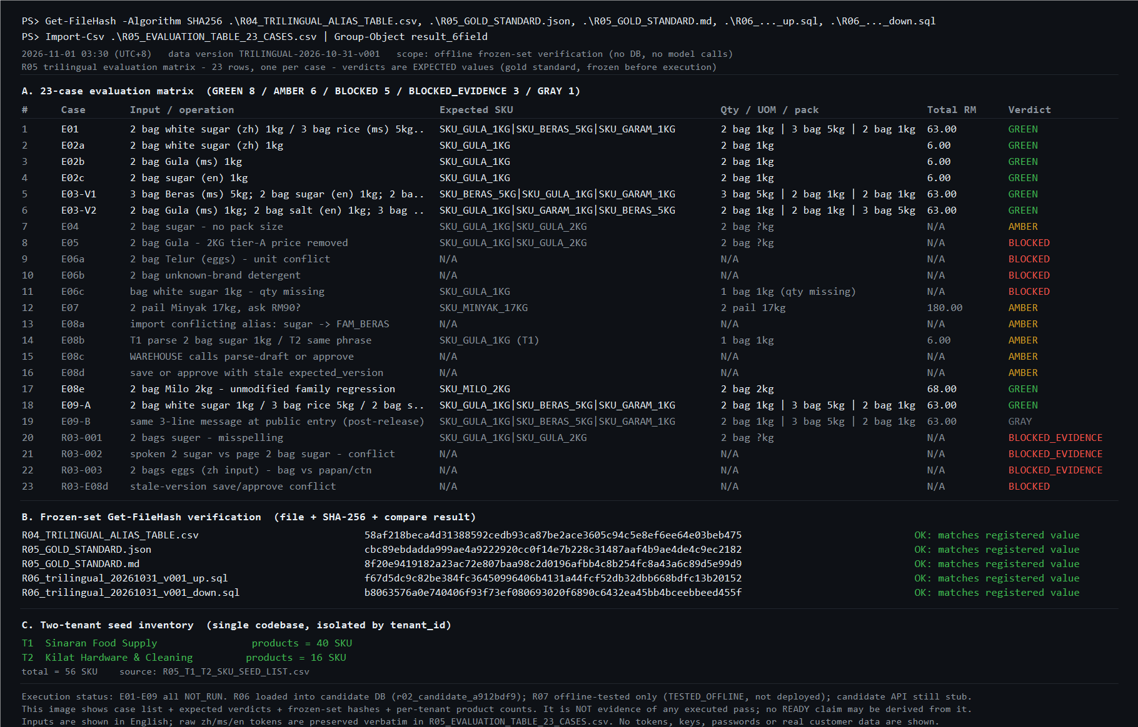
25 · EVIDENCE, THE FROZEN SET
27 / 28
The evaluation set was frozen before anything ran.
Twenty-three cases, each with an expected verdict written down first. The hash block shows the files did not change afterwards.
23
cases, frozen with expected verdicts
8
expected to pass all six fields
40 / 16
SKUs on one codebase, two tenants
Verdicts in the matrix are expected values, not executed results: every case is still NOT_RUN. This page is evidence of rigour, not of a pass — which is why the limits page exists.
Notes:
The strongest page for a sceptical judge: it shows the set was defined before execution, and states plainly that execution has not happened. Never present the GREEN column as a result.

Slide 28
CLOSING
28 / 28
A wrong delivery costs more trust than a slow one.
So the product stops where a guess would cost money — and shows exactly who it asked.
WHAT WE WOULD LIKE NEXT
One merchant week, measured. A judge willing to break the demo. An Orbyte reviewer who reads the rules layer first.
Demo hozier123.github.io/sdc-2026-team-project Code github.com/Hozier123/sdc-2026-team-project
Zhou Jingxi · He Minghao · Xiong Peicheng · Ye Lianghui · Zhan Zhengrong
Notes:
Close on the sentence the whole deck supports, then stop. Do not add a feature list.

