Slide 1
SDC HACKATHON 2026 · DOMAIN 2 ORBYTE SMART SME CHALLENGE
KiraOrder
for
ORBYTE
It knows when not to guess — and who to ask.
Falcons · Xiamen University Malaysia · 1 November 2026
Falcons · KiraOrder for Orbyte
Notes:
Good evening. We are Falcons, from Xiamen University Malaysia. Ten minutes, five people, one order. / 不报全队名字，不念标题。手放到翻页键上。

Slide 2
18:04 · ONE MESSAGE · SIX QUESTIONS IT DOES NOT ANSWER
02 / 17
The order is not the hard part. The missing facts are.
—
Which Gula — the 1 kg pack or the 2 kg pack?
—
Which tier price does this customer buy on?
—
Is the onion in stock, and how much of it?
—
Does “kalau ada” reduce the line, or drop it?
—
Does RM2.80 sit below her tier price?
—
Which egg grade — A, B or C?
Six facts. The message is synthetic; the six questions are ours. One clerk settles all six today — from memory, at the end of the day.
Falcons · KiraOrder for Orbyte
Notes:
This message arrived at six in the evening, on a micro-wholesaler's phone. Two bags of one-kilo sugar. Ten trays of eggs, if we have them. Six facts must be settled before anything can be picked. Which pack size. Which tier price. How much onion is left. Whether “if we have them” means fewer, or none. Whether two-eighty is below her tier price. Which egg grade. None of the six is in the text. The missing facts are the hard part. / 六个问题一条一顿。最后一句停 1 秒。

Slide 3
THE DESK WE BUILD FOR
03 / 17
One clerk. One owner. A phone.
01
02
03
04
One clerk
One owner
One phone
20–80 a day
Takes the order. Settles six facts at once.
Decides the price. Signs the exception.
The message lands here, in three languages.
Orders. Six facts each.
No ERP. No integration. No IT person.
And no one to configure it — so nothing here may ask her to set something up.
Falcons · KiraOrder for Orbyte
Notes:
Who is this for? A micro wholesaler. One clerk takes the order. One owner sets the price. One phone holds the message. Twenty to eighty orders a day. No ERP. No integration. No IT person — and no one to configure it. Today she settles all six from memory. That works — until eleven messages land at once. / One clerk. One owner. A phone. 三个短句拆开，每句留半拍。twenty to eighty 放慢。

Slide 4
THREE ANSWERS ALREADY EXIST
04 / 17
All three optimise the message. None can supply a fact the message does not contain.
01
02
03
By hand
A translating bot
A flag-everything checker
Ask the customer, read the price file, walk to the whiteboard, type the delivery order.
Malay, Chinese and English become a clean, structured order list.
Suspicious lines turn red and the flow stops for a human.
Nothing is wrong except the time — and it collapses when eleven messages land at once.
The list looks perfect and is still wrong. Pack size is not a language problem.
A red flag is a question, not an answer. The work still ends with the clerk.
Falcons · KiraOrder for Orbyte
Notes:
Three answers already exist. A human is accurate but slow. A translating bot makes the message look solved, and the pack size is still wrong. Pack size is not a language problem. A flag-everything checker stops the work and hands it back. A red flag is a question, not an answer. All three improve the message. The facts are somewhere else. / 每列指一下屏幕，不要逐字念小字。

Slide 5
WHAT WE DO DIFFERENTLY
05 / 17
The model proposes. Rules settle. A named person decides.
01 · The model
02 · The rules
03 · The people
It proposes. It never prices.
Facts come from her own data.
A named person signs.
Product candidates, quantities, units, pack sizes and source spans — restricted to the tenant catalogue, or an explicit UNKNOWN.
Tier price, stock and pack size are computed from the merchant’s own catalogue and price file, never generated.
A clerk clears routine orders. The owner decides a below-tier price, and can reject with a reason.
It cannot set a price, approve an order, or issue a delivery order.
A field the data cannot evidence becomes a blocking issue, never a plausible guess.
The warehouse sees picking detail with no prices and no contact numbers.
Falcons · KiraOrder for Orbyte
Notes:
One rule: the model proposes, rules settle, a named person decides. One — the model never prices. It proposes a product, a unit, a pack size, or says UNKNOWN. It cannot approve, and it cannot issue a delivery order. Two — the facts are computed, not generated. Tier price and stock come from her own catalogue. Three — when the data cannot settle a question, the draft stops, at a named desk. The next four minutes take one layer each. / One / Two / Three 重读。最后一句是交棒的桥，说完停顿。

Slide 6
COMMERCIAL VALUE · ONE CODEBASE, MANY SHOPS
06 / 17
A different shop, the same build.
Changing merchant means changing configuration — seed data, catalogue, aliases, policy. Not code. That is what lets one build sell to a hundred shops.
 | SINARAN FOOD SUPPLY (T1) | KILAT HARDWARE & CLEANING (T2)
Category | Food wholesale | Hardware and cleaning supplies
Products | 40 | 16
Inventory | 795 units | 450 units
Customers | 8 | 5
Application code changed | — | None
Tenant isolation is enforced at the API: a T2 token asking for a T1 delivery order receives 404, with or without a tenant header.
Falcons · KiraOrder for Orbyte
Notes:
Why this is a business and not a demo. This is a second shop — a hardware and cleaning distributor. Same build, different configuration. Forty products, then sixteen. Zero lines of application code changed. Changing merchant means changing configuration, not code. That is what lets one build sell to a hundred shops. That is the commercial case, not a feature. / Zero lines… 说完停一拍。不要说成已有客户。

Slide 7
HOW WE EARN MONEY
07 / 17
Charged per approved order. Never per seat.
—
Billing unit: one approved delivery order. Parsing, fallback, rejection and discard are free — we charge only when the merchant got a delivery order she approved.
—
A free tier runs on the rules path: no model call, so a merchant can adopt the discipline of approval and audit before paying anything.
—
Measured cost anchor: US$0.00019 per GPU-second on one 24 GB card; at p50 1.93 s per parse that is about US$0.4 per 1,000 orders — model time only, idle GPU excluded.
—
The price is not set. Freemium — N free orders a month, then per order — is validated by interview in the pilot. We will not print a number we cannot defend.
Per-order revenue follows work the merchant actually accepts, not seats she hopes to fill.
Falcons · KiraOrder for Orbyte
Notes:
Per approved delivery order. Never per seat. Parsing is free. Fallback is free. Rejection is free. We charge only when she approved one. Measured cost: about forty cents per thousand orders, model time only. The price is not set — freemium, then per order. We will not print a number we cannot defend. / 顺序：计费单位 → 成本 → 承认没定价。Never per seat 后停半拍。

Slide 8
FOUR LAYERS · ONE ORDER
08 / 17
One order, four layers.
BACKEND & RULES
AI & DEPLOYMENT
FRONTEND
DATA & QUALITY
He Minghao
Xiong Peicheng
Ye Lianghui
Zhou Jingxi
Where every number comes from — the catalogue, the tier price, the stock — and the approval state machine that refuses a stale edit.
What happens when the model fails: the fallback path, the mode on screen, and a timeout derived from a measured p95.
What a stop looks like: a line that will not settle becomes a card, a question, and a next step the clerk can take.
How we score ourselves: a frozen answer key, strict whole-case scoring, and two tenants on one build.
Each layer answers one question the order cannot.
Numbers, failure, interface, evidence — in the order a single order travels.
Falcons · KiraOrder for Orbyte

Slide 9
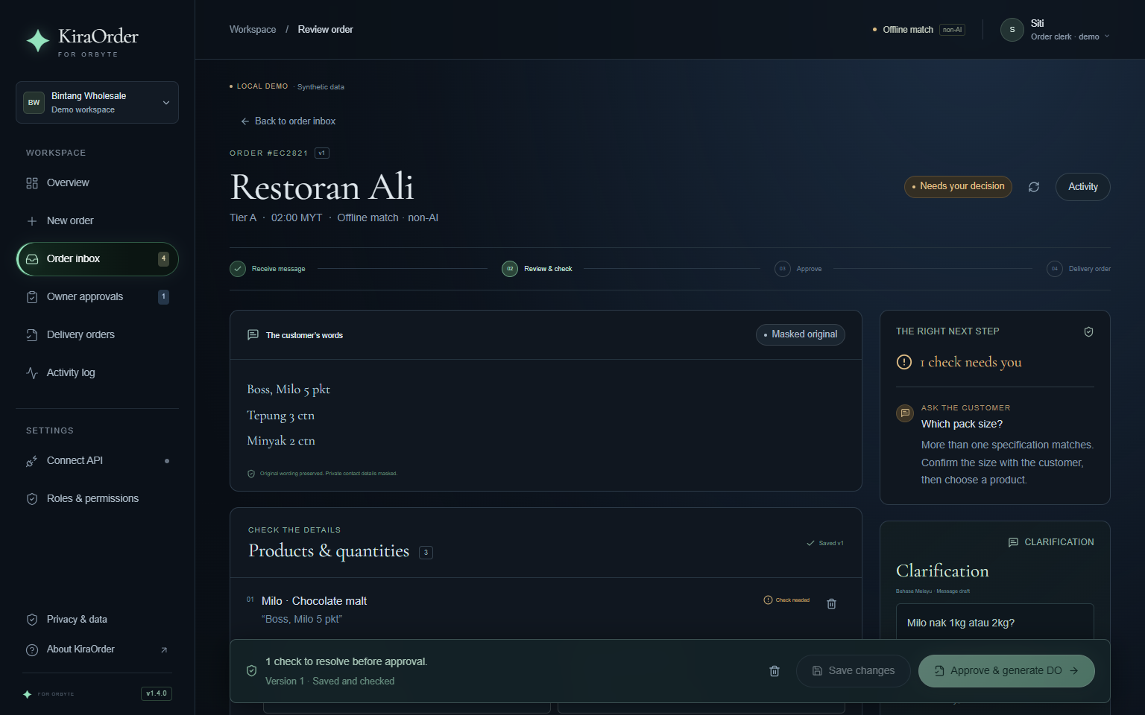
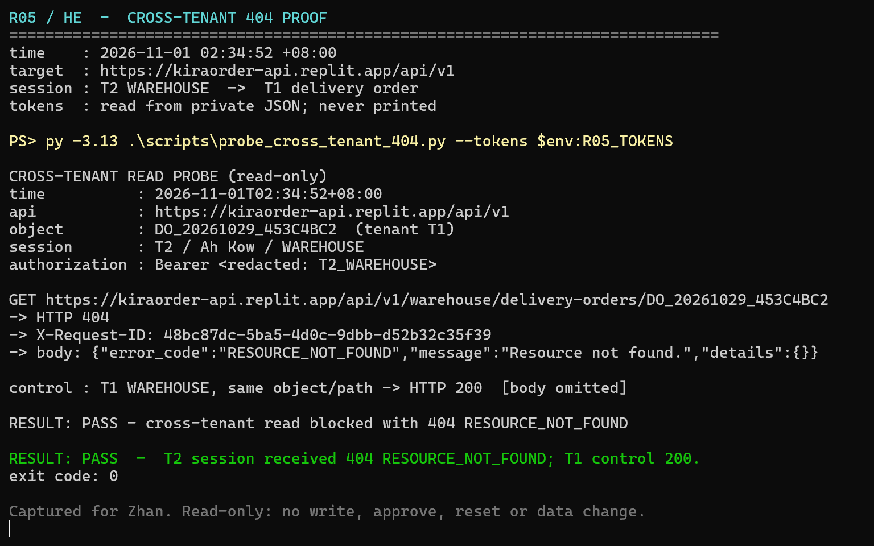
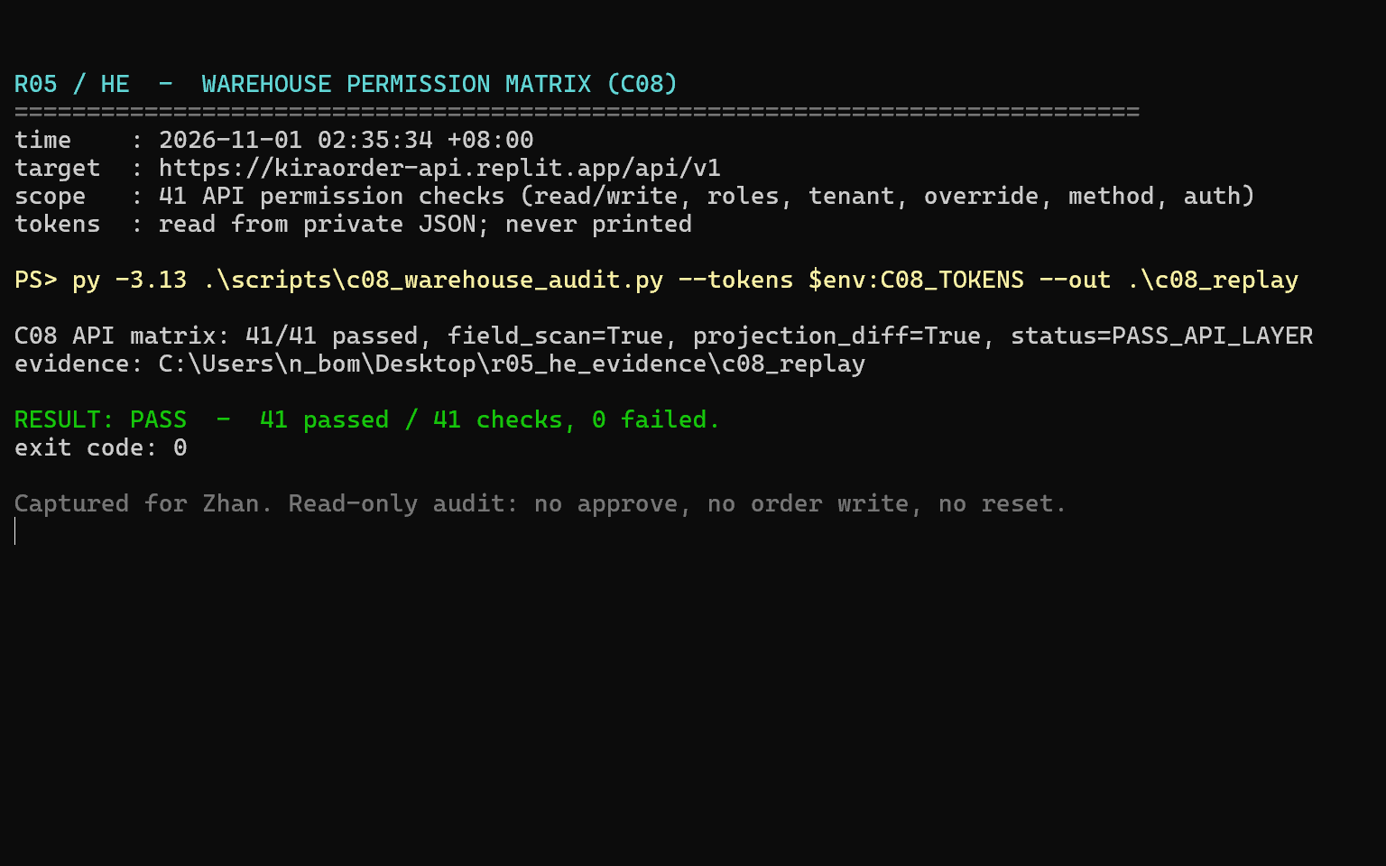
HE MINGHAO · BACKEND & RULES
09 / 17
Where the numbers come from.
INNOVATION
CORE TECHNOLOGY
The model never prices.
An approval state machine with a permission matrix.
Every price, every stock quantity and every pack size is computed from the merchant’s own catalogue — never generated. A field the data cannot evidence becomes a blocking issue instead of a plausible guess.
Unsaved edits cannot be approved. A below-tier price cannot pass without the owner. A cross-tenant read returns 404 — enforced at the API, not hidden on the page.
01 · approval blocked, v1.4.0
02 · T2 reads T1 · 404
03 · 41 / 41 permission checks
Falcons · KiraOrder for Orbyte
Notes:
Minghao, backend and rules. The model never prices. It can propose a product, a unit, a pack size, or say UNKNOWN. Every number you see is computed from her own catalogue: her price, her stock, her pack size. If the data cannot evidence a field, it blocks. It does not guess. Under that is an approval state machine. Unsaved edits cannot be approved. A below-tier price cannot pass without the owner. A cross-tenant read returns 404. Forty-one permission checks. Six concurrent runs, one delivery order each. Every one of them carries a human signature. That is where the numbers come from. / 60 秒。先讲规则，再讲状态机；三张图依次对应审批卡住、跨租户 404、41/41 矩阵，指到再报数。

Slide 10
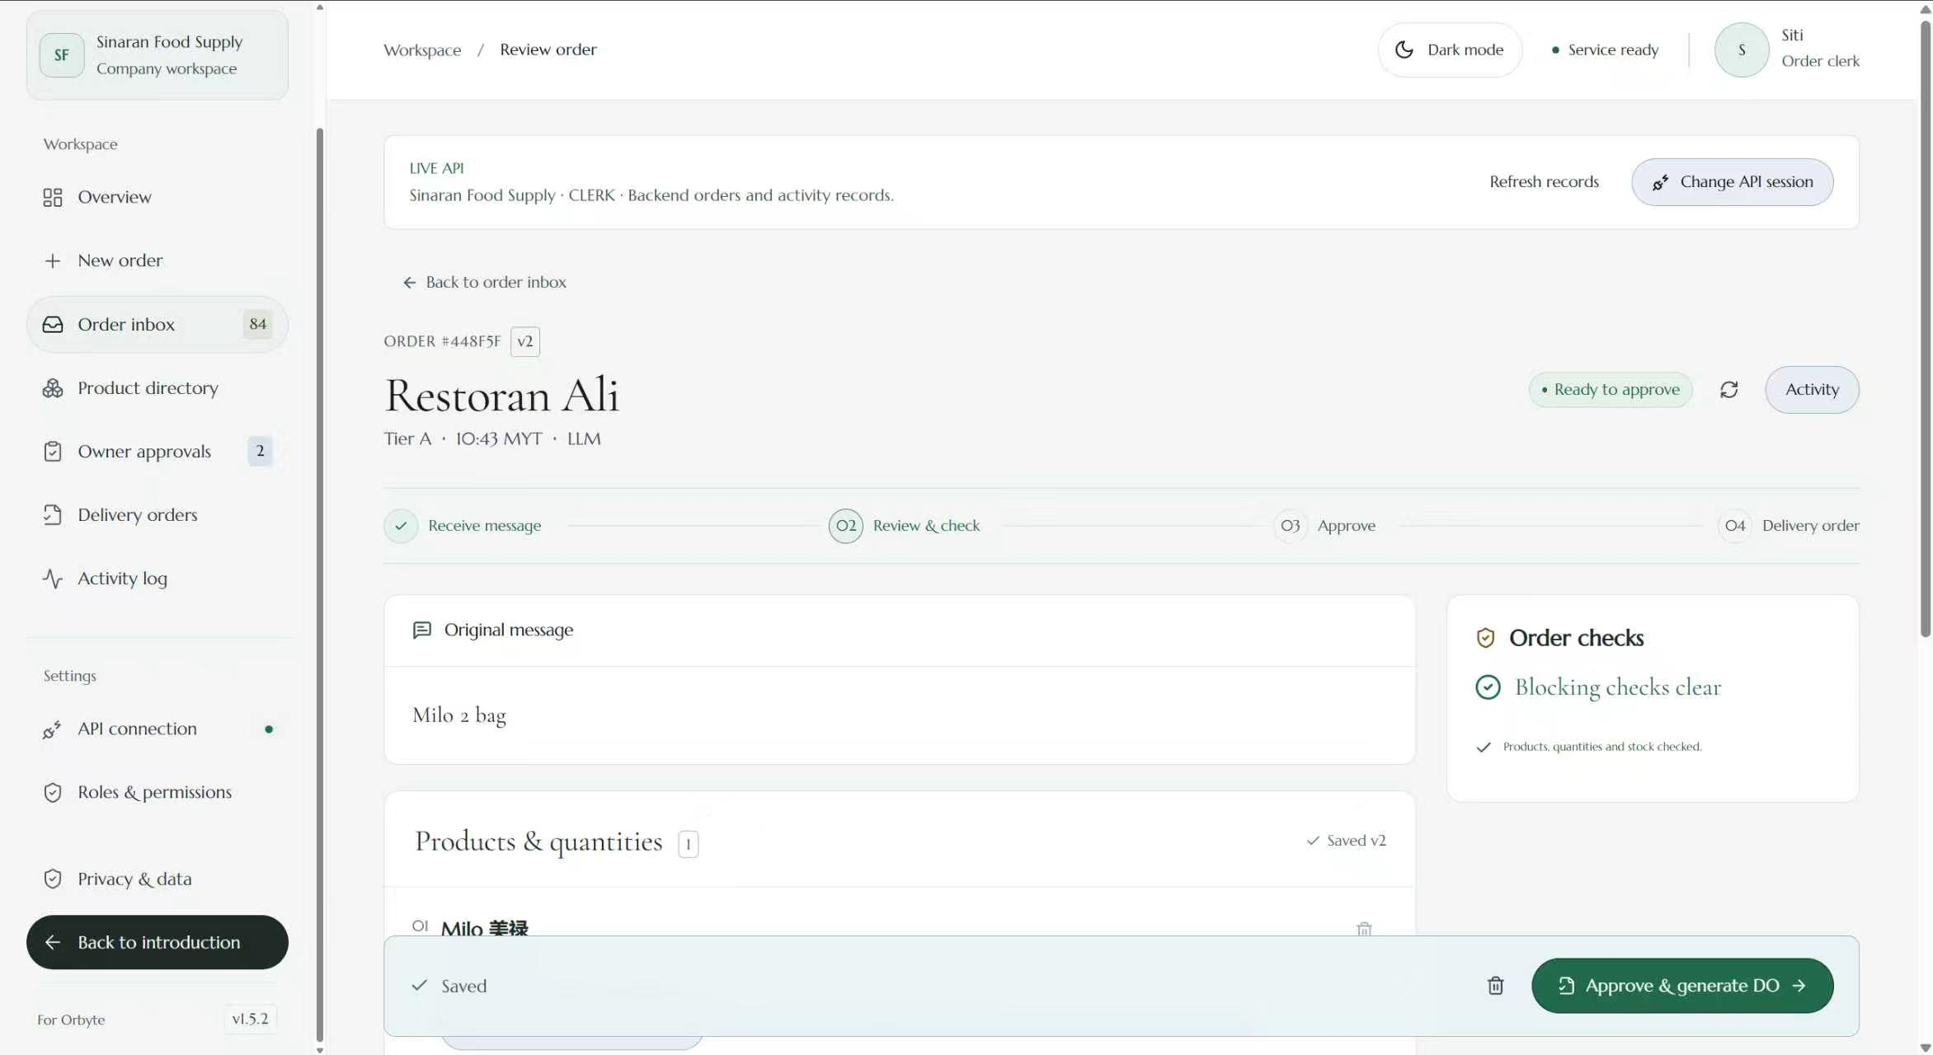
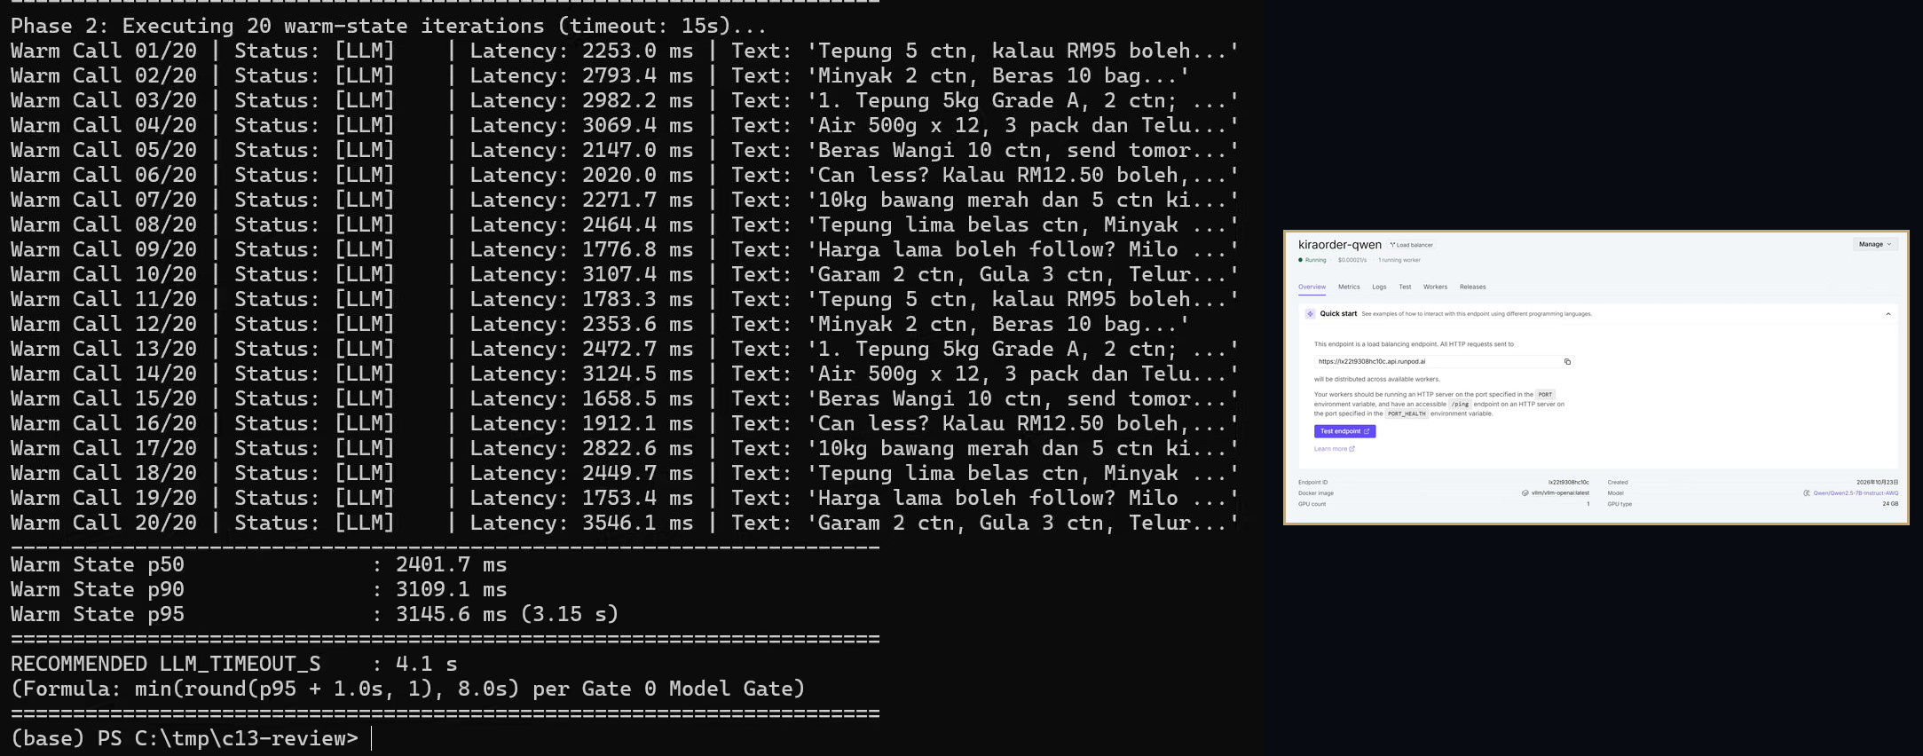
XIONG PEICHENG · AI & DEPLOYMENT
10 / 17
When the model cannot answer, failure is visible.
INNOVATION
CORE TECHNOLOGY
Failure is visible.
An evidence-bound AI contract.
Deterministic fallback, the extraction mode on screen, and no silent guess. If the model is unavailable, the UI shows FALLBACK. If a field is not evidenced, it becomes a blocking issue — not a guess.
Qwen proposes product, quantity, unit and pack. The backend verifies each proposed field against the source span; unsupported fields are blocked, not guessed. Price, stock and approval are never decided by the model.
198.5 s
3.15 s
20 · 0
historical true cold start
warm p95 · timeout 4.1 = round(p95 + 1 s)
warm calls · fallbacks — reliability, not accuracy
Falcons · KiraOrder for Orbyte
Notes:
Peicheng, AI and deployment. A good demo proves the happy path; production is judged on the bad day. Our innovation is making failure visible: deterministic fallback, on-screen mode, no silent guess. The core is an evidence-bound AI contract. Qwen proposes product, quantity, unit and pack; unsupported fields are blocked, not guessed. The model never sets price, stock or approval. The 4.1-second timeout follows measured p95 plus one second and triggers fallback. A historical scale-from-zero cold start took 198.5 seconds. Warm p95: 3.15 seconds over twenty warm calls, zero fallbacks. That is reliability, not accuracy; a system, not just a demo. / 60 秒。p95 用 3.15，不要再提 3.08。198.5 是历史真实冷启动，终端里的 2.73 是预热首调，不要并列。两张图按「顺利路径 → 终端与控制台」的顺序指。

Slide 11
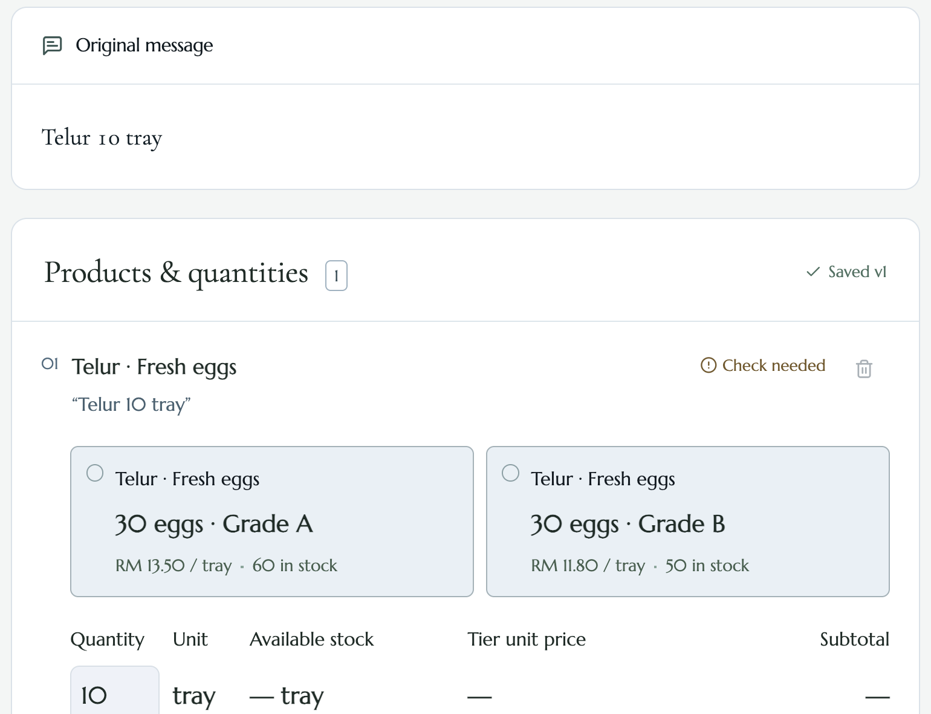
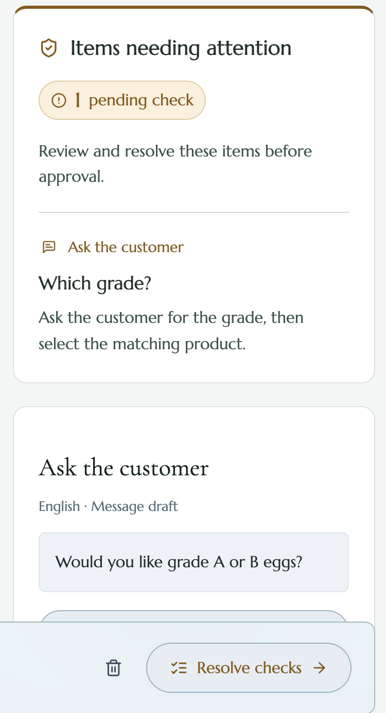
YE LIANGHUI · FRONTEND
11 / 17
Make uncertainty actionable.
INNOVATION
CORE TECHNOLOGY
The screen shows both options.
A dispute becomes a card and a question.
Ten trays of eggs, no grade. Instead of choosing for the clerk, the card puts the two catalogue options side by side — each with its own price and its own stock.
The unresolved line names the field, keeps the span it came from, and drafts the question for the customer. The next step is “Resolve checks”. Approval must wait.
01 · a line that will not settle
02 · the question, drafted
Falcons · KiraOrder for Orbyte
Notes:
[point at the first screen] I am Lianghui, responsible for the frontend. Look at this order: ten trays of eggs, but no grade. The screen shows both options instead of choosing for the clerk. [point to Which grade?] Here it asks “Which grade?” and prepares a question for the customer. The next step is “Resolve checks.” Approval must wait. / 指图与语音同步，不另加解释。这一页 30 秒，翻页前把手停在「Resolve checks」上。

Slide 12
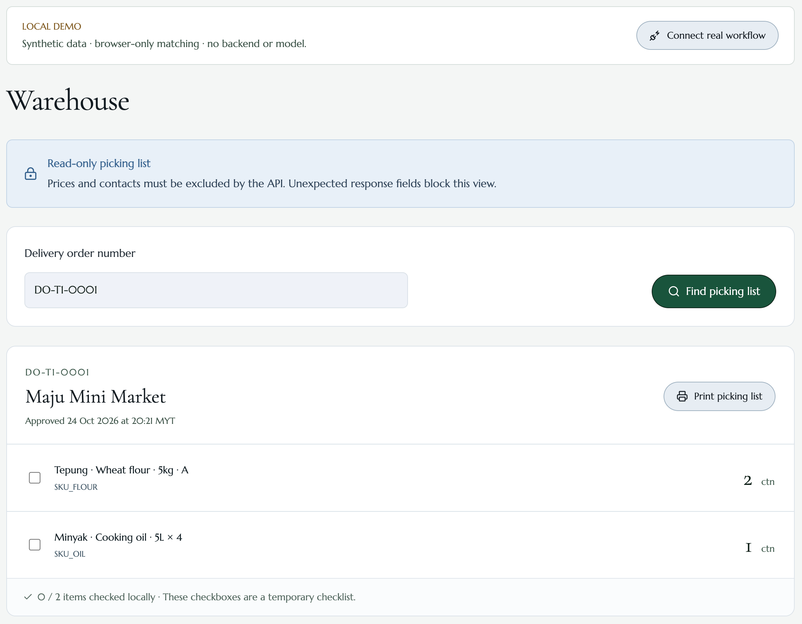
YE LIANGHUI · FRONTEND
12 / 17
Each role gets only what it needs for the next step.
03 · warehouse, four fields
No prices, no totals, no customer contacts — enforced by the API, not hidden on the page.
Falcons · KiraOrder for Orbyte
Notes:
[switch to the warehouse screen] Now look at the warehouse view: products, pack sizes, quantities, and units. No prices or customer contacts. [turn to the judges] My job is to make uncertainty actionable, and give each role the information needed for the next step. These screenshots show the local demo workflow. / 英文共 91 词，按 105 词/分约 52 秒，必须带两次画面切换掐表排练。仓库截图是预置 DO，不要说成是鸡蛋草稿生成的单据。

Slide 13
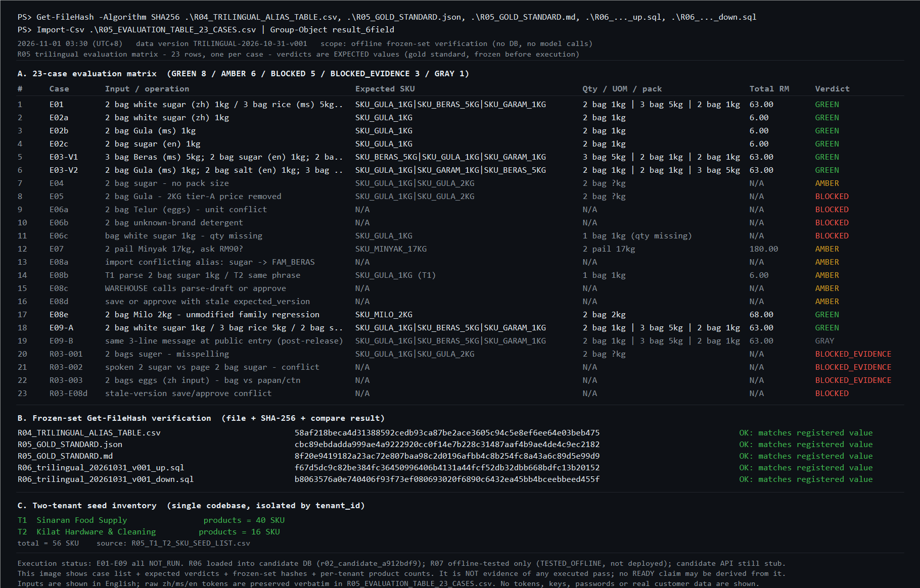
ZHOU JINGXI · DATA & QUALITY
13 / 17
We score against an answer key the model did not write.
INNOVATION
Strict whole-case scoring.
A case passes only when all six fields are right at once. Eight of twenty-three do. Small sample, built by us — and we report the number as it is.
CORE TECHNOLOGY
A frozen set with hashes, and two tenants on one build.
Every frozen file carries a SHA-256, so a re-run can be checked rather than trusted. The same build serves a food catalogue and a hardware catalogue.
8/23
24/31
2
23 cases frozen before execution: eight expected to pass, eight blocked, six amber, one gray. Every case is still NOT_RUN. Hashes verified; 40 / 16 SKUs on one build.
all six fields
correct unit
tenants, one build
Falcons · KiraOrder for Orbyte
Notes:
[switch to the warehouse screen] Now look at the warehouse view: products, pack sizes, quantities, and units. No prices or customer contacts. [turn to the judges] My job is to make uncertainty actionable, and give each role the information needed for the next step. These screenshots show the local demo workflow. / 英文共 91 词，按 105 词/分约 52 秒，必须带两次画面切换掐表排练。仓库截图是预置 DO，不要说成是鸡蛋草稿生成的单据。

Slide 14
LIVE DEMO · FROM THE FRONT DOOR
14 / 17
Homepage, workspace, draft, delivery order.
01
Homepage — dark or light, the merchant's front door
02
Workspace — LIVE API · role: CLERK
03
Restoran Ali · paste 2 bag Gula 1kg · Create draft
04
Read the draft: product, pack size, unit, tier price, stock, source
05
Approve & generate DO — read the number aloud
Point at what it filled — and at what it refused to fill.
Falcons · KiraOrder for Orbyte
Notes:
Jingxi, data and quality. Anyone can build a demo that looks right. The question is who wrote the answer. Ours was written by us, against the business rules — not copied from the model. The scoring is strict: a case passes only when all six fields are right at once. Eight of twenty-three do. Small sample. We built it. I will not round it up. Every frozen file carries a SHA-256, so a re-run can be checked. Two tenants, one build. That is the only accuracy number we have, and we publish it. / 60 秒。这张图是冻结的预期判定（GREEN 8），必须同时说「全部用例仍是 NOT_RUN」，不能说成这次跑过了。8/23 说完立刻补「小样本、自建」，不要等评委问。

Slide 15
DEMO BACKUP · WHEN IT CANNOT BE SURE
15 / 17
It stops — and it stops at the right desk.
01
Edit a line but do not save → Approve stays disabled. Unsaved edits cannot be approved.
02
Record a below-tier price on the Gula line → Send to owner → the draft locks while it waits.
03
Owner role: an empty rejection reason is refused → reject with a reason → order closed.
04
Reopen the draft: closed. No approve, no save, no delivery order.
The point is the disabled button and the closed order, not the enabled one.
Falcons · KiraOrder for Orbyte
Notes:
Now the product, live. We start at the front door: dark or light, the same screen. Then the workspace — connected to the live API, and I am the clerk. One customer, one message. I paste exactly what she wrote. / 10 秒。演示人 Ye，旁白 Zhan。说完立刻切浏览器；不在台上输 token、不登录。

Slide 16
DEMO BACKUP · THE RECORD AND THE WAREHOUSE
16 / 17
What just happened is written down. Not everyone sees everything.
01
Draft activity — read the save, deduct and approve timestamps off the screen, as they are
02
Change record — a matching source becomes MANUAL_SELECTED; pack size 1 kg
03
Warehouse role — find the DO by number: four fields, no price, no total, no contact detail
Say the actor’s name out loud — the log is our answer to “who did this?”
Falcons · KiraOrder for Orbyte
Notes:
Backup page. Use only if the live site fails. Narrate the steps on screen; never debug in front of the judges.

Slide 17
CLOSING
A wrong delivery costs more trust than a slow one.
KiraOrder stops where a guess would cost money — and shows you exactly who it asked.
Zhou Jingxi · He Minghao · Xiong Peicheng · Ye Lianghui · Zhan Zhengrong
Demo hozier123.github.io/sdc-2026-team-project · Code github.com/Hozier123/sdc-2026-team-project
Falcons · KiraOrder for Orbyte
Notes:
Backup page. Use only if the live site fails. Narrate the steps on screen; never debug in front of the judges.

