Slide 1
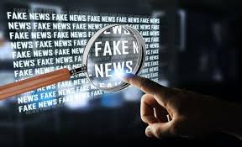
Detection

Slide 2
Why?

Slide 3
Introduction
Fake news denotes a type of yellow press which intentionally presents misinformation or hoaxes spreading through both traditional print news media and recent online social media. Fake news has been existing for a long time, since the “Great moon hoax” published in 1835. In recent years, due to the booming developments of online social networks, fake news for various commercial and political purposes has been appearing in large numbers and widespread in the online world. With deceptive words, online social network users can get infected by these online fake news easily, which has brought about tremendous effects on the offline society already.

Slide 4
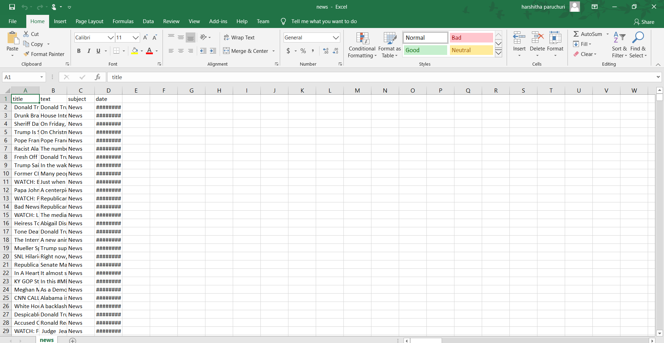
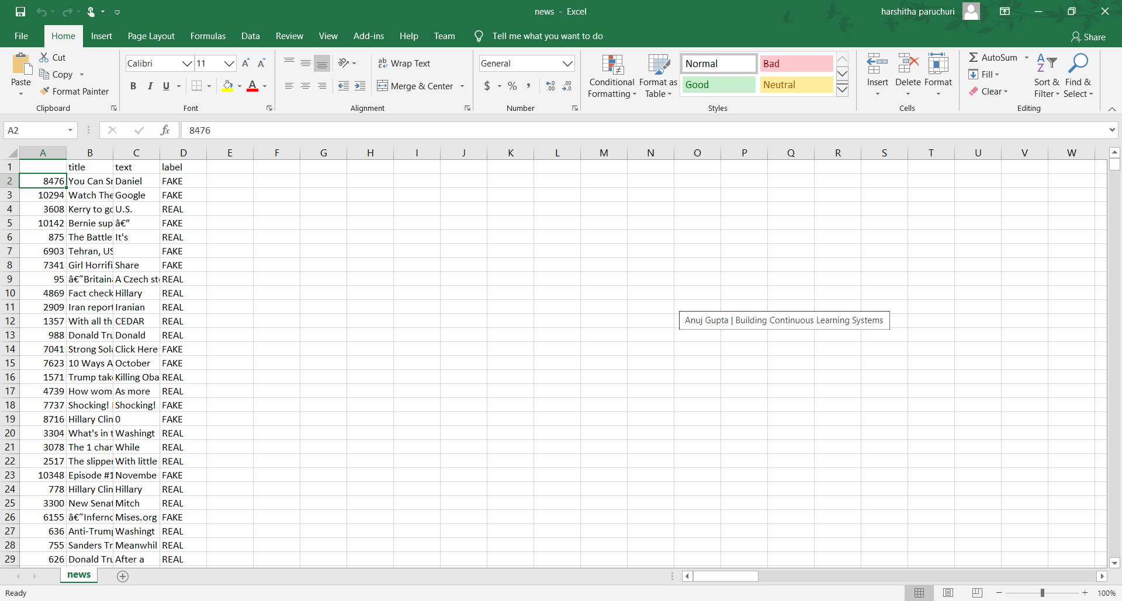
Dataset

Slide 5
Files
fake_news_detection.ipynb
Fake_app.py
Index.html
Style.css

Slide 6
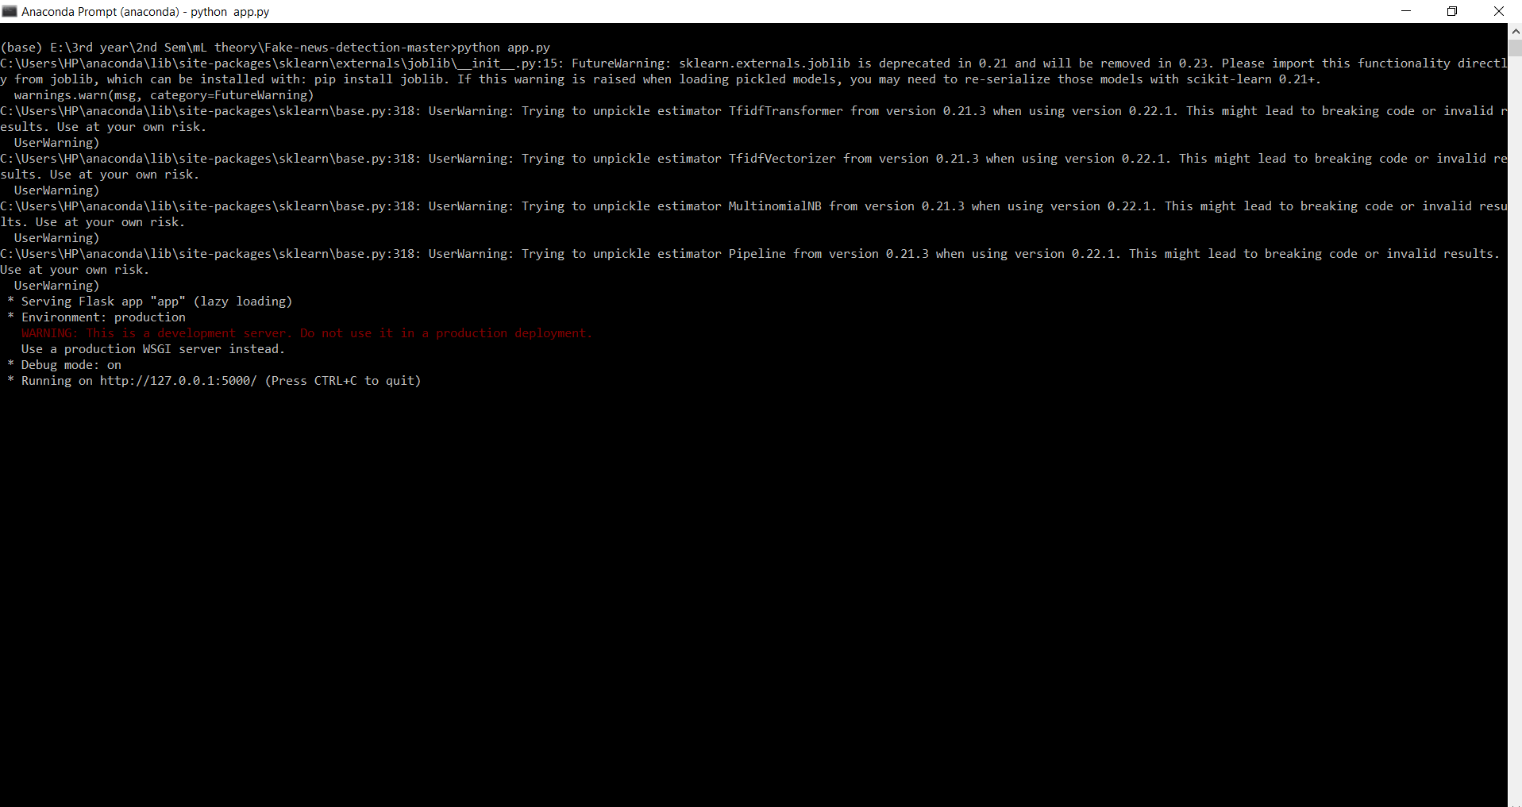
Cmd When I Run Fake_app.Py

Slide 7
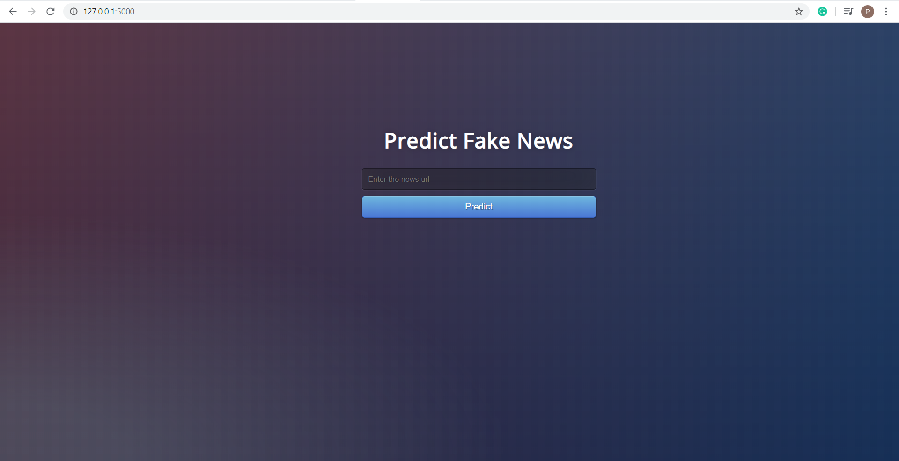
Website

Slide 8
Thank you

