Slide 1
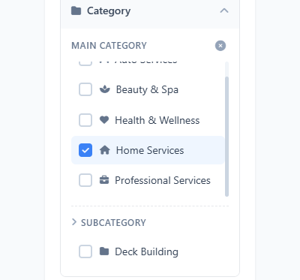
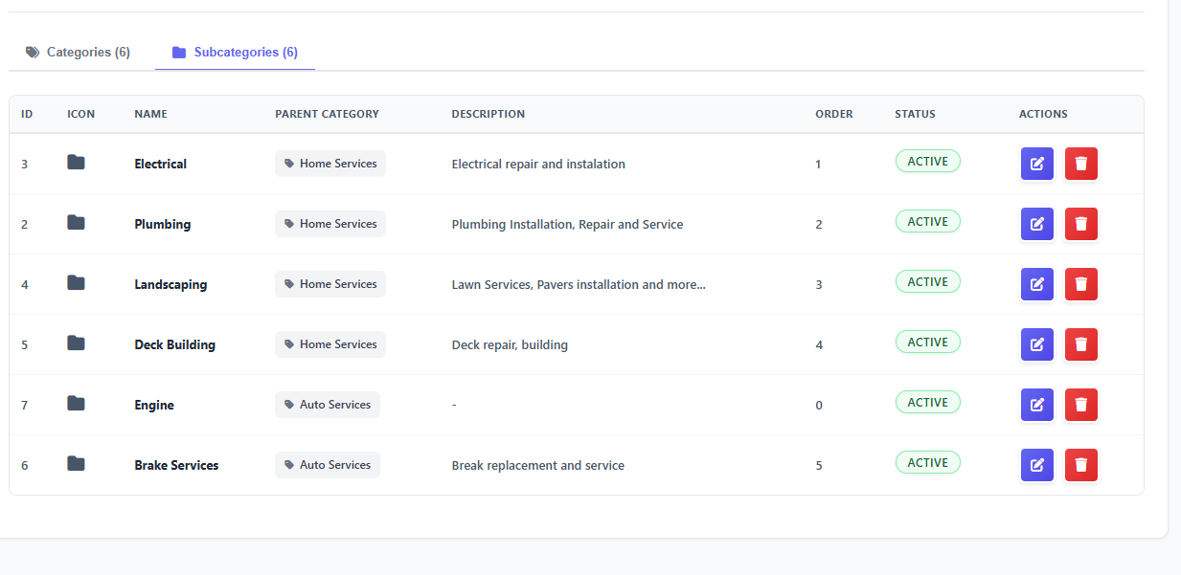





I have several categories added;
Why the are not showing in filters?
Fixed

Slide 2
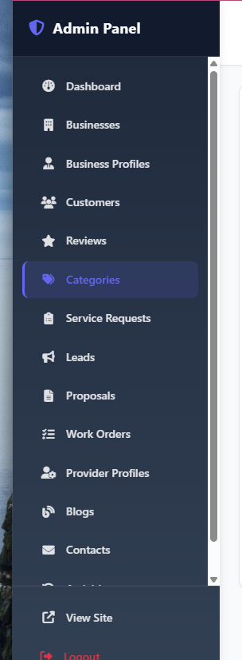



Can you define to be differences between:
Leads
Proposals
Service Requests
Work Orders
And logic for each please
Also, when any of the above are rejected or Not approved – can you add filed for received to be ale to choose the reason for rejecting it:
For example; LEADS >> REJECTED > Reason: [ Too far, Too Expensive, Not Relevant Service Request, Other (Describe)
  Answer:Definitions and logic
  Service Request — Customer's initial request
  Lead — System notification to provider
  Proposal — Provider's offer with price
  Work Order — Active work assignment

Slide 3
Definitions and logic
1. Service Request
What: Customer's initial request for a service
Created by: Customer
Status flow: REQUEST_CREATED → LEAD_ASSIGNED → IN_PROGRESS → COMPLETED → APPROVED → CLOSED
Contains: Project details, category, location, preferred date/time
Logic: System automatically creates Leads for matching providers
2. Lead
What: Notification sent to a provider about a service request
Created by: System (automatically when Service Request is created)
Status flow: submitted → routed → accepted/rejected/cancelled
Contains: Service request info, customer contact (masked), location
Logic: Provider pays to accept → creates Proposal

Slide 4
3. Proposal
What: Provider's offer with price and details
Created by: Provider (when accepting a Lead)
Status flow: SENT → ACCEPTED/REJECTED
Contains: Price, details, payment info
Logic: Customer pays to accept → creates Work Order
4. Work Order
What: Active work assignment after proposal acceptance
Created by: System (when customer accepts proposal)
Status flow: IN_PROGRESS → COMPLETED
Contains: Service request reference, provider, completion status
Logic: Provider marks complete → Customer approves → Review available

Slide 5
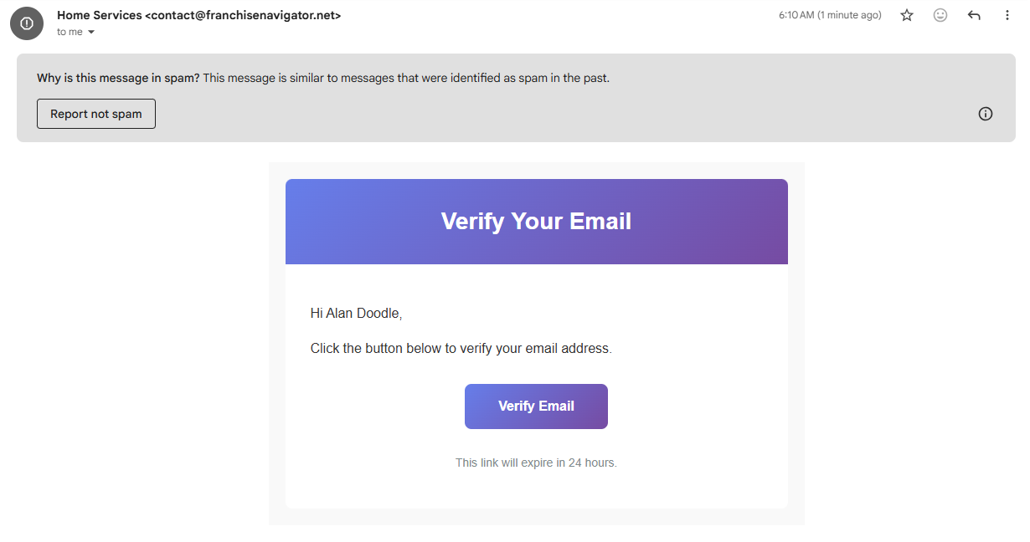
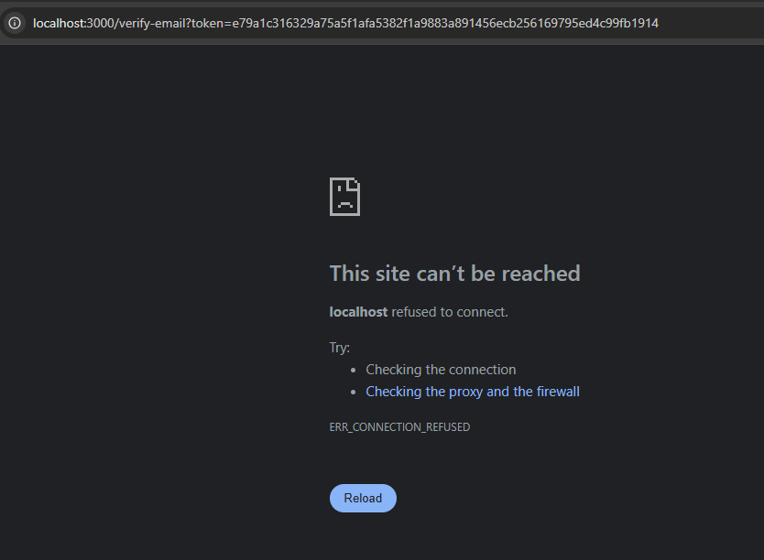
I get this error when I click on Verify EMAIL
Is it on my my end related to web browser?
Fixed

Slide 6
LEADS CONTROLL DASHBOARD
How leads get routed ? I need control Dashboard to be able to route leads and service requests to providers who pay more. Validate leads before sending to providers because many leads may come with bad pone numbers.
I need to max leads / service requests, for Basic plan 10 leads per month Max. Premium = 30 leads Max and Pro Plan = Unlimited
I need to have control check to have leads to go first to featured providers and Pro package service providers. After that the rest gets them.
Validate leads before sending to providers because many leads may come with bad pone numbers.
for exmaple, if click "submit request" button, display modal for phone verification. and then if verification is successed, run for submitting requestion function.
Customers can create service requests without limits (membership is only for providers)
Lead limits only apply when providers accept/pay for leads
Limits are enforced monthly (resets each month)
Pro plan has unlimited leads (null = unlimited)

Slide 7
Resulting behavior
Customer clicks “Submit Request”
Frontend checks:
If no phone: blocks request, shows message to add/verify phone.
If phone exists but not verified/expired: blocks request, shows message.
Only when check-verification returns verified: true does it proceed to your existing validation + submit.
Backend double-checks
Even if someone bypasses the frontend, the API returns 400 unless:
User.phone exists, and
There’s a recent PhoneVerification record with verified: true.
This combination ensures bad / unverifiable phone numbers cannot produce leads and matches your requirement:> “if customer click ‘submit a request’ button, validate phone verification. if successed, run for submitation function.”

