Slide 1

Education, industry experience, & salary
A report on how education and experience affect salary

Slide 2
How do these areas affect pay?
In these charts, you can see how different factors affect the pay of individuals.
The factors include :
Salary
Age
Industry Experience
Gender

Slide 3

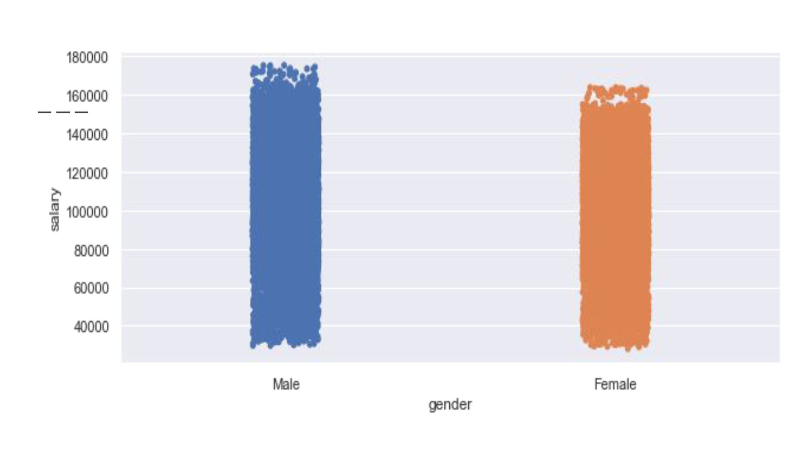

Slide 4
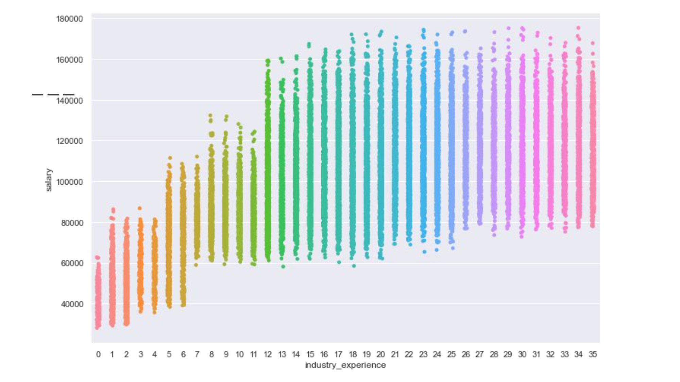

Slide 5
