Slide 1

ScreenSmart
🛡️ Real-time sanctions screening — every payment, sub-second.
👥 TEAM ctrl alt elite
FinTech AI Hackathon · Belgrade · 2026

Slide 2


🙌 WHO WE ARE
Team — ctrl alt elite
Mateja Subin
Andrija Milikić
💻 builder · ctrl alt elite
💻 builder · ctrl alt elite
Two builders at the intersection of AI and finance.
ScreenSmart · ctrl alt elite

Slide 3
🎯 THE PROBLEM
Sanctions are easy to dodge
A blacklist check on a name catches the obvious. Real evasion hides one step away — behind shell companies, nominee owners and chains of intermediaries.
🏢
Shell & front companies
a sanctioned party routes money through a clean-looking company it secretly controls
🔁
Layering & hops
funds pass through several accounts so no single name matches a list
🔤
Typos & transliteration
“Qadhafi” vs “Kaddafi” — fuzzy spelling slips past exact matching
🪙
Crypto & cross-border
wallets and corridors a static list never sees
⚠️ The gap: a name match isn’t enough — you have to follow the network.
ScreenSmart · ctrl alt elite

Slide 4
📊 FUN FACTS
Financial crime, by the numbers
🌍
2–5%
🕵️
~1%
🏢
$70B
of global GDP is laundered every year — up to $2 trillion
of that laundered money is ever detected or seized
estimated yearly cost of shell-company abuse to the US alone
📂
29,000
📈
100+
💸
$3T+
shell companies exposed in the Pandora Papers leak
names added to OFAC’s sanctions list 8 separate times in 2024
in illicit funds flowed through the financial system in 2023
Sources: UNODC · OCCRP · FinCEN · ICIJ Pandora Papers · CNAS 2024 · AML Intelligence

Slide 5
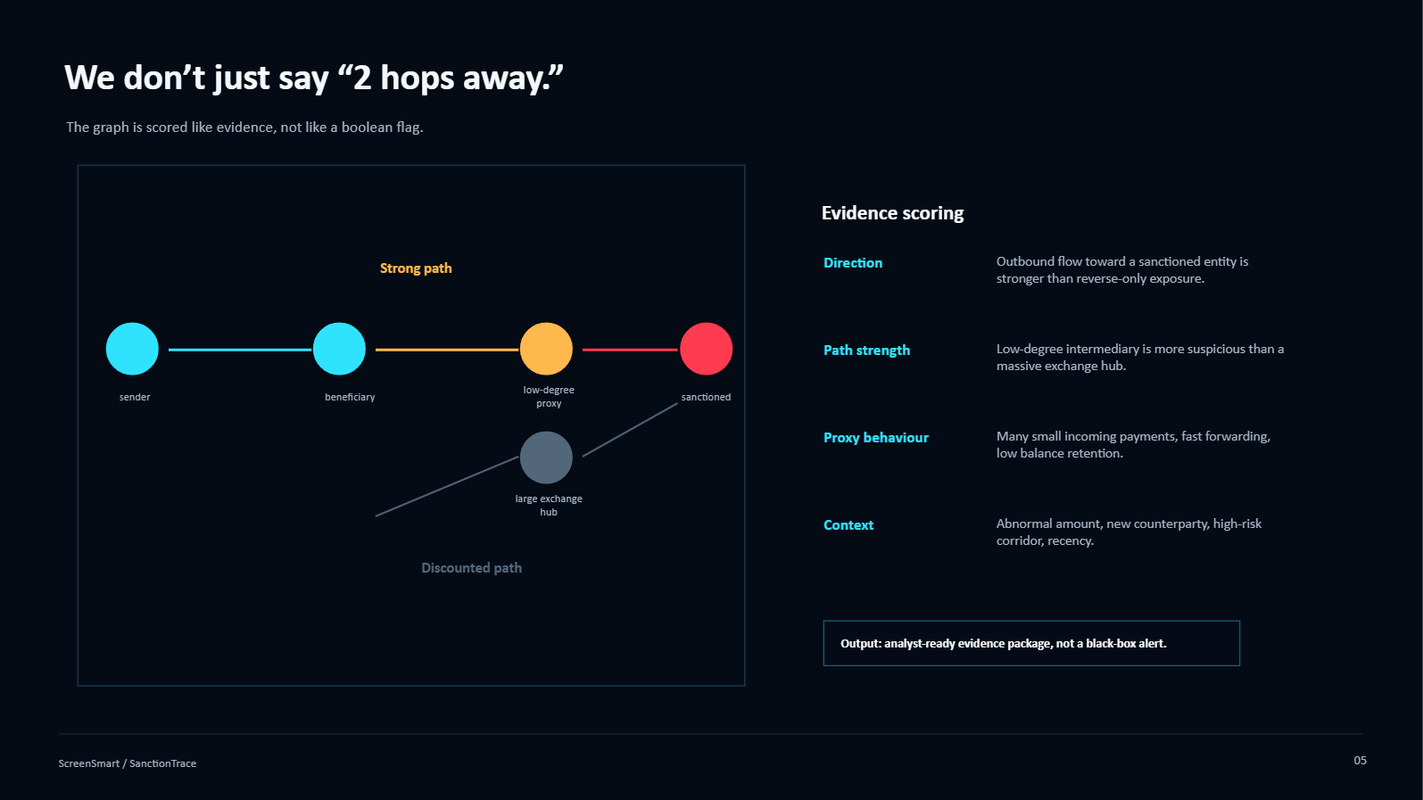
⚙️ HOW IT WORKS
We don’t just say “2 hops away”

Slide 6
🛠️ HOW IT’S BUILT
Tech stack
🧠
Screening engine
🐍 Python
🌳 LightGBM
📈 scikit-learn
🔤 RapidFuzz
⚡
Streaming
🟪 Apache Kafka
🔁 aiokafka
🧩 scatter-gather
🗄️
Data & API
🐘 PostgreSQL
🚀 FastAPI
🔐 JWT
🔌 WebSocket
🤖
AI assistant
🦙 Ollama
💬 llama3.2
🧩 LangGraph
⚡ GPU
🖥️
Frontend
⚛️ React
⚡ Vite
🎨 live canvas
🐳
Infra
🐳 Docker
🌐 nginx
📦 Compose
ScreenSmart · ctrl alt elite

Slide 7
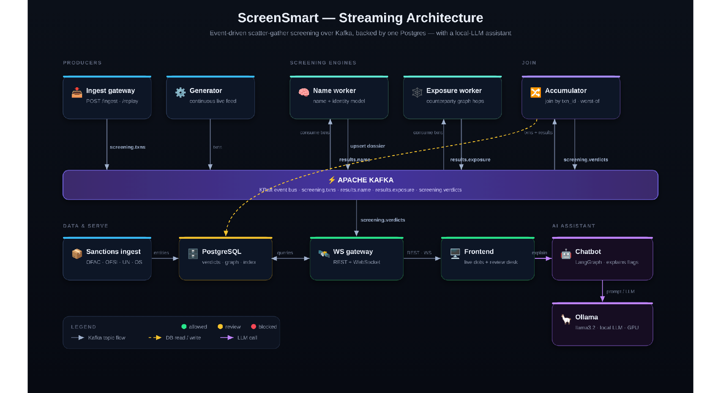
🕸️ ARCHITECTURE
Scatter-gather over Kafka
Two engines screen every payment in parallel — name/identity + network exposure; the accumulator escalates to the worst verdict, and a local LLM explains it.

Slide 8
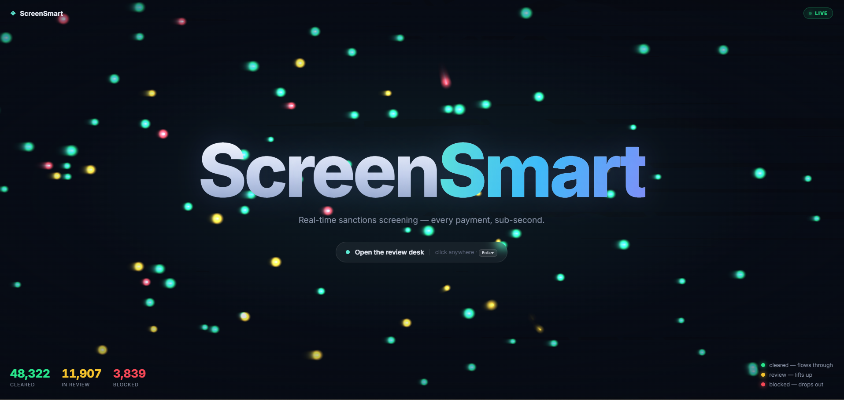
🚀 LET’S SCREEN SOME PAYMENTS
Demo time
🟢 live feed · click any dot · analyst review desk · network-exposure drill-down
ScreenSmart · ctrl alt elite

