Slide 1
WebSocket in Nodejs

Slide 2
Topics
Introduction to WebSocket.
What is Socket.IO?
How Socket.IO Works
Setting up Socket.IO in Node​.JS
Connecting to the Socket.IO Server from the Client
Emitting and handling Events
Broadcasting​ Messages
Room Concept in Socket.IO
Add Authentication and Middleware
Q&A

Slide 3


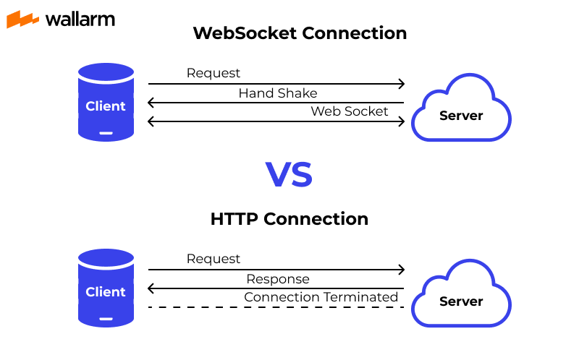

Introduction to WebSocket
WebSocket is a communication protocol that provides full-duplex communication channels over a single TCP connection. It enables bidirectional communication between clients and servers in real-time.

Slide 4
What is Socket.IO?
Socket.IO is a JavaScript library which enables real-time, bidirectional communication between web clients and servers.
It is builds on top of the WebSocket protocol but also provides fallback mechanisms for environments where WebSocket is not supported.
Features:
Real-Time Bidirectional Communication
Cross-Browser Compatibility:
Event-Based Architecture
Scalability

Slide 5
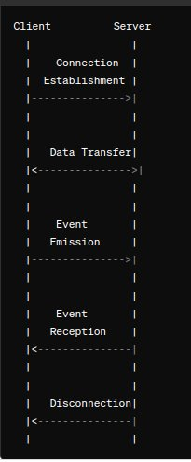
How Socket.IO Works?
Connection Establishment
Data Transfer
Event Emission
Event Reception
Disconnection

Slide 6

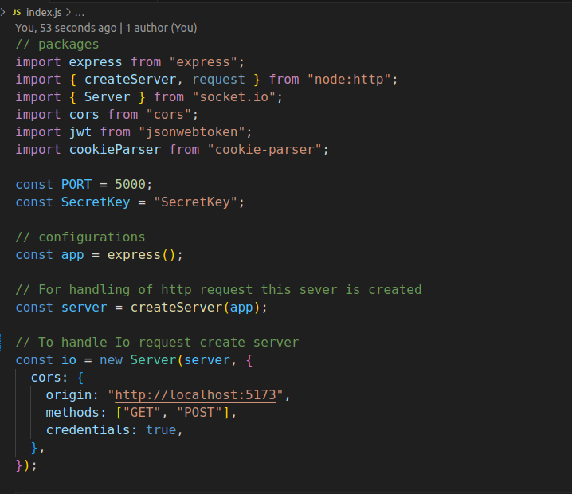
Setting up Socket.IO in NodeJS
Installation socket.io using npm:
npm install socket.io

Slide 7
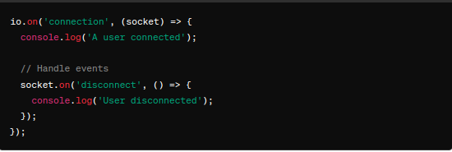
Setting up Socket.IO in Node .JS

Slide 8
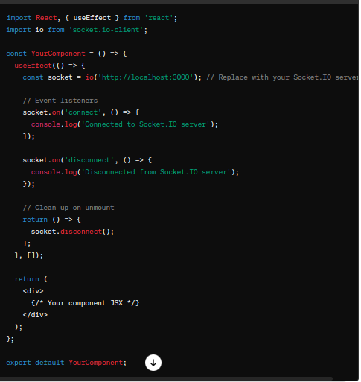
Connecting to the Socket.IO Server from the Client
To connect to a Socket.IO server from a React application use the socket.io-client library
npm install socket.io-client or yarn add socket.io-client
Import and Connect to the Socket.IO Server.

Slide 9
Broadcasting Messages
When a client sends a message event (socket.emit('broadCastmessage', data)), the server receives the message and broadcasts it to all connected clients using io.emit('receive-message', data).
The io.emit() method sends the data to every connected client, including the client that originally sent the message.
If you want to exclude the sender, you can use socket.broadcast.emit() instead.

Slide 10
Room Concept in Socket.IO
When a client wants to join a room, it emits a join-room event to the server, specifying the room name as the event payload. The server then joins the client to the specified room using socket.join(room).
When a client wants to send a message to a specific room, it emits a messageToRoom event to the server, specifying the room name and the message as the event payload. The server then sends the message to all clients in the specified room using io.to(room).emit('message', message).
Clients in the same room will receive the message sent to that room, allowing for targeted communication among groups of clients.
When a client wants to leave a room, it emits a leaveRoom event to the server, specifying the room name as the event payload. The server then removes the client from the specified room using socket.leave(room).

Slide 11
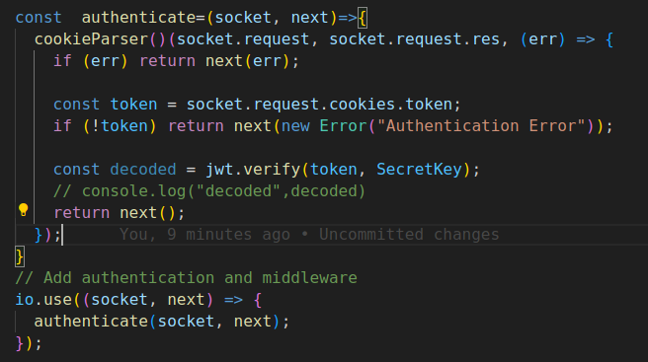
Add Authentication and Middleware
Inside the io.use() method, we pass the authenticate middleware function to authenticate Socket.IO connections. This middleware will be executed for every new connection before the connection event is fired.
Middleware function authenticate that takes the socket and a next function as arguments. This middleware function performs authentication based on a token passed in the cookies.
If the authentication is successful, the next() function is called to proceed with the connection. If authentication fails, an error is passed to the next() function, which results in the connection being rejected.
Once a connection is established and authenticated, the server can handle events and communication with the client as usual.

Slide 12


Slide 13

Thank You

