Slide 1
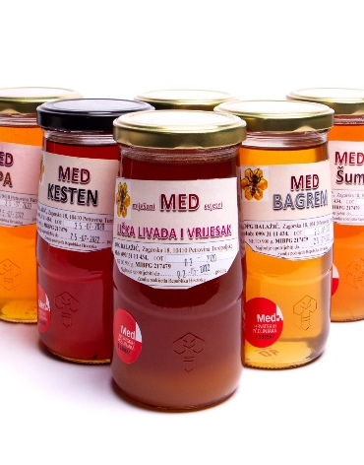

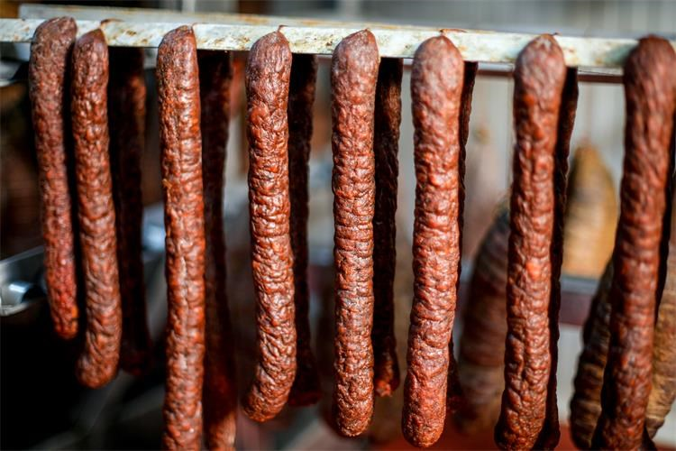
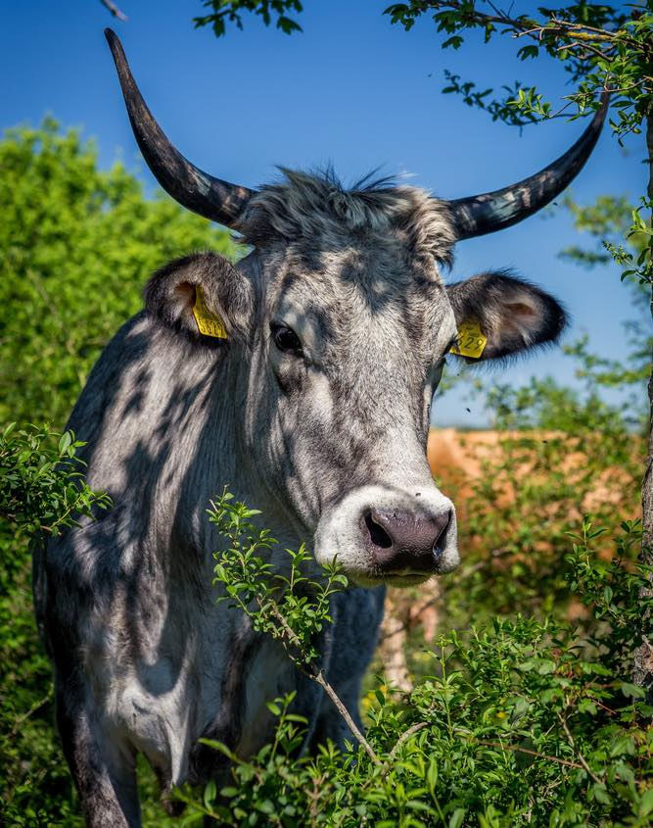
CONCEPT SOLUTION FOR THE NAŠE BLAGO OPEN PORTAL economic area
Students: Sara Kolar, Katarina Marić, Iva Tratnik & Mirta Vulje
Mentor: izv. prof. dr. sc. Dragica Šalamon
AnimCRO
Notes:
Izvor slika boskarin: Meso istarskog goveda - boškarina zaštićeno Oznakom izvornosti na razini EU - Poreština.info - novosti iz Poreča i okolice, Vrsara, Funtane, Višnjana, Lovreča, Kaštelira, Tara (porestina.info)
Izvor slika med: Med Balažić 900G – Mrkvica (ducan-mrkvica.hr)
Izvor slika kobasica: Ministarstvo poljoprivrede - Slavonska kobasica postala 41. hrvatski proizvod zaštićenog naziva u Europskoj uniji (gov.hr)

Slide 2




HAPIH - OSIJEK
HAPIH – ZAGREB
HAPIH - OSIJEK
AZRRI – UNUTAR AGENCIJE
HAPIH - PAZIN

Slide 3
DATA SOURCE | FORMAT | AGGREGATION LEVEL
HAPIH | .pdf | generic data (basic statistics, county level)
MINISTRY OF AGRICULTURE | .pdf | annual reports without statistics
OPEN DATA PORTAL | .csv, .pdf. ,.xslx | yearly, monthly, weekly and daily reports
FAOSTAT | doc, .xslx, .pdf, html | total number of animals per year
BUREAU OF STATISTICS | .xsl, .pdf | generic data (basic statistics, county level)
AZRRI | .pdf | total number of animals in Istria
GENBANK | .jpg | basic statistics animals per year

Slide 4
PUBLIC ADMINISTRATIVE DATA – MINISTRY OF AGRICULTURE
OWNER OF RESTOURANT | TURIST | BREEDER
MARKET DATA
MARKET AND AGRI DATA
MARKET DATA
location of farm
location of cattle houses
location of meat market
location of restaurant
location of farm
location of rural tourism
location of farm
market prices
AGRI DATA
AGRI DATA
quantity production
market prices
quantities of sires and dames
pedigree
breeding values
breeding program

Slide 5









PUBLIC ADMINISTRATIVE DATA – MINISTRY OF AGRICULTURE
OWNER OF RESTOURANT | TURIST | BREEDER
MARKET DATA
MARKET AND AGRI DATA
MARKET DATA
location of farm
location of cattle houses
location of meat market
location of restaurant
location of farm
location of rural tourism
location of farm
market prices
AGRI DATA
AGRI DATA
quantity production
market prices
quantities of sires and dames
pedigree
breeding values
breeding program

Slide 6

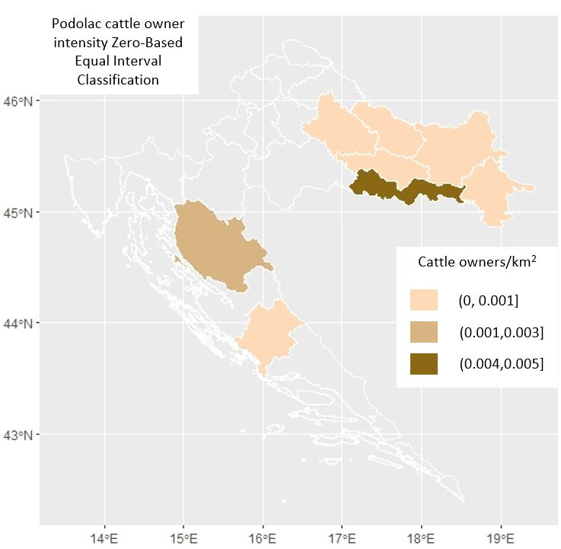
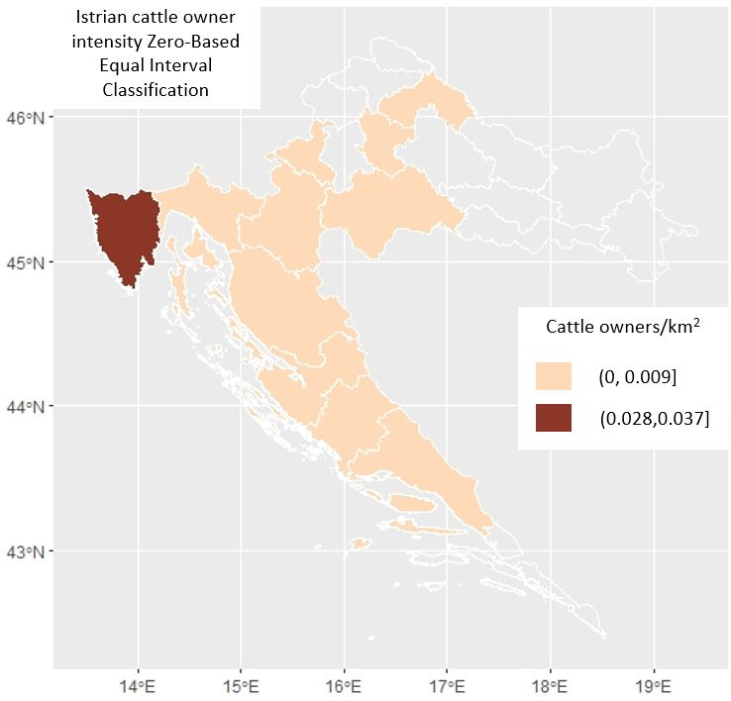
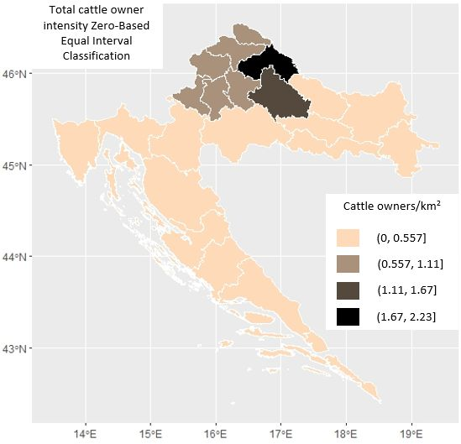
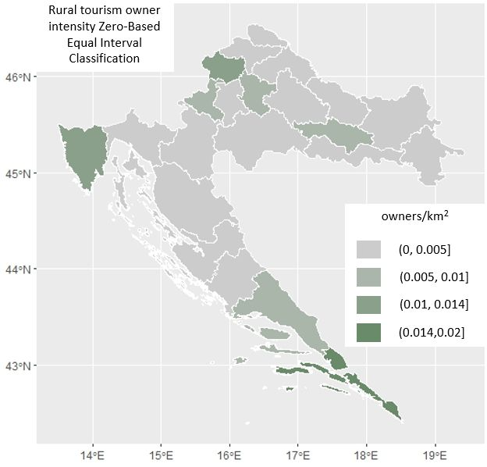
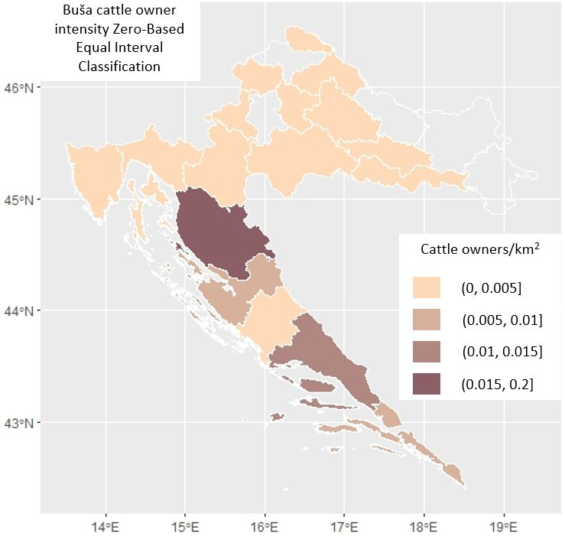

Slide 7
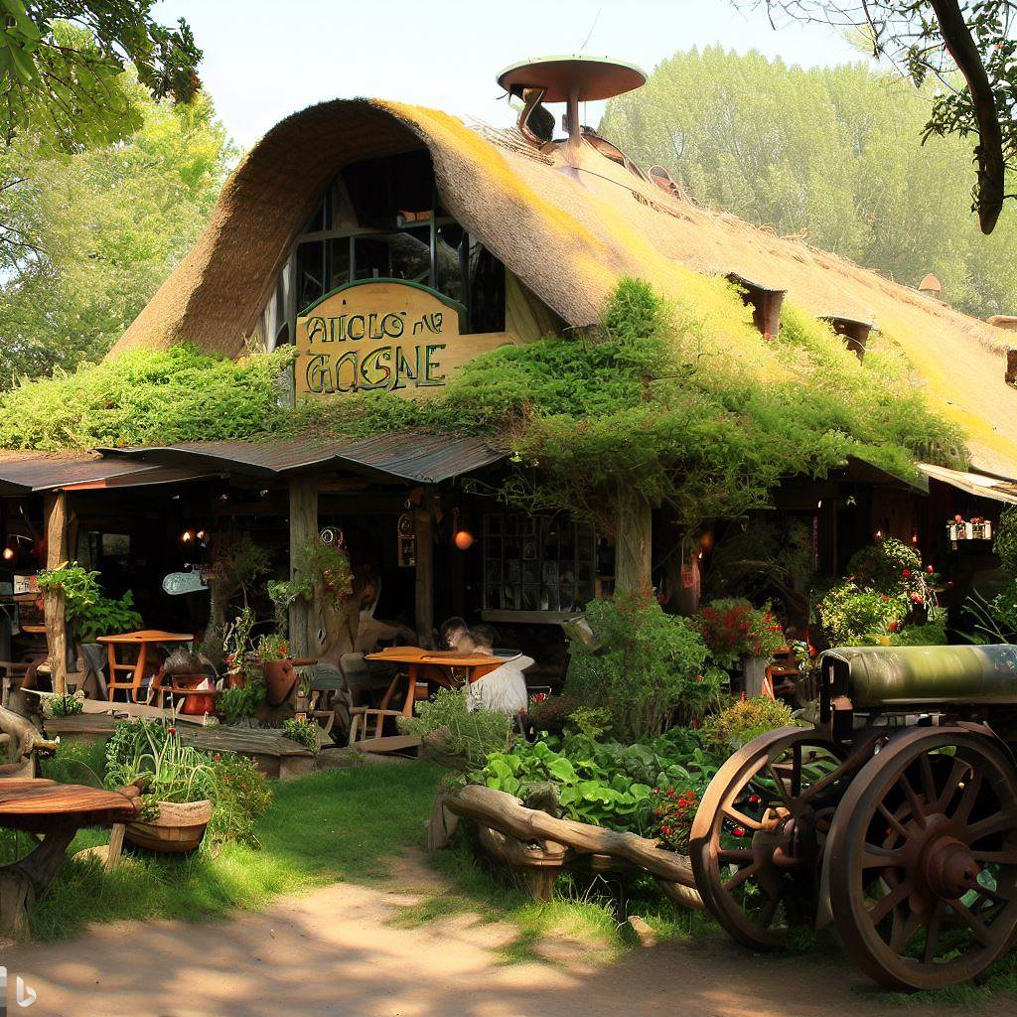



restaurant
dashboard

Slide 8
SOLUTIONS AND BENEFITS
unique centralized agriculture open dana system
geolocation and market data
non-aggregated and machine-readable format
value of agriculture economy
prosperity of rural areas

Slide 9





THANK YOU FOR YOUR ATTENTION

